Slide 1
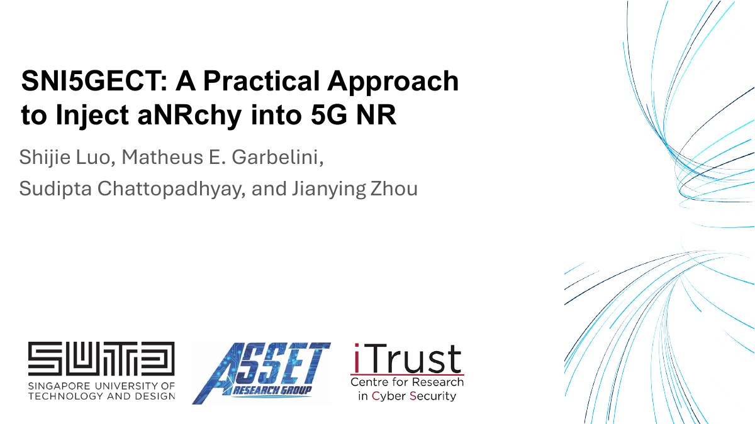
SNI5GECT
A practical approach to inject aNRchy into 5G NR
Shijie Luo, Matheus E. Garbelini, Sudipta Chattopadhyay, Jianying Zhou
USENIX Security 2025
15-slide paper overview
1
Notes:
Say: Start by saying this paper is about a new 5G security testing framework. The key idea is sniffing the live 5G connection and injecting carefully timed downlink messages without pretending to be a rogue base station.

Slide 2
Why Real-World 5G Security Matters
SNI5GECT motivation: widespread 5G use + realistic attack opportunities
5G is moving into critical everyday systems
Where could an opportunity arise?
Beyond faster phones, 5G NR supports systems where reliability and security matter.
A nearby attacker can benefit when a phone loses service and starts a fresh registration procedure.
⌂
Smart homes & connected devices
1
Airport
airplane mode / arrival reconnect
⚙
Industrial control & automation
2
Elevator
temporary coverage loss
+
Healthcare systems
3
Tunnel
signal disappears briefly
▣
Robotics & low-latency applications
4
Underground parking
phone searches again
Why the paper cares
Several 5G design and implementation vulnerabilities have been reported, but risk assessment depends on whether attacks work under real radio constraints.
Fresh registration creates the short pre-authentication window SNI5GECT studies.
Based on Luo et al., USENIX Security 2025
SNI5GECT
Notes:
5G is not just about faster phones. It is increasingly used in areas such as smart homes, industrial systems, healthcare, and robotics, so weaknesses in 5G can potentially affect much more than ordinary mobile communication.
The important question in this paper is whether vulnerabilities that look serious in the lab can actually be exploited under realistic conditions. The authors point out that places such as airports, elevators, tunnels, and underground parking garages are interesting because phones may temporarily lose connectivity and then perform a new registration. That creates the short pre-authentication communication window that SNI5GECT monitors.

Slide 3
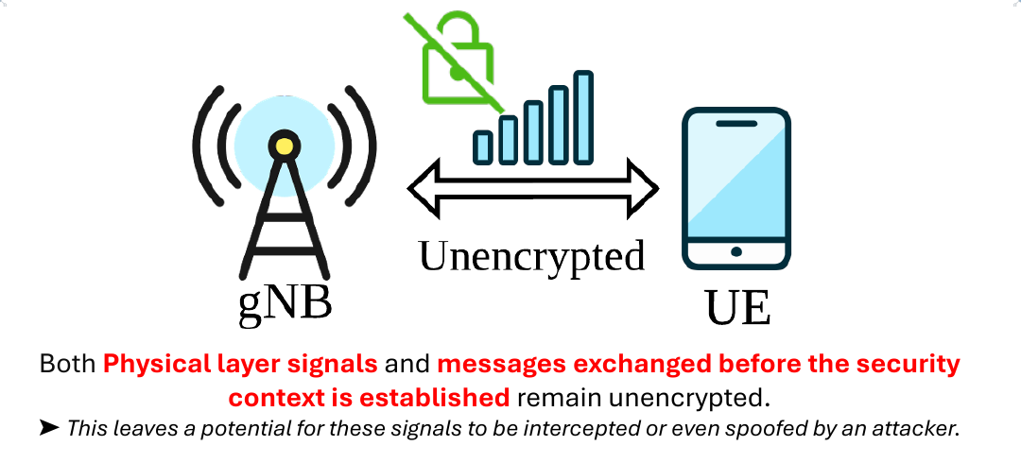
SNI5GECT • USENIX Security 2025
Problem: pre-authentication traffic is exposed
• Before the 5G security context is established, some signals and messages are not protected.
• That creates a small but important attack window.
• The paper studies what is practical over the air, not just in protocol theory.
2
Notes:
Say: Explain that the focus is the initial attach procedure. The UE and gNB have not yet finished setting up security, so some traffic can be observed and influenced.

Slide 4
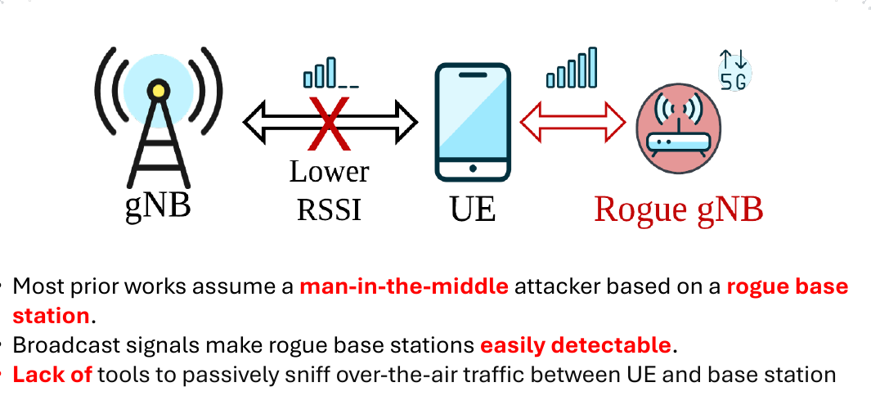
SNI5GECT • USENIX Security 2025
Motivation: avoid the rogue base-station assumption
• Many prior attacks rely on a rogue gNB / fake base station.
• Rogue base stations are intrusive and easier to detect because they broadcast continuously.
• SNI5GECT instead acts as a third party near the UE and legitimate gNB.
3
Notes:
Say: Contrast the old model with this paper. Rather than forcing a phone onto a fake base station, SNI5GECT listens to the real connection and injects at precise moments.

Slide 5
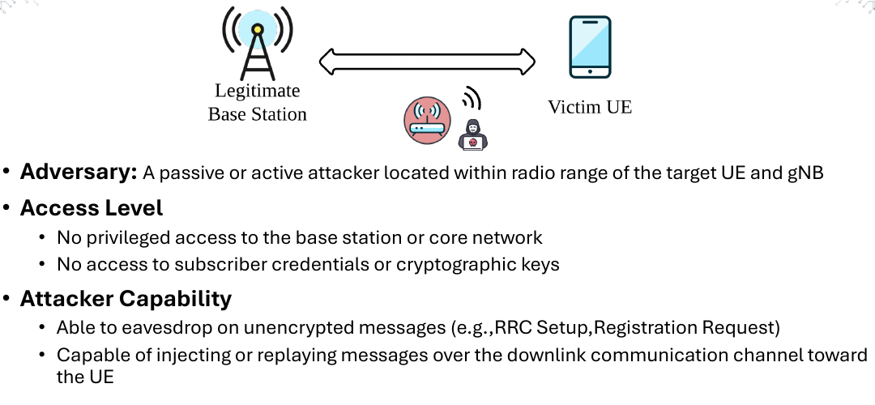
SNI5GECT • USENIX Security 2025
Attacker model
• Attacker is within radio range of the target UE and gNB.
• No access to the core network, base station internals, subscriber credentials, or keys.
• Can eavesdrop on unprotected messages and inject/replay downlink messages toward the UE.
4
Notes:
Say: Emphasize that this is not an all-powerful attacker. The interesting part is that the attacker does not need credentials or a rogue gNB, but must be close enough and well synchronized.

Slide 6
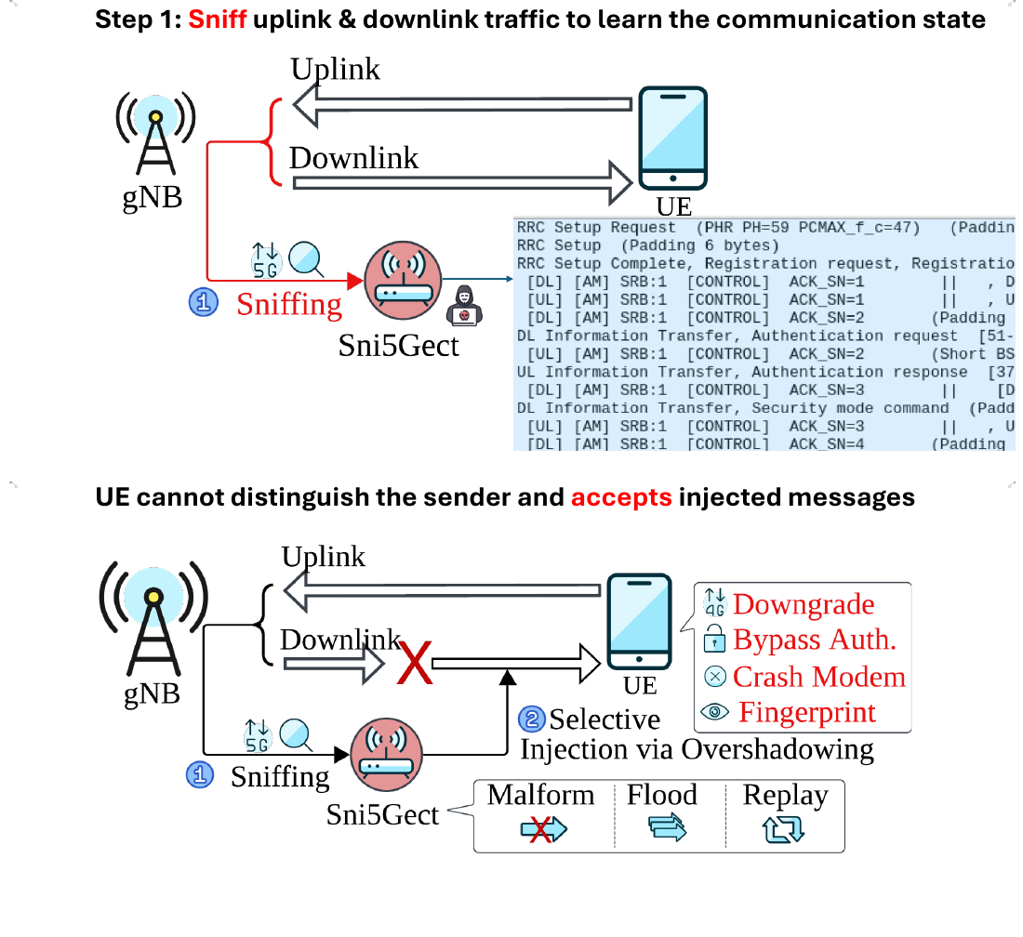
SNI5GECT • USENIX Security 2025
Core idea: sniff first, inject at the right state
• Step 1: sniff uplink and downlink to learn the current protocol state.
• Step 2: craft and inject a downlink message at the exact state where the UE will accept it.
• The UE may then crash, downgrade, reveal identity, or bypass authentication logic.
5
Notes:
Say: Explain the workflow in two simple steps: learn the connection state, then inject a forged message when it matters. The timing is the main challenge.

Slide 7
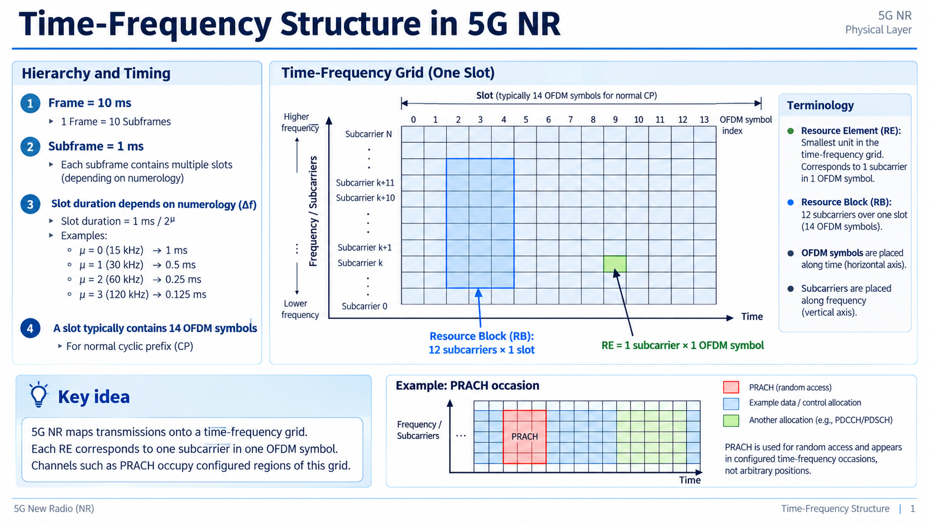

Slide 8
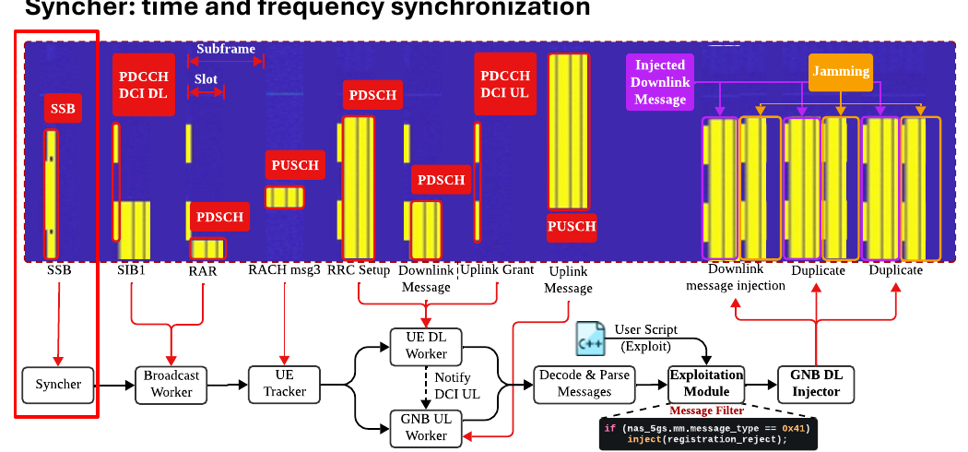
SNI5GECT • USENIX Security 2025
System design: main components
• Syncher keeps time and frequency alignment with the target cell.
• Broadcast Worker decodes SIB1 and detects new UE connections.
• UETracker starts per-UE monitoring after the random access procedure.
6
Notes:
Say: Introduce the architecture. The Syncher is the timing foundation. The Broadcast Worker finds cell configuration and new UEs. UETracker handles per-device message tracking.

Slide 9
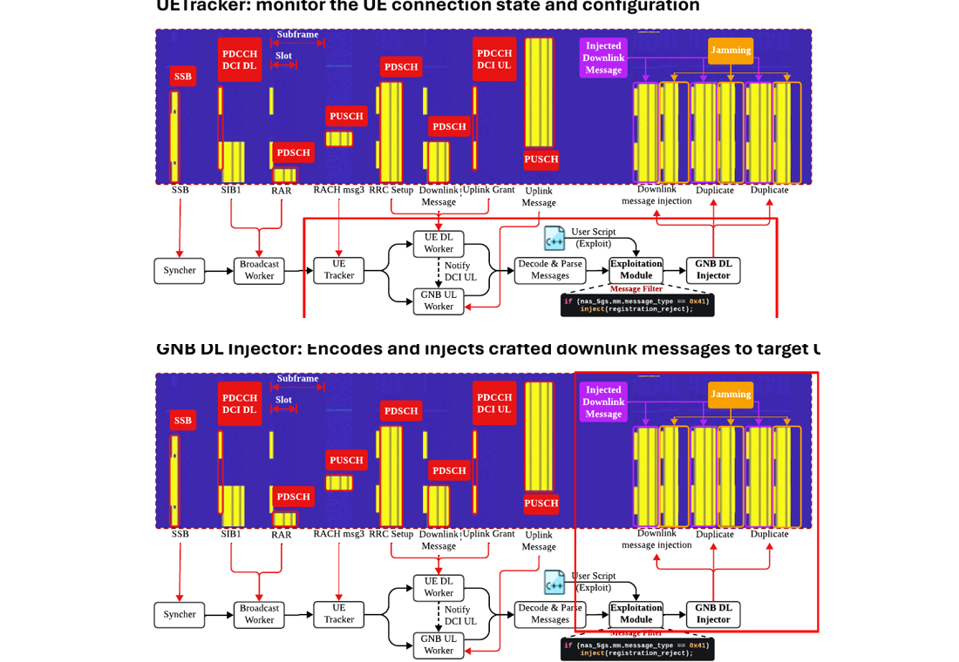
SNI5GECT • USENIX Security 2025
Message tracking and injection pipeline
• UE DL Worker decodes gNB-to-UE downlink messages.
• GNB UL Worker decodes UE-to-gNB uplink messages using timing correction.
• Exploit Module decides whether to trigger an injection; GNB DL Injector sends the crafted message.
7
Notes:
Say: Say that this slide is the full pipeline after a UE is detected. The tool needs both downlink and uplink decoding so it knows exactly which protocol state the UE is in.

Slide 10
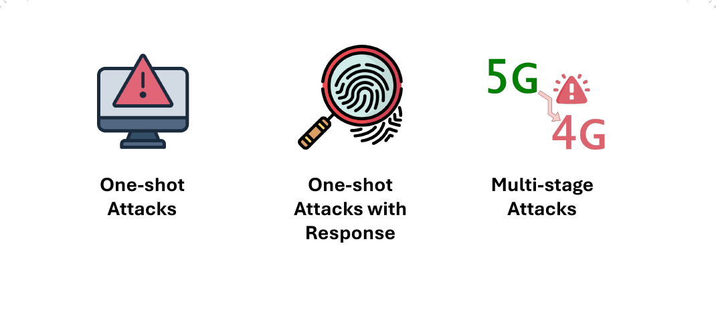
SNI5GECT • USENIX Security 2025
Attack scenarios evaluated
• One-shot attacks: inject once and expect immediate UE behavior.
• One-shot with response: inject once, then sniff the UE response.
• Multi-stage attacks: alternate sniffing and injecting across several states.
8
Notes:
Say: Set up the evaluation categories. The increasing complexity is from simple one-message attacks to stateful multi-step attacks.

Slide 11
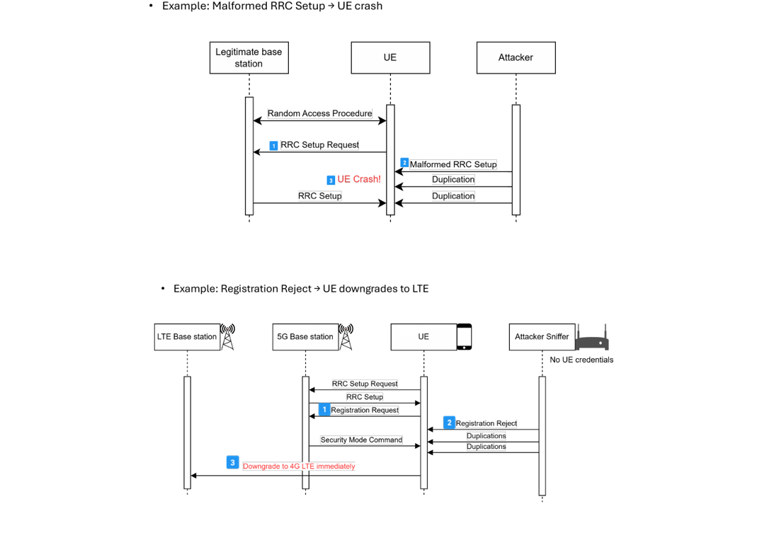
SNI5GECT • USENIX Security 2025
One-shot attacks: crash or downgrade
• Malformed RRC Setup can trigger a UE crash.
• Registration Reject can force downgrade from 5G to LTE.
• These attacks demonstrate immediate reaction to a single injected message.
9
Notes:
Say: Explain the two examples. In both, the attacker injects a single downlink message and the UE reacts immediately, either by crashing or downgrading.

Slide 12
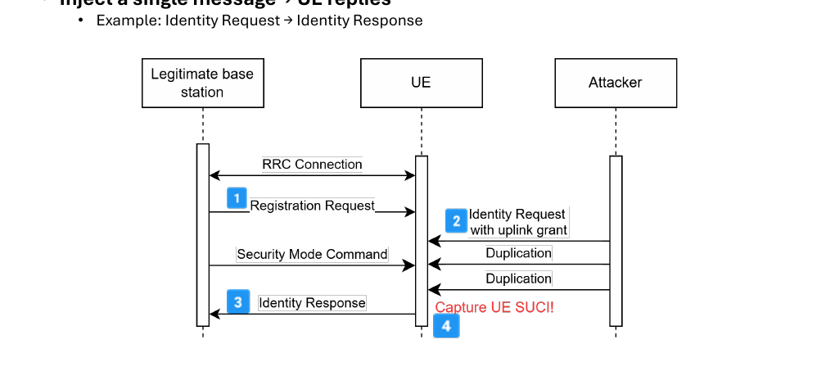
SNI5GECT • USENIX Security 2025
One-shot with response: identity extraction
• Identity Request is injected after observing the right state.
• The UE replies with Identity Response.
• The sniffer captures the UE SUCI, showing active fingerprinting potential.
10
Notes:
Say: This is different from a pure one-shot attack because the attacker also waits for and decodes the UE response. It shows why sniffing plus injection is stronger than injection alone.

Slide 13
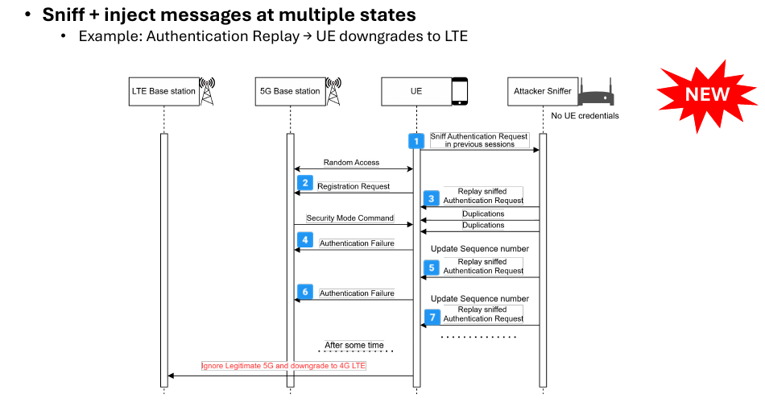
SNI5GECT • USENIX Security 2025
Multi-stage attack: authentication replay
• SNI5GECT can sniff and inject across multiple protocol states.
• The paper presents a new authentication replay downgrade attack.
• The risk was acknowledged through GSMA CVD-2024-0096.
11
Notes:
Say: Describe this as the strongest demonstration of stateful capability. The attack needs more than one injection and depends on tracking the UE over time.

Slide 14
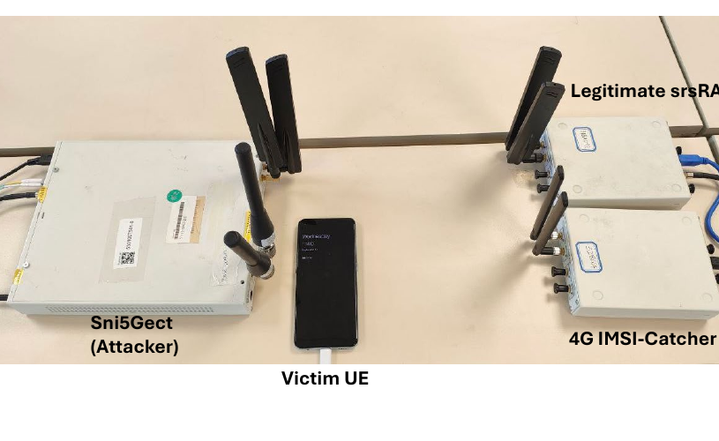
SNI5GECT • USENIX Security 2025
Evaluation setup
• Implemented using SDR-based tooling with srsRAN and WDissector components.
• Evaluated with five 5G-enabled commercial phones.
• Tested against both srsRAN open-source and Effnet commercial gNBs.
12
Notes:
Say: Mention that the experiments are not just simulation. The authors used real phones, SDR hardware, and two kinds of 5G base stations.

Slide 15
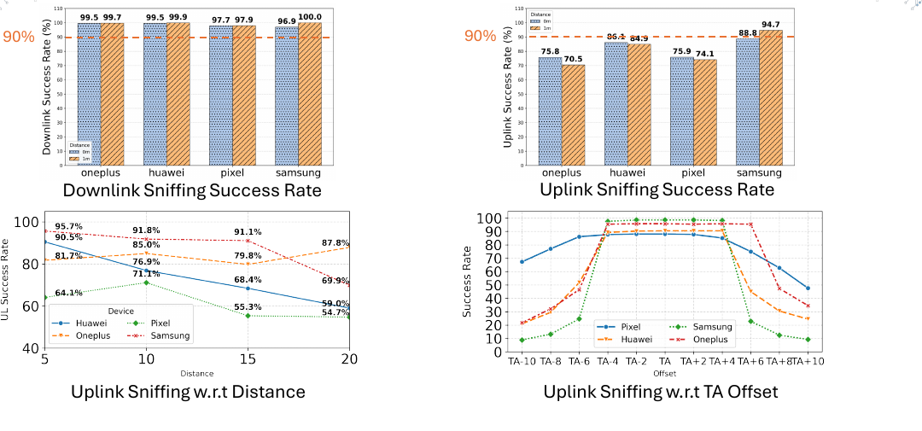
SNI5GECT • USENIX Security 2025
Sniffing results
• Downlink and uplink sniffing were generally above 80%.
• Distance affects uplink more than downlink.
• Timing advance correction is important for uplink decoding.
13
Notes:
Say: Focus on the takeaway rather than every number. The tool can sniff both directions with high success, but uplink is harder because timing alignment is more sensitive.

Slide 16
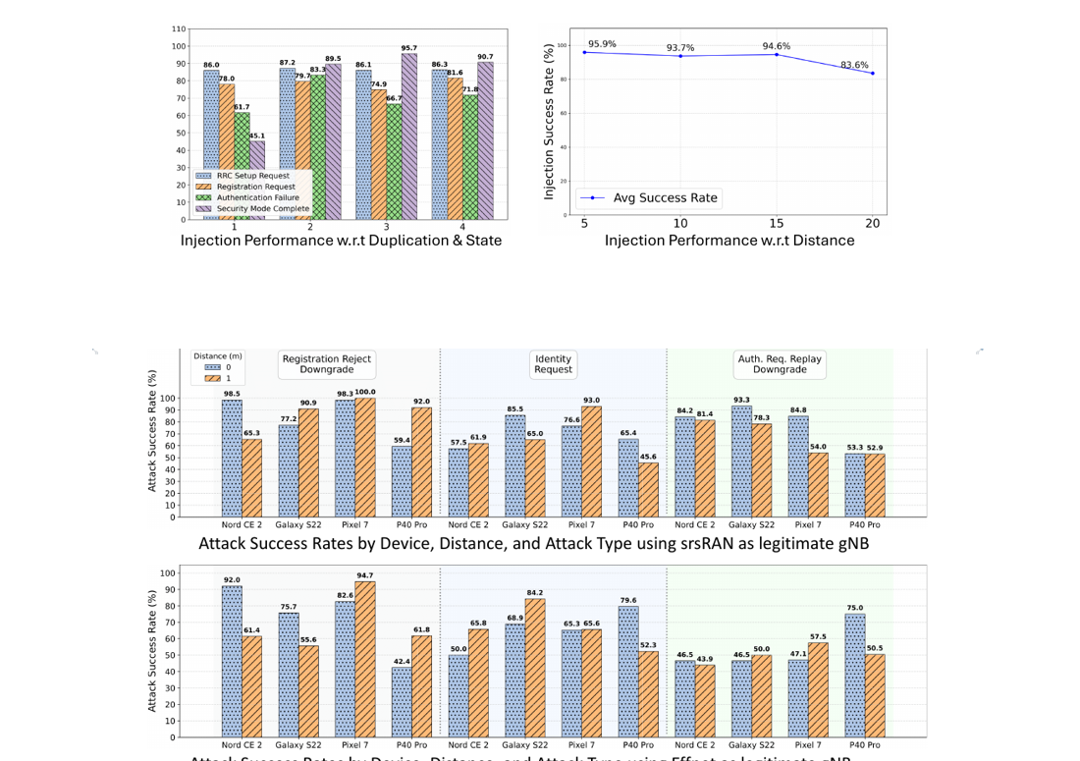
SNI5GECT • USENIX Security 2025
Injection and attack results
• Injection remained practical across different states and distances up to 20 m
with a class B amplifier.
• Attack success rates varied by device, gNB, distance, and attack type.
• The framework works with both open-source and commercial gNB settings.
14
Notes:
Say: Explain that success is not uniform, but the evaluation shows practical attack rates. The important result is that stateful injection worked in realistic setups.

Slide 17
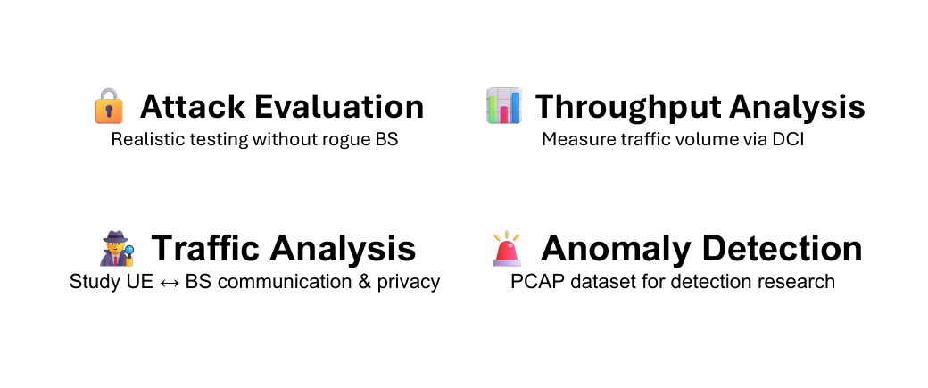
SNI5GECT • USENIX Security 2025
Takeaways, limitations, and reuse
• SNI5GECT shows practical 5G sniffing plus downlink injection without a rogue gNB.
• Limits: known/nearby UE distance, indoor 20 m-scale tests, downlink-only injection, and pre-authentication focus.
• Reuse: attack evaluation, throughput analysis, traffic/privacy studies, and anomaly detection datasets.
15
Notes:
Say: Close with a balanced view. The framework is powerful for research, but it is not universal. The paper frames it as a foundation for 5G security testing and future detection work.

Slide 18
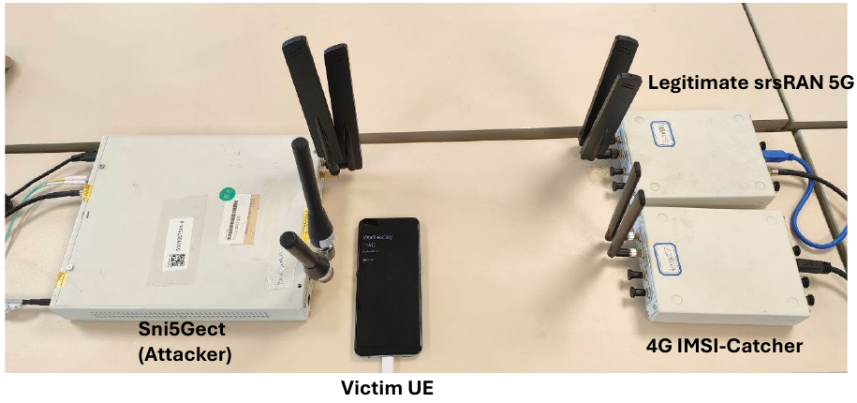
Demo and Resources
SNI5GECT: A Practical Approach to Inject aNRchy into 5G NR
Demo available at:
https://www.usenix.org/conference/usenixsecurity25/presentation/luo-shijie
The demo shows the experimental setup with SNI5GECT as the attacker, a victim UE, a legitimate srsRAN 5G setup, and a 4G IMSI-catcher.
Demo setup from the authors’ slides
Thank you
Questions?
Notes:
What to say:
1. The authors provide a demo and presentation materials through the USENIX Security 2025 presentation page.
2. The demo setup shows SNI5GECT acting as the attacker while the victim phone communicates around a legitimate srsRAN 5G setup and a 4G IMSI-catcher.
3. This is a good final slide because it points the audience to the original resource, then closes the talk with thanks and invites questions.

