Slide 1
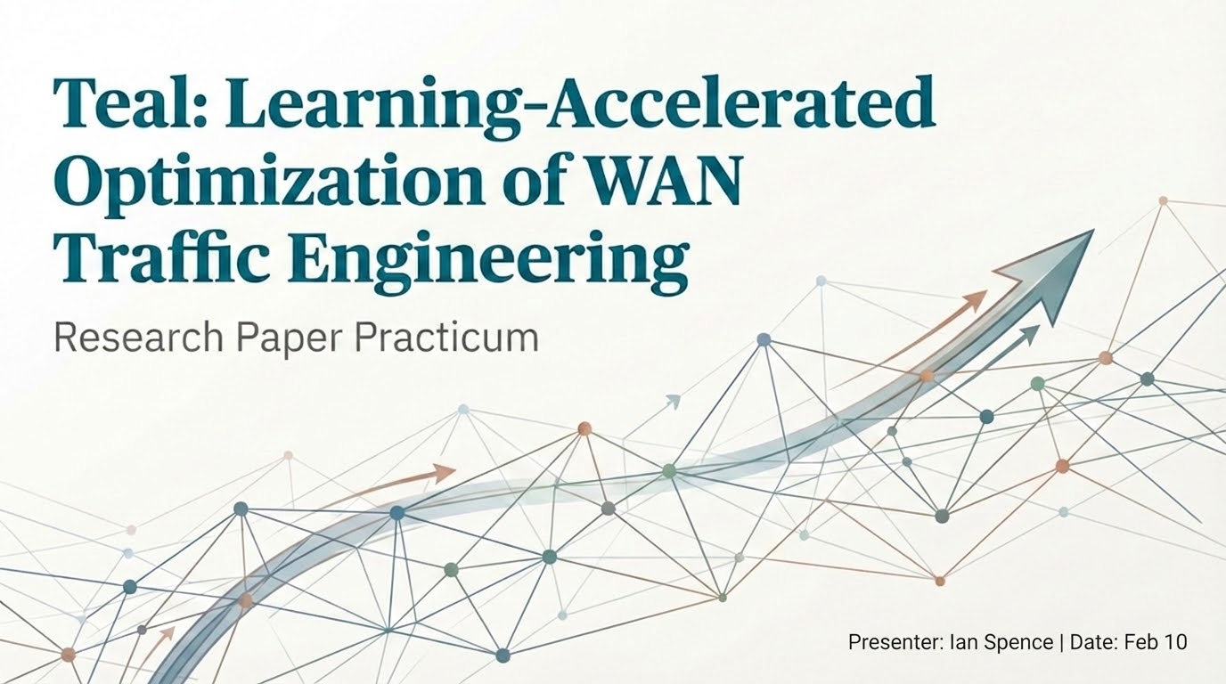

Slide 2



Background
Cloud providers operate planet-scale WANs.
Must enable low-latency and high-throughput applications.
In order to route traffic efficiently, Traffic Engineering (TE) systems are put in place.
Notes:
"To start, we are looking at the massive infrastructure that powers the modern cloud. Major providers invest billions of dollars to build and operate these planet-scale Wide-Area Networks (WANs).
They interconnect geographically distributed datacenters across the globe, scaling up to thousands of nodes and edges
The role of these WANs has evolved. While they used to carry mostly first-party discretionary traffic—like background data backups—today they carry real-time, user-facing traffic.

Slide 3
What is Traffic Engineering (TE)?
Over the past decade, companies have used software defined networking (SDN).
Demands are allocated to achieve
a) High link utilization
b) Fairness among network flows
c) Resilience to link failures in WANs
This is typically viewed as an optimization problem (minimum latency + maximum throughput).
Notes:
For the last ten years, major cloud providers like Google and Microsoft have moved away from decentralized routing protocols. Instead, they have implemented centralized TE systems based on Software-Defined Networking (SDN)
This shift allows for a global view of the network. A centralized 'TE Controller' can see the entire topology and all traffic demands at once, allowing it to make much smarter decisions than individual routers could make on their own
We have three specific goals here:
◦ High Link Utilization: These WANs cost billions to build. We need to fill the fiber cables as efficiently as possible to get a return on that investment,.
◦ Fairness: We need to ensure that no single flow starves others, maintaining fairness among different network services.
◦ Resilience: The allocation must be robust. If a link fails, the system needs to have a plan to reroute traffic immediately so the network survives.
Mathematically, we treat this as a Multi-Commodity Flow problem. The controller receives a matrix of demands and solves a complex optimization algorithm.
The objective is usually to maximize total throughput while keeping latency to a minimum. Traditionally, this is solved using Linear Programming (LP) solvers, which calculate the exact 'split ratios' to divide traffic across available paths

Slide 4
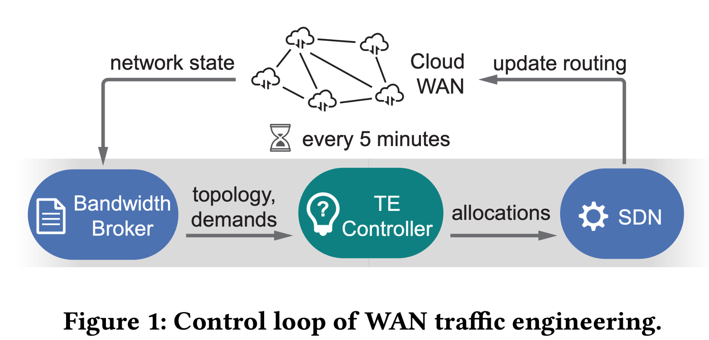
Notes:
The Bandwidth Broker: This component monitors the Cloud WAN to gather the current "network state." It estimates the volume of traffic (demand) that needs to move between datacenters for the upcoming time window and passes this information, along with the current network topology, to the controller.
The TE Controller: Serving as the system's "brain," this controller receives the topology and traffic demands. It solves a complex optimization problem to determine the optimal traffic allocations (i.e., how to split traffic across available paths to avoid congestion).
SDN (Software-Defined Networking): Once the allocations are decided, the SDN layer translates them into specific router configurations. It then executes an "update routing" command to deploy these changes back to the physical Cloud WAN, completing the loop.

Slide 5
Challenges of Current TE: Scalability Crisis
Explosive Network Growth:
Cloud WANs have expanded from tens of datacenters to massive topologies with thousands of nodes.
Increased complexity makes optimization problems exponentially harder to solve.
The 5-Minute Bottleneck:
TE control loops ideally update every 5 minutes to match traffic shifts.
Traditional Linear Programming (LP) solvers can now take up to 5.5 hours to compute a single allocation for large networks.
Operational Consequences:
Stale Routing: The network is forced to use outdated configurations that don't match current traffic.
Poor Reactivity: Inability to respond instantly to sudden traffic bursts or fiber cuts, leading to packet loss
Notes:
The first major challenge we face is simply the sheer scale of modern infrastructure. We aren't managing a few dozen sites anymore; we are looking at topologies with over 1,700 nodes and thousands of edges
Our traditional control systems were designed to run every 5 minutes. The math cannot keep up with the growth. On these large networks, the standard Linear Programming solvers—which used to work quickly—can now take over five hours to finish a single calculation.
Thus, routing lags behind real time traffic needs. By the time the system figures out where to send the traffic, the real-world conditions have already changed. We are effectively driving the network using a map from hours ago, which leads to congestion and reliability issues.

Slide 6
Limitations of Traditional Solutions
Inefficient Parallelism in Standard LP Solvers:
Core algorithms (like Simplex) are inherently sequential, taking step-by-step improvements.
The "Racing" Strategy: Solvers cannot easily split the math, so they run different algorithms on separate threads to see which finishes first.
Result: Diminishing returns—increasing threads from 1 to 16 only yields a 3.8× speedup.
Tradeoffs in "Decomposition" Strategies:
Tools like NCFlow and POP explicitly break the network into smaller sub-problems to force parallelism.
Speed vs. Quality: By losing the global view, these methods produce lower-quality routes, satisfying 6–32% less traffic than optimal solutions.
Coordination Overhead: Merging results from these sub-problems is complex and limits maximum speed
Notes:
So, why not throw more compute at the problem? Traditional solvers struggle with scale due to the underlying mathematics
Standard Linear Programming solvers rely on sequential algorithms. Because step n+1 depends on step n, you can't just split the work across cores.
Instead, solvers use a 'racing strategy': they launch different algorithms on different threads and simply use the result from whichever one finishes first. However, the Result is Diminishing returns—increasing threads from 1 to 16 only yields a 3.8× speedup.
On the other hand, we have specific tools designed to force parallelism by decomposing the network into smaller chunks. While this does make the calculation faster, it introduces a severe penalty in quality. Because these sub-problems don't see the 'big picture' of the global network, they make inefficient decisions. Data shows that these strategies end up satisfying significantly less user demand—up to 30% less—compared to a global solver.
Thus, fast computation of the global network is critical.

Slide 7
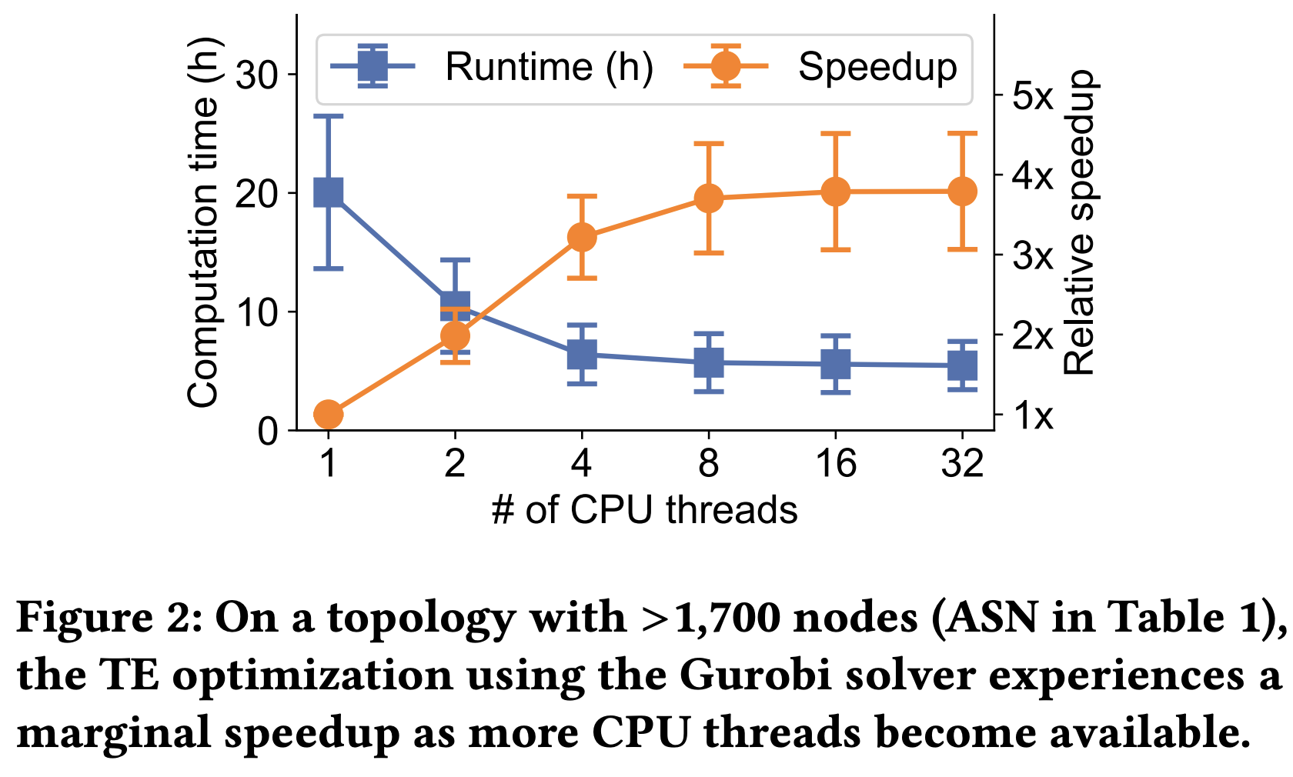

Slide 8
Introducing TEAL
Traffic Engineering Accelerated by Learning
ML Advantage: Massive Parallelism
Unlike sequential LP solvers, Deep Learning relies on matrix multiplications, unlocking the power of thousands of GPU threads.
Leverages vast historical WAN data to train models that achieve near-optimal allocation performance.
Key Challenges in Application:
Topology Ignorance: Naive neural networks ignore the complex connectivity of WANs.
The "Curse of Dimensionality": A 1,000-node network requires up to 4 million decision variables. Training a single "monolithic" model for this is intractable.
Safety & Constraints: Neural networks are "soft" processors; they cannot strictly enforce hard constraints (e.g., link capacity), risking packet drops and network failure.
Notes:
"So, if linear programming is the bottleneck, what is the solution? The answer lies in Machine Learning."
"With judicious design, we can use ML to accelerate optimization significantly. Because Deep Learning consists mainly of matrix multiplications, we can unlock massive parallelism—leveraging thousands of threads on modern GPUs rather than being stuck on sequential CPU processes."
"However, we can't just throw a standard neural network at this problem. We face three distinct challenges:
1. Topology: A vanilla neural network doesn't understand that a network is a graph with connected edges and paths.
2. Dimensionality: The solution space is massive. For a 1,000-node network, a single model would need to output 4 million split ratios. That is simply too complex to train effectively.
3. Safety: This is critical. Neural networks make approximations. If a model tries to push 20 gigs of data through a 10-gig cable, the network fails. Unlike math solvers, standard NNs cannot guarantee they will respect these physical limits."

Slide 9
Solution: FlowGNN
Problem: Standard NNs view networks as simple lists of numbers, missing the graph structure.
Solution: FlowGNN (Custom Graph Neural Network)
Models the network explicitly, treating both physical links (edges) and traffic routes (paths) as nodes in a graph.
The Mechanism: Alternating Layers
GNN Layers (Capacity): "EdgeNodes" exchange info with "PathNodes" to identify congestion on physical cables.
DNN Layers (Demand): Coordinates all available paths for a single demand to split traffic effectively.
The Result: Transforms raw data into rich "flow embeddings"—compact summaries of network state and flow interference.
Notes:
"To solve the first challenge—topology awareness—Teal introduces a custom architecture called FlowGNN."
"Instead of feeding the model a flat list of numbers, FlowGNN explicitly models the network structure. It treats the physical fiber cables and the traffic routes as interacting nodes in a graph."
"It works by alternating between two specific layers:
First, the GNN Layers handle capacity. The physical links 'talk' to the routes that use them, allowing the model to learn exactly where congestion is happening.
Second, the DNN Layers handle demand. They look at all the different paths available for a specific user request and coordinate how to split the traffic."
"The output of this process is what we call 'flow embeddings.' These are rich, compact digital summaries that encode everything the system needs to know about the current state of the network."

Slide 10
Solution: Divide and Conquer with Multi-Agent RL
Problem: The "Curse of Dimensionality"
Independent Agents: TEAL treats each traffic demand as an independent agent.
Shared Knowledge: All agents share a single, lightweight "policy network" (just 4 split ratios per agent).
Global Objective: Agents are trained using Centralized Training, Decentralized Execution. They make local decisions that optimize a global reward (e.g., total network throughput).
Benefit:
Reduces the problem scale from millions of variables to a handful.
Allows the system to scale indefinitely with network size without retraining.
Notes:
“If we tried to build one giant neural network to control the whole WAN, it would never work. The 'Curse of Dimensionality' means we'd have millions of outputs to train.”
"Teal solves this by using Multi-Agent Reinforcement Learning. Instead of one brain controlling everything, we treat every single traffic demand as its own agent."
"Crucially, these agents share a 'brain'—a single, small policy network. This shrinks our problem down massively. Instead of calculating the whole world at once, we just calculate the best move for one agent, repeated thousands of times in parallel."
"To ensure they don't act greedily and clog the network, we train them together. They learn that making a 'selfish' choice might hurt the global reward, so they learn to cooperate”

Slide 11
Solution: Safety via ADMM
Problem: Neural Networks are "Soft"
Deep Learning provides approximations, not exact answers.
A "Safety Net": The output of the neural network is passed through ADMM (Alternating Direction Method of Multipliers).
Mathematical Projection: ADMM takes the "unsafe" approximate solution and mathematically projects it into the "feasible" region.
Speed: Because the neural network provides a high-quality "warm start," ADMM converges in just 2–5 iterations (milliseconds)
Benefit:
Strictly enforces hard constraints.
Ensures zero violations without the long runtime of a full solver.
Notes:
“This leads us to the final major challenge: Safety. Neural networks are probabilistic; they don't naturally respect hard rules. A 99% accurate model is great for image recognition, but in networking, that 1% is no good.”
"Teal bridges this gap with a mathematical layer called ADMM."
"We can think of ADMM as a 'clean-up' crew. The neural network suggests a routing plan that is almost perfect. ADMM takes that suggestion and mathematically tweaks it to ensure it fits strictly within the cable capacities."
"Normally, this math would be slow. But because our neural network gives such a good starting point—what we call a 'warm start'—ADMM only needs a few milliseconds to finish the job. It gives us the safety of a traditional solver with the speed of AI."

Slide 12
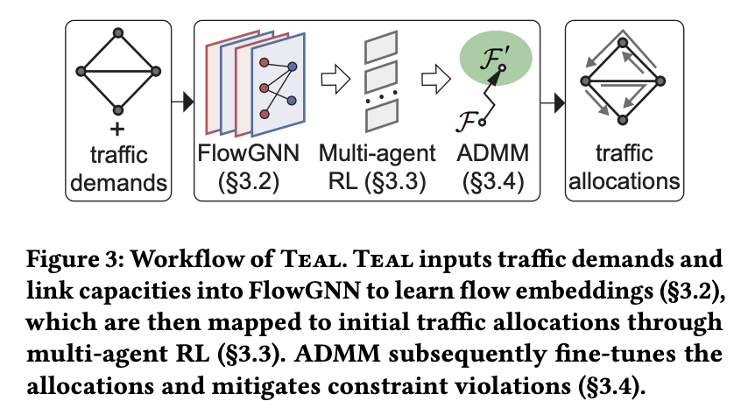
Notes:
“1. FlowGNN (Input Processing): The system takes traffic demands and link capacities and passes them through a Graph Neural Network to learn "flow embeddings" that capture the network's structure and congestion state.
2. Multi-Agent RL (Allocation): These embeddings are fed into a Policy Network, which treats each demand as an independent agent to generate initial traffic splits (allocations) in parallel.
3. ADMM (Fine-Tuning): The initial allocations are passed through ADMM (Alternating Direction Method of Multipliers), a mathematical layer that corrects any safety violations (like overutilized links) to produce the final, feasible traffic allocations.”

Slide 13
Evaluation & Results
Real-World Testing:
Evaluated using traffic matrices from Microsoft’s production WAN.
Tested on massive topologies (>1,700 nodes).
Speed vs. Quality:
Speed: TEAL runs 197–625× faster than other acceleration schemes (NCFlow, POP).
Quality: Satisfies 6–32% more traffic demand than those same schemes.
Latency: Computes global routing in <1 second, enabling real-time reaction to failures.
Conclusion: TEAL achieves near-optimal performance (matching full LP solvers) but does so in milliseconds rather than hours.
Notes:
“The results are compelling. Using real traffic data from Microsoft, Teal was tested against the best existing TE schemes.”
“On the largest networks, Teal isn't just a little faster; it's orders of magnitude faster—up to 600 times faster than the competition.”
“But speed usually costs quality. In this case, it didn't. Because Teal optimizes the global network rather than chopping it into pieces, it satisfied significantly more user demand—up to 30% more than other accelerators.”
“Essentially, Teal gives us the 'best of both worlds': the optimality of a mathematical solver and the real-time speed of a GPU.”

Slide 14
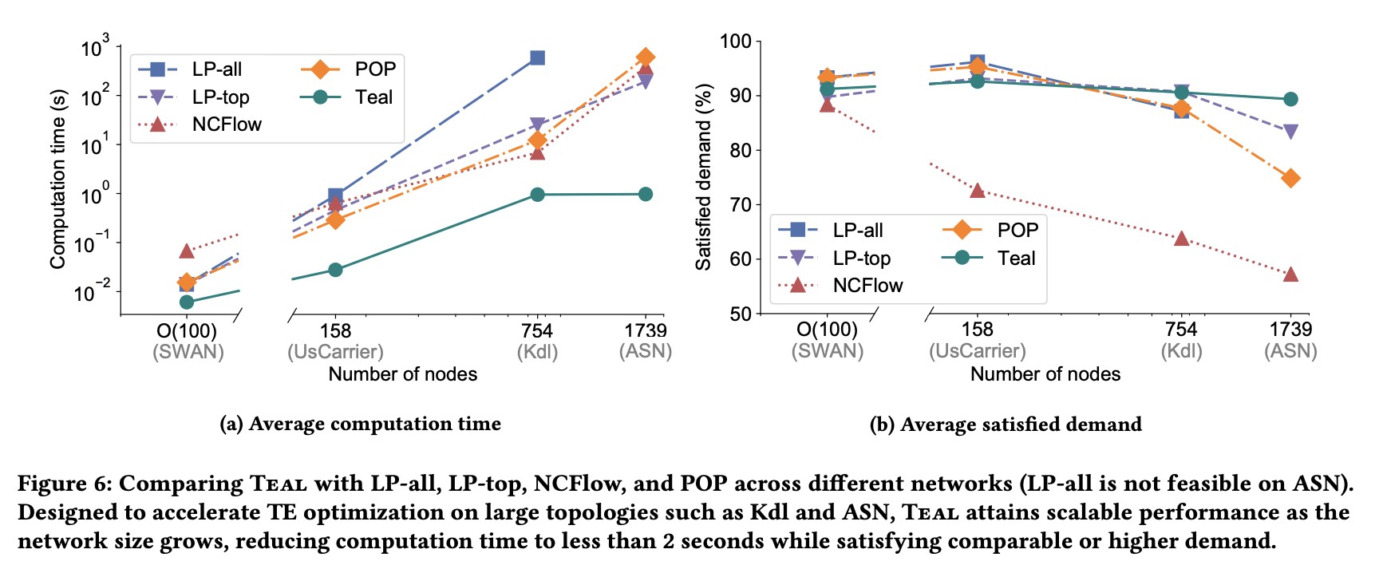

Slide 15
Conclusion
Scalability Crisis is Solved?
TEAL’s Contribution:
Parallelism: Unlocks GPU power for Traffic Engineering.
Architecture: Combines Graph Neural Networks (topology), Multi-Agent RL (scale), and ADMM (safety).
Impact:
Enables real-time control for planet-scale networks.
Ensures high throughput and reliability even as networks grow to thousands of nodes.
Notes:
"To wrap up, the scalability crisis in Traffic Engineering is real. As our cloud infrastructure grows, our old control systems are falling behind."
"Teal represents a fundamental shift in how we solve these problems. By moving from sequential CPU math to parallel GPU learning, we can manage massive networks in real-time."
"Through a carefully designed architecture that handles topology, scale, and safety, Teal proves that Machine Learning is ready to handle the backbone of the internet."

