Slide 1
D²MoE:
Making Large AI Models
Practical on Edge Devices
Dual Routing and Dynamic Scheduling for Efficient On-Device MoE-based LLM Serving
Presenter: Sasha Pernica
Notes:
The paper focuses on a growing problem in artificial intelligence: large language models are becoming increasingly powerful, but their memory requirements make them difficult to run on everyday devices.
The researchers explore how we can improve the efficiency of a particular architecture, called Mixture-of-Experts, by changing how the model selects its computations, stores its weights, and schedules its execution.
The bigger question is whether we can make existing AI architectures more efficient without completely redesigning them.

Slide 2
MOTIVATION
01
Why are researchers using Mixture-of-Experts models?
More capacity without sending every token through every pathway.
Dense transformer
MoE layer
Token A
Token B
Token C
Token D
Router
Shared feed-forward network
Expert 1
Expert 2
Expert 3
Expert 4
Every token uses the same feed-forward pathway.
Inactive
Active
Inactive
Active
All tokens activate the same route.
Multiple specialized experts are available, but a router activates only a subset for each token.
Main takeaway: selective expert activation improves computational efficiency.
Notes:
Instead of relying on a single feed-forward pathway, an MoE layer contains multiple expert networks. A routing mechanism determines which experts should process each token.
This is useful because researchers can increase the total number of model parameters and the model's capacity without requiring every parameter to participate in every computation.
However, this introduces a new challenge. Even though fewer experts are used for computation, the weights of the other experts still have to be stored somewhere."

Slide 3
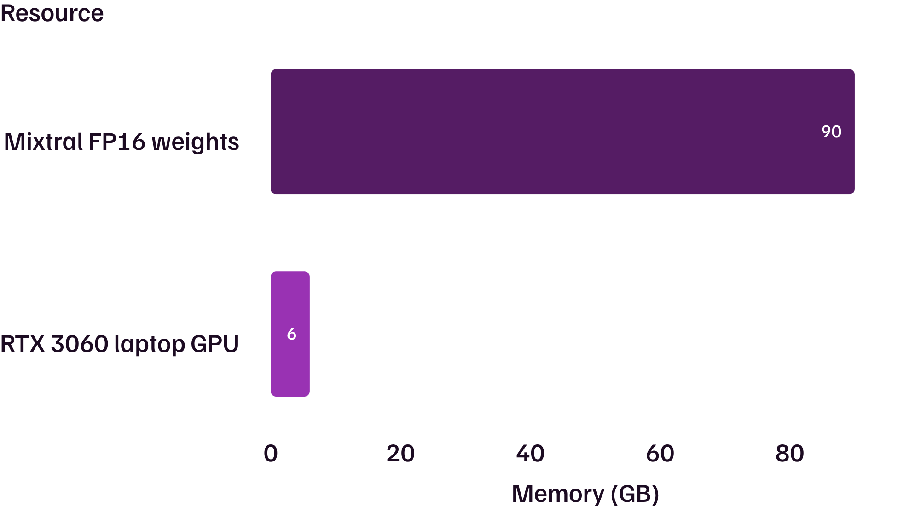
02
THE MEMORY BOTTLENECK
MoE saves computation, but not necessarily memory
89.9%
of Mixtral parameters are experts
All experts still need to be stored, even when only a subset is active for a token.
Main takeaway: reducing computation does not automatically solve the memory bottleneck.
Mixtral FP16 weights: 90+ GB. The model footprint is far beyond the local GPU budget.
Notes:
The authors use Mixtral 8×7B as an example. When its parameters are stored using FP16, the model requires over 90 gigabytes of memory.
For comparison, the NVIDIA RTX 3060 laptop GPU discussed in the paper has only 6 gigabytes of GPU memory.
FP16 is a 16-bit floating-point representation used to store model weights.
More model parameters generally require more memory unless the representation is compressed.
Experts do not all need to fit simultaneously in GPU memory. Some can reside in slower system memory or storage and be transferred when needed.
Moving weights between memory levels introduces additional delays.
Transition: "So why is solving this problem particularly important for edge devices?"

Slide 4



03
WHY EDGE?
Why efficient on-device AI matters
Hardware limits
Inference performance
Deployment opportunity
Large MoE models exceed the memory capacity of many edge devices.
On an RTX 3060, one LLaMA-MoE expert took about 3.1 ms to compute versus about 20 ms to transfer.
Better memory efficiency could make local AI more practical on laptops and embedded systems.
Privacy and cloud-dependence benefits are potential implications, not results individually demonstrated here.
Notes:
Improving on-device inference could make it more practical to run capable AI models on laptops, embedded systems, and other resource-constrained hardware.
Potential benefits Privacy and reduced cloud dependence are potential benefits of local inference, not outcomes individually established by this paper.
, reduced network communication, and greater opportunities for privacy-preserving local processing. These are broader implications of on-device inference, rather than benefits directly demonstrated by every experiment in this paper.
The central challenge is not simply making LLMs faster. It is making them practical to deploy on hardware that cannot store their full models in high-precision GPU memory. Researchers are therefore exploring ways to reduce memory usage while maintaining model quality and avoiding excessive data-transfer delays.

Slide 5
04
THE OPPORTUNITY
Three architectural limitations create an opportunity
01
02
03
Static precision
Changing expert importance
Expensive weight transfers
Fixed bit-width assignments trade accuracy for memory without adapting during inference.
An expert's importance can vary by input token, so offline assignments may be mismatched to the current request.
For 32 LLaMA-MoE requests, expert I/O took 2.6 s versus 2.04 s of computation, with 3.55 s total expert-layer latency.
Notes:
The first is static precision. Quantization allows us to represent expert weights using fewer bits, reducing their memory requirements. However, lower precision can reduce the model's accuracy.
Memory bottlenecks: Large expert networks require substantial storage, even if only some experts are active at once.
Accuracy versus efficiency: Lower-precision quantization saves memory and improves execution speed, but it can reduce prediction quality.
The second problem is that expert importance is not constant. An expert might be very important for one input token but less important for another. This suggests fixed precision assignments may not always be efficien
Data-transfer bottlenecks: If experts are loaded from slower storage when needed, the GPU may spend considerable time waiting rather than computing.

Slide 6
05
D²MOE ARCHITECTURE
D²MoE adds a second routing decision
01
02
Token A
Token B
Traditional MoE
D²MoE
Routed to INT4
Routed to INT2
Which expert should process this token?
Which expert, and at what bit-width, should process this token?
Expert 2
One routing decision: expert selection.
Two routing decisions: expert + precision.
The same expert runs at two bit-widths
Illustrative example: the same expert can operate at different bit-widths.
Illustrative example, not measured results.
Notes:
Traditional MoE systems use a routing mechanism to answer one primary question: which expert should process the current token?
D²MoE introduces a second routing decision: at what precision should that expert operate?
For tokens where precision is especially important, the system can use a higher bit-width to better preserve accuracy. For less sensitive tokens, it can use a lower bit-width to conserve memory resources.
This makes precision a dynamically allocated resource rather than something permanently assigned to each expert.
The broader innovation is that the model becomes adaptive not only in what it computes, but also in how those computations are represented

Slide 7
06
MAKING IT PRACTICAL
Adaptive precision needs smarter storage and scheduling
MWQ: higher precision contains lower
01
Matryoshka Weight Quantization
Higher-bit representations build on lower-bit components, so INT2 → INT3 → INT4 can share stored information instead of duplicating full versions.
INT4
INT3
INT2
INT2 bits sit inside INT3, which sit inside INT4.
HEBF: loading overlaps computing
02
Hottest-Expert-Bit-First scheduling
I/O lane: Expert 2 loads from storage
Prioritize frequently needed expert–bit combinations and overlap weight loading with GPU computation.
Expert 1 loaded
Expert 2 loading
Together, the innovations make dynamic routing practical under constrained memory.
Compute lane: Expert 1 computes while Expert 2 loads
Compute: Expert 1 active
Expert 2 next
Notes:
Innovation
High-level purpose
Token-adaptive bit-width selection
Allocate higher precision when needed and lower precision when sufficient
Matryoshka Weight Quantization (MWQ)
Store different precision levels efficiently by reusing weight representations
MWQ addresses this by organizing weights hierarchically. A lower-bit representation forms the base, and additional quantized information can be used to construct higher-precision representations
Hottest-Expert-Bit-First (HEBF) scheduling
Reduce GPU waiting time by coordinating expert loading and computation

Slide 8



07
EVALUATION
How did the researchers evaluate D²MoE?
Models
Hardware
LLaMA-MoE-3.5B
Mixtral 8×7B
NVIDIA RTX 3060 laptop GPU with 6 GB memory
NVIDIA Jetson AGX Orin 64 GB
Metrics
Inference throughput
Peak memory usage
Serving accuracy
Notes:
The first is inference throughput, or how much output the system can generate over time.
The second is peak memory usage, which is particularly important when a device has limited available memory.
And the third is model accuracy, because reducing resource requirements is only useful if the model still produces reliable results.
The researchers compare D²MoE with existing inference approaches to determine whether the architectural changes lead to meaningful improvements."

Slide 9
08
RESULTS
D²MoE improves efficiency while preserving comparable accuracy
1.39×
53%
INT8
Inference throughput
Lower peak memory
Comparable accuracy
Up to 1.39× higher, the maximum reported improvement over the latest on-device baselines.
Up to 53% lower, the maximum reported reduction versus the reported baseline.
Serving accuracy remains comparable to INT8 counterparts under the evaluated conditions.
These are maximum reported improvements relative to the relevant on-device baselines. The maximum gains do not occur in every scenario and are not universal guarantees.
Notes:
The key innovation is expanding MoE routing from choosing only which expert processes a token to also choosing the precision used by that expert. By combining this flexibility with efficient weight storage and scheduling, D²MoE improves the trade-off between accuracy, memory usage, and inference performance.

Slide 10

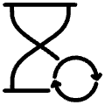

09
OPEN PROBLEMS
What has D²MoE not solved?
Asynchronous workloads
Predictive expert loading
Real user requests arrive unpredictably, making varied requests harder to schedule efficiently.
Forecasting which experts will be needed next could reduce transfer delays further.
Hardware diversity
GPUs, mobile NPUs, and edge systems expose different execution capabilities.
Main takeaway: D²MoE addresses important bottlenecks, but efficient edge inference remains an open systems problem.
Notes:
The first involves asynchronous workloads. In a real deployment, requests may arrive at unpredictable times, making it harder to schedule expert loading and computation efficiently.
The second is predictive expert loading.
D²MoE schedules activated experts, but a future system might predict which experts will be needed for upcoming tokens and load their weights before they are requested.
Finally, hardware diversity remains a challenge.
Different devices have different memory capacities, processing capabilities, and hardware architectures.
An optimization that works well on a GPU may not be equally efficient on a smartphone's neural processing unit.
D²MoE schedules activated experts, but a future system might predict which experts will be needed for upcoming tokens and load their weights before they are requested.

Slide 11




Outlook
11
What broader research directions does D²MoE reveal?
Adaptive inference architectures
Hardware-aware AI
Models that adjust expert choice and precision to each token.
Designs that match model storage and execution to device limits.
Intelligent memory management
Efficient multi-user systems
Smarter caching and loading of expert weights.
Serving many requests on one device without idle resources.
Notes:
The first opportunity is adaptive inference architectures.
D²MoE dynamically adjusts precision, but this raises a broader question: what other computational resources could be allocated dynamically depending on the input?
For example, future systems might adapt computational depth or the number of activated experts.
The second direction is hardware-aware AI.
Rather than designing a model first and then figuring out how to execute it, researchers can jointly consider the model and the hardware it will run on.
Third, intelligent memory management could further improve efficiency. A system might predict expert usage, cache frequently needed weights, or coordinate memory transfers more effectively.
Finally, efficient multi-user inference is another opportunity. Real deployments must manage many requests with different resource demands and arrival times.
The common theme is that AI architectures contain many components that can be redesigned and optimized rather than treated as fixed."

Slide 12
12
Conclusion
The bigger lesson: efficient AI requires system-level thinking
Less compute, same bottleneck
Adaptive precision
Optimize together
MoE reduces active computation, but memory capacity and expert loading remain bottlenecks.
D²MoE combines token-adaptive expert precision with nested weight storage and bit-width-aware scheduling.
Model architecture, representation, memory management, and hardware execution should be optimized together.
Efficient AI is not just about reducing computation. It is about redesigning how models use the entire computing system.
Notes:
Close onD²MoE operates at the intersection of model architecture and hardware execution. Rather than redesigning the entire LLM, the researchers improve how the existing MoE architecture manages precision, memory, and computation during inference.
This is a particularly important research direction because the same underlying model architecture can be made more efficient without requiring an entirely new model design.

