Slide 1
Zhuge
Achieving Consistent Low Latency for Wireless Real-Time Communications with the Shortest Control Loop
Zili Meng et al. · ACM SIGCOMM 2022

Slide 2
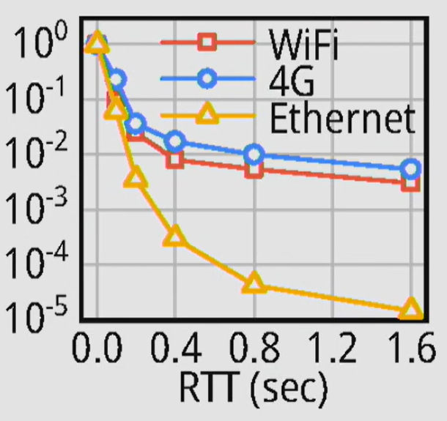
Wireless latency has a long tail
Fraction of RTT measurements that exceed x
Wireless connections have many more high-RTT events than Ethernet.
Source: Meng et al., Fig. 2(a)

Slide 3
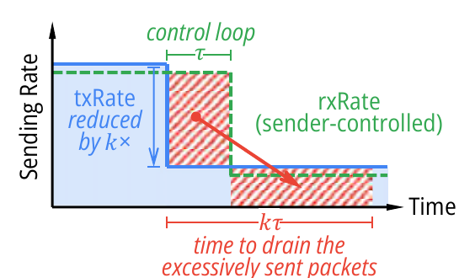
Bandwidth drops fill the AP queue
10 → 3 Mb/s
7 Mb accumulates each second
until the sender slows down.
Source: Meng et al., Fig. 3(a)

Slide 4
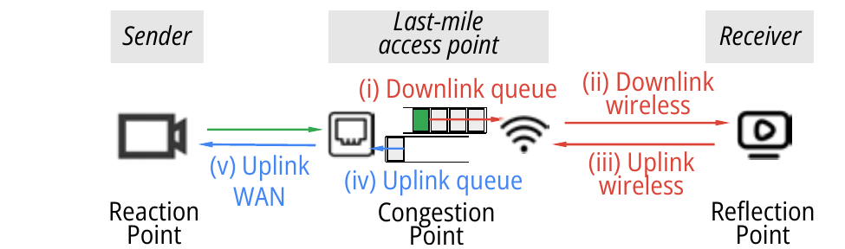
The feedback loop crosses the bottleneck
Data waits at the AP, crosses wireless, reaches the client,
then feedback returns to the sender.
Source: Meng et al., Fig. 1

Slide 5
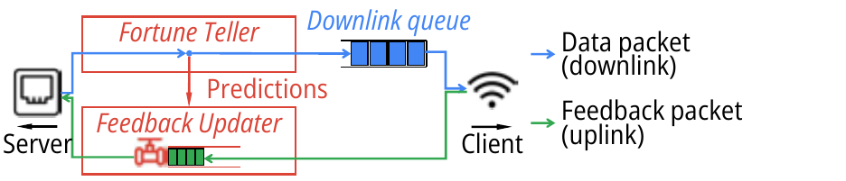
Zhuge acts at the access point
Fortune Teller
Feedback Updater
Predicts delay when data arrives
Signals the sender through feedback
Source: Meng et al., Fig. 5

Slide 6
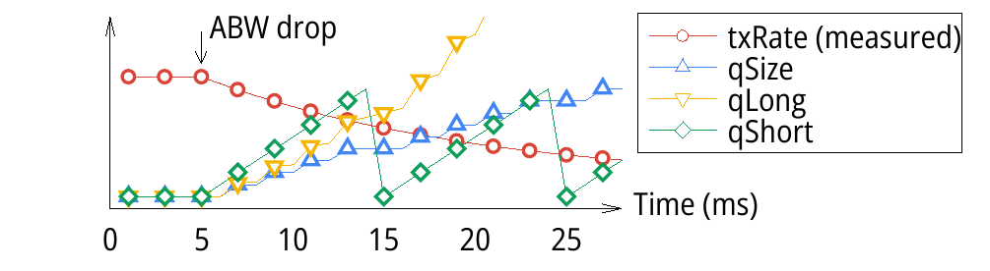
Fortune Teller estimates wireless delay
totalDelay = qLong + qShort + tx
qLong
queue size ÷ average departure rate
qShort
front packet waiting time
tx
wireless transmission interval
qShort reacts first after the bandwidth drop.
Source: Meng et al., Figs. 6–7

Slide 7
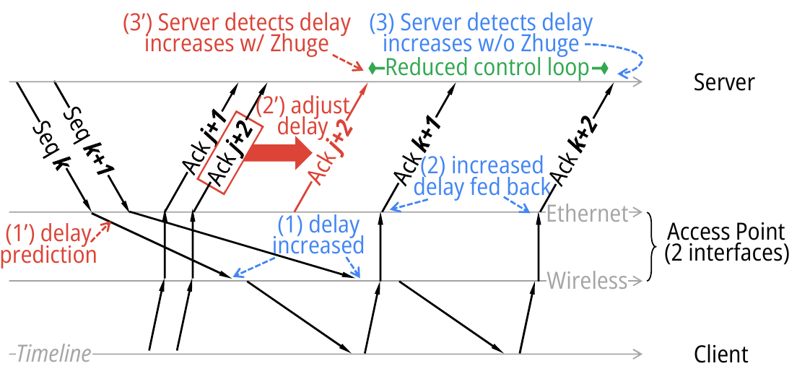
Feedback Updater uses earlier ACKs
Source: Meng et al., Fig. 9

Slide 8
Trace simulations show fewer delays
45–75%
38–92%
fewer RTT events above 200 ms
fewer video frames delayed
more than 400 ms
RTP/RTCP across five wireless traces, compared with the best baseline
Source: Meng et al., Figs. 11 and 13

Slide 9
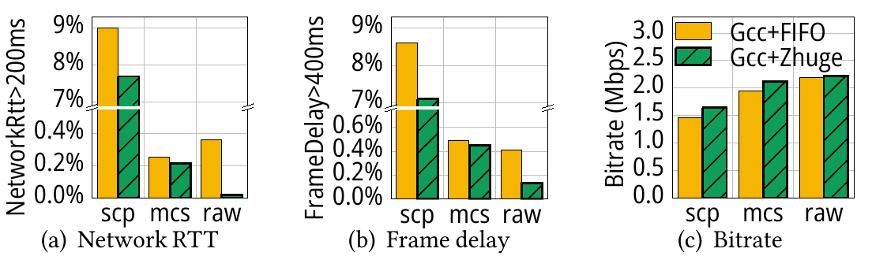
OpenWrt testbed improves latency
17–95% fewer high RTT events
9–67% fewer delayed frames
Source: Meng et al., Fig. 18

Slide 10
Scope and limitations
Last-mile downlink
Applying it to the wireless first mile
would require client integration.
Prediction error
Estimates become less accurate at high delays.
Severe bandwidth drops
Loss and TCP timeouts can limit the benefit.
Source: Meng et al., §6–7 and Fig. 19

Slide 11
Takeaway
Predict delay at AP
Use feedback already returning to the sender
Sender adapts sooner, the queue stays shorter
Meng et al., SIGCOMM 2022

