Slide 1
BLADE: Adaptive Wi-Fi Contention Control for Next-Generation Real-Time Communication (NGRTC)
Fengqian Guo, Tencent; Yuhan Zhou, Peking University and Tencent; Longwei Jiang and Congcong Miao, Tencent; Yuxin Liu, University at Buffalo, SUNY; Chenren Xu, Peking University; Hancheng Lu, Institute of Artificial Intelligence, China; Chang Wen Chen, The Hong Kong Polytechnic University; Yaxiong Xie, University at Buffalo, SUNY; Honghao Liu, Tencent
Presented by Mitchell Thai

Slide 2
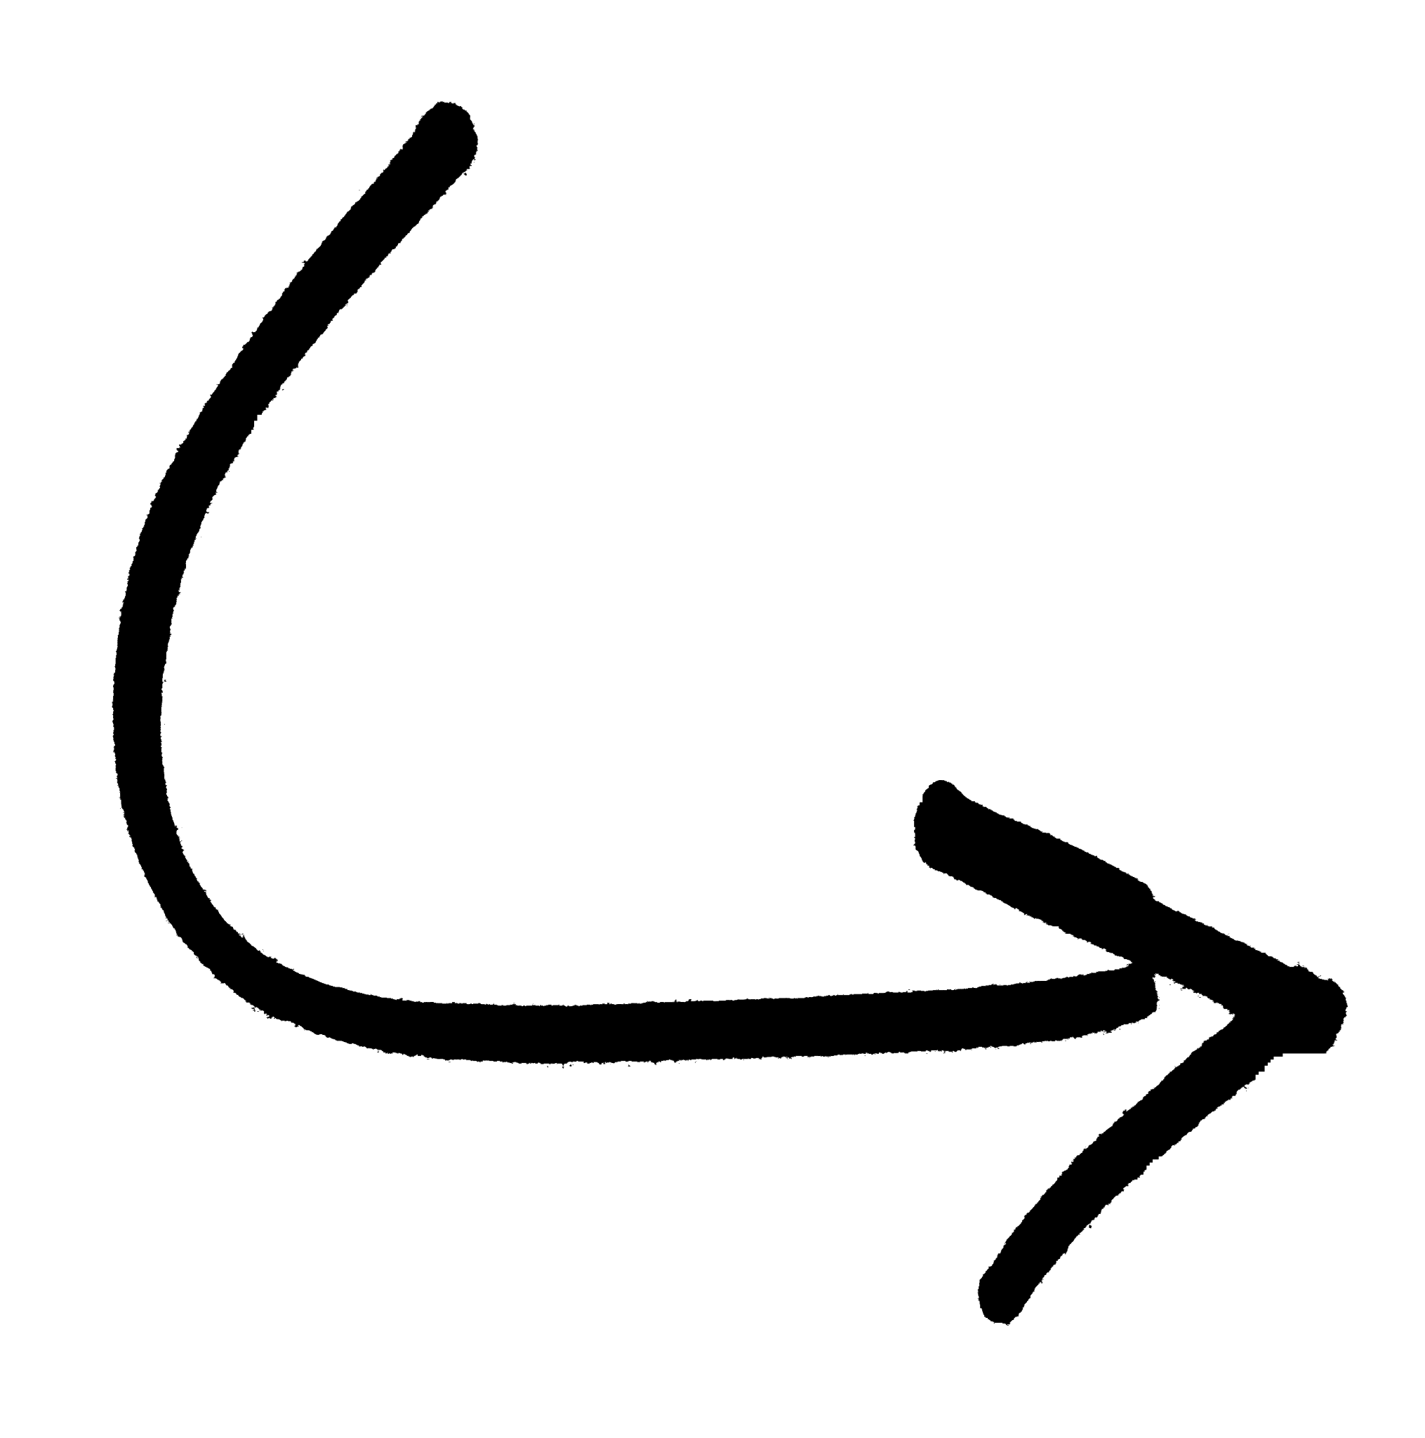






What is Next-Generation Real-Time Communication?
Traditional Real-Time streaming
Next-Gen Real-Time Streaming
Requires much higher bitrate and lower latency

Slide 3
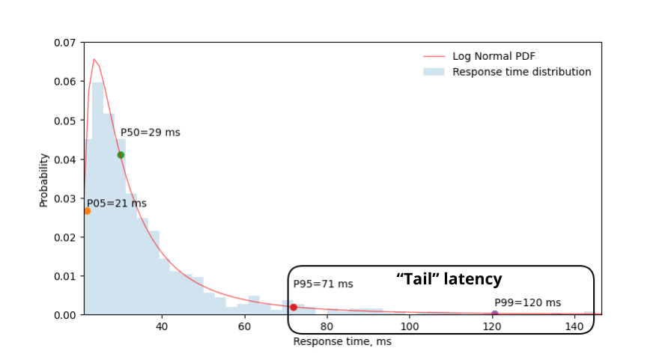
Why is it so difficult to achieve?
Strict QoE Requirement: Consistent low latency, both average and Tail Latency
Tail Latency: Tail latency is the high-percentile response time (such as p99 or p99.9) that captures the slowest slice of a system's requests.
At 60 frames per second, a frame is due every 16 milliseconds.
A 99.9th percentile tail latency means roughly a 0.1% video store rate.
A single late frame stalls the decoder, stalling the following frames
That mathematically equals one freeze/stall every 60 seconds
33% Reduction in user retention time

Slide 4
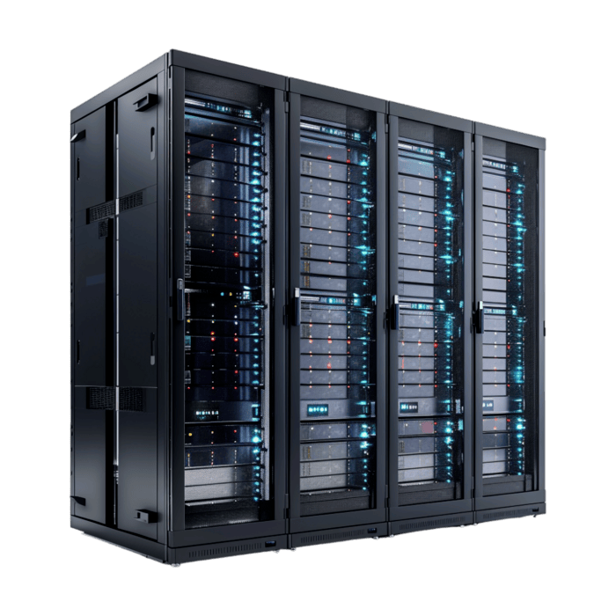
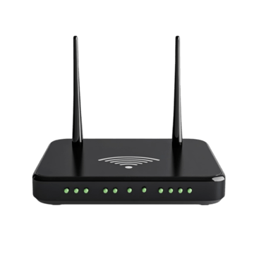



The Streaming Path
Edge Server
WIFI AP
Client Device
WAN
The Remote Side (Edge + WAN): Historically blamed for lag, but modern congestion control has mostly solved this.
The Local Side (Wi-Fi Last Hop): The True Culprit. Even with a clean WAN, tail-latency spikes and packet delays happen entirely on this final wireless leg.

Slide 5
Why is the last hop delayed?
Large scale Measurement Study:
The Methodology: Deployed modified drivers on 200+ commercial APs in real (volunteer) homes.
Collected large-scale telemetry tracking packet-level latency and video performance.
Their Findings:
1. Comprehensive cross-layer analysis proved that the long-distance Wide Area Network (WAN) and edge servers maintain stable, low latency; the extreme tail-latency spikes map directly and exclusively to the local wireless medium.
2. Discovered that while individual packet transmission times over the air are exceptionally fast, the access point experiences severe delivery droughts. These unexpected pauses starve the application, forcing accumulated packets to burst forward simultaneously and triggering severe decoder stalls.

Slide 6
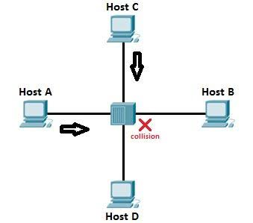
Wi-Fi Contention Leads to Droughts
The Shared Medium Problem
After further investigating the correlation between channel utilization rate and packet delivery rate, there was a perfect match
This tells us that contention is likely the root cause for high tail latency.
But what exactly is contention?
Wi-Fi airwaves are a shared resource. Unlike a dedicated wired cable, multiple devices, neighboring routers, and background traffic are all trying to use the exact same frequency.

Slide 7
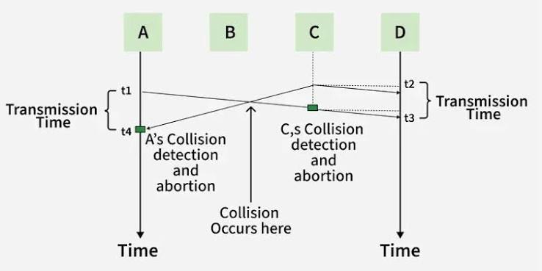
How Legacy CSMA/CA Works:
Carrier Sense Multiple Access with Collision Avoidance (CSMA/CA): Essentially a "polite conversation" protocol.
The AP first listens to the airwaves. Wants to send a packet
Must go through a contention interval
Must wait for an ACK (acknowledgment) from receiving device
Set a backup timer and counter slot from the contention window
802.11 Frame Exchange Sequence
If other packet is detected during this countdown, timer is frozen.
When timer hits 0, packet can be sent

Slide 8
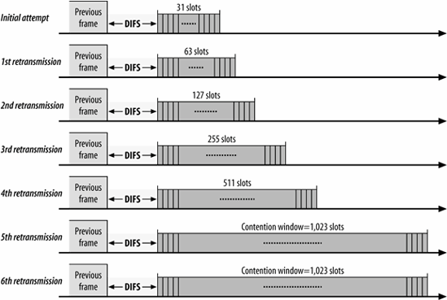
How is Waiting Time Decided?
Contention Window (CW): A dynamic range of time slots (starting at a minimum size) used to randomize router wait times.
Backoff Timer Control:
On each frame exchange sequence, an interval in CW’s range (0 - CW max) is chosen and used to calculate a packets wait time. The higher the CW value, the higher the wait time
CW is initialized to be 15, but every time there is a transmission failure, the CW doubles. Resets to 15 on transmission success.

Slide 9
New Contention Control: BLADE
Goal: Microscopic fair channel access for all transmissions
Problems with current IEEE contention controls
It controls CW based solely on local transmission failures
No channel wide consensus on how to share the air
Microscopic Access Rate (MAR): A shared signal among devices on a channel used to sense transmission traffic
Low collision risk, CW is lowered for all devices
Low MAR
High MAR
High collision risk, CW is raised for all devices

Slide 10
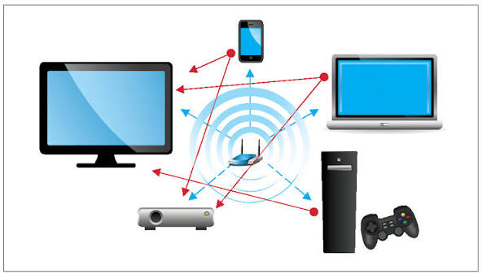
Contention Window Control: BLADE
Two Goals:
Each transmitter rapidly adjusts their CW to the same and optimal CW depending on traffic
Optimal CW is adjusted to ensure channel utilization is also at an optimal level, regardless of # of transmitters or traffic

Slide 11
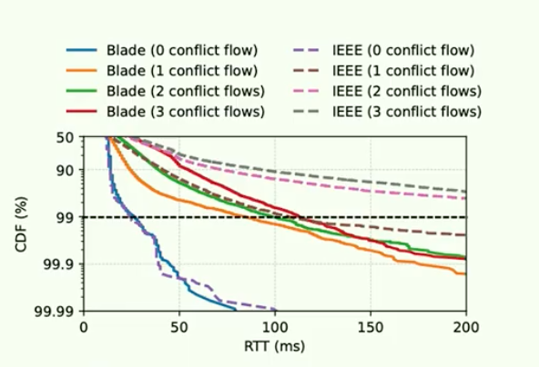
Real World Application
Implemented BLADE contention control on 4 WIFI APs, running them in the same channel.
NGRTC: Ran 3 stress test workloads and one cloud gaming transmission.
Frame latency was cut by over 50%
Video stall rate was cut by over 90%
5x lower tail latency
Non-NGRTC: Ran all four with stress testing workloads using traditional streaming applications
3x lower median delay
3x higher median throughput

Slide 12
Takeaways
The Core Problem: Next-gen real-time apps (cloud gaming, XR) fail not because of core networks, but due to decades-old MAC-layer contention control.
The BLADE Breakthrough: Replaces reactive isolation with Medium Access Rate (MAR) monitoring, acting as a shared congestion thermometer to coordinate contention smoothly.
The Big Impact: 5x lower tail latency and >90% fewer video stalls on real commercial hardware.
The Future of Wi-Fi: Proves we don't need a total hardware overhaul; intelligent software control can unlock ultra-low latency for wireless streaming.

