Slide 1
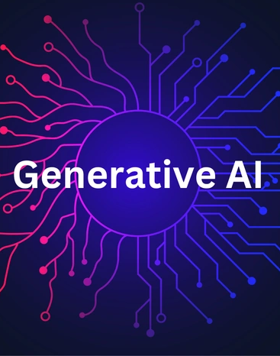
Generative Agents: Interactive Simulacra of Human Behavior
A presentation by Skyler Haas

Slide 2
What we’ve worked towards:
We have envisioned the ability to create believable simulation of human behavior for decades. The possibilities are endless.
However, the range of possible behavior for a human is too large and complex to recreate.
So… we fuse a LLM (ChatGPT) with an agent architecture that can act upon learned “memories and social dynamics”.

Slide 3
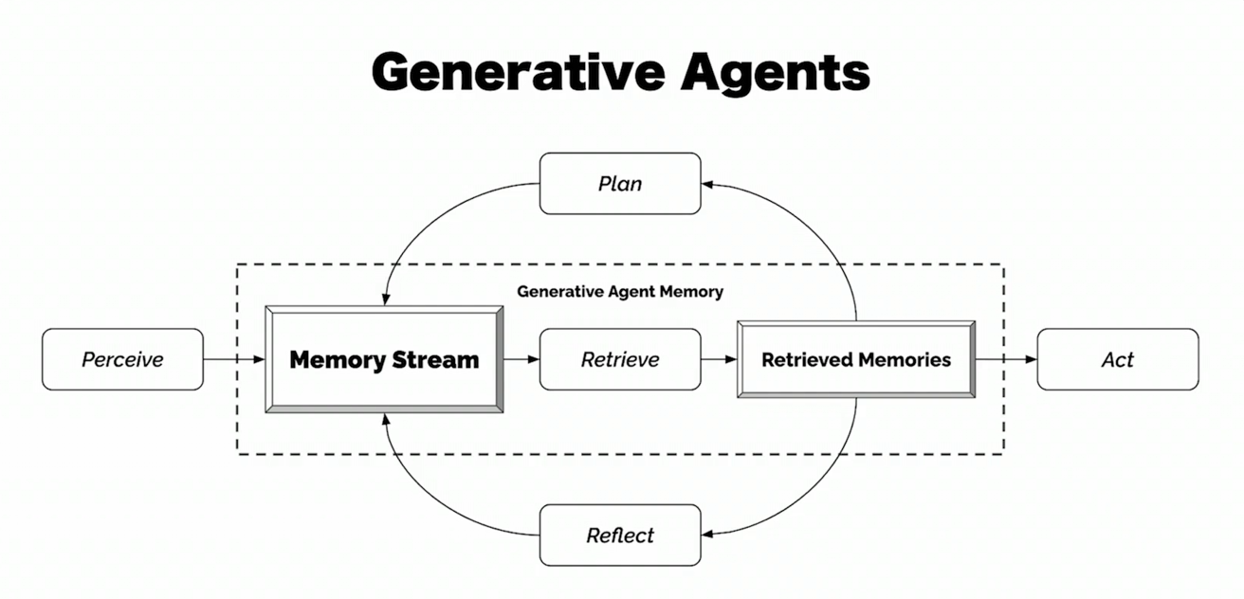

Slide 4
1. The Idea

Slide 5
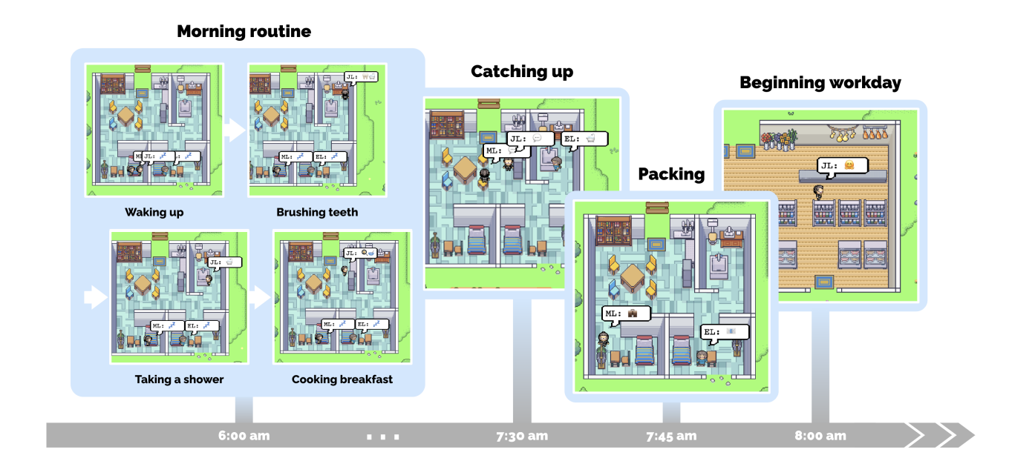
Thanks to Joon Sung Park et al. 2023

Slide 6


Their “behaviors” are composed of smaller action sequences. These actions are reason-based; together, generative agents exhibit emergent societal behaviors.
They remember their actions with one another.
Actions are carried on… Let’s imagine these agents as people.
For example, person 1 has an idea and tells it to person 2.
Person 2 tells it to person 3, for a reason of some relevance.

Slide 7

How? The development of LLMs makes this possible.
These LLMs using web data that reflect us, encode the way we live, talk, and behave.

Slide 8
2. The Dilemma

Slide 9
Humans perceive a lifetime of experiences, remember and make sense of them, and translate into actions that represent us.
We must remember LLMs were:
originally built on the tendency to not remember beyond current interaction
operating on a language not attached to physical reality

Slide 10
Origin: NPC
Drawbacks of previous attempts: simplifying environments/dimensions of agent behavior
Rule-based approaches like behavior trees or finite-state machines
Problem: Cannot remember consequences or do new things
Goal: try to go past procedural knowledge and instead self-learn
Context window that is dynamically updated is the solution

Slide 11
3. The Process

Slide 12

“desk is neat and organized”
Create idea-based sentences using what agent can perceive.
Store the sentences in their natural language format in long-term memory, the memory stream.
Retrieve memory subset that is relevant to current situation.
Then can choose to plan, act, or reflect (using LLM).

Slide 13
Reflections, based on observations, are higher-level, abstract thoughts and can be used as an additional type of memory.
In summary:
Combine perceive->retrieve->act,plan,reflect in order to self-learn, and simulate human creating memories

Slide 14
4. The Future

Slide 15
Power to create AI that can understand and express human behavior.
For the future:
Generative agents are obviously not real people, but their ability to simulate our behavior may help us better understand ourselves when it is not possible to engage in real life.

