Slide 1

PowerInfer-2: Fast LLM Interface on Mobile Devices
By Ryan Baiano

Slide 2

LLMs on Phones – Overview
ChatGPT, Gemini, etc. run through cloud platforms
Locally-run LLMs require high amounts of RAM (30+ GB)
Most smartphones only have 8-16 GB of RAM installed
Notes:
Disk offloading : llama example (loads massive chunk of model, calculates linear, deletes it

Slide 3
LLMs on Phones – Overview
Disk offloading: moves huge chunk of memory into the RAM, calculate, delete, repeat
The problem: phone storage is 12x slower than SSD on a computer
Notes:
Disk offloading : llama example (loads massive chunk of model, calculates linear, deletes it

Slide 4
Innovation: PowerInfer-2
For 1 word, only 5-10% of neurons are used
Using select memory, breaks model into neuron clusters based on subject
Pipeline solution – while NPU calculates, UFS already predicts and sends next word’s cluster
Notes:
Llms are sparse

Slide 5

Previous systems’ problems – LLama
Moved entire layers at a time
Processor sits idle for majority of the time (I/O Starvation)
No prediction feature

Slide 6
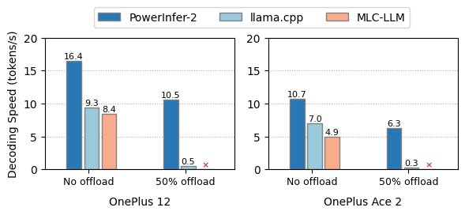

Slide 7
Setbacks / problems with powerinfer-2
Fetching isn’t perfect
Sparsity dependency
Notes:
If AI researchers move toward "Dense" models where every neuron is active to maximize intelligence, PowerInfer-2’s trick of skipping data fails. In a dense model, you’d be back to square one—loading the entire 70GB matrix and hitting that slow "Memory Wall.”
A Dense Model is like a system that requires you to read every single page of all 100 volumes just to answer the question "What is a cat?" It’s thorough, but it’s incredibly slow because you’re moving a massive amount of paper.
A Sparse Model is like a system where, when you ask about a cat, the AI knows that 95 of those volumes are completely irrelevant. It only opens the 5 volumes related to "Animals" and "Biology."

Slide 8

Modern implications
Financial firms
Government
Any institution dealing with proprietary data

Slide 9
SOurce
PowerInfer-2: Fast Large Language Model Inference on a Smartphone

