Slide 1
Toolformer: Language Models Can Teach Themselves to Use Tools
CIS4930
Tomas Caruso

Slide 2

Why This Paper Exists
LLMs are good at language
Bad at math, facts, and time
Scaling alone doesn’t fix this

Slide 3
Core Problem
Models don’t know when or how to use tools
Prior work relies on humans

Slide 4


Key Question
Can a model teach itself to use tools?

Slide 5
Key Idea: Toolformer
Model learns when, which, and how to use tools

Slide 6
Tools Used
QA
Wikipedia Search
Calculator
Calendar
Machine Translation

Slide 7
Training Pipeline
Generate tool calls
01
Execute tools
02
Filter useful ones
03

Slide 8
Clever Part: Filtering
If the model uses a tool and that makes it more confident in its next prediction, that tool call was helpful. If it doesn’t help, or actually makes things worse, it gets thrown away.

Slide 9

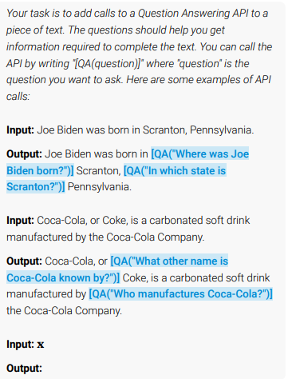
Example
Pittsburgh is known as the Steel City
→ QA tool confirms fact

Slide 10
Fine-Tuning
GPT-J trained on augmented data
Language ability preserved

Slide 11
Evaluation Tasks
Facts
QA
Math
Multilingual
Temporal

Slide 12
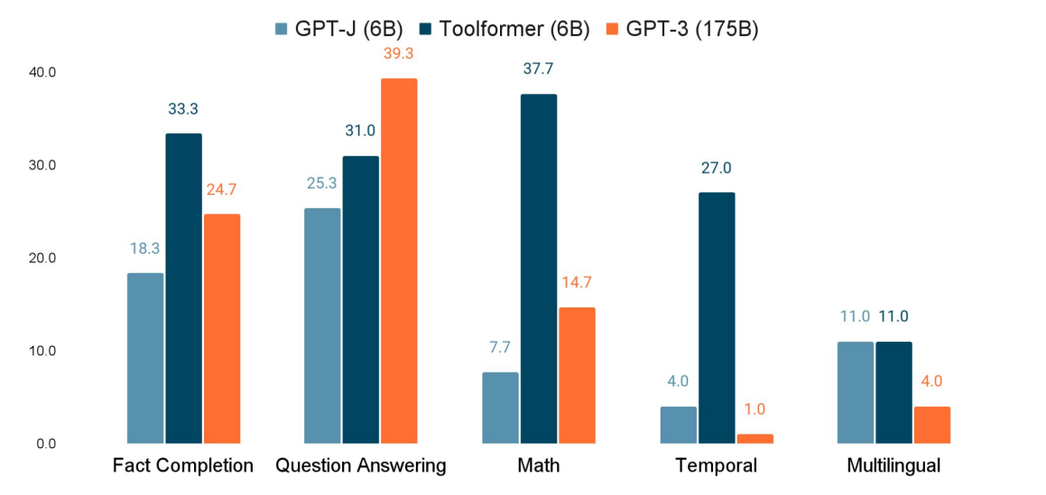
Results
6B Toolformer beats 175B GPT-3 on many tasks

Slide 13
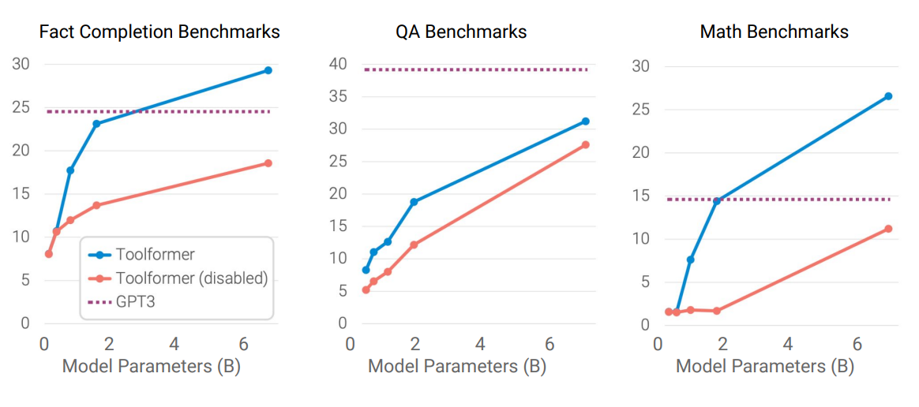
Results
6B Toolformer beats 175B GPT-3 on many tasks

Slide 14

Limitations
One tool at a time
No chaining
Prompt sensitivity

Slide 15

Industry Impact
Smaller models
More reliable systems
AI agents

Slide 16
Final Takeaway
Models don’t need to know everything
They need to know when to ask

