Slide 1
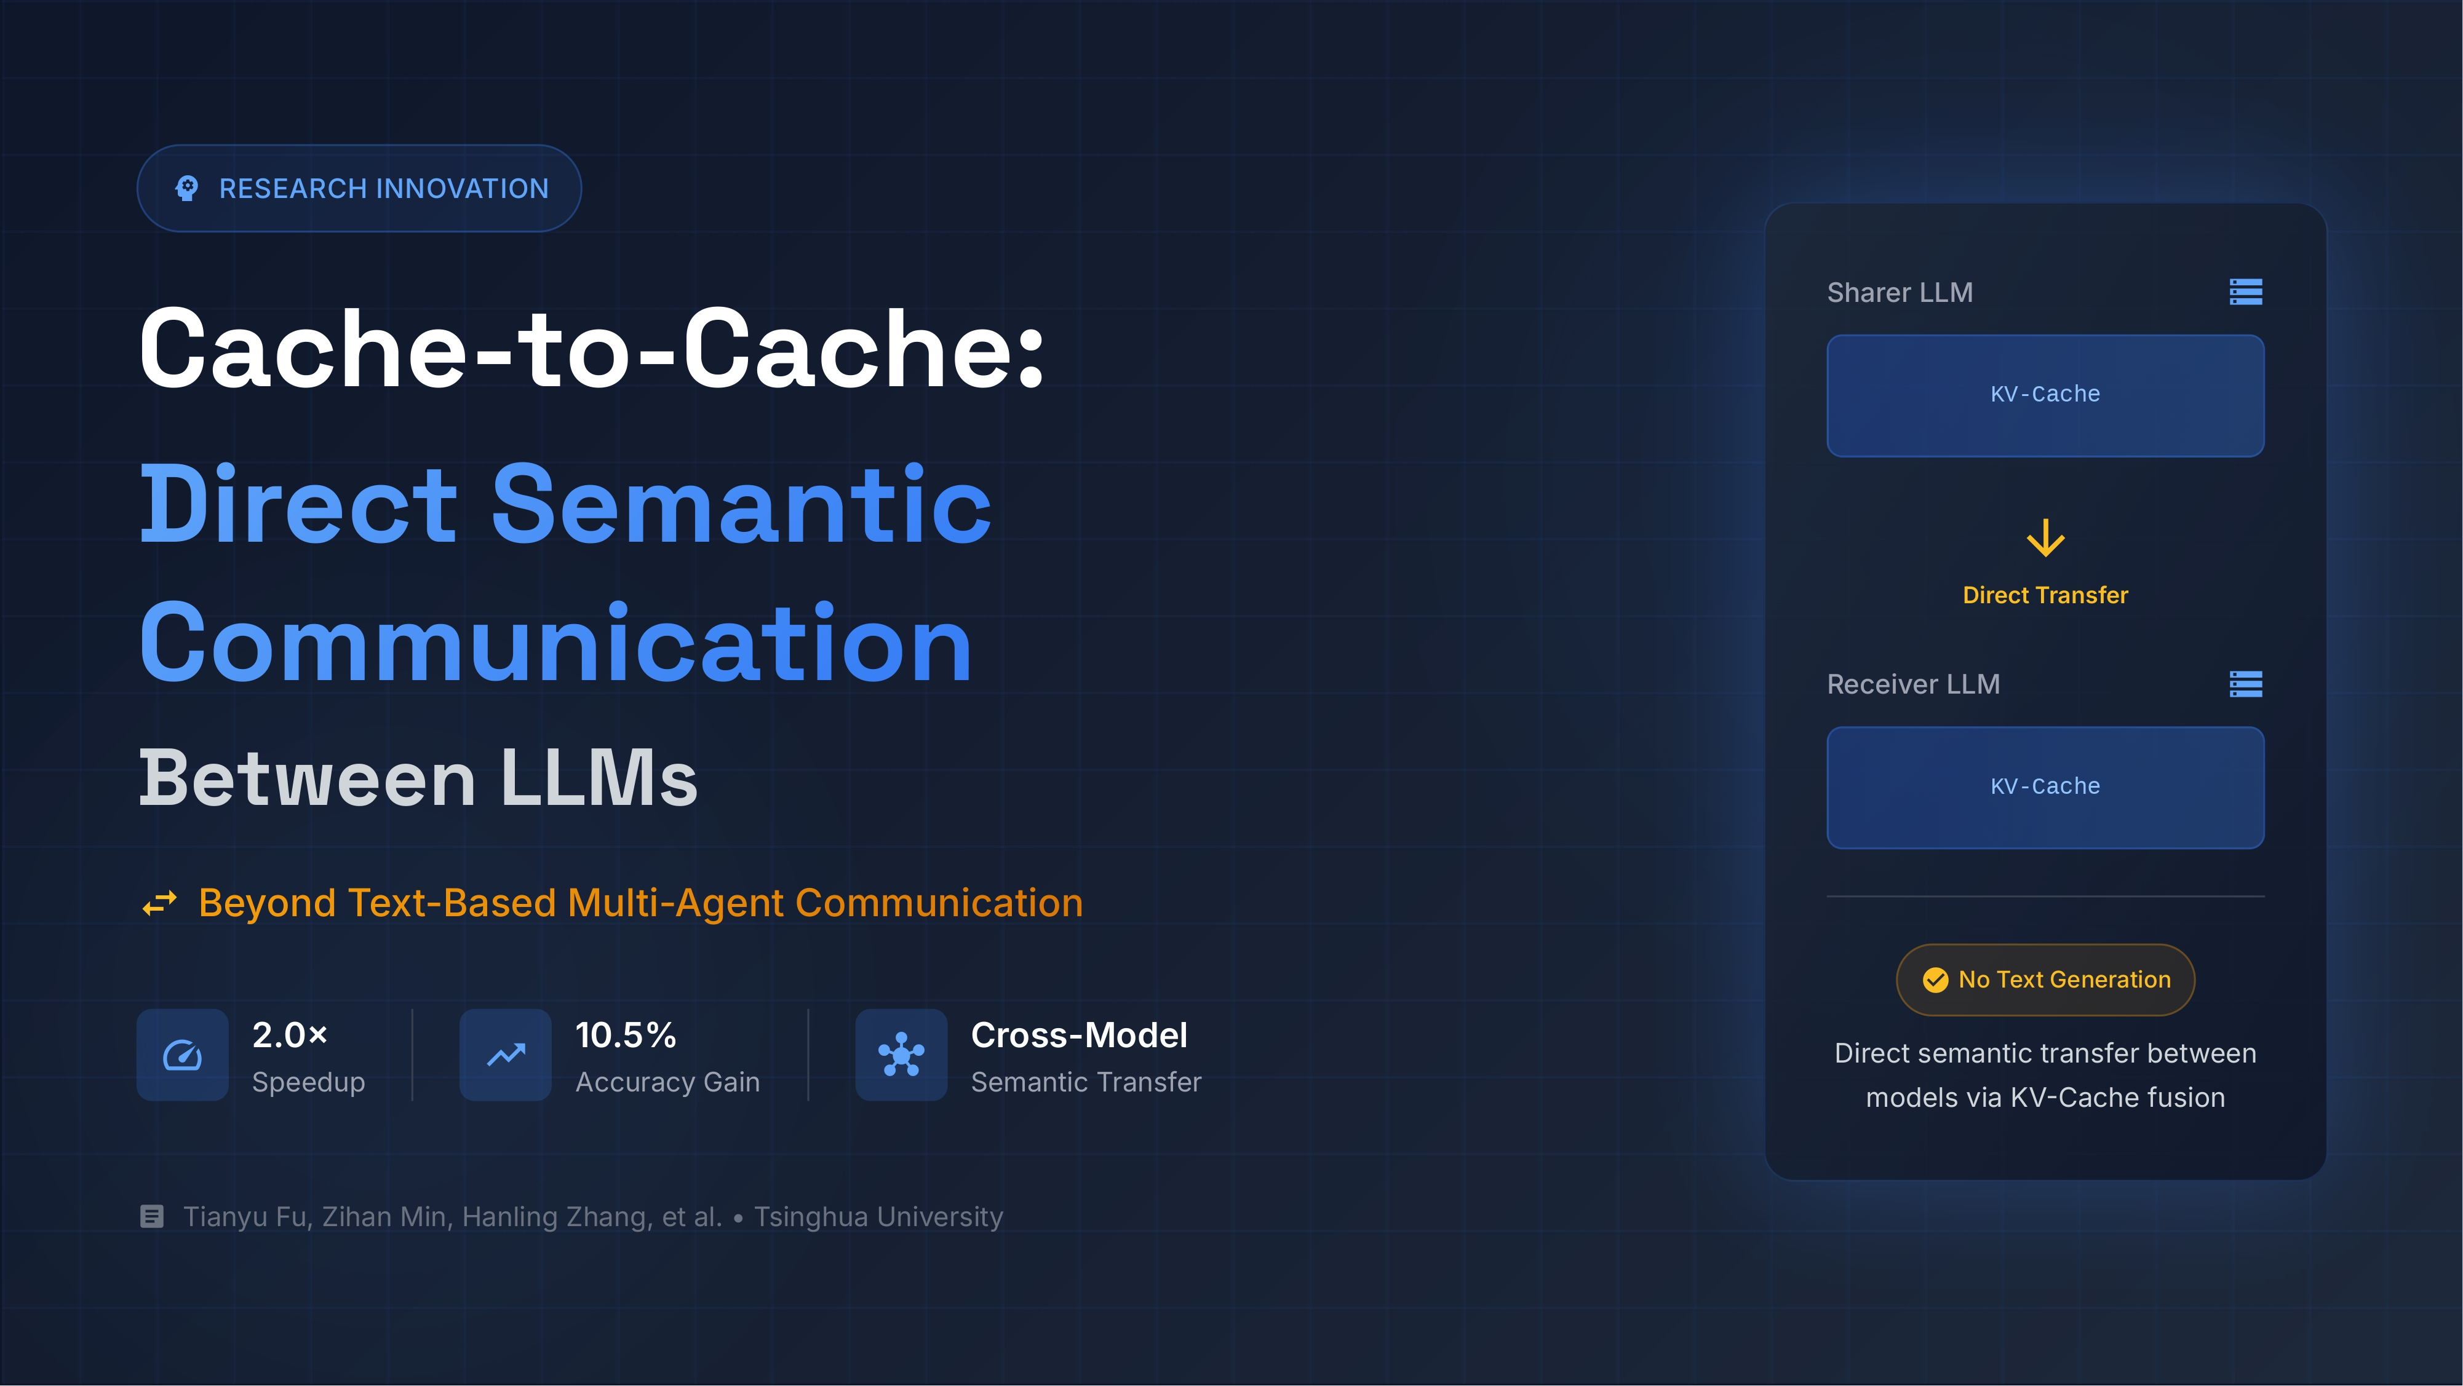
Notes:
The Problem with Current LLM Communication
Welcome, everyone. Today, I want to talk about how large language models (LLMs) talk to each other, and why the current method is fundamentally broken for complex multi-agent systems.

Slide 2
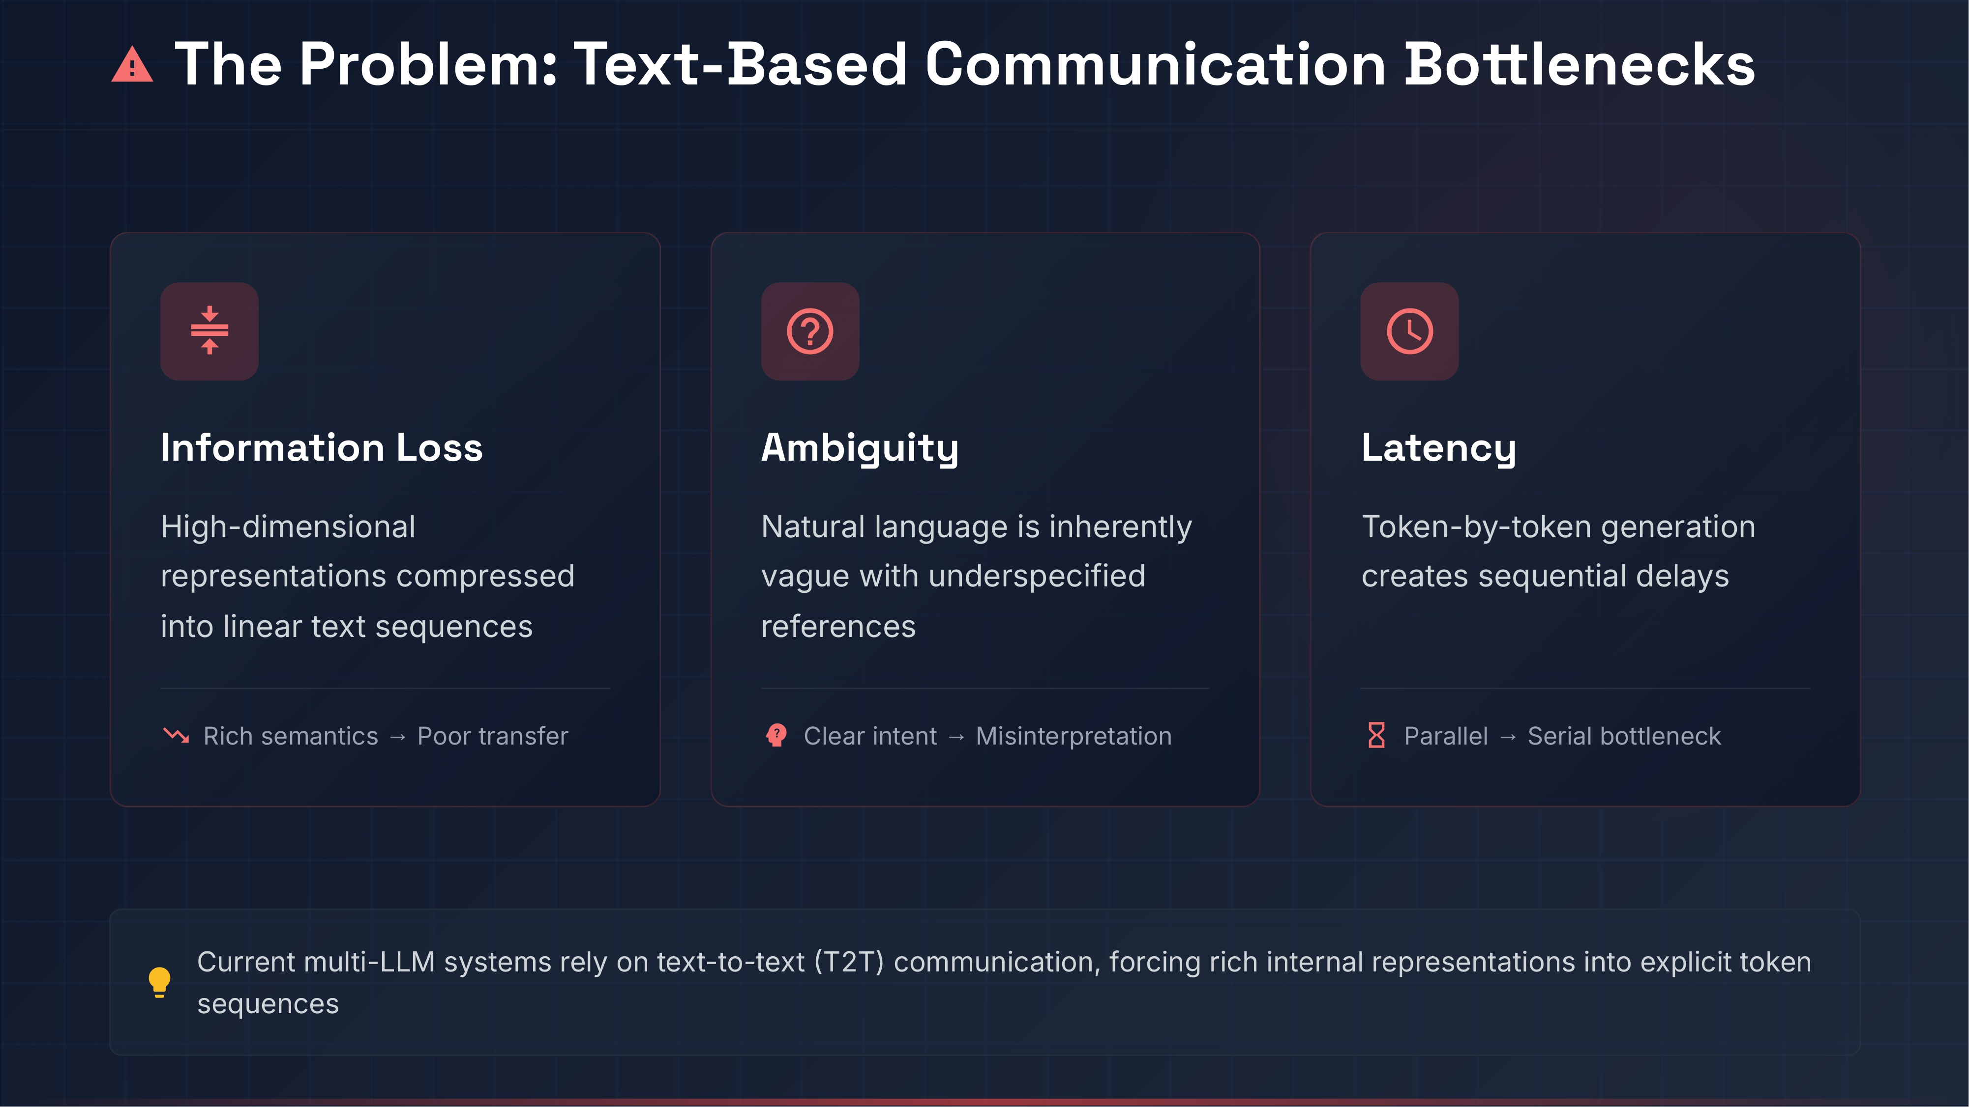
Notes:
Right now, multi-agent systems talk to each other the same way humans do: by writing text. This creates a massive bottleneck.
When a language model has to compress its high-dimensional, internal understanding into a flat string of words, information is lost. Natural language is inherently ambiguous, and the models are forced to guess exact intents based on limited text. Beyond the translation problem, generating text is slow. Outputting data token-by-token introduces severe serial latency. We are building systems that process information at machine speed but forcing them to communicate at typing speed.
The Text Bottleneck: Current multi-LLM systems rely on text-to-text (T2T) communication, which forces models to compress rich, high-dimensional internal representations into linear token sequences.
Information Loss: This compression leads to a massive loss of rich semantic information.
Ambiguity: Natural language is inherently vague and often contains underspecified references, leading to clear intents being misinterpreted.
The Latency Tax: Generating text token-by-token introduces sequential decoding delays, turning parallel processing potential into a serial bottleneck.

Slide 3
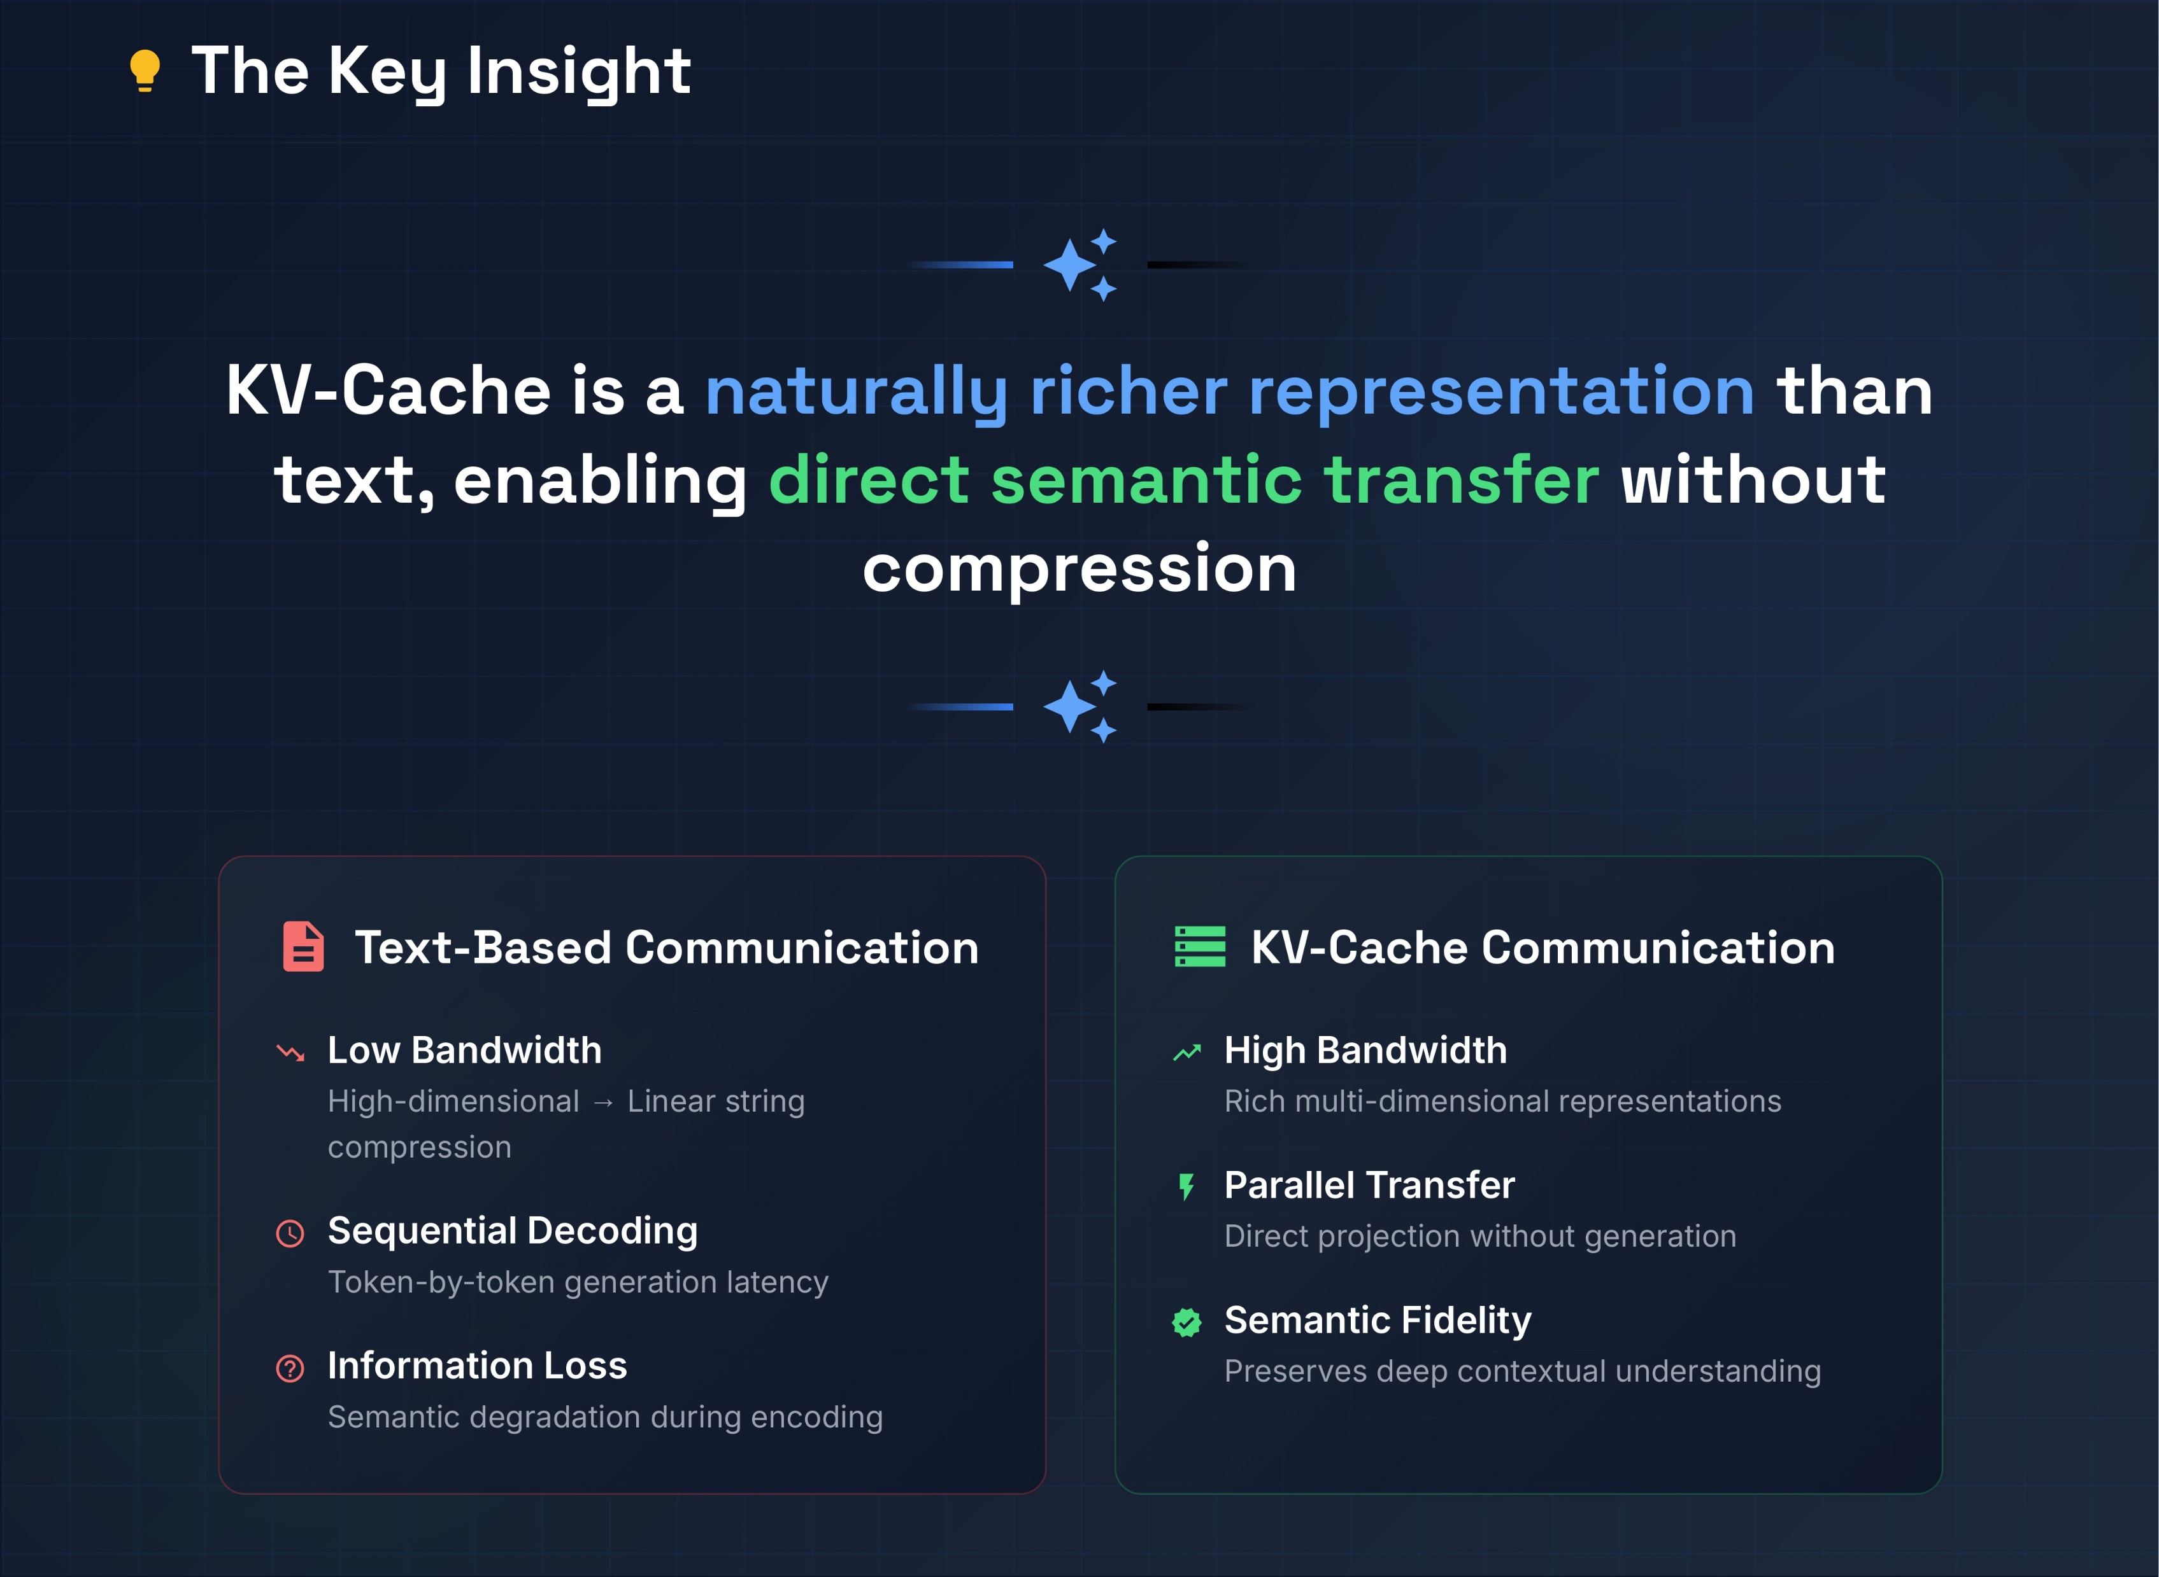
Notes:
So, how do we fix this? Instead of forcing models to talk via generated text, we can share their internal representations directly by transferring the KV-Cache from one model to another.
The method is called Cache-to-Cache, or C2C. When the sender model processes information, we intercept its internal state—specifically, the Key-Value Cache. A specialized neural network module takes that cache, translates it, and fuses it directly into the receiver model. The receiver model absorbs this rich semantic data and continues its reasoning as if it had generated those thoughts itself. We selectively inject this data only into the specific layers of the receiver model that actually need it. No intermediate text is ever generated.

Slide 4
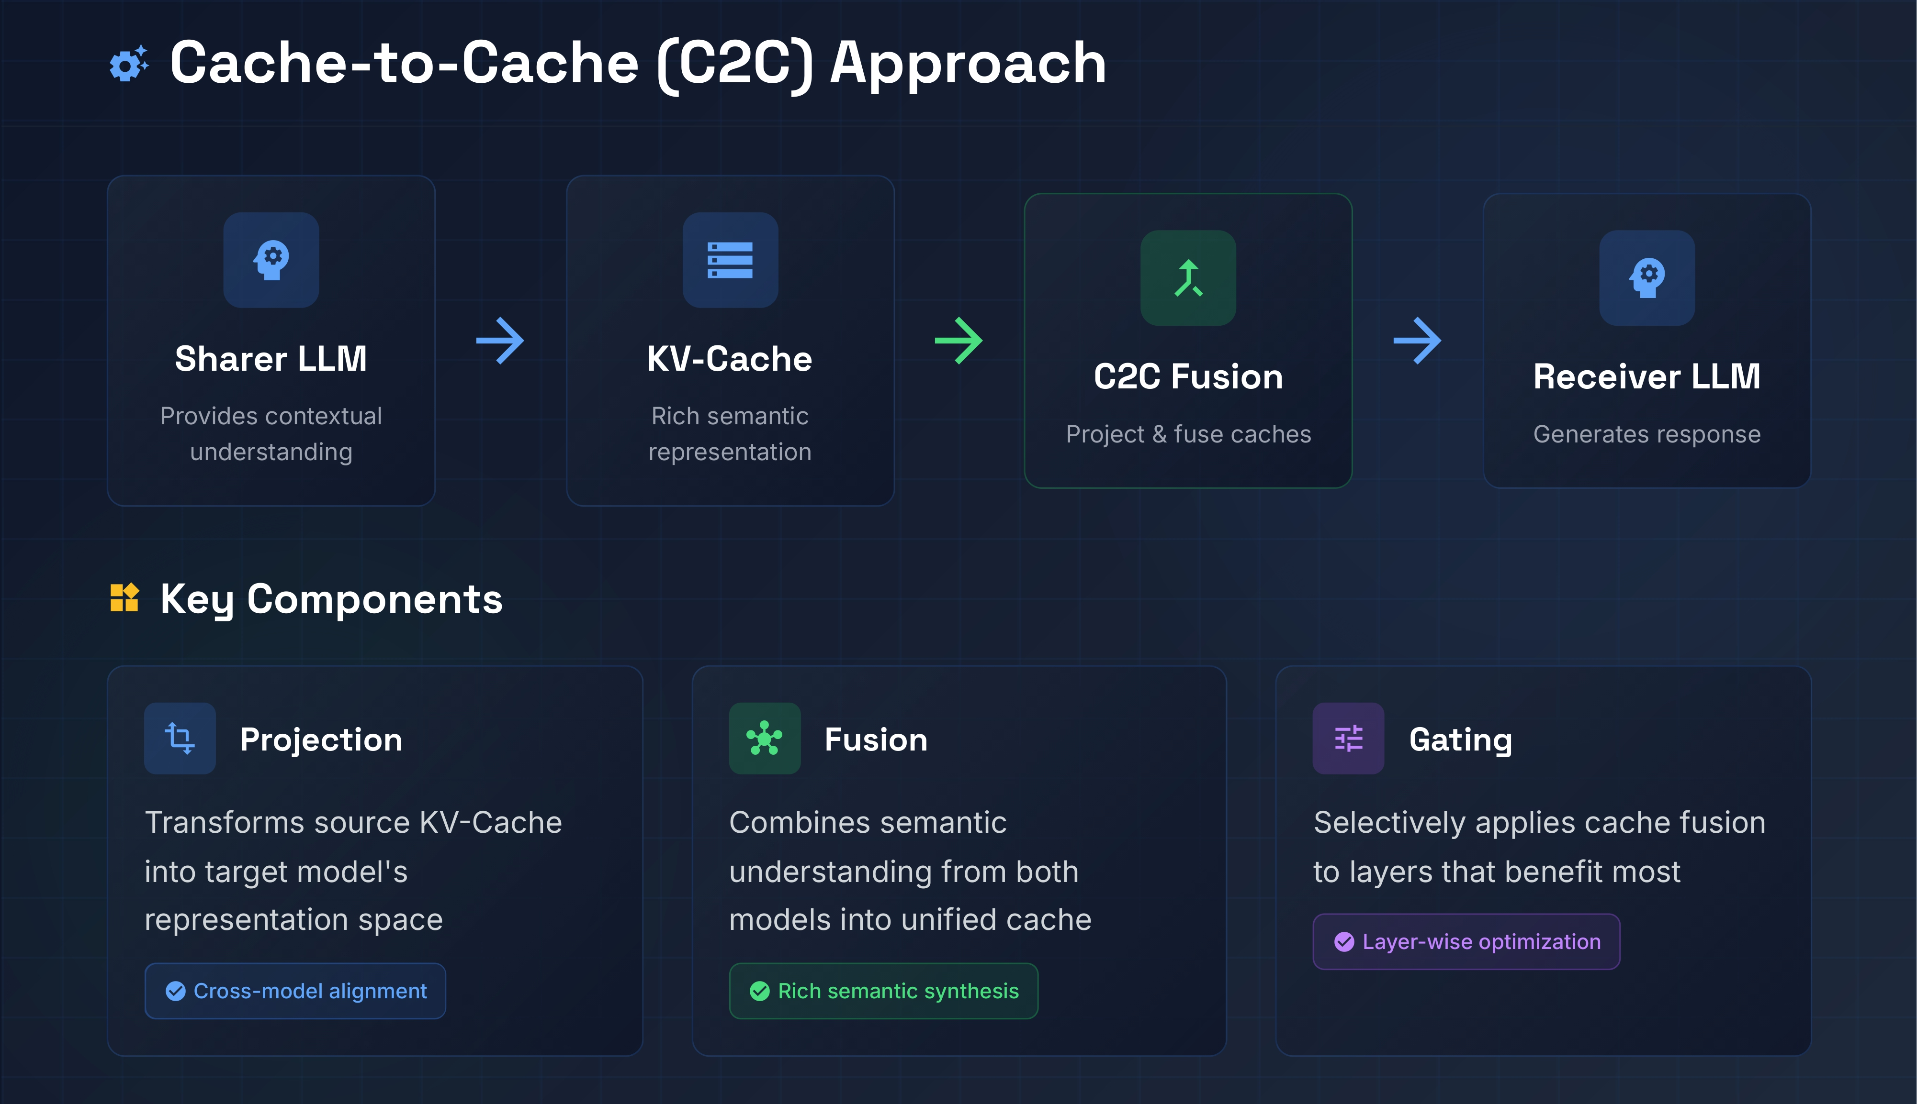
Notes:
Here is the actual mechanic of how Cache-to-Cache works.
When the first model processes a prompt, we capture its internal state—specifically the KV-Cache. We do not wait for it to generate a text response. Instead, a specialized neural network acts as a translator. It takes that cache, reformats it, and injects it directly into the second model.
You can see it as a direct data link between the models. To keep this efficient, the system does not dump the entire cache into the receiver. A gating mechanism acts as a filter, deciding exactly which transformer layers in the receiving model actually need this context. The second model absorbs this data and continues processing as if it came to those conclusions itself. Zero text is generated during the handoff.

Slide 5
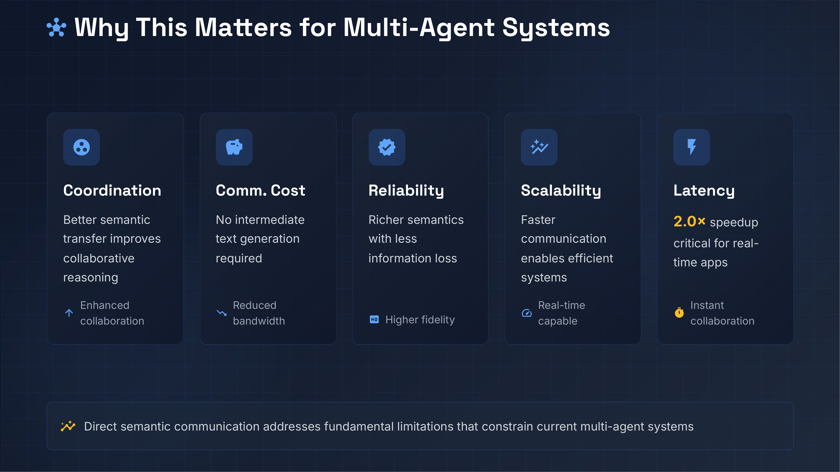
Notes:
For multi-agent systems, skipping the text generation phase entirely improves performance.
Coordination: Agents share deeper reasoning directly, making collaborative problem-solving much better.
Communication Cost: You save massive amounts of compute because zero tokens are wasted generating intermediate text between agents.
Reliability: The receiving agent gets the full, uncompressed intent of the sender. There is less ambiguity and misinterpretation.
Scalability and Latency: Removing the delay of generating extra tokens makes can make multi agent systems operate in real time, which is a requirement when you want to scale. Bypassing text is what makes instant, scalable collaboration practical.

Slide 6
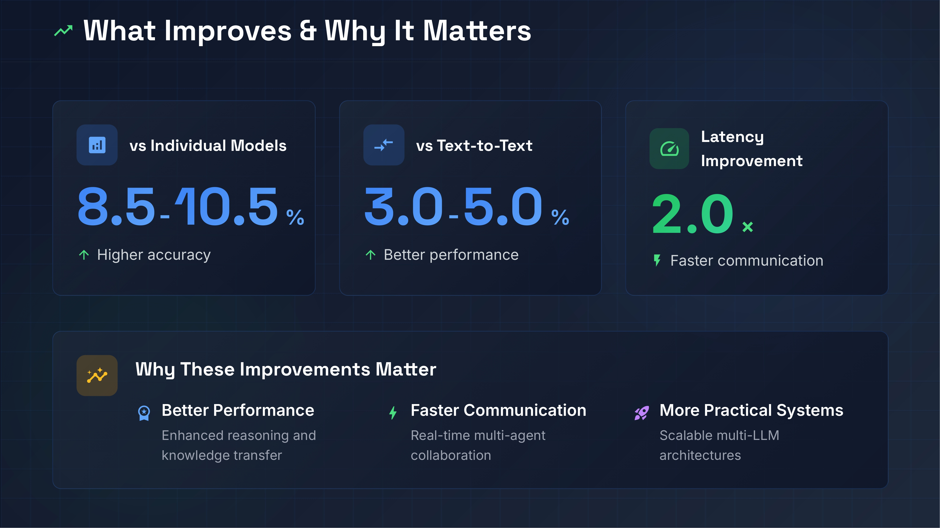
Notes:
In terms of actual metrics: First, we see a 2x speedup in communication latency.
Second, we see an accuracy gain of up to 5% over standard text-to-text setups, and about 10% over models working in isolation.
The reason this matters for system design comes down to fidelity and scale. When models communicate via text, they are compressing complex, high-dimensional probability distributions into flat English words, which drops a massive amount of nuance. Direct transfer keeps that semantic depth intact. Furthermore, if you want to build multi-agent systems that coordinate in real-time, you cannot afford the compute or the time delays of forcing agents to type out messages to one another.

Slide 7
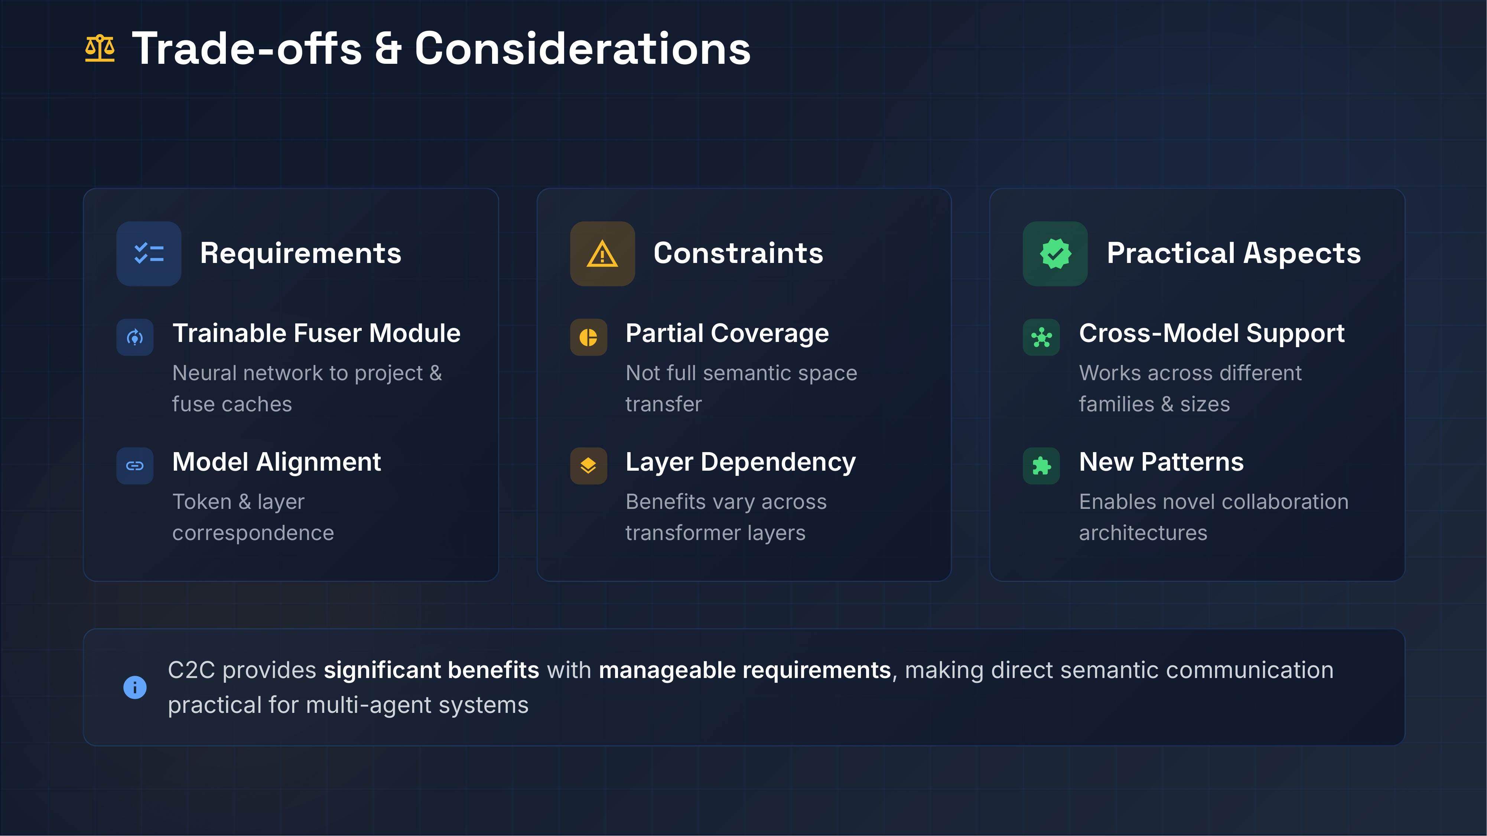
Notes:
This approach comes with specific engineering requirements. You cannot simply plug two random models together and expect them to share a brain.
Direct semantic transfer requires a trainable fuser module—a neural network acting as a translator between the models. It also requires strict model alignment; the models must have token and layer correspondence for the fusion to make sense.
Also, we do not transfer the entire semantic space. Passing everything is too heavy, so the system only targets partial coverage. The performance depend on which specific transformer layers receive the data, meaning you have to tune the architecture to figure out exactly where the fusion is most useful.

Slide 8
