Slide 1


2FiA: Towards WiFi Sensing-Based Authentication with Unique Biometrics
Bofan Li^{1†}, Zhankai Ye^{1†}, Weikuan Yu¹, Yongning Tang², Xin Liu¹*
Florida State University¹
Illinois State University²
Co-Primary Student Authors †
Corresponding Author * | Email : xliu15@fsu.edu
Notes:
Good afternoon, everyone. My name is Bofan Li, “He’s Zhankai Ye” and today we will present our work, 2FiA: Towards WiFi Sensing-Based Authentication with Unique Biometrics.
This is a joint work with Professor Weikuan Yu, Professor Yongning Tang, and Professor Xin Liu, from Florida State University and Illinois State University.

Slide 2
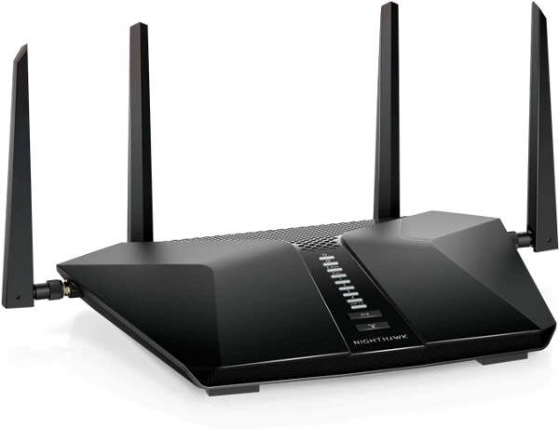











Ubiquitous Wi-Fi Sensing
Ubiquitous
Room-Scale
Building-Scale
City-Scale
Wi-Fi Sensing has been incorporated into the IEEE 802.11bf standard!
Applications
Tracking
Gesture recognition
Vital signs monitoring
Authentication
Notes:
We choose Wi-Fi because wifi is a ubiquitous wireless technology. Many current devices already support Wi-Fi. such as computers and smart devices.
Additionally, the Wi-Fi signal is already everywhere. in our room, buildings, and the public city.
//
Recently, Wi-Fi sensing has also been added to the IEEE 802.11bf standard. This shows that Wi-Fi is no longer only used for communication, but is also becoming a powerful sensing technology.
//
With Wi-Fi sensing, it can support many applications, such as tracking, gesture recognition, vital sign monitoring, and today’s topic authentication.

Slide 3
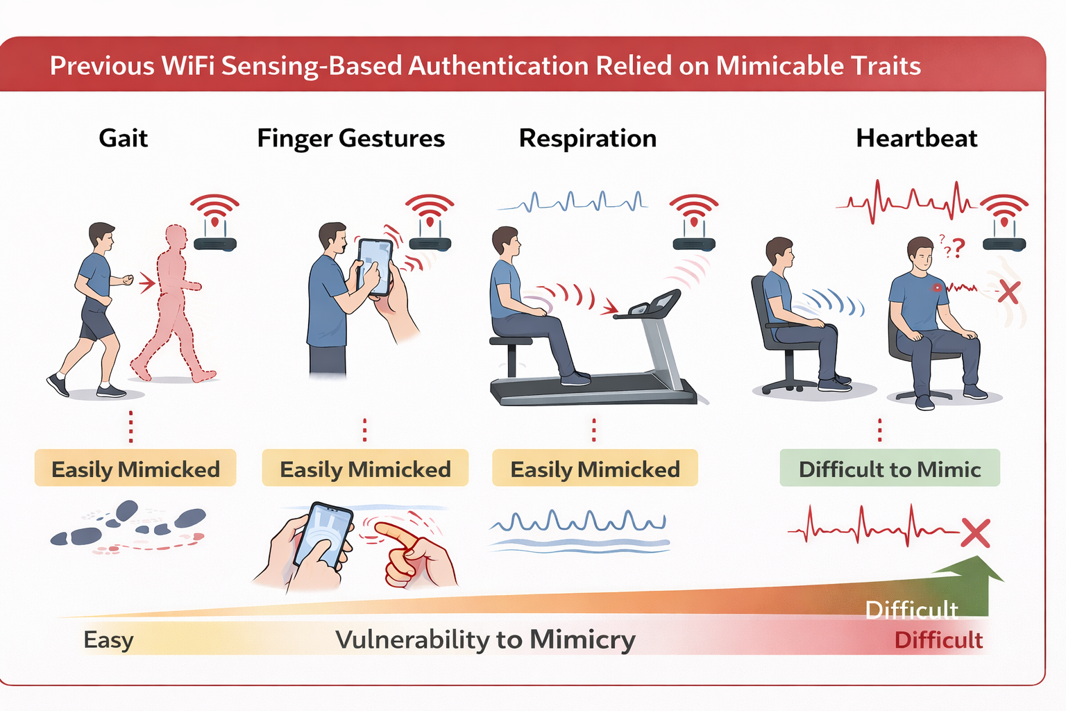
Biometrics for Wi-Fi Human Authentication
Mimic
Difficulty
Gait Gesture
Voluntary
Easy
Finger Gesture
Previous
Voluntary
Respiration
Semi-voluntary
Heartbeat
2FiA
Involuntary
Hard
Notes:
Existing Wi-Fi authentication systems mainly use behavioral biometrics, such as gait gestures, finger gestures, or respiration. These signals are voluntary motions.
//
which means people can intentionally change their biometric patterns.
\\
Because of this, these biometrics may be observed and potentially mimicked by an attacker.
\\
In contrast, heartbeat is much harder to fake because it is involuntary.
\\
Therefore, we choose to combine respiration and heartbeat together to create a continuous and hard-to-mimic authentication system.

Slide 4
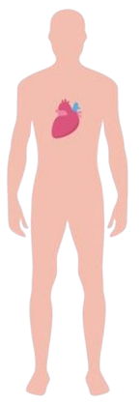

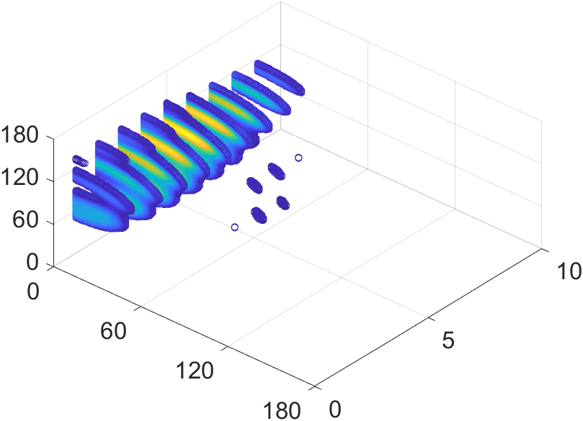



Challenge and Insight
Challenge: Heartbeat is a subtle motion, weak in Wi-Fi signals
Insight: Wi-Fi 3D spatial modeling to locate the thoracic region.
$${AoA}_{el}$$
…
ToF
Antenna
Elevation
Arrays at
WiFi RX
ToF
…
Azimuth
WiFi
$${AoA}_{az}$$
3D Spatial Spectrum
TX
Notes:
However, extracting heartbeat from Wi-Fi is very challenging. Heartbeat is a subtle motion and weak in Wi-Fi signal. It can be buried under other environmental interference.
//
Our key insight is that instead of detecting a heartbeat in the raw Wi-Fi CSI signal. We first use 3D spatial modeling to locate the thoracic region, because both respiration and heartbeat are from the thoracic. “thr a suhk”. In the figure, we show the Wi-Fi signal path reflecting from the thoracic.
//
By estimating angle of arrival azimuth, angle of arrival elevation, and time-of-flight, we can build a 3D spatial spectrum and focus on the region that contains the vital signs signal.
2:50s

Slide 5


Challenge and Insight
Localization of the Thoracic Region
Challenge: Heartbeat is a subtle motion, weak in Wi-Fi signals
Combines spatial spectrum energy with temporal clues to localize the thoracic region.
Insight: Wi-Fi 3D spatial modeling to locate the thoracic region.
$${AoA}_{el}$$
…
ToF
Antenna
Elevation
Elevation
Arrays at
…
WiFi RX
ToF
Time
…
Azimuth
$${AoA}_{az}$$
Azimuth
WiFi
TX
3D Spatial Spectrum
3D Spatial Spectra
Notes:
Here, we show an example of our 3D spectrum. The yellow regions indicate higher signal energy, which means the signal is more likely to come from those regions.

Slide 6
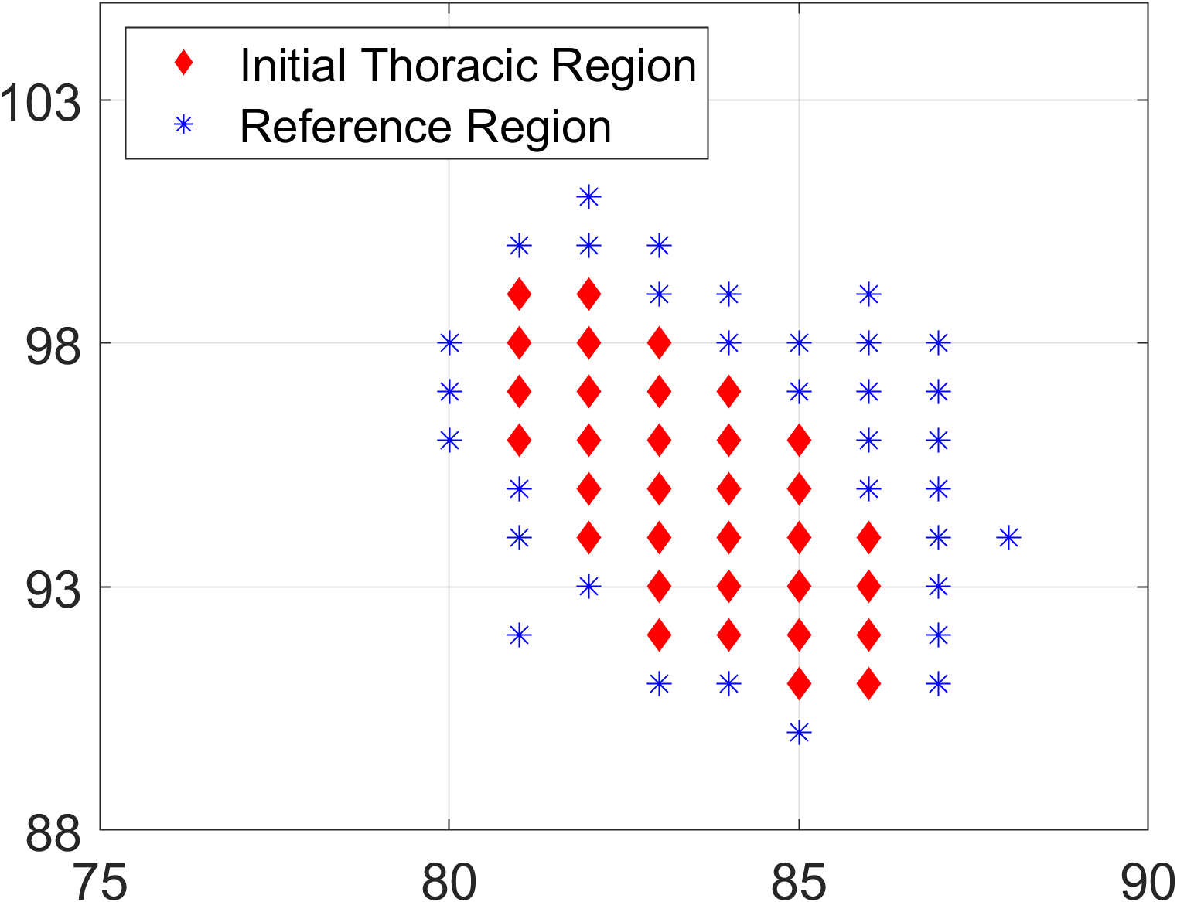
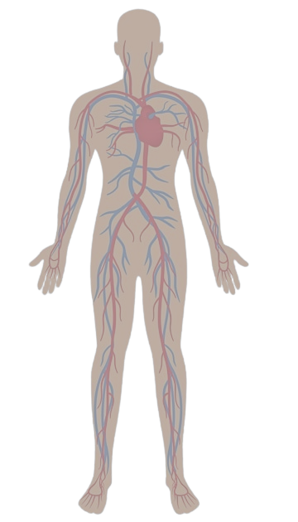


Challenge and Insight
Localization of the Thoracic Region
Challenge: Heartbeat is a subtle motion, weak in Wi-Fi signals
Combines spatial spectrum energy with temporal clues to localize the thoracic region.
Spatial Physiological Signal-to-Noise Ratio (S-PSNR)
How strongly vital signs signal at each region.
Insight: Wi-Fi 3D spatial modeling to locate the thoracic region.
$${AoA}_{el}$$
…
ToF
S-PSNR
Antenna
Elevation
Elevation
Elevation
Arrays at
WiFi RX
…
ToF
Azimuth
Time
…
WiFi
$${AoA}_{az}$$
Azimuth
Azimuth
TX
3D Spatial Spectrum
S-PSNR Spectrum
3D Spatial Spectra
Notes:
Instead of looking at a solo spatial spectrum, we analyze multiple continuous spectra over time. because respiration and heartbeat are “pe ri o dic”.this temporal clues allow us to identify the thoracic region and distinguish it from other reflections, such as static objects in the environment.

Slide 7
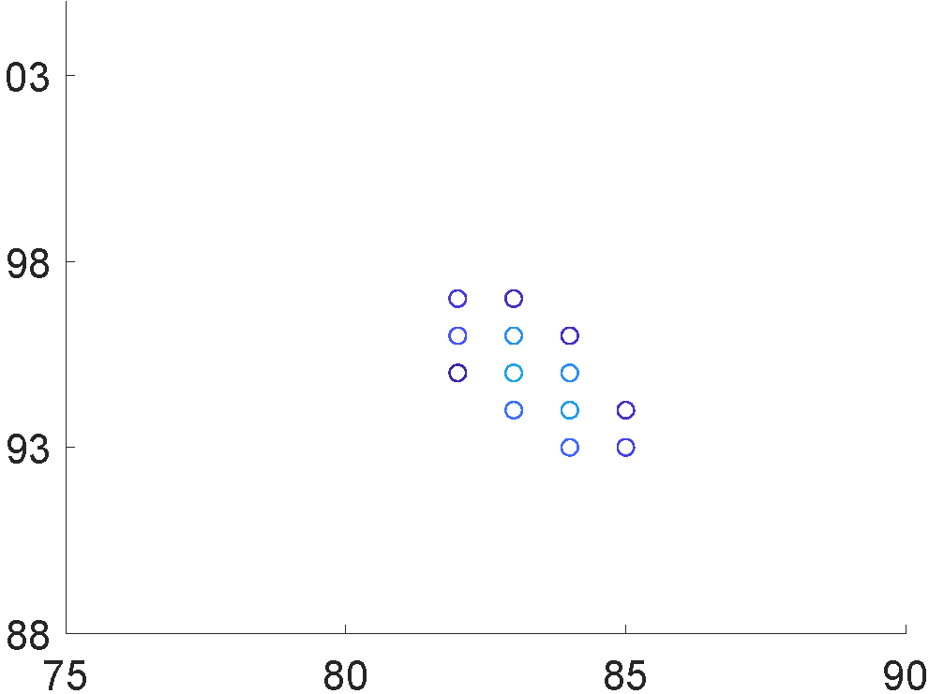
Localization of the Thoracic Region
Combines spatial spectrum energy with temporal clues to localize the thoracic region.
Spatial Physiological Signal-to-Noise Ratio (S-PSNR)
How strongly vital signs signal at each region.
Contrastive signal cancellation and clustering
Refine thoracic region
Refined Thoracic Region
S-PSNR
Refine
Elevation
Elevation
Elevation
Elevation
…
Time
ToF
Azimuth
Azimuth
Azimuth
3D Spatial Spectra
S-PSNR Spectrum
Azimuth
3D Spatial Spectrum
S-PSNR Spectrum
Notes:
After building the spatial-temporal view, we introduce the Spatial Physiological Signal-to-Noise Ratio. The metric measures how much the vital signs appear at each spatial region. A region with high value is more likely to contain respiration and heartbeat- motion. The right figure shows an initial estimate of the thoracic region.

Slide 8
Localization of the Thoracic Region
Contrastive signal cancellation and clustering
Refine thoracic region
Initial Thoracic Region
Refined Thoracic Region
Refine
S-PSNR
Elevation
Elevation
Elevation
…
Time
Azimuth
3D Spatial Spectra
Azimuth
Azimuth
S-PSNR Spectrum
S-PSNR Spectrum
Notes:
However, the initial thoracic region may still contain noise from nearby body parts.
By comparing the initial thoracic region with nearby reference regions, we can remove the shared noise and keep the thoracic region signal.
The figure shows a smaller and cleaner thoracic region and gives us a better signal source for extracting the vital signs.
5min

Slide 9
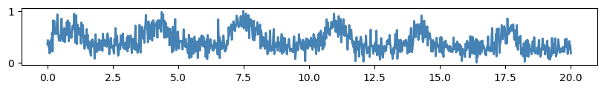
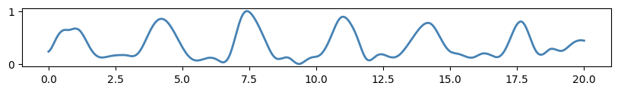
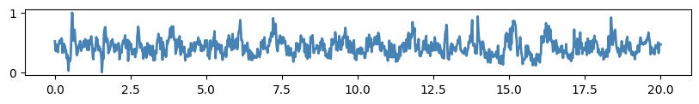
Respiration and Heartbeat Signal Extraction
3D-Spectrum Signal (from Refined Thoracic Region)
Separation and combination
by EMD-based method
Respiration Patterns
Respiration Removal
Heartbeat Signal Candidate
Time (s)
Notes:
After localization, the signal from the thoracic region still contains both respiration and heartbeat.
The top signal is the variation form 3d continuous spectra of the refined thoracic region. As we can see, respiration is much stronger than heartbeat, so it dominates the signal.
// //
So 2FiA extracts the dominant respiration pattern using an EMD-based decomposition method.
//
Then it removes the respiration component from the thoracic signal.
//
After this removal, the remaining signal contains heartbeat cycles candidate.

Slide 10
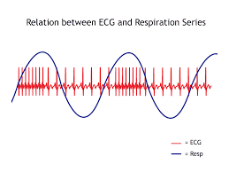
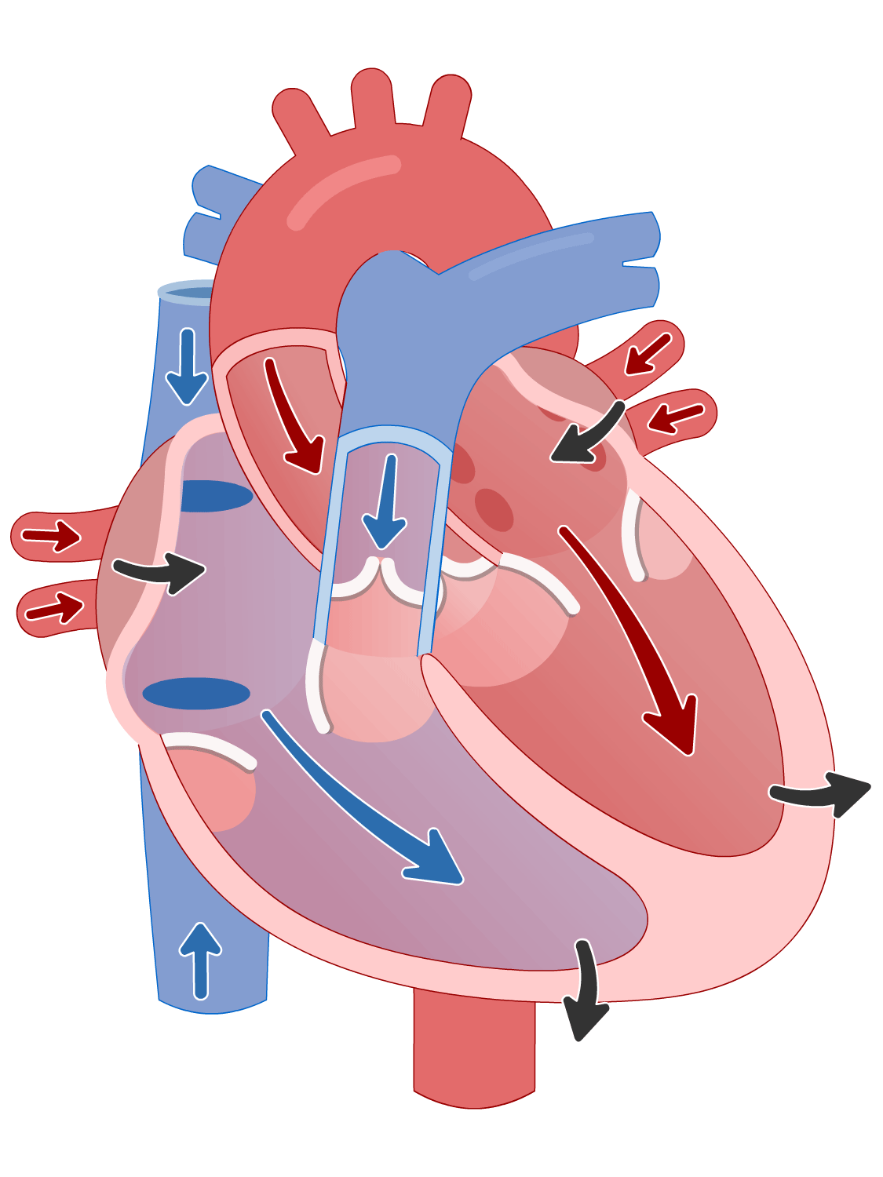
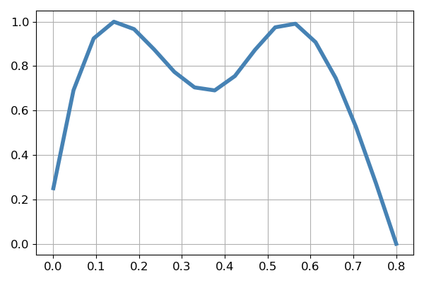
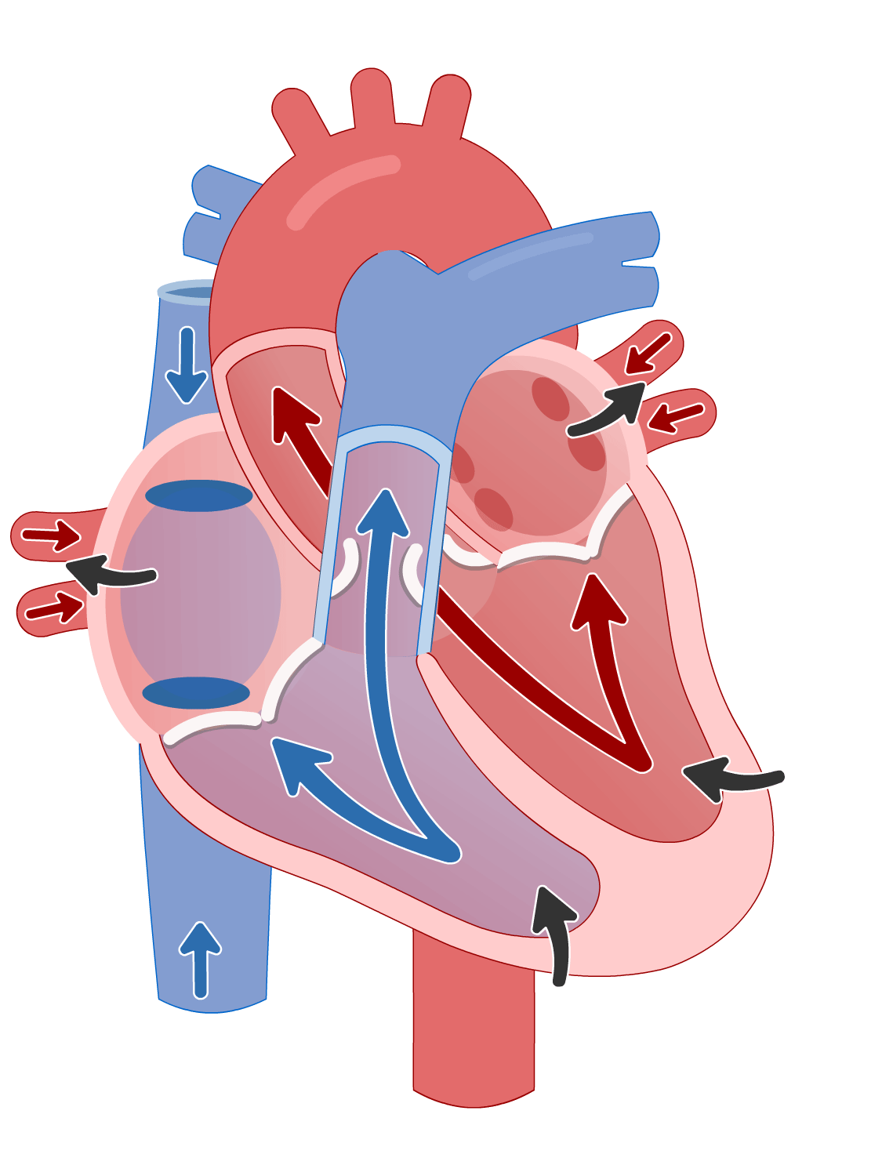
Heartbeat Signal Validation
RSA ( Respiratory Sinus Arrhythmia)
Inhalation, heartbeat interval shorter
Exhalation, heartbeat interval longer
Heartbeat signal is valid if it matches the RSA pattern
Heartbeat Motion Cycle
Validated Heartbeat Cycle
D
AS
VS
D
Gain
VS
AS
Time (s)
Notes:
the heartbeat candidate may still contain residual noise. So we need a way to validate whether the extracted signal is true heartbeats.
2FiA uses a physiological phenomenon called RSA.
RSA describes the natural coupling between respiration and heartbeat. During inhalation, the heart rate increases. During exhalation, the heart rate decreases. 2FiA checks whether the extracted heartbeat candidate follows the expected RSA pattern. If it matches the RSA patterns, we treat it as a valid heartbeat signal.
/ / The right figure shows us a validated heartbeat cycle extracted by our system.

Slide 11




Dual-Factor Authentication Model
Siamese neural network model architecture
Inputs
Embedding
Features
Anchor
Shared
Triplet
Loss
Positive
Weights
Negative
Notes:
After extracting respiration and validating heartbeat, we use both signals for authentication.
2FiA builds a dual-factor authentication model based on a Siamese neural network. The input includes features from both respiration and heartbeat. $ The network maps these features into a shared embedding space.
$ During training, we have selected triplet loss as our loss function. The anchor and positive samples are drawn from the same user, and the negative sample is drawn from a different user. The triplet loss encourages the model to minimize the distance between the anchor-positive pair and maximize the distance between the anchor-negative pair.
This design allows 2FiA to compare a new authentication sample with enrolled user profiles. If the distance is smaller than a threshold, the system accepts the user. Otherwise, it rejects the user.
So the model learns not only individual respiration or heartbeat patterns, but a unified representation of both factors.

Slide 12
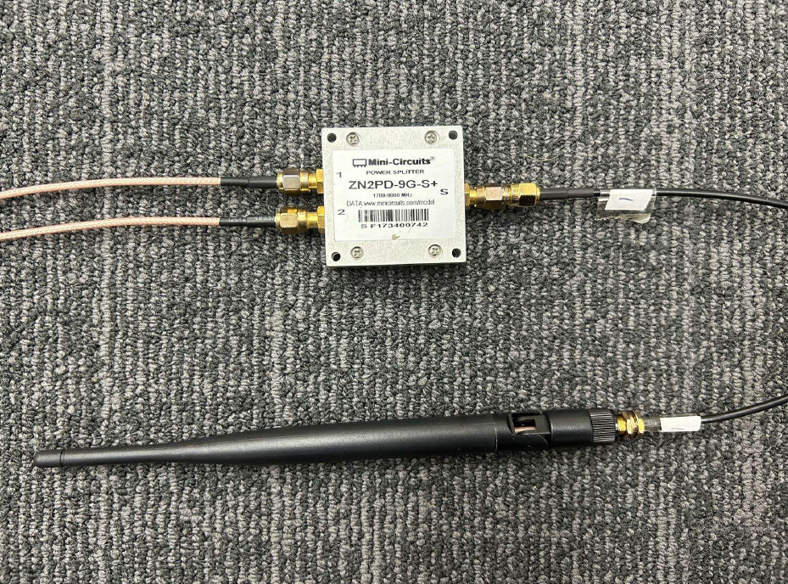
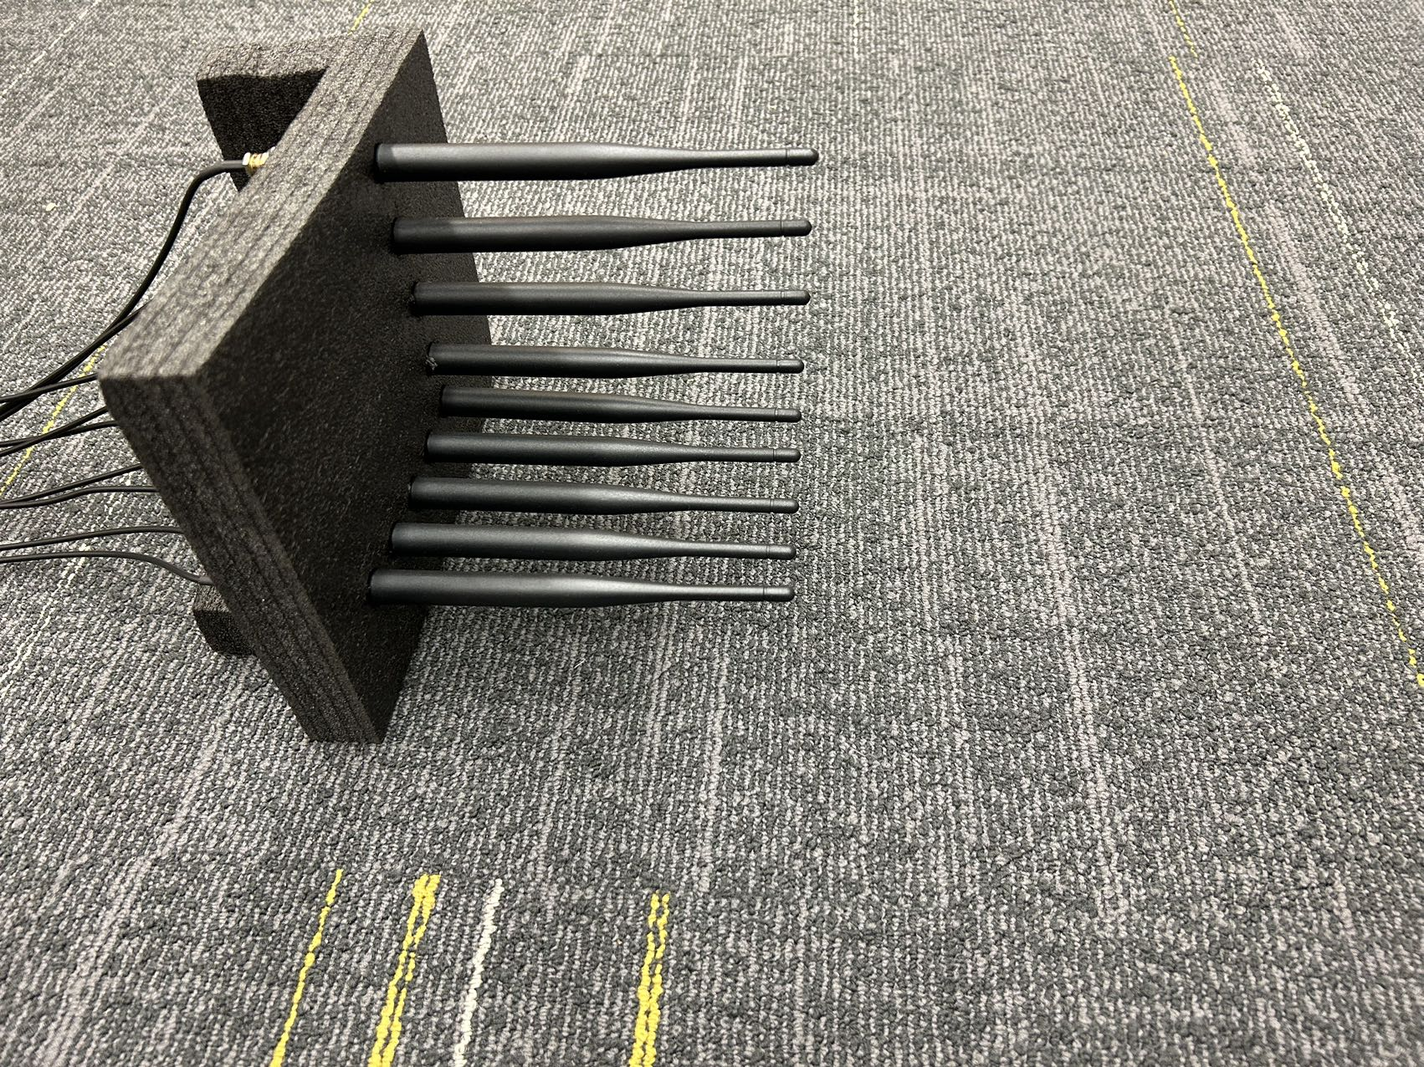
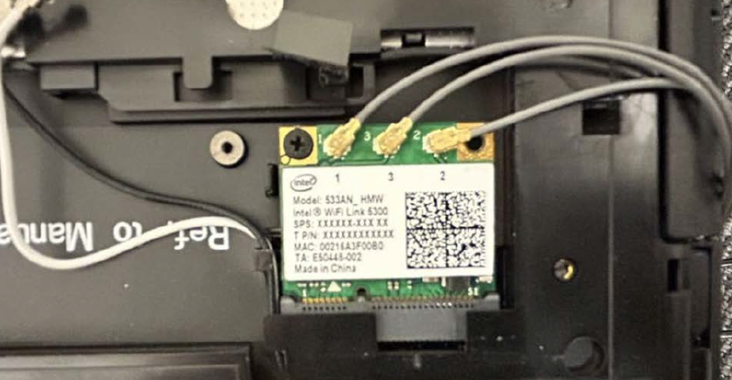

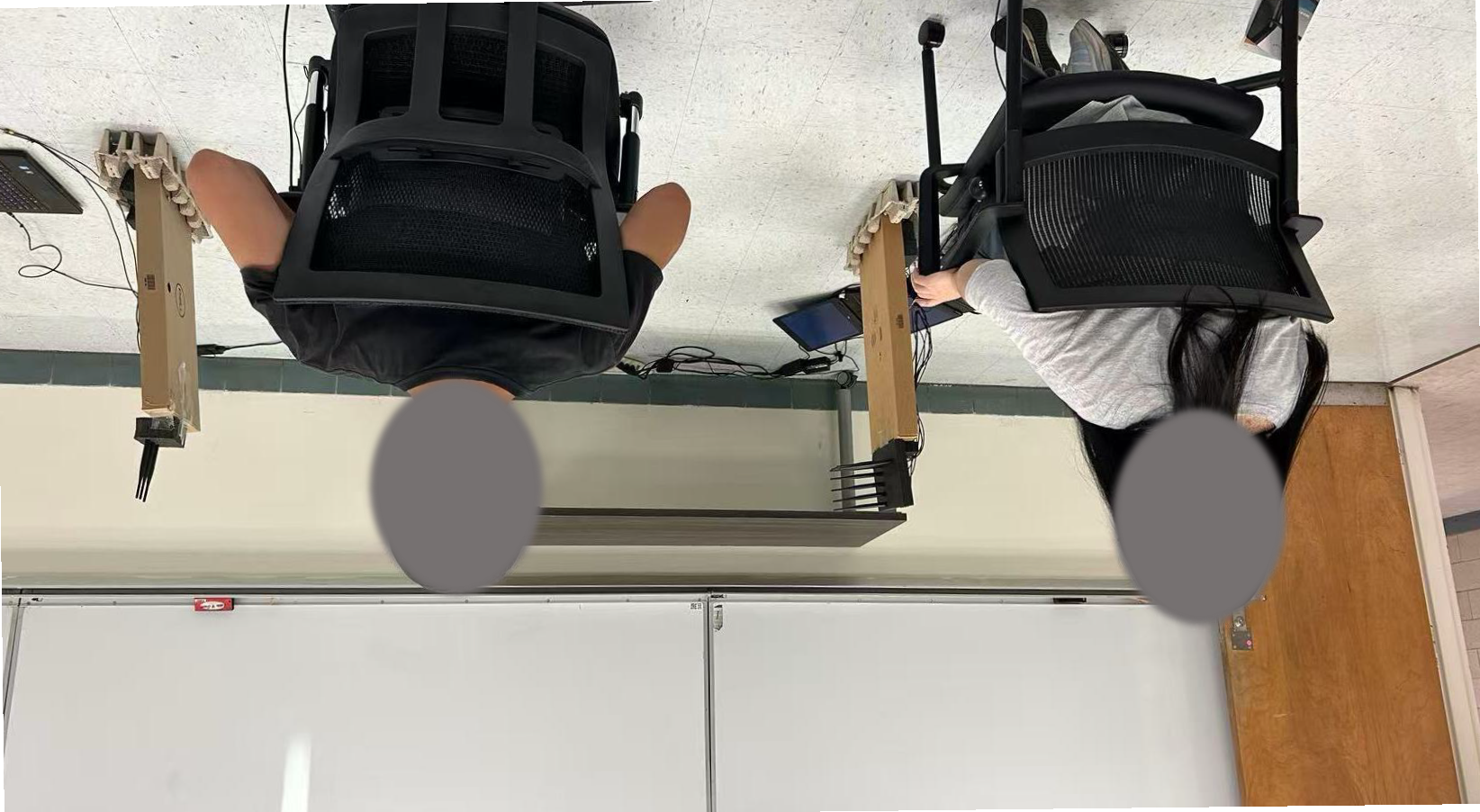





Implementation
Antenna
Antenna Array
Commodity NIC
Transmitter
Receiver
User
Lecture Room
Meeting Room
Laboratory
Two-User Example
8
Notes:
We implement 2FiA using commodity NIC card Wi-Fi devices.
The system includes a transmitter and a receiver with an L-shaped antenna array. $ We evaluate the system in multiple indoor environments, including a meeting room, a laboratory, and a lecture room. These environments have different layouts, furniture, and multipath conditions. Our biotmetrc is environment independent so which help us test whether 2FiA works in realistic settings.
The figure on the bottom right corner also shows a two-user example. This is important because real environments often contain multiple persons.
Therefore, other than multi-user support, 2FiA also needs to recognize which physical user the signal belongs to.

Slide 13

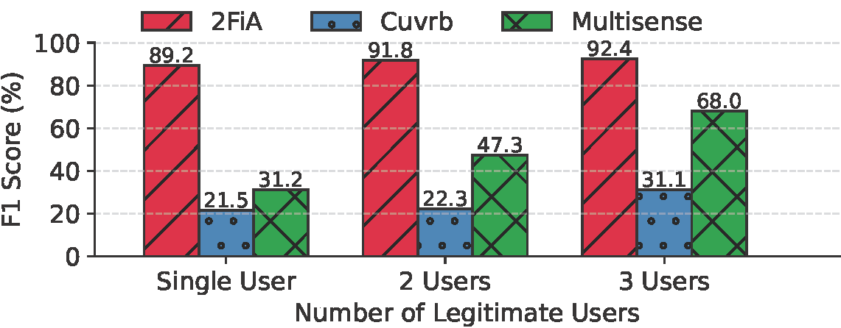
Evaluation Under Multi-User
Multiple legitimate users in a shared room
> 89%
Authentication
F1 score
2FiA physically identifies which user each signal belongs to.
Notes:
Now let’s look at the evaluation results. We conduct multi-user experiment. We select two baselines. CUVRB does not utilize spatial information and uses raw CSI amplitude, so it is vulnerable under multi-person scenarios. MultiSense can separate multi-user respiration waveforms by ICA, but it also doesn’t contain spatial information and cannot tell whose signal belongs to.
$ The result shows that 2FiA achieves over 89% authentication F1 score in multi-user settings.
$ This is because 2FiA uses 3D spatial modeling to physically associate each physiological signal with its corresponding user. In other words, it does not only extract biometric signals; it also understands where those signals come from.

Slide 14
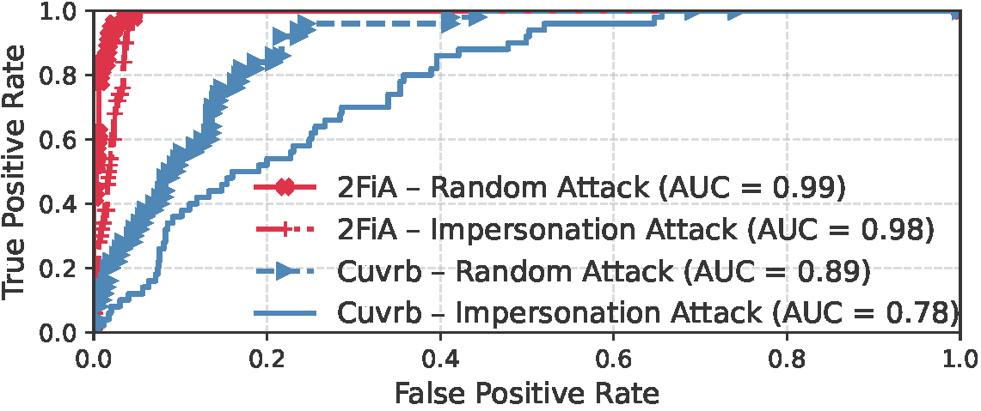

Evaluation Under Attacks
Under random and impersonation attacks
Defense against
two attack types
By combining semi-involuntary respiration and involuntary heartbeat, 2FiA becomes resistant to impersonation attacks.
Notes:
We also evaluate 2FiA under attack scenarios, including random attacks and impersonation attacks.
In a random attack, an attacker does not know the victim’s physiological pattern and simply tries to bypass the authentication system. In an impersonation attack, the attacker tries to mimic the victim’s breathing pattern.
$ Respiration-only systems are vulnerable here, because breathing is semi-voluntary and can be partially imitated. $ But 2FiA combines respiration with heartbeat. Even if an attacker tries to mimic breathing, it is much harder to mimic the victim’s heartbeat pattern.

Slide 15
Thank You!
Conclusion
2FiA integrates semi-voluntary respiration and involuntary heartbeat, enabling contact-free human authentication.
2FiA develops a novel explainable spatio-temporal signal processing pipeline, which may benefit broader Wi-Fi sensing applications beyond authentication.
2FiA remains robust in multi-user and impersonation attack scenarios.
Notes:
To conclude, we present 2FiA, a Wi-Fi sensing-based authentication system that integrates semi-voluntary respiration and involuntary heartbeat for contact-free human authentication.
The main technical contribution is an explainable spatio-temporal signal processing pipeline. It uses 3D spatial modeling to localize the thoracic region, adaptive decomposition to separate respiration and heartbeat, and RSA-based validation to ensure the heartbeat signal is physiologically meaningful.
Our evaluation shows that 2FiA remains robust in multi-user environments and under impersonation attacks.
More broadly, we believe this spatio-temporal Wi-Fi sensing pipeline can benefit applications beyond authentication, such as health monitoring and future smart environments.
10s two sentences
Thank you for your attention.

