Slide 1
CoOrbit
Efficient storage and communication
through collaboration
Achieving Efficient Storage and Communication via Collaboration
Ruichen Li et al. · The Ohio State University · SIGCOMM 2026
Paper presentation · Approximately 25 minutes
Paper p. 1
01

Slide 2
Motivation: imagery accumulates before it can be downlinked
Earth observation (EO) satellites capture imagery over an Area of Interest (AoI), but can downlink it only during contact with a ground station.
Images must wait in onboard storage. Continuous capture and intermittent downlink can exhaust this limited capacity, potentially overwriting data before delivery.
CoOrbit therefore asks which observations should occupy onboard storage in the first place. Reducing this backlog can also reduce communication volume.
The first question is how much new information each capture actually contains.
Sections 1–2, paper pp. 1–3
02

Slide 3
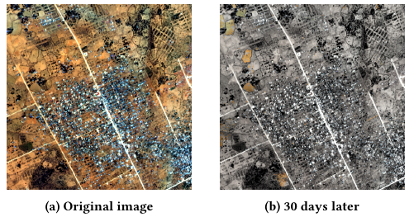
Observation 1: the same region often changes very little
The median cosine similarity of tile embeddings from consecutive daily observations exceeds 0.99, suggesting substantial temporal redundancy.
The images compare the same town before and after 30 days. Only changed pixels remain in color in the later image: 2.68% of all pixels.
This motivates reusing an existing background and retaining updates. The 2.68% figure describes this example, not a universal change rate.
Even changed regions may be captured repeatedly by different satellites.
Section 2, Figures 2–3, paper p. 3
03

Slide 4
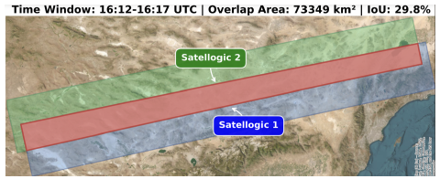
Observation 2: satellites also overlap in space
Neighboring orbits and imaging swaths can overlap. Different satellites may capture the same region within only a few minutes.
In the near-synchronous pass shown here, the overlapping area accounts for 29.8% of the combined coverage.
Across the paper’s 24-hour analysis, overlap averages about 20.0% and reaches 34.9%. This creates a second opportunity for filtering.
The goal is to remove both temporal and spatial redundancy.
Section 2, Figure 4, paper p. 3
04

Slide 5
Core idea: retain changed tiles without duplicate storage
Temporal filtering compares each tile with a historical reference and discards tiles classified as unchanged.
Spatial filtering uses orbit predictions to discard a current tile when another satellite is expected to revisit the same region soon.
Retained tiles wait for downlink and may also be compressed. Filtering selects the content to keep; compression reduces the bytes needed to represent that content.
Making this work requires compact references, coordination, and an uplink budget.
Sections 1, 3.1 and 6.2, paper pp. 2, 4 and 10
05

Slide 6
Three constraints motivate three system modules
Constraint | CoOrbit module | Purpose
Full reference images are large | Change-based Filtering | Detect changes using compact feature vectors
No real-time inter-satellite links (ISLs) | Trajectory-based Lookup Table (LUT) | Predict imminent revisits and overlapping coverage
Limited uplink bandwidth and contact time | Adaptive Layout Planning (ALP) | Allocate reference detail within the uplink budget
Together, these modules form a feedback loop between satellites and the ground.
Section 3.1, paper p. 4
06

Slide 7
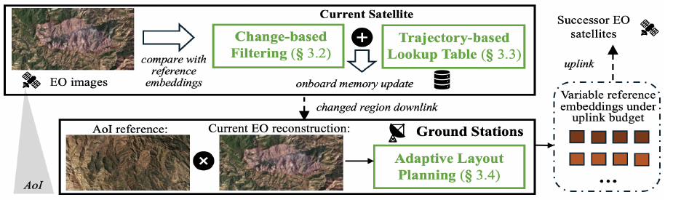
System overview: onboard filtering and ground planning
Onboard: compare imagery with reference embeddings, remove predicted spatial duplicates, and downlink only retained tiles.
On the ground: update the AoI image, generate references within the next satellite’s uplink budget, and upload them.
First, how can a satellite detect changes without storing the full historical image?
Section 3.1, Figure 5, paper p. 4
07

Slide 8
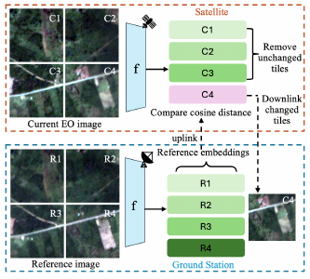
Module 1: compact tile embeddings as references
Divide an image into tiles. Encode current and historical tiles using the same lightweight feature-extraction model.
The prototype uses MobileNetV2 to produce a 1,280-dimensional embedding per tile, summarizing texture, color, and structure.
The satellite keeps historical reference embeddings. It retains the current image pixels for any tile selected for downlink.
Compact representations reduce reference storage, but a filtering rule is still needed.
Sections 3.2 and 5.4, Figure 6, paper pp. 5 and 8
08

Slide 9
Change detection: cosine distance and an adaptive threshold
Cosine distance: dᵢ = 1 − cos(current embedding, reference embedding).
Similar feature directions produce a small distance, suggesting little change.
For the tile distances in the current image, compute the mean μ and standard deviation σ. Set the scene-specific threshold to T = μ + σ.
Retain a tile when dᵢ > T; otherwise discard it. This empirical rule adapts to the scene, but does not guarantee zero missed changes in every setting.
After temporal filtering, the satellite must decide which changed tiles need local retention.
Section 3.2, Equation 1; Section 6.1, paper pp. 5 and 9
09

Slide 10
Module 2: predict overlap without direct satellite links
Two-Line Element sets (TLEs) describe orbital parameters. Each satellite uses them to predict when and where other satellites will revisit its coverage.
The LUT records the next predicted revisit time for each tile. The evaluation uses a maximum five-minute interval to identify near-term overlap.
If satellite B will soon recapture a region, A can discard its overlapping tiles so that B supplies a fresher observation. The LUT occupies only a few KB and is refreshed during ground contact.
Coordination relies on predictable orbits, without real-time confirmation from the next satellite.
Sections 3.3 and 5.3, paper pp. 5–6 and 8
10

Slide 11
How the two filters determine a tile’s outcome
Current tile | Temporal filter | Spatial filter | Outcome
Similar to its reference | Classified as unchanged | No further decision needed | Discard
Changed; B revisits in 3 minutes | Retain | Imminent duplicate coverage | A discards; B observes later
Changed; no revisit within 5 minutes | Retain | No imminent duplicate | A stores it for downlink
The next satellite also needs suitable references to make its own change decisions.
Illustrative examples based on Sections 3.2–3.3 and Appendix Algorithm 1
11

Slide 12
Module 3: reference updates must fit the uplink budget
The ground station has the updated AoI image, but reference uploads are bandwidth-limited. The evaluation uses 32 Kbps uplink, or approximately 4 KB/s.
Reference budget: Cᵢ = Tᵢ × B / S. Here, Tᵢ is contact duration, B is uplink bandwidth, and S is the size of one reference embedding.
Paper example: 10 minutes × 4 KB/s = 2.4 MB. Assuming 40 KB per reference gives about 60 references. This size is an assumption in the budget example.
A fixed budget makes it important to place more reference detail where changes are likely.
Section 3.4, Equation 2, paper p. 6
12

Slide 13
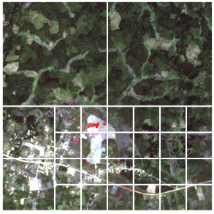
ALP: finer tiles in changing regions, coarser tiles elsewhere
The ground station builds a change map by adding intensity differences and gradient differences, capturing appearance and structural changes.
Start with a coarse grid. Repeatedly split the tile with the highest mean change score until the tile budget or minimum tile size is reached.
Red areas indicate changes. Finer tiles concentrate there, allowing the next satellite to keep smaller updates with less unchanged background.
Reference planning directly controls the granularity of the next filtering cycle.
Section 3.4, Equations 3–4 and Figure 8, paper pp. 5–6
13

Slide 14
The feedback loop and fallback behavior
The ground station updates the AoI image with received tiles, then generates new references. Areas without updates reuse older content, so reconstruction does not provide a new observation of every pixel.
If an uplink ends early, the satellite reuses the most recent available references for missing updates. Stale references may reduce filtering efficiency, but processing can continue.
To accommodate orbit prediction errors, ALP uses a 1 km buffer along the predicted ground track. Larger buffers can accommodate larger position errors.
The evaluation now asks how much this feedback loop saves, and at what cost.
Sections 3.1, 3.4 and 6.4, pp. 4, 6 and 11; reconstruction statement is a workflow interpretation
14

Slide 15
Evaluation: imagery, orbital simulation, and edge hardware
Dimension | Setup and scope
Constellations | 81 Planet satellites; a 200-satellite Walker-star constellation derived from Satellogic TLEs
General EO imagery | DynamicEarthNet; three AoIs in Australia, the United States, and Germany
Event datasets | Three historical wildfire regions; Santa Rosa damage imagery from xBD
Hardware and links | Jetson Xavier NX and AGX Orin; 160 Mbps downlink and 32 Kbps uplink
Simulation assumption | Consecutive daily images stand in for consecutive orbital revisits; no in-orbit deployment
The evaluation measures storage occupancy, communication volume, and processing cost.
Section 5, paper pp. 7–8
15

Slide 16
Metrics: both data volume and retention time matter
Storage cost is measured in byte-hours: onboard bytes integrated over time. For example, 1 GB held for 2 hours and 2 GB held for 1 hour both cost 2 GB·h.
Savings can therefore come from removing data or shortening its waiting time. A 108.6× reduction in byte-hours does not imply the same reduction in peak memory.
Communication cost includes uplink and downlink volume. Compute cost measures latency and power. Storage ablations compare the full baseline, LUT, filtering with ALP, and complete CoOrbit.
The first result concerns CoOrbit’s main objective: cumulative onboard storage cost.
Sections 5.2–5.3 and 6.1, paper pp. 7–9; GB·h example is an illustrative calculation
16

Slide 17
Result 1: 108.6× lower storage cost in the Australia case
Method | Normalized byte-hours (baseline = 100)
Full storage/downlink baseline | 100
CoOrbit | Approximately 0.92 (100 ÷ 108.6)
For the Planet constellation over Australia, CoOrbit reduces byte-hours by 108.6× relative to the baseline that stores and downlinks all captured imagery.
LUT removes spatial duplication. Change filtering with ALP removes temporal redundancy. Combining them gives the largest storage savings.
In one satellite pass, storage remains below 3 GB. The 200-satellite simulation also shows savings, but 108.6× is a scenario-specific result.
Next, do reference uploads offset the savings in downlink traffic?
Section 6.1, Figures 12–16, paper p. 9
17

Slide 18
Result 2: less communication, with further gains from coding
Method | Normalized traffic (baseline = 100)
Full baseline | 100
CoOrbit, without a dedicated codec | Approximately 2.40 (100 ÷ 41.6)
In the Planet Australia case, the paper reports about 41.6× less communication than the full baseline, without an additional image codec.
This saving comes from transmitting fewer tiles. CoOrbit’s coding compression ratio in Table 4 is 1; the 41.6× figure is not a codec compression ratio.
Adding CCSDS 123 reduces the reported volume further to about 10 GB. Filtering complements coding; uncompressed CoOrbit does not beat DeepSpace in every region.
Resource savings also need evidence about detection quality and processing feasibility.
Section 6.2, Figures 19–22 and Table 4, paper p. 10
18

Slide 19
Detection quality: encouraging evidence with limits
Test | Reported result | Interpretation
Validation on 400+ tiles | 0.00% miss rate; 89.06% of redundant tiles removed | Applies to this sample, not every possible scene
DynamicEarthNet samples | 0.52% false positives | Some redundant tiles are retained unnecessarily
Brightness scaled by 0.4–1.6× | Recall of 0.90–1.00 | Robust in these tests, but misses still occur
Rapid scene changes | Text claims more than 20× storage savings | Some Figure 18 points are below 20×; substantial savings remain
Beyond detection quality, deployment also depends on orbital errors and processing throughput.
Section 6.1, Figures 17–18 and Table 3, paper pp. 9–10
19

Slide 20
Deployment: modest overhead, but throughput needs testing
Test | Result | Meaning and limitation
General CoOrbit | AGX Orin: under 2 s/image; both devices: under 10 W | Supports edge execution, not proof of in-orbit readiness
Wildfire variant | Both devices: under 10 s/image and under 15 W | Task detection adds computation
Larger spatial buffers | 3 km: +2.67% storage; 5 km: +8.72% | Modest extra storage accommodates larger orbital errors
Continuous capture | Single-pass case: an image roughly every 0.8 s | Parallelism and queue behavior need sustained-throughput validation
A mission focused on one event type can further reduce the content it retains.
Sections 6.4–6.5, Figures 27–29, pp. 11–12; throughput concern is a discussion point
20

Slide 21
Application extension: retain wildfire-relevant tiles
General CoOrbit keeps tiles classified as changed. The wildfire variant replaces change filtering with GhostNet detection and selects only fire-related tiles.
It then applies LUT-based spatial filtering. Event detection happens first, followed by removal of predicted duplicate coverage.
In Pilbara, storage drops another 10.9× relative to general CoOrbit. The abstract also reports an additional 16.1× communication reduction. These gains use general CoOrbit as the baseline.
The extra savings depend on a mission being willing to discard other kinds of change.
Sections 4 and 6.3; 16.1× communication figure from abstract/introduction, pp. 1–2, 7 and 10–11
21

Slide 22
Discussion: three assumptions deserve closer examination
Will the next satellite deliver usable imagery? Predicted overlap establishes a coverage opportunity. Clouds, failed capture, or failed delivery can make early deletion risky; these failures are not fully quantified.
Are references fresh and aligned? Reusing old embeddings and adding spatial buffers help, but registration, cloud cover, and long-term drift need further validation.
Is information loss acceptable for the task? Storage and traffic metrics should be assessed alongside task recall, reconstruction quality, and end-to-end delivery latency.
The contribution is a coordinated system design whose operating assumptions remain important.
Presentation discussion based on Sections 3, 5 and 6; not claims established by the evaluation
22

Slide 23
Conclusion: remove redundancy before storage fills up
Motivation: temporal stability and overlapping satellite coverage cause repeated imagery to occupy onboard storage and downlink capacity.
Design: embeddings detect changes, a trajectory LUT predicts duplication, and ALP maintains useful references within the uplink budget.
Evidence: the Planet Australia case shows 108.6× lower byte-hours and about 41.6× less communication. Application-specific filtering can save more.
Takeaway: satellite collaboration can determine what deserves retention before data accumulates, in addition to coordinating computation and delivery.
Section 9 and Sections 6.1–6.3, paper pp. 9–12
23

Slide 24
Backup: distinctions that matter in Q&A
Embeddings support comparison, not pixel reconstruction. Ground reconstruction uses historical imagery plus newly received tiles. An embedding and a compressed image serve different purposes.
Spatial filtering predicts a future observation. It does not confirm that another satellite has already delivered the data, and depends on that future observation succeeding.
A lossless codec does not make the overall pipeline lossless. Even if retained tiles are encoded losslessly, discarded current tiles are never downlinked.
ISLs could help propagate fresher references and reduce reliance on ground relays. Reducing redundant onboard storage would still be useful.
Sections 3, 6.2 and 8, paper pp. 4–6, 10 and 12; conceptual interpretation
24

Slide 25
Backup: numerical claims and source ambiguities
108.6× refers to a scenario-specific byte-hour ratio. The 41.6× figure refers to communication volume. They measure different quantities.
The budget example assumes 40 KB per reference, while the prototype produces 1,280-dimensional tile embeddings. The paper does not fully reconcile these descriptions through serialization or aggregation details.
Section 6.1 says rapid-change savings always exceed 20×, but Figure 18 has a lower point for 4 km² at about 10% change. “Substantial savings remain” is the more defensible wording.
Li et al., Achieving Efficient Storage and Communication via Collaboration. SIGCOMM 2026. DOI: 10.1145/3789240.3829176.
Sections 3.4, 5.4 and 6.1–6.2; Figure 18, paper pp. 6 and 8–10
25

