Slide 1
From Bits to Tokens: Knowledge-Driven Generative Communication of Multimodal Data
Xingyu Chen, Zihao Feng, Wuqiong Zhao, Jianrong Ding, Ke Sun, Xinyu Zhang
Presented by: Xander Heilman

Slide 2
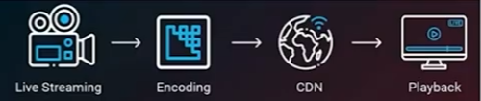
Core Idea
In the past, communication networks were primarily tailored for human consumers
By nature, bit fidelity has always been quite important
  If bits are transferred with low accuracy, that unreliable connection could severely impact the end goal

Slide 3
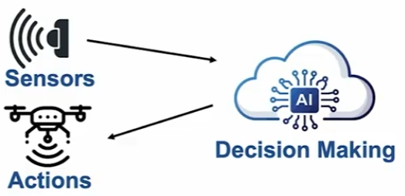
Core Idea
New paradigm: machine decision-makers are now the primary consumers of network bandwidth
  Ex. self-driving automation
When the the focus is shifted from humans to machines, what changes about the data requirements?
  Ex. self-driving cars need some form of pedestrian detection
  Strict bit fidelity leads leads to high accuracy, but at the cost of latency due to retransmissions
  How strict does the bit fidelity really need to be for the sensor to deliver adequate information?
This paper introduces Knowledge-Driven Communication
  Old objective: minimize the bit error rate
  New objective: maximize the “task” accuracy

Slide 4
Knowledge Driven Communication
To better align with the new goal, a new transfer method is implemented
On the network, the sensor now sends tokens rather than bits
Importantly, KDC gives the sender and receiver a shared knowledge base
  Facilitates more accurate recovery
  Ex. given the right context, you know with reasonable certainty that “fox” is the missing word below

Slide 5
Knowledge Driven Communication
Shared knowledge base is one part of the equation
The other key component is a reasoning receiver
  Receiver must be able to act on context in order to accurately recover information
Putting both parts together:
  Transmitter can focus on sending compact, new information (tokens)
  Receiver is able to use the tokens and the knowledge base to focus on the most important elements of the broader picture

Slide 6
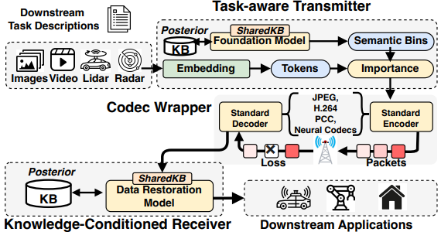
System Architecture
3 primary objectives:
  Efficiency via task-centric data transmission
  Progressive transmission that can adapt to unstable connections
  Generalization for different data and task types

Slide 7
System Architecture
3 pipeline stages:
  Task-aware transmitter embeds multi-modal data into tokens and then prioritizes by task-relevance
  Tokens pass through codec wrapper
    Integrates semantic importance
    Standardizes source coding codecs for compatibility
  Receiver implements KD restoration using shared and posterior knowledge
    Recovers missing/corrupted context
    Facilitates stronger resilience

Slide 8
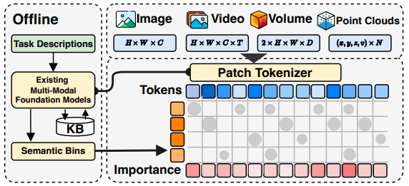
KDC Transmitter (Stage 1)
Unified tokenization function aims to work on multiple types of data
  The data representation for images, video, 2D space, 3D space, etc varies
  As long as a sensor data type has a tokenizer, the transmitter is able to work with it
A mix of data sources can be unified into a single collection of token embeddings

Slide 9
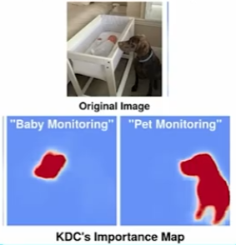
KDC Transmitter (Stage 1)
Task-aware importance: by implementing semantic selection into the transmitter model, zero-shot task adaptation becomes possible
Specifically, KDC is able to use the current task and its KB to grade the importance of each token
If the task changes, the transmitter can grade tokens based on the new task without retraining

Slide 10
Codec Wrapper (Stage 2)
KDC acts as a preprocessing wrapper
Creating a new codec would break the pipeline
  Standards are built into hardware accelerators and network stacks
  Legacy deployments require standard-compliance
Therefore, KDC instead reshapes the input before moving to the codecs
  High-importance regions keep detail, low-importance regions are quantized
Result: low-importance regions have less entropy -> respective codec allocates fewer bits

Slide 11
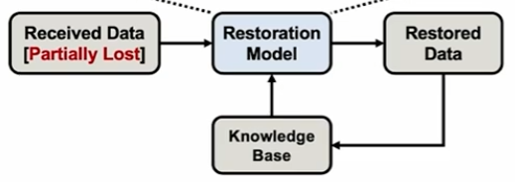
KDC Receiver (Stage 3)
Accepts a partially corrupted token stream
Retrieves context from KB
Uses FiLM with retrieved context to condition restoration weights
Restores missing data
Receiver learns via positive feedback loop

Slide 12
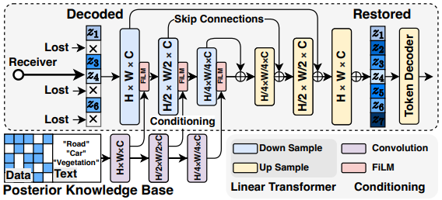
KDC Receiver (Stage 3)
2 primary challenges with data delivery
  Random channel fading disproportionately degrades KDC performance
  When bandwidth is more constrained, fine-grained data is lost in exchange for lower latency
KDC restoration uses both the shared and a posterior KB to address these
Alongside the KBs, the restoration function depends on the data type
  Images/video -> UNet
  Volumes (LiDAR/radar) -> transformers
  Pre-trained once per modality
Posterior KB stores semantic bin embeddings and latent semantic data
  The receiver can perform a k-nearest neighbor search on an embedding corresponding to lost data to retrieve the most relevant contextual samples

Slide 13
KDC Receiver (Stage 3)
Once the receiver has context from the posterior KB, it conditions restoration via FiLM
  FiLM - feature-wise linear modulation
  f = decoder feature map, e_ctx = concated posterior KB reference embedding, 𝛄() and 𝛃() = learned affine transformations
FiLM essentially steers the restoration process by scaling and shifting its internal feature values using a conditioning input

Slide 14
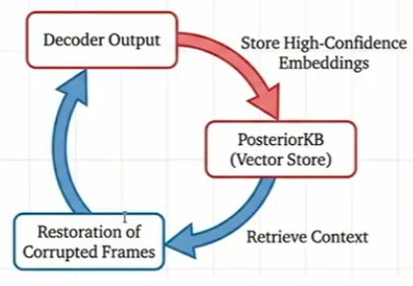
KDC Receiver (Stage 3)
The results of each restoration stage are then used to dynamically update the posterior KB
  Improves tolerance to missing tokens
  Enables incremental refinement of the restoration process
Through knowledge accumulation, the KDC receiver becomes more capability as its KB grows

Slide 15
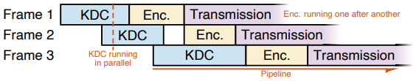
Implementation (Test Setup)
Producer-consumer pipeline
  One frame undergoes transmission, another can be encoded, a third can begin processing
  Encoding creates a computation bottleneck, but KDC addresses it through parallelization
Parallel processing
  Encoding only works sequentially, but KDC operations are stateless
  Further optimized by a cache that detects similarities across consecutive frames

Slide 16
Testbeds
5G - image/video
WiFi - radar
LoRa (Long Range, low power protocol) - LiDAR

Slide 17
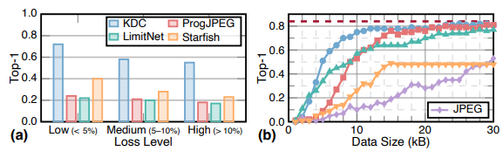
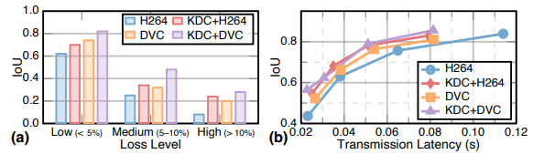
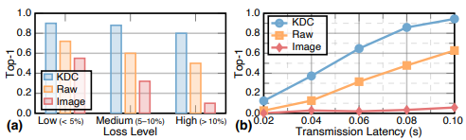
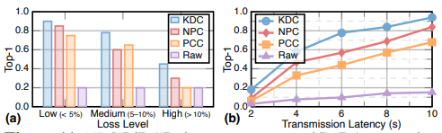
Results
Performance vs Loss (left) -> KDC performs ~3x better
Performance vs Bandwidth (right) -> KDC results in the same accuracy with ~2x bandwidth
Image (5G)
Video (5G)
Radar (Wifi)
LiDAR (LoRa)

Slide 18
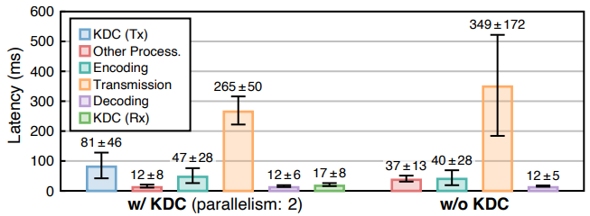
Results - Real-time Performance
Streaming video
  32 FPS at 1080p on a Jetson Orin Nano (edge platform)
  100+ FPS on an RTX 4090 (4080?)
24% lower communication latency, and under 5% pipeline overhead.
  KDC is able to preserve the most important information without sacrificing low latency

Slide 19
Limitations
Bursty loss hinders recovery, and KDC performance eventually approaches the base
  For extended blackouts, the model simply has to fall back to retransmission
Experiment model did not track power usage (could be a pitfall given the overhead)
KDC offers little help for specialized sensor domains (ie ultrasound, sonar)
The transmitter and receiver must have identical models
Intuitively, KDC does not work for cases where the task requires exact reconstruction

Slide 20
Conclusions
Standard network communication is built around human consumers
  Requires bit fidelity, as even moderate packet loss has negative consequences
Many modern use-cases see machine decision-makers as the new consumers
  Machines don’t need every bit of information, just the most important parts
By defining a new communication paradigm that seeks to maximize task accuracy rather than minimize bit errors, KDC is able to cater to these modern use cases more efficiently
  Transmitter and receiver have a shared knowledge base
  Transmitter takes multi-modal sensor inputs, embeds them into tokens, sends to codec
  Receiver takes partially corrupted token stream from codec, uses KB context and restoration model to rebuild lost tokens with a higher accuracy
  Receiver is able to use the model for different tasks without requiring retraining

