Slide 1
From Efficient Motion Recognition to Geometry-Aligned Motion Reasoning
Jackie Ye

Slide 2
Today's Outline
Introduction to Human Action Recognition (HAR)
Principles of Wi-Fi Sensing for Human Mesh Construction
3D mesh-based human action recognition on edge devices
ARiSE: Efficient Mesh-Based HAR at the Edge
Empower Large Language Models (LLMs) to deeply understand human motion.
GeoMotionGPT: Geometry-Aligned Motion Understanding

Slide 3
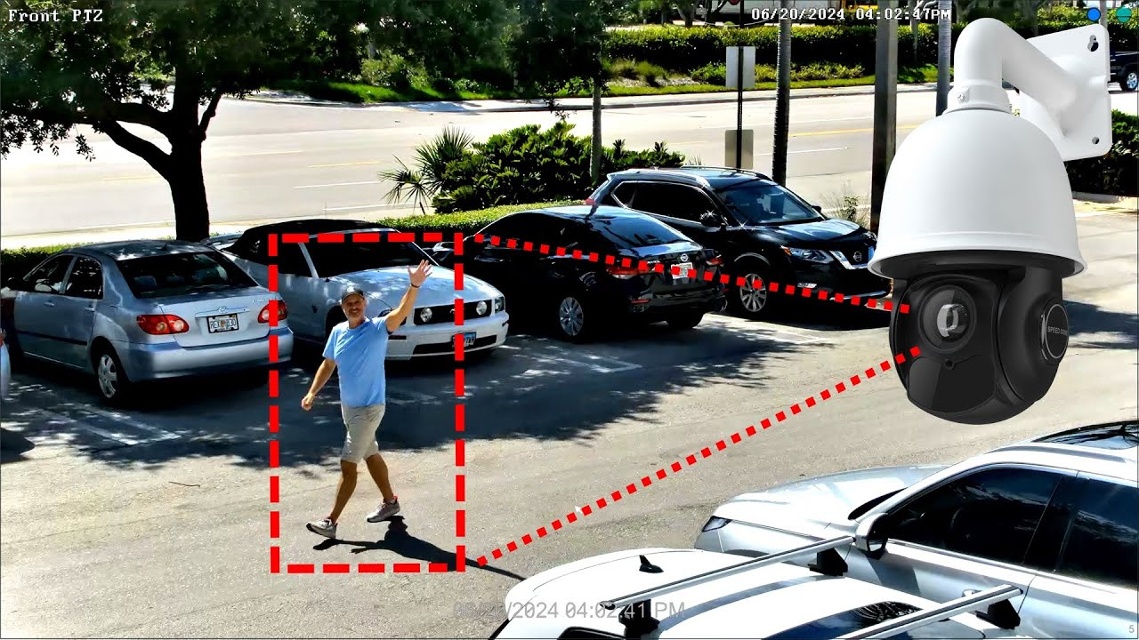
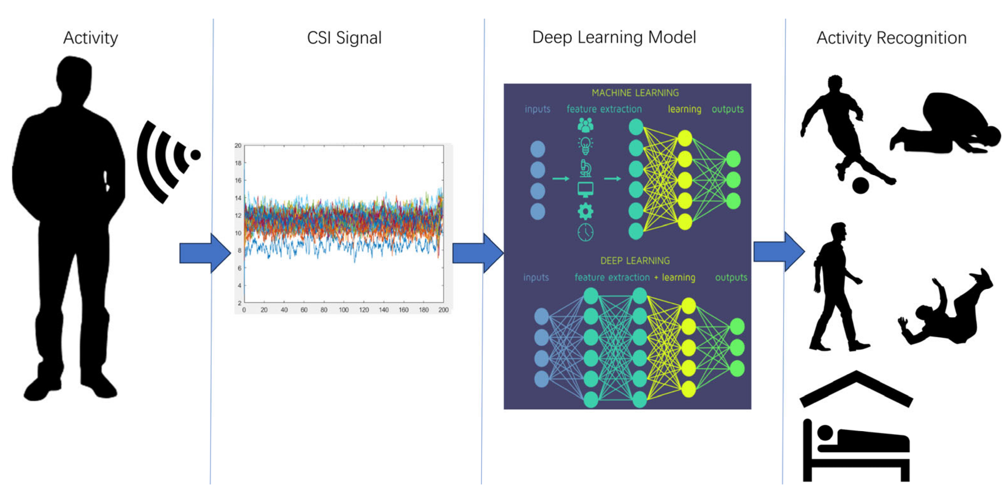
Sensing Modalities in HAR
Vision-Based (RGB/Depth)
RF-Based (Radar/LiDAR)

Slide 4

The Vision Dilemma
Privacy Risks: Cameras capture highly identifiable visual data
Line-of-Sight Dependency: Highly vulnerable to physical occlusions, blind spots, and low-light conditions
Deployment Friction: Unsuitable for sensitive spaces
e.g., bedrooms, healthcare

Slide 5
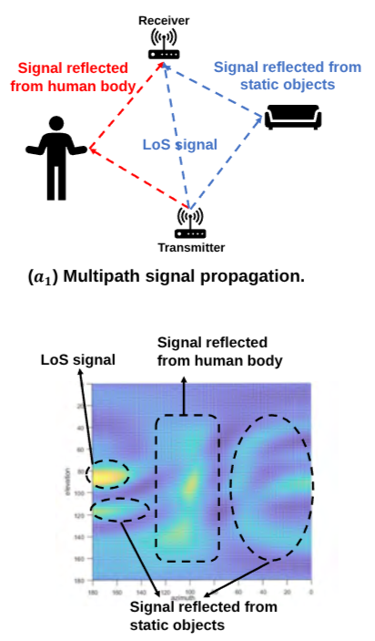
The Mechanics of Wi-Fi Sensing
Channel State Information (CSI)
Captures minute signal reflections from the human body and the environment.
Extracts multi-dimensional spatial dynamics.
Angle of Arrival (AoA)
Can be extracted from CSI
Isolates target movements from static multi-path clutter.
Y. Wang et al., "Wi-Mesh", ACM SenSys 2022.

Slide 6
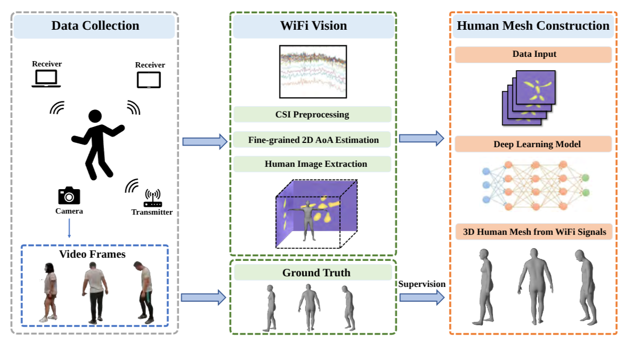
Wi-Fi-based Human Mesh Estimation
Y. Wang et al., "Wi-Mesh", ACM SenSys 2022.

Slide 7
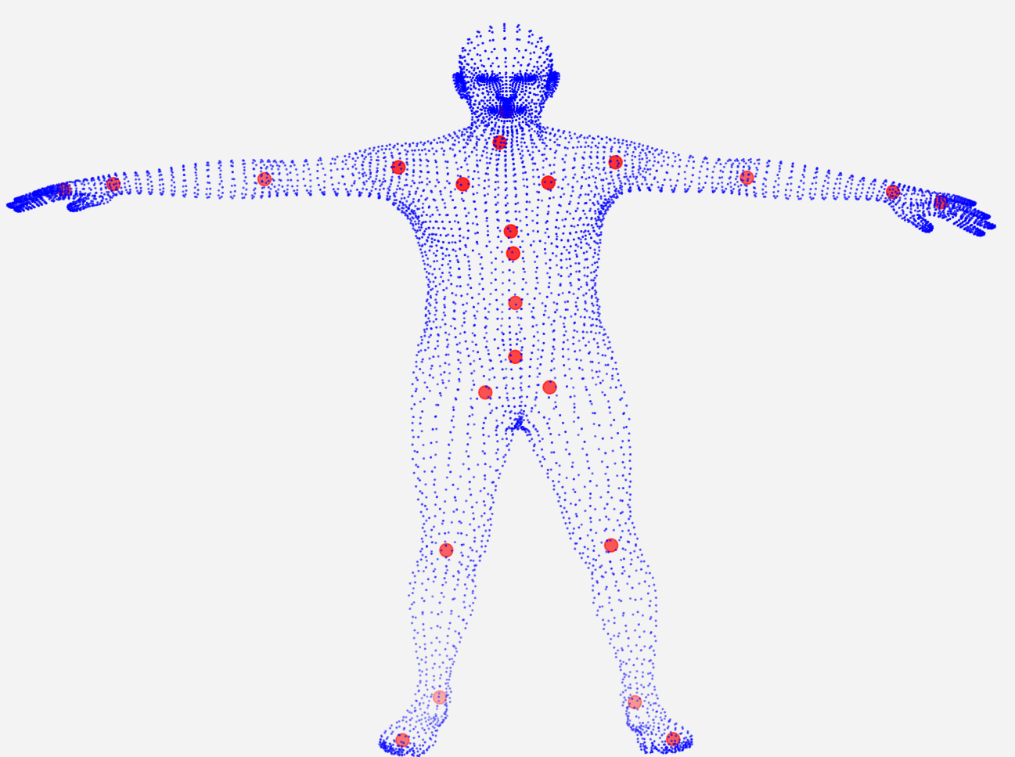
Skinned Multi-Person Linear (SMPL) Model
A standardized, high-fidelity mesh comprising 6,890 vertices.
Decomposes complex human bodies into low-dimensional Shape and Pose parameters.
Uses linear blend skinning to accurately model joint deformations and soft-tissue dynamics.

Slide 8
Performing HAR on SMPL model
Mesh VS. Skeleton: Mesh sequences capture rich surface dynamics and fine-grained articulated movements (e.g., fingers and torso rotation) missed by simple skeletons.
The Bottleneck: Processing sequences of 6,890 vertices per frame creates a massive computational burden, overwhelming edge devices.
>287x increase in spatial computational overhead for a standard CNN.
The Challenge: Overwhelming for resource-constrained edge devices.
Thus, applying down-sampling algorithm is necessary

Slide 9
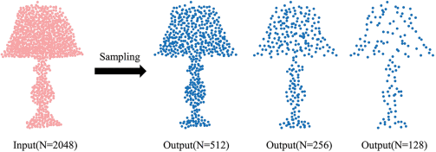
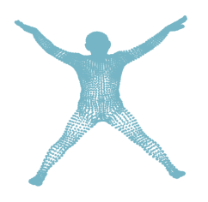
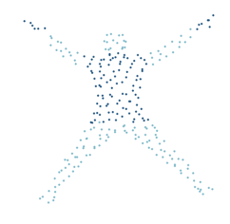
Furthest Point Sampling (FPS) Algorithm
Core Mechanism: Iteratively selects the point that is farthest away from the sampled set.
The Advantage: Provides a uniform, well-distributed geometric coverage.
However: it treats all body parts equally. Over-samples static regions (abdomen), loses critical details (hands/fingers)
Original
Output(N=256)

Slide 10
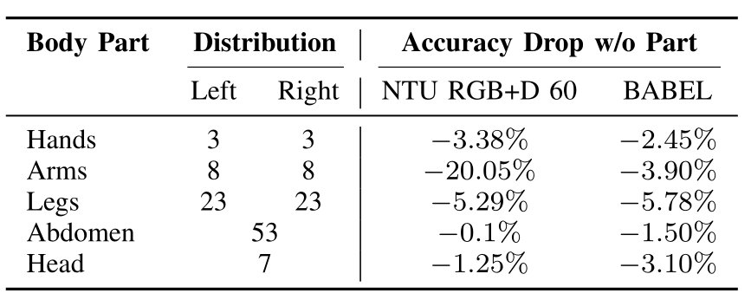
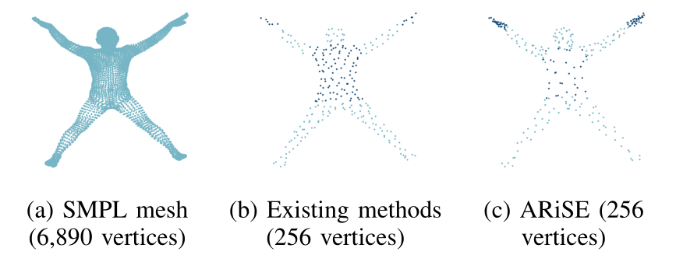
Why Sampling Matters
The Flaw: Global FPS wastes points on static areas (Abdomen: 53 vertices, 0.1% impact).
The Cost: Starves critical motion joints (Arms: 8 vertices, 20.05% drop!).
Our Solution: Partitions the mesh to force high point density on high-value regions (hands/limbs).

Slide 11
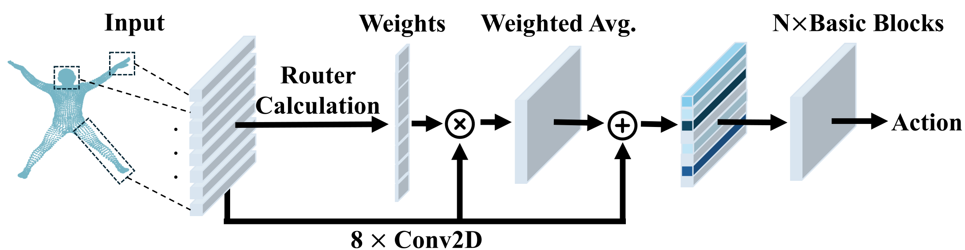
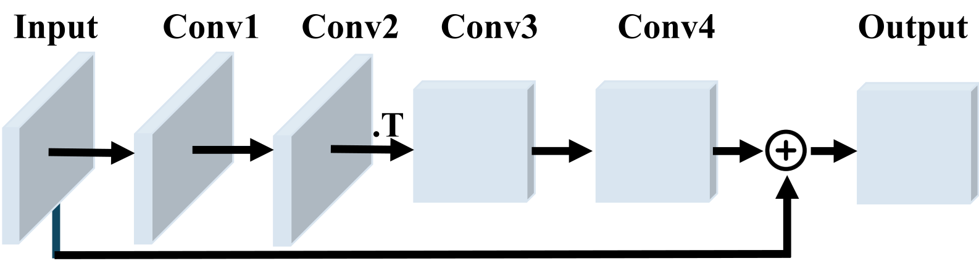
Overall Architecture of ARiSE

Slide 12
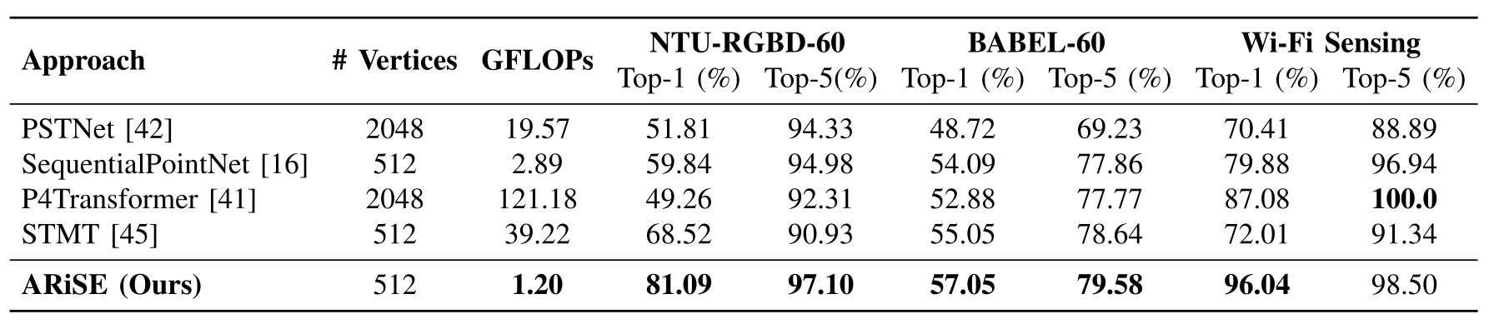
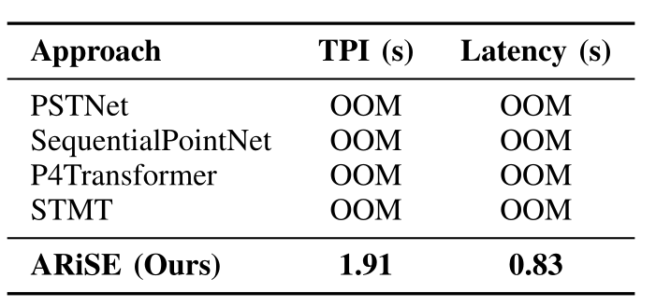
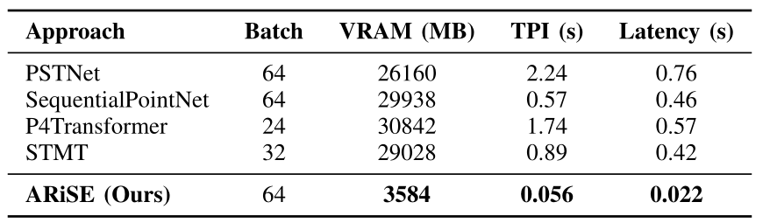
Results of ARiSE

Slide 13
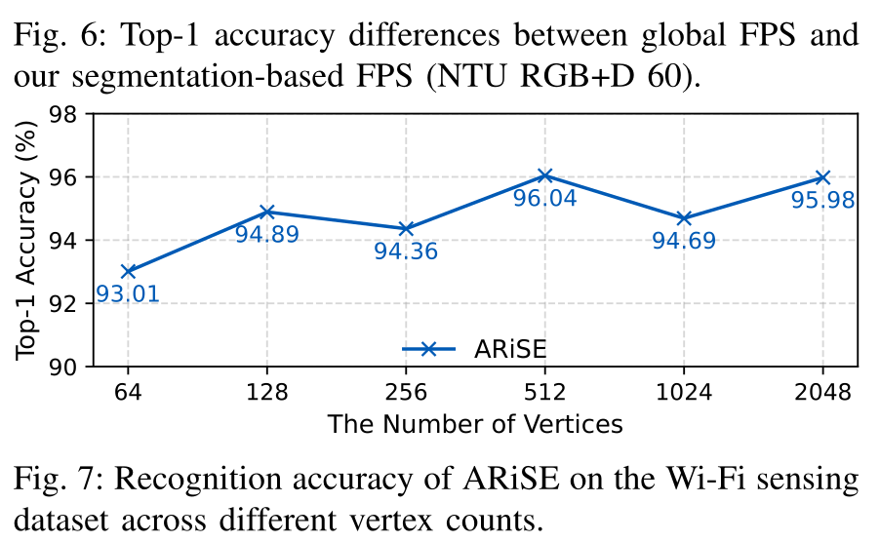
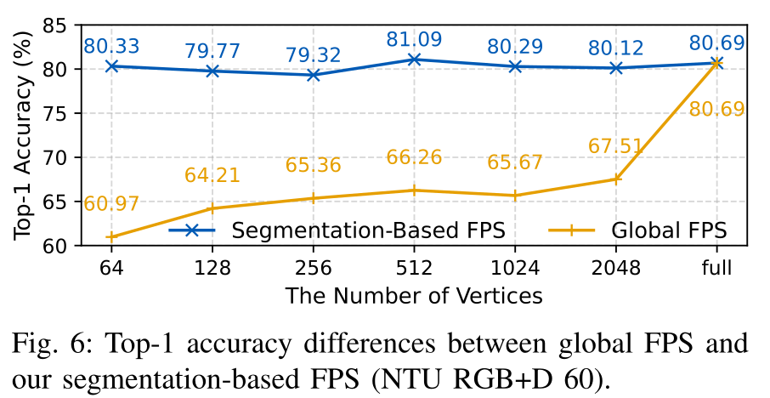
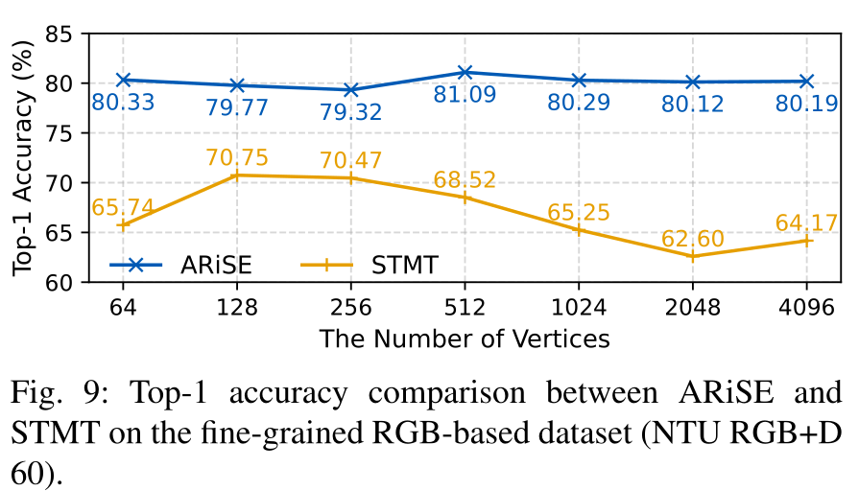
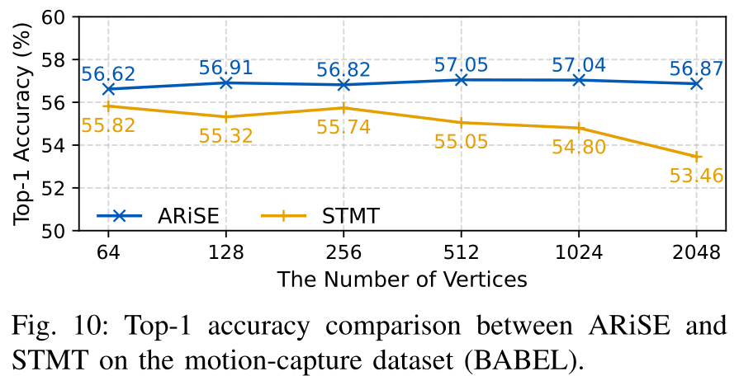
Ablation Studies

Slide 14
Empowering HAR Using LLM
The Paradigm Shift: LLMs unlock complex, unified motion-language reasoning.
The Bridge (Tokenization): Quantizing continuous 3D motions into discrete "motion words" (Codebook IDs).

Slide 15
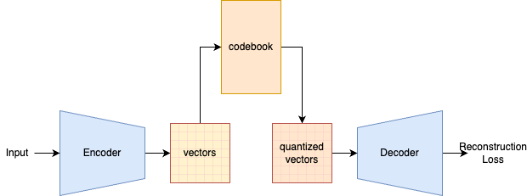
Vector Quantized Variational Auto Encoder (VQ-VAE)

Slide 16
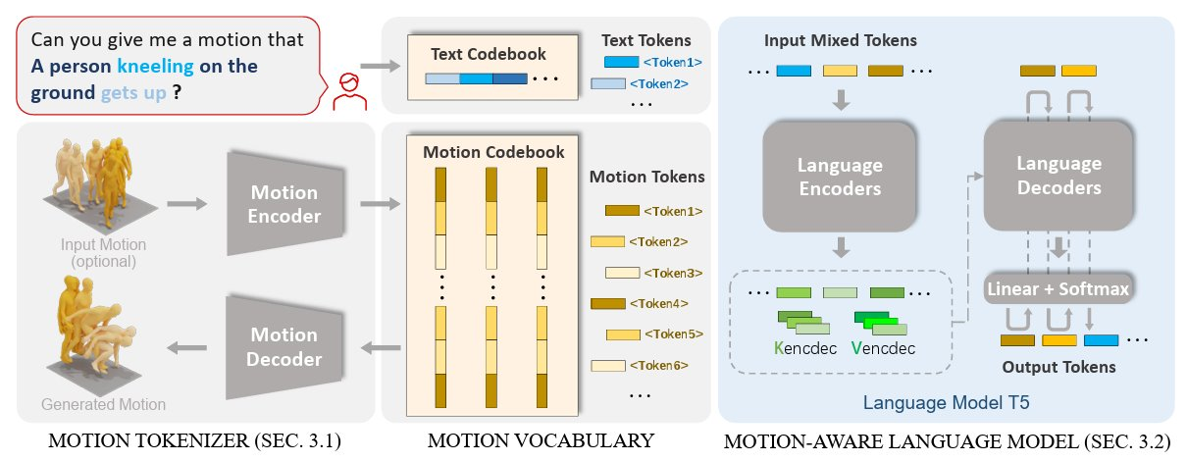
VQ-VAE-based Motion Understanding
B. Jiang et al., "MotionGPT: Human motion as a foreign language", NeurIPS 2023.

Slide 17
Problems of VQ-VAE-based Approaches
Geometric Disconnect: Decouples quantization from semantic learning. Linking modalities solely via Token IDs destroys the intrinsic 3D geometric structure.
Optimization Block: The non-differentiable nearest-neighbor assignment blocks geometry-aware gradients, preventing fine-grained structural control.
Codebook Collapse: Exhibits a severe heavy-tailed usage pattern. A few tokens dominate while many become "dead codes," resulting in overly collapsed and repetitive motion dynamics.

Slide 18
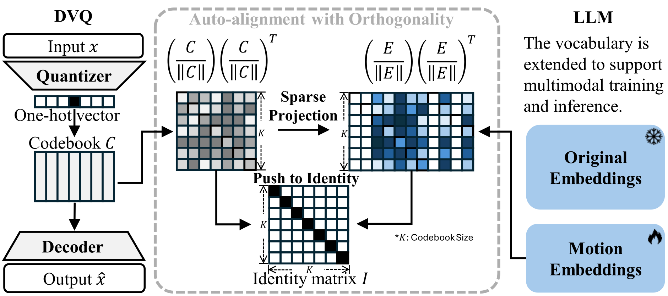
Overall Architecture of GeoMotionGPT

Slide 19
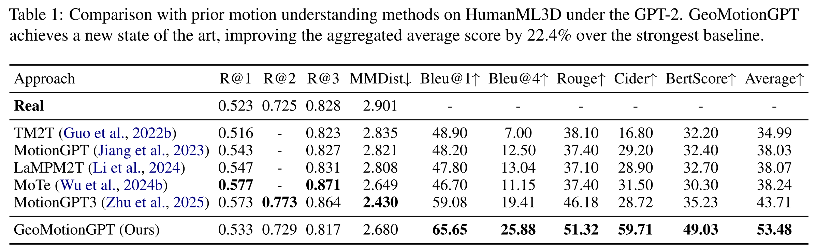
Experiment Results of GeoMotionGPT

Slide 20
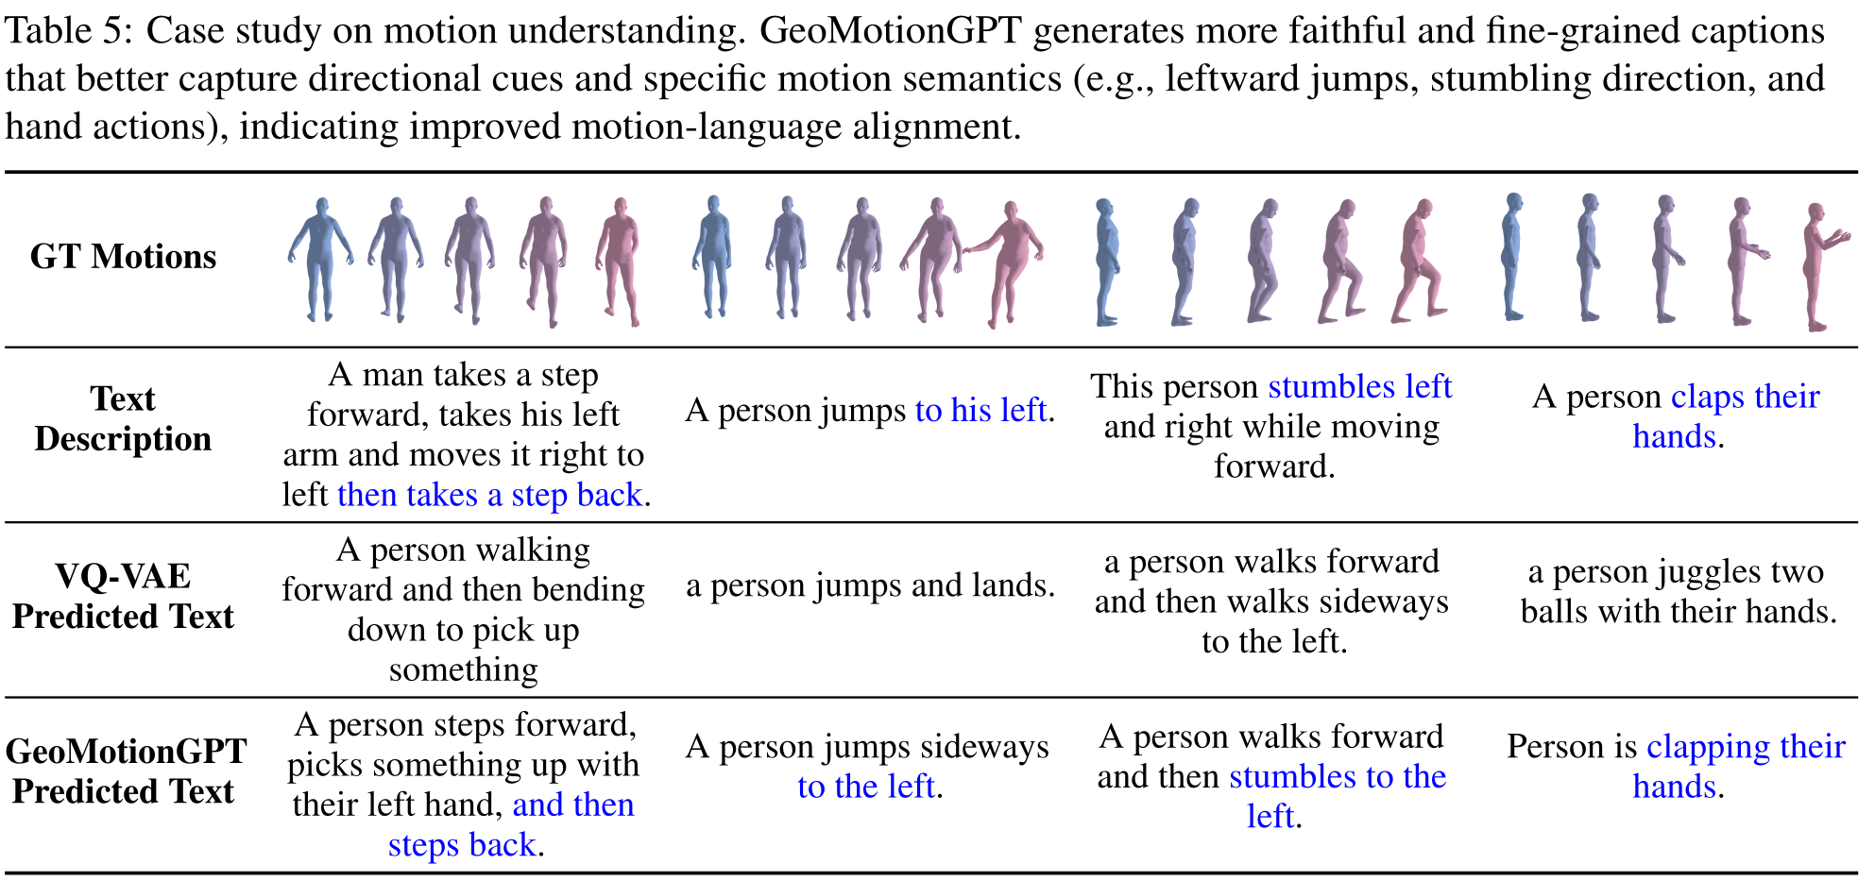
Experiment Results (Con't)

Slide 21
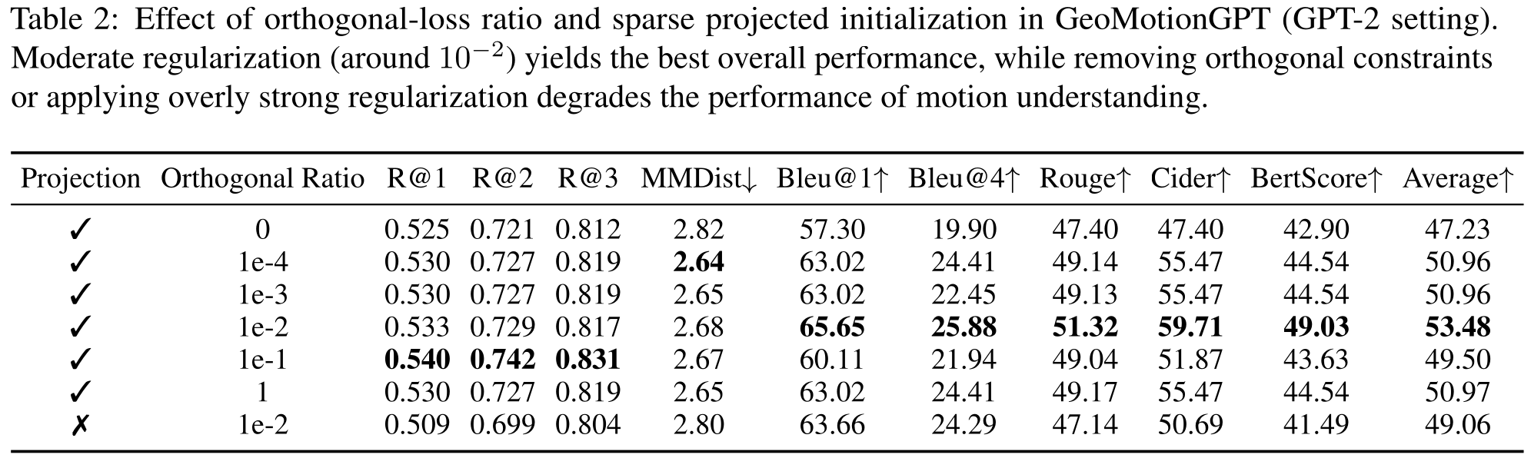
Ablation Studies

