Slide 1

MobileLLM: Optimizing Sub-billion Parameter Language Models for On-Device Use Cases
Zechun Liu
Presenter: Atalia Hernandez

Slide 2
Challenges of LLM usage

Slide 3
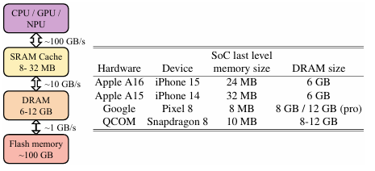

Limited DRAM Capacity on Phones
Large Energy Consumption
Battery Problems

Slide 4

Adaptation for on-device execution
Sub-million model:
350M 8-bit model consuming only 0.035 J/token. iPhone can now support a conversational use for a day
125M model significantly enhance decoding speed which it’s capable of operating 50 tokens/s compared with 7B which performs at 3-6 tokens/second
Contributions to build the most accurate under 1 billion parameters
Deep-and thin model
Block-wise weight sharing
New family model MobileLLM showcasing SOTA performance
Chat and API calling

Slide 5
Improving Sub-billion Scale LLM Design
Structure:
Training Set up
Building a Strong Baseline
Layer Sharing

Slide 6
Training Setup
Experiments conducted on 32 A100 GPUs
The pre-trained models is evaluated on
Zero- shot common sense reasoning task
Questions answering and reading comprehension

Slide 7
Building strong Baseline
Feed-Forward Network Choice
Usage of activation function SwiGLU by changing vanilla FFN to SwiGLU with a boost on zero-shot reasoning from 42.6 to 43.9
Architecture Depth vs Width
Embedding Sharing
Number of Heads and KV-heads

Slide 8
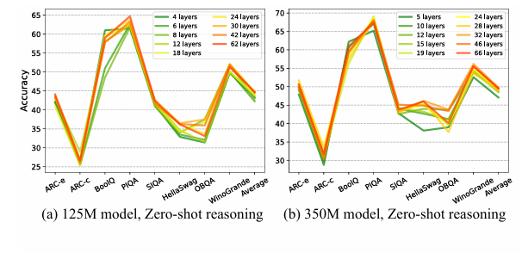
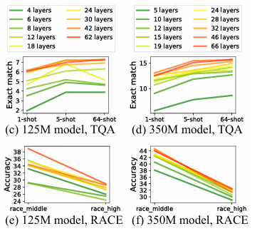
ARCHITECTURE DEPTH VS WIDTH
Study125M and 350M parameters
Training of 19 models: 9 models with 125M and 10 on 350M parameters
Result: Thiner models outperforms wider counterparts suggesting models with 30 or 42 layers performs better than 12.

Slide 9
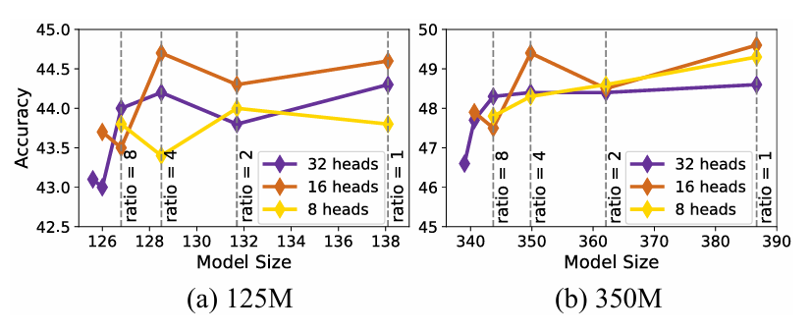
NUMBER OF HEADS AND KV-HEADS
Embedding Sharing
Embedding dimension of 512 and vocabulary size of 32k compromises and input and output of 16 million parameters which it’s 20% of 125M model
Considerably lower in larger language models with 3.7% in 7B model and 0.7% in 70B model
Originally Models use more Key-Value Heads per query making it more expensive and keeping a high memory cache usage.
However, experiments has demonstrated that the less the number of queries heads and the more key value heads are shared, the better performance we obtain from the model.

Slide 10
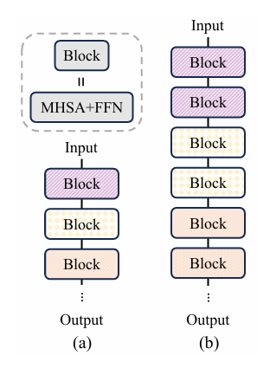
Layer Sharing
DRAM stores the model however is slower processing compared to SRAM which it’s smaller but faster.
It sends the tools to process the input to the SRAM
MobileLLM basically refines the input twice on the same block then changes it. This makes the input/output progress faster.

Slide 11
Downstream Tasks
Chat branchmarks: MobileLLM models outperformed previous sub-billion models and even some models exceeding 1 billion parameters. 350M achieving a win rate of 48.2% making comparable to GPT-3 baseline
Api calling: MobileLLM 350M model achieved intent and structures exact-match scores comparable to 20 times layer models
Experiment
And Results
Main Results
Efficiency
Zero shot performances, it achieved 2.7% higher accuracy than previous 125 Models while MobileLLM 350M showed 4.3 accuracy boost.
Layer sharing: 0.7% of accuracy boost to many previous 350 models.
Knowledge distillation was unsuccessful being 2.6x-3.2x slower to train and yield accuracy from 7B model
When profiled in iPhone 13 MobileLLM-LS incurred only 2.6% increase in execution time compered to the baseline

Slide 12
Conclusion
Our findings indicate that, for smaller models, prioritizing depth over width enhances model performance.
Advanced weight-sharing techniques, including embedding sharing, grouped query attention, and block-wise weight sharing, we achieve significant enhancements in weight utilization within storage-constrained scenarios.
The resulting models denoted as MobileLLM exhibit substantial advancements in zero-shot commonsense reasoning, question answering, and reading comprehension tasks compared to previous SOTA methods.

Slide 13

Questions?

