Slide 1
Elastic On-Device LLM Service
Carter Mason
CIS 4930
Based on: Wangsong Yin1 , Rongjie Yi2 , Daliang Xu2 , Gang Huang1 , Mengwei Xu2,3#, Xuanzhe Liu1
Notes:
“Hi everyone — I’m Carter, and today I’ll be talking about Elastic On-Device LLM Services, a paper from MobiCom 2025.
The central theme is How do we make on-device large language models practical for real applications.”

Slide 2
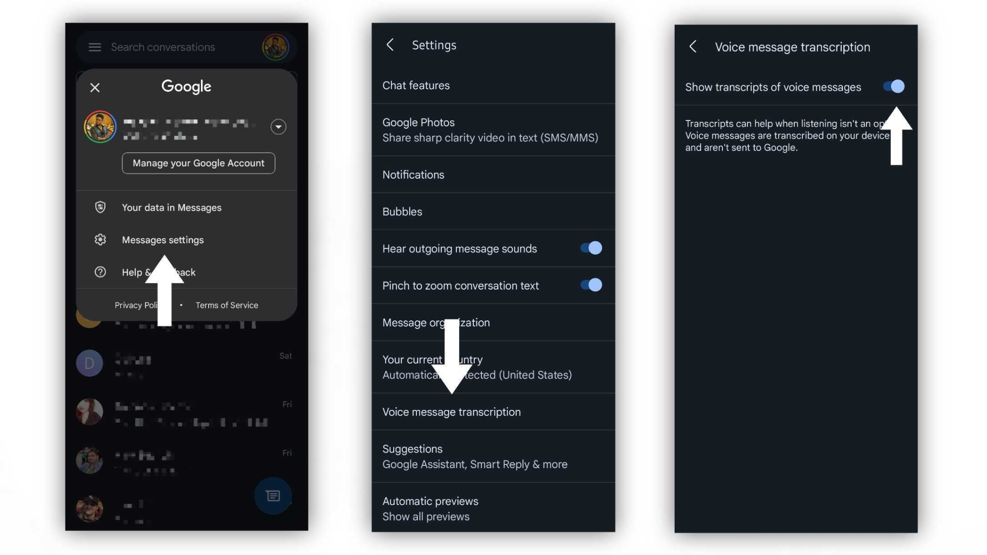
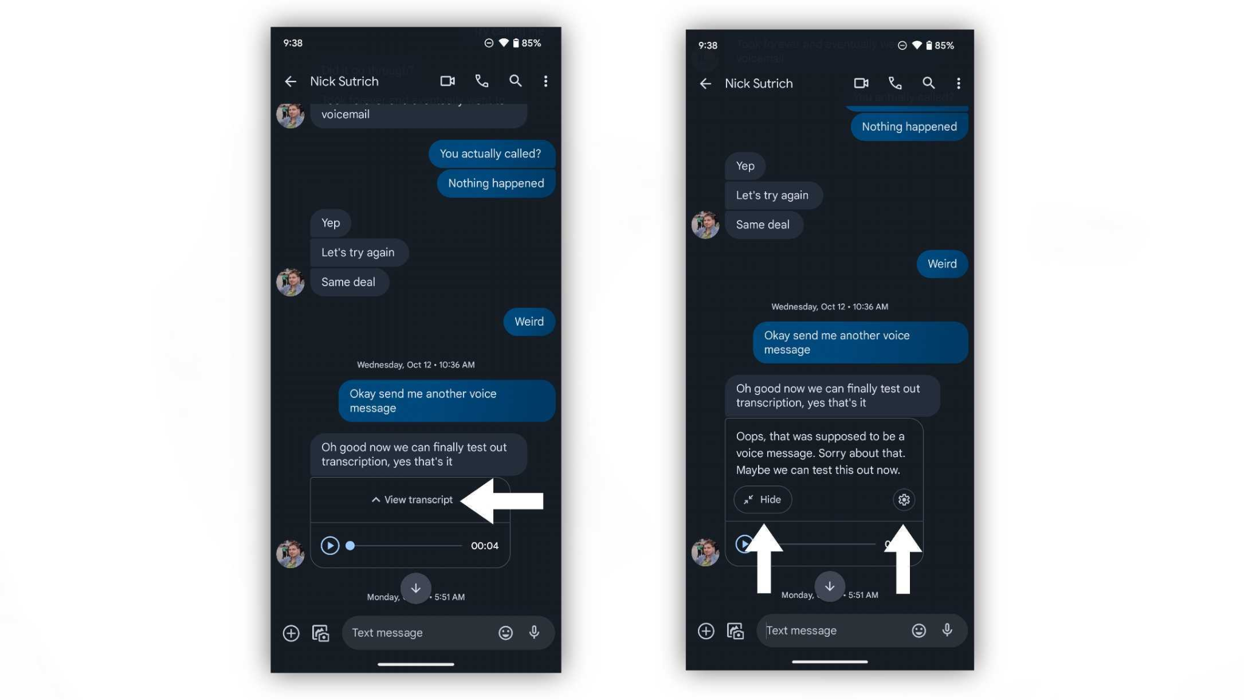
Why On-Device LLMs Matter
Privacy: no cloud transmission
Lower network latency
Shared OS-level LLM service
But constrained by memory, energy, compute
Notes:
Modern phones can run language models locally which gives privacy benefits, avoids network roundtrips, and can make interactions feel more immediate. But phones are resource constrained: limited memory, compute, and especially energy. And user experience demands low latency.”
Google Pixel devices use on-device language models for Smart Reply and voice transcription. These models must meet strict latency requirements while running on limited hardware.”
(Brief pause)
“What we’ll see is that different requests have different latency needs — and one fixed model just doesn’t serve them all well.”

Slide 3
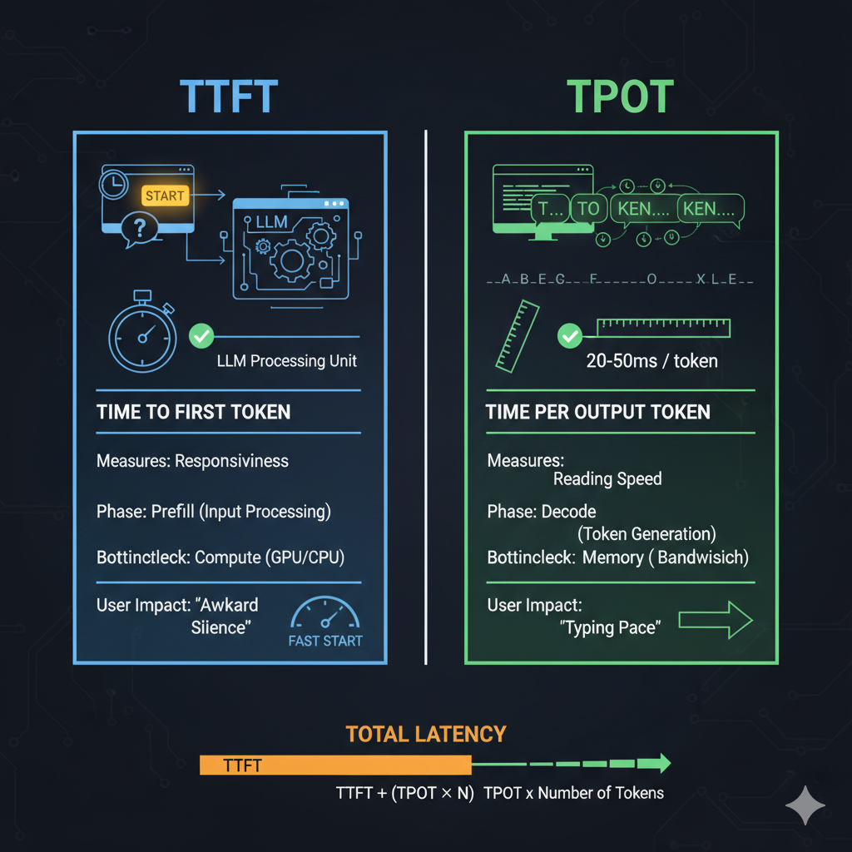
What is an SLO?
A Service-Level Objective (SLO) defines latency targets a request must meet.
TTFT - Time To First Token
TPOT - Time Per Output Token
App | Latency Need
Chatbot | Low TTFT +TPOT
UI Agent | Low TTFT
Background Task | Flexible
Notes:
“When we talk about serving AI requests on a device, we need targets — that’s where SLOs come in. An SLO — a Service-Level Objective — which is the latency constraints for a request.”
“Specifically, the paper uses two metrics:
TTFT — Time To First Token: how fast the model starts responding
TPOT — Time Per Output Token: how fast it continues generating after that.”
(Gesture to example table)
“Different apps — for example, quick text completion versus a long reasoning prompt — have very different SLOs.”

Slide 4
Diversified SLOs
Different apps → different latency requirements
App | Latency Need
Chatbot | Low TTFT + TPOT
UI Agent | Low TTFT
Background Task | Flexible
Notes:
“Now that we understand what an SLO is — a latency target defined by TTFT and TPOT — the key issue is that not all applications need the same latency profile.”
“Different mobile AI tasks have fundamentally different responsiveness requirements.”
“For example, a chatbot must respond quickly and continue generating smoothly, so it needs both low Time-To-First-Token and low Time-Per-Output-Token.”
“In contrast, a UI automation agent — like something controlling an app — mostly needs the first action quickly. After that, token generation can overlap with UI execution, so TPOT is less critical.”
“A background task, like a screen-event recorder, can tolerate slower response because the user is not directly waiting on it.”
“And voice assistants are extremely sensitive to TTFT — if the first token takes too long, it feels broken.”
“So the important takeaway is:”
There is no single latency target that works for all on-device LLM applications.
“And that’s the systems challenge. If we deploy one fixed model on the device, it cannot optimally serve all these diverse SLOs.”
“This diversity is what motivates elasticity.”

Slide 5
The Core Problem
One static model creates a rigid trade-off:
Too large -> slow, drains battery
Too small -> fast, but low quality
Why not use Multiple models?
Too much memory
Slow switching
Duplicated parameters
Can one model adapt per request?
Notes:
So what’s the tension?
Classic approach: load one model on the device.
Problem:
If the model is big then its slow, drains battery.
If it’s small then its fast, but loses quality.
Why not use Multiple models?
Too much memory
Slow switching
Duplicated parameters
“So the question is: can one model behave flexibly to meet different latency goals?”

Slide 6
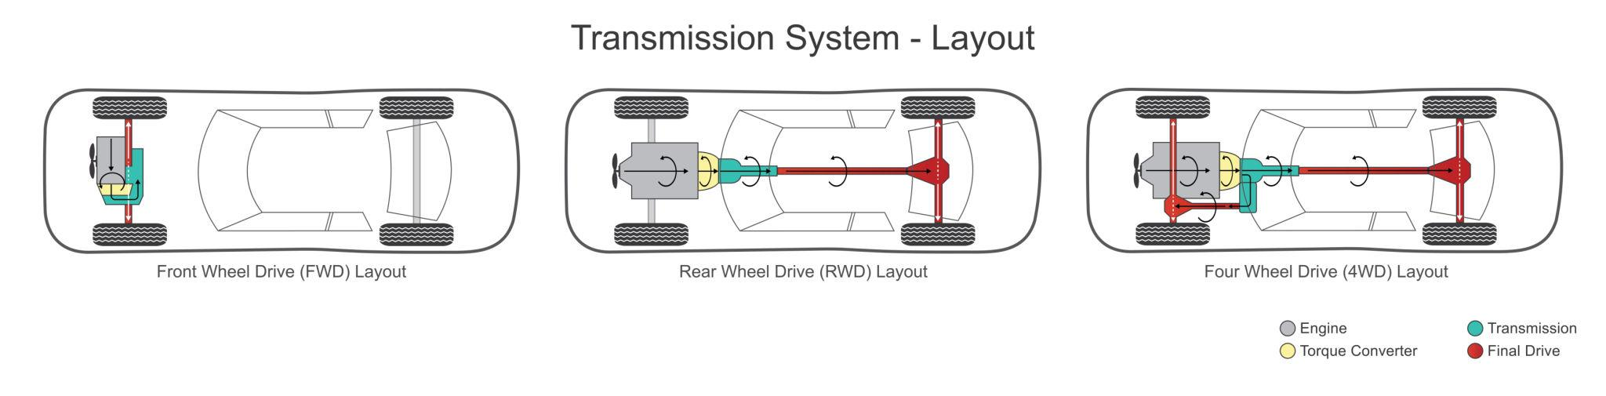
What Does Elasticity Mean
Model scales up/down per request.
Analogy:
Car gears or CPU frequency scaling.
Notes:
“In cloud systems, elasticity refers to scaling resources up and down on demand.
Here, elasticity means the model itself can scale — not by loading multiple separate models, but by extracting parts of one model to match different latency targets.
”What makes this different from the cloud is that we can’t scale hardware on a smartphone. The CPU, memory, and battery are fixed.”
“So instead of scaling hardware, this paper proposes scaling model capacity.”
“In other words, we keep one large model in memory, but we don’t always use all of it.
(Gesturing)
“We can use a car shifting gear as an analogy for this, In first gear, you get quick acceleration but limited top speed.
In higher gears, you get more power but you consume more energy. Just like a car shifts gears depending on whether you need speed or power, an elastic LLM shifts how much of the model it activates depending on latency constraints..”

Slide 7
Model Elasticity
Key idea: rearrange internal units once offline so smaller high-quality sub-models can be extracted instantly.
Reorder neurons by importance
Slice model without data movement
Zero-cost switching
Notes:
To build on the last slide, “The core idea builds on transformer models having some redundancy. The system reorders neurons by importance once offline, and then slices this reordered structure to create smaller sub-models for faster execution.”
“When a request arrives with a strict latency target, the system uses a smaller slice — less compute, faster response. If there’s more time, it uses larger slices.”
This slicing doesn’t retrain the model every time — it’s more like activating only part of the model.
“Imagine the full model is 100% capacity.”
“If we reorder internal units by importance, we can treat the first 40% as the most critical part of the model.”
“So if a request needs to respond fast, we activate only that 40%.”
“If we have more time, we activate 70%.”
“If there’s no latency constraint, we use the full model.”
“This is fundamentally different from loading separate checkpoints.”
That’s how they preserve quality while respecting latency requirements.

Slide 8
Prompt Elasticity
A tiny controller model decides:
Which tokens to keep
How much of the model to use
Chooses model size
Notes:
“But shrinking the model can sometimes reduce quality.
To help with that, the paper introduces a tiny controller model with two heads:
one head scores token importance,
another head decides on the model/prompt mix.”
(Gesturing at diagram)
“So instead of just downsizing the model, the system pairs prompt strategies with model slices to balance quality and speed.”
The tiny controller coordinates how much of the prompt and how much of the model to use so the system meets latency targets without unnecessary quality loss.”
This is the prompt elasticity piece.

Slide 9

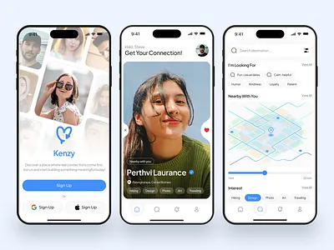
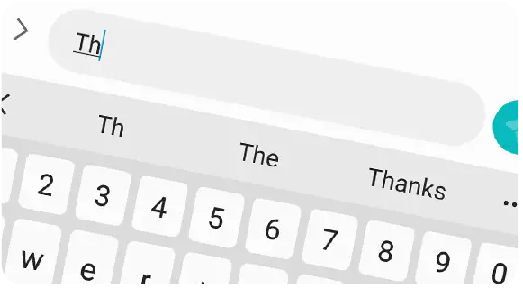
Why This Matters on Phones
Meets latency goals
Saves energy
Preserves memory
Better UX
Notes:
“Imagine the user is typing a message on their phone. They expect auto-suggestions to appear almost instantly — any delay feels laggy.”
(Pause and point to typing image)
“Next, imagine the user interacting with a UI that reacts to AI prompts — for example, triggering a shortcut or editing text based on their commands. If the model is slow, the UI feels unresponsive.”
(Pause and gesture to smooth UI icon)
“And of course, this is a phone — battery life matters. We can’t run huge models constantly without draining the battery.”
(Pause and gesture to battery icon)
“Elastic serving gives us a way to flex: we can use small slices for fast, energy-efficient responses, bigger slices when quality matters more, all without downloading or storing separate copies of the model.”
However it is not perfect which brings me to th3e tradeoffs (next slide)

Slide 10


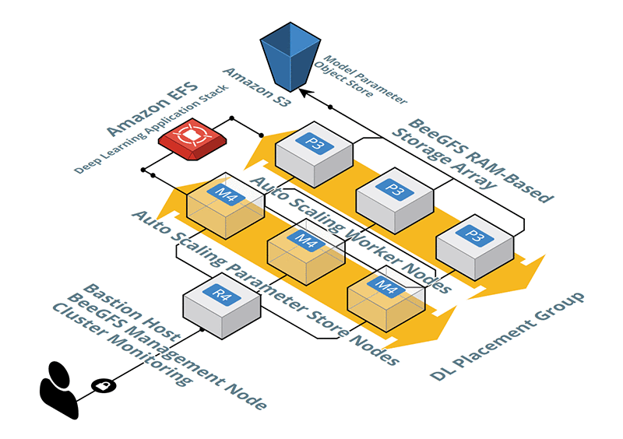
Trade-Offs
Slight accuracy degradation at smaller slices
Added orchestration logic
Offline preprocessing cost
Still bounded by device hardware
Notes:
“However, elasticity isn’t magic.”
“First, smaller slices do lose some accuracy. If you activate only 40% of the model, you simply have fewer parameters contributing to reasoning.”
“Second, the system becomes more complex. Instead of just running a model, we now have orchestration logic — a controller that decides prompt size and model size.”
“Third, there’s an offline preprocessing cost. The reordering and recovery steps require computation before deployment.”
“And finally, we’re still bounded by the phone’s hardware. Even elastic models can’t exceed the CPU or GPU limits.”
“But compared to static models, this adaptive approach gives better overall compliance with latency targets.”

Slide 11
Results Summary
Improves accuracy under strict latency constraints
Up to ~10–15% higher accuracy than static baselines
Meets diverse SLOs more reliably
Minimal switching overhead on device
Notes:
The paper shows that under strict latency constraints — where a static model would either be too slow or too aggressively pruned — ElasticLM achieves up to roughly 10 to 15 percent higher accuracy compared to strong baselines.”
“What’s important here is that this improvement happens specifically under tight latency conditions.”
“In other words, when the system is forced to shrink capacity, elasticity degrades more gracefully.”
(Pause.)
“That’s because the model slices are constructed intentionally — the most important units are preserved — instead of randomly pruning.”
“They also show that switching between model sizes has minimal runtime overhead, which is critical for mobile deployment.”
“So empirically, elasticity gives better accuracy while still respecting latency goals — which is exactly what on-device systems need.”

Slide 12
Conclusion/Takeaways
Elasticity makes one LLM behave like many, tuned to latency constraints.
Notes:
So in summary:
Elastic Serving lets one on-device model behave like multiple effective capacity models, tuned to the latency and quality expectations of different tasks.
This lets us respect user needs while staying practical for constrained phones.”

Slide 13
Thank You, Questions!

