Slide 1
NeurIPS 2023 · Collaborative Perception
How2comm
Communication-Efficient and Collaboration-Pragmatic
Multi-Agent Perception
Autonomous Vehicles
LiDAR Detection
V2X Communication
Dingkang Yang · Kun Yang · Yuzheng Wang · Jing Liu · Peng Zhai · Lihua Zhang
Fudan University
Problem 1 Communication
Redundancy
Problem 2 Transmission
Delay
Problem 3 Collaboration
Heterogeneity

Slide 2
The Problem: Why Single-Agent Perception Isn't Enough
Single-Agent Limitations
Multi-Agent Collaboration Helps — But Adds New Challenges
Occlusions
V2V / V2X communication lets vehicles share sensor data in real time — dramatically improving perception. But this introduces:
1
Objects hidden behind buildings, trucks, or other vehicles are simply invisible to a single sensor.
Communication Redundancy
Limited Range
Sharing all features indiscriminately wastes limited bandwidth.
2
A vehicle's LiDAR only covers a finite radius — beyond that, the world disappears.
Transmission Delay
Data arrives late, causing fast-moving objects to appear in the wrong place.
3
Sparse Point Clouds
At distance, only a handful of points represent an object, making detection unreliable.
Collaboration Heterogeneity
Different LiDAR sensors create feature-space gaps that break fusion.

Slide 3
Three Core Challenges How2comm Solves
Each challenge represents a fundamental barrier to practical collaborative perception
01
Communication Redundancy
02
Transmission Delay
03
Collaboration Heterogeneity
What's happening:
What's happening:
What's happening:
Existing methods either compress everything uniformly or rely on coarse confidence maps to decide what to share.
Data is always transmitted from the past (t₀ = t − τ). A car moving at 60 mph travels ~3 meters in 100ms.
Different agents (vehicles, infrastructure) have different LiDAR hardware — density, range, noise characteristics all differ.
Why it matters:
Why it matters:
Why it matters:
Bandwidth in real V2V/X systems is severely limited (~1 MB). Sending too much data makes real-time collaboration infeasible.
Feature misalignment makes collaboration actively harmful — fused data can place objects in the wrong location.
Naive feature fusion causes feature-space mismatches, and fails to exploit the distinct advantages of each agent's viewpoint.
How2comm's fix:
How2comm's fix:
How2comm's fix:
Spatial-channel message filtering guided by mutual information — send less, but preserve the most useful semantics.
Flow-guided future feature prediction warps past features forward in time to align with the current frame.
STCFormer decouples features into exclusive and common perception regions, handling each appropriately.

Slide 4
How2comm: System Overview
1. Encode
2. Filter
3. Predict
4. Fuse
5. Detect
Shared PointPillar encoder converts LiDAR point clouds to BEV feature maps for all agents
MIC module: spatial-channel attention selects only the most informative features to transmit
FDC module: feature flow warps collaborator features forward to current timestamp t
STCFormer integrates decoupled spatial semantics + temporal context across agents
Regression and classification decoders output 3D bounding boxes for objects
Key design principle: Agents operate asynchronously. The ego vehicle broadcasts what it needs; collaborators send only what fills those gaps. All collaboration happens in intermediate feature space — not raw sensor data (too large) and not final predictions (too lossy).

Slide 5
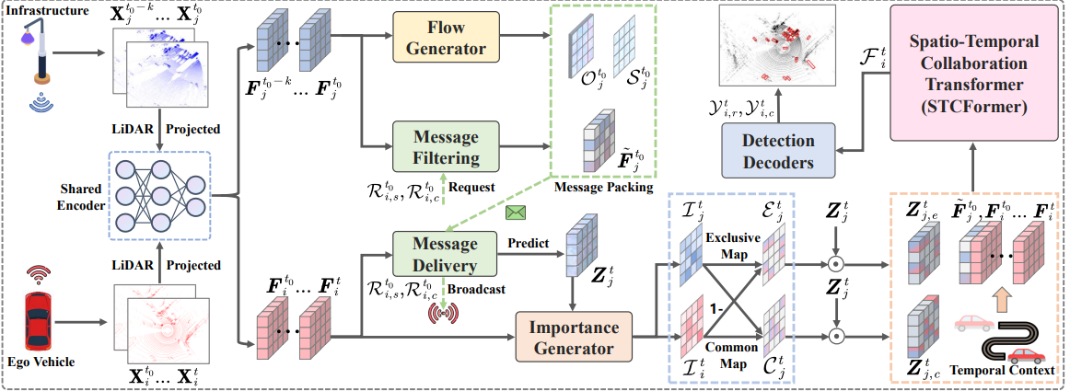
How2comm: System Overview
1. Encode
2. Filter
3. Predict
4. Fuse
5. Detect

Slide 6
Module 1 — Mutual Information-Aware Communication (MIC)
Goal: transmit less data while preserving the most semantically valuable information
How It Works
Why This Is Better
1
Step 1 — Ego Generates Queries
✗
Previous: Feature Compression
The ego vehicle computes spatial attention (which locations matter?) and channel attention (which feature dimensions matter?) for its own BEV feature map.
Autoencoders compress everything uniformly — valuable features get squashed alongside irrelevant ones.
2
Step 2 — Ego Broadcasts Requests
✗
Previous: Spatial Filtering Only
It inverts these attention maps (1 − A) to produce a 'request' signal: what spatial regions and channels does the ego lack?
Confidence maps pick locations but ignore which feature channels matter — half the picture.
3
Step 3 — Collaborator Responds
✓
How2comm: Both Dimensions
The collaborator combines the ego's requests with its own attention to produce a binary mask M, then sends only F̃ = F ⊙ M — a sparse, targeted feature.
Spatial AND channel filtering, guided by what the ego actually needs — targeted, not uniform.
4
Step 4 — Mutual Info Supervision
✓
Bonus: Info Preservation
A Jensen-Shannon divergence loss L_mul ensures the sparse filtered features retain the most critical semantics of the full original features.
The MI supervision loss prevents important semantics from being lost in the filtering process.

Slide 7
Module 2 — Flow-Guided Delay Compensation (FDC)
The Core Problem: At 100ms delay (typical V2X), a vehicle moving at 60 mph has traveled ~2.7 meters. Fusing features from different timestamps causes false positives, ghost objects, and missed detections — collaboration makes things worse, not better.
FDC predicts forward →
t₀−k
t₀
t
Historical frame
(collaborator)
Last transmitted
frame (delayed)
NOW
(ego's frame)
Step 1: Flow Generation
Step 2: Feature Warping
Step 3: Self-Supervised Training
The collaborator runs its historical feature sequence {F^(t₀−k), ..., F^t₀} through a flow generator network to produce a feature flow O^t₀ (direction) and scale matrix S^t₀ (magnitude).
The ego receives the sparse feature F̃^t₀, the flow O^t₀, and scale S^t₀. It estimates the predicted future feature: Z^t = warp(F̃^t₀, (t−t₀)·O^t₀) ⊙ S^t₀
No motion annotations exist in the datasets, so the flow generator is trained by maximizing cosine similarity between the predicted feature Z^t and the actual future feature F^t (used as a proxy label).

Slide 8
Module 3 — Spatio-Temporal Collaboration Transformer (STCFormer)
Goal: pragmatic fusion that handles heterogeneous agents and learns from history
⏱ Temporal Cross-Attention (TCA)
🔀 Decoupled Spatial Attention (DSA)
⚖ Adaptive Late Fusion (ALF)
Problem it solves
Problem it solves
Problem it solves
Point cloud sparsity makes it hard to detect fast-moving objects in a single frame.
Naively fusing all collaborator features ignores the structural difference between shared and unique viewpoints.
Exclusive and common features have different informational value at different spatial locations.
How it works
How it works
How it works
Uses Q-K-V attention across the ego's current frame and all merged historical features (from both ego and collaborators). A 1D temporal convolution extracts sequential dependencies before attention.
An importance generator scores each spatial location for both ego (I^t_i) and collaborator (I^t_j). The collaborator's features are split into: Exclusive Map (1−I^t_i)⊙I^t_j — what only they see; Common Map I^t_i⊙I^t_j — what both see. Separate deformable attention heads handle each.
Two weight maps G^t_e and G^t_c are learned via 1×1 convolutions and softmax. Final output: F^t_i = G^t_e ⊙ F^t_e + G^t_c ⊙ F^t_c — an adaptive, spatially-varying blend.
Key benefit
Key benefit
Key benefit
Historical context fills in gaps left by sparse or occluded current observations.
Exclusive features fill blind spots; common features bridge sensor discrepancies.
Better than simple addition — the network learns where to trust exclusive vs. common information.

Slide 9
The Decoupling Intuition: Why Split Features at All?
Key insight from the paper: In a typical V2X scene, a collaborator has two types of useful information for the ego agent — things they both see (common region) and things only the collaborator sees (exclusive region). These require fundamentally different handling.
EXCLUSIVE REGION
COMMON REGION
(Infrastructure sees, ego does not)
(Both agents see the same area)
▸ This is the collaborator's biggest value-add — compensating for the ego's blind spots.
▸ Both agents observe this area but with DIFFERENT sensors — different LiDAR hardware creates feature gaps.
▸ Typical example: infrastructure camera sees around a corner, or over an occluding truck.
▸ Common region features help the framework bridge the sensor discrepancy / heterogeneity problem.
▸ Without this information, the ego would simply miss these objects.
▸ CSA fuses these complementary views to produce a more robust representation of shared space.
▸ ESA uses deformable attention to sample keypoints specifically in this exclusive zone.
▸ Result: localization errors and feature mismatches are significantly reduced in shared areas.

Slide 10
Quantitative Results: How2comm vs. State of the Art
+8.4%
+7.0%
3 datasets
AP@0.7 improvement
on DAIR-V2X (real-world)
AP@0.7 improvement
on OPV2V (simulated)
DAIR-V2X · V2XSet · OPV2V
All outperform prior SOTA
Model
DAIR-V2X
AP@0.5/0.7
V2XSet
AP@0.5/0.7
OPV2V
AP@0.5/0.7
No Fusion
50.0 / 43.6
60.6 / 40.2
68.7 / 48.7
When2com
46.6 / 32.5
65.1 / 41.9
70.6 / 53.7
V2VNet
52.2 / 38.6
79.1 / 49.3
77.5 / 62.1
DiscoNet
51.4 / 40.0
79.8 / 54.1
81.1 / 64.9
V2X-ViT
51.7 / 40.0
83.6 / 61.4
80.6 / 66.4
CoBEVT
56.1 / 41.5
81.1 / 54.3
81.6 / 67.5
Where2comm
59.3 / 43.5
82.0 / 53.4
82.8 / 67.3
How2comm ✓
62.4 / 47.2
84.1 / 67.0
85.4 / 72.2

Slide 11
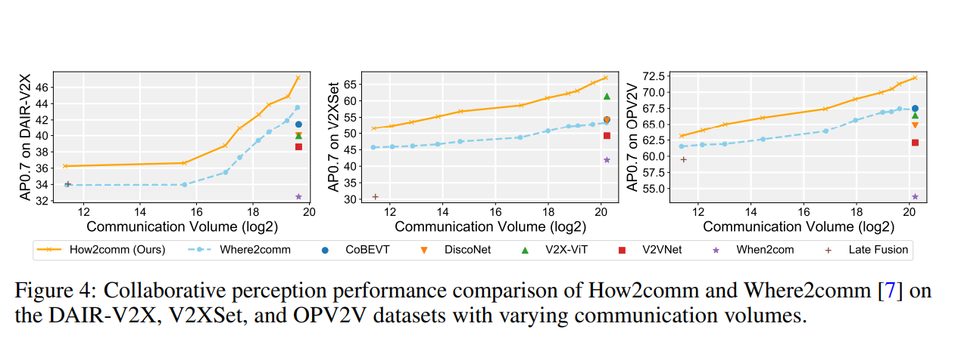
Communication Efficiency: Better Performance, Less Bandwidth
📷 Insert Figure 4 here
(Communication Volume vs. AP@0.7 across all 3 datasets)
Key Takeaways
Dominates at all bandwidth levels
How2comm outperforms Where2comm (the prior best) across every tested communication budget — not just at a specific sweet spot.
Matches SOTA with less data
At lower communication volume, How2comm achieves comparable AP to models that transmit far more — a fundamentally better efficiency curve.
Spatial-channel filtering works
The MIC module is the key driver: by sending targeted features rather than uniform compressions, each byte transmitted carries more useful information.
MI supervision prevents degradation
Without the mutual information loss, aggressive filtering would drop useful semantics. The supervision term keeps quality high even at high sparsity.

Slide 12
Robustness: Surviving Real-World Noise
Real deployments are messy. How2comm was stress-tested under three types of noise:
Localization Error
Heading Error
Transmission Delay
GPS / positioning drift (0–0.5m std dev)
Orientation/yaw noise (0–1.0° std dev)
Temporal lag of 0–400ms
What it simulates
What it simulates
What it simulates
Agents don't know their exact position — a realistic problem in urban canyons and GPS-denied environments.
Even small rotational errors in how an agent thinks it's facing cause significant feature map misalignment when projected to ego coordinates.
Network congestion, processing overhead, and wireless channel variability all contribute to delayed data in real V2X systems.
How2comm's performance
How2comm's performance
How2comm's performance
Stays above all baselines and above 'No Fusion' at all error levels. Some methods (V2VNet, When2com) fall below No Fusion beyond 0.2m — collaboration actively hurts them.
Maintains the largest margin over competing methods. The STCFormer's attention mechanism is robust to small spatial misalignments by design.
Improves AP@0.7 by 7.5% over No Fusion even at severe 400ms delay on DAIR-V2X — the FDC module directly compensates by predicting future features.

Slide 13
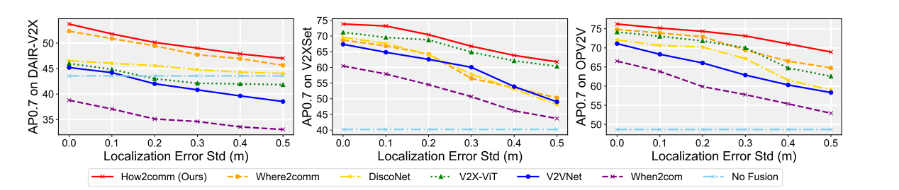
Robustness: Surviving Real-World Noise
Real deployments are messy. How2comm was stress-tested under three types of noise:
Localization Error
GPS / positioning drift (0–0.5m std dev)

Slide 14
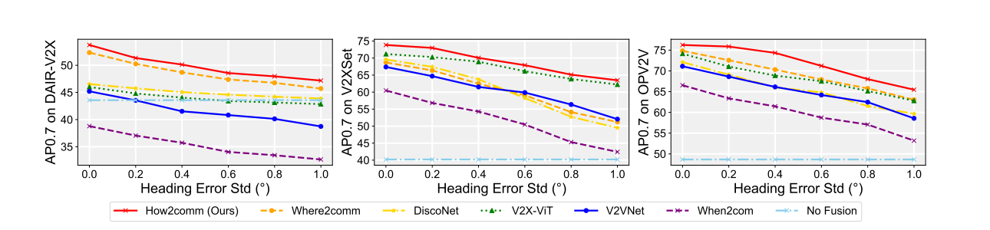
Robustness: Surviving Real-World Noise
Real deployments are messy. How2comm was stress-tested under three types of noise:
Heading Error
Orientation/yaw noise (0–1.0° std dev)

Slide 15
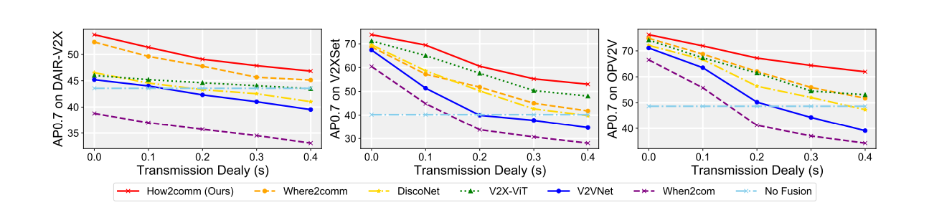
Robustness: Surviving Real-World Noise
Real deployments are messy. How2comm was stress-tested under three types of noise:
Temporal lag of 0–400ms
Transmission Delay
Temporal lag of 0–400ms

Slide 16
Conclusion & Future Work
How2comm is the first framework to jointly address all three core challenges of collaborative perception
MIC
Mutual Info-Aware Communication
FDC
Flow-Guided Delay Compensation
STCFormer
Spatio-Temporal Collaboration Transformer
Send less, but better — spatial-channel filtering with MI supervision preserves critical semantics under bandwidth constraints.
Predict the future — feature flow warping aligns collaborator data to the current timestamp, defeating the transmission delay problem.
Think holistically — decoupled exclusive/common spatial attention + temporal context produces robust, heterogeneity-aware fusion.
Results: SOTA on DAIR-V2X (+8.4% AP@0.7), V2XSet, and OPV2V (+7.0% AP@0.7) · Superior under localization error, heading error, and transmission delay
Limitation
Future Work
Only exploits short-term historical frames for temporal context. Long sequences are left for future work.
(1) Long-term temporal modeling with extended point cloud sequences. (2) Uncertainty-aware feature flow prediction for more reliable warping.

