Slide 1
RESEARCH PAPER PRESENTATION
Artic: AI-oriented Real-time Communication for MLLM Video Assistant
Making video assistants faster and more accurate over imperfect networks
Jiangkai Wu · Zhiyuan Ren · Junquan Zhong · Liming Liu · Xinggong Zhang
Peking University | February 2026
Presenter: Armani Ruiz • Course: Future Edge Networks
Wu et al. • Artic • arXiv:2602.12641 (2026)
01
Notes:
Introduce the authors and the central goal: real-time video assistants require a network to optimize for AI answer quality, not just video image quality.

Slide 2

BACKGROUND
Why this problem matters
A video assistant receives live video over a network
Unstable uplink bandwidth hurts responsiveness and understanding
An MLLM interprets the scene and answers questions
RTC = real-time communication • MLLM = multimodal large language model
Wu et al. • Artic • arXiv:2602.12641 (2026)
02
Notes:
Explain uplink: the user device sends camera frames to an AI service. Conventional video streaming optimizes visual experience; here the recipient is an AI model. Point to Figure 1.

Slide 3
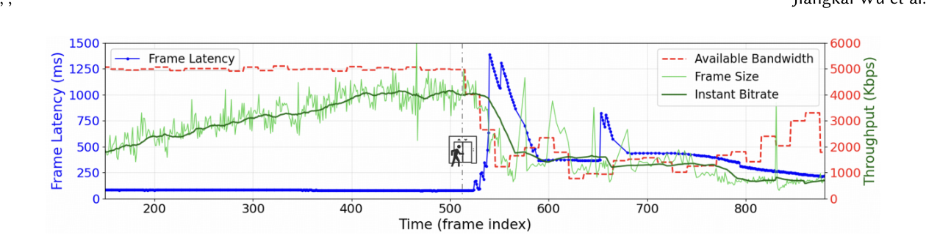
PROBLEM
The mismatch: video quality ≠ answer quality
Conventional congestion control may raise bitrate when bandwidth allows
Aggressive bitrate can create queues and latency spikes
More bits do not always improve MLLM answer accuracy
Figure 2 • Paper’s latency measurement
Wu et al. • Artic • arXiv:2602.12641 (2026)
03
Notes:
The system should not maximize video bitrate by default. Extra encoded bits can compete with real-time latency while adding little to AI performance. Figure 2 motivates rate adaptation.

Slide 4
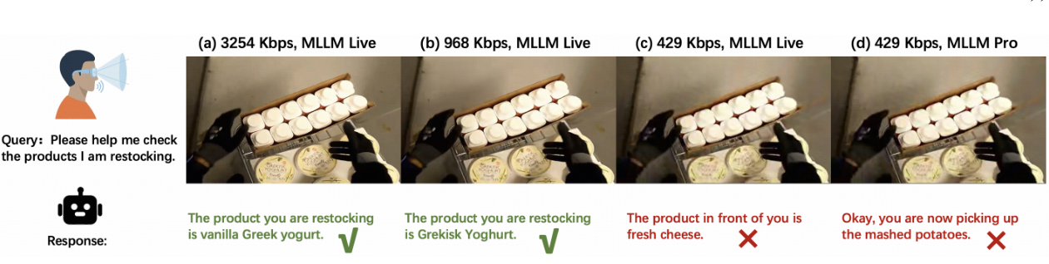
MEASUREMENT
Key observation: AI accuracy saturates
When the model already has enough visual information, increasing bitrate can waste bandwidth.
Wu et al. • Artic • arXiv:2602.12641 (2026)
04
Notes:
Walk through Figure 3. The accuracy curve saturates with quality, and different regions contribute differently to an answer. These two observations motivate Artic’s two mechanisms.

Slide 5
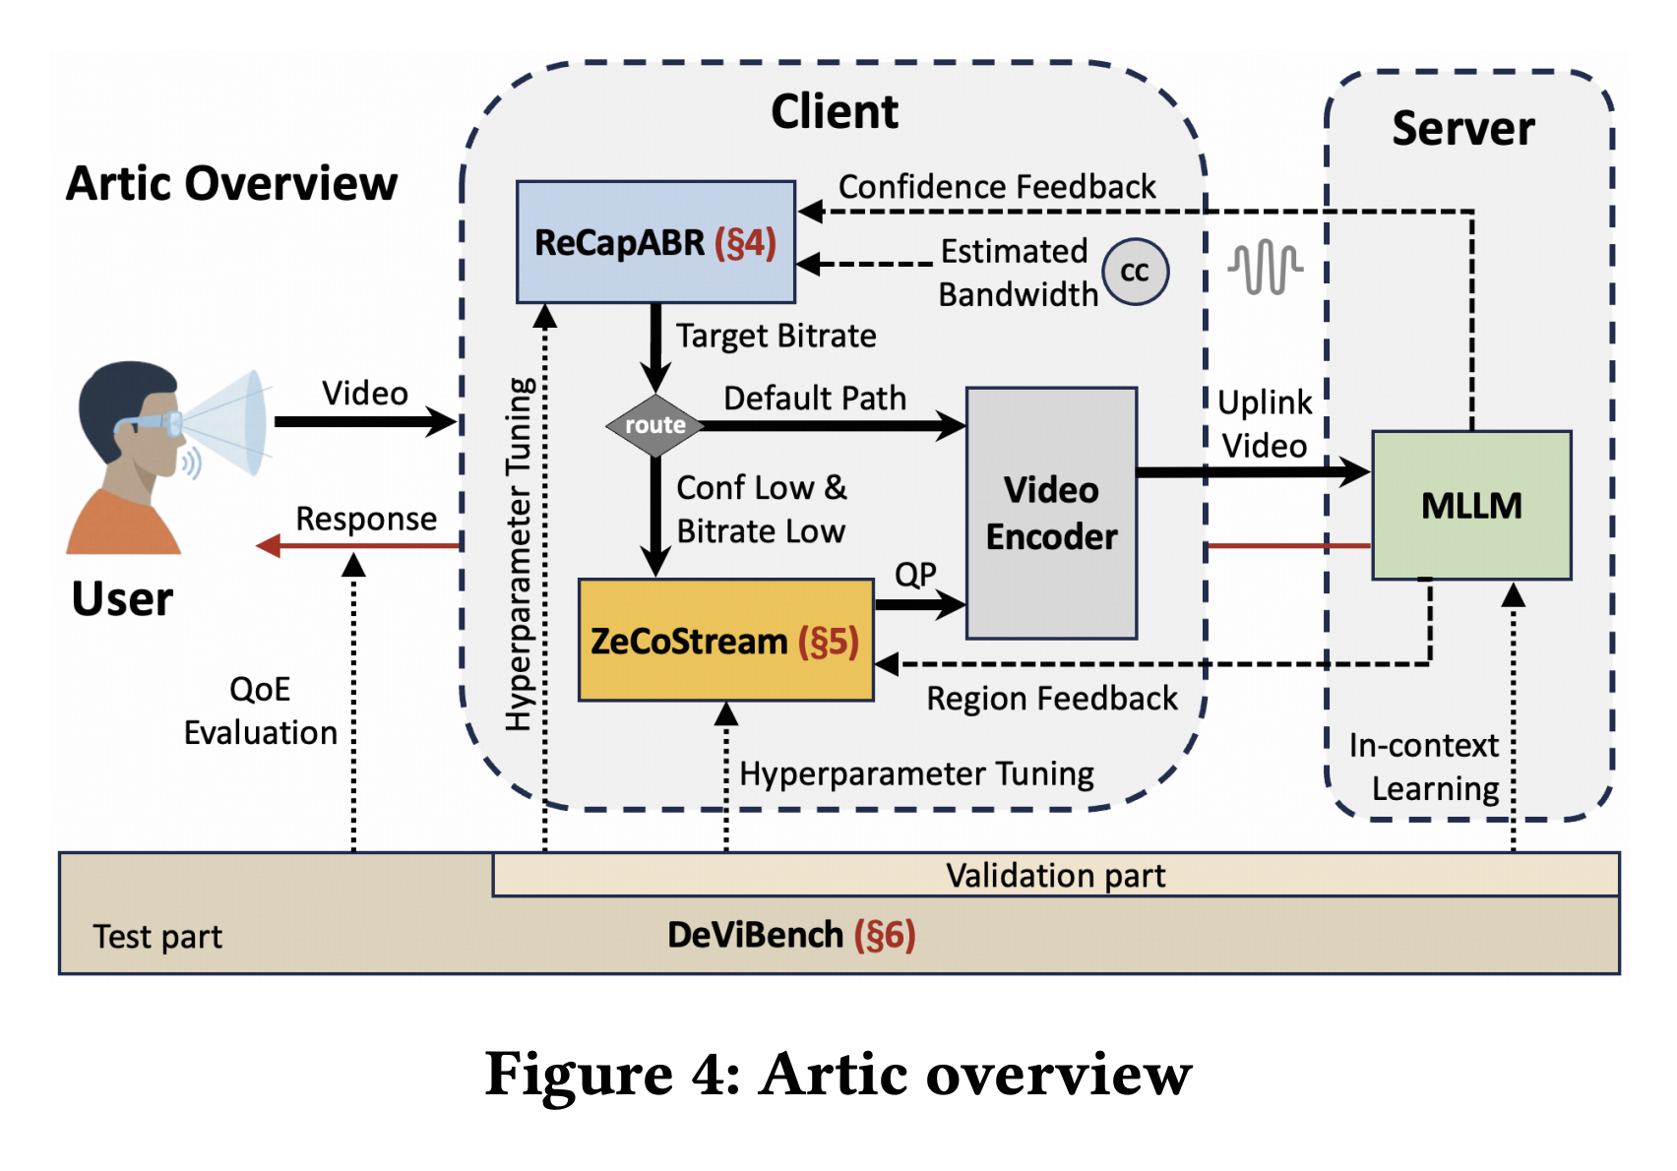
SOLUTION
Artic: the system at a glance
ReCapABR
Adapt bitrate to AI capability
ZeCoStream
Preserve answer-relevant details
Wu et al. • Artic • arXiv:2602.12641 (2026)
05
Notes:
Introduce the two parts and their relationship. ReCapABR adjusts the rate of the stream using feedback about whether AI has enough information. ZeCoStream spends the available bits on the regions relevant to the request. DeViBench tests them.

Slide 6
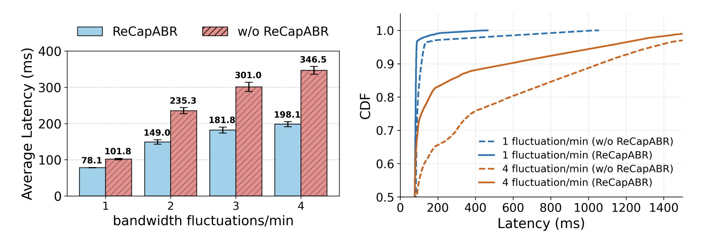
METHOD 1
ReCapABR: bitrate matched to AI needs
Use feedback about the MLLM’s response capability
Leave network headroom to absorb fluctuations
Cap bitrate once the model has sufficient information
148.4 ms
lower mean latency in a tested high-fluctuation setting
Wu et al. • Artic • arXiv:2602.12641 (2026)
06
Notes:
ReCapABR is not a universal fixed-bitrate rule. The cap follows the response capability of the MLLM. A test with four bandwidth fluctuations per minute reported a 148.4 ms average-latency reduction relative to its baseline.

Slide 7
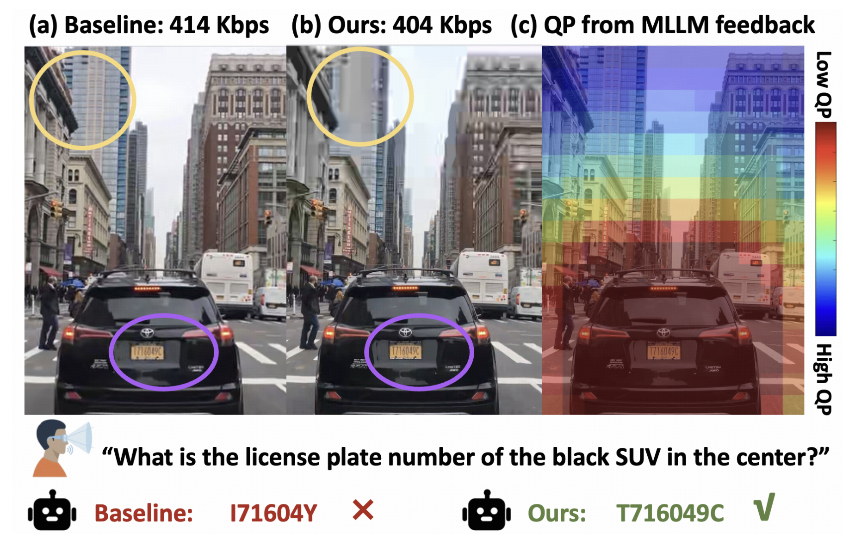
METHOD 2
ZeCoStream: spend bits where they matter
Identify objects/regions relevant to the question
Preserve important visual details while compressing other areas
Account for delayed feedback and moving objects
At 290 Kbps
39% → 60%
Answer accuracy: standard encoding → ZeCoStream
Wu et al. • Artic • arXiv:2602.12641 (2026)
07
Notes:
Use the figure to show how bitrate allocation changes spatially, not merely overall rate. At 290 Kbps, accuracy increases from 39 percent to 60 percent in the paper’s experiment. Avoid assuming all scenes benefit equally.

Slide 8
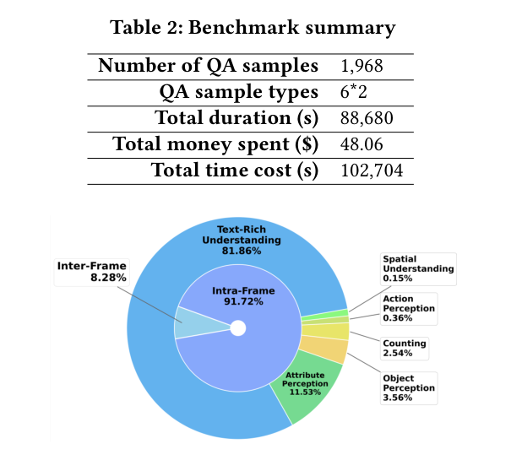
EVALUATION
DeViBench: testing answers under degraded video
1,968
validated question–answer samples
88,680 s
total video duration
Benchmarks are designed to reveal errors caused by lower-quality video.
Wu et al. • Artic • arXiv:2602.12641 (2026)
08
Notes:
This benchmark is a contribution, not just a footnote. It retains questions where degrading the input can meaningfully affect AI responses. Only 22.57 percent of initially constructed QA pairs survived the validation process.

Slide 9
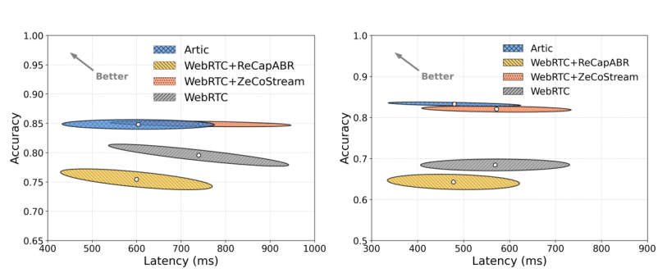
RESULTS
Overall results in real-world uplink traces
+15.12%
reported accuracy improvement
−135.31 ms
reported latency reduction
Figure 13 • Performance with BBR and GCC congestion control
Wu et al. • Artic • arXiv:2602.12641 (2026)
09
Notes:
Clearly label the 15.12 percent as the paper’s reported overall improvement; individual plotted settings can differ. Figure 13 contrasts Artic with baseline RTC under real-world traces.

Slide 10
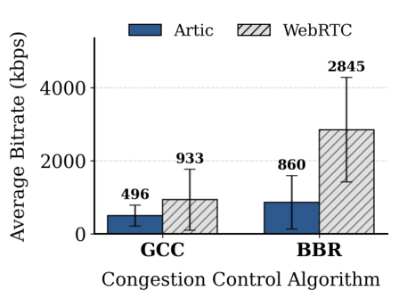
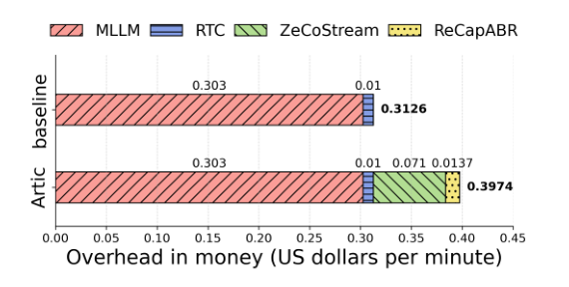
DISCUSSION
Tradeoffs: network savings, higher AI cost
Up to 69.77%
+27.13%
less bandwidth overhead (reported setting)
monetary cost: $0.3126/min → $0.3974/min
Wu et al. • Artic • arXiv:2602.12641 (2026)
10
Notes:
Discuss where the gain comes from and who pays for it. The paper reports different bandwidth-savings figures depending on the congestion-control baseline, including 46.84 and 69.77 percent. Greater encoding and AI-related overhead increases dollar cost.

Slide 11
TAKEAWAYS AND CONCLUSION
What should we take away?
Optimize video streaming for AI response quality, not only pixel quality
Combine response-aware bitrate control with content-aware encoding
Real-world traces show better accuracy and lower latency
Open question: robustness across more tasks, models, and live deployments
Main message: the “best” video stream depends on what the AI needs to answer.
Which matters more for an AI video assistant:
better video quality or better answers?
Wu et al. • Artic • arXiv:2602.12641 (2026)
11
Notes:
Conclude with the paradigm shift from human-oriented RTC to AI-oriented RTC. Mention that model feedback and evaluation coverage are open challenges.

