Slide 1

SMUFF
Faster file transfers
between nearby devices
Gannon Wooley
CIS5930 · Future Edge Technology
Notes:
This presentation covers SMUFF. Its full title is Towards Line Rate Wi-Fi Direct Transport with Orchestrated On-device Buffer Management. The everyday problem that this team wanted to solve is simple: two nearby phones may have a fast wireless connection, but a file still transfers more slowly than the connection should allow. SMUFF asks how software inside the devices can better use that capacity. We’re going to focus on where the system fits, the assumptions it changes, the evidence, and the broader research opportunities.

Slide 2
A fast wireless link can still transfer files slowly
655 Mbps
The opportunity
Improve the software path so the transfer uses more of the available wireless capacity.
Practical line-rate benchmark
442 Mbps
TCP CUBIC average throughput
One pilot setting in §2.3, not a universal Wi-Fi speed.
02
Notes:
Imagine transferring a large video or game asset between two nearby devices. The radio is only one part of the process. In one pilot measurement in this paper, the practical wireless line rate was 655 megabits per second, but TCP CUBIC averaged 442. Line rate here means the practical link capacity used as the paper’s benchmark, after wireless overhead, rather than the advertised physical radio rate. Throughput means the useful delivery rate achieved by the transfer. These numbers describe one setting, not every Wi-Fi connection. The gap motivates research into the transport software. Faster completion also matters for battery-powered devices and local sharing that avoids a cloud transfer.

Slide 3
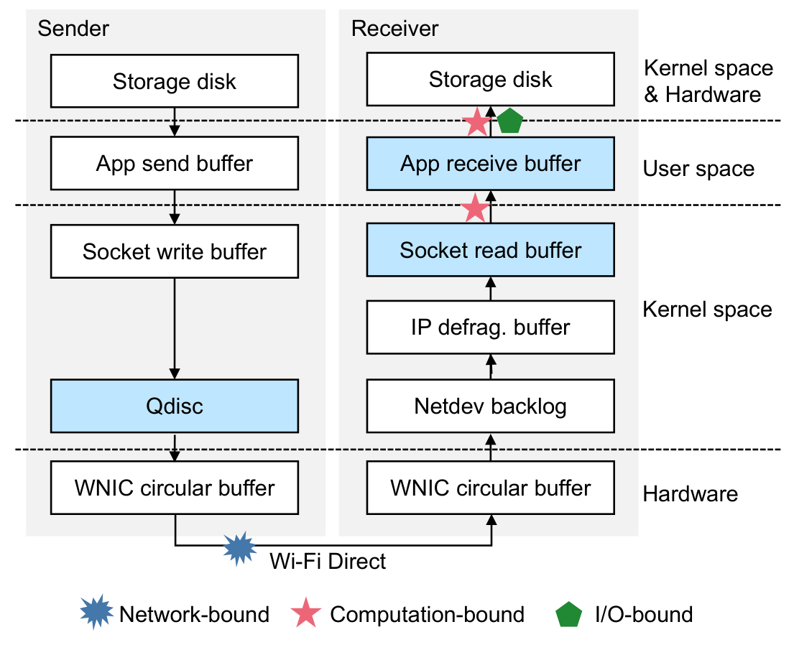
Where SMUFF fits
Buffer
Temporary storage for data waiting to be processed or transmitted.
SMUFF’s role
Coordinate the on-device data path over an existing Wi-Fi Direct link.
Original Figure 1, p. 1370. Blue queues are vulnerable to overflow.
03
Notes:
Wi-Fi Direct lets nearby devices establish a direct wireless connection without an external access point forwarding the data. It supplies the wireless link, but applications still need a way to transfer files reliably. This figure shows the path through the sender and receiver. Data moves through applications, operating-system queues, wireless hardware, and storage. A buffer is temporary storage for data waiting for the next stage. SMUFF is a file-transfer system service on the devices. It uses UDP (User Datagram Protocol which sends packets without guaranteeing that they even arrive or arrive in the correct order) and adds its own reliability and sending-rate control. It does not replace the Wi-Fi radio. Its opportunity is coordinating the software above that existing link.

Slide 4
Why existing transport leaves capacity unused
Issue | Why it matters here
Cost of reliable delivery | Frequent acknowledgments consume airtime and processing
Conservative rate control | Startup and reactions to wireless loss can reduce throughput
Incomplete buffer visibility | Other queues may overflow or run empty
The design assumptions of a long Internet path may be inefficient on a direct link.
04
Notes:
The paper identifies three related problems. First, reliable delivery has a cost. Acknowledgments tell the sender what arrived, but too many of them compete with data traffic on the wireless channel. Packet processing also uses CPU time. Second, general transport algorithms probe capacity and react to loss. Those choices make sense on many Internet paths, but can underuse this short direct link. Third, looking at only the transport buffer misses other queues that may fill or run empty. This doesn’t mean TCP or QUIC are universally bad, it just means that this particular environment offers information and control that a more specialized design can utilize more efficiently.

Slide 5
The opportunity: both endpoints can expose state
General Internet transport
Direct device-to-device transport
Infer conditions along a path with intermediate devices.
Use reported queue state from the cooperating endpoints.
Sending rate should follow the bottleneck in the entire data path.
05
Notes:
On a long Internet path, a sender usually cannot inspect all the intermediate routers. It estimates what is happening from delay, loss, and acknowledgments. Here the data path is inside two cooperating devices connected by one wireless hop. SMUFF is able to collect information about the critical on-device queues and use it to decide how fast to send. A good analogy to better explain is a production line whose workstations report how much work is waiting. That lets the first workstation avoid sending too little or overwhelming the next one. Obviously there are still wireless fluctuations and hardware limitations, but the opportunity gained is better visibility of the relevant queues, not perfect knowledge of every hidden hardware buffer.

Slide 6
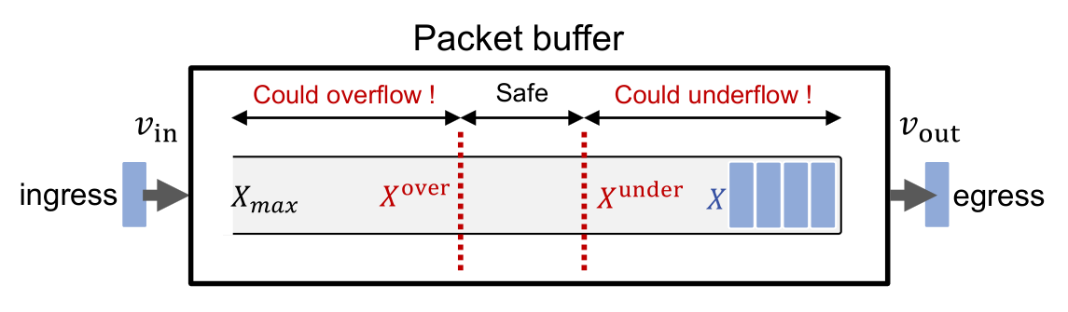
The key idea: a safe buffer range
Too much queued
Too little queued
The queue can overflow and drop data.
The bottleneck can run out of work.
Original Figure 7, p. 1374. The safe range accounts for control delay.
06
Notes:
To keep the analogy going, think of a buffer as a waiting area before the slowest workstation. If the waiting area is empty, that workstation may sit idle and capacity goes unused. If it is completely full, new arrivals can be dropped. SMUFF tries to keep the bottleneck buffer within a safe range: enough data to keep it busy, with enough room to absorb changes. This figure is the paper’s single-buffer illustration. We can ignore its equations and symbols for this overview. The safe range also accounts for feedback delay, because a reported queue state may already be outdated when the sender acts on it. SMUFF extends this reasoning across multiple buffers.

Slide 7
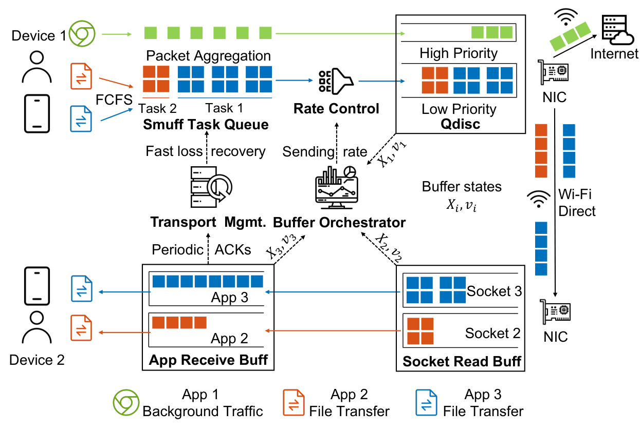
SMUFF’s system architecture
Buffer orchestrator
Observe queues and choose the sending rate.
Transport manager
Deliver the file reliably and recover missing data.
Original Figure 6, p. 1373. The service runs on the communicating devices.
07
Notes:
This is the original SMUFF overview. We’re just going to focus on two components. The buffer orchestrator collects queue information and calculates the sending rate. The transport manager ensures that the file arrives reliably and recovers missing data. Applications submit file-transfer tasks to the service, which schedules them. The receiver is going to report its state periodically. SMUFF reduces routine acknowledgment frequency but can ask for retransmission quickly when it detects a loss. It also gives foreground traffic higher priority to reduce interference with other activities. These features work together: rate control prevents unnecessary loss, while recovery handles loss that still occurs over wireless.

Slide 8
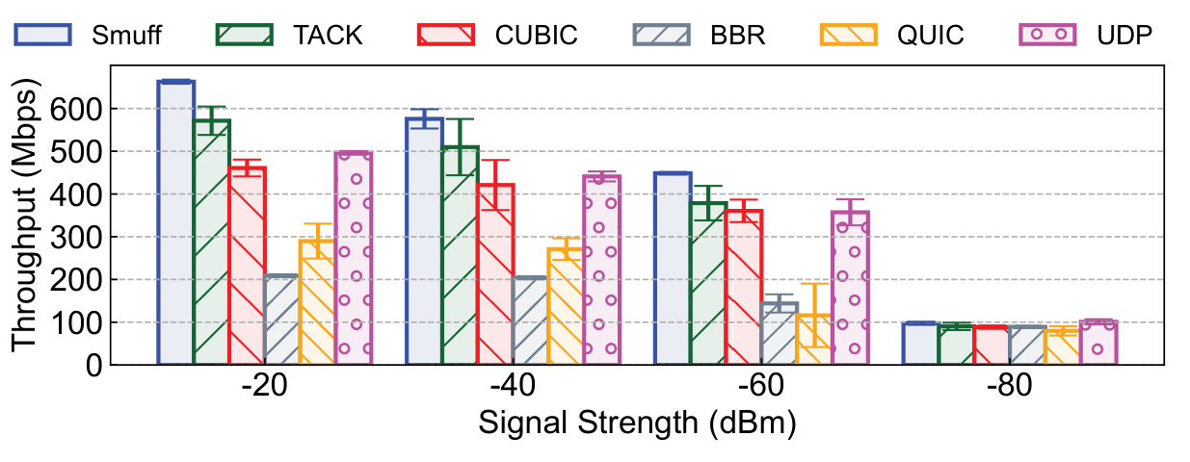
Results across signal conditions
Reading it
Higher bars are better.
More negative dBm means a weaker signal.
The gain narrows at very weak signal strength.
Original Figure 11, p. 1378. 1 GB transfer. UDP does not guarantee delivery.
08
Notes:
This is Figure 11 from the paper. The graph is showing a comparison between multiple types of data transfer protocols. The horizontal axis represents signal strength: more negative values meaning a weaker signal. The vertical axis is throughput in megabits per second, so higher megabits per second, the better. Focus on the blue SMUFF bars and compare them with the other methods in each group. In the reported good-signal settings, the text reports a 17.8 to 18.2 percent improvement over TACK, a TCP variant designed for wireless networks. At the weakest signal, the methods become much closer. UDP appears as a baseline, but it does not provide reliable delivery, so it is not equivalent to a reliable file-transfer service. These tests transfer a one-gigabyte file. As you can see, Smuff is consistently outperforming the other data transfer protocols, with better signal strength resulting in a larger gap.

Slide 9
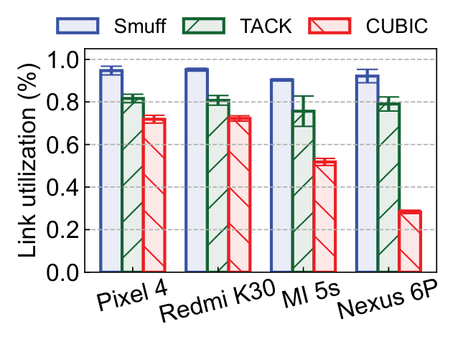
Results across four phone models
94.7%
of practical line rate
at best in this test
Four sender models
Pixel 4 receiver
Original Figure 13, p. 1378. Axis value 1.0 represents 100% utilization.
09
Notes:
This original graph compares SMUFF with TACK and TCP CUBIC on four phone models. Link utilization means achieved throughput divided by the practical line rate. The figure uses fractions: 1.0 means 100 percent. SMUFF achieves up to 94.7 percent in this experiment. That is a best observed result, not the average across every condition. The study changes the sender model while using a Pixel 4 as the receiver. This supports portability across the tested devices, but does not prove the same outcome on every phone. Most experiments elsewhere use two Pixel 4 devices, and the researchers repeat each test 30 times. Like the previous graph, we’re seeing Smuff outperform the other options by pretty good margins, CUBIC being the biggest difference.

Slide 10
Deployment and tradeoffs
Practical deployment
Important tradeoffs
Android system service
Standard system APIs
No proprietary hardware or kernel changes for SMUFF
More queued data can add delay
Foreground traffic still needs protection
Aggregation helps efficiency but increases loss sensitivity
The evaluation focuses on reliable bulk transfer over a direct link.
10
Notes:
The implementation is a userspace Android system service. The authors report that it uses standard APIs and needs no proprietary hardware or kernel modification for SMUFF itself. This is a deployment strength, but userspace system service should not be confused with a guarantee that any ordinary phone app can install it without platform integration. There are tradeoffs. Keeping data queued can add latency or compete with other traffic. Prioritization helps, but the paper reports that it cannot fully remove the impact because firmware buffers do not provide the same control. Packet aggregation also saves processing, but makes loss more costly, so SMUFF goes ahead and disables it above a loss threshold.

Slide 11
Where SMUFF fits in the research landscape
Research direction | What it contributes
Queue-based transport | Use queue information to guide the sending rate
Wireless reliability and acknowledgments | Handle loss while reducing channel contention
Wireless capacity estimation | Track a link whose speed changes over time
SMUFF’s position | Coordinate critical endpoint buffers on a direct link
11
Notes:
The related-work section shows several research directions around transport. Queue-based approaches use information from queues to improve rate decisions, often relying on feedback from network devices. Wireless transport designs address distinctive wireless problems, such as losses and competition between acknowledgments and data. Other systems estimate changing wireless capacity from observations like arrivals and delay. SMUFF fits into this landscape by exploiting direct access to critical queues on cooperating endpoints. The broader theme is that a network architecture gives researchers several things to redesign: what to measure, where to measure it, how to communicate feedback, and what objective the controller should optimize.

Slide 12
Research opportunities the paper opens
Opportunity | Research question
Other direct links | Which assumptions still hold on a different link technology?
Interactive applications | How should the controller balance speed and delay?
Hardware queue visibility | Can better feedback protect foreground traffic more effectively?
More shared resources | What changes when multiple devices or transfers compete?
Extensions and discussion questions, not results demonstrated for all these settings.
12
Notes:
The paper discusses extending the approach to other one-hop networks and applications such as video streaming. Those are possible extensions, rather than broadly validated results in this evaluation. We can build further questions from that idea. How should the controller balance throughput against latency for interactive traffic? Could more visibility into hardware queues improve coexistence with other flows? Would the design still work well when several devices or transfers share resources? The last question changes the assumptions, so it needs new evaluation and likely new control policies. These opportunities connect the work to future edge and device-to-device systems without claiming that SMUFF already solves general 5G transport.

Slide 13
The bigger lesson
Fast hardware needs
coordinated software.
SMUFF uses buffer feedback to keep the bottleneck busy without overwhelming the data path.
Discussion: how much responsiveness should a device trade for a faster file transfer?
13
Notes:
The main lesson is that a faster radio does not automatically produce a faster application. SMUFF improves reliable file transfer by coordinating the buffers and rates throughout the on-device path. The direct-link architecture makes useful queue information available to the controller. The results show high utilization in the tested scenarios, while the limitations remind us that bulk-transfer speed is only one goal. For discussion, consider this: if a file transfer finishes sooner but another app becomes less responsive, has the system improved? The answer depends on the application’s needs, which is exactly why architecture remains a research platform rather than a finished system to memorize.

Slide 14
Source and figure credits
Chengke Wang et al. · USENIX NSDI 2024
SMUFF: Towards Line Rate Wi-Fi Direct Transport
with Orchestrated On-device Buffer Management
Proceedings, pp. 1369–1383
https://www.usenix.org/conference/nsdi24/presentation/wang-chengke
Original figures used: 1, 6, 7, 11, and 13
Research proposals are labeled separately from reported results.
14

