Slide 1
Concurrency: Processes and Threads
Xin Liu
xl24j@fsu.edu
COP 4610 Operating Systems

Slide 2
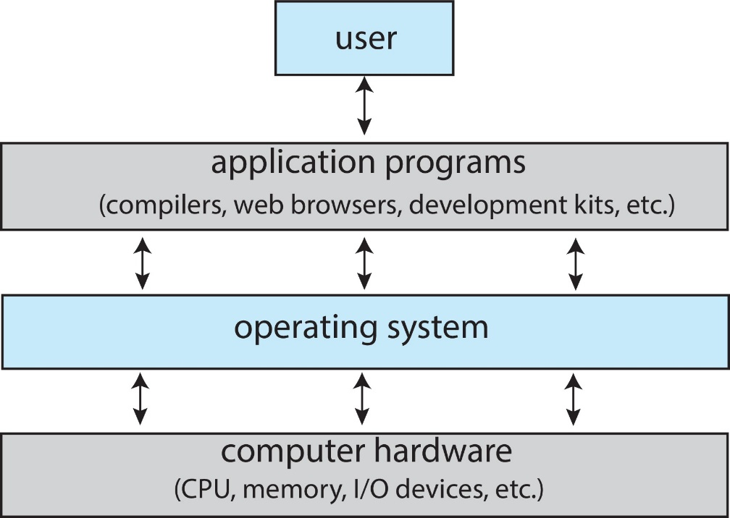
Abstract View of Components of Computer
OS is a program that acts as an intermediary between a user of a computer and the computer hardware.
OS hides the complexity and limitations of hardware from application programmers.

Slide 3
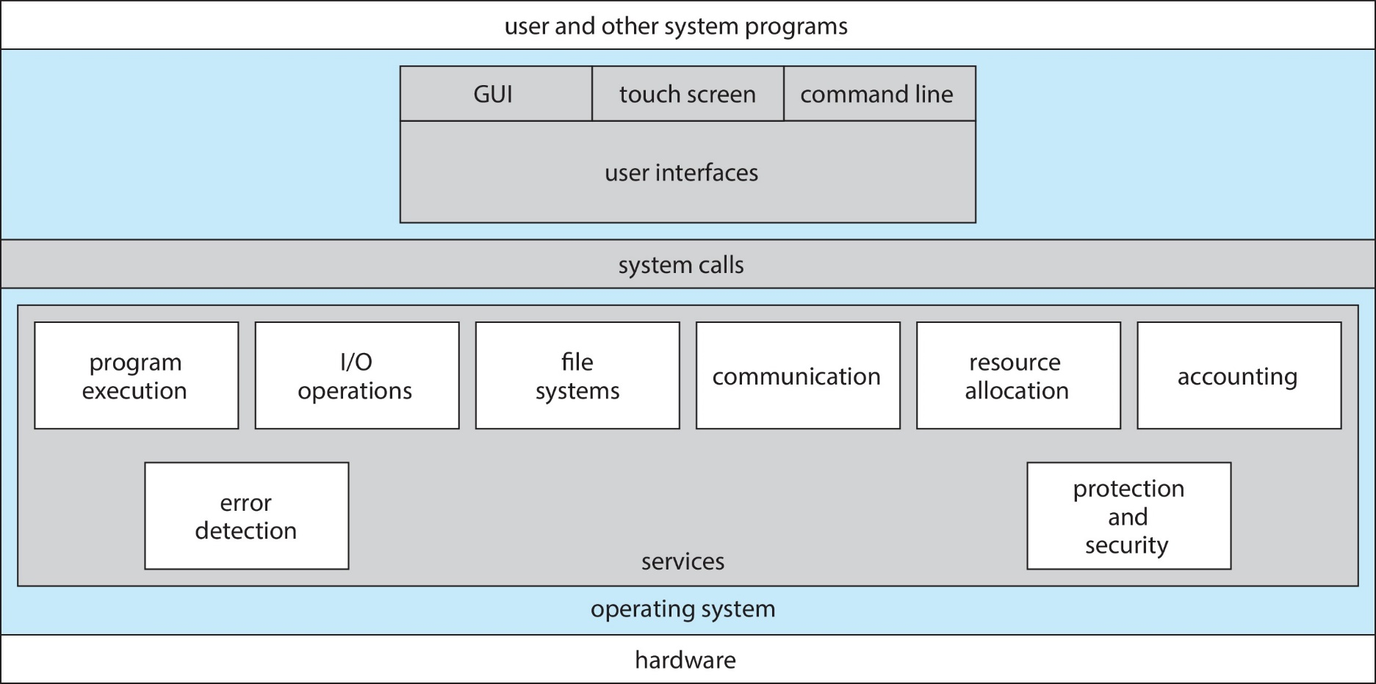
A View of Operating System Services

Slide 4
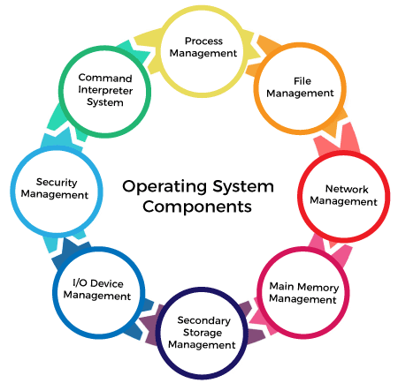
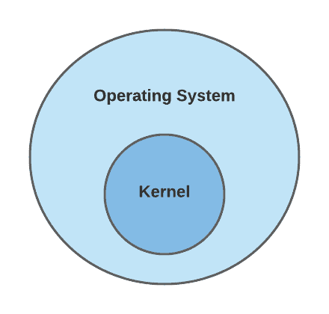
Kernel: The Core of the Operating System

Slide 5
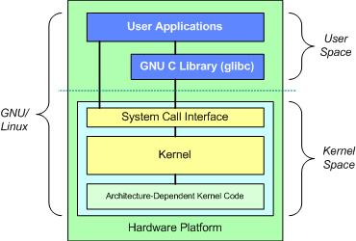
Dual-Mode Operations: Kernel Space and User Space
A mechanism to protect apps from crashing the OS
Kernel space is the memory area where the operating system kernel runs, with the highest level of privileges.
Function: Manages system resources such as memory, CPU, and device drivers.
Security: Due to its high privileges, kernel space code must be very stable and secure; any errors can cause system crashes.
Access: Only code running in kernel mode can access kernel space; user mode code cannot directly access it.
User space is the memory area where regular applications run, with lower privileges.
Function: Runs user applications like browsers, text editors, etc.
Security: Errors in user space typically do not affect the overall system stability due to its lower privileges.
Access: Code running in user mode can only access user space and must use system calls to interact with the kernel.
Important

Slide 6
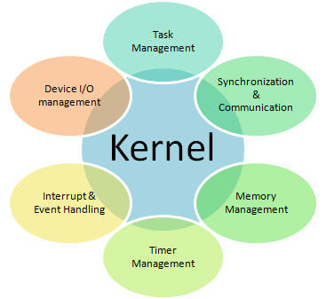
Understanding the Kernel
Task Management: Schedules and manages processes.
Memory Management: Allocates memory to processes.
Device I/O Management: Controls interactions with external devices.
Synchronization & Communication: Ensures smooth process interaction.
Interrupt & Event Handling: Responds to hardware events and interrupts.
Timer Management: Manages system time and timers.

Slide 7
Kernel Design and Trends
Monolithic, Layered, Microkernel, Modular
Trend: Hybrid (Based on the microkernel, driven by the rise of distributed networks, enabling platforms like smart watches, smart TVs, and laptops to run the same OS kernel while loading corresponding modules, including monolithic ones.)
Important

Slide 8

Why Concurrency?
Allows multiple applications to run at the same time
Analogy: juggling
What is an applications?
A Program that runs on the OS.

Slide 9
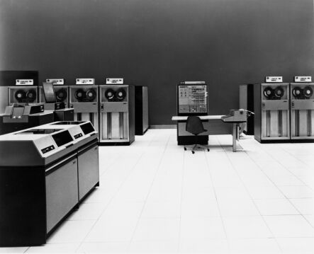
History Phase I: Hardware Expensive, Humans Cheap
Hardware: mainframes
OS: human operators
Handle one job (a unit of processing) at a time
Computer time wasted
while
operators walk around
the machine room
IBM System/360

Slide 10
OS Design Goal in Phase I
Efficient use of the hardware
Batch System:
Collects a batch of jobs before processing and processes them sequentially
Emphasizes throughput by reducing idle time during job collection and processing.
Multiprogramming:
Allows multiple programs to run simultaneously, improving CPU utilization by switching between jobs.
Efficiently handles both I/O-bound and CPU-bound jobs, minimizing idle CPU time.
Key Point: Focuses on maximizing system resource usage by running multiple tasks concurrently.

Slide 11
Why Concurrency?
Allows multiple applications to run at the same time
Analogy: juggling
What is an applications?
A Program that runs on the OS.

Slide 12
Abstract View of Components of Computer
OS is a program that acts as an intermediary between a user of a computer and the computer hardware.
What is a program?

Slide 13
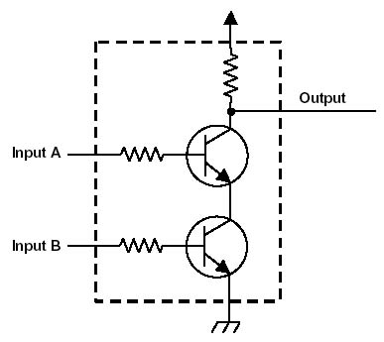
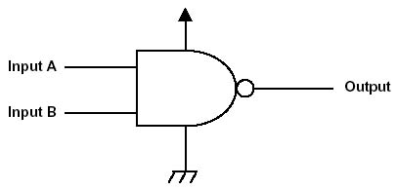
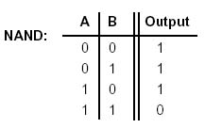
One Logic Gate
Truth Table

Slide 14
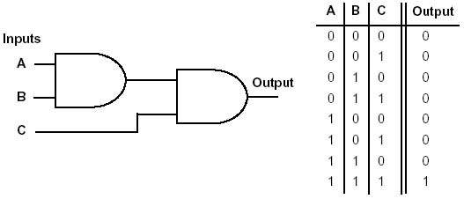
Two Logic Gates
Truth Table

Slide 15
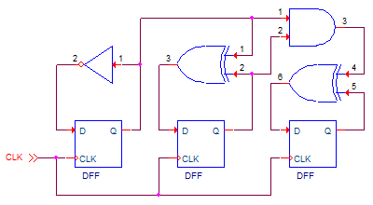
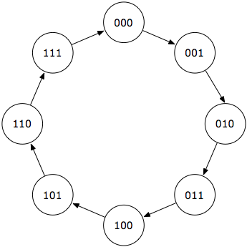
More Logic Gates
Q₂ | Q₁ | Q₀ | D₂ | D₁ | D₀
0 | 0 | 0 | 0 | 0 | 1
0 | 0 | 1 | 0 | 1 | 0
0 | 1 | 0 | 0 | 1 | 1
0 | 1 | 1 | 1 | 0 | 0
1 | 0 | 0 | 1 | 0 | 1
1 | 0 | 1 | 1 | 1 | 0
1 | 1 | 0 | 1 | 1 | 1
1 | 1 | 1 | 0 | 0 | 0
Truth Table
Finite State Machine

Slide 16
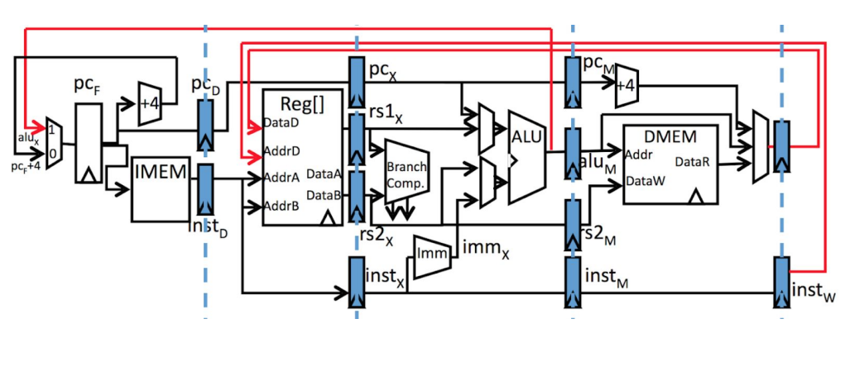
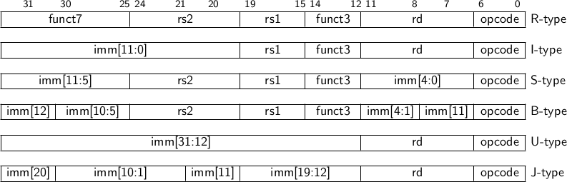
Millions of Logic Gates
RISC-V-RV32I

Slide 17
From CPU to Program
CPU is a state machine.
A program running on a CPU is inevitably also a state machine

Slide 18
State in the State Machine of Program
Program Counter (PC): It indicates the position of the instruction currently being executed.
Register State: The current values of all registers, including general-purpose and specialized registers.
Memory State: The data stored in the program's memory, especially the values of local variables, global variables, etc.
Input/Output State: The interaction state of the program with external devices, such as the keyboard or display.
Stack State: The current state of the function call stack, including function calls, local variables, return addresses, etc.

Slide 19
From the Application’s Perspective
How an application works:
Processing Computations and Logic:
Applications directly execute logic and arithmetic operations via the CPU, handling internal data and state changes, such as computation results, conditional checks, variable assignments, etc.
When an application needs hardware resources, it makes a system call.
The application passes its state to the OS.
The OS manages hardware and returns control to the application
Computation -> System Call -> Computation -> System Call …
OS hides the complexity and limitations of hardware from application programmers.

Slide 20
Example: Smallest size HelloWorld.c
#include <stdio.h>
int main()
{
printf("Hello, OS World!\n");
}
#include <sys/syscall.h>
.globl _start
_start:
movq $1, %rax # write(
movq $1, %rdi # fd=1,
movq $st, %rsi # buf=st,
movq $(ed - st), %rdx # count=ed-st,
syscall # )
movq $60, %rax # exit(
movq $1, %rdi # status=1
syscall # )
st:
.ascii "\033[01;31mHello, OS World\033[0m\n"
ed:
>gcc helloworld.c
>gcc –verbose helloworld.c
>ls –l a.out
15960 bytes
>gcc helloWorld_asm.s -c && ld helloWorld_asm.o
>ls –l a.out
4856 bytes

Slide 21
Why Concurrency?
Allows multiple applications to run at the same time
Analogy: juggling
Program is a state machine.
What is the red ball?
A State.

Slide 22
Benefits of Concurrency
Better performance
One application uses only the processor
One application uses only the disk drive
Completion time is shorter when running both concurrently than consecutively

Slide 23
Drawbacks of Concurrency
Applications need to be protected from one another
Additional coordination mechanisms among applications
Overhead to switch among applications
Potential performance degradation when running too many applications

Slide 24
Thread
A sequential execution stream
The smallest CPU scheduling unit
Can be programmed as if it owns the entire CPU
Implication: an infinite loop within a thread won’t halt the system
Illusion of multiple CPUs on a single-CPU machine

Slide 25
Thread Benefits
Simplified programming model per thread
Example: Microsoft Word
One thread for grammar check; one thread for spelling check; one thread for formatting; and so on…
Can be programmed independently
Simplifies the development of large applications

Slide 26
Address Space
Contains all states necessary to run a program
Code, data, stack
Program counter
Register values
Resources required by the program
Status of the running program
A mechanism to protect one app from crashing another app

Slide 27
Process
An address space + at least one thread of execution
Address space offers protection among processes
Threads offer concurrency
A fundamental unit of computation

Slide 28
Process =? Program
Program: a collection of statements in C or any programming languages
Process: a running instance of the program, with additional states and system resources
Two processes can run the same program
The code segment of two processes are the same program
A program can create multiple processes
Example: gcc, chrome

Slide 29
Real-life Analogy?
Program: a recipe
Process: everything needed to cook
e.g., kitchen
Two chefs can cook the same recipe in different kitchens
One complex recipe can involve several chefs

Slide 30
Some Definitions
Uniprogramming: running one process at a time
Multiprogramming: running multiple processes on a machine

Slide 31
Some Definitions
Multithreading: having multiple threads per address space (threads share the same address space)
Multiprocessing: running programs on a machine with multiple processors
Multitasking: a single user can run multiple processes

Slide 32
Classifications of OSes
 | Single address space | Multiple address spaces
Single thread | MS DOS, Macintosh | Traditional UNIX
Multiple threads | Embedded systems | Windows, iOS

Slide 33
Threads & Thread Control Block
A thread owns a thread control block
Execution states of the thread
The status of the thread
Running or sleeping
Scheduling information of the thread
e.g., priority

Slide 34
Threads & Dispatching Loop
Threads are run from a dispatching loop
Can be thought as a per-CPU thread
LOOP
Run thread
Save states
Choose a new thread to run
Load states from a different thread
Context
switch
Scheduling

Slide 35
Simple? Not quite…
How does the dispatcher regain control after a thread starts running?
What states should a thread save?
How does the dispatcher choose the next thread?

Slide 36
How does the dispatcher regain control?
Two ways:
Internal events (“Sleeping Beauty”)
Yield—a thread gives up CPU voluntarily
A thread is waiting for I/O
A thread is waiting for some other thread
External events
Interrupts—a complete disk request
Timer—it’s like an alarm clock

Slide 37
What states should a thread save?
Anything that the next thread may trash before a context switch
Program counter
Registers
Changes in execution stack

Slide 38
How does the dispatcher choose the next thread?
The dispatcher keeps a list of threads that are ready to run
If no threads are ready
Dispatcher just loops
If one thread is ready
Easy

Slide 39
How does the dispatcher choose the next thread?
If more than one thread are ready
We choose the next thread based on the scheduling policies
Examples
FIFO (first in, first out)
LIFO (last in, first out)
Priority-based policies

Slide 40
How does the dispatcher choose the next thread?
Additional control by the dispatcher on how to share the CPU
Suppose we have three threads
Run to completion
A
B
C
Time
Timeshare the CPU
A
B
C
A
B
C
A
C
A
C
Time

Slide 41
Per-thread States
Each thread can be in one of the three states
Running: has the CPU
Blocked: waiting for I/O or another thread
Ready to run: on the ready list, waiting for the CPU

Slide 42
Per-thread State Diagram
Running
Scheduled
I/O request
Yield, timer
Ready
Blocked
I/O complete
Important

Slide 43
For Multi-core Machines
Each core has a dispatcher loop
Decide which thread will execute next
One core has a global dispatcher loop
Decide which core to execute a thread

Slide 44
Parallelism vs. Concurrency
Parallel computations
Computations can happen at the same time on separate cores
Concurrent computations
One unit of computation does not depend on another unit of computation
Can be done in parallel on multiple cores
Can time share a single core (not parallel)

Slide 45
Real-life Example
Two hands are playing piano in parallel (not concurrently)
Notes from left and right hands are dependent on each other
Two separate groups singing ‘row row row your boat’ concurrently (and in parallel)

Slide 46

Amdahl’s Law
Identifies potential performance gains from adding cores
P = % of program that can be executed in parallel
N = number of cores
$speedup ≤ \frac{1}{(1−P)+ \frac{P}{N}}$
Important

Slide 47

Amdahl’s Law
Example
P = 75% of program that can be executed in parallel
N = 2 cores
$speedup ≤ \frac{1}{(1−0.75) + \frac{0.75}{2}}$ = 1.6

Slide 48
Takeaways
OS is a state machine.
Process, Thread, Address Space
Thread Dispatch Loop
Amdahl’s Law

