Slide 1
Lecture 21: Computer Networks

Slide 2
Computer Networks
Advantages of Distributed Systems
Network Structure
Communication Structure
Mobile Network

Slide 3
Overview
A computer network is a collection of loosely coupled nodes interconnected by a communications network
Nodes variously called processors, computers, machines, hosts
Site is location of the machine, node refers to specific system
Generally a server has a resource a client node at a different site wants to use

Slide 4
Overview (Cont.)
Nodes may exist in a client-server, peer-to-peer, or hybrid configuration.
In client-server configuration, server has a resource that a client would like to use
In peer-to-peer configuration, each node shares equal responsibilities and can act as both clients and servers
Communication over a network occurs through message passing
All higher-level functions of a standalone system can be expanded to encompass a distributed system

Slide 5
Reasons for Computer Network
Resource sharing
Sharing files or printing at remote sites
Processing information in a distributed database
Using remote specialized hardware devices such as graphics processing units (GPUs)
Computation speedup
Distribute subcomputations among various sites to run concurrently
Load balancing – moving jobs to more lightly-loaded sites
Reliability
Detect and recover from site failure, function transfer, reintegrate failed site

Slide 6
Network Structure
Local-Area Network (LAN) – designed to cover small geographical area
Consists of multiple computers (workstations, laptops, mobile devices), peripherals (printers, storage arrays), and routers providing access to other networks
Ethernet and/or Wireless (WiFi) most common way to construct LANs
Ethernet defined by standard IEEE 802.3 with speeds typically varying from 10Mbps to over 10Gbps
WiFi defined by standard IEEE 802.11 with speeds typically varying from 11Mbps to over 400Mbps.
Both standards constantly evolving

Slide 7
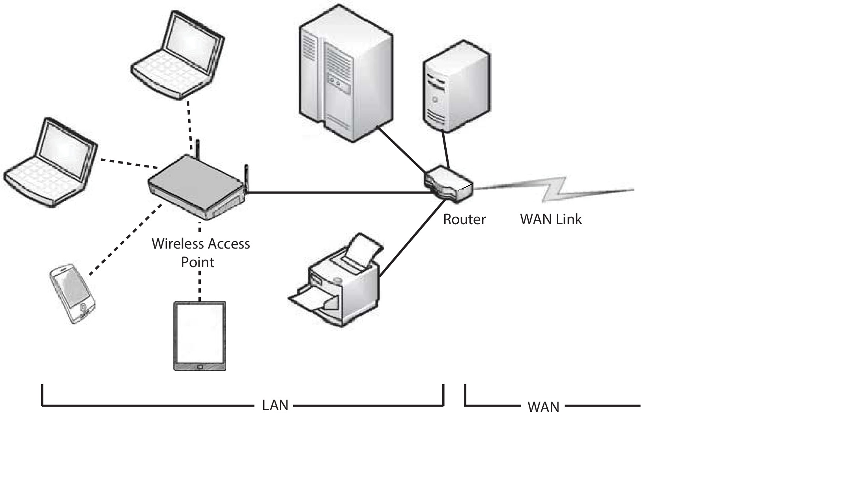
Local-Area Network (LAN)

Slide 8
Network Structure (Cont.)
Wide-Area Network (WAN) – links geographically separated sites
Point-to-point connections via links
Telephone lines, leased (dedicated data) lines, optical cable, microwave links, radio waves, and satellite channels
Implemented via routers to direct traffic from one network to another
Internet (World Wide Web) WAN enables hosts world wide to communicate
Speeds vary
Many backbone providers have speeds at 40-100Gbps
Local Internet Service Providers (ISPs) may be slower
WAN links constantly being upgraded
WANs and LANs interconnect, similar to cell phone network:
Cell phones use radio waves to cell towers
Towers connect to other towers and hubs

Slide 9
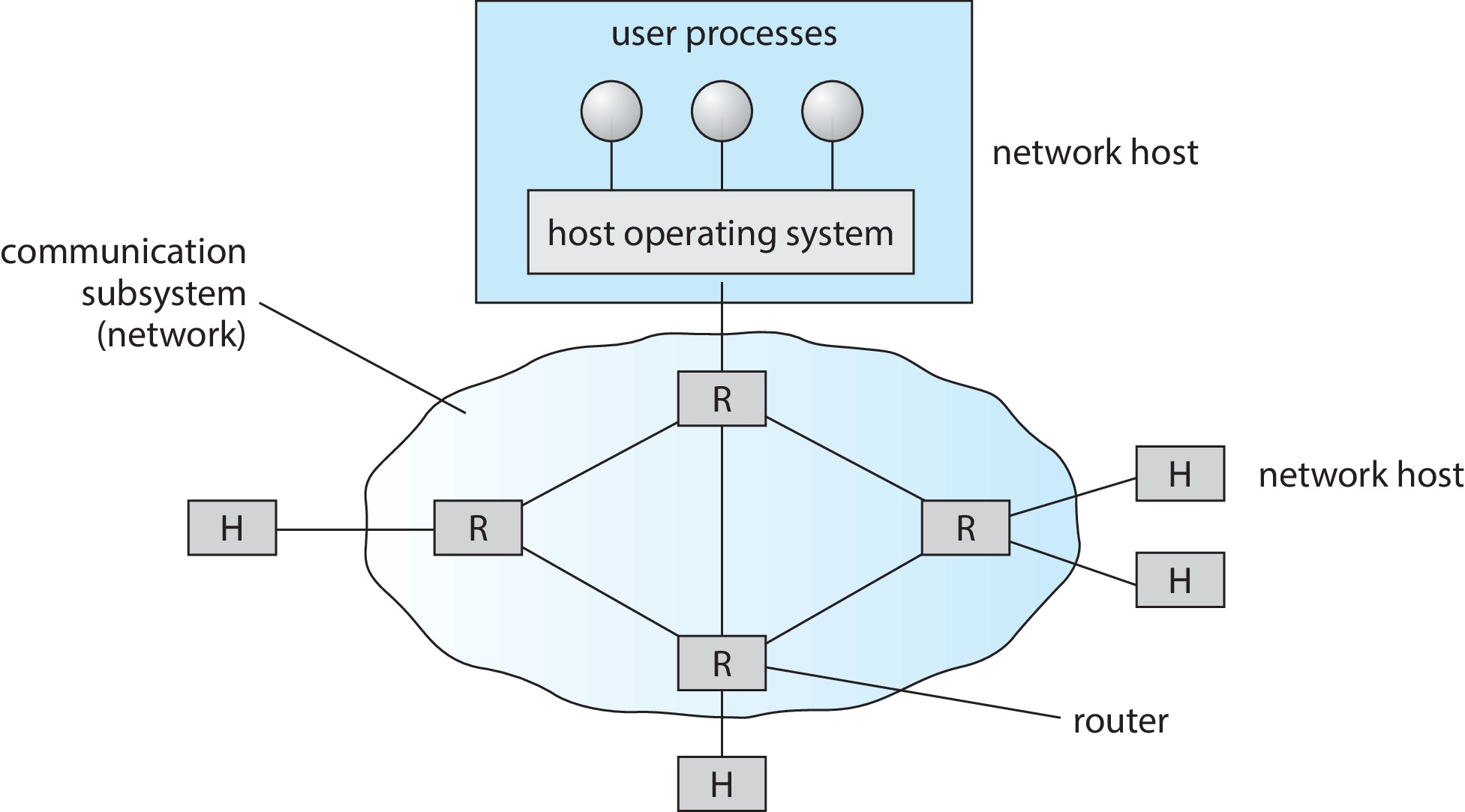
Wide-Area Network (WAN)

Slide 10
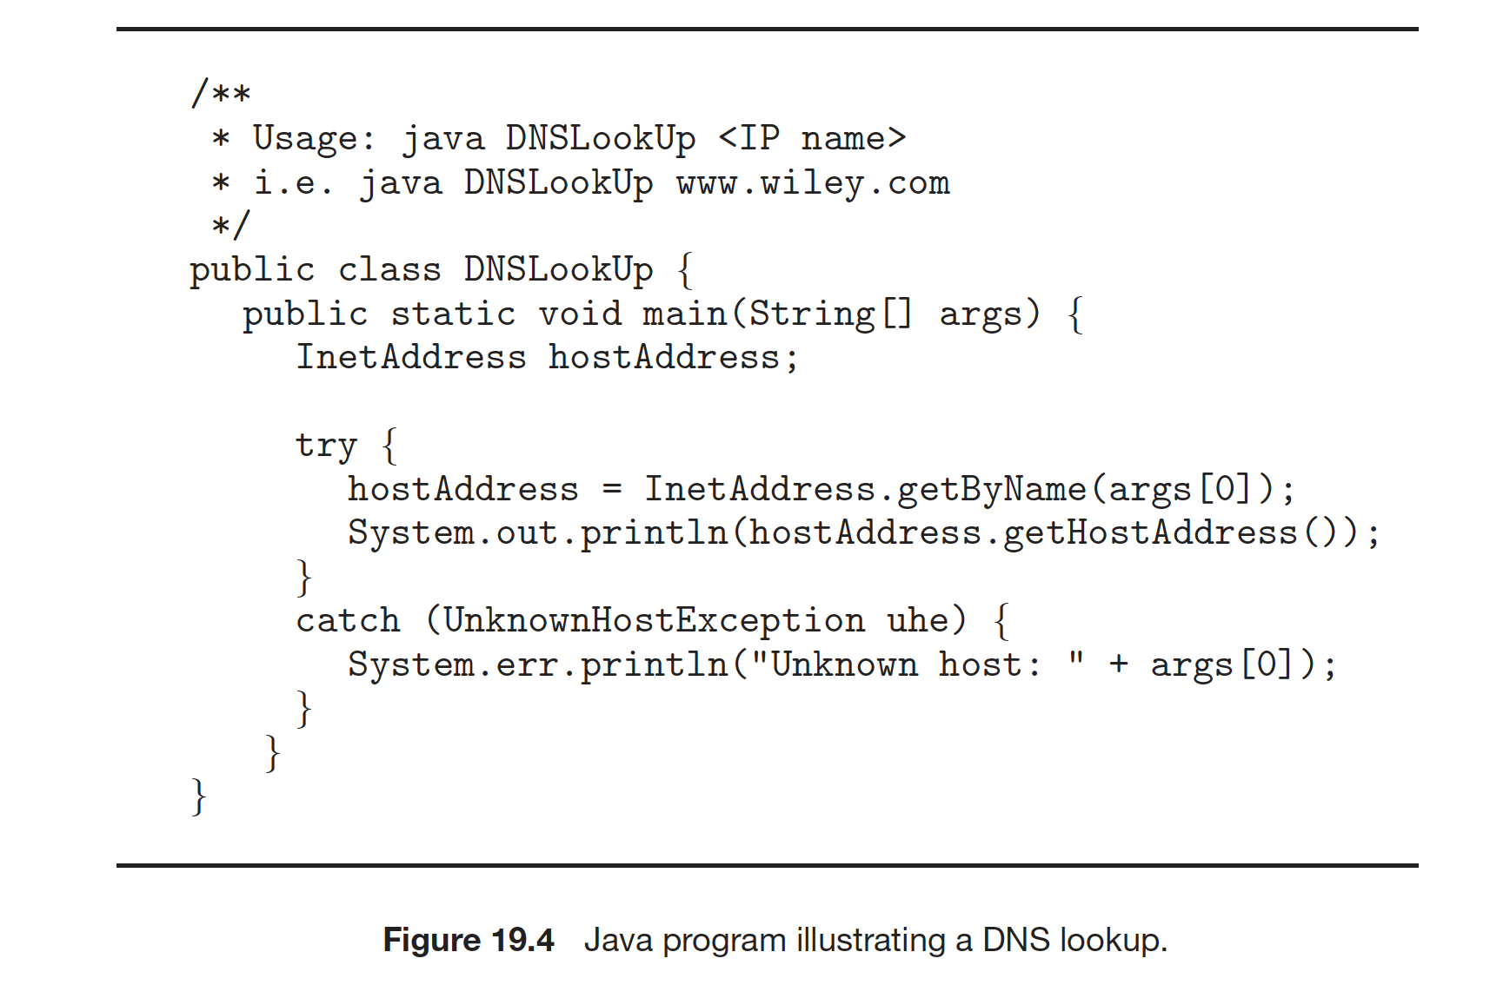
Naming and Name Resolution
Each computer system in the network has a unique name
Each process in a given system has a unique name (process-id)
Identify processes on remote systems by
<host-name, process-id> pair
Domain name system (DNS) – specifies the naming structure of the hosts, as well as name to address resolution (Internet)

Slide 11
Communication Protocol
The communication network is partitioned into the following multiple layers:
Layer 1: Physical layer – handles the mechanical and electrical details of the physical transmission of a bit stream
Layer 2: Data-link layer – handles the frames, or fixed-length parts of packets, including any error detection and recovery that occurred in the physical layer
Layer 3: Network layer – provides connections and routes packets in the communication network, including handling the address of outgoing packets, decoding the address of incoming packets, and maintaining routing information for proper response to changing load levels

Slide 12
Communication Protocol (Cont.)
Layer 4: Transport layer – responsible for low-level network access and for message transfer between clients, including partitioning messages into packets, maintaining packet order, controlling flow, and generating physical addresses
Layer 5: Session layer – implements sessions, or process-to-process communications protocols
Layer 6: Presentation layer – resolves the differences in formats among the various sites in the network, including character conversions, and half duplex/full duplex (echoing)
Layer 7: Application layer – interacts directly with the users, deals with file transfer, remote-login protocols and electronic mail, as well as schemas for distributed databases

Slide 13
OSI Network Model
Logical communication between two computers, with the three lowest-level layers implemented in hardware

Slide 14
OSI Protocol Stack

Slide 15
OSI Network Message

Slide 16
The OSI model
The OSI model formalizes some of the earlier work done in network protocols but was developed in the late 1970s and is currently not in widespread use
The most widely adopted protocol stack is the TCP/IP model, which has been adopted by virtually all Internet sites
The TCP/IP protocol stack has fewer layers than the OSI model. Theoretically, because it combines several functions in each layer, it is more difficult to implement but more efficient than OSI networking
The relationship between the OSI and TCP/IP models is shown in the next slide

Slide 17
The OSI and TCP/IP Protocol Stacks

Slide 18
TCP/IP Example
Every host has a name and an associated IP address (host-id)
Hierarchical and segmented
Sending system checks routing tables and locates a router to send packet
Router uses segmented network part of host-id to determine where to transfer packet
This may repeat among multiple routers
Destination system receives the packet
Packet may be complete message, or it may need to be reassembled into larger message spanning multiple packets

Slide 19
TCP/IP Example (Cont.)
Within a network, how does a packet move from sender (host or router) to receiver?
Every Ethernet/WiFi device has a Media Access Control (MAC) address
Two devices on same LAN communicate via MAC address
If a system needs to send data to another system, it needs to discover the IP to MAC address mapping
Uses address resolution protocol (ARP)
A broadcast uses a special network address to signal that all hosts should receive and process the packet
Not forwarded by routers to different networks

Slide 20
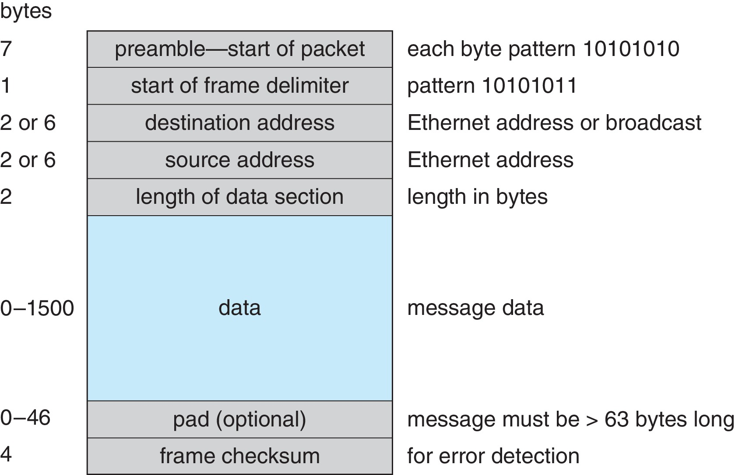
Ethernet Packet

Slide 21
Transport Protocols UDP and TCP
Once a host with a specific IP address receives a packet, it must somehow pass it to the correct waiting process
Transport protocols TCP and UDP identify receiving and sending processes through the use of a port number
Allows host with single IP address to have multiple server/client processes sending/receiving packets
Well-known port numbers are used for many services
FTP – port and 21
ssh – port 22
SMTP – port 25
HTTP – port 80
Transport protocol can be simple or can add reliability to network packet stream

Slide 22
User Datagram Protocol
UDP is unreliable – bare-bones extension to IP with addition of port number
Since there are no guarantees of delivery in the lower network (IP) layer, packets may become lost
Packets may also be received out-out-order
UDP is also connectionless – no connection setup at the beginning of the transmission to set up state
Also no connection tear-down at the end of transmission
UDP packets are also called datagrams

Slide 23
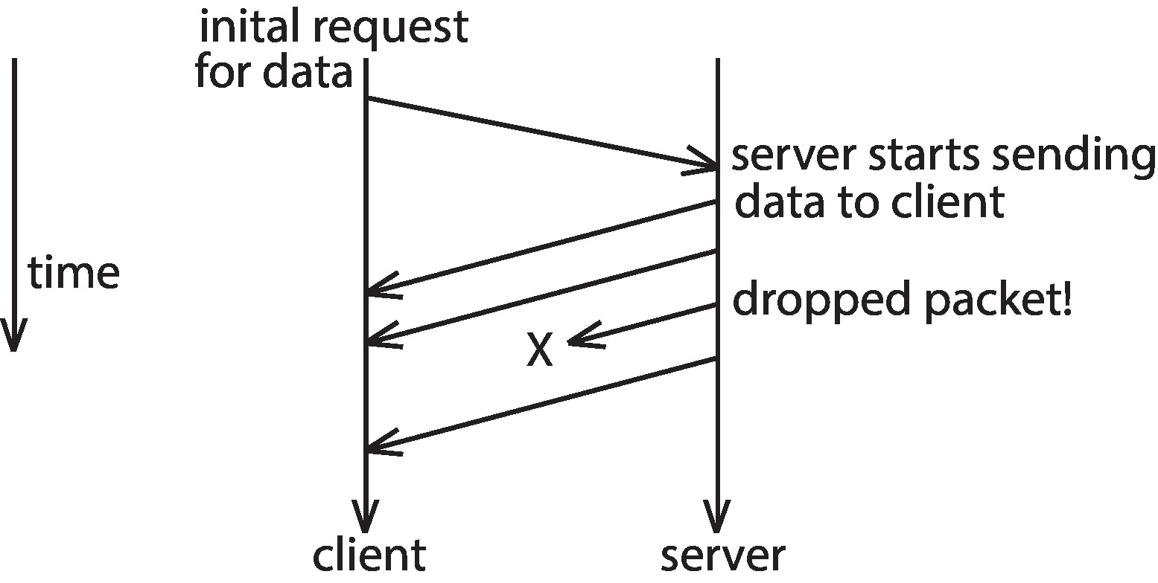
UDP Dropped Packet Example

Slide 24
Transmission Control Protocol
TCP is both reliable and connection-oriented
In addition to port number, TCP provides abstraction to allow in-order, uninterrupted byte-stream across an unreliable network
Whenever host sends packet, the receiver must send an acknowledgement packet (ACK). If ACK not received before a timer expires, sender will resend.
Sequence numbers in TCP header allow receiver to put packets in order and notice missing packets
Connections are initiated with series of control packets called a three-way handshake
Connections also closed with series of control packets

Slide 25
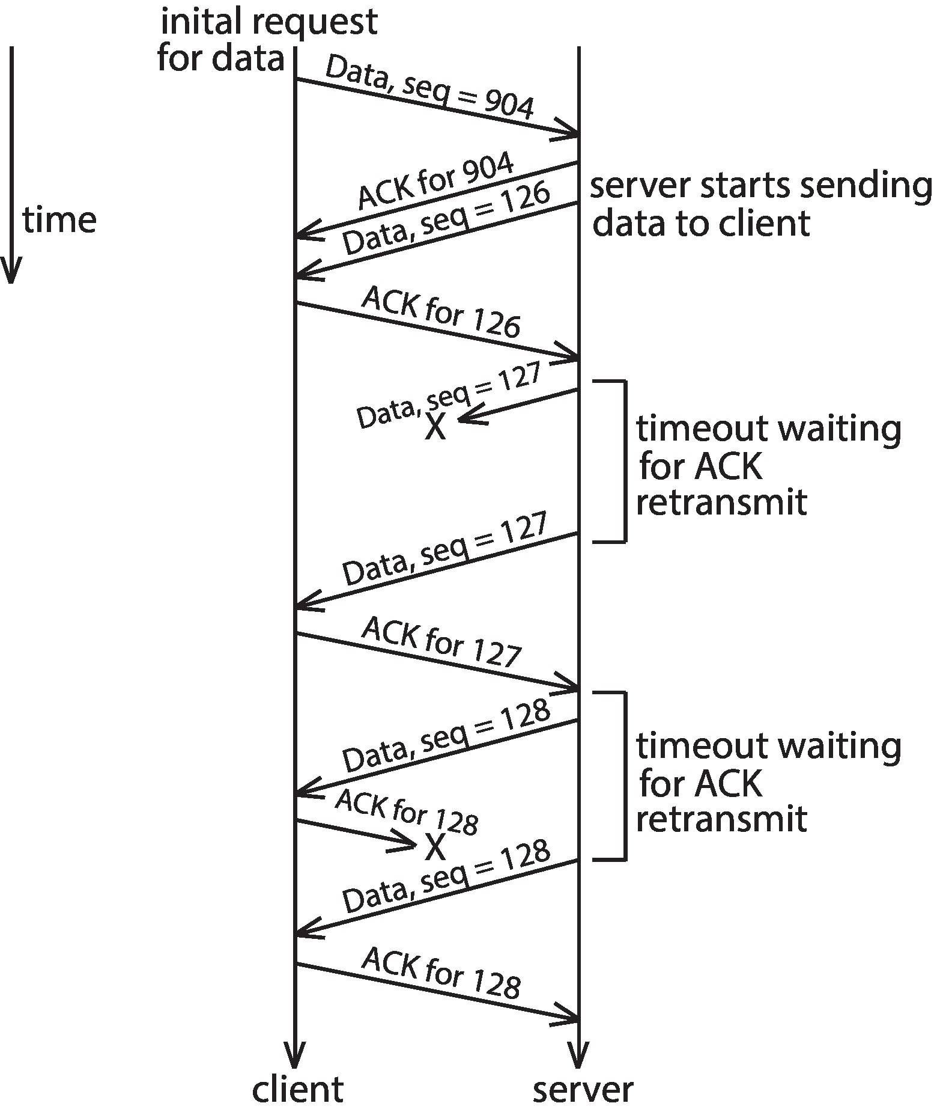
TCP Data Transfer Scenario

Slide 26
Transmission Control Protocol (Cont.)
Receiver can send a cumulative ACK to acknowledge series of packets
Server can also send multiple packets before waiting for ACKs
Takes advantage of network throughput
Flow of packets regulated through flow control and congestion control
Flow control – prevents sender from overrunning capacity of receiver
Congestion control – approximates congestion of the network to slow down or speed up packet sending rate

Slide 27
End of Lecture 21

