Slide 1
Memory Protection and Address Translation
Xin Liu
Operating Systems
COP 4610

Slide 2
This Lecture…
Different address translation schemes
Base-and-bound translation
Segmentation
Paging
Multi-level translation
Paged page tables
Hashed page tables
Inverted page tables
Dual-mode Operations

Slide 3
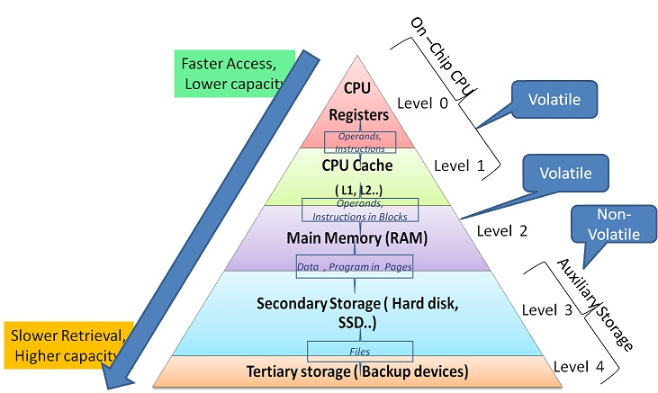
Memory Architecture

Slide 4
Memory Addresses
Memory is byte-addressable
Each memory address can specify the location of a byte
unsigned char memory[MEMORY_SIZE]
To access
memory[virtual_memory_address]

Slide 5
Up to This Point
Threads provide the illusion of an infinite number of CPUs
On a single processor machine
Memory management provides a different set of illusions
Protected memory
Infinite amount of memory
Transparent sharing

Slide 6
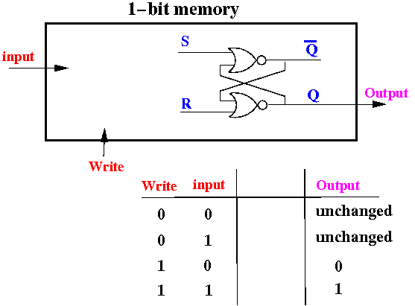
Physical vs. Virtual Memory
Physical memory
No protection
Limited size
Sharing visible to processes

Slide 7
Physical vs. Virtual Memory
Physical memory | Virtual memory
No protection | Each process isolated from others and from OS
Limited size | Illusion of infinite memory
Sharing visible to processes | Each process cannot tell if memory is shared

Slide 8
Memory Organizations
Simplest: uniprogramming without memory protection
Each application runs within a hardwired range of physical memory addresses
One application runs at a time
Application can use the same physical addresses every time, across reboots
E.g., Embedded System

Slide 9
Uniprogramming Without Memory Protection
Applications typically use the lower memory addresses
An OS uses the higher memory addresses
An application can address any physical memory location (may cause an OS crash)
Application
Operating system
000000
ffffff
Physical memory

Slide 10
Multiprogramming Without Memory Protection
When a program is copied into memory, a linker-loader alters the code of the program (e.g., loads, stores, and jumps)
To use the address of where the program lands in memory

Slide 11
Multiprogramming Without Memory Protection
Bugs in any program can cause other programs to crash, even the OS
Application 1
Application 2
Operating system
000000
ffffff
Physical memory

Slide 12
Multiprogrammed OS With Memory Protection
Memory protection keeps user programs from crashing one another and the OS
Two hardware-supported mechanisms
Address translation
Dual-mode operation

Slide 13
Address Translation
Each process is associated with an address space, or all the physical addresses a process can touch
However, each process believes that it owns the entire memory, starting with the virtual address 0
The missing piece is a translation table
Translate every memory reference from virtual to physical addresses

Slide 14
Address Translation Visualized
Unidirectional
Virtual
addresses
Translation table
Physical
addresses
Data reads or writes
(untranslated)

Slide 15
More on Address Translations
Translation provides protection
Processes cannot talk about other processes’ addresses, nor about the OS addresses
OS uses physical addresses directly
No translations

Slide 16
Assumptions
32-bit machines
1-GB RAM max

Slide 17
Base-and-Bound Translation
Each process is loaded into a contiguous region of physical memory
Processes are protected from one another
Base
Virtual address
+
Physical address
>
Error
Bound

Slide 18
Base-and-Bound Translation
Each process “thinks” that it owns a dedicated machine, with memory addresses from 0 to bound
Virtual addresses
Physical addresses
0
code
data
…
stack
base = 6250
code
data
…
stack
bound
6250 + bound

Slide 19
Base-and-Bound Translation
An OS can move a process around
By copying bits
Changing the base and bound registers

Slide 20
Pros/Cons of Base-and-Bound Translation
+ Simplicity
+ Speed
- External fragmentation: memory wasted because the available memory is not contiguous for allocation
- Difficult to share programs
Each instance of a program needs to have a copy of the code segment

Slide 21
Pros/Cons of Base-and-Bound Translation
- Memory allocation is complex
Need to find contiguous chunks of free memory
First fit: Use the first free memory region that is big enough
Best fit: Use the smallest free memory region
Worst fit: Use the largest free memory region
Reorganization involves copying
- Does not work well when address spaces grow and shrink dynamically

Slide 22
Segmentation
Segment: a logically contiguous memory region
Segmentation-based translation: use a table of base-and-bound pairs

Slide 23
Segmentation Illustrated
Virtual addresses
Physical addresses
0x0
0x0
code
data
0x6ff
0x4ff
0x1000
data
0x14ff
0x2000
stack
0x2fff
0x3000
stack
0x3fff
0x4000
code
0x46ff

Slide 24
Segmentation Diagram
30 bits
up to 30 bits
Physical seg base
Seg bound
Physical seg base
Seg bound
2² entries
Physical seg base
Seg bound
up to 30 bits
Virt seg #
Offset
+
Phy addr
32 - 30 = 2 bits
for 32-bit machines
log₂(1GB) = 30 bits for 1GB of RAM
>
Error

Slide 25
Segmentation Diagram
0x4000
0x700
00
code
0x0
0x500
01
data
10
0x2000
0x1000
stack
2
0x80000200
+
0x2200
1000 0000 0000 0000 0000 0010 0000 0000
>

Slide 26
Segmentation Diagram
00
0x4000
0x700
code
0x0
0x500
01
data
10
0x2000
0x1000
stack
2
0x40000100
+
?
>

Slide 27
Segmentation Diagram
0x4000
0x700
00
code
0x0
0x500
01
data
10
0x2000
0x1000
stack
2
0x00000800
+
?
>

Slide 28
Segmentation Translation
virtual_address = virtual_segment_number:offset
physical_base_address = segment_table[virtual_segment_number]
physical_address = physical_base_address + offset

Slide 29
Pros/Cons of Segmentation
+ Easier to grow/shrink individual segments
+ Finer control of segment accesses
e.g., read-only for shared code segment
Recall the semantics of fork()…
+ More efficient use of physical space
+ Multiple processes can share the same code segment
- Memory allocation is still complex
Requires contiguous allocation

Slide 30
Paging
Paging-based translation: memory allocation via fixed-size chunks of memory, or pages
Uses a bitmap to track the allocation status of memory pages
Translation granularity is a page

Slide 31
Paging Illustrated
Virtual addresses
Physical addresses
0x0
0x0
0x1000
0x1000
0x2000
0x2000
0x3000
0x3000
0x3fff
0x4000

Slide 32
Paged Memory Acces
unsigned char memory[N_PAGES][PAGE_SIZE]
To access
memory[virtual_page_number][page_offset]

Slide 33
Paging Diagram
32 – 12 = 20 bits for 32-bit machines
log₂(4KB) = 12 bits for 4-KB pages
Virtual page number
Offset
Page table size
>
Physical page number
2²⁰ entries
Physical page number
Physical page number
Physical page number
Offset
Error
log₂(1GB) = 30 bits for 1GB of RAM

Slide 34
Paging Example
0000 0000 0000 0000 0000 0100 0000 0000
0
0x00000400
2
>
…0000
00004
0
…0001
00000
1
…0010
00002
2
4
0x00004400

Slide 35
Paging Example
0
0x00001200
2
>
…0000
00004
0
…0001
00000
1
…0010
00002
2
4
?

Slide 36
Paging Example
0
0x00002500
2
>
…0000
00004
0
…0001
00000
1
…0010
00002
2
4
?

Slide 37
Paging Translation
virtual_address = virtual_page_number:offset
physical_page_number = page_table[virtual_page_number]
physical_address = physical_page_number:offset

Slide 38
Pros and Cons of Paging
+ Easier memory allocation
+ Allows code sharing
- Internal fragmentation: allocated pages are not fully used
- Page table can potentially be very large
32-bit architecture with 1-KB pages can require 4M table entries

Slide 39
Multi-Level Translation
Segmented-paging translation: breaks the page table into segments
Paged page tables: Two-level tree of page tables

Slide 40
Segmented Paging
30 bits for 1-GB RAM
32 - 3 - 12 = 17 bits
Page table base
Page table bound
Page table base
Page table bound
2³ entries
Page table base
Page table bound
12 bits for 4-KB pages
18 bits
num of
entries
defined by
bound; up
to 2¹⁷
entries
Seg #
Virt page #
Offset
Phy page #
+
Phy page #
log₂(6 segments)
= 3 bits
Phy page #
>
Error

Slide 41
Segmented Paging
32 – 3 – 12 = 17 bits
2¹⁷
Seg #
Virt page #
Offset
Page table size
>
Phy page #
Phy page #
Phy page #
Phy page #
Offset
Error
log₂(1GB) = 30 bits for 1GB of RAM

Slide 42
Segmented Paging Example
Page table
segment starting
address
Page table
segment number
Number of page
table entries
000
0x00000000
0x16
001
0x00003000
0x1000
010
0x50000000
0x20
0x20002003
0x00003000
001
00 … 0010
… 0011
Phy page #
+
Phy page #
0 0000 0000 0000 0010
0000 0000 0011
Phy page #
>
Error

Slide 43
Segmented Paging
0x20002003
001
… 0010
… 0011
0x1000
0 0000 0000 0000 0010
Page table
Entry number
0000 0000 0011
>
00
0x70000
01
0x70004
10
0x70008
0x70008
0x003
Error

Slide 44
Segmented Paging Example
Page table
segment starting
address
Page table
segment number
Number of page
Table entries
000
0x00000000
0x16
001
0x00003000
0x1000
010
0x50000000
0x20
0x21002005
0x00003000
?
?
?
Phy page #
+
Phy page #
?
?
Phy page #
>
Error

Slide 45
Segmented Paging Example
Page table
segment starting
address
Page table
segment number
Number of page
Table entries
000
0x00000000
0x16
001
0x00003000
0x1000
010
0x50000000
0x20
0x21002005
0x00003000
001
… 0101
Phy page #
+
Phy page #
0 0001 0000 0000 0010
0000 0000 0101
Phy page #
>
Error

Slide 46
Segmented Paging Translation
virtual_address = segment_number:page_number:offset
page_table = segment_table[segment_number]
physical_page_number =
page_table[virtual_page_number]
physical_address = physical_page_number:offset

Slide 47
Pros/Cons of Segmented Paging
+ Code sharing
+ Reduced memory requirements for page tables
- Higher overhead and complexity
- Page tables still need to be contiguous
- Two lookups per memory reference

Slide 48
Paged Page Tables
12 bits
12 bits for 4-KB pages
Page table num
Virt page num
Offset
Page table address (30 bits)
2¹²
entries
Page table address
Page table address
Phy page num
2⁸
entries
Phy page num
Phy page num
Phy page num (18 bits)
Offset

Slide 49
Paged Page Table Translation
virtual_address = page_table_num:virtual_page_num:offset
page_table = page_table_address[page_table_num]
physical_page_num = page_table[virtual_page_num]
physical_address = physical_page_num:offset

Slide 50
Pros/Cons of Paged Page Tables
+ Can be generalized into multi-level paging
- Multiple memory lookups are required to translate a virtual address
Can be accelerated with translation lookaside buffers (TLBs)
Store recently translated memory addresses for short-term reuses

Slide 51
Hashed Page Tables
Physical_address
= hash(virtual_page_num):offset
+ Conceptually simple
- Need to handle collisions
- Need one hash table per address space

Slide 52
Inverted Page Table
One hash entry per physical page
physical_address
= hash(pid, virtual_page_num):offset
+ The number of page table entries is proportional to the size of physical RAM
Collision handling

Slide 53
Dual-mode Operation Revisited
Translation tables offer protection if they cannot be altered by applications
An application can only touch its address space under the user mode
HW requires the CPU to be in the kernel mode to modify the address translation tables

Slide 54
Details of Dual-mode Operations
How the CPU is shared between the kernel and user processes
How processes interact among themselves

Slide 55
Switching from the Kernel to User Mode
To run a user program, the kernel
Creates a process and initialize the address space
Loads the program into the memory
Initializes translation tables
Sets the HW pointer to the translation table
Sets the CPU to user mode
Jumps to the entry point of the program

Slide 56
To Run a Program
jump
User level
Kernel level
Translation table
Hardware pointer
PC
user mode

Slide 57
Switching from User Mode to Kernel Mode
Voluntary
System calls: a user process asks the OS to do something on the process’s behalf
Involuntary
Hardware interrupts (e.g., I/O)
Program exceptions (e.g., segmentation fault)

Slide 58
Switching from User Mode to Kernel Mode
For all cases, hardware atomically performs the following steps
Sets the CPU to kernel mode
Saves the current program counter
Jumps to the handler in the kernel
The handler saves old register values

Slide 59
Switching from User Mode to Kernel Mode
Unlike context switching among threads, to switch among processes
Need to save and restore pointers to translation tables
To resume process execution
Kernel reloads old register values
Sets CPU to user mode
Jumps to the old program counter

Slide 60

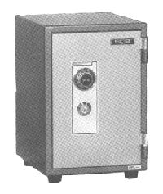
User → Kernel
User level
Kernel level
PC
set kernel mode
handler
trusted code
PC
register values
translation tables
(for processes)

Slide 61
Kernel → User
User level
Kernel level
PC
set kernel mode
handler
trusted code
PC
register values
translation tables
(for processes)

Slide 62
Kernel → User
User level
Kernel level
PC
handler
trusted code
user mode
PC
register values
translation tables
(for processes)

Slide 63
Communication Between Address Spaces
Processes communicate among address spaces via interprocess communication (IPC)
Byte stream (e.g., pipe)
Message passing (send/receive)
File system (e.g., read and write files)
Shared memory
Bugs can propagate from one process to another

Slide 64
Interprocess Communication
Direct
send(P₁, message);
receive(P₂, message);
One-to-one communication
Indirect
Mailboxes or ports
send(mailbox_A, message);
receive(mailbox_A, message);
Many-to-many communication

Slide 65
Protection Without HW Support
HW-supported protection can be slow
Requires applications be separated into address spaces to achieve fault isolation
What if your apps are built by multiple vendors? (e.g., Chrome plug-ins)
Can we run two programs in the same address space, with safety guarantees?

Slide 66
Protection via Strong Typing
Programming languages may disallow the misuse of data structures (casting)
e.g., LISP and Java
Java has its own virtual machines
A Java program can run on different HW and OSes

Slide 67
Protection via Software Fault Isolation
Compilers generate code that is provably safe
e.g., a pointer cannot reference illegal addresses
With aggressive optimizations, the overhead can be as low as 5%

Slide 68
Protection via Software Fault Isolation
A malicious user cannot jump to the last line and do damage, since safe is a legal address
Original instruction | Compiler-modified version
st r2, (r1) | safe = a legal address
 | safe = r1
 | Check safe is still legal
 | st r2, (safe)

