Slide 1
Caching and TLBs
Xin Liu
Operating Systems
COP 4610

Slide 2
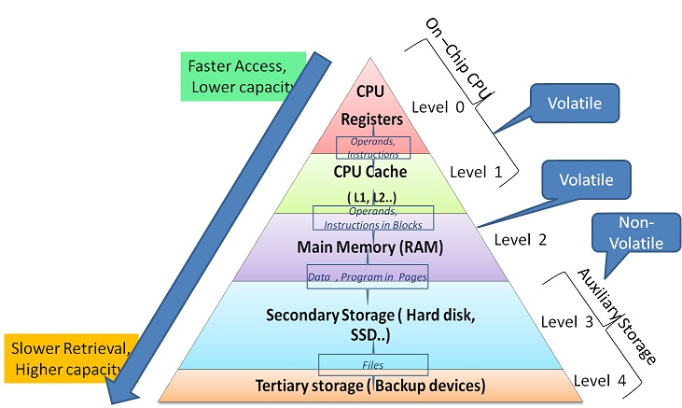
Memory Architecture

Slide 3
Caching
Stores copies of data at places that can be accessed more quickly than accessing the original
Speeds up access to frequently used data
At a cost: slows down the infrequently used data

Slide 4
Caching in Memory Hierarchy
Provides the illusion of TB storage
With register access time
 |  | Access Time | Size | Cost
Primary memory | Registers | 1 clock cycle | ~500 bytes | On chip
 | Cache (L1/L2) | 1-2 clock cycles | < 10 MB
 | Main memory | 1-4 clock cycles | < 64 GB | $3/GB
Secondary memory | SSD | 25-100 μsec | < 2 TB | $60/TB
 | Disk | 5-10 msec | < 16 TB | $10/TB

Slide 5
Caching in Memory Hierarchy
Exploits two hardware characteristics
Smaller memory provides faster access times
Large memory provides cheaper storage per byte
Puts frequently accessed data in small, fast, and expensive memory
Assumption: non-random program access behaviors

Slide 6
Locality in Access Patterns
Temporal locality: recently referenced locations are more likely to be referenced soon
e.g., files
Spatial locality: referenced locations tend to be clustered
e.g., listing all files under a directory

Slide 7
Caching
Does not work well for programs with little localities
e.g., scanning the entire disk
Leaves behind cache content with no localities (cache pollution)

Slide 8
Generic Issues in Caching
Effective metrics
Cache hit: a lookup is resolved by the content stored in cache
Cache miss: a lookup is resolved elsewhere
Effective access time
= P(hit)*(hit_cost) + P(miss)*(miss_cost)

Slide 9
Effective Access Time
Cache hit rate: 99%
Cost of checking: 2 clock cycles
Cache miss rate: 1%
Cost of going elsewhere: 4 clock cycles
Effective access time:
99%*2 + 1%*(2 + 4)
= 1.98 + 0.06 = 2.04 (clock cycles)

Slide 10
Another Example of Effective Access Time
 | Access time | Cache hit rate
L1 cache | 1 clock cycle | 50%
L2 cache | 2 clock cycles | 50%
Memory | 4 clock cycles | 100%
Effective access time = T_{L1}
= P_{hit}*cost_{hit} + P_{miss}*cost_{miss}

Slide 11
Another Example of Effective Access Time
 | Access time | Cache hit rate
L1 cache | 1 clock cycle | 50%
L2 cache | 2 clock cycles | 50%
Memory | 4 clock cycles | 100%
Effective access time = T_{L1}
= P_{hit}*cost_{hit} + P_{miss}*cost_{miss}
= P_{L1_hit}*cost_{L1_hit} + P_{L1_miss}*cost_{L1_miss}
= 1/2*(1 cc) + 1/2*cost_{L1_miss}
= 1/2*(1 cc) + 1/2*(1 cc + T_{L2})

Slide 12
Another Example of Effective Access Time
 | Access time | Cache hit rate
L1 cache | 1 clock cycle | 50%
L2 cache | 2 clock cycles | 50%
Memory | 4 clock cycles | 100%
T_{L2}
= P_{hit}*cost_{hit} + P_{miss}*cost_{miss}
= P_{L2_hit}*cost_{L2_hit} + P_{L2_miss}*cost_{L2_miss}
= 1/2*(2 cc) + 1/2*cost_{L2_miss}
= 1/2*(2 cc) + 1/2*(2 cc + 4 cc) = 1 + 3 = 4

Slide 13
Another Example of Effective Access Time
 | Access time | Cache hit rate
L1 cache | 1 clock cycle | 50%
L2 cache | 2 clock cycles | 50%
Memory | 4 clock cycles | 100%
Effective access time = T_{L1}
= 1/2*(1 cc) + 1/2*(1 cc + T_{L2})
= 1/2*(1 cc) + 1/2*(1 cc + 4 cc)
= 1/2 + 5/2 = 6/2 = 3

Slide 14
Another Example of Effective Access Time
 | Access time | Cache hit rate
L1 cache | 1 clock cycle | 50%
L2 cache | 2 clock cycles | 50%
Memory | 4 clock cycles | 100%
L1
50%
1 cycle
50%
1 cycle
hit
L2
50%
2 cycles
50%
2 cycles
hit
memory
100%
4 cycles
hit

Slide 15
Another Example of Effective Access Time
Effective access time = 1/2*1
+ 1/2*1/2(1 + 2)
+ 1/2*1/2*1*(1 + 2 + 4)
L1
50%
1 cycle
50%
1 cycle
hit
L2
50%
2 cycles
50%
2 cycles
hit
memory
100%
4 cycles
hit

Slide 16
Another Example of Effective Access Time
Effective access time = 1/2*1
+ 1/2*1/2(1 + 2)
+ 1/2*1/2*1*(1 + 2 + 4)
= 2/4 + 3/4 + 7/4
= 12/4 = 3

Slide 17
Another Example of Effective Access Time
Bottom up approach
Effective access time of memory
= 4*100% = 4
Effective access time of memory w/ L2 cache
= 1/2*2 +1/2*(2 + 4) = 1/2 + 6/2 = 4
Effective access time of memory w/ L1/L2 caches
= 1/2*1 + 1/2(1 + 4)
= 1/2 + 5/2 = 6/2 = 3

Slide 18
Reasons for Cache Misses
Compulsory misses: data brought into the cache for the first time
e.g., booting
Capacity misses: caused by the limited size of a cache
A program may require a hash table that exceeds the cache capacity
Random access pattern
No caching policy can be effective

Slide 19
Reasons for Cache Misses
Misses due to competing cache entries: a cache entry assigned to two pieces of data
When both active
Each will preempt the other
Policy misses: caused by cache replacement policy, which chooses which cache entry to replace when the cache is full

Slide 20
C-3P0?
Compulsory misses
Capacity misses
Competing cache entries
Policy misses

Slide 21
Design Issues of Caching
How is a cache entry lookup performed?
Which cache entry should be replaced when the cache is full?
How to maintain consistency between the cache copy and the real data?

Slide 22
Caching Applied to Address Translation
Process references the same page repeatedly
Translating each virtual address to physical address is wasteful
Translation lookaside buffer (TLB)
Tracks frequently used translations
Avoids translations in the common case

Slide 23
Caching Applied to Address Translation
In TLB
Virtual
addresses
TLB
Physical
addresses
Translation table
Data reads or writes
(untranslated)

Slide 24
Example of the TLB Content
Virtual page number (VPN) | Physical page number (PPN) | Control bits
2 | 1 | Valid, rw
- | - | Invalid
0 | 4 | Valid, rw

Slide 25
TLB Lookups
Sequential search of the TLB table
Direct mapping: assigns each virtual page to a specific slot in the TLB
e.g., use upper bits of VPN to index TLB

Slide 26
Direct Mapping
if (TLB[UpperBits(vpn)].vpn == vpn) {
return TLB[UpperBits(vpn)].ppn;
} else {
ppn = PageTable[vpn];
TLB[UpperBits(vpn)].control = INVALID;
TLB[UpperBits(vpn)].vpn = vpn;
TLB[UpperBits(vpn)].ppn = ppn;
TLB[UpperBits(vpn)].control = VALID | RW
return ppn;
}

Slide 27
Direct Mapping
When use only high order bits
Two pages may compete for the same TLB entry
May toss out needed TLB entries
When use only low order bits
TLB reference will be clustered
Failing to use full range of TLB entries
Common approach: combine both

Slide 28
TLB Lookups
Sequential search of the TLB table
Direct mapping: assigns each virtual page to a specific slot in the TLB
e.g., use upper bits of VPN to index TLB
Set associativity: uses N TLB banks to perform lookups in parallel

Slide 29
Two-Way Associative Cache
VPN
hash
VPN
PPN
VPN
PPN
VPN
PPN
VPN
PPN
VPN
PPN
VPN
PPN
=
=

Slide 30
Two-Way Associative Cache
VPN
hash
VPN
PPN
VPN
PPN
VPN
PPN
VPN
PPN
VPN
PPN
VPN
PPN
=
=

Slide 31
Two-Way Associative Cache
VPN
hash
VPN
PPN
VPN
PPN
VPN
PPN
VPN
PPN
VPN
PPN
VPN
PPN
=
=
If miss, translate and replace one of the entries

Slide 32
TLB Lookups
Direct mapping: assigns each virtual page to a specific slot in the TLB
e.g., use upper bits of VPN to index TLB
Set associativity: use N TLB banks to perform lookups in parallel
Fully associative cache: allows looking up all TLB entries in parallel

Slide 33
Fully Associative Cache
VPN
hash
VPN
PPN
VPN
PPN
VPN
PPN
=
=
=

Slide 34
Fully Associative Cache
VPN
hash
VPN
PPN
VPN
PPN
VPN
PPN
=
=
=

Slide 35
Fully Associative Cache
VPN
hash
VPN
PPN
VPN
PPN
VPN
PPN
=
=
=
If miss, translate and replace one of the entries

Slide 36
TLB Lookups
Typically
TLBs are small and fully associative
Hardware caches (L1/L2) use direct mapped or set-associative cache

Slide 37
Relationship Between TLB and HW Memory Caches
We can extend the principle of TLB
Virtually addressed cache: between the CPU and the translation tables
Physically addressed cache: between the translation tables and the main memory

Slide 38
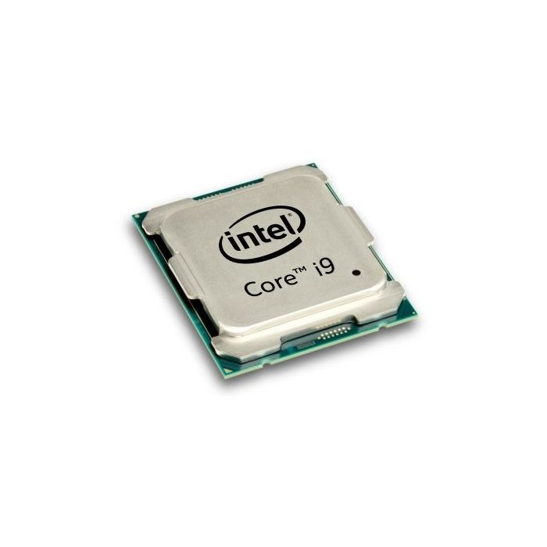
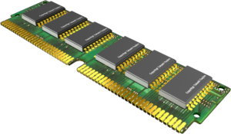
Relationship Between TLB and HW Memory Caches
Virtually
addressed cache
Physically
addressed cache
VA
data
TLB
PA
data
VA
data
PA
data
PA
data
Translation
tables
PA
PA
data
data
PA
data
Data reads or writes
(untranslated)

Slide 39
Consistency between TLB and Page Tables
Different processes have different page tables
TLB entries are invalidated on context switches
Alternatives:
Tag TLB entries with process IDs
Additional cost of hardware and comparisons per lookup

Slide 40
Replacement of TLB Entries
Direct mapping
Entry replaced whenever a VPN mismatches
Associative caches
Random replacement
LRU (least recently used)
MRU (most recently used)
Depending on reference patterns

Slide 41
Replacement of TLB Entries
Hardware-level
TLB replacement is mostly random
Simple and fast
Software-level
Memory page replacements are more sophisticated
CPU cycles vs. cache hit rate

Slide 42
Two Ways to Commit Data Changes
Write-through: Immediately writes updated data from the cache back to memory as soon as the cache is modified.
Ensures data in cache and memory is always consistent.
Typically used for critical data where immediate consistency is important.

Slide 43
Two Ways to Commit Data Changes
Write-back: Delays writing data from the cache to memory until the cache block is evicted or replaced.
Reduces the number of write operations to memory by combining multiple updates.
More efficient for frequent updates, but the data in memory may be out of sync until the write-back occurs.

