Slide 1
Storage Device
Xin Liu
Operating Systems
COP 4610

Slide 2
Disk as An Storage Device
An old storage technology
Invented in the 50s
Incredibly complicated

Slide 3
Disk Characteristics
Disk platters: coated with magnetic materials for recording
Disk platters

Slide 4
Disk Characteristics
Each disk platter is divided into concentric tracks
Disk platters
Track

Slide 5
Disk Characteristics
Disk arm: moves a comb of disk heads
Only one disk head is active for reading/writing
Disk heads
Disk platters
Disk arm
Track

Slide 6
Disk Characteristics
A track is further divided into sectors. A sector is the smallest unit of disk storage
Disk heads
Disk platters
Sector
Disk arm
Track

Slide 7
Disk Characteristics
A cylinder consists of all tracks with a given disk arm position
Disk heads
Disk platters
Sector
Disk arm
Cylinder
Track

Slide 8
Disk Characteristics
Cylinders are further divided into zones
Disk heads
Disk platters
Sector
Disk arm
Cylinder
Track
Zones

Slide 9
Disk Characteristics
Zone-bit recording: zones near the edge store more information (higher bandwidth)
Disk heads
Disk platters
Sector
Disk arm
Cylinder
Track
Zones

Slide 10
Hard Disk Trivia…
Aerodynamically designed to fly
As close to the surface as possible
No room for air molecules
Therefore, hard drives are filled with special inert gas
If head touches the surface
Head crash
Scrapes off magnetic information

Slide 11
More About Hard Drives Than You Ever Want to Know
Track skew: starting position of each track is slightly skewed
Minimize rotational delay when sequentially transferring bytes across tracks
Thermo-calibrations: performed to account for changes of radius due to temperature changes
Typically 100 to 1,000 bits are inserted between sectors to account for minor inaccuracies

Slide 12
Disk Access Time
Seek time: the time to position disk heads (~4 msec on average)
Rotational latency: the time to rotate the target sector to underneath the head
Assume 7,200 rotations per minute (RPM)
7,200 RPM / 60 min/sec= 120 RPS
1/120 RPS = ~8 msec per rotation
Average rotational delay is ~4 msec

Slide 13
Disk Access Time
Transfer time: the time to transfer bytes
Assumptions:
300 Mbytes/sec
4-Kbyte disk blocks
Time to transfer a block takes 0.07 msec
Disk access time
Seek time + rotational delay + transfer time

Slide 14
Disk Performance Metrics
Latency
Seek time + rotational delay
Bandwidth
Bytes transferred / disk access time

Slide 15
Examples of Disk Access Times
If disk blocks are randomly accessed
Average disk access time = ~8 msec
Assume 4-Kbyte blocks
4 Kbyte / 8 msec = ~500 Kbyte/sec
If disk blocks of the same cylinder are randomly accessed without disk seeks
Average disk access time = ~4 msec
4 Kbyte / 4 msec = ~ 1 Mbyte/sec

Slide 16
Examples of Disk Access Times
If disk blocks are accessed sequentially
Without seeks and rotational delays
Bandwidth: 300 Mbytes/sec
Key to good disk performance
Minimize seek time and rotational latency

Slide 17
Disk Tradeoffs
Assumes 1,000-bit paddings between sectors
Larger sector size → better bandwidth
Wasteful if only 1 byte out of 1 Mbyte is needed
Sector size | Space utilization | Transfer rate (data / time)
1 byte | 8 bits/1008 bits (0.8%) | 125 bytes/sec (1 byte / 8 msec)
4 Kbytes | 4096 bytes/4221 bytes (97%) | 500 Kbytes/sec (4 Kbytes / 8 msec)
1 Mbyte | (~100%) | 300 Mbytes/sec (peak bandwidth)

Slide 18
Disk Controller
Few popular standards
IDE (integrated device electronics)
ATA (advanced technology attachment interface)
SCSI (small computer systems interface)
SATA (serial ATA)
Differences
Performance
Parallelism

Slide 19
Disk Device Driver
Major goal: reduce seek time for disk accesses
Schedule disk request to minimize disk arm movements

Slide 20
Disk Arm Scheduling Policies
First come, first serve (FCFS): requests are served in the order of arrival
+ Fair among requesters
- Poor for accesses to random disk blocks
Shortest seek time first (SSTF): picks the request that is closest to the current disk arm position
+ Good at reducing seeks
May result in starvation
Note: SSTF is not optimal

Slide 21
Disk Arm Scheduling Policies
SCAN: takes the closest request in the direction of travel (an example of elevator algorithm)
+ no starvation
- a new request can wait for almost two full scans of the disk

Slide 22
Disk Arm Scheduling Policies
Circular SCAN (C-SCAN): disk arm always serves requests by scanning in one direction
Once the arm finishes scanning for one direction
Returns to the 0th track for the next round of scanning

Slide 23
First Come, First Serve
Request queue: 3, 6, 1, 0, 7
Head start position: 2
7
6
5
4
Tracks
3
2
1
Time
0

Slide 24
First Come, First Serve
Request queue: 3, 6, 1, 0, 7
Head start position: 2
Total seek distance: 1 + 3 + 5 + 1 + 7 = 17
7
6
5
4
Tracks
3
2
1
Time
0

Slide 25
Shortest Seek Distance First
Request queue: 3, 6, 1, 0, 7
Head start position: 2
7
6
5
4
Tracks
3
2
1
Time
0

Slide 26
Shortest Seek Distance First
Request queue: 3, 6, 1, 0, 7
Head start position: 2
Total seek distance: 1 + 2 + 1 + 6 + 1 = 10
7
6
5
4
Tracks
3
2
1
Time
0

Slide 27
SCAN
Request queue: 3, 6, 1, 0, 7
Head start position: 2
7
6
5
4
Tracks
3
2
1
Time
0

Slide 28
SCAN
Request queue: 3, 6, 1, 0, 7
Head start position: 2
Total seek distance: 1 + 1 + 3 + 3 + 1 = 9
7
6
5
4
Tracks
3
2
1
Time
0

Slide 29
C-SCAN
Request queue: 3, 6, 1, 0, 7
Head start position: 2
7
6
5
4
Tracks
3
2
1
Time
0

Slide 30
C-SCAN (always reach both ends)
Request queue: 3, 6, 1, 0, 7
Head start position: 2
Total seek distance: 1 + 3 + 1 + 7 + 1 = 13
7
6
5
4
Tracks
3
2
1
Time
0

Slide 31
Flash Memory
A form of solid-state memory similar to ROM
Holds data without power supply
Reads are fast
Can be written once, more slowly
Can be erased, but very slowly
Limited number of erase cycles before degradation (800 – 100,000)

Slide 32
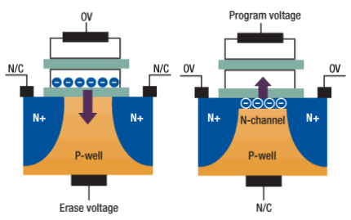
Physical Characteristics

Slide 33
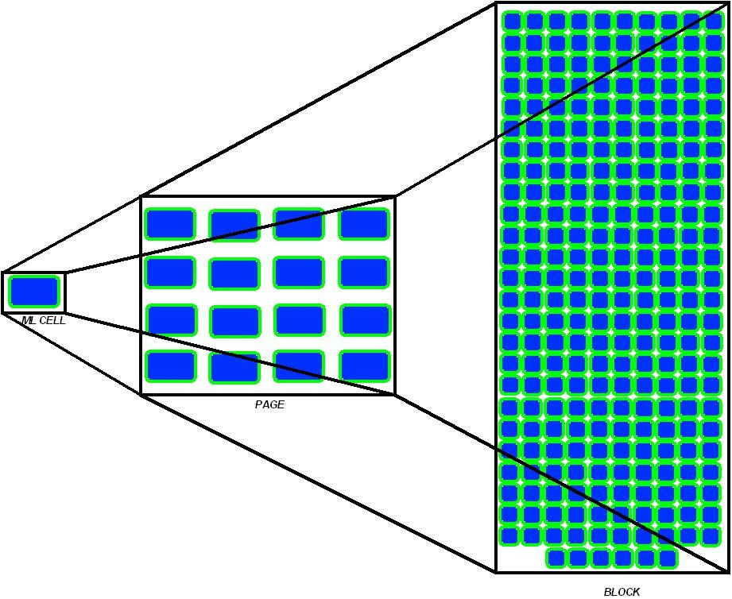
Grouping of SSD Cells

Slide 34
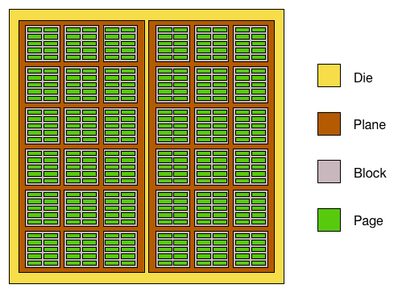
An SSD Die

Slide 35
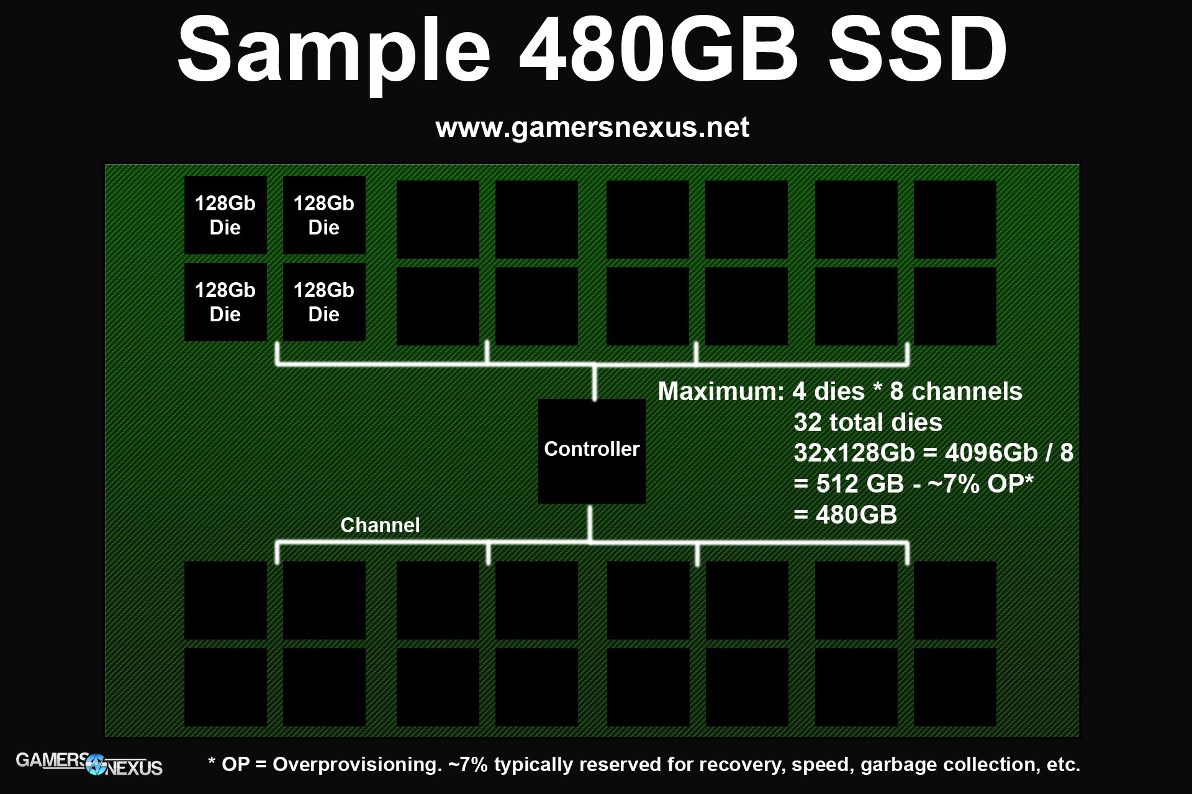
An SSD Device

Slide 36
NOR Flash
Used in cellular phones and PDAs
Byte-addressable
Can write and erase individual bytes
Can execute programs
Mostly replaced by DRAM + NAND flash

Slide 37
NAND Flash
Used in smartphones, digital cameras, and thumb drives
Page-addressible
1 flash page ~= 1 disk block (1-4KB)
Cannot run programs
Erased in flash blocks
Consists of 4 - 64 flash pages
May not be atomic

Slide 38
Writing In Flash Memory
If writing to empty flash page (~disk block), just write
If writing to previously written location, erase it, then write
While erasing a flash block
May access other pages via other IO channels
Number of channels limited by power (e.g., 16 channels max)

Slide 39
Implications of Slow Erases
The use of flash translation layer (FTL)
Write new version elsewhere
Erase the old version later

Slide 40
Implications of Limited Erase Cycles
Wear-leveling mechanism
Track the number of write/erase cycles for each page
Spread writes/erases uniformly across storage locations
Better to group writes within a block and erase together once
Than to scatter writes to many blocks

Slide 41
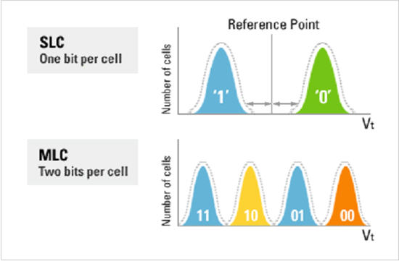
Multi-level cells
Use multiple voltage levels to represent bits

Slide 42
Implications of MLC
Higher density lowers price/GB
Need exponential number of voltage levels to for linear increase in density
Maxed out quickly

Slide 43
Performance Characteristics
 |  | Samsung SSD 970 Pro
Read | Latency | 2 μs/4KB
 | Bandwidth | 3500 MB/s
Write | Latency | 2 μs/4KB
 | Bandwidth | 2300 MB/s
Power | Active | 5.2W
 | Idle | 30 mW
Cost |  | $0.1/GB
Notes:
2018 Samsung datasheet
2021 Amazon price

Slide 44
Pros/Cons of Flash Memory
Small and light
Uses less power than disk
Read time comparable to DRAM
No rotation/seek complexities
No moving parts (shock resistant)
Expensive (compared to disk)
Slow erase cycle (4.5ms)
Limited number of erase cycles

Slide 45
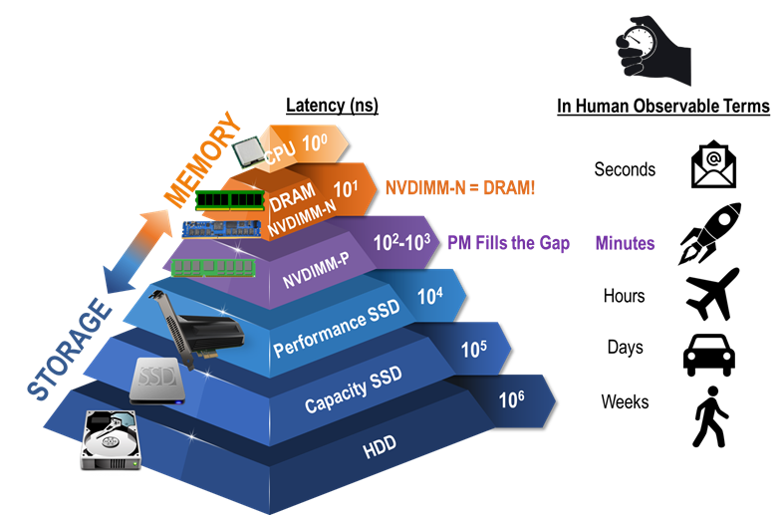
Persistent RAM

Slide 46
Persistent RAM
Byte-addressible
 |  | Intel Optane DC
Read | Latency | 32 ns/256B
 | Bandwidth | 6.8 GB/s
Write | Latency | 128 ns/256B
 | Bandwidth | 1.85 GB/s
Power | Active | 15W
Cost |  | $5/GB

