Slide 1
CPU Scheduling
Xin Liu
xl24j@fsu.edu
COP 4610 Operating Systems

Slide 2
Outline
How is the first process created?
How is the second process created?
How to manage processes?

Slide 3
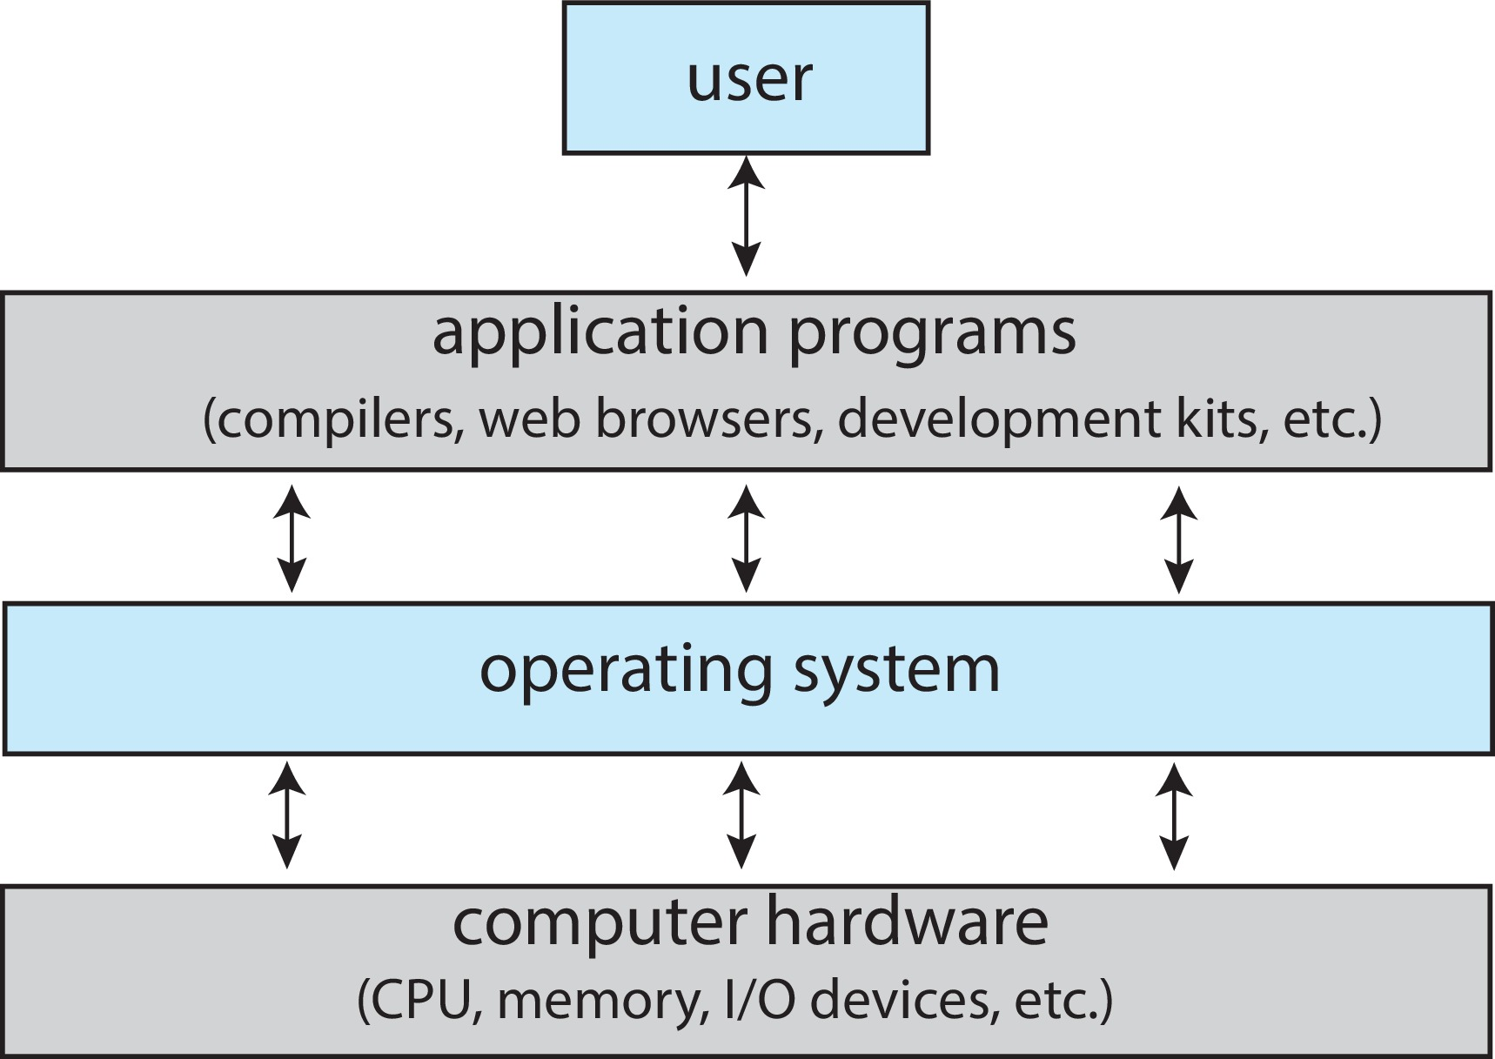
Recap
CPU is a state machine.
A program (whether an OS or application) running on a CPU is inevitably a state machine.
Initial State
S1
…
End
S2
If we are given the initial state, we can deduce what the next state will be. The key is knowing:
Where is the initial state?

Slide 4
The Beginning of Everything
An application runs on the OS
-> OS creates the application's initial state
Initial State
OS
APP
Who creates the initial state of OS?

Slide 5
Who creates the initial state of OS?
Well…it’s a long story…
  It starts with a simple computing machine
Long, Long,
Long Ago…
(During the 1940s)

Slide 6
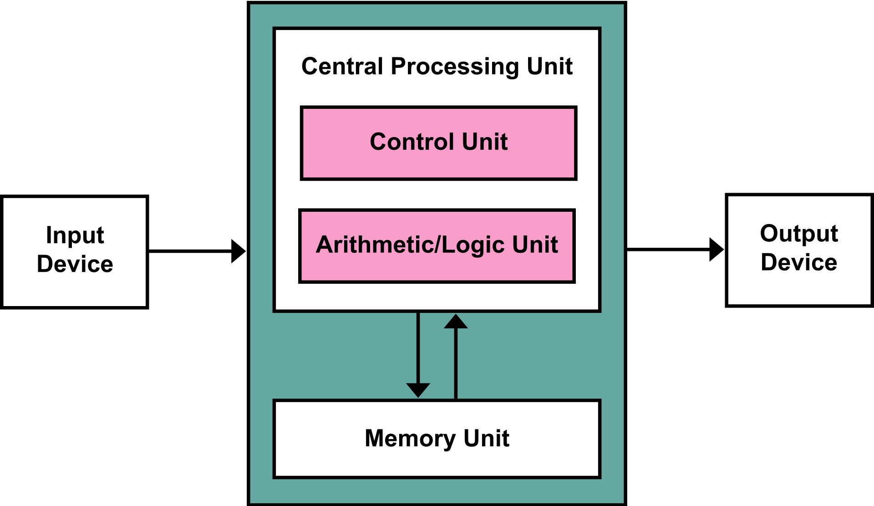
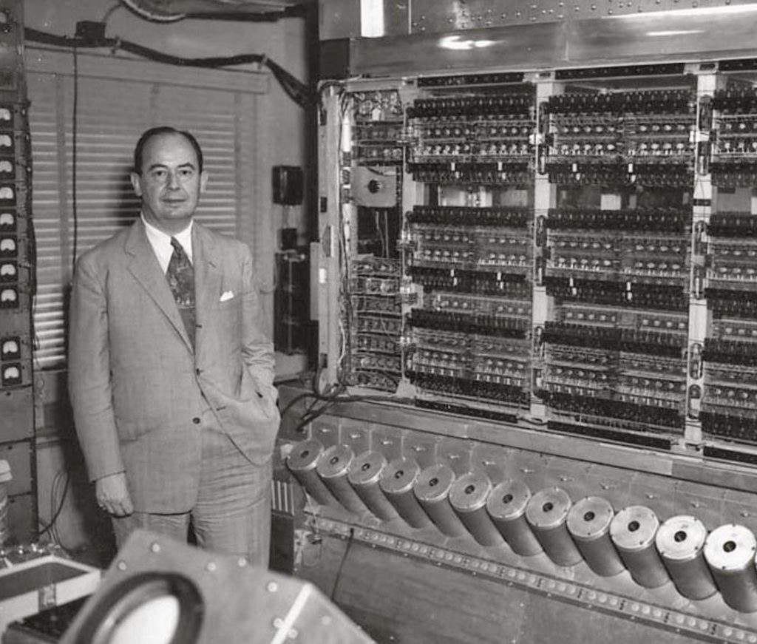
Long, Long, Long Ago…(during the 1940s)
John von Neumann invented von Neumann computer architecture
  A CPU
  A memory unit
  I/O devices (e.g.,
  disks and tapes)

Slide 7
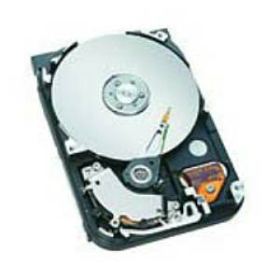
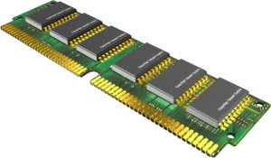
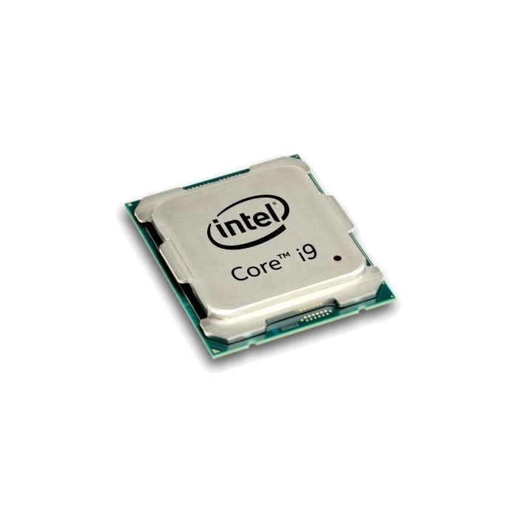
von Neumann Architecture
In von Neumann Architecture,
Programs are stored on storage devices
Programs are copied into memory for execution
CPU reads each instruction in the program and executes accordingly

Slide 8
A Simple CPU Model
Fetch-execute algorithm
The CPU fetches the instruction:
  The program counter (PC) is loaded with the address of the instruction
  The instruction register (IR) is loaded with the instruction from the address
The CPU decodes the instruction.
The CPU executes the instruction.

Slide 9
The CPU fetches the instruction
PC = <address of the first instruction>
…
PC
3000
load r3, b
3000
load r4, c
3004
IR
load r3, b
…
Memory addresses

Slide 10
The CPU fetches the instruction
while (not halt) {
// increment PC
…
PC
3000
load r3, b
3000
load r4, c
3004
IR
load r3, b
…
Memory addresses

Slide 11
Fetch-Execute Algorithm
while (not halt) {
// increment PC
…
PC
3004
load r3, b
3000
// execute(IR)
load r4, c
3004
IR
load r3, b
…
Memory addresses

Slide 12
The CPU fetches the instruction
while (not halt) {
// increment PC
…
PC
3004
load r3, b
3000
// execute(IR)
load r4, c
3004
IR
load r4, c
…
// IR = memory
// content of PC
}
Memory addresses

Slide 13
OS Booting Sequence
The address of the first instruction is fixed
It is stored in read-only-memory (ROM)

Slide 14
Booting Procedure for i386 Machines
On i386 machines, ROM stores a Basic Input/Output System (BIOS)
  BIOS contains information on how to access storage devices
Being replaced with United Extended Firmware Interface (UEFI)
  To access storage > 2TB

Slide 15
BIOS Code
Performs Power-On Self Test (POST)
  Checks memory and devices for their presence and correct operations
  If you are old as I am, you might remember:
    For ancient computers, you will hear memory counting, which consists of noises from the hard drive and CDROM, followed by a final beep

Slide 16
After the POST
The master boot record (MBR) is loaded from the boot device (e.g., a hard drive configured in BIOS)
The MBR is stored at the first logical sector of the boot device that
  Fits into a single 512-byte disk sector (boot sector)
  Describes the physical layout of the disk (e.g., number of tracks)
MBR is being replaced by GUID Partition Table (GPT) for 64-bit addressing

Slide 17

After Getting the Info on the Boot Device
BIOS loads a more sophisticated loader from other sectors on disk
  Under old Linux, this sophisticated loader is called LILO (Linux Loader)
  It has nothing to do with Lilo and Stitch
  Linux uses GRUB (GRand Unified Bootloader) nowadays
The more sophisticated loader loads the operating system

Slide 18
More on OS Loaders
LILO
  Partly stored in MBR with the disk partition table
    A user can specify which disk partition and OS image to
    boot
    Windows loader assumes only one bootable disk partition
  After loading the kernel image, LILO sets the kernel mode and jumps to the entry point of an operating system

Slide 19
Booting Sequence After A CPU Reset
A CPU jumps to a fixed address in ROM,
Loads the BIOS (UEFI),
Performs POST,
Loads MBR (GPT) from the boot device (hard drive),
Loads an OS loader (LILO, GRUB),
Loads the kernel image,
Sets the kernel mode, and
Jumps to the OS entry point -- init
Read Latest Linux Kernel Code:
https://elixir.bootlin.com/linux/v6.10.9/source/init/main.c#L1523
Important

Slide 20
Can We Really See Every Instruction Executed After a CPU Reset?
"Talk is cheap. Show me the code."— Linus Torvalds
Computer System Axiom:
  If you can imagine it, someone has already done it.
Simulation Option: QEMU
  Createed by legendary hacker and genius programmer Fabrice Bellard
  QEMU:A fast and portable dynamic translator (USENIX ATC'05)
  Powers Android Virtual Devices, VirtualBox, and more
  (All built on QEMU)
Real Machine Option: JTAG (Joint Test Action Group) Debugger
  A series of physical debugging registers
  Allows integration with gdb (!!!)

Slide 21
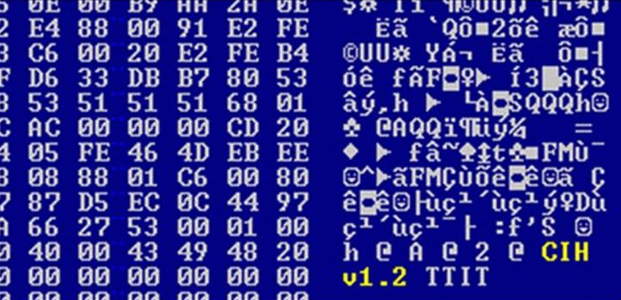
A Side Story: Firmware Virus (1998)
Firmware is usually read-only (though...)
  The Intel 430TX (Pentium) chipset allows writing to Flash ROM.
    By writing a specific sequence to Flash BIOS, the Flash ROM becomes writable.
    This provides a channel for firmware updates.
  Getting this sequence isn’t too difficult.
    It seems the documentation even provides it. 🤔 Boom...
Chen Ing-Hau, the author of CIH, was arrested but not convicted.

Slide 22
Linux Initialization
Set up a number of things:
  Trap table: Handles system calls and exceptions.
  Interrupt handlers: Manage external hardware interrupts.
  Scheduler: Decides which processes run and when.
  Clock: Manages system time and scheduling.
  Kernel modules: Loads additional functionality for the kernel.
  …
  Process manager: Controls process creation, termination, and state changes.

Slide 23
How is the first process created?
Process 1:
Is instantiated from the init (now systemd for parallelism) program
Is the ancestor of all processes
Controls transitions between runlevels
Executes startup and shutdown scripts for each runlevel

Slide 24
Runlevels
Level 0: shutdown
Level 1: single-user
Level 2: multi-user (without network file system)
Level 3: full multi-user
Level 5: X11
Level 6: reboot

Slide 25
Process Creation
Via the fork system call family
Before we discuss process creation, a few words on system calls…

Slide 26
System Calls
System calls allow processes running at the user mode to access kernel functions that run under the kernel mode
Prevent processes from doing bad things, such as
  Halting the entire operating system
  Modifying the MBR

Slide 27

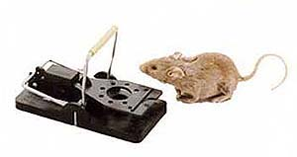
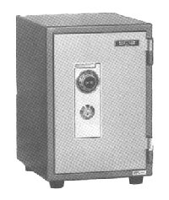
UNIX System Calls
Implemented through the trap instruction
  The program in user mode makes a system call request (like read).
  trap instruction is triggered, switching the CPU to kernel mode.
  The kernel takes control and looks up the system call number.
  It uses a branch table (system call table) to find the correct service.
  The trusted code is executed to perform the requested operation.
  The system then returns to user mode, and the program continues running.
trap
set kernel mode
user level
kernel level
branch table
trusted code
Important

Slide 28
This Is How Simple Operating Systems Are!
CPU Reset
Firmware (BIOS/UEFI)
Boot Loader (MBR, LILO/GRUB)
Kernel_start()
Use ls /sbin/init -l to check if systemd is being used
Read Latest Linux Kernel Code:
https://elixir.bootlin.com/linux/v6.10.9/source/init/main.c#L1523
Process 1
Process Management
  fork, exec, and exit
Memory Management
  mmap –virtual address space
File management
  open, close, read, write
  mkdir, link, unlink
Application Program (state machine)
+
system call
Process
Management
Memory
Management
File
Management
You can use system call to create the world!

Slide 29
fork()
  Creates a complete copy of the state machine
    Copies memory, register states, and other process information
    int fork(); - system call used to create a new process
  How fork() Works:
    Immediately copies the state machine, including the entire memory space
    The newly created process (child) returns 0
    The process that calls fork() (parent) returns the child process ID (PID)

Slide 30
A fork Example, Nag.c
#include <stdio.h>
#include <unistd.h>
#include <sys/types.h>
int main() {
pid_t pid;
if ((pid = fork()) == 0) {
while (1) {
printf(“child’s return value %d: I want to play…\n”, pid);
}
} else {
while (1) {
printf(“parent’s return value %d: After the project…\n”, pid);
}
}
return 0;
}

Slide 31
A fork Example, Nag.c
#include <stdio.h>
#include <unistd.h>
#include <sys/types.h>
int main() {
pid_t pid;
if ((pid = 3128) == 0) {
while (1) {
printf(“child’s return value %d: I want to play…\n”, pid);
}
} else {
while (1) {
printf(“parent’s return value %d: After the project…\n”, pid);
}
}
return 0;
}
#include <stdio.h>
#include <unistd.h>
#include <sys/types.h>
int main() {
pid_t pid;
if ((pid = 0) == 0) {
while (1) {
printf(“child’s return value %d: I want to play…\n”, pid);
}
} else {
while (1) {
printf(“parent’s return value %d: After the project…\n”, pid);
}
}
return 0;
}
Parent process
Child process

Slide 32
Nag.c Outputs
>a.out
child’s return value 0: I want to play…
child’s return value 0: I want to play…
child’s return value 0: I want to play…
…// context switch
parent’s return value 3218: After the project…
parent’s return value 3218: After the project…
parent’s return value 3218: After the project…
…// context switch
child’s return value 0: I want to play…
child’s return value 0: I want to play…
child’s return value 0: I want to play…
^C
>

Slide 33
Why clone a process?

Slide 34
Why clone a process?
Simplifies parameter passing
  Environmental variables, permissions, etc.
Performance optimization
  Copy on write

Slide 35
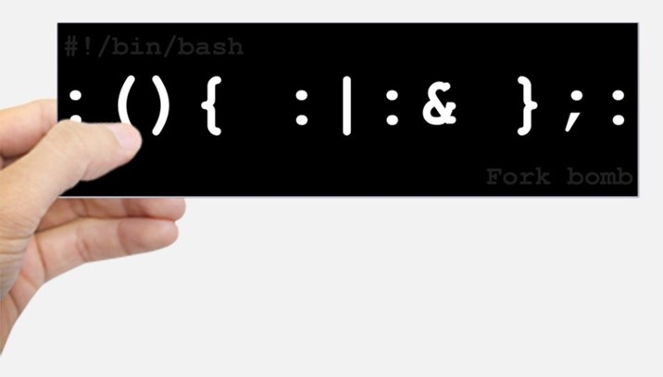
Also,…don’t try it (or try it in docker)
Fork Bomb:
while (1) {
fork();
}
Or
fork() {fork | fork &} ; fork
In bash, colons are allowed as identifiers... the symbol for fork is a colon.

Slide 36
The exec System Call Family
A fork by itself is not interesting
To make a process run a program that is different from the parent process, you need exec system call
exec starts a program by overwriting the current process
E.g.,
int execve(const char *filename, char * const argv[], char * const envp[]);
  Executes a program named filename
  Allows setting parameters argv (arguments) and environment variables envp
  Directly corresponds to the arguments passed to main()!

Slide 37
The exit System Call Family
Destroy the current state machine and allow for a return value.
The termination of the child process will notify the parent process (explained in later lessons)

Slide 38
Thread Creation
Use pthread_create() instead of fork()
A newly created thread will share the address space of the current process and all resources (e.g., open files)
+ Efficient sharing of states
- Potential corruptions by a misbehaving thread

Slide 39
Address Space
Contains all states necessary to run a program
  Code, data, stack
  Program counter
  Register values
  Resources required by the program
  Status of the running program
A mechanism to protect one app from crashing another app
Inspect the address space of a process
  pmap - report memory of a process

Slide 40

Understanding Address Space through Game Cheats
Pioneers of esports: Real-Time Strategy (RTS) Games
Command and Conquer (Westwood), Starcraft (Blizzard), ...
What if we wanted to 'tamper with' the execution of the game...?
  ps aux | grap starcraft
  pmap <pid>
  change data:
    gdb -p <process_id>
    x /10x 0x<address>
    set *(int *)0x<address> = <new_value>

Slide 41

Understanding Address Space through Game Cheats
Game is also state machine.
  ps aux | grap pugb
  pmap <pid>
  change data:
    gdb -p <process_id>
    x /10x 0x<address>
    set *(int *)0x<address> = <new_value>
PUBG: BATTLEGROUNDS

Slide 42
CPU Scheduler
A CPU scheduler is responsible for
  Removal of running process from the CPU
  Selection of the next running process
    Based on a particular strategy
CPU Reset
Firmware (BIOS/UEFI)
Boot Loader (MBR, LILO/GRUB)
Kernel_start()
Process 1
Process 2
…
Process 3
Application Program (state machine)
+
system call
Process X
Process
Management

Slide 43
Goals for a Scheduler
Maximize
  CPU utilization: keep the CPU as busy as possible
  Throughput: the number of processes completed per unit time

Slide 44
Goals for a Scheduler
Minimize
  Response time: the time of submission to the time the first response is produced
  Wait time: total time spent waiting in the ready queue
  Turnaround time: the time of submission to the time of completion

Slide 45
Goals for a Scheduler
Suppose we have processes A, B, and C, submitted at time 0
We want to know the response time, wait time, and turnaround time of process A
turnaround time
wait time
+
+
response time = 0
A
B
C
A
B
C
A
C
A
C
Time

Slide 46
Goals for a Scheduler
Suppose we have processes A, B, and C, submitted at time 0
We want to know the response time, wait time, and turnaround time of process B
turnaround time
wait time
+
response time
A
B
C
A
B
C
A
C
A
C
Time

Slide 47
Goals for a Scheduler
Suppose we have processes A, B, and C, submitted at time 0
We want to know the response time, wait time, and turnaround time of process C
turnaround time
wait time
+
+
+
response time
A
B
C
A
B
C
A
C
A
C
Time

Slide 48
Goals for a Scheduler
Suppose we have processes A and B submitted at time 0; process C, time 1
We want to know the response time, wait time, and turnaround time of process C
turnaround time
wait time
+
+
+
response time
A
B
C
A
B
C
A
C
A
C
Time

Slide 49
Goals for a Scheduler
Achieve fairness
  What is fair?
    Guaranteed to have at least 1/n share
    How do two people divide a cake in a fair way?
There are tensions among these goals

Slide 50
Assumptions
Each user runs one process
Each process is single threaded
Processes are independent
They are not realistic assumptions; they serve to simplify analyses

Slide 51
Scheduling Policies
FIFO (first in, first out)
Round robin
SJF (shortest job first)
Multilevel feedback queues
Lottery scheduling

Slide 52
FIFO
FIFO: assigns the CPU based on the order of requests
  Nonpreemptive: A process keeps running on a CPU until it is blocked or terminated
  Also known as FCFS (first come, first serve)
  + Simple
  - Short jobs can get stuck behind long jobs

Slide 53
Round Robin
Round Robin (RR) periodically releases the CPU from long-running jobs
  Based on timer interrupts so short jobs can get a fair share of CPU time
  Preemptive: a process can be forced to leave its running state and replaced by another running process
  Time slice: interval between timer interrupts

Slide 54
More on Round Robin
If time slice is too long
  Scheduling degrades to FIFO
If time slice is too short
  Throughput suffers
  Context switching cost dominates

Slide 55
Round Robin (Time slice = 100)
Process 1
Process 2
Process 3
RR
1
Time
0
100
200
300
400
500
600
700
800
Important

Slide 56
Round Robin (Time slice = 100)
Process 1
Process 2
Process 3
RR
1
Time
0
100
200
300
400
500
600
700
800

Slide 57
Round Robin (Time slice = 100)
Process 1
Process 2
Process 3
RR
1
3
Time
0
100
200
300
400
500
600
700
800

Slide 58
Round Robin (Time slice = 100)
Process 1
Process 2
Process 3
RR
1
3
Time
0
100
200
300
400
500
600
700
800

Slide 59
Round Robin (Time slice = 100)
Process 1
Process 2
Process 3
RR
1
3
1
Time
0
100
200
300
400
500
600
700
800

Slide 60
Round Robin (Time slice = 100)
Process 1
Process 2
Process 3
RR
1
3
1
Time
0
100
200
300
400
500
600
700
800

Slide 61
Round Robin (Time slice = 100)
Process 1
Process 2
Process 3
RR
1
3
1
2
Time
0
100
200
300
400
500
600
700
800

Slide 62
Round Robin (Time slice = 100)
Process 1
Process 2
Process 3
RR
1
3
1
2
Time
0
100
200
300
400
500
600
700
800

Slide 63
Round Robin (Time slice = 100)
Process 1
Process 2
Process 3
RR
1
3
1
2
3
Time
0
100
200
300
400
500
600
700
800

Slide 64
Round Robin (Time slice = 100)
Process 1
Process 2
Process 3
RR
1
3
1
2
3
Time
0
100
200
300
400
500
600
700
800

Slide 65
Round Robin (Time slice = 100)
Process 1
Process 2
Process 3
RR
1
3
1
2
3
1
Time
0
100
200
300
400
500
600
700
800

Slide 66
Round Robin (Time slice = 100)
Process 1
Process 2
Process 3
RR
1
3
1
2
3
1
Time
0
100
200
300
400
500
600
700
800

Slide 67
Round Robin (Time slice = 100)
Process 1
Process 2
Process 3
RR
1
3
1
2
3
1
2
Time
0
100
200
300
400
500
600
700
800

Slide 68
Round Robin (Time slice = 100)
Process 1
Process 2
Process 3
RR
1
3
1
2
3
1
2
Time
0
100
200
300
400
500
600
700
800

Slide 69
Round Robin (Time slice = 100)
Process 1
Process 2
Process 3
RR
1
3
1
2
3
1
2
1
Time
0
100
200
300
400
500
600
700
800

Slide 70
Round Robin (Time slice = 100)
Process 1
Process 2
Process 3
RR
1
3
1
2
3
1
2
1
Time
0
100
200
300
400
500
600
700
800

Slide 71
Round Robin (Time slice = 100)
Process 1
Process 2
Process 3
RR
1
3
1
2
3
1
2
1
2
Time
0
100
200
300
400
500
600
700
800

Slide 72
Round Robin (Time slice = 100)
Process 1
Process 2
Process 3
RR
1
3
1
2
3
1
2
1
2
Time
0
100
200
300
400
500
600
700
800

Slide 73
Round Robin (Time slice = 100)
Process 1
Process 2
Process 3
RR
1
3
1
2
3
1
2
1
2
Time
Response time for process 1: 0
Response time for process 2: 300 – 150 = 150
Response time for process 3: 100 – 50 = 50
0
100
200
300
400
500
600
700
800

Slide 74
Round Robin (Time slice = 100)
Process 1
Process 2
Process 3
RR
1
3
1
2
3
1
2
1
2
Time
0
100
200
300
400
500
600
700
800
Wait time for process 1: 0 + (200 – 100) + (500 – 300) + (700 - 600) = 400
Wait time for process 2: (300 – 150) + (600 – 400) + (800 – 700) = 450
Wait time for process 3: (100 - 50) + (400 – 200) = 250

Slide 75
Round Robin (Time slice = 100)
Process 1
Process 2
Process 3
RR
1
3
1
2
3
1
2
1
2
Time
0
100
200
300
400
500
600
700
800
Turnaround time for process 1: 800 – 0 = 800
Turnaround time for process 2: 900 – 150 = 750
Turnaround time for process 3: 500 – 50 = 450

Slide 76
FIFO vs. Round Robin
With zero-cost context switch, is RR always better than FIFO?

Slide 77
FIFO vs. Round Robin
Suppose we have three jobs of equal length
turnaround time of C
turnaround time of B
turnaround time of A
A
B
C
A
B
C
A
B
C
Time
Round Robin
turnaround time of C
turnaround time of B
turnaround time of A
A
B
C
Time
FIFO

Slide 78
FIFO vs. Round Robin
Round Robin
  + Shorter response time
  + Fair sharing of CPU
  - Not all jobs are preemptive
  - Not good for jobs of the same length

Slide 79
Shortest Job First (SJF)
SJF runs whatever job puts the least demand on the CPU, also known as STCF (shortest time to completion first)
  + Provably optimal
  + Great for short jobs
  + Small degradation for long jobs
Real life example: supermarket express checkouts

Slide 80
SJF Illustrated
turnaround time of C
turnaround time of B
turnaround time of A
wait time of C
wait time of B
wait time of A = 0
response time of C
response time of B
response time of A = 0
A
B
C
Time
Shortest Job First

Slide 81
Shortest Remaining Time First (SRTF)
SRTF: a preemptive version of SJF
  If a job arrives with a shorter time to completion, SRTF preempts the CPU for the new job
  Also known as SRTCF (shortest remaining time to completion first)
  Generally used as the base case for comparisons

Slide 82
SJF and SRTF vs. FIFO and Round Robin
If all jobs are the same length, SJF → FIFO
  FIFO is the best you can do
If jobs have varying length
  Short jobs do not get stuck behind long jobs under SRTF

Slide 83
A More Complicated Scenario (Arrival Times = 0)
Process A (6 units of CPU request)
  100% CPU
  0% I/O
Process B (6 units of CPU request)
  100% CPU
  0% I/O
Process C (infinite loop)
  33% CPU
  67% I/O
A
Time
B
Time
C
C
C
C
C
C
Time

Slide 84
A More Complicated Scenario
FIFO
  CPU
  I/O
Round Robin with time slice = 3 units
  CPU
  I/O
A
B
C
C
Poor response and wait time for process C
Time
A
B
C
A
B
C
C
C
Disk utilization: 29% (2 out of 7 units)
Time
Important

Slide 85
A More Complicated Scenario
Round Robin with time slice = 1 unit
  CPU
  I/O
SRTCF
  CPU
  I/O
A
B
C
A
B
C
A
B
C
A
B
C
A
B
C
A
B
C
C
C
C
C
Disk utilization 66% (2 out of 3 units)
Time
C
A
C
A
C
A
C
B
C
B
C
C
C
C
C
Disk utilization: 66% (2 out of 3 units)
Time

Slide 86
Drawbacks of Shortest Job First
- Starvation: constant arrivals of short jobs can keep long ones from running
- There is no way to know the completion time of jobs (most of the time)
  Some solutions
    Ask the user, who may not know any better
    If a user cheats, the job is killed

Slide 87
Priority Scheduling (Multilevel Queues)
Priority scheduling: The process with the highest priority runs first
Priority 0:
Priority 1:
Priority 2:
Assume that low numbers represent high priority
C
A
B
C
A
B
Time
Priority Scheduling

Slide 88
Priority Scheduling
+ Generalization of SJF
  With SJF, higher priority is inversely proportionally to requested_CPU_time
Starvation
  To prevent starvation, mechanisms like aging can be used, where the priority of a process increases the longer it waits.

Slide 89
Multilevel Feedback Queues
Multilevel feedback queues use multiple queues with different priorities
  Round robin at each priority level
  Run highest priority jobs first
  Once those finish, run next highest priority, etc
  Jobs start in the highest priority queue
  If time slice expires, drop the job by one level
  If time slice does not expire, push the job up by one level

Slide 90
Multilevel Feedback Queues
time = 0
Priority 0 (time slice = 1):
Priority 1 (time slice = 2):
Priority 2 (time slice = 4):
A
B
C
Time
Important

Slide 91
Multilevel Feedback Queues
time = 1
Priority 0 (time slice = 1):
Priority 1 (time slice = 2):
Priority 2 (time slice = 4):
B
C
A
A
Time

Slide 92
Multilevel Feedback Queues
time = 2
Priority 0 (time slice = 1):
Priority 1 (time slice = 2):
Priority 2 (time slice = 4):
C
A
B
A
B
Time

Slide 93
Multilevel Feedback Queues
time = 3
Priority 0 (time slice = 1):
Priority 1 (time slice = 2):
Priority 2 (time slice = 4):
A
B
C
A
B
C
Time

Slide 94
Multilevel Feedback Queues
time = 3
Priority 0 (time slice = 1):
Priority 1 (time slice = 2):
Priority 2 (time slice = 4):
A
B
C
suppose process A is blocked on an I/O
A
B
C
Time

Slide 95
Multilevel Feedback Queues
time = 3
Priority 0 (time slice = 1):
Priority 1 (time slice = 2):
Priority 2 (time slice = 4):
A
B
C
suppose process A is blocked on an I/O
A
B
C
Time

Slide 96
Multilevel Feedback Queues
time = 5
Priority 0 (time slice = 1):
Priority 1 (time slice = 2):
Priority 2 (time slice = 4):
A
C
suppose process A is returned from an I/O
A
B
C
B
Time

Slide 97
Multilevel Feedback Queues
time = 6
Priority 0 (time slice = 1):
Priority 1 (time slice = 2):
Priority 2 (time slice = 4):
C
A
B
C
B
A
Time

Slide 98
Multilevel Feedback Queues
Priority 0 (time slice = 1):
Priority 1 (time slice = 2):
Priority 2 (time slice = 4):
time = 8
C
A
B
C
B
A
C
Time

Slide 99
Multilevel Feedback Queues
time = 9
Priority 0 (time slice = 1):
Priority 1 (time slice = 2):
Priority 2 (time slice = 4):
A
B
C
B
A
C
C
Time

Slide 100
Multilevel Feedback Queues
Approximates SRTF
  A CPU-bound job drops like a rock
  I/O-bound jobs stay near the top
  Still unfair for long running jobs
  Counter-measure: Aging
    Increase the priority of long running jobs if they are not serviced for a period of time
    Tricky to tune aging

Slide 101
Lottery Scheduling
Lottery scheduling is an adaptive scheduling approach to address the fairness problem
  Each process owns some tickets
  On each time slice, a ticket is randomly picked
  On average, the allocated CPU time is proportional to the number of tickets given to each job

Slide 102
Lottery Scheduling
To approximate SJF, short jobs get more tickets
To avoid starvation, each job gets at least one ticket

Slide 103
Lottery Scheduling Example
short jobs: 10 tickets each
long jobs: 1 ticket each
# short jobs/# long jobs | % of CPU for each short job | % of CPU for each long job
1/1 | 91% (10/11) | 9% (1/11)
0/2 | 0% | 50%
2/0 | 50% | 0%
10/1 | 10% (10/101) | 1% (1/101)
1/10 | 50% (10/20) | 5% (1/20)
Important

Slide 104
Pros and Cons of Lottery Scheduling
+ Good for coordinating computers with different computing power
+ Good for controlling the schedules for child processes
- Not as good for real-time systems

Slide 105
Multicore Scheduling
Single-queue multiprocessor scheduling (SQMS)
  CPU1
  CPU2
Another SQMS
  CPU1
  CPU2
A
C
B
A
C
B
A
C
B
A
C
B
A
C
B
B
A
C
B
A
C
B
A
C
B
A
C
B
A
C
Expensive to migrate jobs across CPUs
(Poor CPU affinity)
Time
A
C
A
C
A
C
A
C
A
C
A
B
C
B
C
B
C
B
C
B
C
Time

Slide 106
More Schedulers
Multi-queue scheduling
O(1) scheduler
Completely Fair Scheduler (CFS)

Slide 107
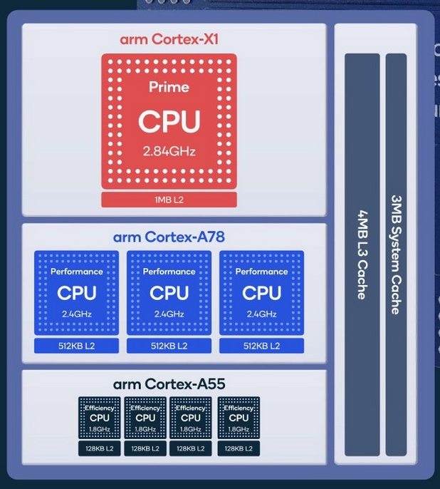
Real World
Big.LITTLE
  Snapdragon 888
Others
  Distance
  Power
  …

Slide 108
Takeaways
OS boot sequence
Process creation, and address space
CPU scheduling policies

