Slide 1
Introduction and History
Xin Liu
xl24j@fsu.edu
COP 4610 Operating Systems

Slide 2
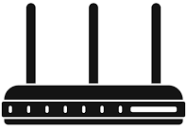
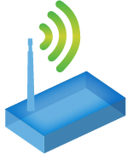
Who am I?
Edge
Cloud
Wired
Xin Liu
  Assistant Professor in CS, FSU
  PhD in CE, UMBC, 2022
  Post-doctoral Research, OSU, 2 years
  Research Focus
  Next generation of edge
  networks (6G and beyond)
  Experience
  Over 10 years of embedded
  system development experience
Wireless
Sensor Nodes

Slide 3

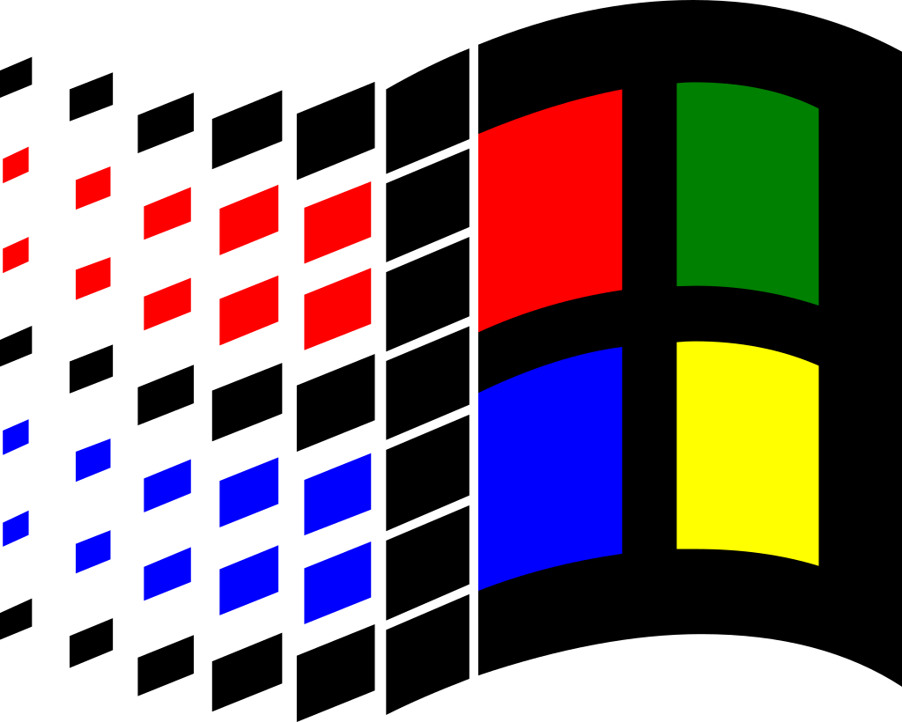
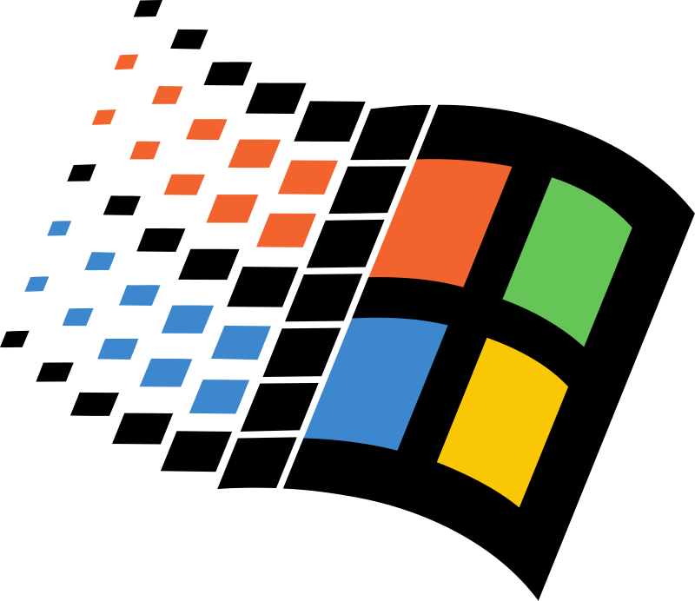
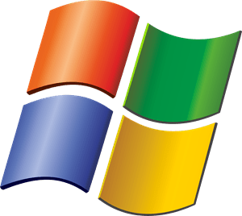
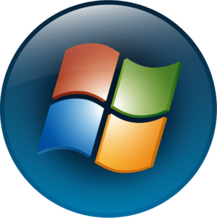
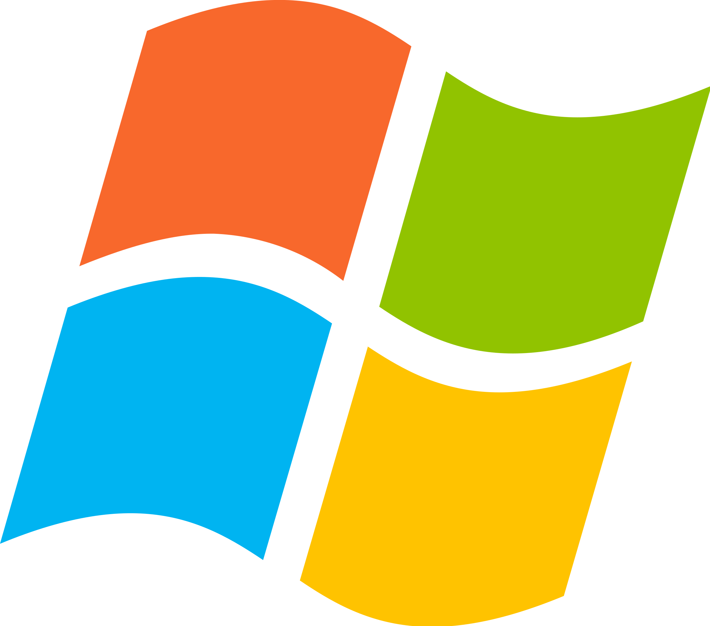
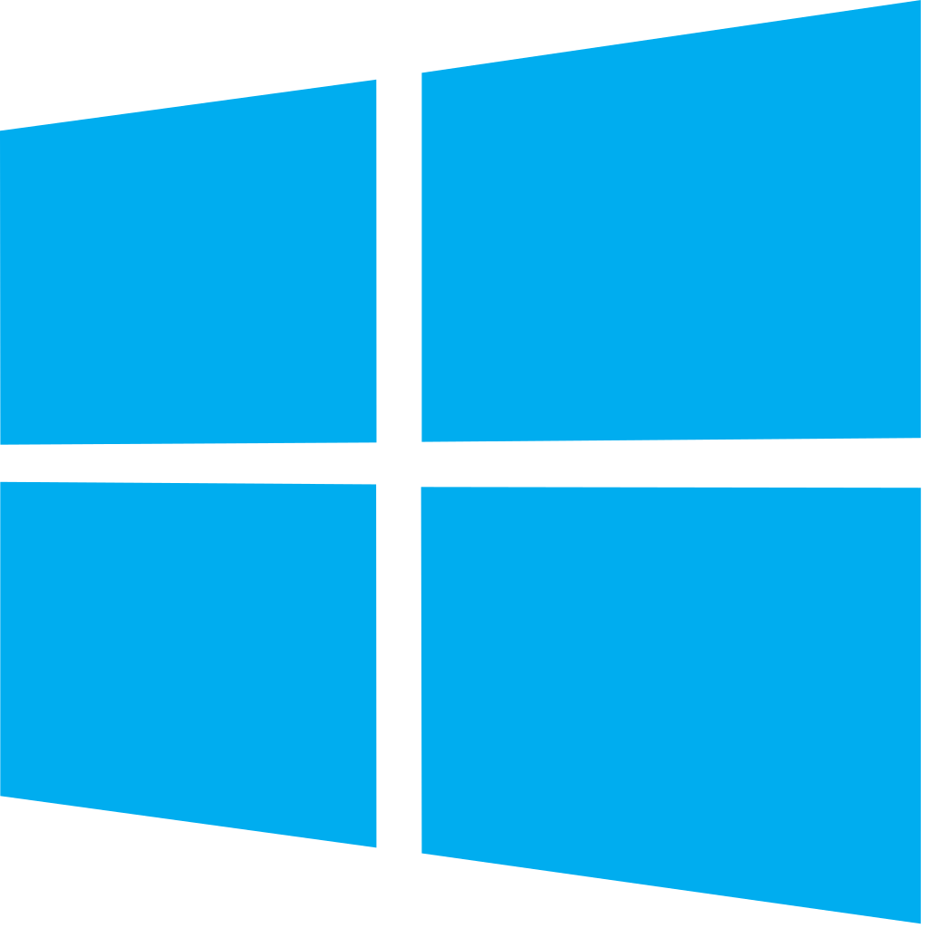


First Operating System
Window 1
1985
Window 3.1
1992
Window 95
1995
Window XP
2001
Window Vista
2006
Window 7
2009
…
Window 8
2012
Window 10
2015
Window 11
2021
Which was the first version of Windows you ever used?

Slide 4
First Operating System
Window 1
1985
Window 3.1
1992
Window 95
1995
Window XP
2001
Window Vista
2006
Window 7
2009
Reliability：
1. System Stability
2. Software Compatibility
3. Security
4. Data Integrity
5. Fault Recovery
…
…
Window 8
2012
Window 10
2015
Window 11
2021
Which was the first version of Windows you ever used?

Slide 5
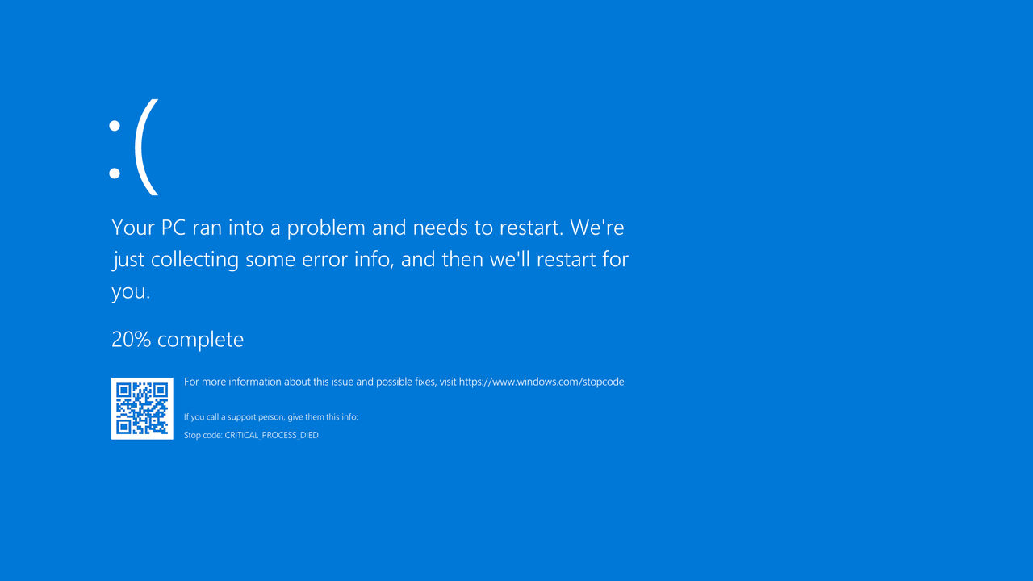
First Operating System
Window 1
1985
Window 3.1
1992
Window 95
1995
Window XP
2001
Window Vista
2006
Window 7
2009
Window 8
2012
Window 10
2015
Window 11
2021
Blue Screen of Death

Slide 6
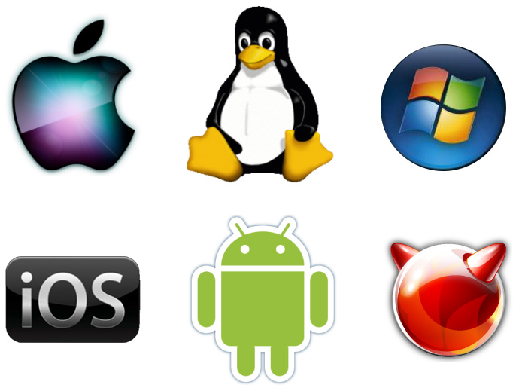
Other Classic Operating Systems
macOS
Linux
Windows
iOS
Android
Which operating systems are you using right now?

Slide 7
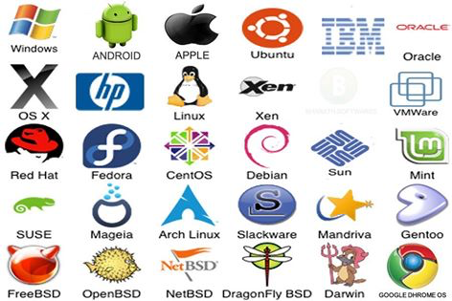
More Operating Systems
Which are the operating systems you are using right now?

Slide 8
What is an Operating System?
A program that acts as an intermediary between a user of a computer and the computer hardware
Key Characteristics:
  Program, Not Hardware: The operating system is software that manages the hardware, not a physical component itself.
  Acts as an Intermediary: It serves as a bridge between the user and the computer hardware, facilitating communication and resource management.

Slide 9
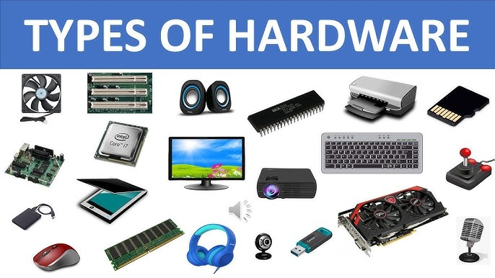
Computer System Structure
Computer system can be divided into four components:
  Hardware – provides basic computing resources
    CPU, memory, I/O devices

Slide 10
Computer System Structure
Computer system can be divided into four components:
  Hardware – provides basic computing resources
    CPU, memory, I/O devices
  Operating system
    Controls and coordinates use of hardware among various applications and users

Slide 11
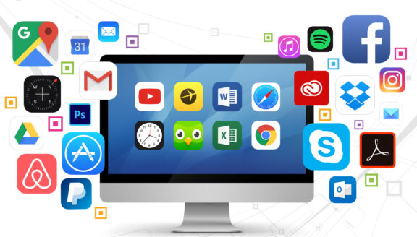
Computer System Structure
Computer system can be divided into four components:
  Hardware – provides basic computing resources
    CPU, memory, I/O devices
  Operating system
    Controls and coordinates use of hardware among various applications and users
  Application programs
    Define the ways in which the system resources are used to solve the computing problems of the users
    Word processors, compilers, web browsers, database systems, video games

Slide 12
Computer System Structure
Computer system can be divided into four components:
  Hardware – provides basic computing resources
    CPU, memory, I/O devices
  Operating system
    Controls and coordinates use of hardware among various applications and users
  Application programs
    Define the ways in which the system resources are used to solve the computing problems of the users
    Word processors, compilers, web browsers, database systems, video games
  Users
    People, machines, other computers

Slide 13
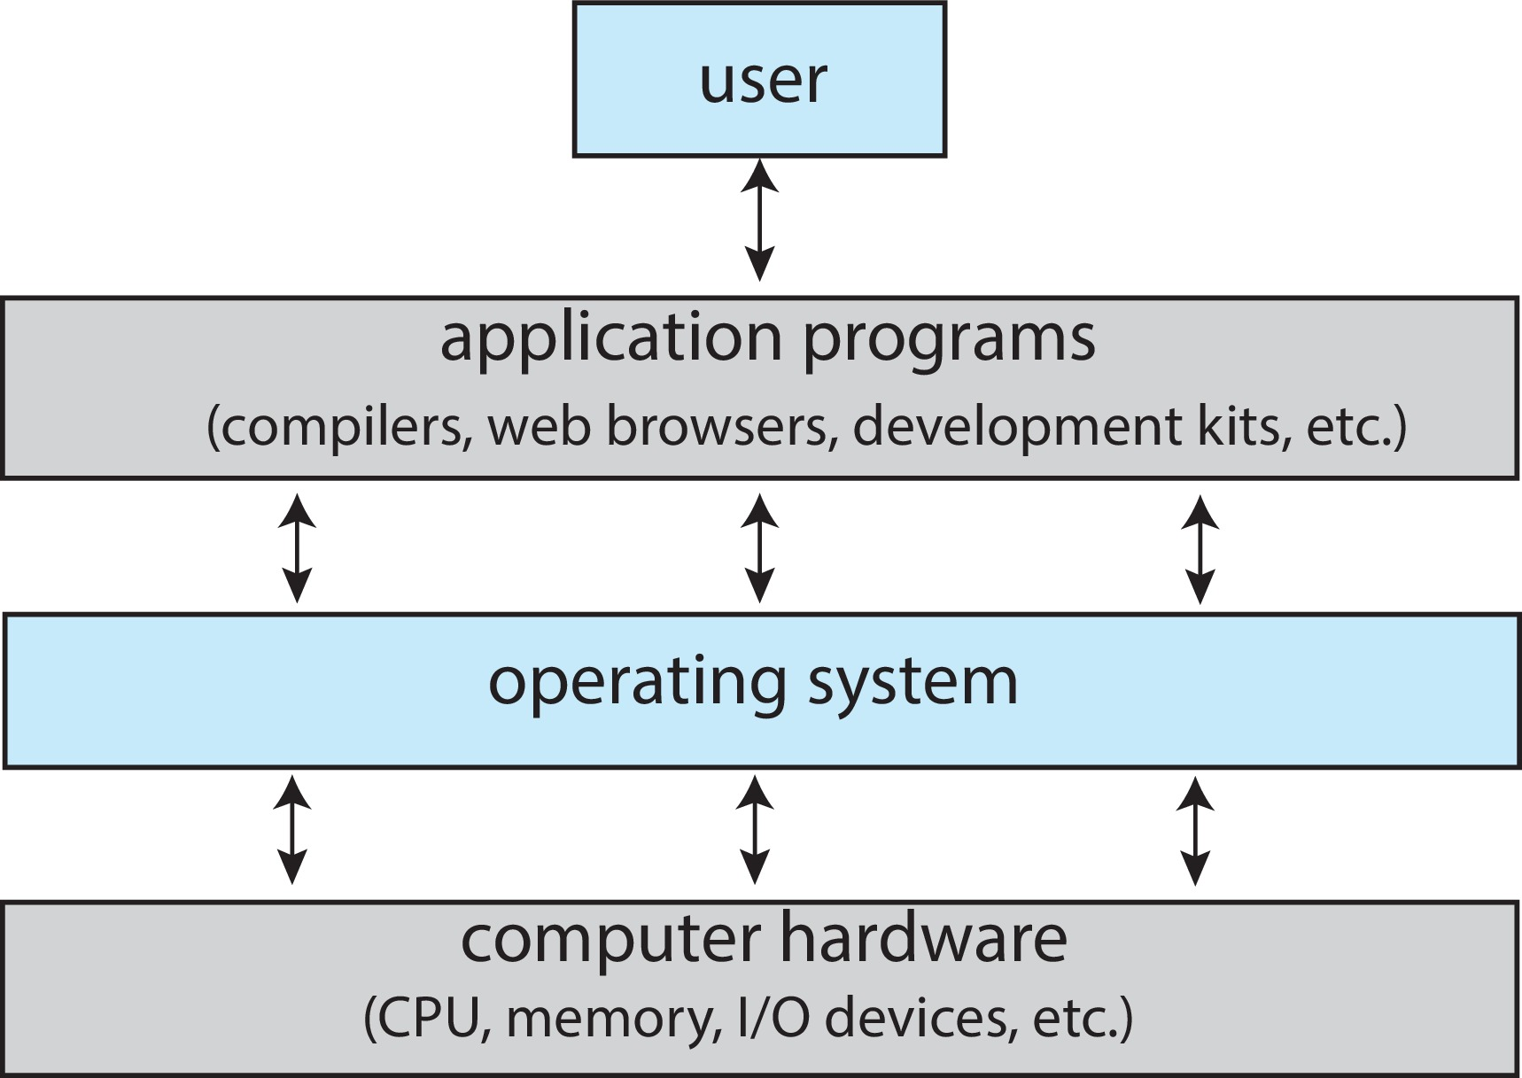
Abstract View of Components of Computer
Operating system goals:
  Execute user programs and make solving user problems easier
  Make the computer system convenient to use
  Use the computer hardware in an efficient manner

Slide 14
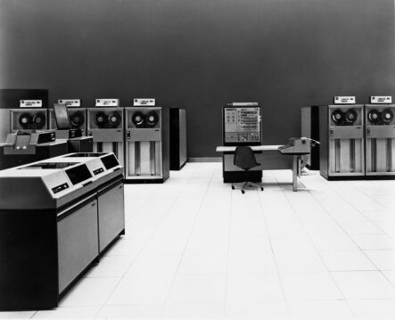
History Phase I:
Hardware Expensive, Humans Cheap
Hardware: mainframes
OS: human operators
  Handle one job (a unit of processing) at a time
  Computer time wasted
  while
  operators walk around
  the machine room
IBM System/360

Slide 15
OS Design Goal
Efficient use of the hardware
  Batch system: collects a batch of jobs before processing them and printing out results
    Job collection, job processing, and printing out results can occur concurrently
  Multiprogramming: multiple programs can run concurrently
    Example: I/O-bound jobs and CPU-bound jobs

Slide 16
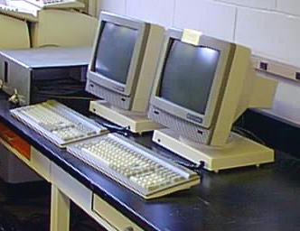
History Phase II:
Hardware Cheap, Humans Expensive
Hardware: terminals
OS design goal: more efficient use of human resources
  Timesharing systems: each user can afford to own terminals to interact
  with machines
  The operating system could support multiple users simultaneously, each with their own terminal
  Each user had an efficient and
  responsive experience,
  without the need for
  dedicated machines for each person

Slide 17
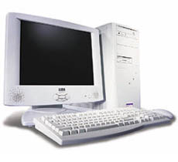
History Phase III: Hardware Very Cheap, Humans Very Expensive
Hardware: personal computers
OS design goal: allowing a user to perform many tasks at the same time
  Multitasking: a single user can run multiple programs on the same machine at the same time
  Multiprocessing: the ability to use multiple processors on the same machine

Slide 18
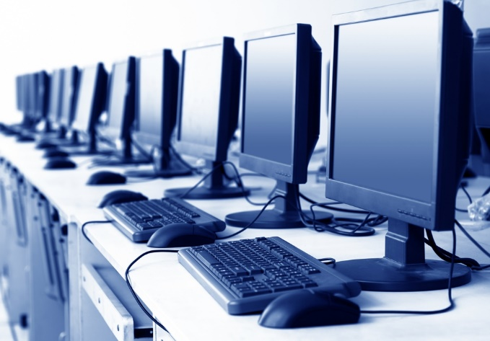
History Phase IV:
Distributed Systems
Hardware: computers with networks
OS design goal: ease of resource sharing among machines
E.g., cloud computing

Slide 19
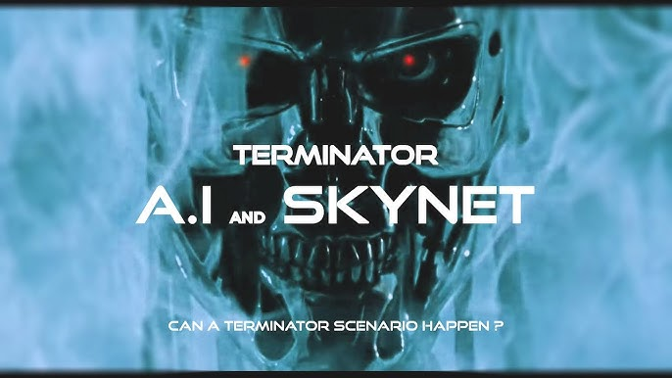
History Phase V, VI, VII?
AI As Operating System?

Slide 20
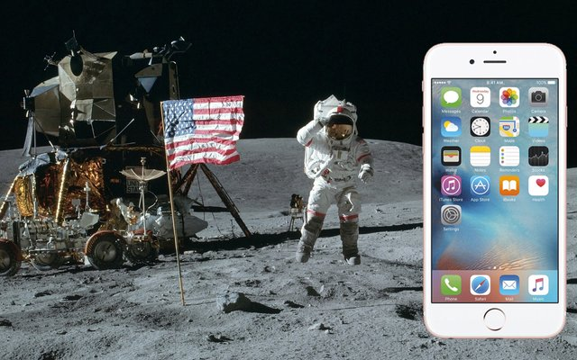
History of OS: Change!
 |  | 1980 | 2020 | Factor
Speed | CPU | 1 MIPS | 88K MIPS | 8.8 x 10⁴
 | Memory | 500 ns | 0.6 ns | 8.3 x 10²
 | Storage | 18 ms | 300 ns | 1.8 x 10⁵
 | Network | 300 bits/sec | 100 Gb/s | 3.6 x 10⁸
Capacity | Memory | 64 Kbytes | 3 TB | 5.0 x 10⁷
 | Disk | 1 Mbytes | 16 TB | 1.6 x 10⁷
Cost | Per MIP | $100K/MIP | $0.0066/MIP | 1.4 x 10⁷
Other | Address bits | 8 | 64 | 8
 | Users/CPU | 10s | 0.01 | 1.0 x 10⁻³

Slide 21
Abstract View of Components of Computer
  Hides the complexity and limitations of hardware from application programmers

Slide 22
Takeaways
OS is a program that acts as an intermediary between a user of a computer and the computer hardware
OS hides the complexity and limitations of hardware from application programmers

Slide 23
Syllabus Time https://xinliulab.github.io/cop4610.html

