Slide 1
Class Action Lawsuits Prediction Models
Team 8
Xiongfei (Jimmy) Ding, Xinlu Tu, Man (Sidney) Zhu, Yuhe Zhu

Slide 2
Agenda
01
Data Cleaning & Methods Introduction
02
Filed Frequency Model
03
Settled Frequency Model
04
Severity Model
05
Implementation

Slide 3
Data Cleaning & Methods Introduction
1

Slide 4
Data Collecting
Add missing financials by Capital IQ
Reclassify industry: “Industry”, “Sector”, “Primary industry” and “SIC industry”
Choose “Industry”

Slide 5
The Big Picture of Our Models
Filed Frequency
Settled Frequency
Damage Amount
Expected Damage Amount
×
×
=

Slide 6
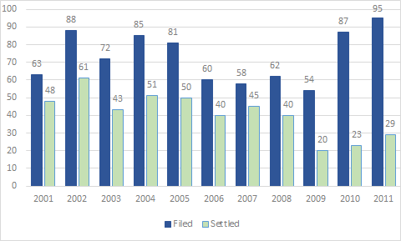
Data Description

Slide 7
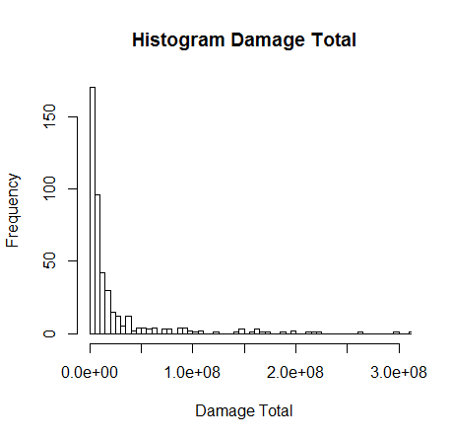
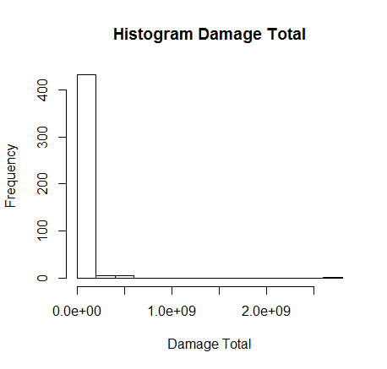
Data Description

Slide 8
Data Cleaning
Use prior year’s financial data to predict current year
Three data sets
Filed. csv (45434 Observations, 58 Variables)
Settled. csv (935 Observations, 85 Variables)
Damaged. csv (451 Observations, 85 Variables)

Slide 9
Filed Frequency Model
2

Slide 10
Methods for Frequency Models
Logistic Regression
Random Forest
Linear Discriminant Analysis
Model seleciton criterion: Receiver Operating Characteristic (ROC) curve

Slide 11
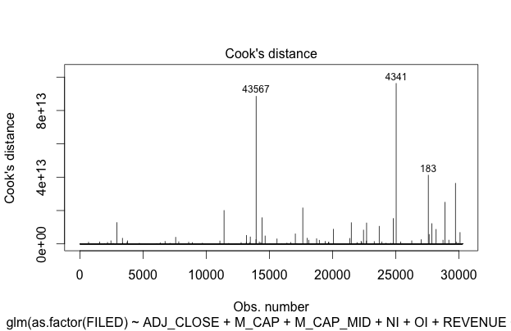
Logistic Regression
Cook’s distance:
568 influential points
511 points have FILED=1
Stepwise selection:
Only one variable is removed: prior year’s margin

Slide 12
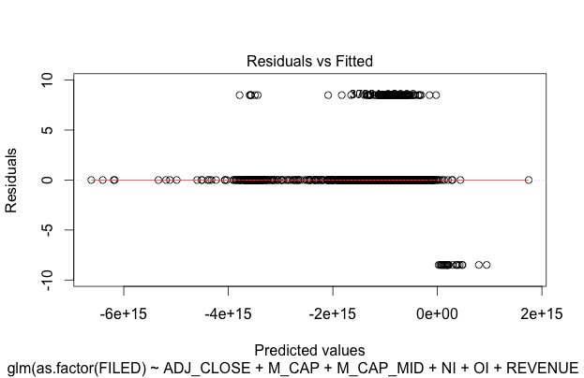
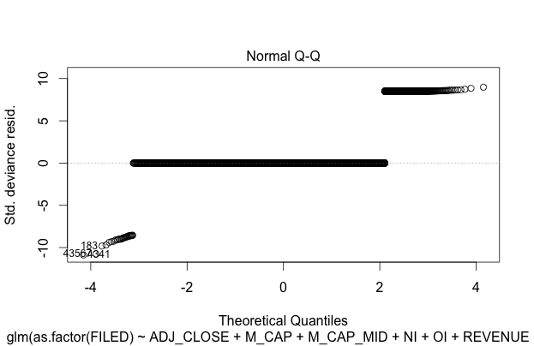
Logistic Regression
 | Predicted 0 | Predicted 1 | Error Rate
Actual 0 | 29715 | 27 | 9.0781-04
Actual 1 | 538 | 9 | 0.9835
Goodness of Fit (GOF) test:
P-value< 2.2e-16

Slide 13
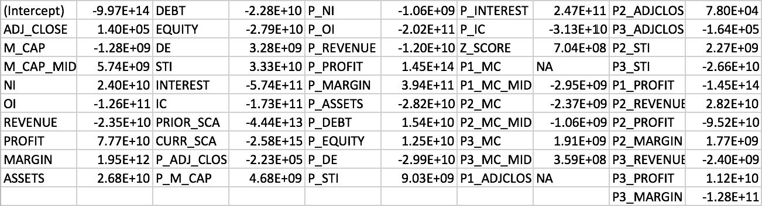
Logistic Regression
Coefficients– 50 variables

Slide 14
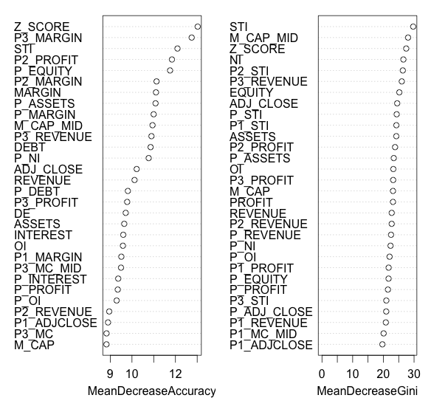
Random Forest

Slide 15
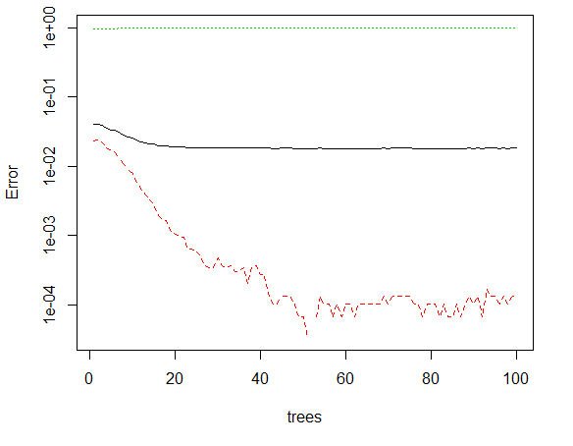
Random Forest
 | Predicted 0 | Predicted 1 | Error Rate
Actual 0 | 29738 | 4 | 1.3449e-04
Actual 1 | 545 | 2 | 9.9634-01

Slide 16
Linear Discriminant Analysis
Prior probabilities of groups:
Actual 0 | Actual 1
0.9819 | 0.0181
Two methods for variable selection:
1. Stepwise selection result from logistic regression
2. Important variables selected by Random Forest

Slide 17
Linear Discriminant Analysis

Slide 18
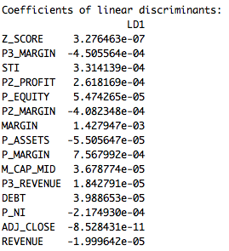
Linear Discriminant Analysis
Predicted results
 | Predicted 0 | Predicted 1 | Error Rate
Actual 0 | 29648 | 94 | 0.00316051
Actual 1 | 535 | 12 | 0.97806216

Slide 19
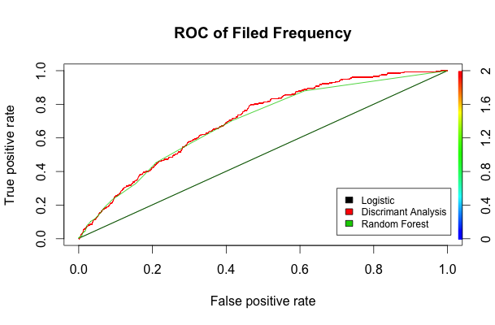
Model Selection
AUC Score:
LG: 0.4989
RF: 0.6897
DA: 0.7036
Final Model:
Random Forest
Linear Discriminant Analysis

Slide 20
Model for Each Industry
Same process for each industry
Overall model: 10
Random Forest: 22
Linear Discriminant Analysis: 26
Logistic Regression: 6

Slide 21
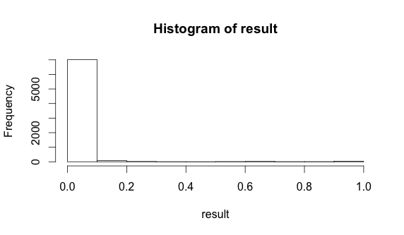
Test Result
Result description:

Slide 22
Settled Frequency Model
3

Slide 23
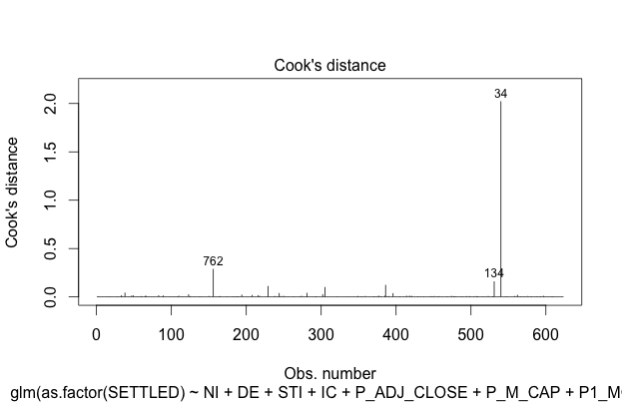
Logistic Regression
Cook’s distance:
Only 1 influential point
Stepwise selection:
16 variables are selcted

Slide 24
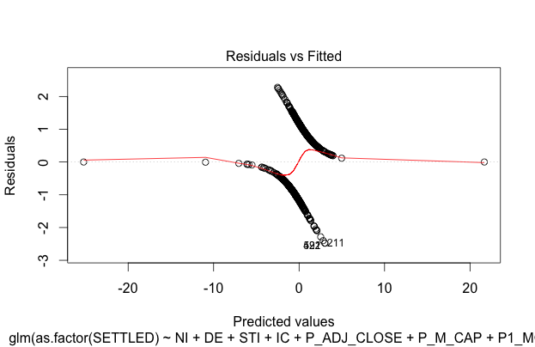
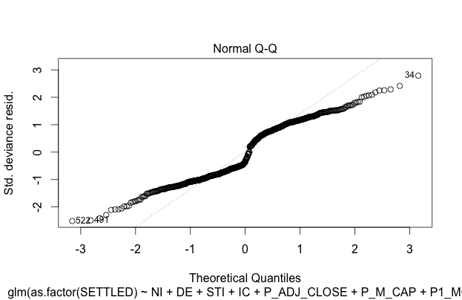
Logistic Regression
 | Predicted 0 | Predicted 1 | Error Rate
Actual 0 | 256 | 74 | 0.2242
Actual 1 | 92 | 201 | 0.3140
Goodness of Fit (GOF) test:
P-value=0.0568

Slide 25
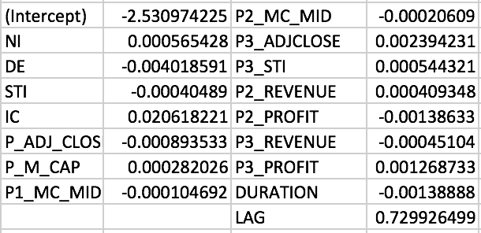
Logistic Regression
Coefficients– 16 variables

Slide 26
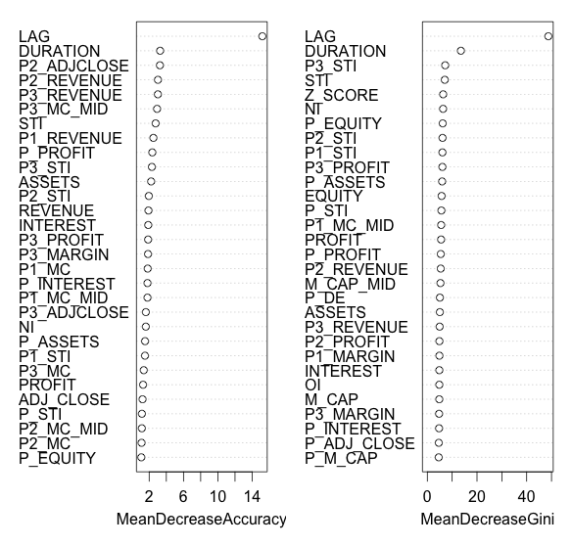
Random Forest

Slide 27
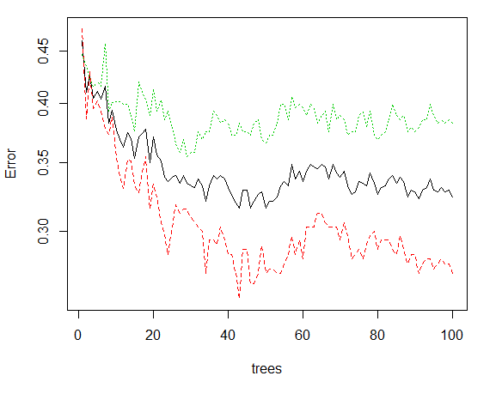
Random Forest
 | Predicted 0 | Predicted 1 | Error Rate
Actual 0 | 244 | 86 | 0.2606
Actual 1 | 116 | 177 | 0.3959

Slide 28
Linear Discriminant Analysis
Prior probabilities of groups:
Actual 0 | Actual 1
0.5297 | 0.4703
Stepwise selection result from logistic regression

Slide 29
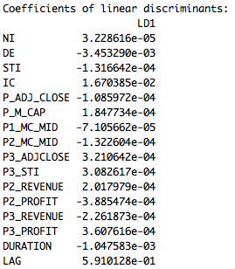
Linear Discriminant Analysis
Predicted results
 | Predicted 0 | Predicted 1 | Error Rate
Actual 0 | 261 | 69 | 0.2091
Actual 1 | 101 | 192 | 0.3447

Slide 30
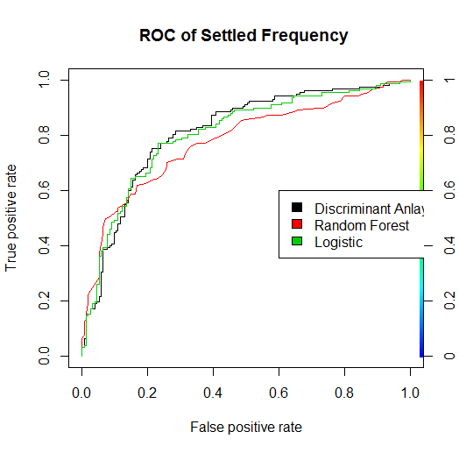
Model Selection
AUC Score:
LG: 0.8046
RF: 0.7775
DA: 0.8126
Final Model:
Logistic Regression
Random Forest
Linear Discriminant Analysis

Slide 31

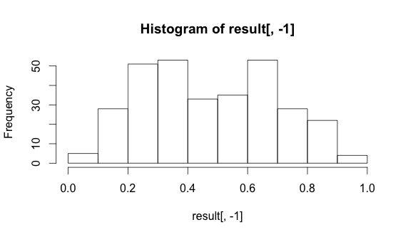
Test Result
Result description:

Slide 32
Severity Model
4

Slide 33
Methods for Severity Models
ANOVA test of industries
Linear regression
Principal Component Analysis (PCA)
Neural network
Model Selection Criterion: Mean Absolute Percent Error (MAPE)

Slide 34
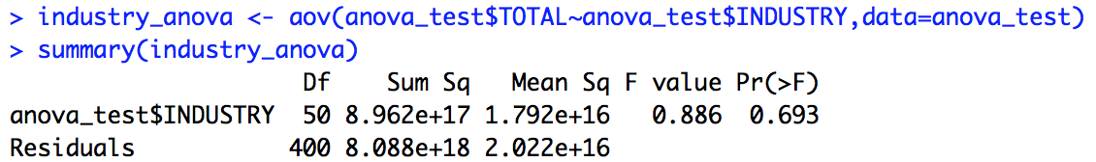
Linear Regression
ANOVA test on industries

Slide 35
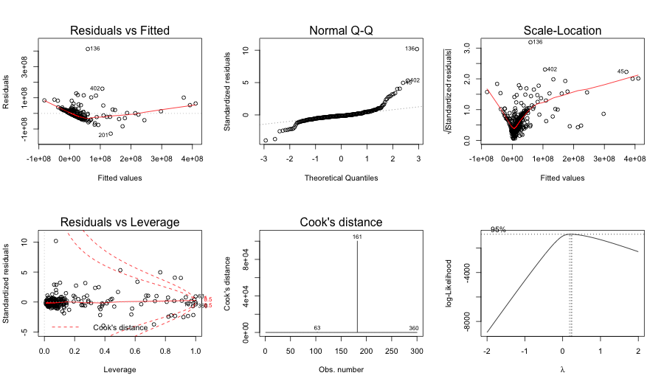
Linear Regression

Slide 36
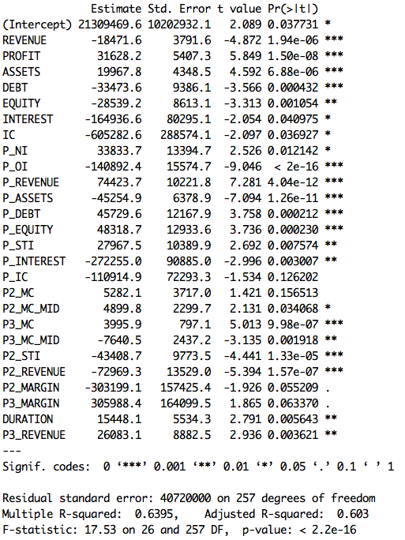
Linear Regression
Variable selection

Slide 37
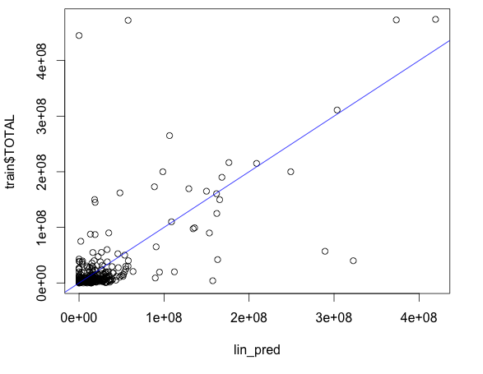
Linear Regression
Prediction
Replace negative values with 0

Slide 38
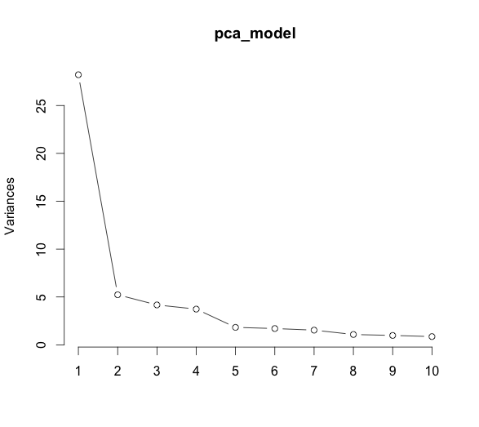
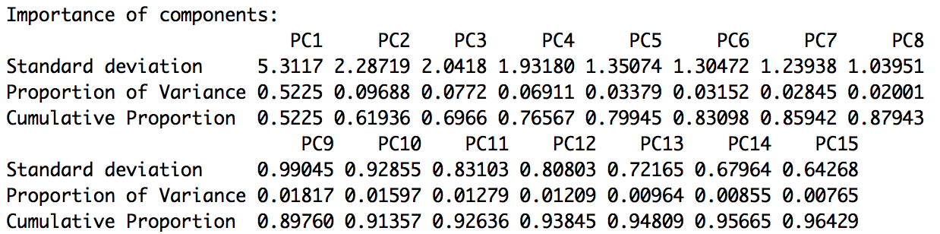
PCA
Fit model with scale
Choose PC1-PC15
Linear regression
Variable selection:
PC1 + PC4 + PC5 + PC7 + PC8 + PC9 + PC11

Slide 39
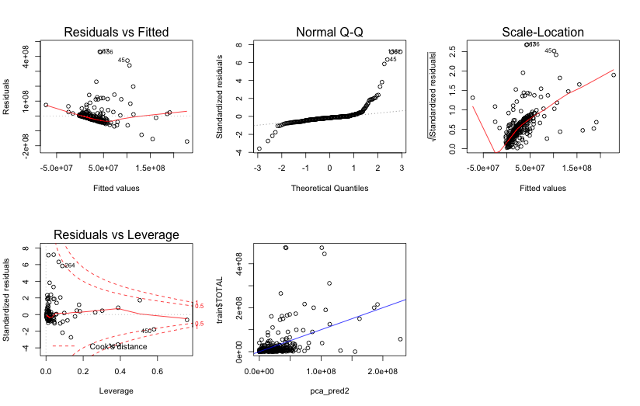
PCA

Slide 40
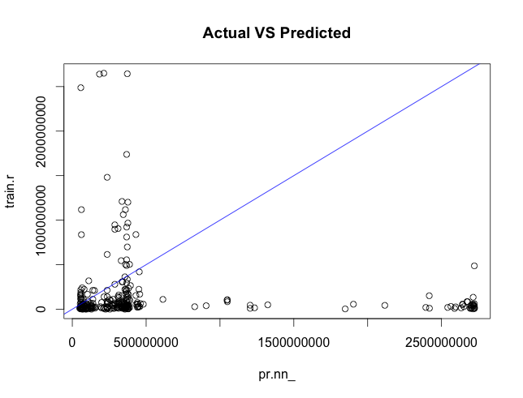
Neural Network
Preparation
Generalized linear model
Standardized dataset
Neural Network
Prediction

Slide 41
Model Selection
Final Model:
Linear Regression
Principal Component Analysis
Model | MAPE
Linear Regression | 3.8603
Principal Component Analysis | 3.4635
Neural Network | 14.6484

Slide 42
Suggestions for Improvement
Include more data such as information about the top management team
Deal with the negative prediction values instead of assigning zero in severity model

Slide 43
Conclusion
Filed Frequency Model:
Random Forest + Linear Discriminant Analysis
Settled Frequency Model:
Logistic Regression +Random Forest + Linear Discriminant Analysis
Severity Model:
Linear Regression + Principal Component Analysis

Slide 44
Model Implementation
5

Slide 45
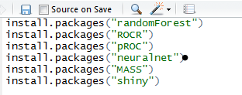

Implementation
Extract AXIS.zip and TEAM8.zip, and put the extracted folders in your RStudio directory
Install packages
Run Shiny App

Slide 46
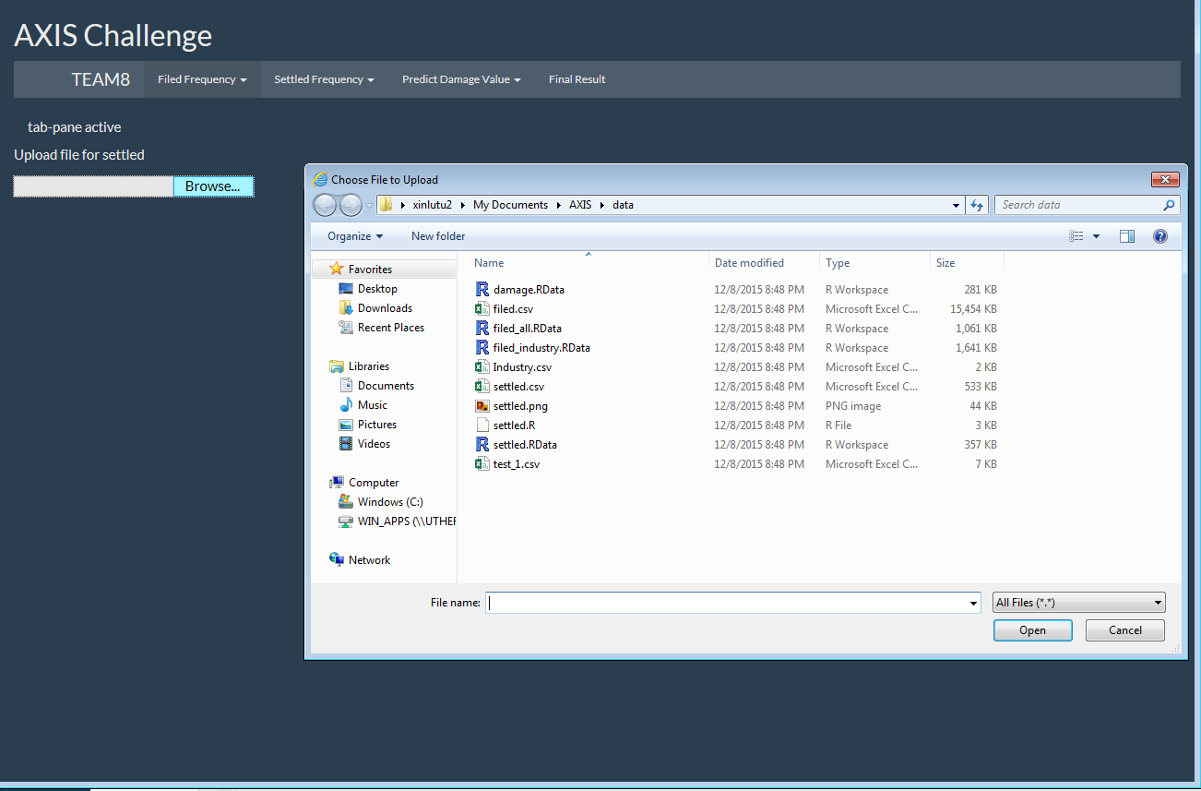
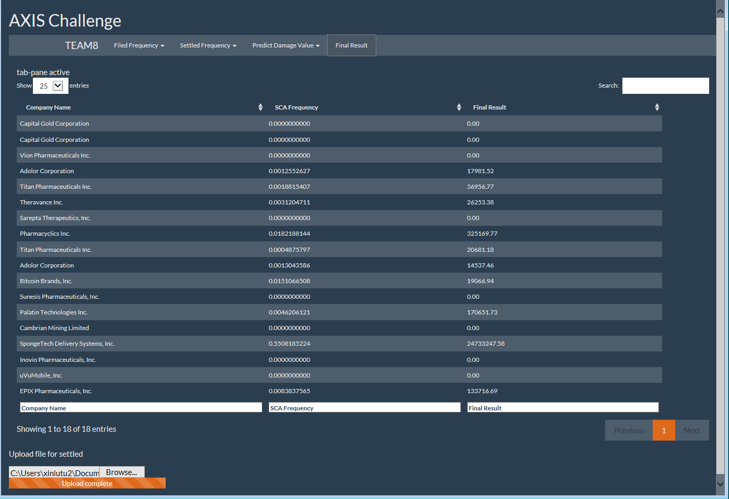
Implementation
Search the Company
Upload File
Result
Choose Test File

Slide 47
THANKS!
Any questions?

