Slide 1
Informal Introduction to MetaHDL
xin.meng@exar.com

Slide 2
Agenda
Why MetaHDL?
Syntax
Compiler Usage
Notes to VPerl users

Slide 3
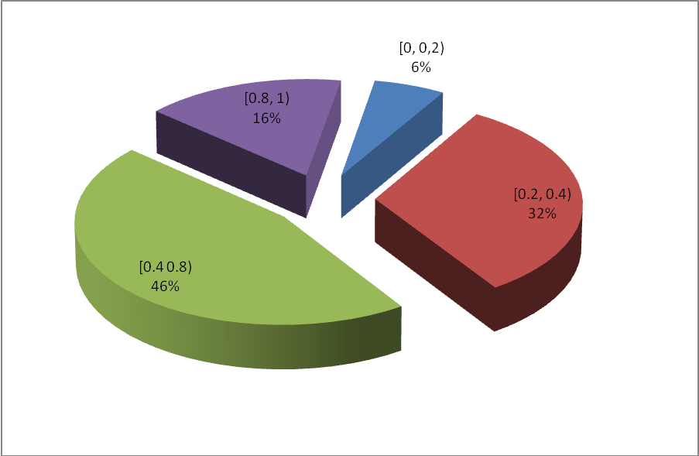
Why MetaHDL -Redundancy

Slide 4
Why MetaHDL -Reuse
Architecture level code configuration: preprocessor
Parameter in RTL
Combined with declaration
Readability
Maintainability
Quality

Slide 5
Syntax: Background
Port and declarations can be inferred from code
Inter-connection semantics: same name should be connected
Code style vs. Syntax
Code configuration must focus on “core” logic
Only 4 blocks:
FF
comb
FSM ::= FF | comb
inst ::= FF | comb | FSM | inst

Slide 6
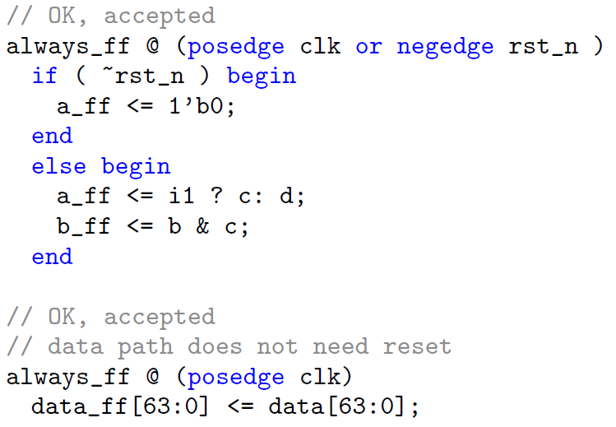
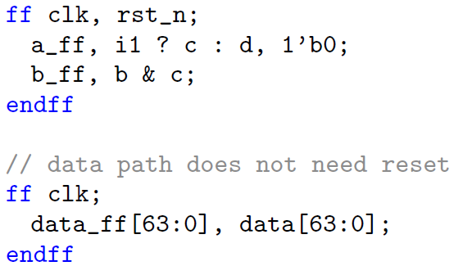
Syntax: FF

Slide 7
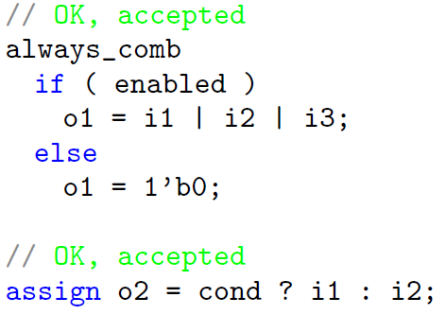
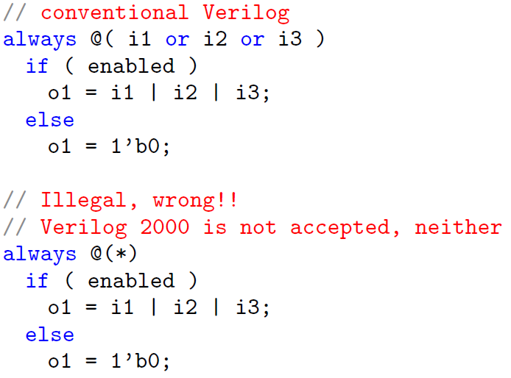
Syntax: comb

Slide 8
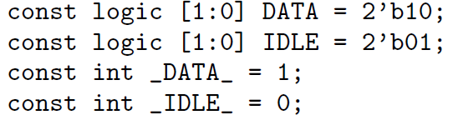
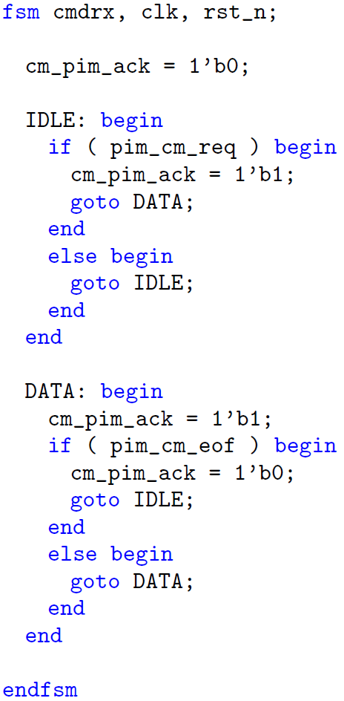
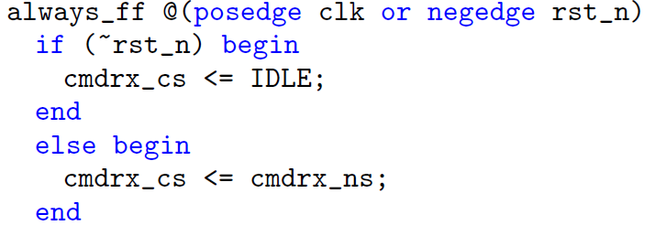
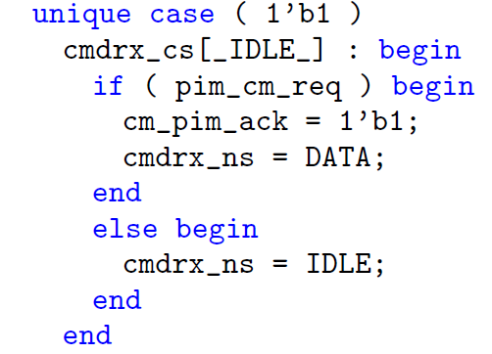
Syntax: FSM

Slide 9
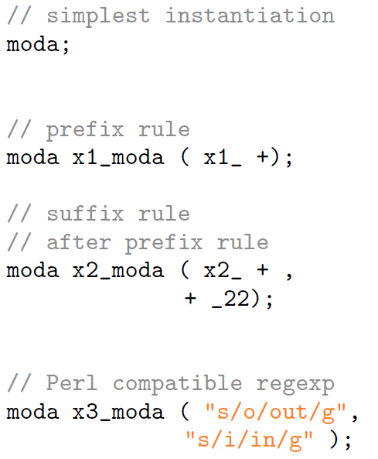
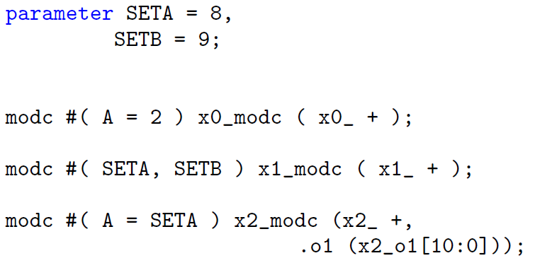
Syntax: inst

Slide 10
Code Configuration: Preprocessor
`define, `ifdef, `ifndef
`if, `case, `while, `for,
`let
+, -, *, /, %, **
&&, ||,
!, ^, &, |, >>, <<
LOG2(), CEIL(), FLOOR(), ROUND(), MAX(), MIN(), ODD(), EVEN(), ABS()

Slide 11
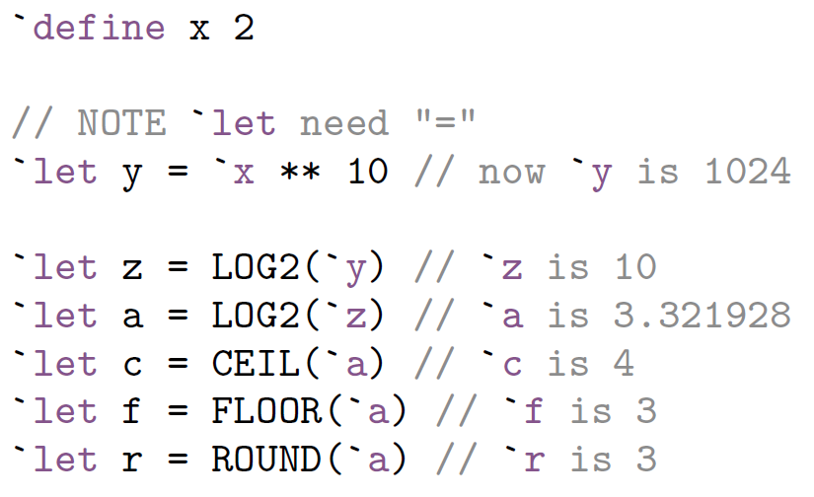
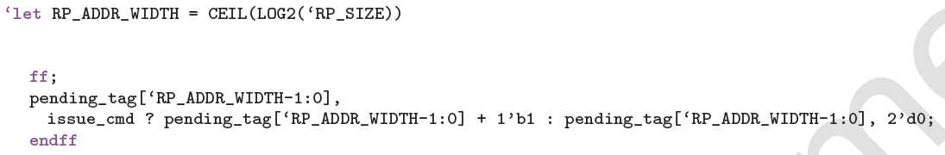
Code Configuration: Preprocessor cont’d

Slide 12
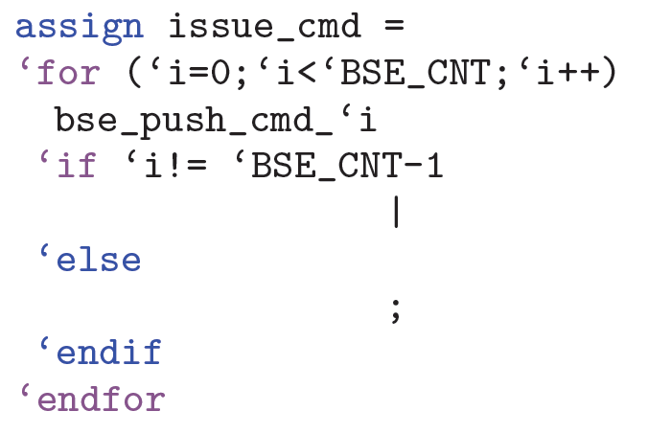
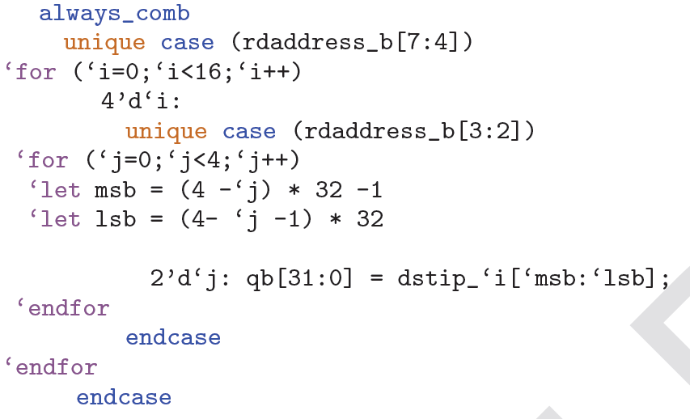
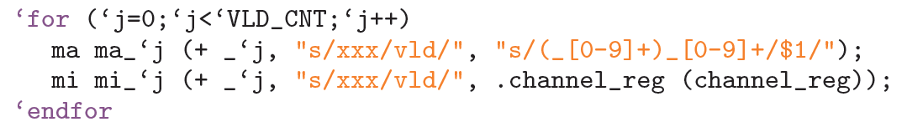
Code Configuration: Preprocessor cont’d

Slide 13
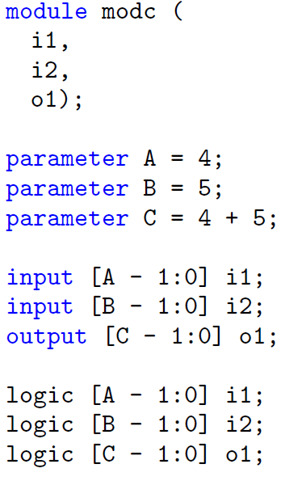
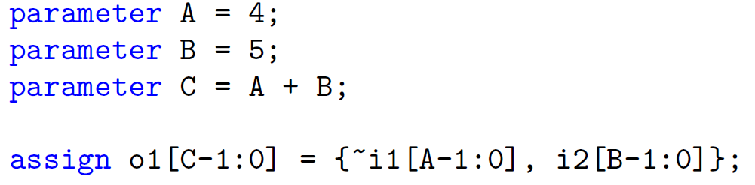
Code Configuration: Parameter tracing

Slide 14
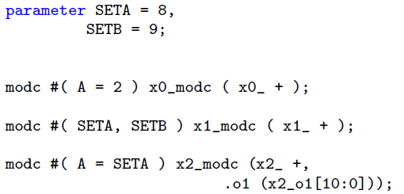
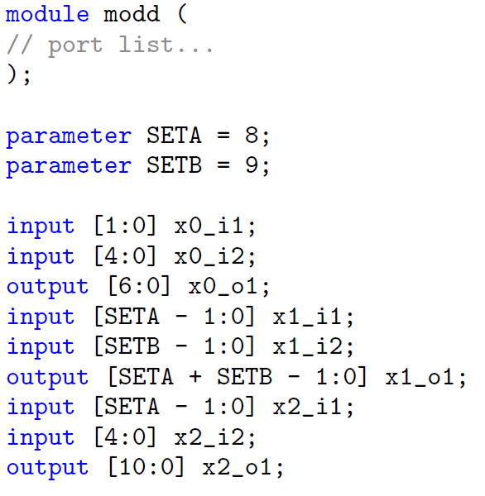
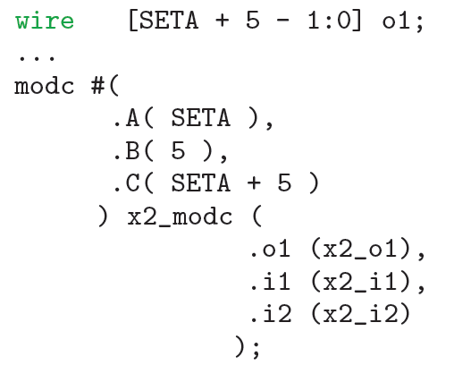
Code Configuration: Parameter tracing cont’d

Slide 15
Compiler Usage: Include and output
Command line:
% mhdlc [options] files
% mhdlc64 [options] files
Include path contains all dependent modules:
-I
Generated code are all put in output path
-o
Generated code can be SystemVerilog or Verilog
-verilog

Slide 16
Compiler Usage: Macro on command line
-D option works just like in gcc
% mhdlc -DVLD_CNT=4 -DBSE_CNT=4 -DRP_SIZE=4

Slide 17
Compiler Usage: Dependency resolving
Resolve dependency on the fly
% mhdlc dma.mhdl
all submodules are generated automatically
Comprehensive vs. Fast
Redefinitions are reported
-F option: Fast resolving
Performance: 30x-60x compared to VPerl

Slide 18
Compiler Usage: control variable
portchk
modname
outfile

