Slide 1
Ethnographic Fieldwork at a University IT Security Office
Xinming (Simon) Ou
Kansas State University
Joint work with John McHugh, S. Raj Rajagopalan, Sathya Chandran Sundaramurthy, and Michael Wesch

Slide 2

SOC Monkey’s Life
Automated Situation Awareness
Users and data assets
IDS alerts
Reasoning System
Network configuration
Vulnerability
reports
Apache
1.3.4
bug!
Security advisories

Slide 3
On-going Ethnographic Fieldwork
Multiple PhD students embedded with security analysts at a campus network
Incident response and forensics
Firewall management
Managing host-based intrusion detection (IDS) and anti-virus systems
Collaborating with an anthropologist
Teaches us the proper fieldwork methods
Helps us understand/handle the “human” aspects

Slide 4


The University SOC
CISO
Incident Response and Forensics
Firewall Management
Antivirus and Phishing Scams
PCI Compliance

Slide 5
The University SOC
CISO
Incident Response and Forensics
Firewall Management
Antivirus and Phishing Scams
PCI Compliance

Slide 6





Ticket Generation
Firewall Logs
ARP Logs
This process takes up to 10 min in the worst case
MAC to User ID Logs

Slide 7
This is not an Isolated Problem
See the talk tomorrow:
Beehive: Large-Scale Log Analysis for Detecting Suspicious Activity in Enterprise Networks

Slide 8

Let’s implement a caching database
Reduced ticket generation time to just seconds

Slide 9
Gained acceptance into the SOC
This led to more collaboration from the incident response analyst
Starting to move from peripheral participation to full participation

Slide 10
Threat Intelligence Framework
Notes:
Show that the tool has automated log collection.

Slide 11



Use Cases
Automated Phishing Scam Detection
Automated Ticket Generation
Tracking Stolen Laptops
Anomalous Traffic Detection

Slide 12
Observations
Lack of any documentation of the needs that fieldworker ended up addressing
Standard processes for procurement simply cannot capture the need
Lack of awareness of the existence of these problems on the vendor community
The problems are not on the radar of commercial solution providers even though the problem is old
Lack of awareness of these problems among the academic community
Lack of papers that address the real problem even though there are many papers on overlapping areas

Slide 13
Observations
We are developing a way not just to automate the tasks of an analyst, but to create tools that the analyst actually wants to use to help them.
Analyst co-creating the tool with us – in a sense
Creates a rich space for reaching deeper insights
The relationship between humans and their tools: how humans shape tools and how tools shape humans
Anthropology offers a century of reflection to consider

Slide 14
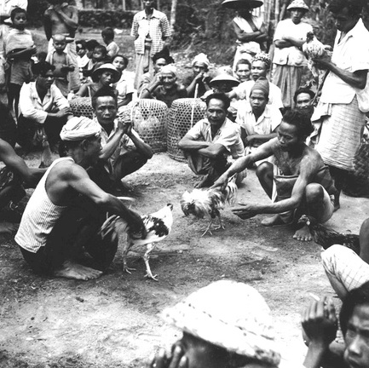
Same Type of Story from Anthropology
Clifford Geertz. Deep Play: Notes on the Balinese Cockfight. 1972.

Slide 15
Formulating “Grounded Theory”
Strips
Ethnographic data (an interaction, bit of an interview, sequence of behavior, etc.)
Frame
A knowledge structure or schema or hypothesis that makes sense of the data.
Rich Point
Any moment where a new strip does not make sense in terms of the current frame.
The Professional Stranger : An Informal Introduction to Ethnography. Michael Agar, 1980

Slide 16
Our Current “Frame”
Investigation patterns repeat across incidents.
Investigation procedures often need to be refined frequently
The software that automates parts of the process must then be modified frequently
This process is time consuming for a SOC operator
The iterations of the software were addition, deletion, or modification of modules

Slide 17
Alternative Software Development Strategy
Design a specification language
This must be easy enough for analysts to learn and use
Must be extensible and be able to optimize
A translator to implement the specifications
The translator uses modular components to achieve this
Related idea has been proposed by other researchers as well:
See Borders, et al. Chimera: A Declarative Language for Streaming Network Traffic Analysis, USENIX Security 2012.
Generative Programming paradigm will help in achieving our vision

Slide 18
Generative Programming
Development of software families rather than specific software
Analogous to automation in manufacturing
Software must be made of interchangeable modules
This ensures component optimization
Automated way to assemble the components
This requires domain knowledge

Slide 19
Generative Programming Model
Configuration Knowledge
Illegal feature combinations
Default settings
Default dependencies
Construction rules
Optimizations
Problem Space
Domain-specific concepts and
Features
Solution Space
Elementary components
Maximum combinability
Minimum redundancy
Domain-Specific Language (DSL)
Translator
Security Solutions
Image source: Generative Programming, Krzysztof Czarnecki and Ulrich W. Eizenecker

Slide 20
Ethnographic Fieldwork-guided Cybersecurity Research
Social acceptance by the community of practice
Apprenticeship
Models, Algorithms,Tools
Questioning, Reflection, and Reconstruction

Slide 21







Bringing Anthropology into Cybersecurity Project Team
John McHugh
Redjack, LLC
Xinming Ou
K-State
Raj Rajagopalan
Honeywell
Michael Wesch
K-State
Sathya Chandran Sundaramurthy
K-State
Yuping Li
K-State
We would like to thank the support provided by the National Science Foundation

Slide 22
Related Effort
What Makes a Good CSIRT
DHS-funded three-year project
George Mason University, HP, and Dartmouth
Organizational psychology: knowledge, skills and abilities; teams; interactions
Economy: costs and benefit
Results derived from interviews, focus groups, and observation

Slide 23
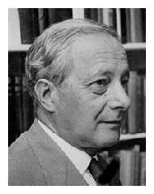
Why Anthropology?
“We can know more than we can tell.”
- Michael Polanyi

