Slide 1
The problem with teaching Cyber security
Raj Rajagopalan
Honeywell Research
(siva.rajagopalan@honeywell.com)
Oct 7, 2013

Slide 2
My Position
With a few exceptions, the following groups of people have no clue about the needs of security practice:

Slide 3
My Position
With a few exceptions, the following groups of people have no clue about the needs of security practice:
  Academicians

Slide 4
My Position
With a few exceptions, the following groups of people have no clue about the needs of security practice:
  Academicians
  Corporate Researchers

Slide 5
My Position
With a few exceptions, the following groups of people have no clue about the needs of security practice:
  Academicians
  Corporate Researchers
  Software manufacturers

Slide 6

How do I know?
Using Anthropology to improve Technology
  Charles Leinbach and Ron Sears studied the needs of RV users using anthropological techniques
  Helped create one of the most popular RV designs of all time
Study in progress on Security Incident Response and Forensics using Anthropological techniques¹
  Grad student “embedded” in the KSU Security Operations Center (SOC) for the past six months
  Observing and understanding the needs, pressures, and drivers of security analysts
What we have learned so far
  Incident response is as much a people problem as it is a technical problem
  Product manufacturers do not have basic familiarity in security
  Even after so many interviews with the analyst some of the knowledge is hard for him to explain
  It is important to extract this knowledge if researchers want to develop useful forensic tools
¹With Xinming Ou, John McHugh, and Mike Wesch. supported by NSF Grant No. CNS-1314925 with KSU and RedJack, LLC.

Slide 7
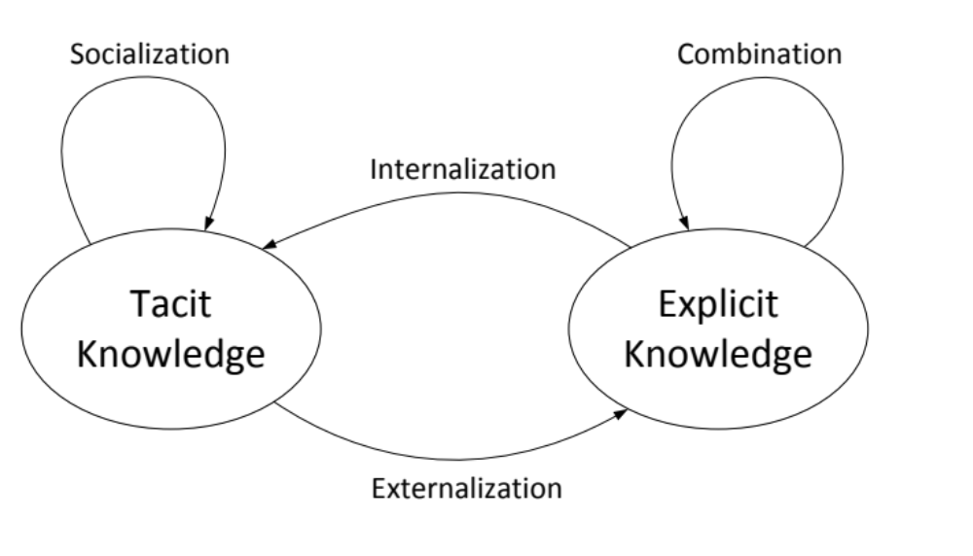
Anthropology-guided Cybersecurity Research
Social acceptance by the community of practice
Apprenticeship
Models, Algorithms,Tools
Questioning, Reflection, and Reconstruction
Notes:
Widen the workforce by enabling less skilled people to do the mundane jobs. E.g. K-State SOC has pushed this to NOC. Make best use of the time of skilled labor.

Slide 8
Golden Observations
We need humility and empathy to understand security practitioners. We have to want to learn their perspective.
Our theories about real security will necessarily be messy. We have to learn to embrace imperfection in our models.
We have to be honest about the mistakes and flaws in our tools.
“Field work” is essential to know what the real problems and constraints are.

