Slide 1
Accelerating Program Analyses by Cross-Program Training
Sulekha Kulkarni, Ravi Mangal, Xin Zhang, Mayur Naik
Georgia Tech

Slide 2


Motivation
App
Library
Notes:
Practical applications today are built atop large libraries that provide well-defined functionality. Moreover, multiple applications share these libraries. When such applications are analyzed, the entire shared code is potentially reanalyzed each time. This seems redundant.

Slide 3
Motivation
App A
App B
Library
Notes:
Here is a more abstract view of multiple applications sharing common code. Apps A and B are two applications that make calls to methods in a library that they both use. These methods in turn call other methods.

Slide 4
Existing Approach 1: Whole-Program Analysis
App A
App B
App B
Library
Notes:
Let us consider one application, say App B. A traditional whole-program analysis starts from the main method of App B and proceeds to analyze all methods transitively reachable from it. A whole-program analysis is lazy in the sense that it analyzes only the methods reachable from main. Moreover, it reanalyzes the entire program from scratch each time: there is no reuse.

Slide 5
Existing Approach 2: Compositional Analysis
App A
App B
App B
Library
Notes:
A second alternative is compositional analysis. It analyzes each method of the library independent of any application. Each method is analyzed in every possible calling context and a symbolic summary is generated. Compositional analysis is not lazy but is reusable: it analyzes all methods of a library once. When an application, say, App B needs to be analyzed, the symbolic summaries of the methods it calls are instantiated with specific calling contexts. But, the instantiation has a cost: it does not come for free.

Slide 6
An Idea
Can we synergistically combine the laziness of the whole-program approach with the reuse of the compositional approach?

Slide 7
Our Contributions
New approach to accelerate inter-procedural static analysis
Synergistically combines compositional and whole-program approaches
Polymer: generic framework for analyses written in Datalog
Requires pre/post condition specification per analysis
Demonstrated speedup for two popular analyses
2.6x for call-graph analysis and 5.2x for pointer analysis on 10 Java programs from Dacapo benchmark suite

Slide 8



Overall Architecture
Polymer
Analysis
+
Pre/Post Spec
Offline Phase
Online Phase
Analysis Result
Summaries
App A
App B
App C
App D
Library
How to define a summary for an analysis in Datalog?
Which summaries to learn in the Offline phase?
Which summaries to reuse in the Online phase?

Slide 9
Graph Reachability Example
Input: A directed graph with:
a distinguished root node
each node in application or library
Problem: Which application nodes are reachable from the root node?
Notes:
Lets look at a graph reachability example that models a simple program analysis. The input to this analysis is a program represented as a directed graph. This graph has a distinguished root node, denoted B0. Moreover, each node in the graph either belongs to the application (denoted B) or the library (denoted L). The goal of this analysis is to determine which application nodes B1, B2, B3 are reachable from the root node B0.
A naïve whole-program analysis will compute reachability of all L and B nodes. However, since the L nodes represent a shared library, the analysis could take advantage of previously analyzed programs such as A in the offline phase in order to significantly accelerate the analysis of program B in the online phase.
Lets see how we can do this by learning and reusing summaries.

Slide 10
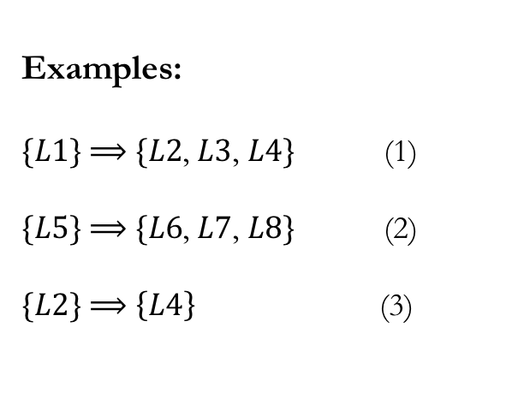

Our Definition of a Summary
$${tuples}_{pre}⟹{tuples}_{post}$$
Examples:
$\{L1\}$ $⟹$ $\{L2$, $L3$, $L4\}$ (1)
$\{L5\}$ $⟹$ $\{L6$, $L7$, $L8\}$ (2)
$\{L2\}$ $⟹$ $\left\{L4\right\}$ (3)
In general, there are multiple valid choices for summaries.
Notes:
Since Datalog operates on tuples, it is natural to define summaries as a pre/post pair over sets of tuples.
If analysis facts in ${tuples}_{pre}$ hold, then analysis facts in ${tuples}_{post}$ hold.
Lets look at some examples….
For the graph reachability analysis, the tuples in summaries concern reachability facts. In a realistic setting, the tuples could be sets of arbitrary program facts.

Slide 11



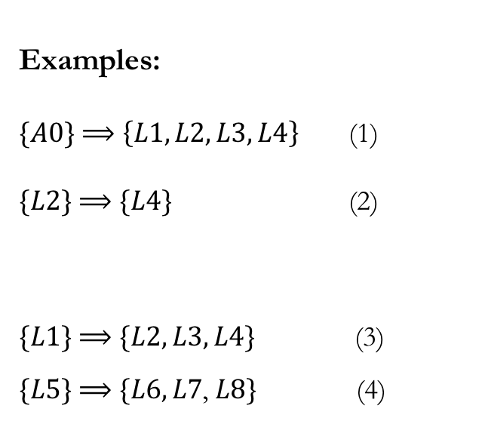

Choosing Good Summaries
Examples:
$\{A0\}$ $⟹$ $\left\{L1, L2, L3, L4\right\}$ (1)
$\{L2\}$ $⟹$ $\{L4\}$ (2)
$\{L1\}$ $⟹$ $\{L2, L3, L4\}$ (3)
$\{L5\}$ $⟹$ $\{L6, L7$, $L8\}$ (4)
PickGoodPre is a specification for ${tuples}_{pre}$
PickGoodPre returns $\{ \left\{L1\right\}, \left\{L5\right\} \}$
Notes:
What is a good summary?
A good summary is one that is reusable across programs and saves considerable amount of work when used.
When can a summary be used?
To use a summary, the tuples in ${tuples}_{pre}$ have to exist.
Then, the tuples in ${tuples}_{post}$ can be inserted.
Lets look at some summaries to see whether they are good or bad.
is bad because it has a fact that A0 is reachable in tuples_pre that is specific to graph A. This fact will never hold in a different program. All facts in a summary have to be over the shared code.
is bad because it hardly saves any work. For this summary to be applicable, reachability of L1 and L2 need to be derived. If the analysis needs to descend deeper into the library for a summary to be applicable, then such summaries do not save much work. As I will show later in the experimental results we have measured the loss in performance when the analysis has to descend deeper into the library, for realistic analyses.
and (4) are good summaries.
PGPre is a function that returns the set of tuples_pre for which we need to record summaries.
For this Graph reachability analysis, PGPre picks the library nodes that are directly reachable from the app nodes. Therefore, it returns ….

Slide 12
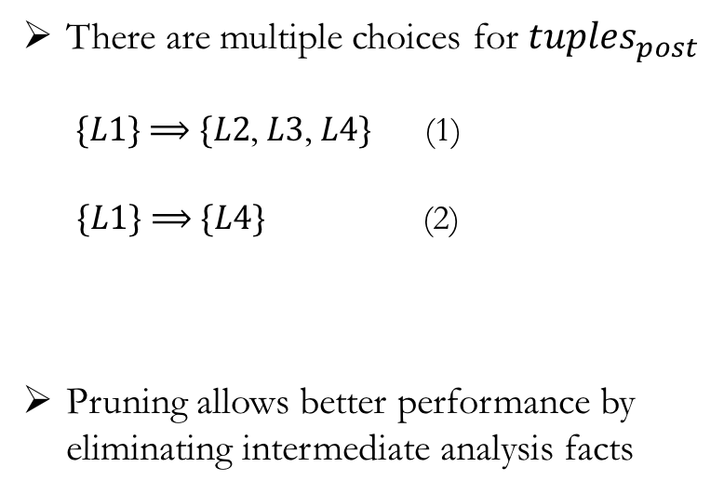
Choosing Good Summaries (contd.)
There are multiple choices for ${tuples}_{post}$
$\{L1\}$ $⟹$ $\{L2$, $L3$, $L4\}$ (1)
$\{L1\}$ $⟹$ $\{L4\}$ (2)
Pruning allows better performance by eliminating intermediate analysis facts
Pruned!
Notes:
In the end, say: Pruning is a precarious balancing act: under-pruning curtails performance, over-pruning affects soundness.
How could pruning affect soundness? Lets see that next.

Slide 13
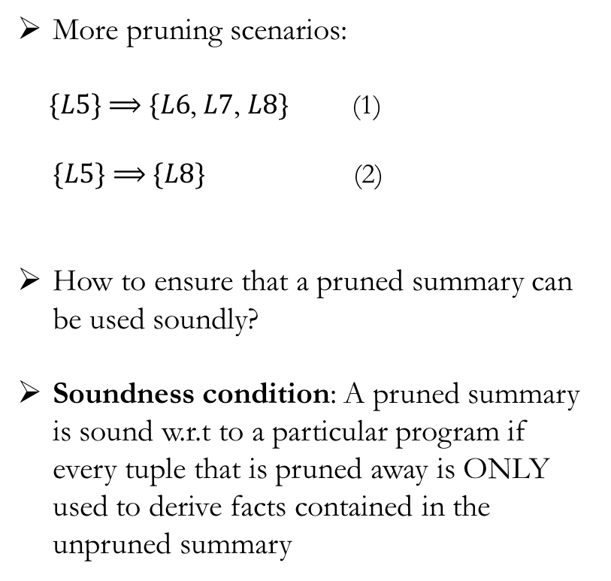
Ensuring Soundness
More pruning scenarios:
$\{L5\}$ $⟹$ $\{L6$, $L7$, $L8\}$ (1)
$\{L5\}$ $⟹$ $\{L8\}$ (2)
How to ensure that a pruned summary can be used soundly?
Soundness condition: A pruned summary is sound w.r.t to a particular program if every tuple that is pruned away is ONLY used to derive facts contained in the unpruned summary
Unsound for B
Notes:
In the end, say: How can we enforce this soundness condition?

Slide 14
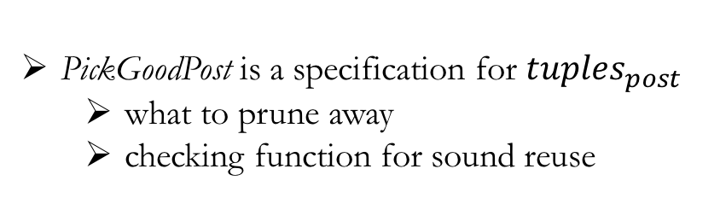
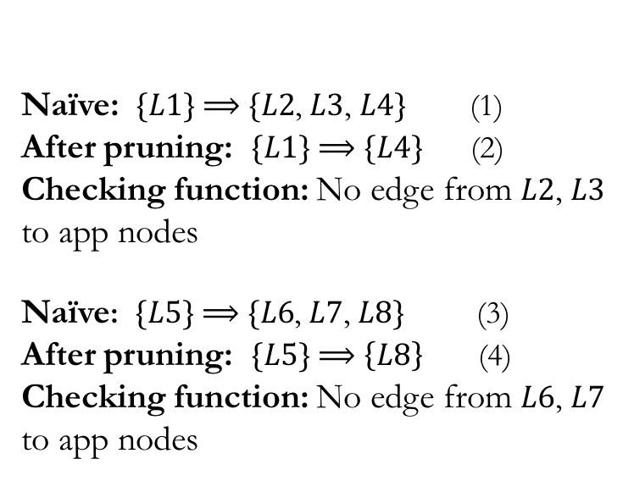
Ensuring Soundness (contd.)
PickGoodPost is a specification for ${tuples}_{post}$
what to prune away
checking function for sound reuse
Naïve: $\{L1\}$ $⟹$ $\{L2$, $L3$, $L4\}$ (1)
After pruning: $\{L1\}$ $⟹$ $\{L4\}$ (2)
Checking function: No edge from $L2$, $L3$ to app nodes
Naïve: $\{L5\}$ $⟹$ $\{L6$, $L7$, $L8\}$ (3)
After pruning: $\{L5\}$ $⟹$ $\left\{L8\right\}$ (4)
Checking function: No edge from $L6$, $L7$ to app nodes

Slide 15
Putting it All Together
PickGoodPre : Impacts performance
PickGoodPost : Impacts performance and soundness
Specifies what can be pruned
Provides a checking function to prevent the unsound use of pruned summaries
Main Theorem: If PickGoodPost satisfies the soundness condition, then reusing learnt summaries produces the same analysis results as analyzing from scratch.
Notes:
Here, say that the definitions of PGPre and PGPost are analysis-specific and the analysis writer has to provide us those.

Slide 16
Experimental Setup
Implemented Polymer using bddbddb Datalog solver and Chord framework for analyzing Java bytecode
Applied to two analyses:
call-graph analysis
flow- and context-insensitive
pointer analysis
flow- and context-sensitive, on-the-fly call graph
Evaluated on 10 Java programs from Dacapo benchmark suite (208-419 KLOC each)
Notes:
After describing the expt setup, say that we will discuss the expt results for pointer analysis only.
Then about PickGoodPre/Post for pointer analysis:
1. inspired by standard notions of summaries in literature, namely, procedure summaries over observable input/output facts
2. from our experience, it is straightforward for analysis designers
3. future work: automate

Slide 17
Evaluation Methodology
Speedup
Baseline: Uses no training data
Ideal: Uses best possible training data
Actual: Uses training data from a realistic corpus
Sensitivity to training data
Functionality: Train on subset of library modules
Abstraction: Train on deeper library modules
Notes:
For evaluation, we address the two questions:
How much can Polymer speedup an analysis when provided with training data?
How sensitive is the speedup to variation in training data?
For speedup, we compared Polymer’s perf in 3 settings:
…., …. , …..
We measure two kinds of sensitivities:
Functionality: Polymer accelerates the analysis of a given program multiple times, with different sets of summaries.
Abstraction: Polymer accelerates the analysis of a given program multiple times. Each time it is forced to descend deeper into the library to be able to reuse summaries.

Slide 18
Benchmark Characteristics
 | classes |  | methods |  | bytecode(KB) |  | KLOC
 | app | total | app | total | app | total | app | total
antlr | 109 | 1,091 | 873 | 7,220 | 81 | 467 | 26 | 224
avrora | 78 | 1,062 | 523 | 6,905 | 35 | 423 | 16 | 214
bloat | 277 | 1,269 | 2,651 | 9,133 | 195 | 586 | 59 | 258
chart | 181 | 1,756 | 1,461 | 11,450 | 101 | 778 | 53 | 366
hsqldb | 189 | 1,341 | 2,441 | 10,223 | 190 | 670 | 96 | 322
luindex | 193 | 1,175 | 1,316 | 7,741 | 99 | 487 | 38 | 237
lusearch | 173 | 1,157 | 1,119 | 7,601 | 77 | 477 | 33 | 231
pmd | 348 | 1,357 | 2,590 | 9,105 | 186 | 578 | 46 | 247
sunflow | 165 | 1,894 | 1,328 | 13,356 | 117 | 934 | 25 | 419
xalan | 42 | 1,036 | 372 | 6,772 | 28 | 417 | 9 | 208
Notes:
Sunflow is the largest benchmark in our experiments.

Slide 19
Pointer Analysis: Speedup
Notes:
10-fold cross validation
Why is Actual close to Ideal?
Though the Dacapo benchmarks are very different programs they use the JDK in similar ways.
Why is the speedup for bloat, pmd and xalan so low?
Because the time spent in analyzing application-specific parts is relatively large.

Slide 20
Pointer Analysis: Varying Library Functionality
Notes:
Let’s examine one box plot. This corresponds to avrora, that is, the analysis of avrora is performed nine times, each time using summaries from a different training app.
The box plot shows the distribution of speedup achieved.
The blue dot is the speedup achieved when the combined training data from all these nine other programs is available.
There may be a “best” training program but others give reasonable speedup, too.

Slide 21
Pointer Analysis: Varying Library Abstraction
Sunflow
Notes:
Iteration 1: All summaries from training available
Iteration 2: Summaries that were used in iteration 1 not available
Summaries for methods at deeper abstraction layers do not yield significant speedup

Slide 22
Conclusion
Practical programs share many large modules of code
Polymer accelerates declarative analyses on such programs
Requires analysis-specific functions PickGoodPre and PickGoodPost to learn summaries
Soundly reuses these summaries to accelerate the analysis of unseen programs
Polymer achieves average speedups of 2.6x for call graph analysis and 5.2x for the points-to analysis
A step towards scaling analyses for Big Code applications

