Slide 1


Hybrid Top-down and Bottom-up Interprocedural Analysis
Xin Zhang, Ravi Mangal, Mayur Naik
Georgia Tech
Hongseok Yang
Oxford University

Slide 2











Two approaches to interprocedural analysis
Top-down approach
Bottom-up approach
main(){
f();
…
f();
}
f(){
g();
…
g();
}

Slide 3
Two approaches to interprocedural analysis
Top-down approach
Bottom-up approach
SWIFT
Consider only contexts in program.
Monomorphic summaries.
Low reusability.
Blow-up with number of contexts.
Cheap to compute.
Cheap to instantiate.
Easy to implement.
Consider all possible contexts.
Polymorphic summaries.
High reusability.
Blow-up with number of cases.
Expensive to compute.
Expensive to instantiate.
Hard to implement.

Slide 4
Typestate analysis example [Fink et al. ISSTA’06]
main() {
v1 = new File(); // h1
p1: foo(v1);
v2 = new File(); // h2
p2: foo(v2);
v3 = new File(); // h3
p3: foo(v3);
}
foo(File f) {
f.open();
f.close();
}
open
closed
opened
close
close
open
error

Slide 5

Top-down approach
Allocation site
main() {
v1 = new File(); // h1
$\{(h_{1}, closed, \left\{v_{1}\right\},∅)\}$
p1: foo(v1);
v2 = new File(); // h2
p2: foo(v2);
v3 = new File(); // h3
p3: foo(v3);
}
foo(File f) {
f.open();
f.close();
}

Slide 6
Top-down approach
Type-state
main() {
v1 = new File(); // h1
$\{(h_{1}, closed, \left\{v_{1}\right\},∅)\}$
p1: foo(v1);
v2 = new File(); // h2
p2: foo(v2);
v3 = new File(); // h3
p3: foo(v3);
}
foo(File f) {
f.open();
f.close();
}

Slide 7
Top-down approach
Must-alias accesspath set
main() {
v1 = new File(); // h1
$\{(h_{1}, closed, \left\{v_{1}\right\},∅)\}$
p1: foo(v1);
v2 = new File(); // h2
p2: foo(v2);
v3 = new File(); // h3
p3: foo(v3);
}
foo(File f) {
f.open();
f.close();
}

Slide 8
Top-down approach
Must-not-alias accesspath set
main() {
v1 = new File(); // h1
$\{(h_{1}, closed, \left\{v_{1}\right\},∅)\}$
p1: foo(v1);
v2 = new File(); // h2
p2: foo(v2);
v3 = new File(); // h3
p3: foo(v3);
}
foo(File f) {
f.open();
f.close();
}

Slide 9
Top-down approach
main() {
v1 = new File(); // h1
$\{(h_{1}, closed, \left\{v_{1}\right\},∅)\}$
p1: foo(v1);
v2 = new File(); // h2
p2: foo(v2);
v3 = new File(); // h3
p3: foo(v3);
}
foo(File f) {
f.open();
f.close();
}

Slide 10
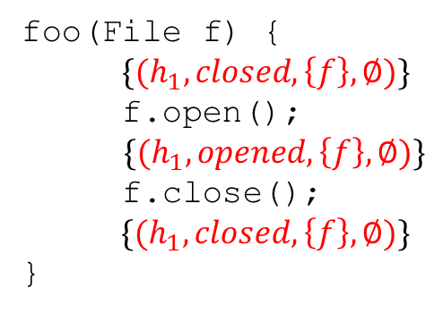
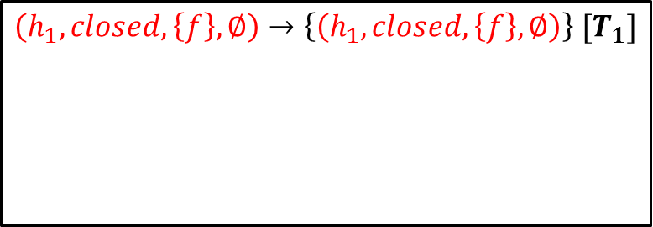
Top-down approach
Top-down summaries
main() {
v1 = new File(); // h1
$\{(h_{1}, closed, \left\{v_{1}\right\},∅)\}$
p1: foo(v1);
v2 = new File(); // h2
p2: foo(v2);
v3 = new File(); // h3
p3: foo(v3);
}
$\left(h_{1}, closed, \left\{f\right\},∅\right)→\left\{\left(h_{1}, closed, \left\{f\right\},∅\right)\right\} [T_{1}]$
foo(File f) {
$\{(h_{1}, closed, \left\{f\right\},∅)\}$
f.open();
$\{(h_{1}, opened, \left\{f\right\},∅)\}$
f.close();
$\{(h_{1}, closed, \left\{f\right\},∅)\}$
}
T₁

Slide 11
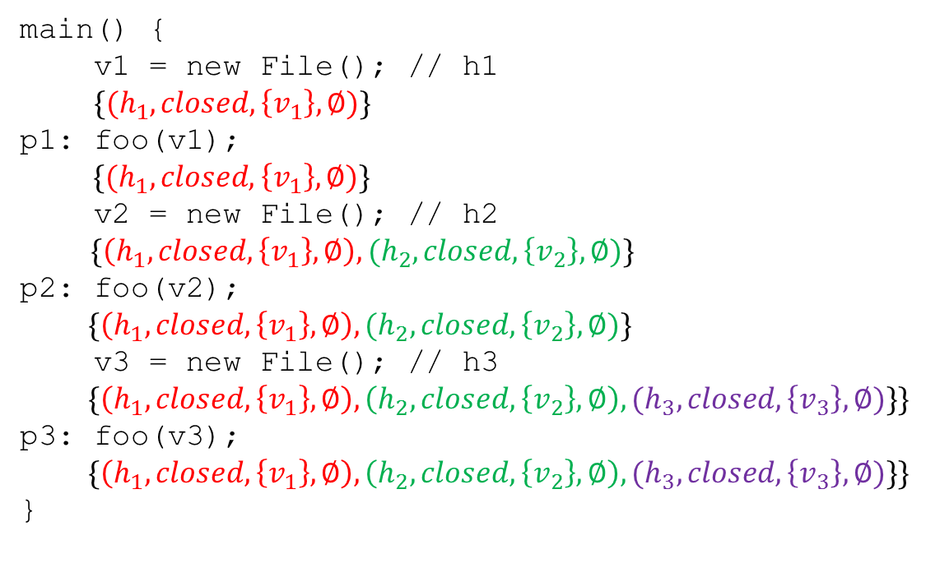

Top-down approach
Low Reusability
Top-down summaries
$$\left(h_{1}, closed, \left\{f\right\},∅\right)→\left\{\left(h_{1}, closed, \left\{f\right\},∅\right)\right\} [T_{1}]$$
$$\left(h_{1}, closed,∅,\left\{f\right\}\right)→\left\{\left(h_{1}, closed,∅,\left\{f\right\}\right)\right\} \left[T_{2}\right]$$
$$\left(h_{2}, closed, \left\{f\right\},∅\right)→\left\{\left(h_{2}, closed, \left\{f\right\},∅\right)\right\} \left[T_{3}\right]$$
$$\left(h_{2}, closed,∅,\left\{f\right\}\right)→\left\{\left(h_{2}, closed,∅,\left\{f\right\}\right)\right\} [T_{4}]$$
$$\left(h_{3}, closed,\left\{f\right\},∅\right)→\left\{\left(h_{3}, closed,\left\{f\right\},∅\right)\right\} [T_{5}]$$
main() {
v1 = new File(); // h1
$\{(h_{1}, closed, \left\{v_{1}\right\},∅)\}$
p1: foo(v1);
$\{(h_{1}, closed, \left\{v_{1}\right\},∅)\}$
v2 = new File(); // h2
$\{\left(h_{1}, closed, \left\{v_{1}\right\},∅\right),(h_{2}, closed, \left\{v_{2}\right\},∅)\}$
p2: foo(v2);
$$\{\left(h_{1}, closed, \left\{v_{1}\right\},∅\right),(h_{2}, closed, \left\{v_{2}\right\},∅)\}$$
v3 = new File(); // h3
$$\{\left(h_{1}, closed, \left\{v_{1}\right\},∅\right),\left(h_{2}, closed, \left\{v_{2}\right\},∅\right),(h_{3}, closed, \left\{v_{3}\right\},∅)\}\}$$
p3: foo(v3);
$$\{\left(h_{1}, closed, \left\{v_{1}\right\},∅\right),\left(h_{2}, closed, \left\{v_{2}\right\},∅\right),(h_{3}, closed, \left\{v_{3}\right\},∅)\}\}$$
}
foo(File f) {
f.open();f.close();
}
T₂

Slide 12
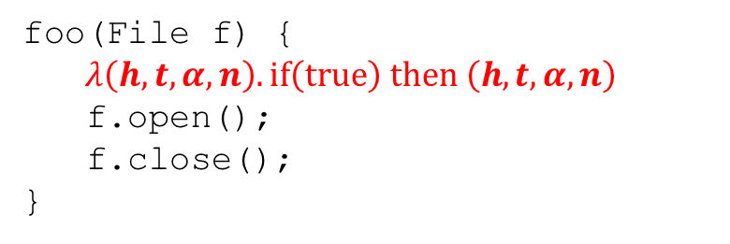
Bottom-up approach
foo(File f) {
$λ\left(h, t,α,n\right). if\left(true\right) then \left(h, t,α,n\right)$
f.open();
f.close();
}

Slide 13
Bottom-up approach
Symbolic abstract object
foo(File f) {
$λ\left(h, t,α,n\right). if\left(true\right) then \left(h, t,α,n\right)$
f.open();
f.close();
}

Slide 14
Bottom-up approach
Case condition
foo(File f) {
$λ\left(h, t,α,n\right). if\left(true\right) then \left(h, t,α,n\right)$
f.open();
f.close();
}

Slide 15
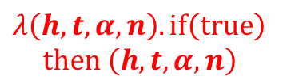
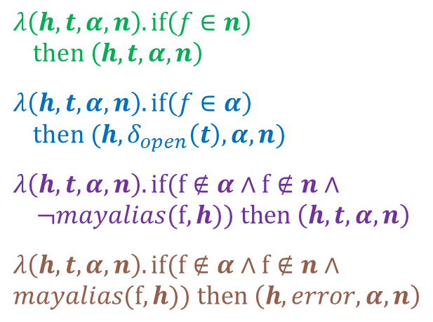
Bottom-up approach
$$λ\left(h, t,α,n\right). if\left(f∈n\right)$$
$then \left(h, t,α,n\right)$
$$λ\left(h, t,α,n\right). if\left(f∈α\right)$$
$then (h,δ_{open}\left(t\right),α,n)$
$$λ\left(h, t,α,n\right). if(f∉α∧f∉n∧$$
$$¬mayalias(f,h)) then \left(h,t,α,n\right)$$
$$λ\left(h, t,α,n\right). if(f∉α∧f∉n∧$$
$$mayalias(f,h)) then \left(h,error,α,n\right)$$
$$λ\left(h, t,α,n\right). if\left(true\right)$$
$then \left(h, t,α,n\right)$
f.open()
Exponential blowup

Slide 16
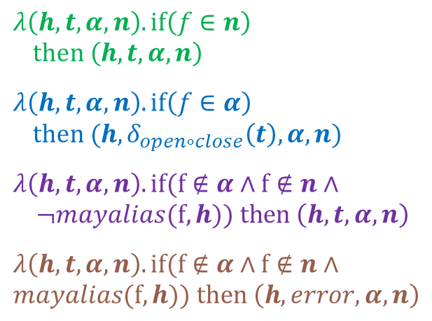
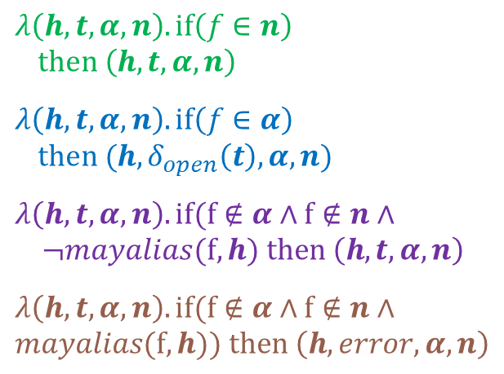
Bottom-up approach
$$λ\left(h, t,α,n\right). if\left(f∈n\right)$$
$then \left(h, t,α,n\right)$
$$λ\left(h, t,α,n\right). if\left(f∈α\right)$$
$then (h,δ_{open}\left(t\right),α,n)$
$$λ\left(h, t,α,n\right). if(f∉α∧f∉n∧$$
$$¬mayalias(f,h) then \left(h,t,α,n\right)$$
$$λ\left(h, t,α,n\right). if(f∉α∧f∉n∧$$
$$mayalias(f,h)) then \left(h,error,α,n\right)$$
$$λ\left(h, t,α,n\right). if\left(f∈n\right)$$
$then \left(h, t,α,n\right)$
$$λ\left(h, t,α,n\right). if\left(f∈α\right)$$
$then (h,δ_{open∘close}\left(t\right),α,n)$
$$λ\left(h, t,α,n\right). if(f∉α∧f∉n∧$$
$$¬mayalias(f,h)) then \left(h,t,α,n\right)$$
$$λ\left(h, t,α,n\right). if(f∉α∧f∉n∧$$
$$mayalias(f,h)) then \left(h,error,α,n\right)$$
f.close()

Slide 17

Bottom-up approach
Bottom-up summaries
$$λ\left(h, t,α,n\right). if\left(f∈n\right) then \left(h, t,α,n\right) \left[B_{1}\right]$$
$$λ\left(h, t,α,n\right). if\left(f∈α\right) [B_{2}]$$
$then (h,δ_{open∘close}\left(t\right),α,n)$
$$λ\left(h, t,α,n\right). if(f∉α∧f∉n∧ [B_{3}]$$
$$¬mayalias(f,h)) then \left(h,t,α,n\right)$$
$$λ\left(h, t,α,n\right). if(f∉α∧f∉n∧ [B_{4}]$$
$$mayalias(f,h)) then \left(h,error,α,n\right)$$
foo(File f) {
f.open();
f.close();
}

Slide 18
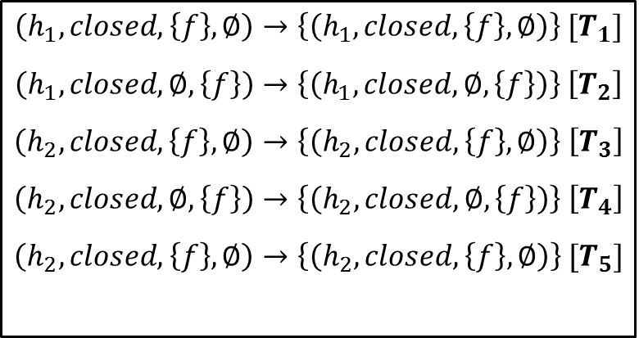
Top-down summaries vs. bottom-up summaries
Top-down summaries
Bottom-up summaries
$$\left(h_{1}, closed, \left\{f\right\},∅\right)→\left\{\left(h_{1}, closed, \left\{f\right\},∅\right)\right\} [T_{1}]$$
$$\left(h_{1}, closed,∅,\left\{f\right\}\right)→\left\{\left(h_{1}, closed,∅,\left\{f\right\}\right)\right\} \left[T_{2}\right]$$
$$\left(h_{2}, closed, \left\{f\right\},∅\right)→\left\{\left(h_{2}, closed, \left\{f\right\},∅\right)\right\} \left[T_{3}\right]$$
$$\left(h_{2}, closed,∅,\left\{f\right\}\right)→\left\{\left(h_{2}, closed,∅,\left\{f\right\}\right)\right\} \left[T_{4}\right]$$
$$\left(h_{2}, closed,\left\{f\right\},∅\right)→\left\{\left(h_{2}, closed,\left\{f\right\},∅\right)\right\} [T_{5}]$$
$$λ\left(h, t,α,n\right). if\left(f∈n\right) then \left(h, t,α,n\right) \left[B_{1}\right]$$
$$λ\left(h, t,α,n\right). if\left(f∈α\right) [B_{2}]$$
$then (h,δ_{open∘close}\left(t\right),α,n)$
$$λ\left(h, t,α,n\right). if(f∉α∧f∉n∧ [B_{3}]$$
$$¬mayalias(f,h)) then \left(h,t,α,n\right)$$
$$λ\left(h, t,α,n\right). if(f∉α∧f∉n∧ [B_{4}]$$
$$mayalias(f,h)) then \left(h,error,α,n\right)$$

Slide 19
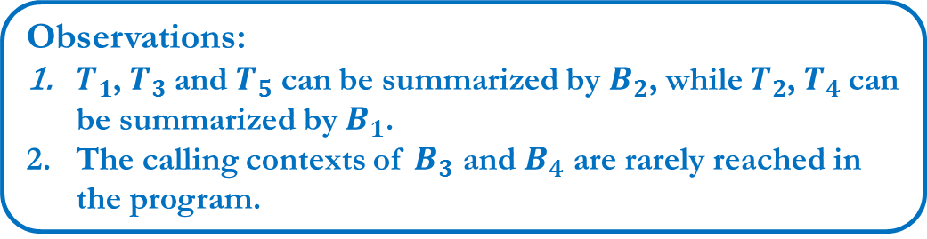
Top-down summaries vs. bottom-up summaries
Top-down summaries
Bottom-up summaries
$$\left(h_{1}, closed, \left\{f\right\},∅\right)→\left\{\left(h_{1}, closed, \left\{f\right\},∅\right)\right\} [T_{1}]$$
$$\left(h_{1}, closed,∅,\left\{f\right\}\right)→\left\{\left(h_{1}, closed,∅,\left\{f\right\}\right)\right\} \left[T_{2}\right]$$
$$\left(h_{2}, closed, \left\{f\right\},∅\right)→\left\{\left(h_{2}, closed, \left\{f\right\},∅\right)\right\} \left[T_{3}\right]$$
$$\left(h_{2}, closed,∅,\left\{f\right\}\right)→\left\{\left(h_{2}, closed,∅,\left\{f\right\}\right)\right\} \left[T_{4}\right]$$
$$\left(h_{2}, closed,\left\{f\right\},∅\right)→\left\{\left(h_{2}, closed,\left\{f\right\},∅\right)\right\} [T_{5}]$$
$$λ\left(h, t,α,n\right). if\left(f∈n\right) then \left(h, t,α,n\right) \left[B_{1}\right]$$
$$λ\left(h, t,α,n\right). if\left(f∈α\right) [B_{2}]$$
$then (h,δ_{open∘close}\left(t\right),α,n)$
$$λ\left(h, t,α,n\right). if(f∉α∧f∉n∧ [B_{3}]$$
$$¬mayalias(f,h)) then \left(h,t,α,n\right)$$
$$λ\left(h, t,α,n\right). if(f∉α∧f∉n∧ [B_{4}]$$
$$mayalias(f,h)) then \left(h,error,α,n\right)$$
Observations:
$T_{1}$, $T_{3}$and $T_{5}$ can be summarized by $B_{2}$, while $T_{2}$, $T_{4}$can be summarized by $B_{1}$.
The calling contexts of $B_{3}$ and $B_{4}$ are rarely reached in the program.

Slide 20






















The SWIFT algorithm with parameter $k$ and $θ$
Top-down
Bottom-up
f(){
…
a;
…
}
$${ c}_{1}$$
…
$${ c}_{θ}$$
a
$$T_{f_{1}}$$
…
$$T_{f_{k}}$$
$$B_{f_{i}}$$
…
$${ c}_{1}′$$
$${ c}_{2}′$$
$${ c}_{3}′$$
$${ c}_{m}′$$
prune
$$k$$
…
$${ c}_{1}′′$$
$${ c}_{θ}′′$$
$${ c}_{θ−1}$$
Top $θ$
$${ c}_{θ}$$
$$B_{f_{1}}$$
…
$$B_{f_{θ}}$$
$${ c}_{θ+1}$$
$$θ$$

Slide 21
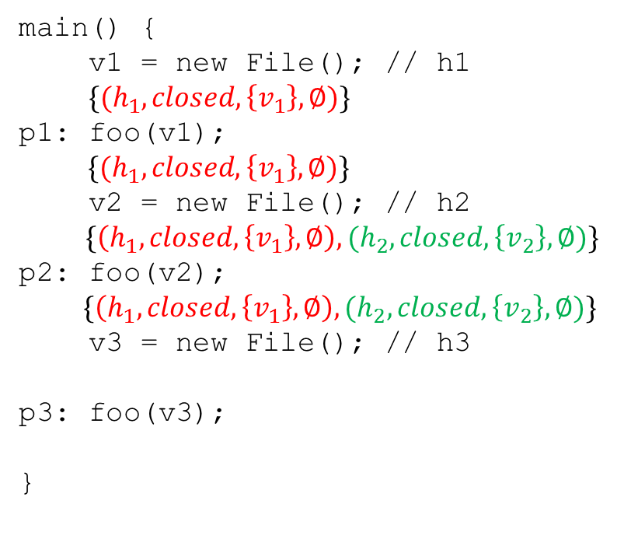
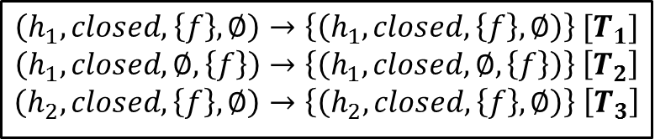

Type-state example with $k=3, θ=2$
main() {
v1 = new File(); // h1
$\{(h_{1}, closed, \left\{v_{1}\right\},∅)\}$
p1: foo(v1);
$\{(h_{1}, closed, \left\{v_{1}\right\},∅)\}$
v2 = new File(); // h2
$\{\left(h_{1}, closed, \left\{v_{1}\right\},∅\right),(h_{2}, closed, \left\{v_{2}\right\},∅)\}$
p2: foo(v2);
$$\{\left(h_{1}, closed, \left\{v_{1}\right\},∅\right),(h_{2}, closed, \left\{v_{2}\right\},∅)\}$$
v3 = new File(); // h3
p3: foo(v3);
}
Top-down summaries
$$\left(h_{1}, closed, \left\{f\right\},∅\right)→\left\{\left(h_{1}, closed, \left\{f\right\},∅\right)\right\} [T_{1}]$$
$$\left(h_{1}, closed,∅,\left\{f\right\}\right)→\left\{\left(h_{1}, closed,∅,\left\{f\right\}\right)\right\} \left[T_{2}\right]$$
$$\left(h_{2}, closed, \left\{f\right\},∅\right)→\left\{\left(h_{2}, closed, \left\{f\right\},∅\right)\right\} \left[T_{3}\right]$$

Slide 22
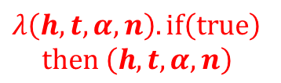





Type-state example with $k=3, θ=2$
$$λ\left(h, t,α,n\right). if\left(f∈n\right)$$
$then \left(h, t,α,n\right)$
$$λ\left(h, t,α,n\right). if\left(f∈α\right)$$
$then (h,δ_{open}\left(t\right),α,n)$
$$λ\left(h, t,α,n\right). if(f∉α∧f∉n∧$$
$$¬mayalias(f,h)) then \left(h,t,α,n\right)$$
$$λ\left(h, t,α,n\right). if(f∉α∧f∉n∧$$
$$mayalias(f,h)) then \left(h,error,α,n\right)$$
$$C_{1}$$
$$λ\left(h, t,α,n\right). if\left(true\right)$$
$then \left(h, t,α,n\right)$
f.open()
$$C_{2}$$
$$C_{3}$$
$$C_{4}$$
Top-down summaries
$$\left(h_{1}, closed, \left\{f\right\},∅\right)→\left\{\left(h_{1}, closed, \left\{f\right\},∅\right)\right\} [T_{1}]$$
$$\left(h_{1}, closed,∅,\left\{f\right\}\right)→\left\{\left(h_{1}, closed,∅,\left\{f\right\}\right)\right\} \left[T_{2}\right]$$
$$\left(h_{2}, closed, \left\{f\right\},∅\right)→\left\{\left(h_{2}, closed, \left\{f\right\},∅\right)\right\} \left[T_{3}\right]$$

Slide 23

Type-state example with $k=3, θ=2$
$$λ\left(h, t,α,n\right). if\left(f∈n\right)$$
$then \left(h, t,α,n\right)$
$$λ\left(h, t,α,n\right). if\left(f∈α\right)$$
$then (h,δ_{open}\left(t\right),α,n)$
$$C_{1}$$
$$λ\left(h, t,α,n\right). if\left(true\right)$$
$then \left(h, t,α,n\right)$
f.open()
$$C_{2}$$
Top-down summaries
$$\left(h_{1}, closed, \left\{f\right\},∅\right)→\left\{\left(h_{1}, closed, \left\{f\right\},∅\right)\right\} [T_{1}]$$
$$\left(h_{1}, closed,∅,\left\{f\right\}\right)→\left\{\left(h_{1}, closed,∅,\left\{f\right\}\right)\right\} \left[T_{2}\right]$$
$$\left(h_{2}, closed, \left\{f\right\},∅\right)→\left\{\left(h_{2}, closed, \left\{f\right\},∅\right)\right\} \left[T_{3}\right]$$

Slide 24
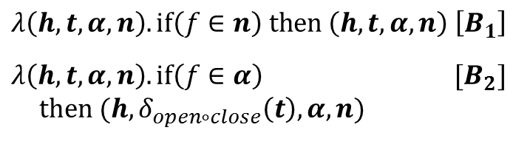
Type-state example with $k=3, θ=2$
Bottom-up summaries
foo(File f) {
f.open();
f.close();
}
$$λ\left(h, t,α,n\right). if\left(f∈n\right) then \left(h, t,α,n\right) \left[B_{1}\right]$$
$$λ\left(h, t,α,n\right). if\left(f∈α\right) [B_{2}]$$
$then (h,δ_{open∘close}\left(t\right),α,n)$

Slide 25
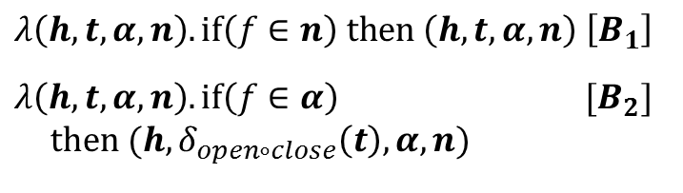



Type-state example with $k=3, θ=2$
Bottom-up summaries
main() {
v1 = new File(); // h1
$\{(h_{1}, closed, \left\{v_{1}\right\},∅)\}$
p1: foo(v1);
$\{(h_{1}, closed, \left\{v_{1}\right\},∅)\}$
v2 = new File(); // h2
$\{\left(h_{1}, closed, \left\{v_{1}\right\},∅\right),(h_{2}, closed, \left\{v_{2}\right\},∅)\}$
p2: foo(v2);
$$\{\left(h_{1}, closed, \left\{v_{1}\right\},∅\right),(h_{2}, closed, \left\{v_{2}\right\},∅)\}$$
v3 = new File(); // h3
$$\{\left(h_{1}, closed, \left\{v_{1}\right\},∅\right),\left(h_{2}, closed, \left\{v_{2}\right\},∅\right),(h_{3}, closed, \left\{v_{3}\right\},∅)\}\}$$
p3: foo(v3);
$$\{\left(h_{1}, closed, \left\{v_{1}\right\},∅\right),\left(h_{2}, closed, \left\{v_{2}\right\},∅\right),(h_{3}, closed, \left\{v_{3}\right\},∅)\}\}$$
}
$$λ\left(h, t,α,n\right). if\left(f∈n\right) then \left(h, t,α,n\right) \left[B_{1}\right]$$
$$λ\left(h, t,α,n\right). if\left(f∈α\right) [B_{2}]$$
$then (h,δ_{open∘close}\left(t\right),α,n)$
$${ B}_{1}$$
$${ B}_{1}$$
$${ B}_{2}$$

Slide 26
Implementation
Generic framework atop JChord to analyze Java programs
Top-down part (TD) based on tabulation algorithm
Bottom-up part (BU) based on relational analysis with pruning
Obligations on analysis designer:
TD and BU instances meeting certain coincidence conditions
Values of parameters k and θ
Instantiated the framework for:
Type-state analysis (based on SAFE [Fink et al. ISSTA’06])
“kill-gen” analyses (reaching definitions, live variables, etc.)

Slide 27
Benchmarks
 | classes | methods | bytecode (KB) | KLOC
jpat-p | 176 | 766 | 39 | 78
elevator | 188 | 899 | 52 | 88
toba-s | 158 | 745 | 56 | 69
javasrc-p | 135 | 789 | 60 | 66
hedc | 353 | 2.1k | 140 | 153
antlr | 350 | 2.4k | 186 | 131
luindex | 619 | 3.7k | 235 | 190
lusearch | 640 | 3.9k | 250 | 198
kawa-c | 529 | 3.4k | 174 | 186
avrora | 1.5k | 6.2k | 325 | 193
rhino-a | 330 | 2.3k | 162 | 153
sablecc-j | 876 | 5.1k | 276 | 257

Slide 28
Experiment results: running time (k = 5, θ = 1)
 | TD (top-down) | BU (bottom-up) | SWIFT | speedup over TD | speedup over BU
jpat-p | 0.91s | 15.62s | 1.79s | 0.5X | 9X
elevator | 1.59s | 6m35s | 3.36s | 0.5X | 118X
toba-s | 20.4s | timeout | 5s | 4X | -
javasrc-p | 4m44s | timeout | 12s | 24X | -
hedc | 22m57s | timeout | 41s | 33X | -
antlr | 35m28s | timeout | 36s | 59X | -
luindex | 43m26s | timeout | 1m53s | 23X | -
lusearch | 31m39s | timeout | 1m52s | 17X | -
kawa-c | 23m52s | timeout | 1m6s | 22X | -
avrora | timeout | timeout | 6m35s | - | -
rhino-a | timeout | timeout | 6m39s | - | -
sable-cc | timeout | timeout | 4m25s | - | -

Slide 29
Experiment results: number of summaries
 | top-down |  |  | bottom-up
 | TD | SWIFT | drop | BU | SWIFT | drop
jpat-p | 6.5k | 1.7k | 74% | 2.3k | 0.3k | 87%
elevator | 8.4k | 2.9k | 66% | 12k | 0.5k | 96%
toba-s | 68.5k | 3.5k | 95% | - | 0.6k | -
javasrc-p | 319k | 5k | 98% | - | 0.7k | -
hedc | 891k | 11k | 99% | - | 1.8k | -
antlr | 1.3m | 13k | 99% | - | 2k | -
luindex | 2.3m | 20k | 99% | - | 3k | -
lusearch | 1.9m | 21k | 99% | - | 3.5k | -
kawa-c | 1.7m | 19k | 99% | - | 3k | -
avrora | - | 91k | - | - | 5.4k | -
rhino-a | - | 16k | - | - | 2k | -
sable-cc | - | 26k | - | - | 4.8k | -

Slide 30
Number of top-down summaries per method

Slide 31
Number of top-down summaries per method

Slide 32
Future directions
Applying SWIFT to analyses with richer abstract domains
Predicate abstraction, shape analysis, integer analysis, etc.
Automating SWIFT to reduce analysis designer obligations
Identifying analysis classes like “kill/gen”
Automatically synthesizing TD from BU, or vice versa
Extending SWIFT to reuse summaries across programs
Programs increasingly use large libraries (e.g., JDK, Android)
Key challenge: higher-order functions (callbacks)

Slide 33
Conclusion
A new approach for scaling interprocedural analysis
Synergistically combines two dominant approaches: top-down and bottom-up
General formal framework embodying the approach
Coincidence conditions and tuning parameters
Implementation of the framework for Java
Instantiated on type-state analysis and “kill/gen” analyses
Outperforms baseline approaches on upto 250 KLOC

