Slide 1
Finding Optimum Abstractions in Parametric Dataflow Analysis
Xin Zhang
Georgia Tech
Mayur Naik
Georgia Tech
Hongseok Yang
University of Oxford
Notes:
Thank you. Good morning, this is Xin Zhang from Georgia Tech. Today I am going to talk about finding optimum abstractions in parametric dataflow analysis. This is a joint work with Mayur Naik and Hongseok Yang.

Slide 2

A Key Challenge for Static Analysis
Scalability
Precision
Notes:
A major challenge in static analysis is to balance the precision and scalability. In the talk, we’re going to propose a new approach to address this problem.

Slide 3
Our setting
Abstraction a
assert(x != null)
Program p
_{Static Analysis S}
Query q
p ` q
p 0 q
Notes:
In our setting, we have a sound static analysis S. S is configured by abstraction a. We try to use S to prove query q on program p. You can view Query q as an assertion in the program. Abstraction a only controls the scalability and precision of S. No matter which a we choose, S is always sound.

Slide 4
Our setting
a1
a2
_{S}
_{S}
q1
p
q2
p ` q1 ?
p ` q2 ?
Notes:
For different queries, we might want to use different abstractions to prove them to get better precision and scalability. And this is the core idea of query-driven approach

Slide 5
Our setting
1 | 0 | 1 | 1 | 0
0 | 1 | 0 | 1 | 0
_{S}
_{S}
q1
p
q2
p ` q1 ?
p ` q2 ?
Notes:
To be concrete, you can view the abstractions as different bit vectors with the same lengths. The abstractions of many existing static analysis can be encoded in this way.

Slide 6
Example 1: Predicate Abstraction
Predicates to use as abstraction predicates
Predicates to use in predicate abstraction
1 | 0 | 1 | 1 | 0
0 | 1 | 0 | 1 | 0
_{S}
_{S}
q1
p
q2
p ` q1 ?
p ` q2 ?
Notes:
For example, these bitvectors can represent predicates to use in predicate abstraction.

Slide 7
Example 2: Cloning­‐based Pointer Analysis
K value to use for each call and each allocation site
Predicates to use in predicate abstraction
1 | 0 | 1 | 1 | 0
0 | 1 | 0 | 1 | 0
_{S}
_{S}
q1
p
q2
p ` q1 ?
p ` q2 ?
Notes:
Also, they can represent different k values for each call site and allocation site in cloning-based analysis. After introducing the setting, let’s define the problem we want to solve.

Slide 8
Problem Statement
An efficient algorithm with:
INPUTS:
program p and property q
abstractions A = { a₁, …, a_{n} }
boolean function S(p, q, a)
OUTPUT:
Proof: a 2 A: S(p, q, a) = true
8 a’ 2 A: (a’ · a Æ S(p, q, a’) = true) ) a’ = a
Impossibility: @ a 2 A: S(p, q, a) = true
a
_{S}
p
q
Optimum Abstraction
p ` q ?
Notes:
Our goal of this paper is to find an efficient algorithm whose input is the setting we described. Specially, we have a set of abstractions captial A.
OK, so what is the output?
There’re two outputs we’re after.
First, if the query is provable, we want to find an abstraction which can prove it. Not only can it prove the query, we also want it to be the cheapest. And we call it the optimal abstraction
Second, if the query is not provable, we want the algorithm to tell us that the query is impossible to prove using any abstraction of the family

Slide 9
Problem Statement
1111 most expensive
An efficient algorithm with:
INPUTS:
program p and property q
abstractions A = { a₁, …, a_{n} }
boolean function S(p, q, a)
OUTPUT:
Proof: a 2 A: S(p, q, a) = true
8 a’ 2 A: (a’ · a Æ S(p, q, a’) = true) ) a’ = a
Impossibility: @ a 2 A: S(p, q, a) = true
A
S(p, q, a)
!S(p, q, a)
0110 optimum
0000 least expensive
Optimum Abstraction
Notes:
To visualize the problem, we have a lattice of abstractions called A. And the abstractions here are ordered by costs. Usually the more costly an analysis is, the more precise it is. The green part represents the abstractions which can prove the query, and at the top is the costliest abstraction, all bit set to 1.
The yellow part represents the abstractions that cannot prove the query, out of them, the bottom is the cheapest abstraction, which is all bit set to 0.
Our goal is to exactly find the cheapest viable abstraction, which is the lowest point of the green part. To solve this problem, we propose a novel iterative refinement-based approach.

Slide 10
Example: Typestate Analysis
Type-state set ts
open()
x = new File;
<{closed}, {x}>
y = x;
z = x;
x.open();
y.close();
assert1(x, closed);
assert2(x, opened);
closed
opened
close()
close()
open()
error
Notes:
Through out this talk, I’ll illustrate our approach using typestate analysis as an example. On the right, there’s example program. In this example program, a file handle is created. And a series operations are called on it. At the end of the program, there are two queries which check the state of the File. We try to use typestate analysis to prove these two queries.
The typestate analysis is very popular analysis. It is fully context and flow sensitive. Its abstract state contains two parts.The first part is a type-state set. It contains the possible states that the object can be in. And the states of the file object is specified by the finite state machine on the left hand side.

Slide 11
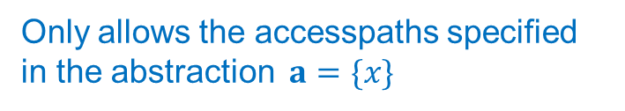
Example: Typestate Analysis
Must-alias accesspath set ms
Only allows the accesspaths specified in the abstraction $a=\{x\}$
x = new File;
<{closed}, {x}>
y = x;
<{closed}, {x}>
z = x;
<{closed}, {x}>
x.open();
<{opened}, {x}>
y.close();
<{opened, closed}, {x}>
assert1(x, closed);
assert2(x, opened);
Strong update
Weak update
Failed
Failed
Notes:
The second part of the abstract object is a must-set. It contains all the accesspath which must-alias with the object. Ideally we want to keep all the acccesspaths that must alias with the object. But it will make the analysis not scalable. To balance the precision and scalability, we config this part using the abstraction a. Only accesspath contained in a can be added to the must set. Suppose we only allow to track x here, after the File handle is created, we’ll add x to the must-set. But we won’t add y and z to the mustset, because they’re not included in the parameter. As a result, we’ll have a strong update after the invocation of open and weak update after the invocation of close. And both assertions will fail.

Slide 12
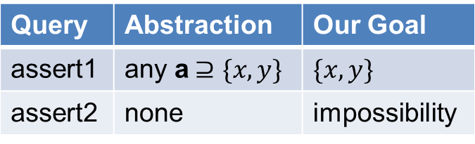
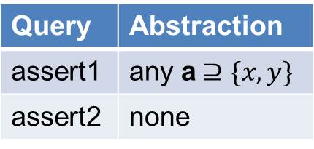
Example: Typestate Analysis
x = new File;
y = x;
z = x;
x.open();
y.close();
assert1(x, closed);
assert2(x, opened);
Query | Abstraction
assert1 | any a$⊇\{x, y\}$
assert2 | none
Query | Abstraction | Our Goal
assert1 | any a$⊇\{x, y\}$ | $$\{x, y\}$$
assert2 | none | impossibility
Notes:
Actually for these two queries, assert1 is provable using any abstraction that is a super set of {x,y}. And assert2 is not provable using any abstraction. Our goal is to find the optimum abstraction {x,y} for assert1, and declare impossibility for assert2

Slide 13
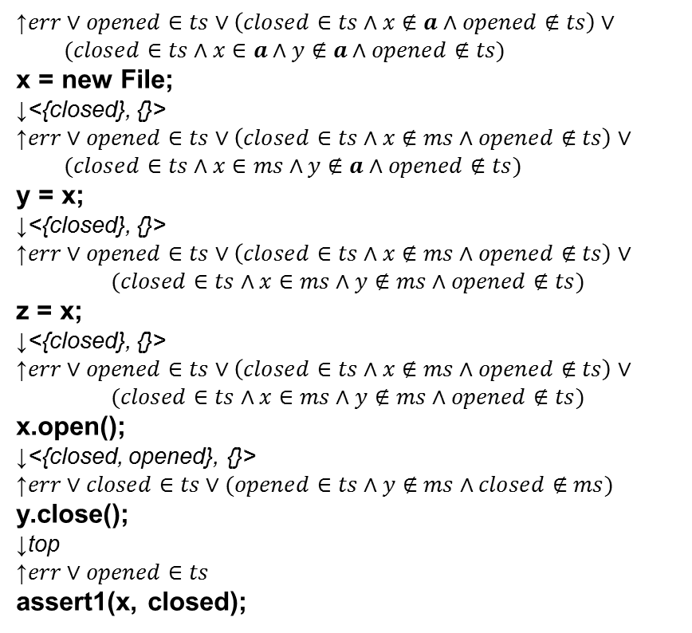
Example: Typestate Analysis
↑$err∨opened∈ts∨\left(closed∈ts∧x∉a∧opened∉ts\right)∨$
$(closed∈ts∧x∈a∧y∉a∧opened∉ts)$
x = new File;
↓<{closed}, {}>
↑$err∨opened∈ts∨\left(closed∈ts∧x∉ms∧opened∉ts\right)∨$
$(closed∈ts∧x∈ms∧y∉a∧opened∉ts)$
y = x;
↓<{closed}, {}>
↑$err∨opened∈ts∨\left(closed∈ts∧x∉ms∧opened∉ts\right)∨$
$$(closed∈ts∧x∈ms∧y∉ms∧opened∉ts)$$
z = x;
↓<{closed}, {}>
↑$err∨opened∈ts∨\left(closed∈ts∧x∉ms∧opened∉ts\right)∨$
$$(closed∈ts∧x∈ms∧y∉ms∧opened∉ts)$$
x.open();
↓<{closed, opened}, {}>
↑$err∨closed∈ts∨(opened∈ts∧y∉ms∧closed∉ms)$
y.close();
↓top
↑$err∨opened∈ts$
assert1(x, closed);
x = new File;
y = x;
z = x;
x.open();
y.close();
assert1(x, closed);
assert2(x, opened);
Query | Abstraction
assert1
assert2
{}
Failed
Naïve approach: calculating weakest precondition (WP)
Notes:
Let us first look at assert1. If we consider applying refinement-based approach here, it is natural to start with the cheapest abstraction, which is an empty set here. As a result, we’ll fail to prove the query.
But we also get a counterexample meantime.
Our next step is to summarize the reason why we fail on this trace, and try to get the next parameter.
One naïve approach is to analyze backward on this trace and calculate weakest precondition. This condition is expressed in disjunctive norm form.
We start from the query point, and there’re two ways we can fail to prove this query. We keep pushing backward, and each clause we keep is one case which we can fail to prove the query. When we reach the entry, we conclude that if we don’t include both x and y, we will fail to prove the query. Although it successfully finds the optimum abstraction, but we can see the size of the formula grows very fast although we only have 5 lines code.

Slide 14
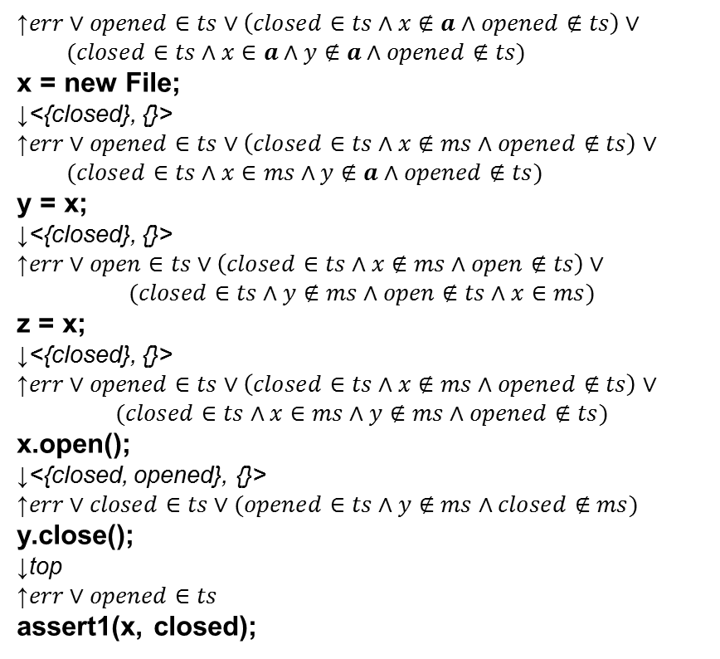
Example: Typestate Analysis
↑$err∨opened∈ts∨\left(closed∈ts∧x∉a∧opened∉ts\right)∨$
$(closed∈ts∧x∈a∧y∉a∧opened∉ts)$
x = new File;
↓<{closed}, {}>
↑$err∨opened∈ts∨\left(closed∈ts∧x∉ms∧opened∉ts\right)∨$
$(closed∈ts∧x∈ms∧y∉a∧opened∉ts)$
y = x;
↓<{closed}, {}>
↑$err∨open∈ts∨\left(closed∈ts∧x∉ms∧open∉ts\right)∨$
$$(closed∈ts∧y∉ms∧open∉ts∧x∈ms)$$
z = x;
↓<{closed}, {}>
↑$err∨opened∈ts∨\left(closed∈ts∧x∉ms∧opened∉ts\right)∨$
$$(closed∈ts∧x∈ms∧y∉ms∧opened∉ts)$$
x.open();
↓<{closed, opened}, {}>
↑$err∨closed∈ts∨(opened∈ts∧y∉ms∧closed∉ms)$
y.close();
↓top
↑$err∨opened∈ts$
assert1(x, closed);
x = new File;
y = x;
z = x;
x.open();
y.close();
assert1(x, closed);
assert2(x, opened);
unreachable
Exponential Blowup!
Query | Abstraction
assert1
assert2
{}
Failed
Naïve approach: calculating weakest precondition (WP)
Notes:
Usually the naïve approach will have an exponential blowup. What’s more, if we look more closely to the formula, some clauses are not even reachable from the entry. So obviously some efforts are wasted here.

Slide 15
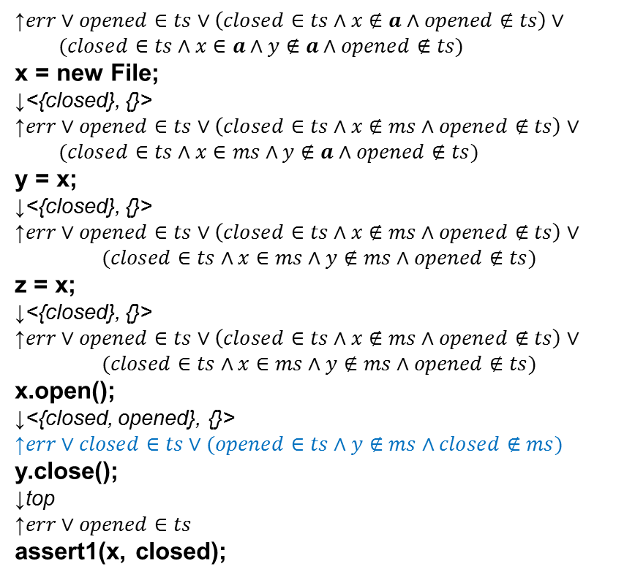
Example: Typestate Analysis
↑$err∨opened∈ts∨\left(closed∈ts∧x∉a∧opened∉ts\right)∨$
$(closed∈ts∧x∈a∧y∉a∧opened∉ts)$
x = new File;
↓<{closed}, {}>
↑$err∨opened∈ts∨\left(closed∈ts∧x∉ms∧opened∉ts\right)∨$
$(closed∈ts∧x∈ms∧y∉a∧opened∉ts)$
y = x;
↓<{closed}, {}>
↑$err∨opened∈ts∨\left(closed∈ts∧x∉ms∧opened∉ts\right)∨$
$$(closed∈ts∧x∈ms∧y∉ms∧opened∉ts)$$
z = x;
↓<{closed}, {}>
↑$err∨opened∈ts∨\left(closed∈ts∧x∉ms∧opened∉ts\right)∨$
$$(closed∈ts∧x∈ms∧y∉ms∧opened∉ts)$$
x.open();
↓<{closed, opened}, {}>
↑$err∨closed∈ts∨(opened∈ts∧y∉ms∧closed∉ms)$
y.close();
↓top
↑$err∨opened∈ts$
assert1(x, closed);
Too large?
Let’s ignore part of it!
Notes:
So how do we solve the two problems?
Well, if the formula is too large, let us just ignore part of it! But which part to ignore?
This problem is not so easy.

Slide 16
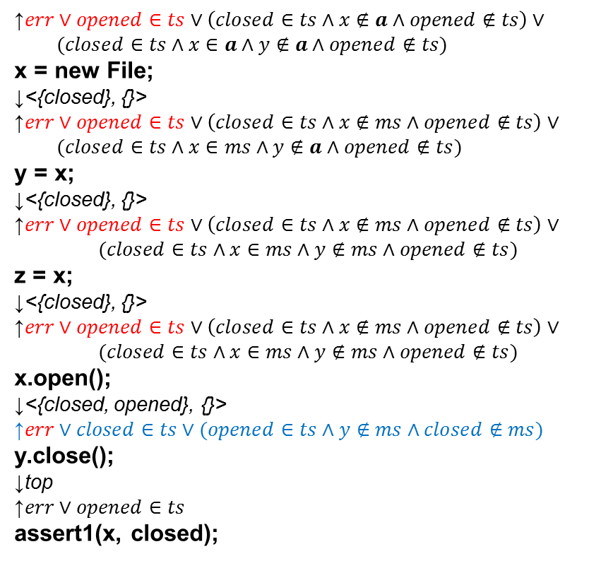
Example: Typestate Analysis
↑$err∨opened∈ts∨\left(closed∈ts∧x∉a∧opened∉ts\right)∨$
$(closed∈ts∧x∈a∧y∉a∧opened∉ts)$
x = new File;
↓<{closed}, {}>
↑$err∨opened∈ts∨\left(closed∈ts∧x∉ms∧opened∉ts\right)∨$
$(closed∈ts∧x∈ms∧y∉a∧opened∉ts)$
y = x;
↓<{closed}, {}>
↑$err∨opened∈ts∨\left(closed∈ts∧x∉ms∧opened∉ts\right)∨$
$$(closed∈ts∧x∈ms∧y∉ms∧opened∉ts)$$
z = x;
↓<{closed}, {}>
↑$err∨opened∈ts∨\left(closed∈ts∧x∉ms∧opened∉ts\right)∨$
$$(closed∈ts∧x∈ms∧y∉ms∧opened∉ts)$$
x.open();
↓<{closed, opened}, {}>
↑$err∨closed∈ts∨(opened∈ts∧y∉ms∧closed∉ms)$
y.close();
↓top
↑$err∨opened∈ts$
assert1(x, closed);
Unreachable
Notes:
If we look at this formula, the first disjunct actually is an unreachable state. We certainly want to ignore it.

Slide 17
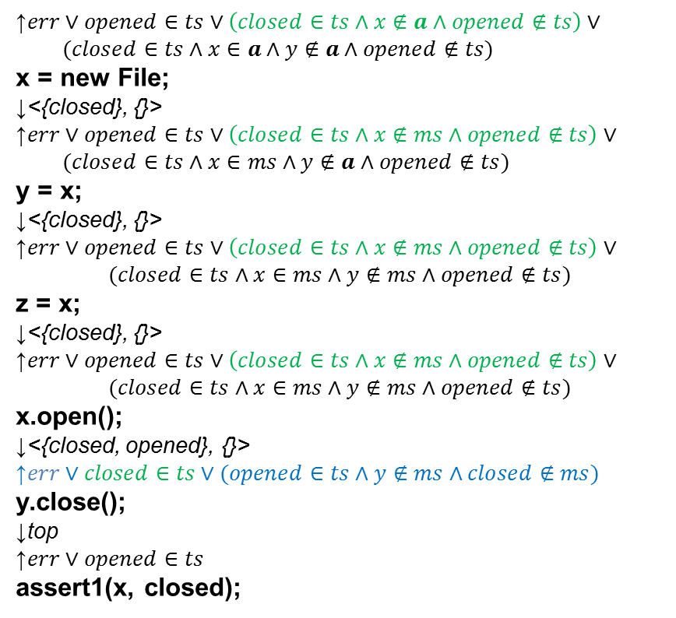
Example: Typestate Analysis
↑$err∨opened∈ts∨\left(closed∈ts∧x∉a∧opened∉ts\right)∨$
$(closed∈ts∧x∈a∧y∉a∧opened∉ts)$
x = new File;
↓<{closed}, {}>
↑$err∨opened∈ts∨\left(closed∈ts∧x∉ms∧opened∉ts\right)∨$
$(closed∈ts∧x∈ms∧y∉a∧opened∉ts)$
y = x;
↓<{closed}, {}>
↑$err∨opened∈ts∨\left(closed∈ts∧x∉ms∧opened∉ts\right)∨$
$$(closed∈ts∧x∈ms∧y∉ms∧opened∉ts)$$
z = x;
↓<{closed}, {}>
↑$err∨opened∈ts∨\left(closed∈ts∧x∉ms∧opened∉ts\right)∨$
$$(closed∈ts∧x∈ms∧y∉ms∧opened∉ts)$$
x.open();
↓<{closed, opened}, {}>
↑$err∨closed∈ts∨(opened∈ts∧y∉ms∧closed∉ms)$
y.close();
↓top
↑$err∨opened∈ts$
assert1(x, closed);
Intersect with the forward state
Notes:
The second disjunct is reachable. Moreover, if summarizes the reason why we fail on this run. If there’s only one disjunct we want to keep, this is the one. How do we distinguish this clause from the other clauses? The answer is we can look at the state of the forward state, which is the state of the typestate analysis. And we can observe there’s an intersection between the current disjunct and the forward state.

Slide 18
Example: Typestate Analysis
↑$err∨opened∈ts∨\left(closed∈ts∧x∉a∧opened∉ts\right)∨$
$(closed∈ts∧x∈a∧y∉a∧opened∉ts)$
x = new File;
↓<{closed}, {}>
↑$err∨opened∈ts∨\left(closed∈ts∧x∉ms∧opened∉ts\right)∨$
$(closed∈ts∧x∈ms∧y∉a∧opened∉ts)$
y = x;
↓<{closed}, {}>
↑$err∨opened∈ts∨\left(closed∈ts∧x∉ms∧opened∉ts\right)∨$
$$(closed∈ts∧x∈ms∧y∉ms∧opened∉ts)$$
z = x;
↓<{closed}, {}>
↑$err∨opened∈ts∨\left(closed∈ts∧x∉ms∧opened∉ts\right)∨$
$$(closed∈ts∧x∈ms∧y∉ms∧opened∉ts)$$
x.open();
↓<{closed, opened}, {}>
↑$err∨closed∈ts∨(opened∈ts∧y∉ms∧closed∉ms)$
y.close();
↓top
↑$err∨opened∈ts$
assert1(x, closed);
Keep as many disjuncts as possible
Intersect with forward state
Notes:
In general,there’re two guidelines to do the analysis:
To balance the scalability of backward analysis and the number of iterations, we want to keep as many disjuncts as possible.
If we cannot keep all due to scalability issue, we will drop some of the disjuncts, which is an underapproximation. But we want to at least keep the disjuncts intersecting with the forward state.

Slide 19
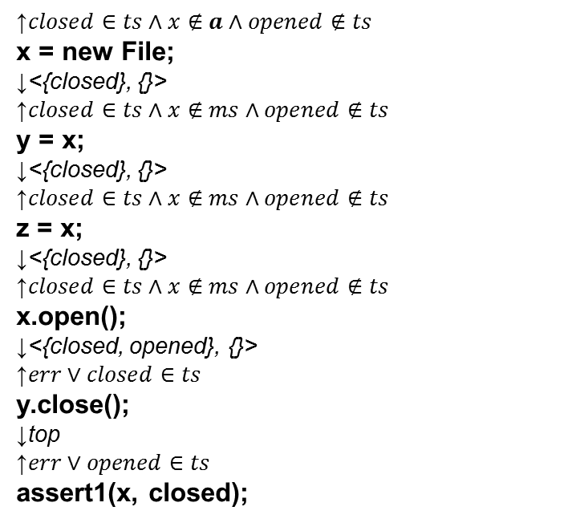
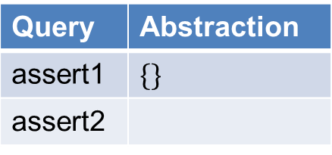
Example: Typestate Analysis
x = new File;
y = x;
z = x;
x.open();
y.close();
assert1(x, closed);
assert2(x, opened);
↑$closed∈ts∧x∉a∧opened∉ts$
x = new File;
↓<{closed}, {}>
↑$closed∈ts∧x∉ms∧opened∉ts$
y = x;
↓<{closed}, {}>
↑$closed∈ts∧x∉ms∧opened∉ts$
z = x;
↓<{closed}, {}>
↑$closed∈ts∧x∉ms∧opened∉ts$
x.open();
↓<{closed, opened}, {}>
↑$err∨closed∈ts$
y.close();
↓top
↑$err∨opened∈ts$
assert1(x, closed);
Query | Abstraction
assert1 | $$\{\}$$
assert2
Failed
Our approach: WP + Underapproximation
Notes:
OK, let us see how exactly our approach solves assert1. Same with the naïve approach, we start with the empty set as the abstraction. We fail to prove the query. Suppose now because of resource limitation, we can only track one disjunct. As a result, we’ll keep the err disjunct at the query point. And we keep pushing backward, (turn page)

Slide 20



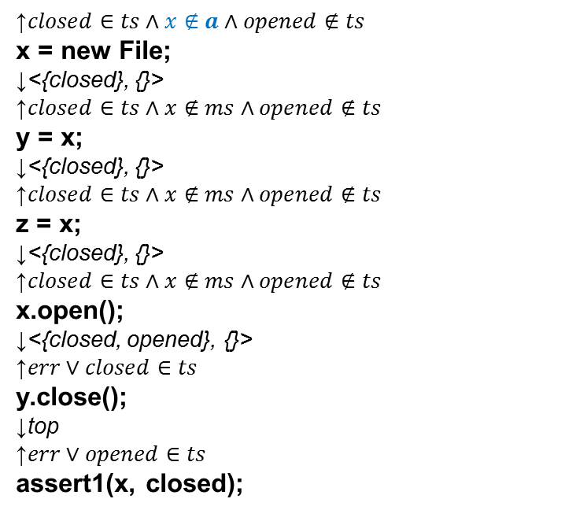

Example: Typestate Analysis
$$y∈a$$
↑$closed∈ts∧x∉a∧opened∉ts$
x = new File;
↓<{closed}, {}>
↑$closed∈ts∧x∉ms∧opened∉ts$
y = x;
↓<{closed}, {}>
↑$closed∈ts∧x∉ms∧opened∉ts$
z = x;
↓<{closed}, {}>
↑$closed∈ts∧x∉ms∧opened∉ts$
x.open();
↓<{closed, opened}, {}>
↑$err∨closed∈ts$
y.close();
↓top
↑$err∨opened∈ts$
assert1(x, closed);
$$x∉a$$
$$x∈a$$
$$y∉a$$
Query | Abstraction
assert1 | $$\{\}$$
assert2
Failed
Our approach: WP + Underapproximation
Notes:
We finally conclude that x not in a is the reason why current run fail. As a result, we successfully elimiate all the abstractions without x.

Slide 21
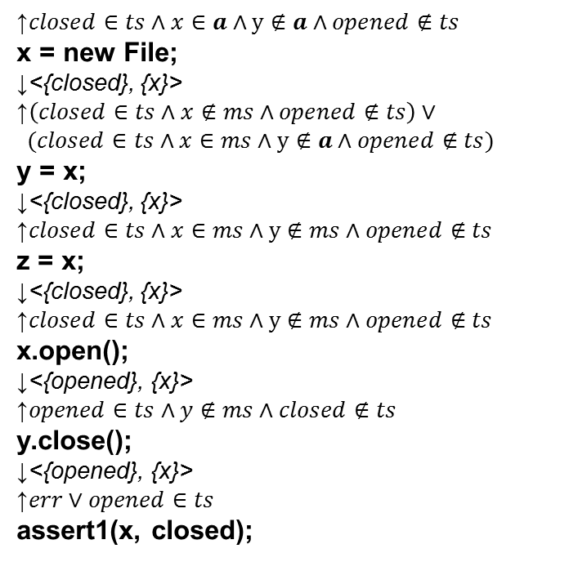
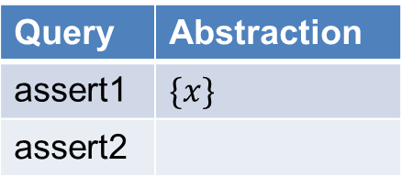
Example: Typestate Analysis
$$y∈a$$
↑$closed∈ts∧x∈a∧y∉a∧opened∉ts$
x = new File;
↓<{closed}, {x}>
↑$\left(closed∈ts∧x∉ms∧opened∉ts\right)∨$
$$(closed∈ts∧x∈ms∧y∉a∧opened∉ts)$$
y = x;
↓<{closed}, {x}>
↑$closed∈ts∧x∈ms∧y∉ms∧opened∉ts$
z = x;
↓<{closed}, {x}>
↑$closed∈ts∧x∈ms∧y∉ms∧opened∉ts$
x.open();
↓<{opened}, {x}>
↑$opened∈ts∧y∉ms∧closed∉ts$
y.close();
↓<{opened}, {x}>
↑$err∨opened∈ts$
assert1(x, closed);
$$x∉a$$
$$x∈a$$
$$y∉a$$
Query | Abstraction
assert1 | $$\{x\}$$
assert2
Failed
Our approach: WP + Underapproximation
Notes:
In the next iteration, we use the abstraction with only x in it, which is our current viable cheapest abstraction.
This time, at the query point, we choose a different disjunct as current iteration fails in a different way.

Slide 22
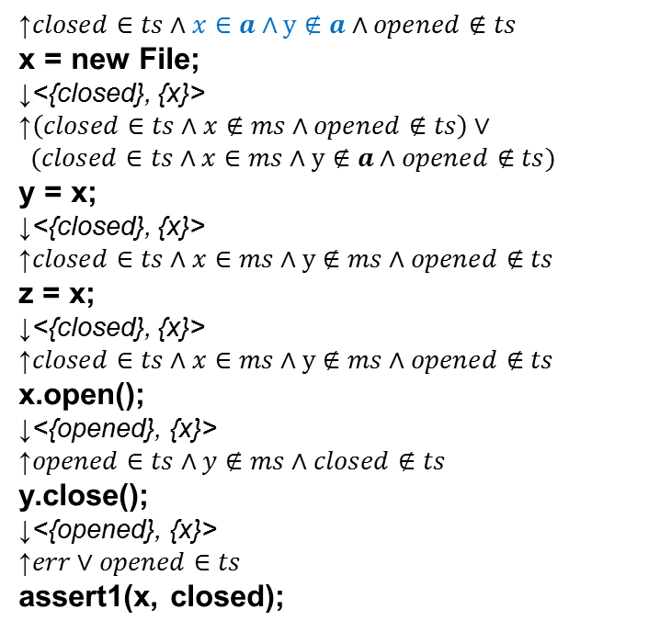
Example: Typestate Analysis
$$y∈a$$
↑$closed∈ts∧x∈a∧y∉a∧opened∉ts$
x = new File;
↓<{closed}, {x}>
↑$\left(closed∈ts∧x∉ms∧opened∉ts\right)∨$
$$(closed∈ts∧x∈ms∧y∉a∧opened∉ts)$$
y = x;
↓<{closed}, {x}>
↑$closed∈ts∧x∈ms∧y∉ms∧opened∉ts$
z = x;
↓<{closed}, {x}>
↑$closed∈ts∧x∈ms∧y∉ms∧opened∉ts$
x.open();
↓<{opened}, {x}>
↑$opened∈ts∧y∉ms∧closed∉ts$
y.close();
↓<{opened}, {x}>
↑$err∨opened∈ts$
assert1(x, closed);
$$x∉a$$
$$x∈a$$
$$y∉a$$
Query | Abstraction
assert1 | $$\{x\}$$
assert2
Failed
Our approach: WP + Underapproximation
Notes:
And eventually, we conclude that when we have x in the abstraction, if we don’t have y, the analysis will still fail.

Slide 23
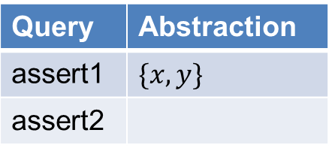
Example: Typestate Analysis
$$y∈a$$
x = new File;
↓<{closed}, {x}>
y = x;
↓<{closed}, {x, y}>
z = x;
↓<{closed}, {x, y}>
x.open();
↓<{opened}, {x, y}>
y.close();
↓<{closed}, {x, y}>
assert1(x, closed);
$$x∉a$$
$$y∉a$$
Query | Abstraction
assert1 | $$\{x, y\}$$
assert2
Proof!
Our approach: WP + Underapproximation
Notes:
With all the information generated in previous two iterations, we now have {x,y} as the cheapest abstraction, and we get a proof. It is worth mentioning that although z also aliases with the file object, we never talked about it in the process. In practice, there could be many variables like it. But our approach won’t be affected.
Also, we take two iterations to finish the proof, is because we only allow to keep one disjunct. If we allow more, we have a chance to finish it in one iteration.

Slide 24
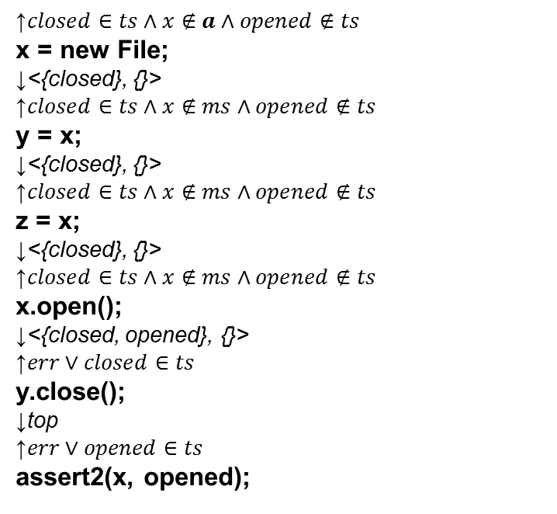
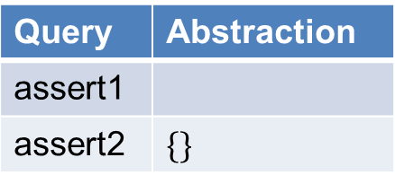
Example: Typestate Analysis
x = new File;
y = x;
z = x;
x.open();
y.close();
assert1(x, closed);
assert2(x, opened);
↑$closed∈ts∧x∉a∧opened∉ts$
x = new File;
↓<{closed}, {}>
↑$closed∈ts∧x∉ms∧opened∉ts$
y = x;
↓<{closed}, {}>
↑$closed∈ts∧x∉ms∧opened∉ts$
z = x;
↓<{closed}, {}>
↑$closed∈ts∧x∉ms∧opened∉ts$
x.open();
↓<{closed, opened}, {}>
↑$err∨closed∈ts$
y.close();
↓top
↑$err∨opened∈ts$
assert2(x, opened);
Query | Abstraction
assert1
assert2 | $$\{\}$$
Failed
Our approach: WP + Underapproximation
Notes:
For assert2, the first iteration is identical to the assert 1. It first tries with empty set as the abstraction.

Slide 25
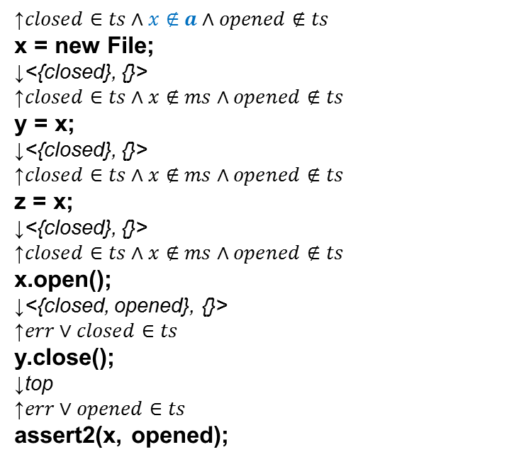
Example: Typestate Analysis
$$y∈a$$
↑$closed∈ts∧x∉a∧opened∉ts$
x = new File;
↓<{closed}, {}>
↑$closed∈ts∧x∉ms∧opened∉ts$
y = x;
↓<{closed}, {}>
↑$closed∈ts∧x∉ms∧opened∉ts$
z = x;
↓<{closed}, {}>
↑$closed∈ts∧x∉ms∧opened∉ts$
x.open();
↓<{closed, opened}, {}>
↑$err∨closed∈ts$
y.close();
↓top
↑$err∨opened∈ts$
assert2(x, opened);
$$x∉a$$
$$x∈a$$
$$y∉a$$
Query | Abstraction
assert1
assert2 | $$\{\}$$
Failed
Our approach: WP + Underapproximation
Notes:
And it concludes to prove the query we have to include x.

Slide 26
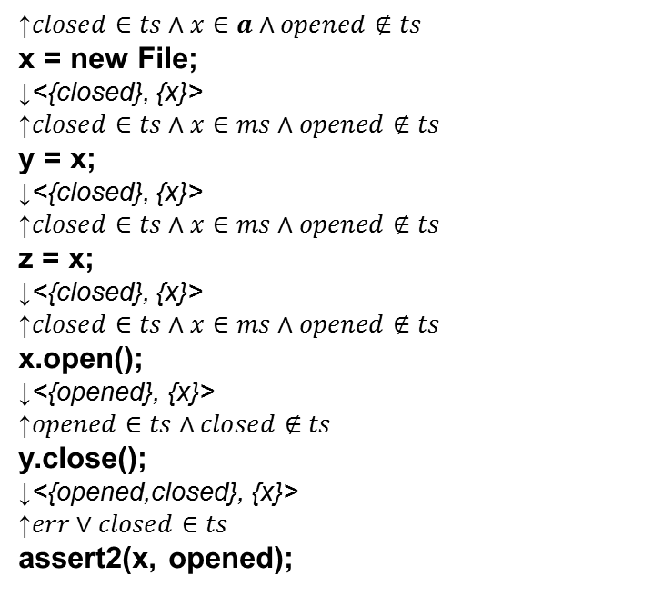
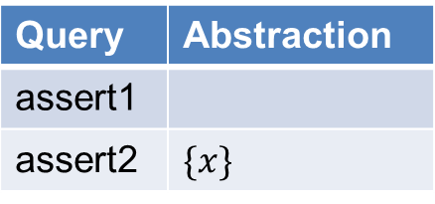
Example: Typestate Analysis
$$y∈a$$
↑$closed∈ts∧x∈a∧opened∉ts$
x = new File;
↓<{closed}, {x}>
↑$closed∈ts∧x∈ms∧opened∉ts$
y = x;
↓<{closed}, {x}>
↑$closed∈ts∧x∈ms∧opened∉ts$
z = x;
↓<{closed}, {x}>
↑$closed∈ts∧x∈ms∧opened∉ts$
x.open();
↓<{opened}, {x}>
↑$opened∈ts∧closed∉ts$
y.close();
↓<{opened,closed}, {x}>
↑$err∨closed∈ts$
assert2(x, opened);
$$x∉a$$
$$x∈a$$
$$y∉a$$
Query | Abstraction
assert1
assert2 | $$\{x\}$$
Failed
Our approach: WP + Underapproximation
Notes:
The second iteration, we also try with set {x}. As we go backward, we choose closed in ts as the disjunct to keep. But this time, when we reach the start, we conclude that x in abstraction is the reason we fail this run. Obviously, there’s a contradiction between current iteration and previous iteration.

Slide 27

Example: Typestate Analysis
In paper: a general framework for parametric dataflow analysis
$$y∈a$$
Impossibility!
↑$closed∈ts∧x∈a∧opened∉ts$
x = new File;
↓<{closed}, {x}>
↑$closed∈ts∧x∈ms∧opened∉ts$
y = x;
↓<{closed}, {x}>
↑$closed∈ts∧x∈ms∧opened∉ts$
z = x;
↓<{closed}, {x}>
↑$closed∈ts∧x∈ms∧opened∉ts$
x.open();
↓<{opened}, {x}>
↑$opened∈ts∧closed∉ts$
y.close();
↓<{opened,closed}, {x}>
↑$err∨closed∈ts$
assert2(x, opened);
$$x∉a$$
$$x∈a$$
$$y∉a$$
Query | Abstraction
assert1
assert2 | $$\{x\}$$
Failed
Our approach: WP + Underapproximation
Notes:
This iteration eliminates the abstractions containing x. And last iteration has already eliminate all the asbstraction without x. So we conclude no ab straction can prove this query, and we get an impossibility result.

Slide 28
Experiment
Implementation in Chord for Java programs
2 Client Analyses: Typestate and Thread-Escape
Both fully context- and flow-sensitive analyses
Only scale with sparse parameters
7 Java Benchmarks
Notes:
To demonstrate our approach on some real client analyses. We implement our general framework in Chord for java programs. And we take two client analyses, typestate and thread-escape analyses. These two analyses are both fully…. And they only…
We pick 7 real-world java benchmarks.

Slide 29
Benchmarks
name | bytecode(KB) | KLOC | log|A|
 |  |  | thread-escape | typestate
tsp | 391 | 269 | 569 | 6,175
elevator | 390 | 269 | 352 | 6,180
hedc | 442 | 283 | 1,400 | 7,326
weblech | 504 | 326 | 2,993 | 7,663
antlr | 532 | 303 | 16,563 | 7,748
avrora | 634 | 340 | 37,797 | 10,151
lusearch | 511 | 314 | 14,508 | 7,395
Notes:
And this table shows the characteristics of the benchmark. And we can see, overage these benchmarks contain half million bytecode. And the size of the abstraction families vary from 2 to the power of 352 to 2 to the power of 38 hundred

Slide 30
Precision: Thread-Escape Analysis
209 221 552 658 5857 14322 6726 (Total # Queries)
Resolved: ~90%
Previous: ~40% [POPL12]
Notes:
This chart shows the precision of the thread-escape analysis. Each bar shows the percentage of resolved queries on different benchmarks. The part with dashline on it represents the queries proven, and the blank part is the queries found impossible to prove. Finally, some queries are unresolved because either the static analysis or our backward analysis timed out. They are shown with the part having dots on it. As we can see, on average, around 90% queries got resolved, while our previous work only resolved 40% of the queries.

Slide 31
Precision: Typestate Analysis
12 72 170 71 7903 5052 3644 (Total # Queries)
Notes:
This the precision bar chart of the typestate analysis. Compared with thread-escape, all queries are resolved, but only around 25% got proven. This is because the typestate analysis lacks the implementation of some advanced features. And our approach successfully found impossibilities for these queries in a relative short time, which I will show on the following slides.

Slide 32
Scalability: Number of iterations
Notes:
One measurement of scalability is the # of iterations. This is the chart shows the number on one of our largest benchmarks. X axle shows the number of iterations, and y axles shows the number of queries which requires a certain number of iterations. The blank bar represents the proven queries, while the bar with dash represents the impossible queries. As we can see, most impossible queries are fund within 1 iterations, and most provable queries are proved within 4 iterations. But there’re also some queries which take as many as 97 iterations.

Slide 33
Scalability: Number of iterations
Notes:
The results on other benchmarks look similar.

Slide 34
Scalability: Running time
Notes:
Another measurement of the scalability is the running time. This chart shows the number of queries which requires different running times. Similarly, the blank bars are for proven queries, and the bars with dash lines are for impossible quries. As we see, most queries are proven or found impossibility within just 1 minute. But some queires need as many as 173 minutes.

Slide 35
Scalability: Running time
Notes:
The result on other benchmarks look similar.

Slide 36
Size of optimal abstractions
Notes:
After looking at the precision and scalability measurement, it is interesting to know what’s the size of optimal abstractions for each query. And this chart shows the number of queries needing different abstraction size. And we can see, most of the optimum abstractions are of size 1-3. It means only up to 3 bits in the bitvector are set to 1. But we also notice here, some abstractions require as many as 96 bits to set to 1.

Slide 37
Size of optimal abstractions
Notes:
This slide show the result on other benchmarks.

Slide 38
Related work
Modern pointer analysis
Demand-driven, query-driven, …
Heintze & Tardieu ’01, Guyer & Lin ’03, Sridharan & Bodik ’06, ...
CEGAR model checkers: SLAM, BLAST, YOGI, …
Work on concrete counterexamples
Can disprove queries
No optimality guarantee – can over-refine and hurt scalability.
No impossibility - can cause divergence.
Notes:
Our approach is related to modern pointer analysis, which also tries to balance the precision and scalability for individual queries.
CEGAR model checkers also try to refine the abstraction on counterexamples. But one difference is that their refinement works on concrete counterxamples. As a result they can disprove queries.
More importantly, their approaches differ from ours in the following two ways:
Some times these model checkers can do over refine. As a result, there’s no guarantee for optimum abstractions, and sometimes it will hurt the scalability.
With that, we end our talk today.

Slide 39
Thank you!
Q&A

