Slide 1
Salary Prediction for AI-related jobs
End-to-End Machine Learning Solution on AWS
2024SP_MLDS Cloud Engineering for Data Science Final Project
Wen-Chi Lee, Jeansue Wu, Tzuliang Huang, Xinran Wang

Slide 2
Objective
Business Question
Key Components
AWS Services
What are the determinants of salary for AI-related jobs from 2021 to 2023?
S3, ECS, EC2, Quicksight
Data collection, preprocessing, model building, deployment, and visualization.

Slide 3
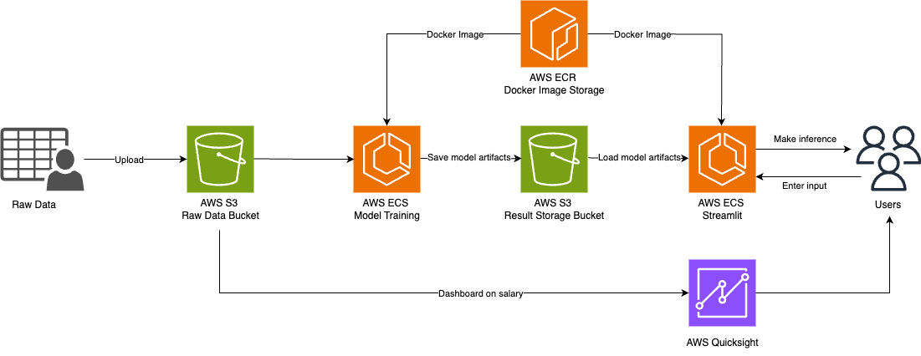
Architecture Diagram
Notes:
Model Training: Once the data is uploaded, it is utilized by AWS ECS for model training.
Docker Image Storage: Our trained models are containerized and stored in AWS ECR, ensuring that we have a consistent environment for deployment and scalability.
Saving Model Artifacts: After training, the model artifacts are saved back into a different S3 bucket, the Result Storage Bucket,
Streamlit Application: For user interaction, we have a Streamlit application running on AWS ECS. This application loads the model artifacts from the Result Storage Bucket and provides an interface for users to make inferences by entering their input data.

Slide 4
Architecture Diagram
Notes:
Our trained models are containerized and stored in AWS ECR, ensuring that we have a consistent environment for deployment and scalability.
Saving Model Artifacts: After training, the model artifacts are saved back into a different S3 bucket, the Result Storage Bucket,
Streamlit Application: For user interaction, we have a Streamlit application running on AWS ECS. This application loads the model artifacts from the Result Storage Bucket and provides an interface for users to make inferences by entering their input data.

Slide 5
Cost Estimator
01
AWS S3 Bucket
0.04 USD
1. Raw: S3 Standard Storage (1 GB) per month
2. Results: S3 Standard Storage (1 GB) per month
02
AWS ECR
TOTAL
Monthly Cost Estimate
0.08 USD
Amount of data stored (800 MB per month)
AWS Fargate
03
Operating system (Linux), CPU Architecture (ARM), Average duration (1 minutes), Number of tasks or pods (1 per day), Amount of ephemeral storage allocated for Amazon ECS (20 GB)
0.00 USD
31.52 USD
04
Amazon QuickSight
31.40 USD
Number of working days per month (22), SPICE capacity in gigabytes (GB) (10), Number of authors (1), Number of readers (5)

Slide 6
Data Sources and Pre-processing
Salary trends from 2021 to 2023
Experience Level | Entry-Level to Senior
Employment Types | Full-time, intern…
Job Titles | Data Engineers, Data Scientists…
Salary | In USD
Location | Globally
Company Sizes | Classified to S, M, L
02
Outliers
03
Removed specialized positions (e.g., "Autonomous Vehicle Technician") and major outliers.
01
Mapping
Mapped job titles into broad categories (Data Scientist, Data Analyst, Machine Learning Engineer).
Filtering
Curated dataset for full-time roles

Slide 7
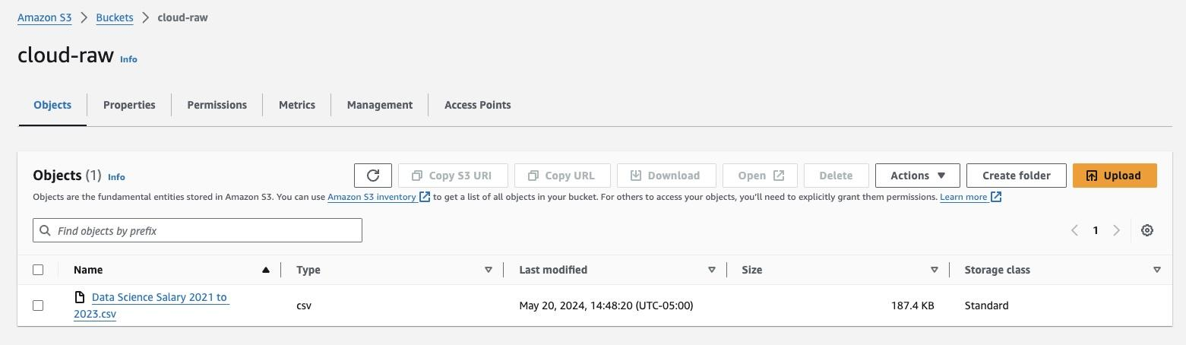
Data Storage
Raw data stored in S3

Slide 8
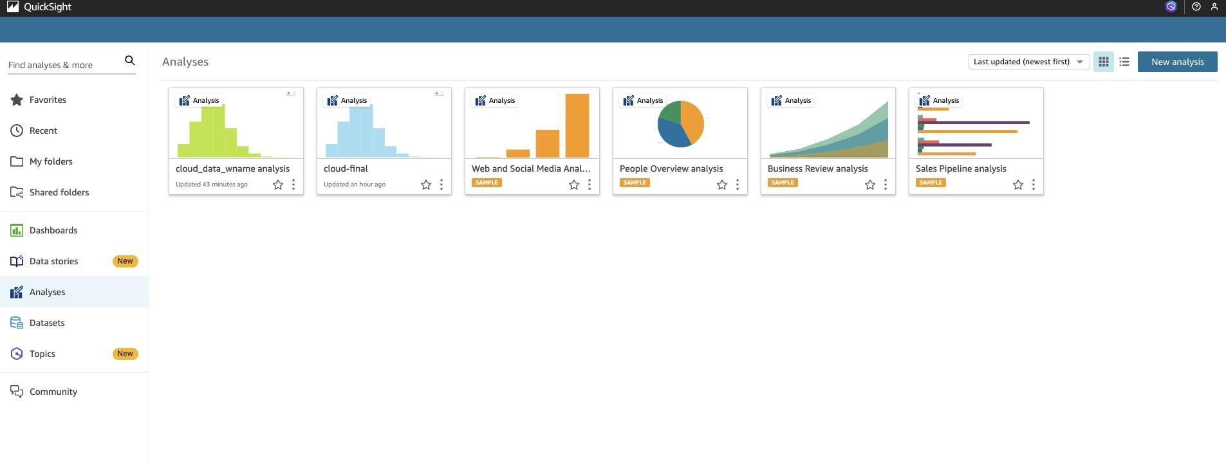
QuickSight
Use Quicksight fro EDA

Slide 9
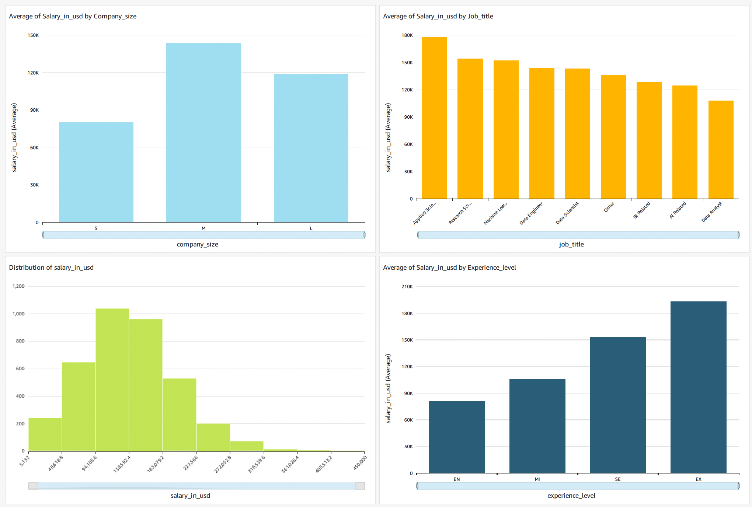
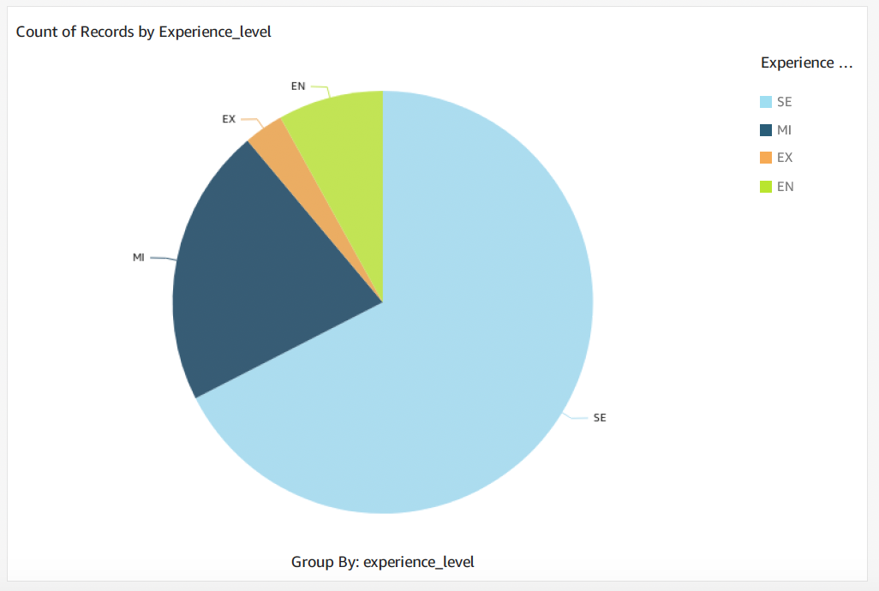
QuickSight EDA
Company Size and Salary: Medium-sized companies offer the highest average salaries, followed by large and small companies.
Job Title and Salary: Analytical Sales and Research Scientist roles have the highest average salaries among job titles.
Experience Level Distribution: The majority of professionals are Senior level (SE), followed by Mid-level (MI), Entry-level (EN), and Executive (EX).

Slide 10
QuickSight EDA
Salary Distribution: Most salaries cluster between $100,000 and $150,000, with a right-skewed distribution.
Experience Level and Salary: Executives (EX) earn the highest average salaries, followed by Senior (SE), Mid-level (MI), and Entry-level (EN).

Slide 11
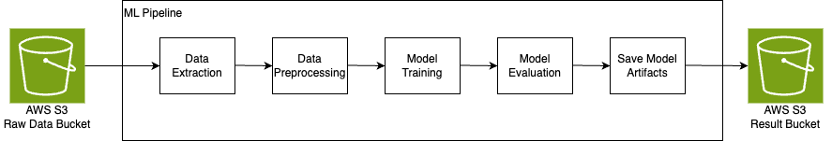
Create Pipeline
Automate the deployment process with a well-defined pipeline to ensure consistent and efficient deployment on AWS.
Random Forest
Gradient Boost
XGBoost

Slide 12
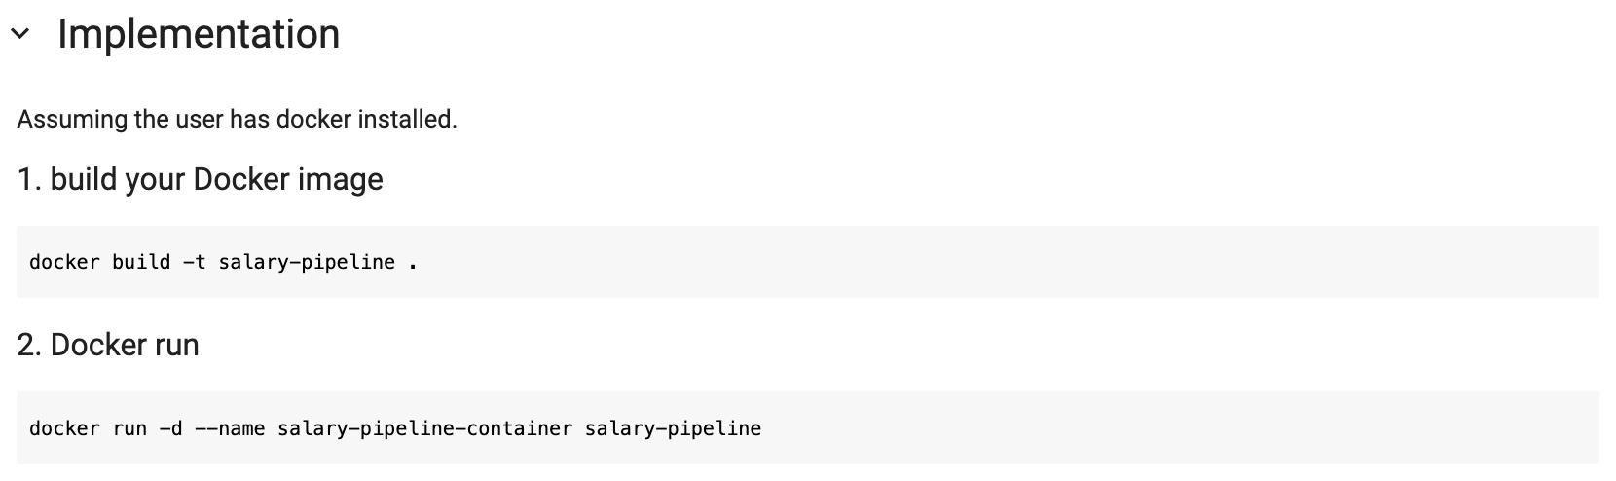
Run in Dockerfile
Build and configure the application within a Docker container to ensure portability and reproducibility.

Slide 13
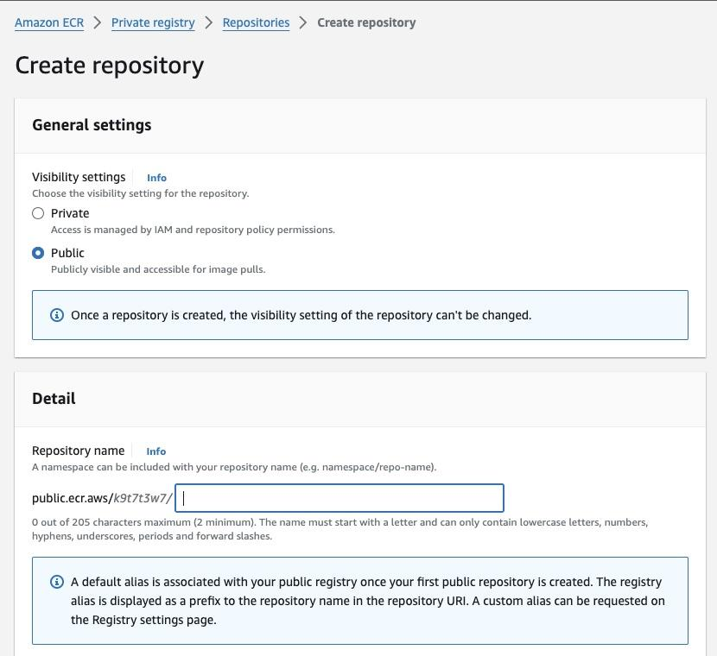
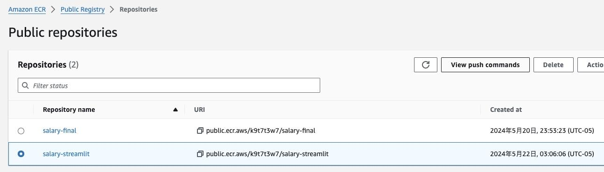
Upload Docker Image to ECR
Push the Docker image to Amazon Elastic Container Registry (ECR) for secure, scalable storage and management.

Slide 14
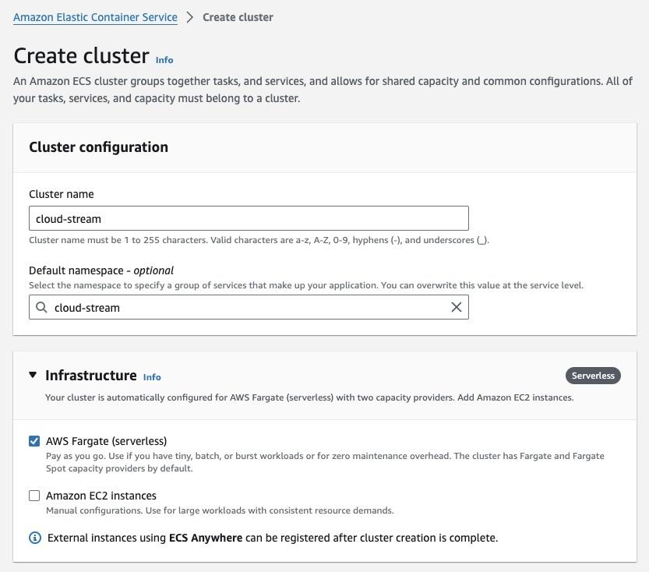
Create ECS cluster
Set up an Amazon ECS cluster to manage the deployment of containerized applications
Better integration, cost efficient and scalable.

Slide 15
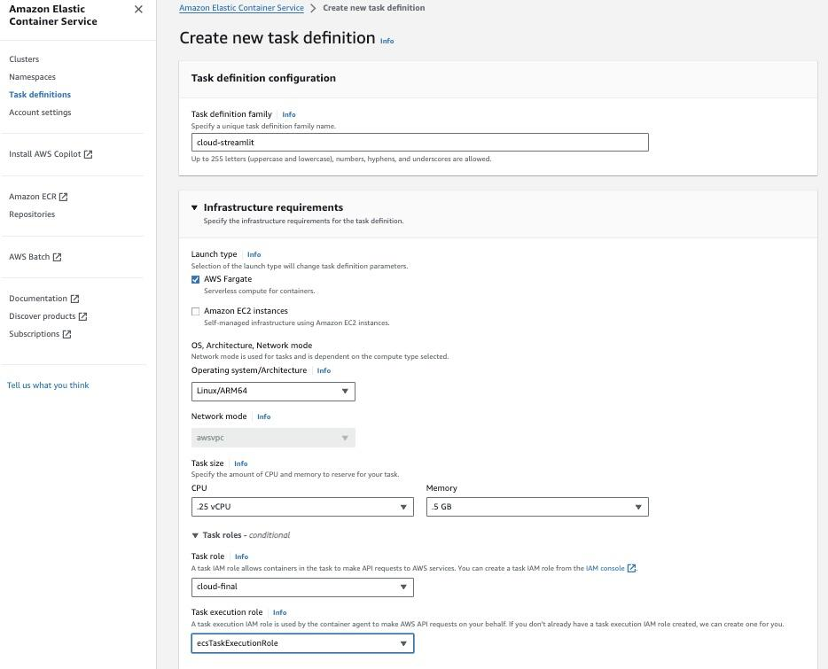
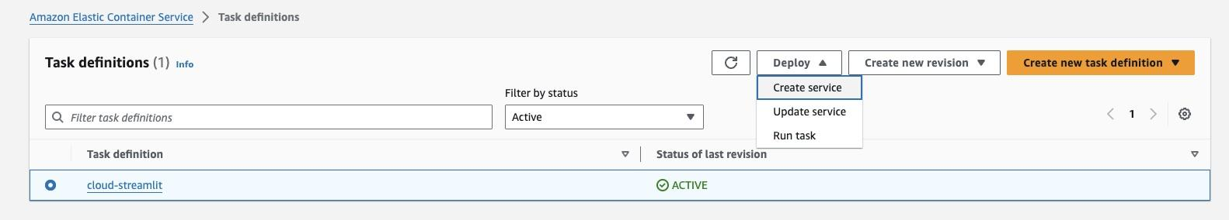
Create Task Definition
Define the necessary resources and configurations for running Docker containers as tasks within the ECS cluster

Slide 16
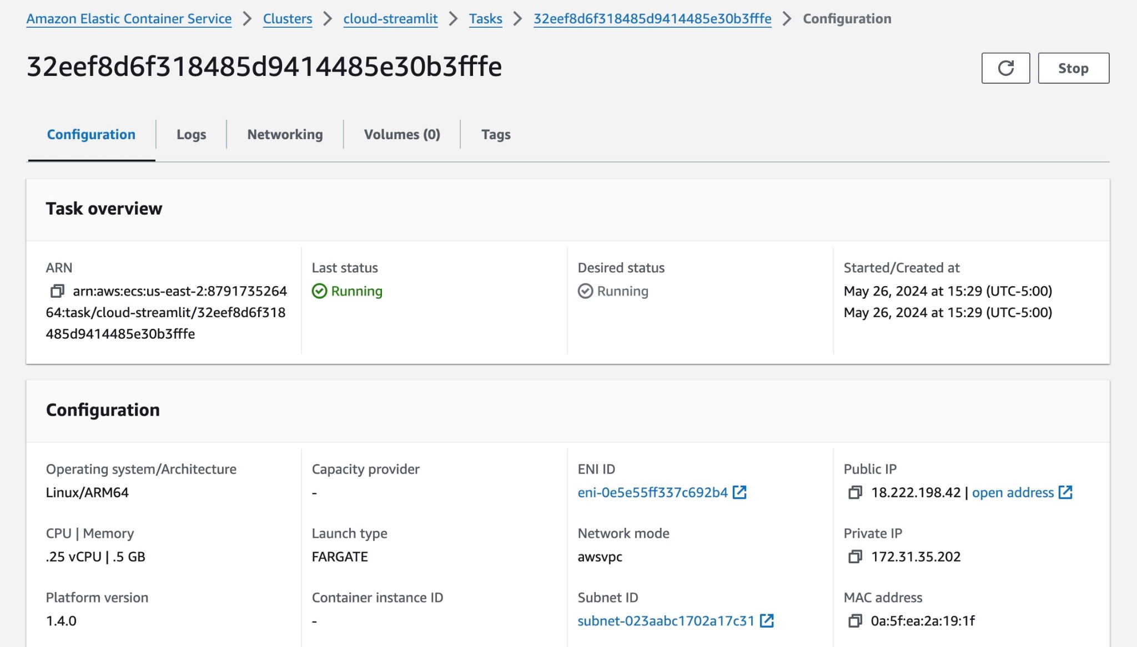
Service Deployment
Deploy the application services on the ECS cluster to ensure high availability and scalability.

Slide 17
Models
Algorithm | Overview | Implementation | R² (%) | RMSE
Random Forest | Ensemble of decision trees | 500 trees, hyperparameter tuning, cross-validation | 42.02 | 46865.95
Gradient Boost | Sequential decision trees | GridSearchCV, learning rate 0.2, max depth 3, 100 trees | 43.6 | 46221.6
XGBoost | Advanced Gradient Boosting with optimizations | alpha 10, colsample_bytree 0.3, learning rate 0.2, max depth 5, 50 trees | 42.81 | 46544.86

Slide 18
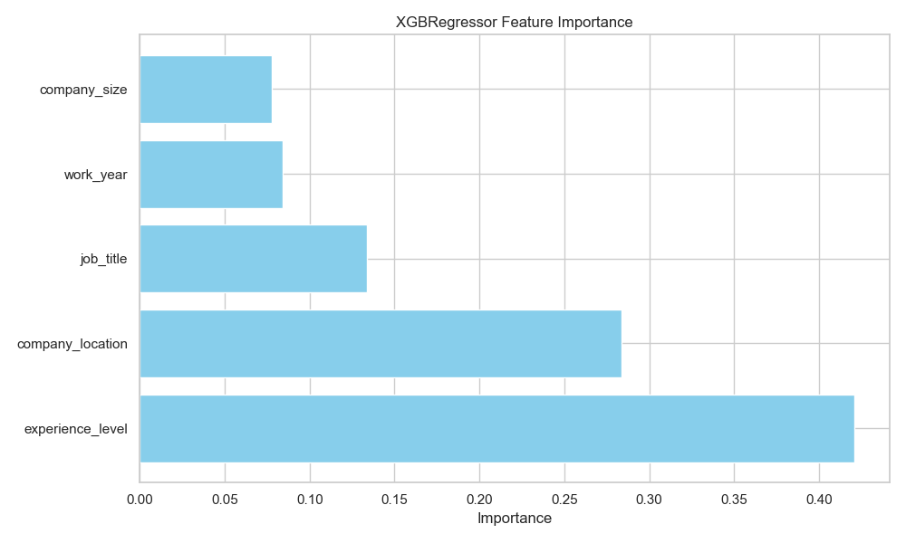
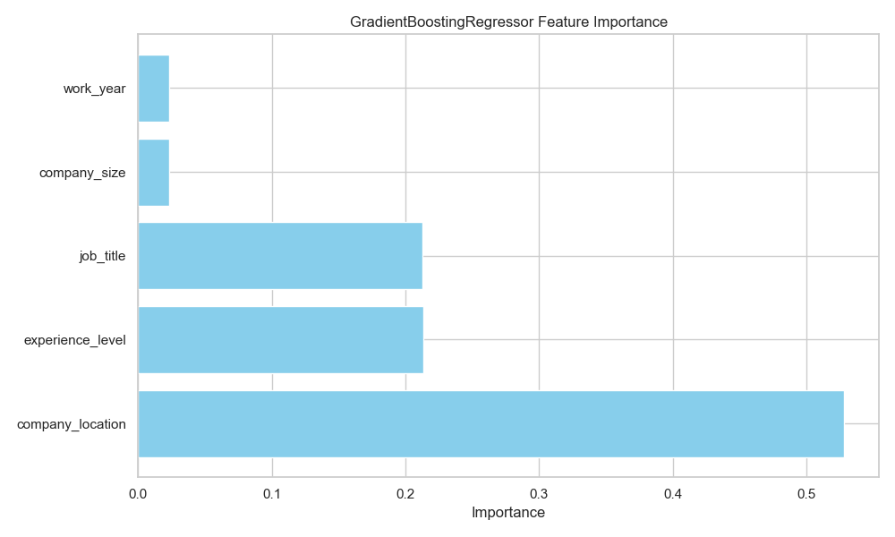
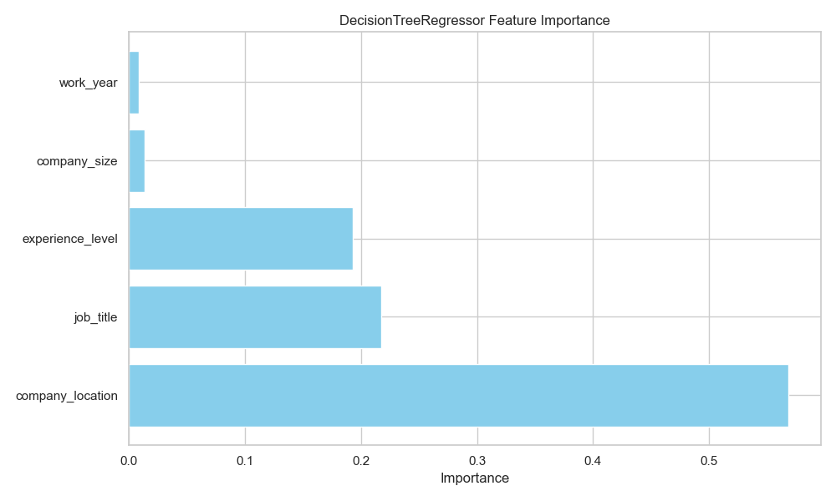
Feature Importance
Company's location, job title, and experience level are the most crucial factors in determining a person’s salary.

Slide 19
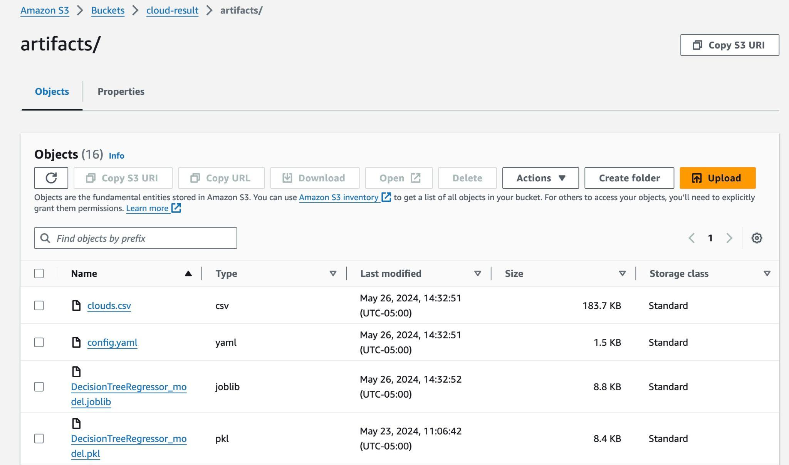
Result Artifacts
Generate and store artifacts, such as logs and performance metrics, to analyze the deployment results and ensure continuous improvement.

Slide 20
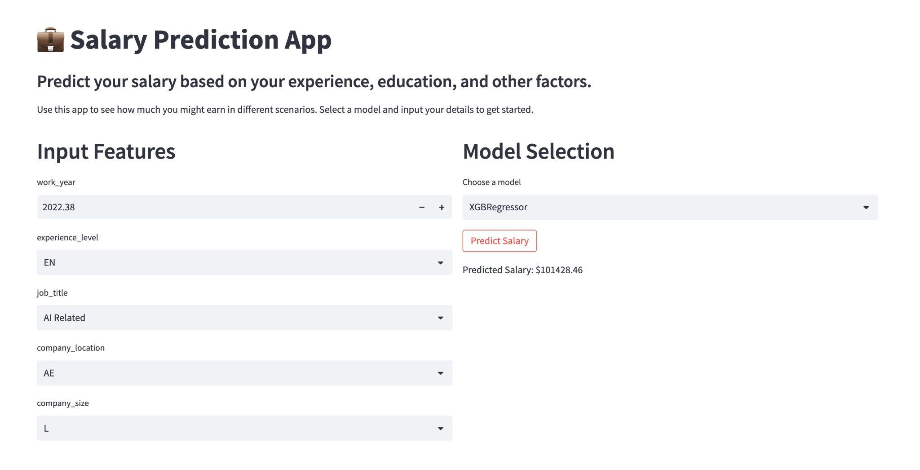
Streamlit Interface
Launch a Streamlit interface for user interaction, providing a user-friendly front end for the deployed application.

Slide 21
Thank you!

