Slide 1

Movie Recommender System
MLDS 421_Data Mining-Final Project Team 14:
Jeansue Wu, Jiayue Tian, Muhammet Ali Buyuknacar, Xinran Wang

Slide 2

Table of contents
01
02
03
04
Introduction
Background + Objectives
Data
EDA + Feature Engineering
Methods & Results
Dimension Reduction
Text Vectorization + Clustering
Recommender System
Conclusion

Slide 3

01
Introduction
Background + Objectives

Slide 4

Introduction
Movie recommendation systems, standing as pivotal tools, guide audiences to cinematic experiences that resonate with their tastes and preferences.
These systems, fueled by advancements in data analytics and machine learning, are important for the commercial success of streaming platforms.
High-level Business Objective: developing a recommendation system to increase viewer retention, enhance user experience, and drive platform loyalty.

Slide 5
02
Data
EDA + Feature Engineering

Slide 6
Data Description
The Movies Dataset from Kaggle (The Movies Dataset (kaggle.com))
Collected from TMDB and GroupLens
100,000 ratings from 700 users for a subset of 9,000 movies
Movie information about overview, budget, revenue, average votes, number of votes, popularity, released year, released month, released day, runtime, language, genres, country, company, cast size, and crew size
Rating information about ratings from 1 to 5 by different user for different movie

Slide 7
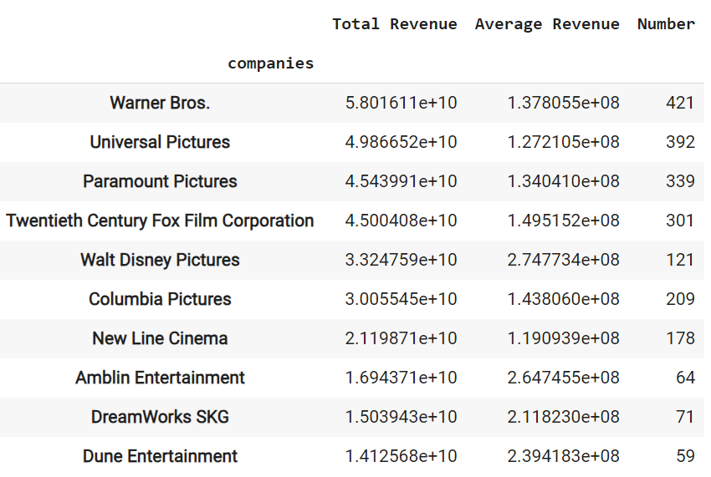
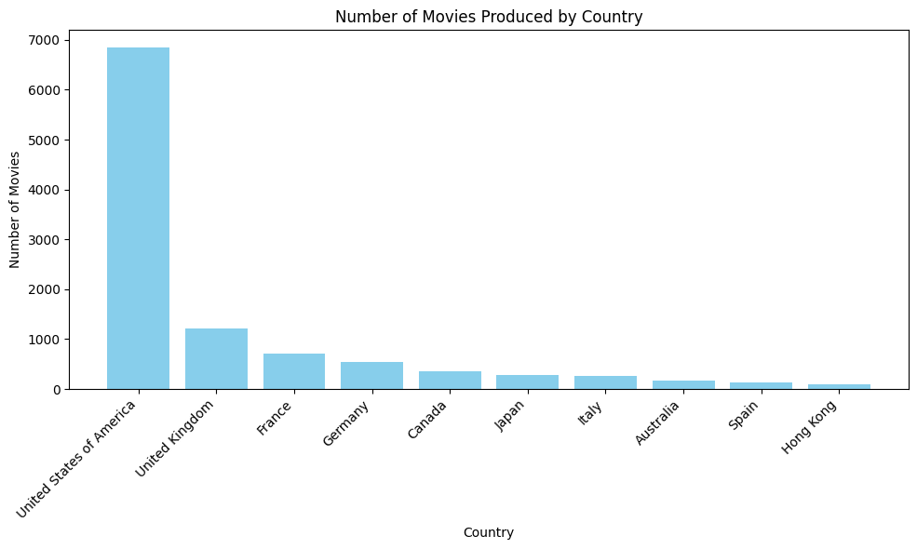
EDA for important features
Country:
Company:

Slide 8
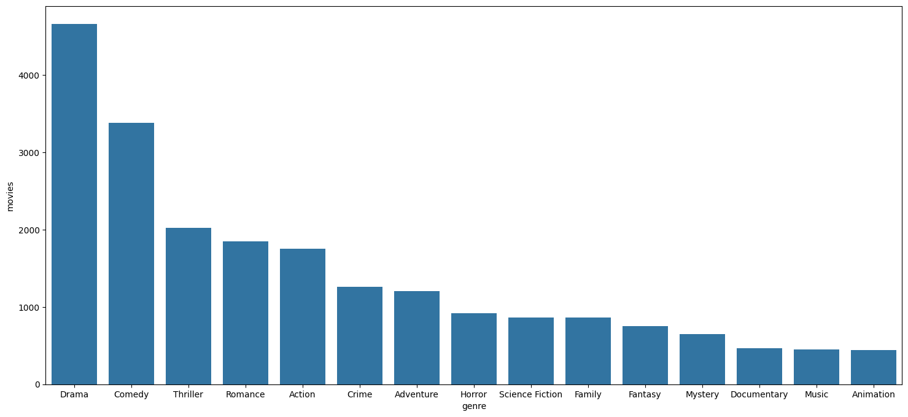
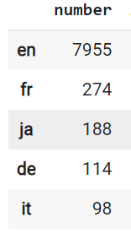
EDA for important features
Language:
Genre:

Slide 9
Feature Engineering
Genres
Production Companies
Country
Language
is_Animation, is_Comedy…
is_Warner Bros, is_Universal Pictures…
is_US, is_UK
is _English
One-hot encoding
Year (numerical)
Month (is_Jan, is_Feb…)
Day (is_Mon, is_Tue…)
Released Date
Split

Slide 10
03
Methods & Results
Dimension Reduction
Text Vectorization + Clustering
Recommender System

Slide 11
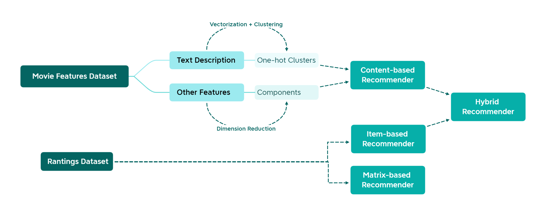
Mindmap

Slide 12
Dimension Reduction
62 cols
2 cols
Algorithms:
PCA
t-SNE
UMAP
After Feature Engineering
After Dimension Reduction

Slide 13
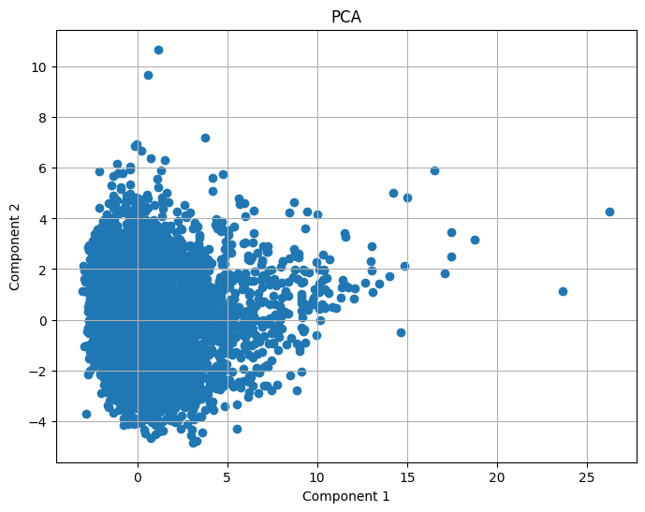
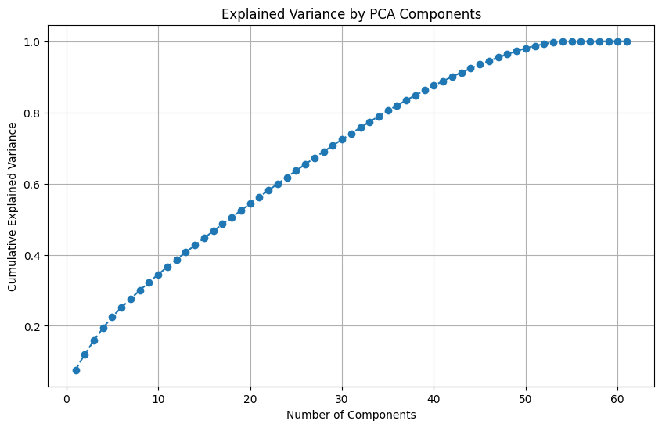
Dimension Reduction
PCA:

Slide 14
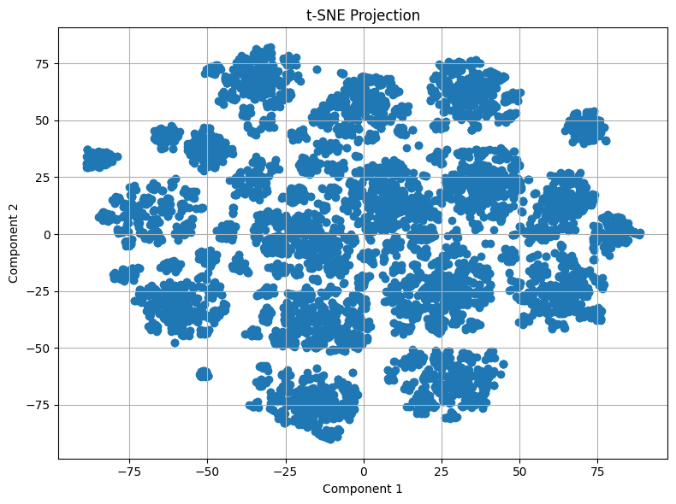
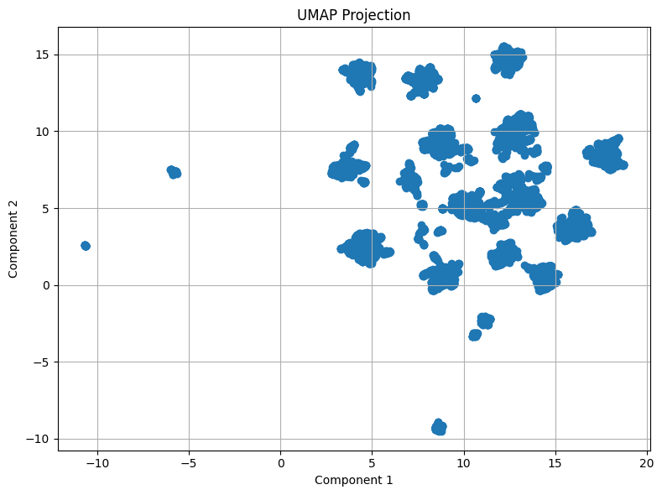
Dimension Reduction
t-SNE:
UMAP:

Slide 15
Text Vectorization
9,099
14,630
Combine the overview and tagline of movies together
Transform raw text data into a cleaned, normalized form that can then be converted into a numerical format (TF-IDF)
tfidf_matrix.shape:
Overviews of Movies
Number of Words

Slide 16
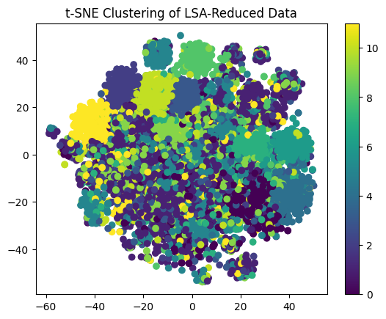
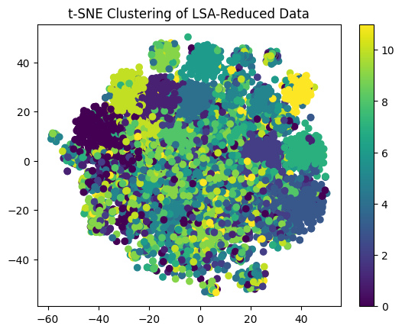
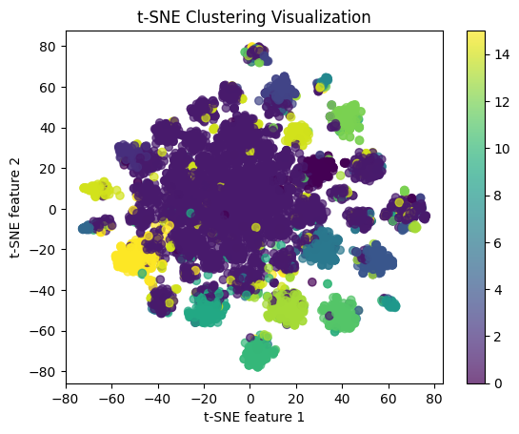
Clustering (Based on Description)
Factorization | Clustering
SVD | K-means
SVD | Spectral Clustering
NMF (n_components = 100) | K-means (k=16)
Silhouette Score: 0.033 0.031 0.164

Slide 17
Clustering (Based on Description)
Factorization | Clustering
NMF (n_components = 100) | K-means (k=16)
Factorization: Employed Non-negative Matrix Factorization (NMF) with n_components = 100 to decompose the TF-IDF matrix into lower-dimensional representations, capturing latent semantic features within the document-term space.
Clustering: Utilized K-means clustering algorithm with k=16 clusters to group documents with similar content together based on their TF-IDF representations.

Slide 18
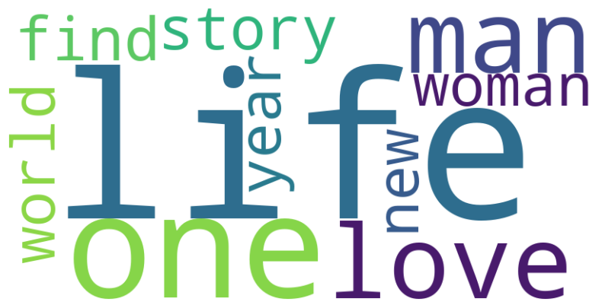
Clustering (Based on Description)
Visualizing the Largest Cluster:
CLUSTER SIZE TOP WORDS
0: 5481 life one love man story find world woman new year
1: 229 evil battle power stop world monster good must ancient demon
2: 373 comedy couple romantic relationship love life one new friend two
3: 53 harry dirty voldemort hogwarts callahan ron hermione dark year time
4: 264 town small life new girl come one woman texas big
5: 262 run kill go hit life two new man baby get
6: 203 john novel based lennon film life adaptation love time man
7: 258 detective case christmas murder private police santa cop truth eve
8: 223 road car trip race country hit accident life cross get
9: 308 come two friend one life man young world love family
10: 277 fight art martial master force man hero one must street
11: 265 adventure ever find world new life greatest two boy way
12: 55 vampire blood dracula hunter horror hunt force count blade werewolf
13: 159 rock band music singer star roll tour concert musical life
14: 208 sister life family brother woman young home year love girl
15: 121 los angeles life girlfriend go city get new film day

Slide 19
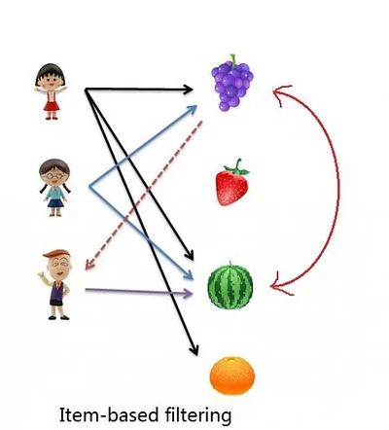
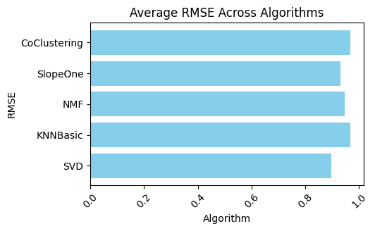
Item-Based Recommender
No significant difference between algorithms
Best Item-Based Algorithm: KNNBasic
k=60, min_k=5, shrinkage=10, similarity=msd
MSE: 0.8693

Slide 20
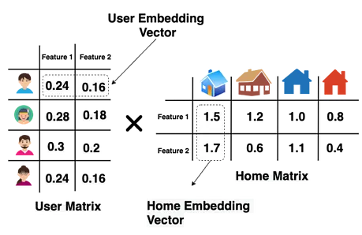
Matrix-Based Recommender
Best Matrix-Based Algorithm: SVD
n_factors = 150
lr_all = 0.01
reg_all = 0.1
MSE : 0.7829

Slide 21
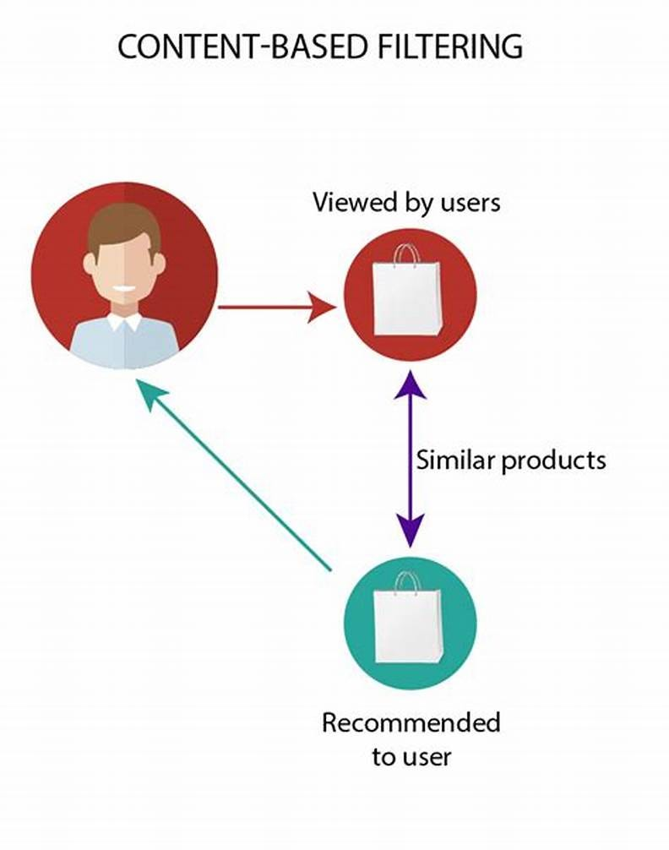
Content-Based Recommender
Based on:
2 UMAP Components
15 Cluster Labels
Model: NearestNeighbors
n_neighbors = 40
algorithm = auto
metric = cosine
Finds 40 similar movies for a given movie

Slide 22
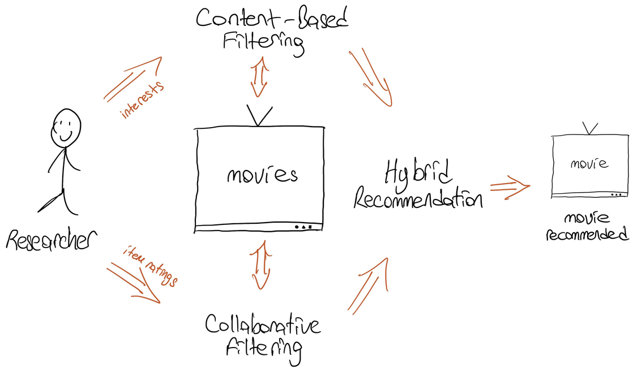
Hybrid Recommender
Experimentations with combining item-based, content-based, matrix-based and popularity
Final Hybrid Recommender: Content-Based + Item-Based
For a certain user the candidate pool is filtered based on content-based recommender and sorted by item-based recommender to give the top k recommendations.

Slide 23

Conclusion
To reach our goals of:
Increasing viewer retention
Enhancing user experience
Driving platform loyalty
Final model: Hybrid Recommender
Takes into account of:
content features
user-item relationships

Slide 24
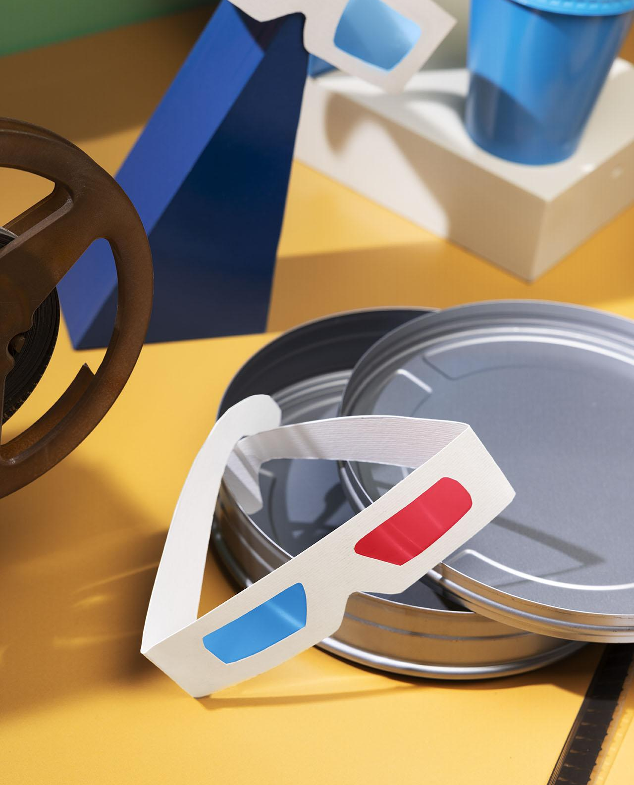
Thanks!

