Slide 1
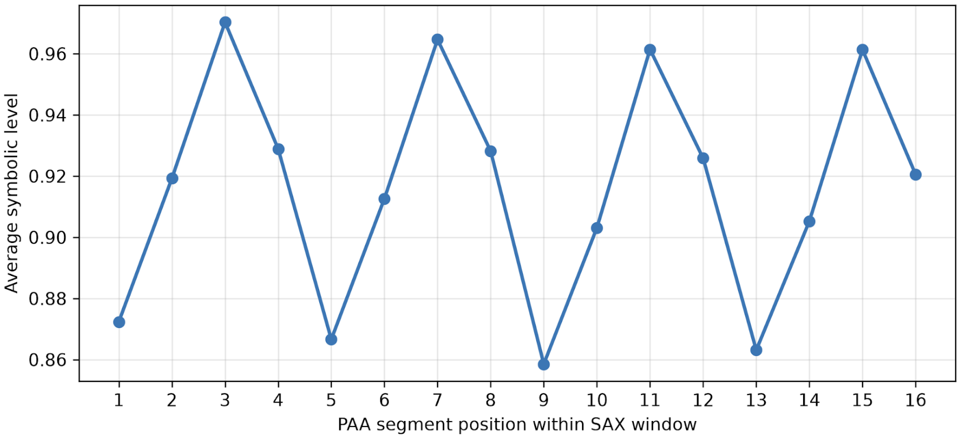
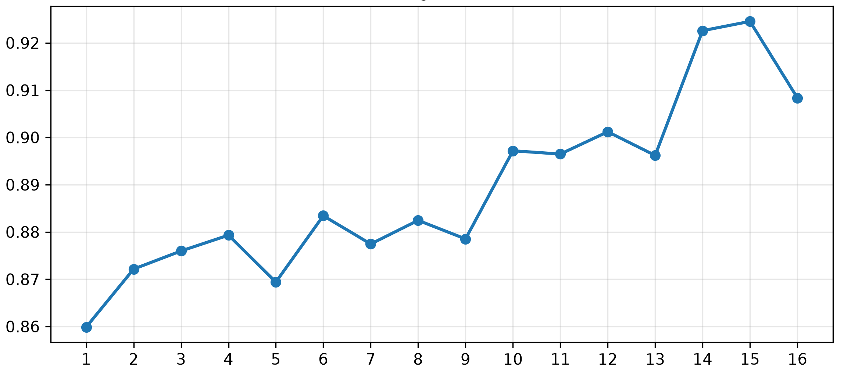
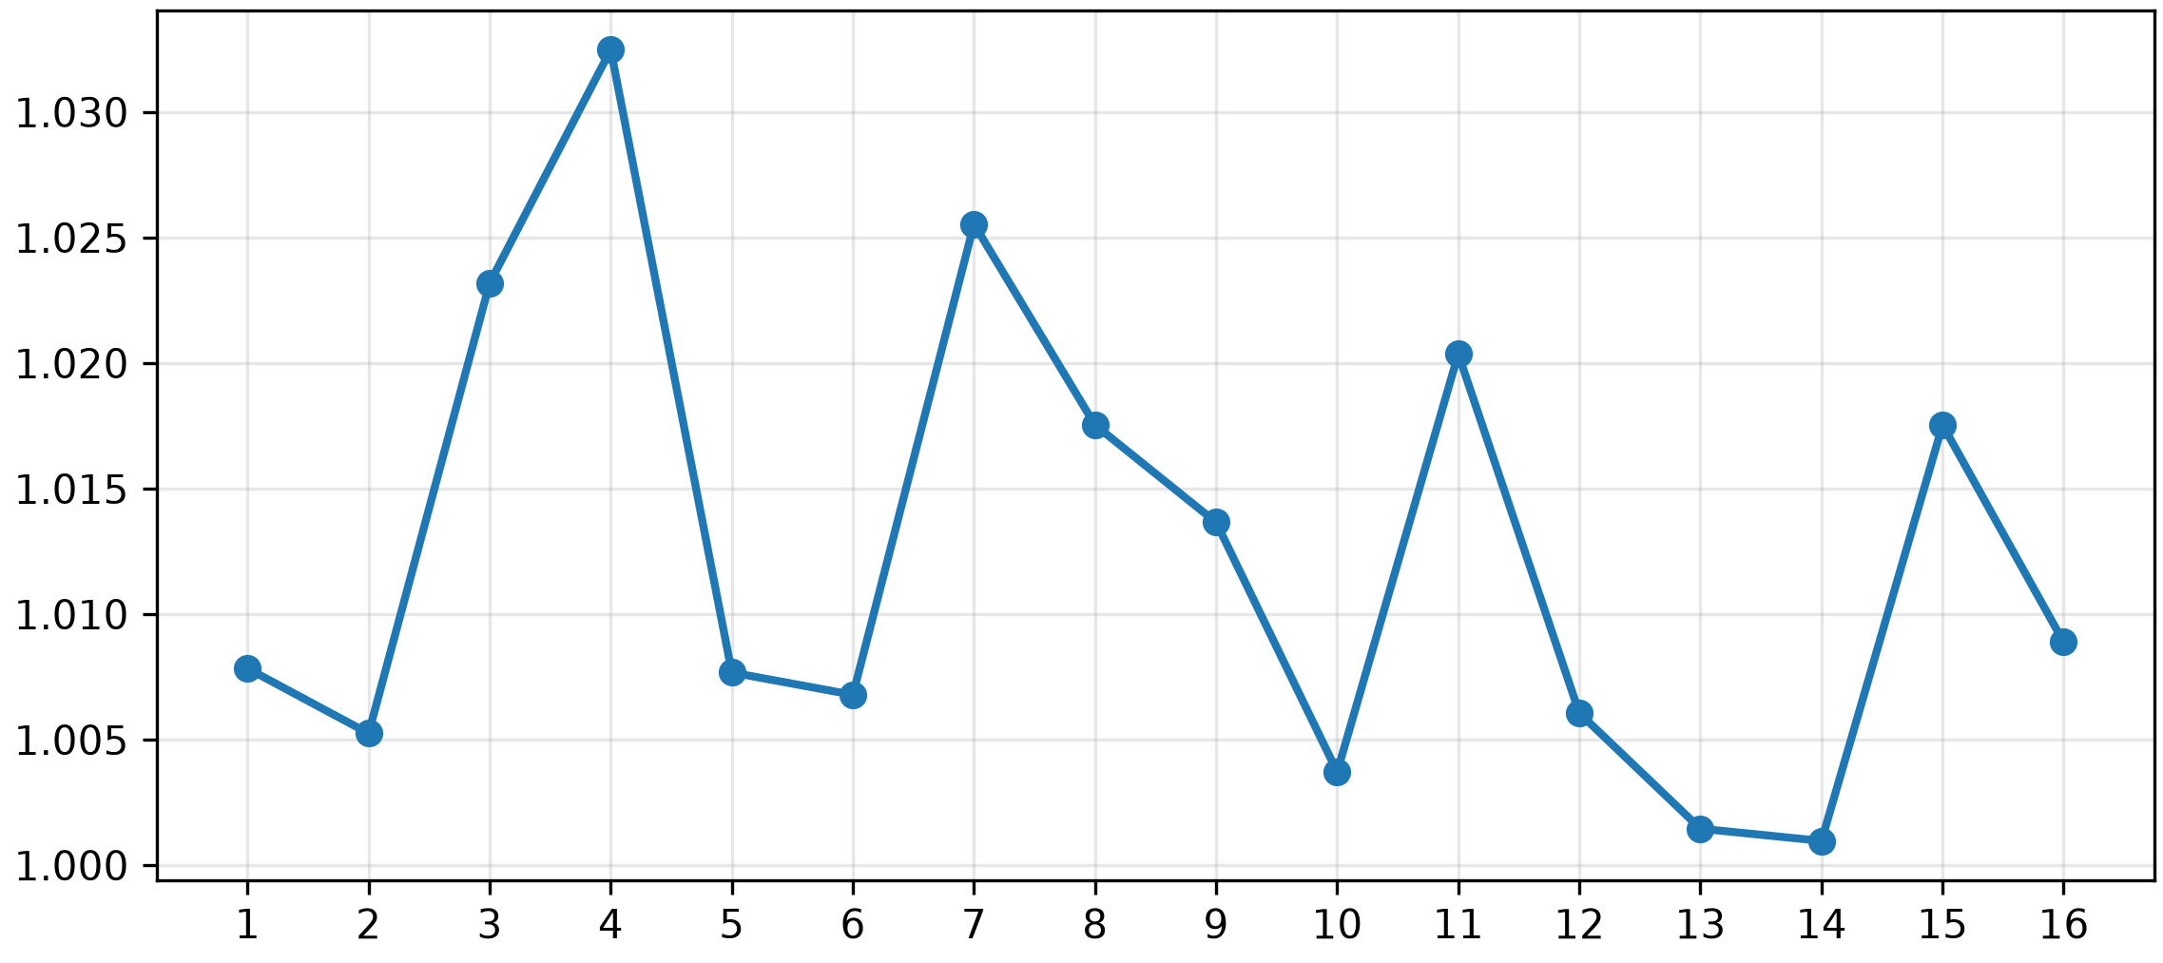
Cluster 0, 107 terms, stability = 0.64
Cluster 1, 98 terms, stability = 0.64
Cluster 7, 119 terms, stability = 0.84

