Slide 1

Smart Stock Consultant
System design
Group 9
Huang Xinrun A0231555J
Guo Fangjie A0231415U
Wang Yangxi A0231505U

Slide 2
PART1
Overall architecture
Predict one or several companies stocks’ trend
Recommend 3 stocks that will rise today
Q&A about stock information through chatbot
Notes:
system interface: web application
the front end: Jinjia2 Template, Semantic UI and JQuery techniques
the back end: apply- the Flask Framework to handle the request from the front end
the chatbot module: Google Dialogflow Platform

Slide 3
PART1
Overall architecture
User interface
Notes:
system interface: web application
the front end: Jinjia2 Template, Semantic UI and JQuery techniques
the back end: apply- the Flask Framework to handle the request from the front end
the chatbot module: Google Dialogflow Platform

Slide 4
PART2
Data Sources
Alpha Vantage (https://www.alphavantage.co/documentation/): a website that provides enterprise-grade financial market data through a set of powerful and developer-friendly APIs.
companiesmarketcap (https://companiesmarketcap.com/#): a website that ranks the market value of global listed companies based on data from the New York Stock Exchange.
We calculated 11 indicators for model training and prediction, including MA, PSY, AROON_Up, AROON_Down, CCI, CMO, MACD, RSI, STOCHK, STOCHD and BIAS.

Slide 5
Algorithm implementation
PART3
data covering 4000 working days
Technical indicators including MA、PSY etc. reflecting stock trends.
The annual return is calculated by purchasing and selling the stock based on our predicting method in 253 working days
If it is predicted to rise, we buy it , else we sell it or do nothing

Slide 6
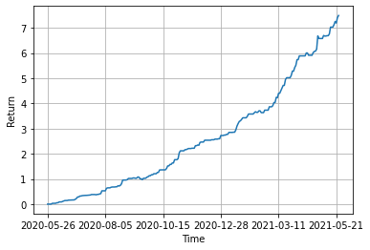
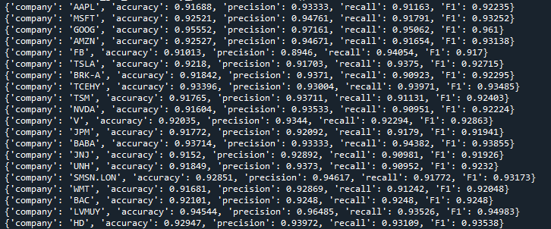
Algorithm implementation
PART3
Test set evaluation
annual return(Facebook)

Slide 7
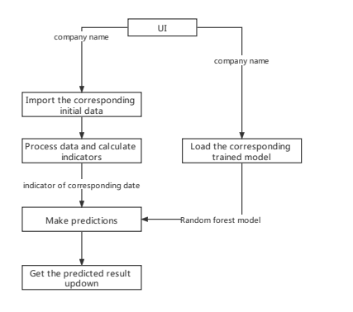
Prediction and Recommend module
PART4
Prediction: give a prediction whether this company stock would go up or go down based on the company name selected by the user
Notes:
Give a forecast value based on the company name selected by the user
Select the top five companies that are expected to rise and recommend them to users

Slide 8
Prediction and Recommend module
PART4
Recommend: select the top 3 companies that are expected to rise and have the highest annual return.
Predict stock trend today
Add to recommendation list
Sort list by their annual return
Recommend top 3 companies
Notes:
Give a forecast value based on the company name selected by the user
Select the top five companies that are expected to rise and recommend them to users

Slide 9
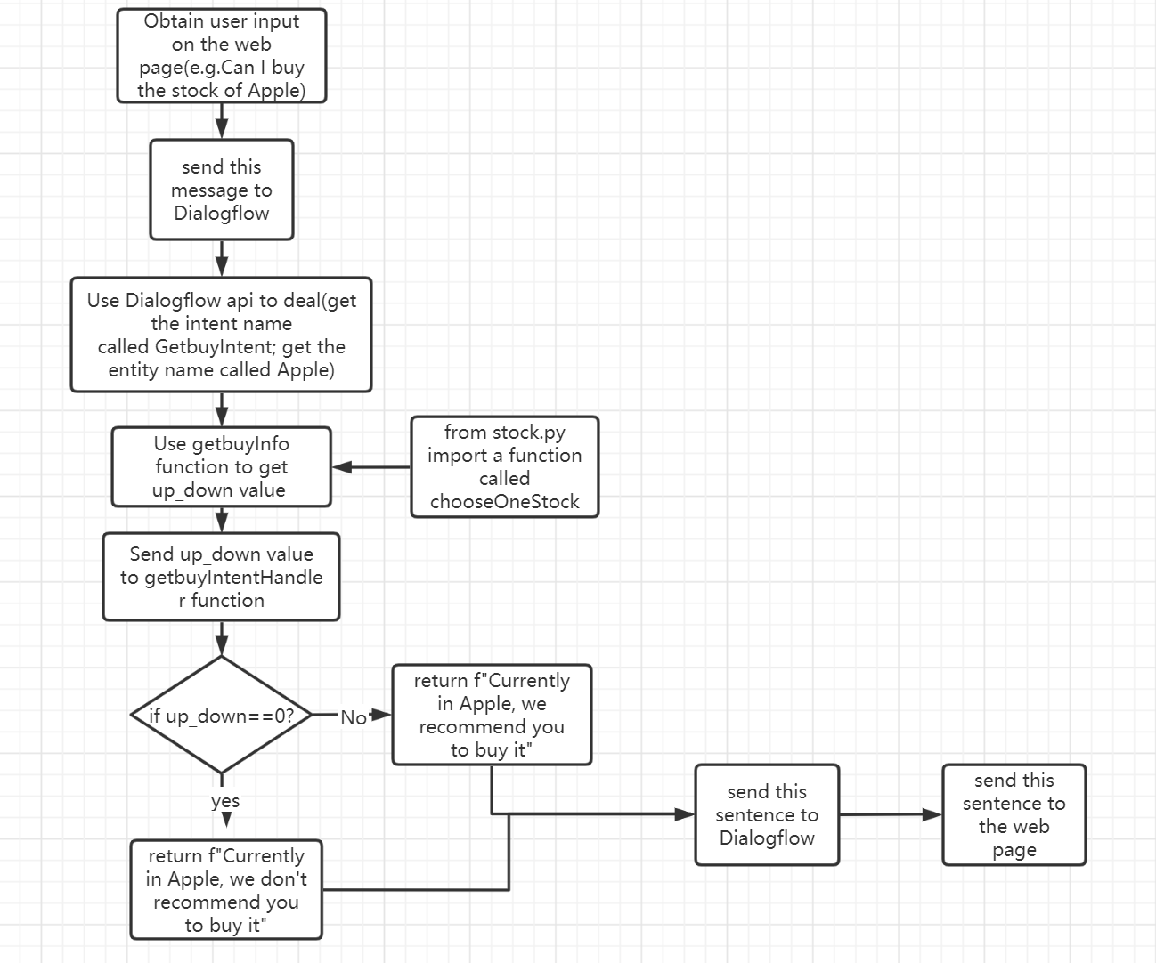
Chatbot module
PART 4
Chatbot module: analyze the user’s question and answer the question.
Obtain user question
Call Dialogflow to analyze
Get the user’s intent and slot
Generate the answer
Return the answer
Obtain question
Call dialogflow API
Analyze user’s intent and slots
Generate the answer

Slide 10
Thanks for Listening!

Slide 11
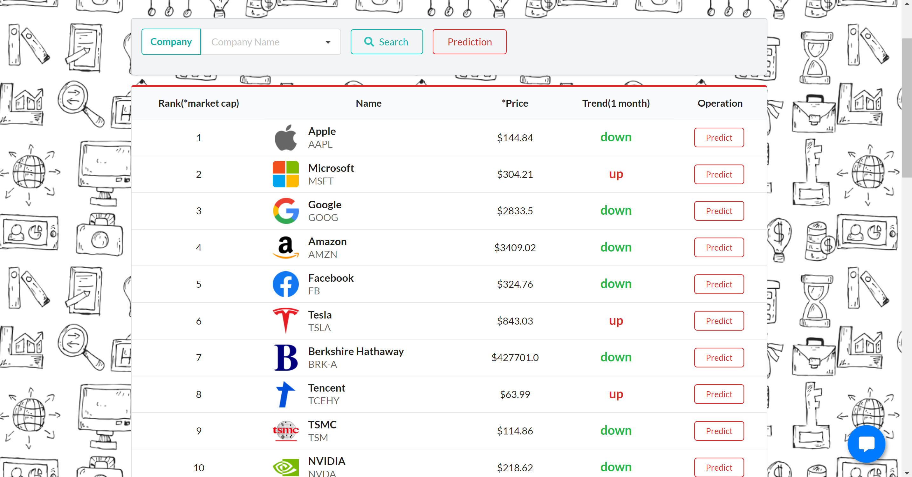
PART1
User Interface

Slide 12
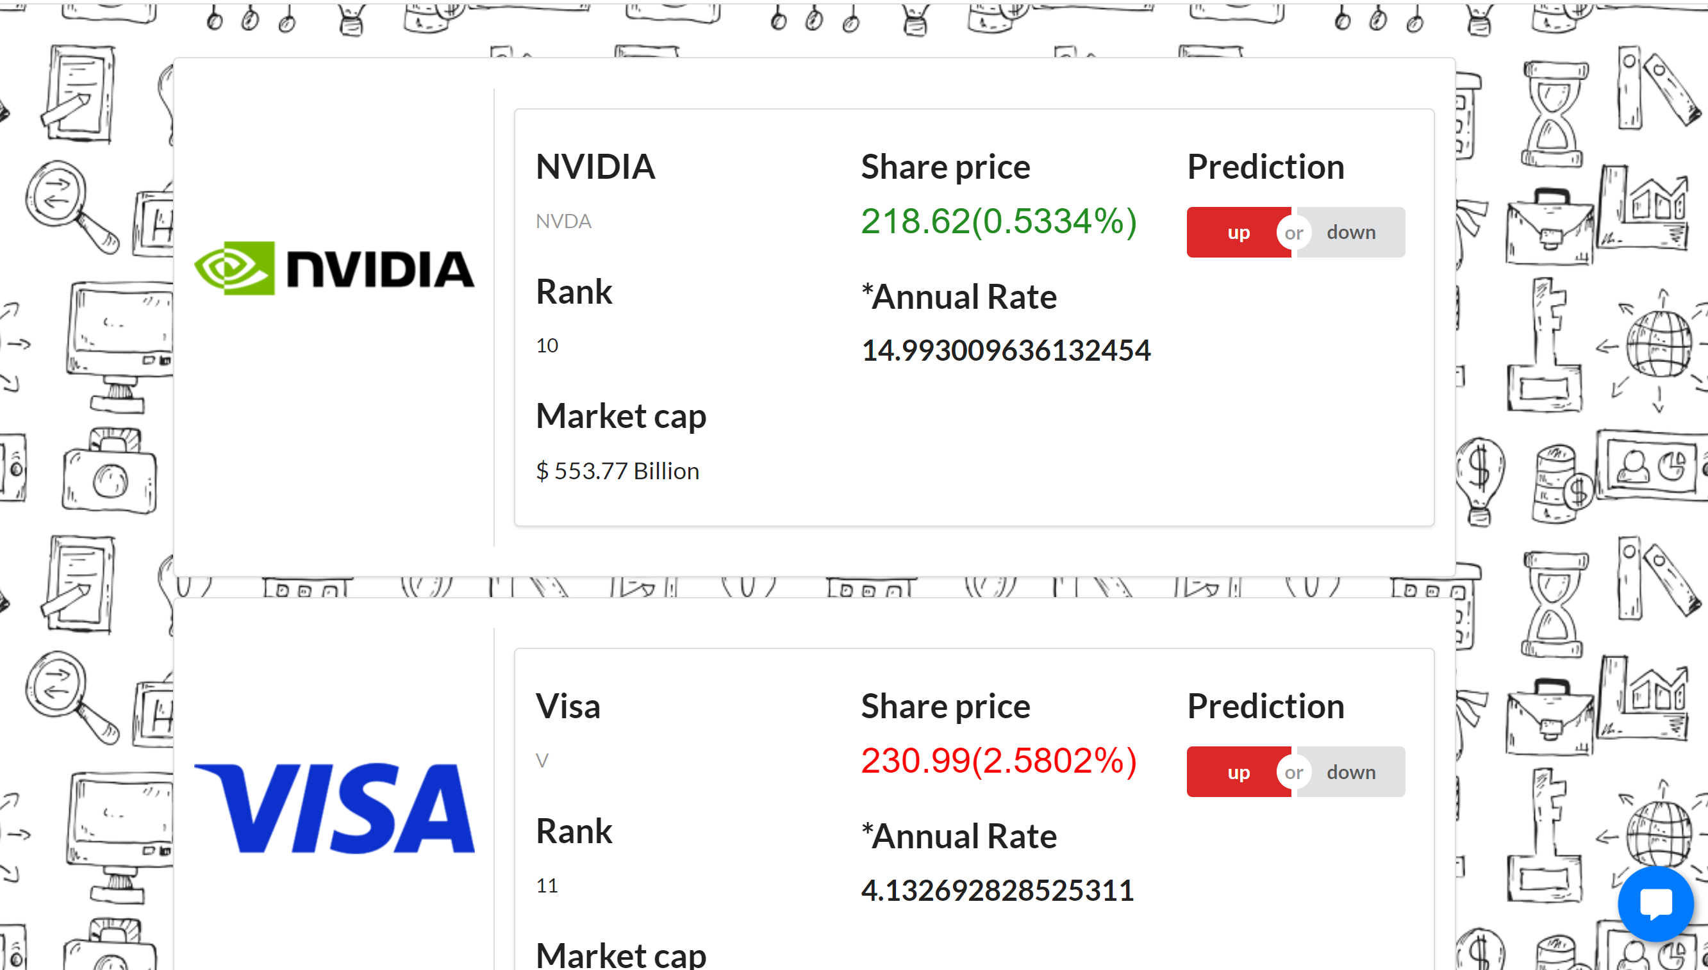
PART1
User Interface

Slide 13
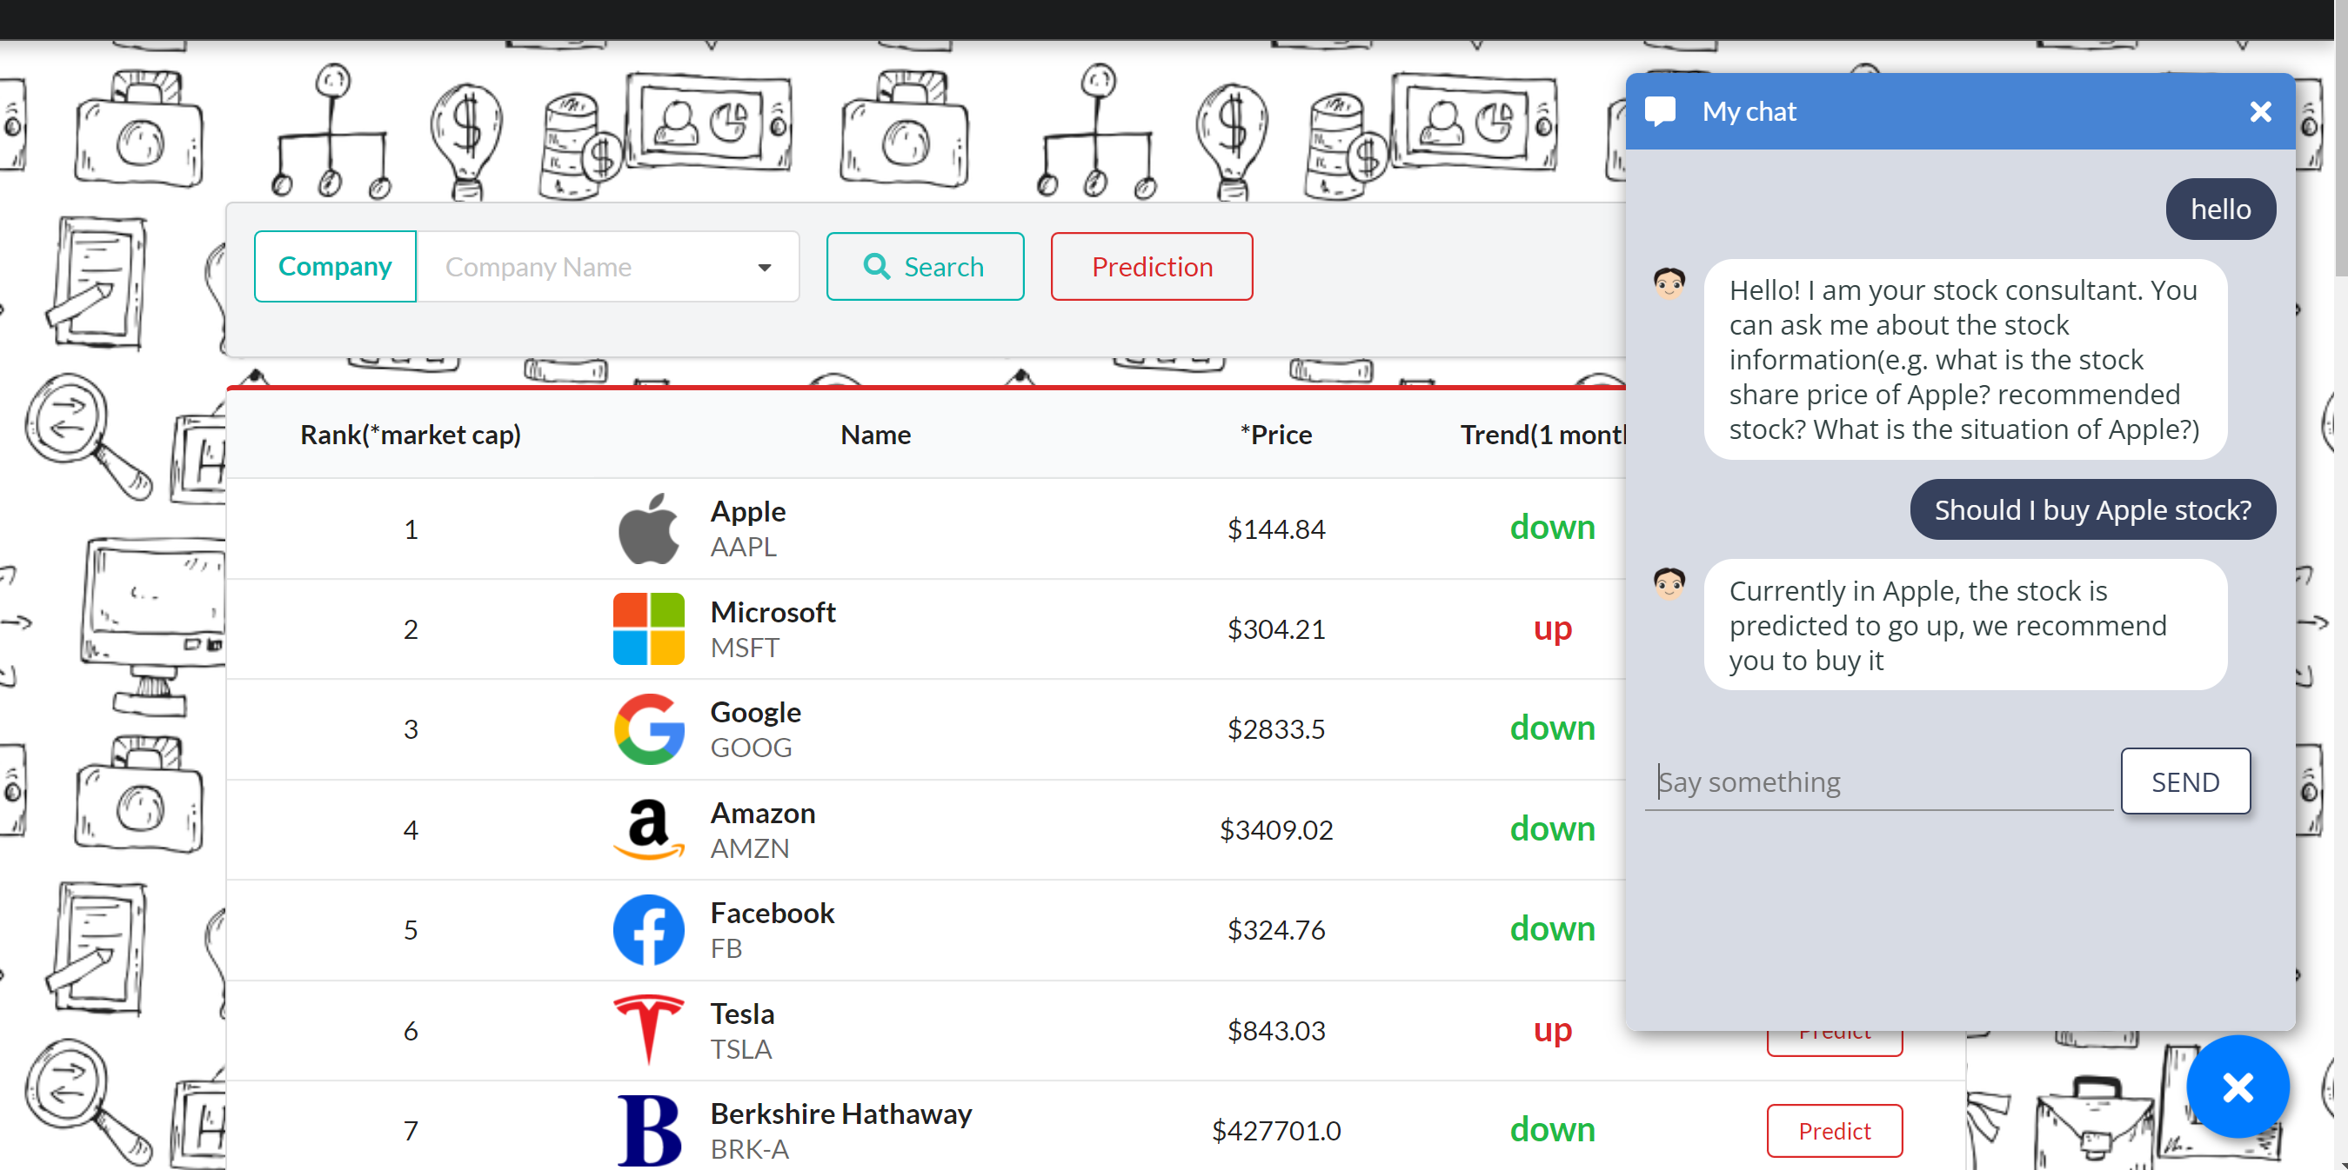
PART1
User Interface
Notes:
It shows the chatbot ui design in the bottom right corner of our web page

