Slide 1

ISS Project Seminar
SMART STOCK CONSULTANT
Organizer: Group 9:
Huang Xinrun , A0231555J
Wang Yangxi , A0231505U
Guo Fangjie , A0231415U

Slide 2
CONTENTS
PART1
Background
PART2
Business Pain
& Value
PART3
Objective
&Scope
PART4
Use Case Demo
PART5
Pricing

Slide 3
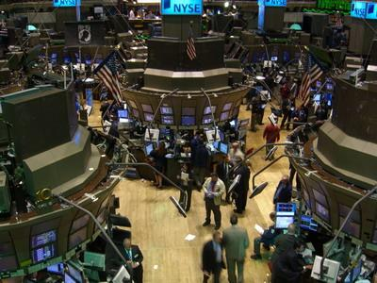
PART1
Background
Nowadays, living conditions are getting better and better, and more and more people have the need to invest in financial management, which has caused more and more attention on stock investment in walks of life .
New York Stock Exchange

Slide 4
PART2
Business Pain
Traditional methods are not accurate and stable
Consulting experts spends too much time and money
Business Value
Use AI technology to predict.
Add chatbot for consulting.
User friendly

Slide 5
PART3
Objective
We aim to develop a system that can get dataset from the stock exchange, and use decision tree and random forests to make model for prediction. Plus, we choose to add chatbot to our system. In this way, our system is more accurate and easier to use.
Scope
We aim to develop a system that can give users stock investment recommendations among the top 30 companies in the New York Stock Exchange ranked by market capitalization.
Our product can predict the trend of stocks of user interests.
Recommend stocks that will rise and has large potential to earn lots of money.

Slide 6
Use Case Demo
PART4
What should I buy?
Should I buy Apple stock?
Smart Stock Consultant
what is the stock share
price of Apple?
What is the prediction
of Apple stock today ?

Slide 7
Use Case Demo
PART4
Present our system

Slide 8

Pricing
PART5
Users can enjoy our system services by paying membership fees, which is less than the cost of consulting an expert.

Slide 9
Thanks for Listening!

