Slide 1

HashFlow for Better Flow Record Collection
Zhao Zongyi, Shi Xingang, et al
Tsinghua University
July 6th, 2019
Notes:
Hello, everyone, my name is Zhao Zongyi, I am from Tsinghua University of China. I am very glad to present my paper to you.

Slide 2
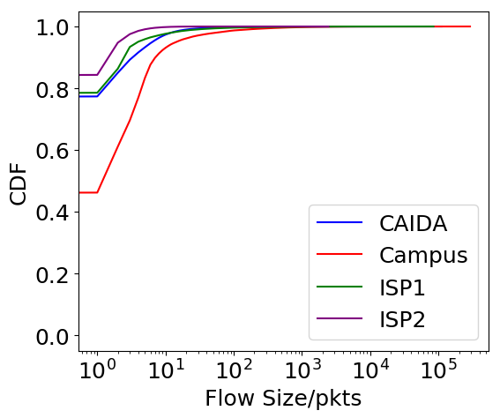
Skewed Flow Size Distribution in Network
A small portion of flows (elephant flows) contribute a large part of the network traffic.
Campus network of Tsinghua Univ. in 2014:
6.3% of the flows are larger than 10 packets but contribute 84.2% of the traffic.
CAIDA in 2018:
2.3% of the flows are larger than 10 packet but contribute 50.3% of the traffic.
Usually elephant flows are more important than the mouse flows.
Notes:
As we all know, the network traffic usually follows a skewed distribution, so that the elephant flows, although they are a small portion of the flows, will contribute a large part of the traffic.
For example, we define a flow with no less than 10 packets as an elephant flow. In the trace from the campus network of Tsinghua University in 2014, 6.3% of the flows are elephant flows but the elephant flows contribute 84.2% of the traffic.
In the trace from CAIDA in 2018, 2.3% of the flows are elephant flows, but the elephant flows contribute 50.3% of the traffic.
So we consider the elephant flows more important, and record the elephant flows preferentially.

Slide 3
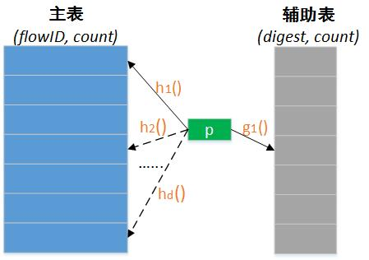
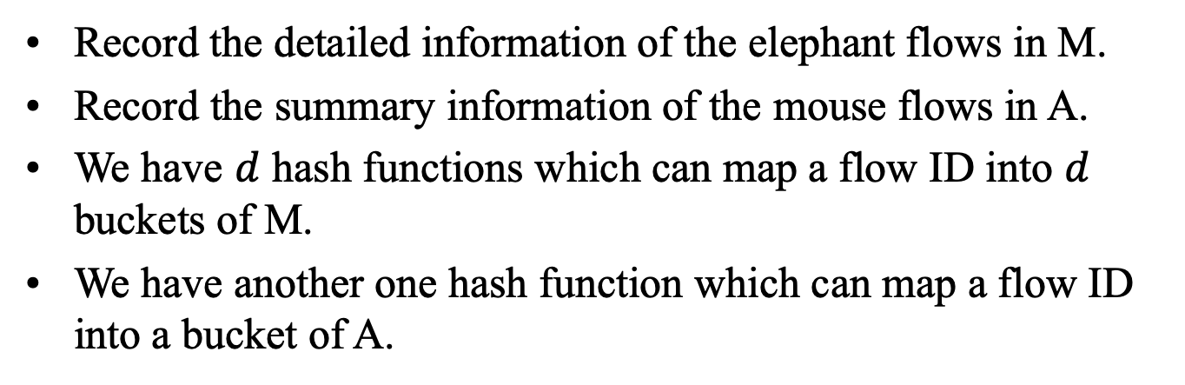
Data Structure of HashFlow
main table
ancillary table
The data structure consists of a main table (M) and an ancillary table (A).
The content of buckets in M is in the form of (FlowID, count).
The content of buckets in A is in the form of (digest, count).
Record the detailed information of the elephant flows in M.
Record the summary information of the mouse flows in A.
We have $d$ hash functions which can map a flow ID into $d$ buckets of M.
We have another one hash function which can map a flow ID into a bucket of A.
Notes:
We designed an algorithm, HashFlow.
The data structure of HashFlow consists of a main table and an ancillary table. Each bucket of the main table consists of a flow ID and a packet counter. Each bucket of the ancillary table consists of a digest and a temporary counter. In our implementation, the size of a flow ID is 13 bytes, and the size of counter is 4 bytes. So each bucket in main table occupies 17 bytes. On the other hand, each digest and temporary counter occupies 1 byte, so each bucket of the ancillary table occupies 2 bytes.
We have d hash functions associated with the main table, and another hash function associated with the ancillary table. Each hash function can map a packet to a bucket in the main table or ancillary table randomly.

Slide 4
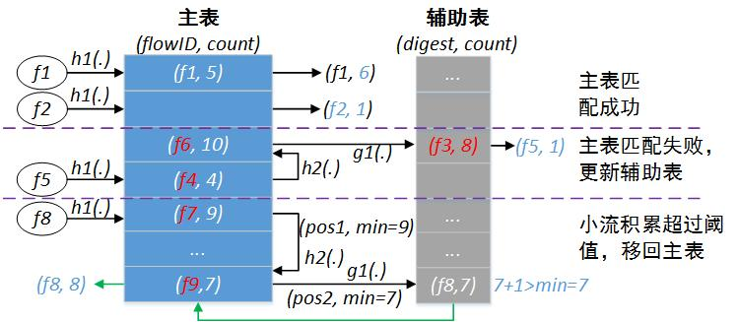


Description of HashFlow
Map the packet into main table using $h_{1}, h_{2}, ⋯,h_{d}$ in turn.
If an suitable bucket is found in main table, update it and finish the processing.
Otherwise map the packet into the ancillary table using $g_{1}$.
Promote a flow record from the ancillary table back into the main table when certain condition is met.
main table
ancillary table
$$d=2$$
Notes:
When a packet arrives, we will map it to the main table and try to find a bucket for it there. If we fail to find a suitable bucket for the packet, we will map the packet to the ancillary table. When certain condition is met we will promote a flow from the ancillary table back into the main table.
In this figure, when a packet f1 arrives, we will map it to the main table. Since the bucket has the same flow ID as the packet, we simply increment the counter value by 1.
When a packet f2 arrives, since the corresponding bucket is empty, we write the flow ID into this bucket and set the counter value to 1.
When a packet f5 arrives, we firstly try to map the packet to the main table. Since collision occurs in both buckets, we map the packet to the ancillary table. Collision occurs again in the ancillary table, but we discard the existing record in the bucket and update it with the new arrival packet.
When a packet f8 arrives, and collision occurs at both buckets of the main table, we map the packet to the ancillary table. In the process we record the bucket with the smallest counter value. Since the bucket in ancillary table has the same digest as the new arrival packet, we increment the temporary counter by 1. We noticed that the temporary counter has larger value than the bucket in the main table we have just recorded. So we promote this record back into the main table and replace the bucket with the least counter value.

Slide 5
Advantages of HashFlow
It records the specific information of elephant flows.
This information consists of flow ID and packet count.
It records the summary information of mouse flows.
We can estimate the number of mouse flows by ancillary table.
Promote a flow from ancillary table back into the main table automatically when it is large enough.
The utilization of memory is relatively high.
Notes:
The advantage of HashFlow is that it records specific information for the elephant flows while maintaining summary information for the mouse flows, which enable us to estimate the number of mouse flows.
It will promote a flow from the ancillary table back into the main table, when the flow grows to be large enough.
The utilization of memory is relatively high compared with other similar algorithms.
We will illustrate the advantages in the following.

Slide 6
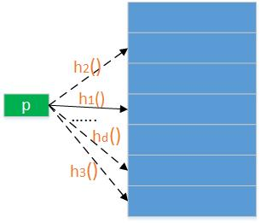
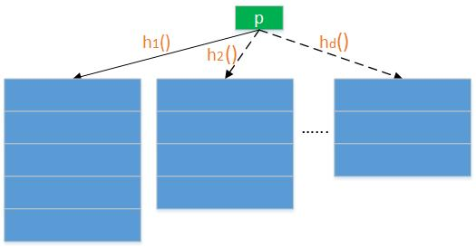
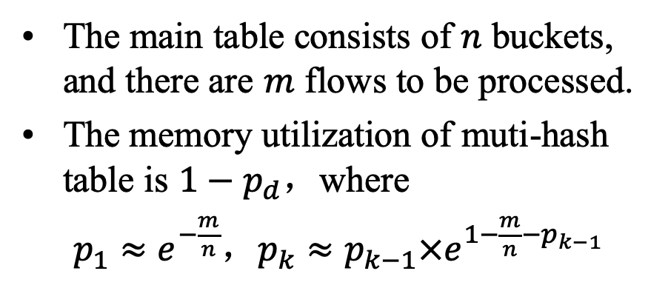
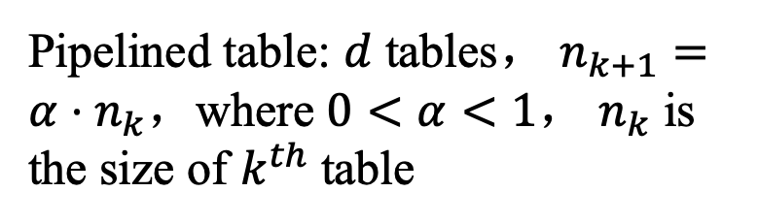
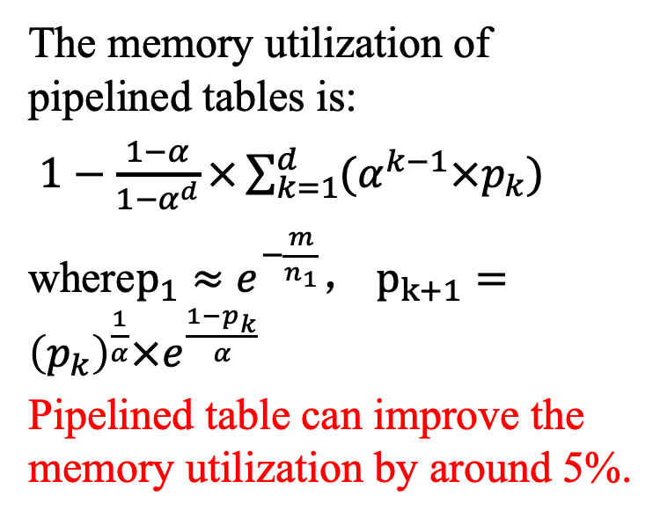
Restructure the Main Table
The main table consists of $n$ buckets, and there are $m$ flows to be processed.
The memory utilization of muti-hash table is $1−p_{d}$，where
$p_{1}≈e^{−\frac{m}{n}}$，$p_{k}≈p_{k−1}×e^{1−\frac{m}{n}−p_{k−1}}$
The memory utilization of pipelined tables is:
$1−\frac{1−α}{1−α^{d}}×\sum_{k=1}^{d}{(α^{k−1}×p_{k})}$
where$p_{1}≈e^{−\frac{m}{n_{1}}}$， $p_{k+1}={\left(p_{k}\right)}^{\frac{1}{α}}×e^{\frac{1−p_{k}}{α}}$
Pipelined table can improve the memory utilization by around 5%.
Pipelined table: $d$ tables， $n_{k+1}=α⋅n_{k}$，where $0<α<1$， $n_{k}$ is the size of $k^{th}$ table
Notes:
As there are multiple hash functions associated with the main table, we have two methods to organize the main table. Suppose that the main table consists of n buckets and we have m flows to be processed. We have d hash functions associated with the main table. The first method is that we map a flow to one of the n buckets independently. The second method is to divide the main table into d subtables, and associate a hash function with each of the subtables. Moreover, we decrease the size of the subtables proportionally with a factor alpha. We can calculate the memory utilization when the number of flows is large enough. Analysis shows that the pipelined table method can improve the memory utilization by around 5%.

Slide 7
Experiment Setup
Counterparts:
FlowRadar [NSDI’16]
HashPipe [SOSR’17]
ElasticSketch [SIGCOMM’18]
Experiment platform:
Software P4 switch: bmv2
Traces:
Campus network of Tsinghua Univ., 2014
CAIDA, 2018
China Telecom, 2016.
Hongkong Global Communication, 2008
Notes:
We implement the HashFlow in BMv2 as well as the hardware P4 switch, but the primary results are from the BMv2 platform. We take FlowRadar, HashPipe and ElasticSketch as benchmark to evaluate the performance of HashFlow. Our traces are from the campus network of Tsinghua University, CAIDA datasets, China Telecom and Hongkong Global Communication respectively.

Slide 8
Experiment Setup (cont.)
Metrics:
The number of recorded flows
The Average Relative Error (ARE) of the recorded flows
The F1 Score of heavy hitter detection
The ARE of heavy hitter detection
The accuracy of flow number estimation
Throughput
Notes:
Our evaluation metrics include the number of recorded flows, the average relative error of the recorded flows, the F1 score of the heavy hitter detection, the average relative error of the heavy hitter detection, the accuracy of the flow number estimation and the throughput of the system.

Slide 9
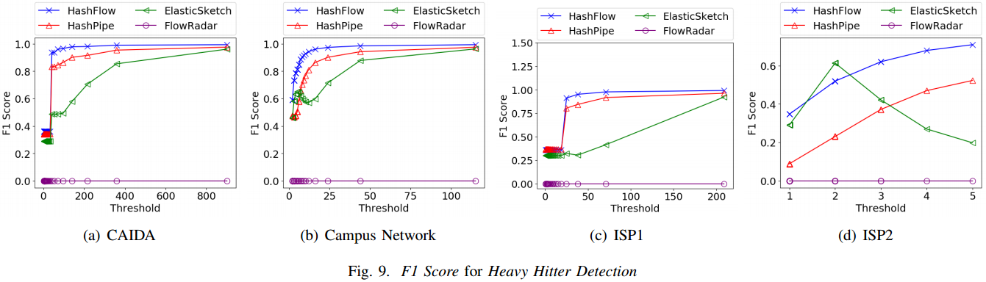
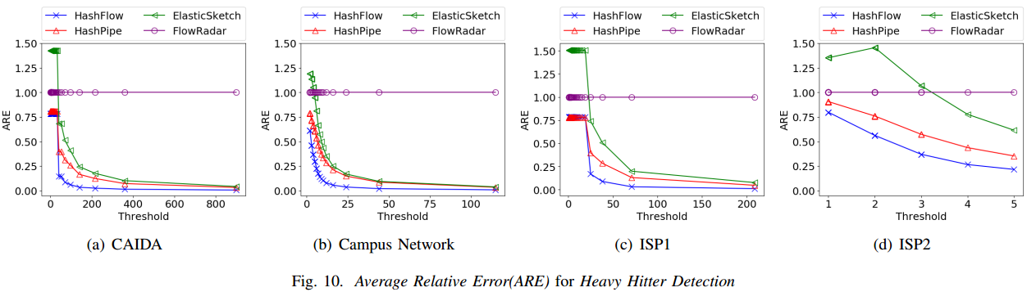
Evaluation
Notes:
This is the results of the evaluation.

Slide 10
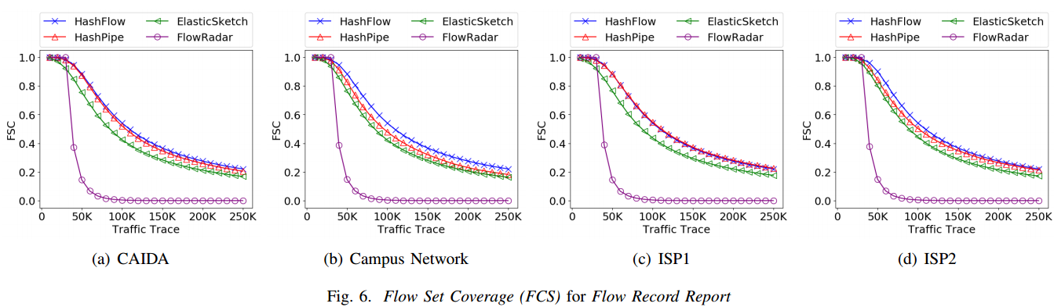
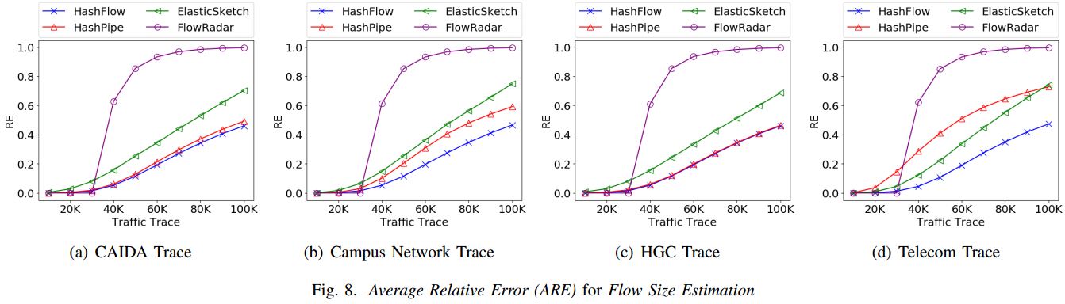
Evaluation (cont.)

Slide 11
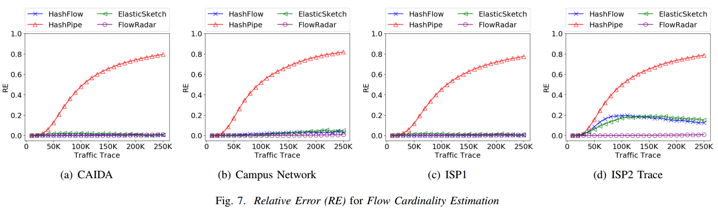
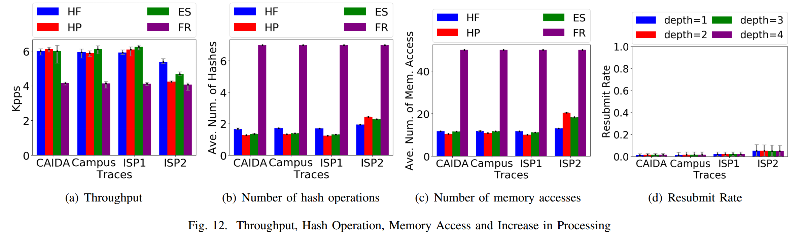
Evaluation (cont.)

Slide 12
Summary of Evaluation
HashFlow accurately record around 55K flows with 1MB of memory, which is 12.5% higher than the others.
HashFlow achieves a relative error of around 11.6% for the size estimation of 50K flows, while the estimation error of the best competitor is 42.9% higher.
HashFlow detects 96.1% of the heavy hitters out of 250K flows with a size estimation error of 5.6%, which is 11.3% and 73.7% better than the best competitor respectively.
The resubmit rate of HashFlow is normally smaller than 2%.

Slide 13
Q&A
Notes:
Thank you!

