Slide 1
Programmable Measurement Architecture for Data Centers
Minlan Yu
University of Southern California

Slide 2



Management = Measurement + Control
Trafﬁc engineering, load balancing
Identify large traffic aggregates, traffic changes
Understand flow properties (size, entropy, etc.)
Performance diagnosis, troubleshooting
Measure delay, throughput for individual flows
Accounting
Count resource usage for tenants
Notes:
Management is important, yet underexplored
Taking 80% of IT budget
Responsible for 62% of outages
Measurement is at least half of network management
Figuring out what’s going on is harder than
deciding what to do

Slide 3
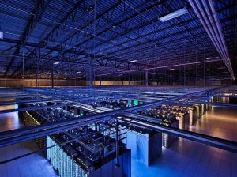
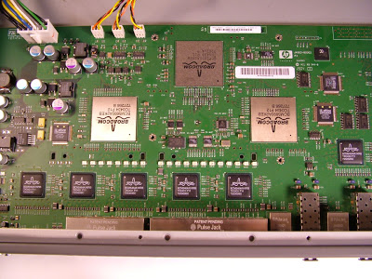
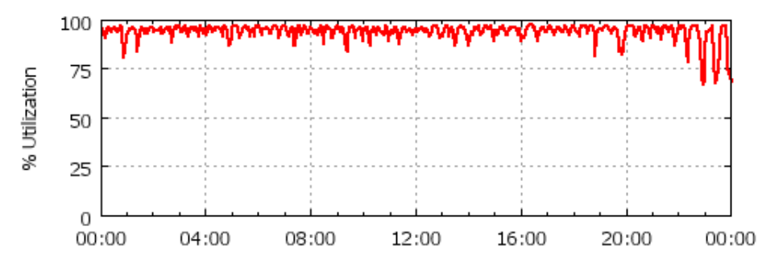

Measurement Becoming Increasingly Important
Dramatically expanding data centers
Rapidly changing technologies
Provide network-wide visibility at scale
Monitor the impact of new technology
Increasing network utilization
Quickly identify failures and effects
Notes:
Network management is an increasingly important but difficult problem: We need to manage rapidly expand- ing data center infrastructures with rapidly changing network technologies, while achieving many management goals such as high availability, high performance, but low capital and operational expenditures.

Slide 4
Problems of measurement support in today’s data centers
Notes:
What measurement support do today’s DCs provide?

Slide 5
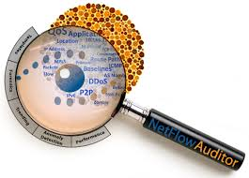
Lack of Resource Efficiency
Too much data with increasing link speed & scale
Operators:
Passively analyze
the data they have
No way to create the data they want
Network devices:
Limited resources for measurement
Heavy sampling in NetFlow/sFlow
Missing important flows
We need efficient measurement support at devices to create the data we want within resource constraints
Notes:
No control of what to measure and what not to measure, devices only have limited resources
No way to generate the data we want

Slide 6
Lack of Generic Abstraction
Researchers design solutions for specific queries
Identifying big flows (heavy hitters), flow changes
DDoS detection, anomaly detection
Hard to support point solutions in practice
Vendors have no generic support
Operators write their own scripts for different systems
We need a generic abstraction for operators to program different measurement queries
Notes:
Researchers also take the data they have
Data center brings new opportunities
to rethink a generic solutions for many queries

Slide 7
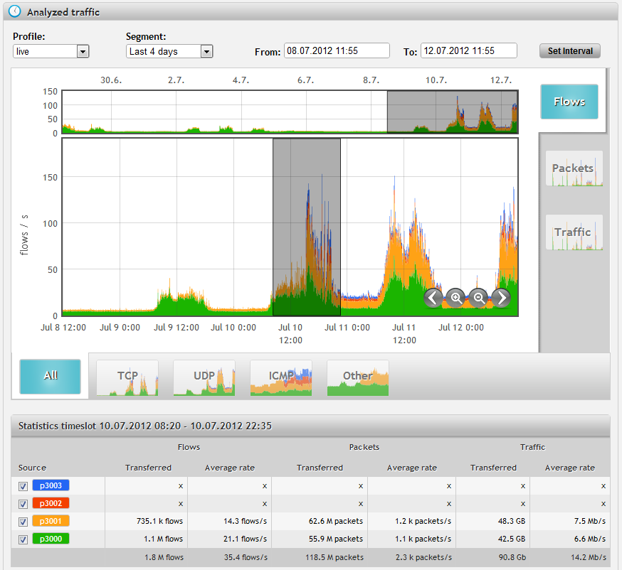
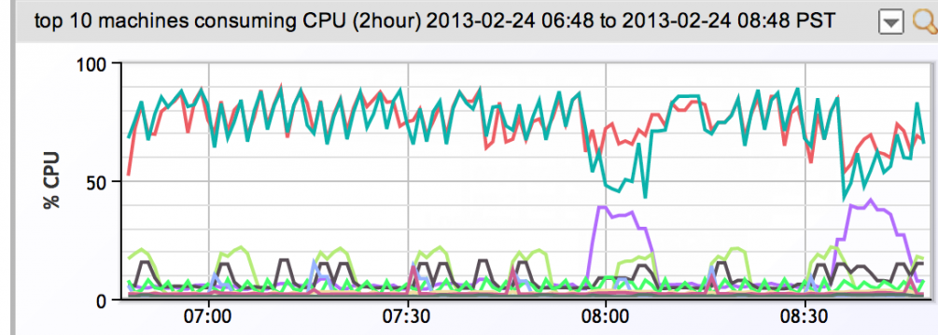
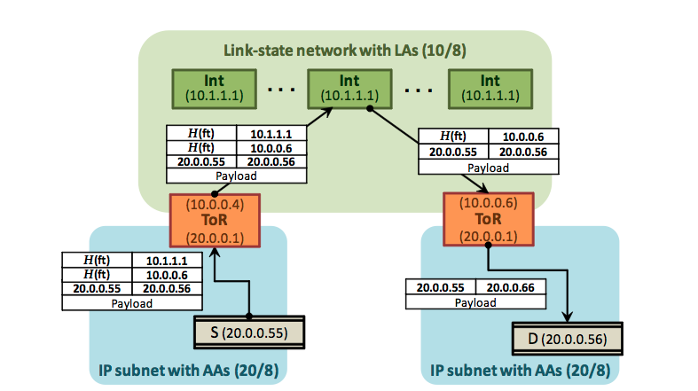
Lack of Network-wide Visibility
Operators manually integrate many data sources
NetFlow at 1-10K switches
Application logs from 1-10M VMs
Topology, routing, link utilization…
And middleboxes, FPGAs …
We need to automatically integrate information across the entire network
Notes:
For example, to diagnose performance problems…

Slide 8

Challenges for Measurement Support
Expressive queries
(Traffic volumes, changes, anomalies)
Network-wide visibility
(hosts, switches)
Our Solution:
Dynamically collect and automatically integrate
the right data, at the right place and the right time
Resource efficiency
(Limited CPU/Mem at devices)

Slide 9

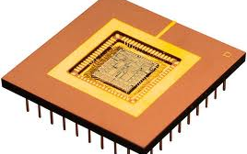
Programmable Measurement Architecture
Specify measurement queries
Measurement Framework
Expressive Abstractions
Efficient runtime
Dynamically configure devices
Automatically collect the right data
DREAM
(SIGCOMM’14)
OpenSketch
(NSDI’13)
SNAP
(NSDI’11)
FlowTags (NSDI’14)
Switches
FPGAs
Hosts
Middleboxes
9
Notes:
Operators first specify…
My research focuses on how to redesign the network to address the three challenges at the same time. I built two systems:
Due to the three challenges, today, network operators devote tremendous time and effort to network management.
Yankee group reports that in enterprises 80% of IT budget is spent on network management.
But they can only support a limited management tasks.
I built two new systems that make the network more scalable and easier to manage.
Focus on DIFANE, and give a brief description of SNAP
How to design network functions that best support different management tasks
How to implement different management tasks in the network

Slide 10
Key Approaches
Expressive abstractions for diverse queries
Operators define the data they want
Devices provide generic, efficient primitives
Efficient runtime to handle resource constraints
Autofocus on the right data at the right place
Dynamically allocate resources over time
Tradeoffs between accuracy and resources
Network-wide view
Bring host into the measurement scope
Tag to trace packets in the network

Slide 11
Programmable Measurement Architecture
Specify measurement queries
Measurement Framework
Expressive Abstractions
Efficient runtime
Dynamically configure devices
Automatically collect the right data
DREAM
(SIGCOMM’14)
OpenSketch
(NSDI’13)
SNAP
(NSDI’11)
FlowTags (NSDI’14)
Switches
FPGAs
Hosts
Middleboxes
11
Notes:
Operators first specify…
My research focuses on how to redesign the network to address the three challenges at the same time. I built two systems:
Due to the three challenges, today, network operators devote tremendous time and effort to network management.
Yankee group reports that in enterprises 80% of IT budget is spent on network management.
But they can only support a limited management tasks.
I built two new systems that make the network more scalable and easier to manage.
Focus on DIFANE, and give a brief description of SNAP
How to design network functions that best support different management tasks
How to implement different management tasks in the network

Slide 12
Switches DREAM: dynamic flow-based measurement (SIGCOMM’14)
Notes:
Talk about how SNAP helps developers and auto-adaptation

Slide 13
DREAM: Dynamic Flow-based Measurement
Heavy Hitter detection
Change detection
Measurement Framework
Dynamically configure devices
Automatically collect the right data
Source IP: 10.0.1.130/31
#Bytes=1M
Source IP: 55.3.4.32/30
#Bytes=5M
Switches
FPGAs
Hosts
Middleboxes
13
Notes:
Operators first specify…
My research focuses on how to redesign the network to address the three challenges at the same time. I built two systems:
Due to the three challenges, today, network operators devote tremendous time and effort to network management.
Yankee group reports that in enterprises 80% of IT budget is spent on network management.
But they can only support a limited management tasks.
I built two new systems that make the network more scalable and easier to manage.
Focus on DIFANE, and give a brief description of SNAP
How to design network functions that best support different management tasks
How to implement different management tasks in the network

Slide 14
Heavy Hitter Detection
41
26
15
Controller
13
13
5
10
Find src IPs > 10Mbps
00
01
10
11
Install rules
Fetch counters
00
13MB
01
13MB
10
5MB
11
10MB
Problem: Requires too many TCAM entries
64K IPs to monitor a /16 prefix >> ~4K TCAMs at switches
Notes:
The challenge for using TCAMs is that the number of TCAM entries in switches is limited for power and cost reasons.
We illustrate this using an example measurement task, heavy hitter detection.
Suppose that we are interested in detecting heavy hitters as source IP addresses that send more than 10Mbps.
One way to visualize the traffic from source IP addresses is to use a prefix tree shown on the left.
The numbers inside nodes show the size of their traffic, and the numbers below the leaves show the addresses.
In this prefix tree, we have two heavy hitters in the left subtree.
We can configure rules at switches to monitor all IPs, and periodically fetch counters.
In our example, each switch would have 4 rules, one for each distinct source IP address.
This solution requires too many TCAM entries. [p]
For example, to monitor a large prefix, it needs 64K TCAM entries while today switches have about 4K entries. [p]

Slide 15
Key Problem
How to support many concurrent measurement queries
with limited TCAM resources at commodity switches?
Notes:
So far we have talked about how to find the right configuration of TCAMs for a single task.
But to support many concurrent tasks, we can use other ideas to efficiently use TCAMs.

Slide 16
Tradeoff Accuracy for Resources
36
Monitor internal node to reduce TCAM usage
26
10
13
13
5
5
00
01
10
11
41
26
15
Missed heavy hitters
13
13
5
10
00
01
10
11
Notes:
We can reduce the number of required TCAM entries by monitoring internal nodes in the prefix tree.
In this example, the right subtree has very little traffic, so monitoring the root of the right subtree is enough.
That node has a total traffic of 5, so none of its leaves can be heavy hitters.
The prefix tree on the bottom shows the updated TCAM configuration: this tree now requires only three TCAM entries.

Slide 17
Diminishing Return of Resource-Accuracy Tradeoffs
7%
Accuracy Bound
82%
Can accept an accuracy bound <100% to save TCAMs
Notes:
Changes over traffic and patterns, so we need to estimating the current accuracy
It is possible to be more aggressive in reducing TCAM usage.
We have found a pattern of diminishing returns in accuracy for many measurement tasks.
In this figure, as we double TCAM entries, the accuracy gain becomes smaller and smaller.
Also the additional heavy hitters detected are small and close to the threshold.
So, we can significantly reduce TCAM usage by keeping task accuracy above a bound that is below 100%.

Slide 18
Temporal Multiplexing across Queries
Different queries require different TCAMs over time because of traffic changes
Query 1
Query 2
# TCAMs Required
Time
Notes:
Challenge: moving goal of changing follow the many moving goals tradoeffs of convergence and efficiency
This figure shows how many TCAMs are required for heavy hitter detection task over time.
If two tasks have different TCAM requirements at different times, we can use statistical multiplexing to reduce TCAM usage.
For this, we need to dynamically allocate TCAMs and to reconfigure them.

Slide 19
Spatial Multiplexing across Switches
The same query requires different TCAMs at switches because of traffic distribution
# TCAMs Required
Switch A
Switch B
Notes:
Accuracy of the same query depend on the resources across switches

Slide 20
Insights and Challenges
Leverage resource-accuracy tradeoffs
Challenge: Cannot know the accuracy groundtruth
Solution: Online accuracy algorithm
Temporal multiplexing across queries
Challenge: Required resources change over time
Solution: Dynamic resource allocation algorithm rather than one shot optimization
Spatial multiplexing across switches
Challenge: Query accuracy depends on multiple switches
Solution: Consider both overall query accuracy and per-switch accuracy
Notes:
Management is important, yet underexplored
Taking 80% of IT budget
Responsible for 62% of outages
Measurement is at least half of network management
Figuring out what’s going on is harder than
deciding what to do

Slide 21



DREAM: Dynamic TCAM Allocation
Allocate TCAM
Estimate accuracy
Enough TCAMs → High accuracy → Satisfied
Not enough TCAMs → Low accuracy → Unsatisfied
Notes:
The first challenge is dynamic TCAM allocation.
The general idea behind our algorithm is to iteratively and periodically
(a) estimate the instantaneous accuracy of tasks and
(b) adapt TCAM allocation to keep all tasks satisfied.
In this example, suppose that we have two tasks and have estimated their accuracy.
One with happy face has high accuracy and is rich which means it has enough TCAMs,
and another with sad face has low accuracy and is poor.
In the allocation step, we take resources from the rich task and give to the poor one.
Later when tasks measure using the new allocation and we estimate their accuracy, both tasks become satisfied.
In an earlier slide, we showed the curve of the accuracy of measurement vs. the number of allocated TCAMs.
In general, this curve is not known beforehand, and changes with traffic and the specific parameters of a task.
Thus, it is not possible to formulate a one-shot optimization problem for this.
So, we choose an iterative approach.
Second, we don’t know the current accuracy of a task because we don’t have ground truth.
Thus we must estimate accuracy.
I will now describe each of these components.

Slide 22
DREAM: Dynamic TCAM Allocation
Allocate TCAM
Estimate accuracy
Measure
Dynamic TCAM allocation that ensures fast convergence & resource efficiency
Online accuracy estimation algorithms based on prefix tree and measurement algorithm
Notes:
The first challenge is dynamic TCAM allocation.
The general idea behind our algorithm is to iteratively and periodically
(a) estimate the instantaneous accuracy of tasks and
(b) adapt TCAM allocation to keep all tasks satisfied.
In this example, suppose that we have two tasks and have estimated their accuracy.
One with happy face has high accuracy and is rich which means it has enough TCAMs,
and another with sad face has low accuracy and is poor.
In the allocation step, we take resources from the rich task and give to the poor one.
Later when tasks measure using the new allocation and we estimate their accuracy, both tasks become satisfied.
In an earlier slide, we showed the curve of the accuracy of measurement vs. the number of allocated TCAMs.
In general, this curve is not known beforehand, and changes with traffic and the specific parameters of a task.
Thus, it is not possible to formulate a one-shot optimization problem for this.
So, we choose an iterative approach.
Second, we don’t know the current accuracy of a task because we don’t have ground truth.
Thus we must estimate accuracy.
I will now describe each of these components.

Slide 23
Prototype and Evaluation
Prototype
Built on Floodlight controller and OpenFlow switches
Support heavy hitters, hierarchical HH, and change detection
Evaluation
Maximize #queries with accuracy guarantees
Significantly outperforms fixed allocation
Scales well to larger networks

Slide 24
DREAM Takeaways
DREAM: an efficient runtime for resource allocation
Support many concurrent measurement queries
With today’s flow-based switches
Key Approach
Spatial & Temporal resource multiplexing across queries
Tradeoff accuracy for resources
Limitations
Can only support heavy hitters and change detection
Due to the limited interfaces at switches
Notes:
Don’t downgrade dream. Say it’s still important….

Slide 25
Reconfigurable Devices OpenSketch: Sketch-based measurement (NSDI’13)
Notes:
Talk about how SNAP helps developers and auto-adaptation

Slide 26
OpenSketch: Sketch-based Measurement
Heavy hitters
DDoS detection
Flow size dist.
Measurement Framework
Dynamically configure devices
Automatically collect the right data
Switches
FPGAs
Hosts
Middleboxes
26
Notes:
Operators first specify…
My research focuses on how to redesign the network to address the three challenges at the same time. I built two systems:
Due to the three challenges, today, network operators devote tremendous time and effort to network management.
Yankee group reports that in enterprises 80% of IT budget is spent on network management.
But they can only support a limited management tasks.
I built two new systems that make the network more scalable and easier to manage.
Focus on DIFANE, and give a brief description of SNAP
How to design network functions that best support different management tasks
How to implement different management tasks in the network

Slide 27
Streaming Algorithms for Individual Queries
How many unique IPs send traffic to host A?
bitmap
Who’s sending a lot to host A?
Count-Min Sketch:
Hash
0
0
0
1
0
0
0
1
0
1
0
1
0
0
0
Data plane
Control plane
3
0
5
1
9
Query: 23.43.12.1
Hash1
# bytes from 23.43.12.1
Hash2
0
1
9
3
0
5
3
4
Hash3
1
2
0
3
4
Pick min: 3
Notes:
Bitmap for #unique items, Bloom filter for set member check
Summarize packet information with Sketches
Not general
Require customized hardware or network processors
Hard to implement all solutions in one device

Slide 28
Generic and Efficient Measurement
Streaming algorithms are efficient, but not general
Require customized hardware or network processors
Hard to implement all solutions in one device
OpenSketch: New measurement support at FGPAs
General and efficient data plane based on sketches
Easy to implement at reconfigurable devices
Modularized control plane with automatic configuration

Slide 29
Flexible Data Plane
Picking the packets to measure
Storing & exporting data
Classifying a set of flows
(e.g., Bloom filter for blacklisting IP set)
Filtering traffic
(e.g., from host A)
Diverse mappings between counters & flows
(e.g., more counters for elephant flows)
Notes:
Classification is missing, match on other packet header fields, hash values., and many other data structures

Slide 30
OpenSketch 3-stage pipeline
3
0
5
1
9
Hash1
# bytes from 23.43.12.1 to host A
Hash2
0
1
9
3
0
Hash3
1
2
0
3
4
Notes:
Classification is missing, match on other packet header fields, hash values., and many other data structures

Slide 31
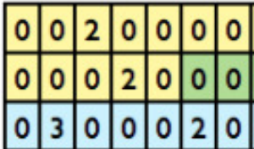
Build on Existing Switch Components
Simple hash function
Traffic diversity adds randomness
Only 10-100 TCAMs after hashing
Logical tables with flexible sizes
SRAM counters accessed by addresses

Slide 32
Example Measurement tasks
Heavy hitter detection
Who’s sending a lot to host A?
count-min sketch to count volume of ﬂows
reversible sketch to identify ﬂows with heavy counts in the count-min sketch
# bytes from host A
CountMin Sketch
Reversible Sketch

Slide 33
Support Many Measurement Tasks
Measurement Programs | Building blocks | Line of Code
Heavy hitters | Count-min sketch; Reversible sketch | Config:10 Query: 20
Superspreaders | Count-min sketch; Bitmap; Reversible sketch | Config:10 Query:: 14
Traffic change detection | Count-min sketch; Reversible sketch | Config:10 Query: 30
Trafﬁc entropy on port ﬁeld | Multi-resolution classiﬁer; Count-min sketch | Config:10 Query: 60
Flow size distribution | multi-resolution classiﬁer; hash table | Conﬁg:10 Query: 109

Slide 34
OpenSketch Prototype on NetFPGA

Slide 35
OpenSketch Takeaways
OpenSketch: New programmable data plane design
Generic support for more types of queries
Easy to implement with reconfigurable devices
More efficient than NetFlow measurement
Key approach
Generic abstraction for many streaming algorithms
Provable resource-accuracy tradeoffs
Limitations
Only works for traffic measurement inside the network
No access to application level information

Slide 36
Hosts SNAP: Profiling network-application interactions (NSDI’11)
Notes:
Talk about how SNAP helps developers and auto-adaptation

Slide 37
SNAP: Profiling network-application interactions
Perf. diagnosis
Workload monitoring
Measurement Framework
Dynamically configure devices
Automatically collect the right data
Switches
FPGAs
Hosts
Middleboxes
37
Notes:
Operators first specify…
My research focuses on how to redesign the network to address the three challenges at the same time. I built two systems:
Due to the three challenges, today, network operators devote tremendous time and effort to network management.
Yankee group reports that in enterprises 80% of IT budget is spent on network management.
But they can only support a limited management tasks.
I built two new systems that make the network more scalable and easier to manage.
Focus on DIFANE, and give a brief description of SNAP
How to design network functions that best support different management tasks
How to implement different management tasks in the network

Slide 38
Challenges of Datacenter Diagnosis
Large complex applications
Hundreds of application components
Tens of thousands of servers
New performance problems
Update code to add features or ﬁx bugs
Change components while app is still in operation
Old performance problems (Human factors)
Developers may not understand network well
Nagle’s algorithm, delayed ACK, etc.
Notes:
We have many low-level protocols such as….that is a mystery to developers without a networking background, but these protocols may have significant performance impact. It could be a disaster for a database expert to work with a TCP stack
- slide 34: audience probably won't know what "Nagle's algorithm" and "delayed ACK" are. you can finesse this out loud, and say that networking protocols have many low-level mechanisms (and view these as examples you don't expect the audience to know).
in practice, I think Microsoft doesn't
really "hot swap" in the new code, but rather brings up new images for a
service and gradually phase out the old ones your point is more that change
in constant.
Just stress the point about constant influx of new developers out loud.
silly window syndrome

Slide 39
Diagnosis in Today’s Data Center
Packet trace:
Filter out trace for long delay req.
Application logs:
#Requests/sec
Response time
1% req. >200ms delay
Host
App
Too expensive
Application-specific
OS
Packet sniffer
SNAP:
Diagnose net-app interactions
Switch logs:
#bytes/pkts per minute
Generic, fine-grained, and lightweight
Too coarse-grained
Notes:
Google and microsoft
100K$ a few monitoring machines monitor two racks of servers

Slide 40
SNAP: A Scalable Net-App Profiler that runs everywhere, all the time

Slide 41
SNAP Architecture
Online, lightweight processing & diagnosis
Offline, cross-conn diagnosis
Management System
Topology, routing
Conn → proc/app
At each host for every connection
Cross-connection correlation
Collect data
Performance Classifier
Offending app,
host, link, or switch
Adaptively polling per-socket statistics in OS
Snapshots (#bytes in send buffer)
Cumulative counters (#FastRetrans)
Classifying based on the stages of data transfer
Sender app→send buffer→network→receiver
Notes:
Overview to give sense of what SNAP is
Tuning polling rate to reduce overhead
Input
Topology, routing information
Mapping from connections to processes/apps
Sharing the same switch/link, app code

Slide 42
Programmable SNAP
Virtual tables at hosts
Lazy update to the controller
#Bytes in send buffer,
#FastRetrans
…
App CPU usage,
App mem usage,
…
SQL like query language at the controller
def queryTest():
q = (Select(‘app’, ‘FastRetrans’) *
From('HostConnection') *
Where(('app','==',’web service’)) *
Every(5 mintue))
return q

Slide 43
SNAP in the Real World
Deployed in a production data center
8K machines, 700 applications
Ran SNAP for a week, collected terabytes of data
Diagnosis results
Identified 15 major performance problems
21% applications have network performance problems
Notes:
Terabytes , less than 1 GB per machine per day
Read every 500 ms
700 always running, persistent connection
> - summarize that you found 15 serious performance bugs and worked with
developers to fix their code.

Slide 44
Characterizing Perf. Limitations
#Apps that are limited for > 50% of the time
Send Buffer
Send buffer not large enough
1 App
Fast retransmission
Timeout
Network
6 Apps
Receiver
8 Apps
Not reading fast enough (CPU, disk, etc.)
Not ACKing fast enough (Delayed ACK)
144 Apps
Notes:
6 apps self inflicted packet loss" "incast
Life of transfer: be sure to talk about ack
One connection is always limited by one component, it’s good for the network, if it’s limited by apps
Nagle and delayed ack… : small data which trigger Nagle’s algo.

Slide 45
SNAP Takeaways
SNAP: Scalable network-application profiler
Identify performance problems for net-app interactions
Scalable, lightweight data collection at all hosts
Key approach
Extend network measurement to end hosts
Automatic integration with network configurations
Limitations
Require mappings of applications and IP addresses
Mappings may change with middleboxes

Slide 46
FlowTags: Tracing dynamic middlebox actions
Performance diagnosis
Problem attribution
Measurement Framework
Dynamically configure devices
Automatically collect the right data
Switches
FPGAs
Hosts
Middleboxes
46
Notes:
Operators first specify…
My research focuses on how to redesign the network to address the three challenges at the same time. I built two systems:
Due to the three challenges, today, network operators devote tremendous time and effort to network management.
Yankee group reports that in enterprises 80% of IT budget is spent on network management.
But they can only support a limited management tasks.
I built two new systems that make the network more scalable and easier to manage.
Focus on DIFANE, and give a brief description of SNAP
How to design network functions that best support different management tasks
How to implement different management tasks in the network

Slide 47

Modifications → Attribution is hard
Middleboxes modify packets
FW Config in terms of original principals
NAT
Firewall
Block H1: 192.168.1.1
Block H3: 192.168.1.3
H1 192.168.1.1
Internet
H2
192.168.1.2
S₁
S₂
H3
192.168.1.3
Goal: enable policy diagnosis and attribution
despite dynamic middlebox behaviors

Slide 48
FlowTags Key Ideas
Middleboxes need to restore SDN tenets
Strong bindings between a packet and its origins
Explicit policies decide the paths that packets follow
Add missing contextual information as Tags
NAT gives IP mappings
Proxy provides cache hit/miss info
FlowTags controller configures tagging logic

Slide 49
Walk-through example of end system
Tag Generation
NAT Add Tags
FW Decode Tags
FW Config in terms of original principals
SrcIP | Tag
192.168.1.1 | 1
192.168.1.2 | 2
192.168.1.3 | 3
Tag | OrigSrcIP
1 | 192.168.1.1
3 | 192.168.1.3
Block H1: 192.168.1.1
Block H3: 192.168.1.3
H1 192.168.1.1
Tag Consumption
NAT
FW
H2
192.168.1.2
Internet
S₁
S₂
Tag | Forward
1,3 | FW
2 | Internet
H3
192.168.1.3
S2 FlowTable
Tag Consumption
Notes:
We have three hosts H1 − H3 private address space; the ad- ministrator wants to block Internet access for H1, H3, and allow H2’s packets to pass through without going to the firewall. The controller (not shown) configures the NAT to associate outgoing packets from H1 , H2 , and H3 with
the Tags 1, 2, and 3, respectively, and add these to pre- specified header fields. (See §5.3). The controller configures the firewall so that it can decode the Tags to map the observed IP addresses (i.e., in “public” address space using RFC1918 terminology) to the original hosts, thus meeting the ORIGINBINDING requirement. Similarly, the controller configures the switches to allow packets with Tag 2 to pass through without going to the firewall, thus meeting the PATHSFOLLOWPOLICY requirement. As an added benefit, the administrator can configure fire- wall rules w.r.t. the original host IP addresses, without needing to worry about the NAT-induced modifications.

Slide 50
FlowTags Takeaways
FlowTags: Handle dynamic packet modifications
Support policy verification, testing, and diagnosis
Use tags to record packet modifications
25-75 lines of code changes at middleboxes
<1% overhead to middlebox processing
Key approach
Tagging at one place for attribution at other places

Slide 51
Programmable Measurement Architecture
Specify measurement queries
Measurement Framework
Expressive Abstractions
Efficient runtime
Dynamically configure devices
Automatically collect the right data
Traffic measurement inside the network
Performance Diagnosis
Attribution
DREAM
Flow counters
OpenSketch
New measurement pipeline
SNAP
TCP & socket statistics
FlowTags
Tagging APIs
Switches
FPGAs
Hosts
Middleboxes
51
Notes:
Operators first specify…
My research focuses on how to redesign the network to address the three challenges at the same time. I built two systems:
Due to the three challenges, today, network operators devote tremendous time and effort to network management.
Yankee group reports that in enterprises 80% of IT budget is spent on network management.
But they can only support a limited management tasks.
I built two new systems that make the network more scalable and easier to manage.
Focus on DIFANE, and give a brief description of SNAP
How to design network functions that best support different management tasks
How to implement different management tasks in the network

Slide 52
Extending Network Architecture to Broader Scopes
Abstractions for programming different goals
Network Devices
Integrations with the entire network
Measurement
Control
Algorithms to use limited resources
Notes:
Measurement is as important as control in network devices

Slide 53
Thanks to my Collaborators
USC: Ramesh Govindan, Rui Miao, Masoud Moshref
Princeton
Jennifer Rexford, Lavanya Jose, Peng Sun, Mike Freedman, David Walker
CMU: Vyas Sekar, Seyed Fayazbakhsh
Google: Amin Vahdat, Jeff Mogul
Microsoft
Albert Greenberg, Lihua Yuan, Dave Maltz, Changhoon Kim, Srinkath Kandula

