Slide 1
NLP之从入坑到放弃
Zhicheng Liu

Slide 2

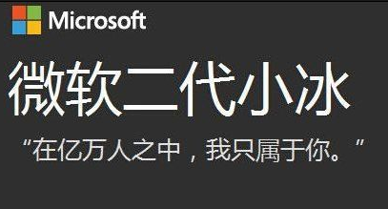

NLP
Natural Language Processing
Definition:
a field of computer science
concerned with the interactions between computers and human/natural language
Applications:
Machine translation
Spoken dialog systems
Speech recognition
…
Notes:
[1].

Slide 3


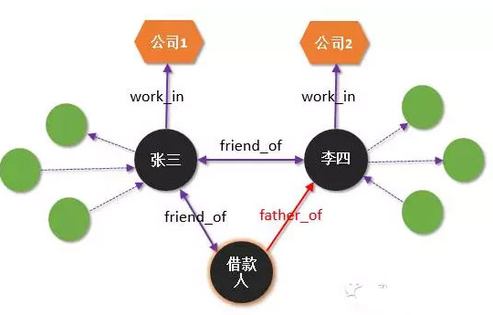
NLP Goals
Human Voice
Speech Recognition (SR)
Intent
Named Entity
Natural Language Understanding (NLU)
Text
Natural Language Generation (NLG)
Text To Speech (TTS)
Voice
知识图谱
搜索引擎
Notes:
四个部分的例子， 网页

Slide 4
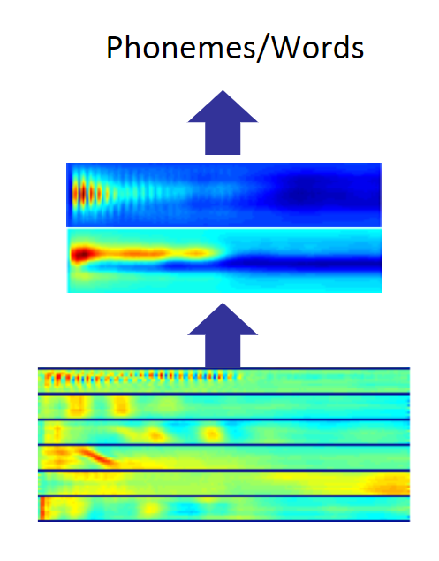
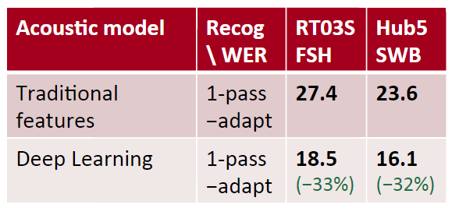
Deep Learning for Speech
The first breakthrough results of “deep learning” on large datasets happened in speech recognition
Context-Dependent Pre-trained Deep Neural Networks for Large Vocabulary Speech Recognition Dahl et al. (2010)
Acoustic model: 声学模型 Recog WER: Recognition Word Error Rate
CNN -based

Slide 5
NLU: The hardest and the most important
Two samples help you understand NLU
Google Translation (basic GNMT)
Question Answering System (such as: 小冰 basic model)

Slide 6
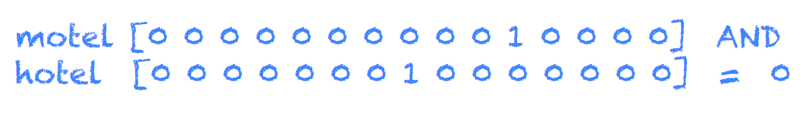
First Step: Word Embedding/Vectors
Definition: the idea that is represented by a word, phrase, etc.
“ugly and out-of-date”: One-hot encoding
Disadvantages?
Too Large
No meaning (下图，相近的词语却没有任何体现)
Notes:
one-hot编码长度和词库大小有关
忽略的词的意思

Slide 7

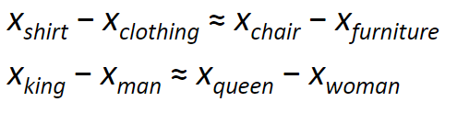
Word Embedding/Vectors
Currently: Low dimensional vectors (fixed length)
Word2Vec[1] (advantages? distance means meaning of word)
FastText[2] (advantages? fast)
[1]. Mikolov T, Chen K, Corrado G, et al. Efficient estimation of word representations in vector space[J]. arXiv preprint arXiv:1301.3781, 2013
[2]. Joulin A, Grave E, Bojanowski P, et al. Bag of tricks for efficient text classification[J]. arXiv preprint arXiv:1607.01759, 2016.

Slide 8
Chinese Word Segmentation[1]
I am a student vs 我是一个学生
How to represent “我是一个学生”?
我/ 是/ 一个/ 学生/
CRF model (条件随机场)
[1]. Xue N. Chinese word segmentation as character tagging[J]. International Journal of Computational Linguistics & Chinese Language Processing, Volume 8, Number 1, February 2003: Special Issue on Word Formation and Chinese Language Processing, 2003, 8(1): 29-48.

Slide 9
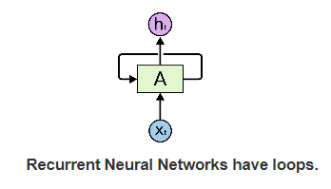
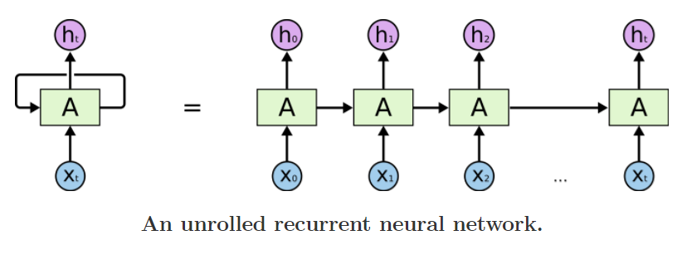
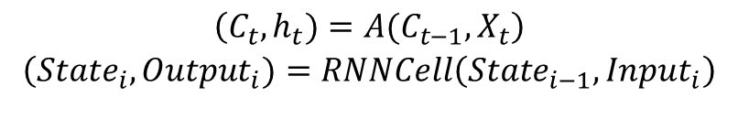
RNN (Recurrent Neural Networks)
$$\begin{matrix}\left(C_{t},h_{t})=A(C_{t−1},X_{t}\right) \\ \left(State_{i},Output_{i})=RNNCell\left(State_{i−1},Input_{i}\right)\right. \\ \end{matrix}$$
Deep Network

Slide 10
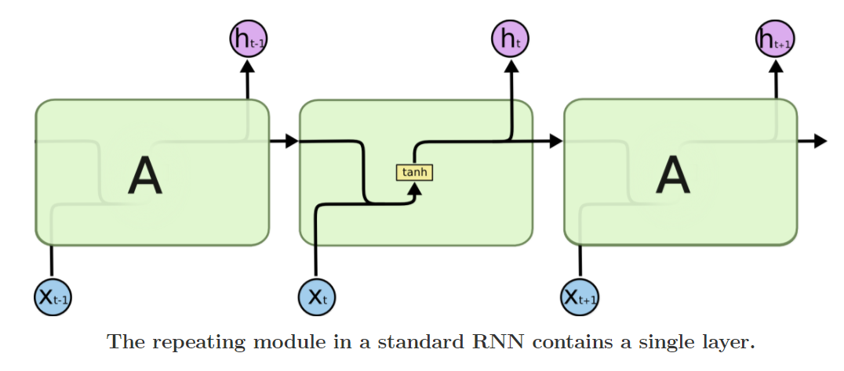
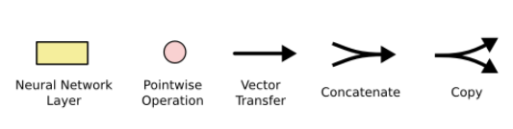

RNN (Recurrent Neural Networks)
$$\begin{matrix}C_{t}=h_{t} \\ \end{matrix}$$
1. 多次经过tanh函数之后记忆缺失严重，state(100)中几乎不包含X(1)的信息

Slide 11
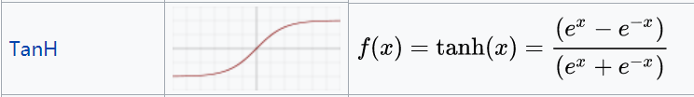
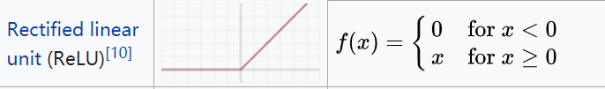
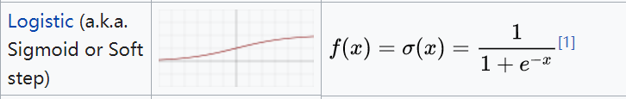
Activation Function
1. 为什么不采用ReLU函数?

Slide 12
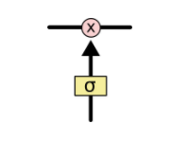
Gate
Gate: 门
theta: 神经元 y = activation function(Wx + b) 则有 0<=y<=1
ps. 与上周所讲保持一致
矩阵对应元素相乘。如果与神经元点乘之后的数值为零矩阵，表示该门不允许任何数据通过（遗忘了所有记忆）；如果与神经元点乘之后的数值为全1矩阵，表示允许所有数据通过（清楚地记住了所有事情）

Slide 13
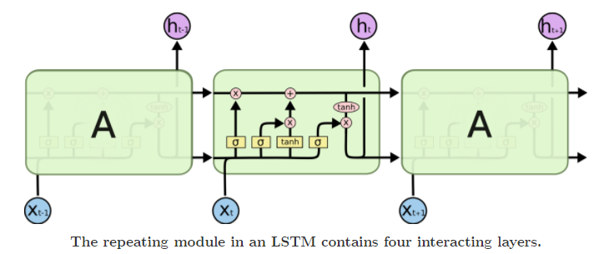
LSTM (Long Short Term Memory networks)

Slide 14
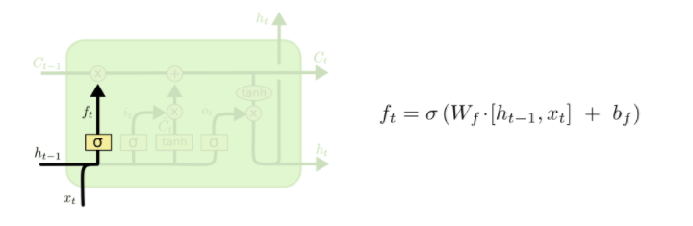
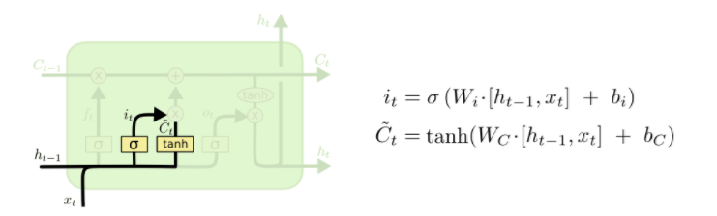
LSTM: Forget Gate, Input Gate
根据上文和当前词汇，神经网络决定我忘记了哪些部分。
f(t) forget gate
根据上文和当前词汇，神经网络决定我学到了什么。
i(t) input gate

Slide 15
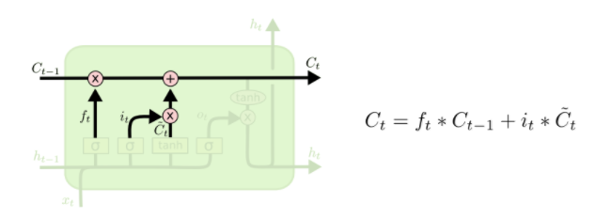
LSTM: Memory
C(t) is memory

Slide 16
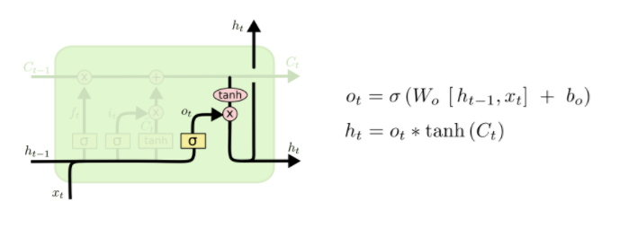
LSTM: output
根据当前词确定我们可能的输出。
根据当前记忆C(t)，我们应该输出那个部分。
For example: call 对应 电话，但是要根据语境可能翻译成呼叫。
[1]. Mikolov T, Karafiát M, Burget L, et al. Recurrent neural network based language model[C]//Eleventh Annual Conference of the International Speech Communication Association. 2010.
[2]. Sundermeyer M, Schlüter R, Ney H. LSTM neural networks for language modeling[C]//Thirteenth Annual Conference of the International Speech Communication Association. 2012.
[3]. Chung J, Gulcehre C, Cho K H, et al. Empirical evaluation of gated recurrent neural networks on sequence modeling[J]. arXiv preprint arXiv:1412.3555, 2014.

Slide 17
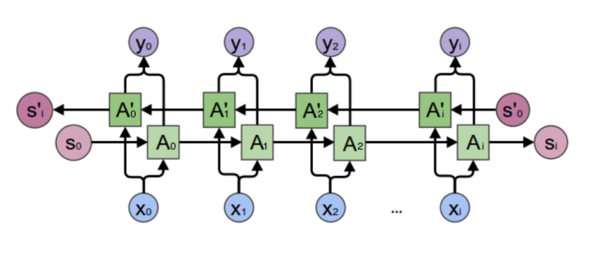
Bi-directional LSTM
为什么用双向 LSTM？
单向的 RNN，是根据前面的信息推出后面的，但有时候只看前面的词是不够的， 我今天不舒服，我打算 __ (一天)。
“去医院”，“睡觉”，“请假”

Slide 18
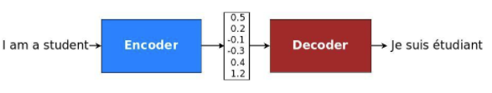
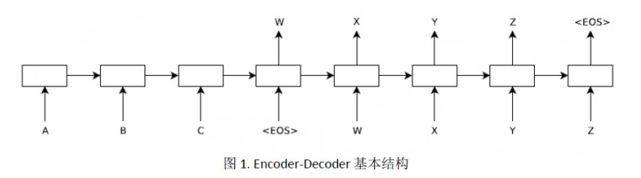
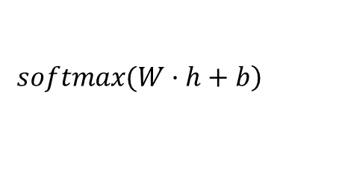
Sequence-To-Sequence Model
1. Embedding: 将字符串表示成词向量
2. LSTM-Encoder
3. LSTM-Decoder
4.
$$\left.softmax(W·h+b\right)$$

Slide 19
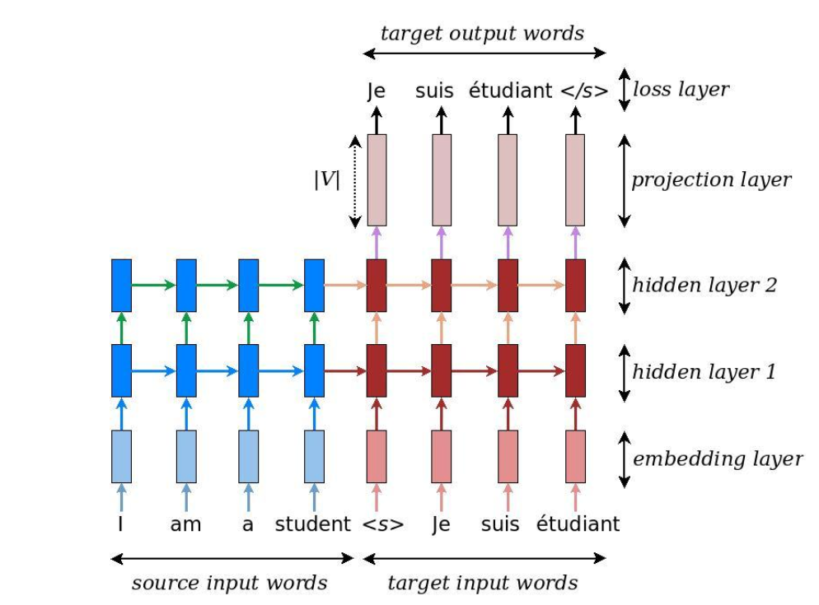
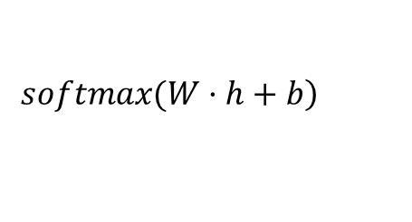
Sequence-To-Sequence Model
蓝色部分为两个堆叠的LSTM Cell，构成Encoder
红色部分为两个堆叠的LSTM Cell，构成Decoder
softmax产生一个长度为|V|（词库大小）的向量，代表翻译成该词的概率，概率越接近1则表示该词越可能成为翻译结果
$$\left.softmax(W·h+b\right)$$

Slide 20
Sequence-To-Sequence Model
The length of decoded word is decided by network itself.
Loss function:
交叉熵 loss = q * log(p) 链式法则
batch-based GSD with momentum (AdamOptimizer)
贪心算法获得最佳翻译句子
The length of decoded word is decided by network itself.
Loss function:
X, Y, Z 通过softmax函数得到翻译成某个词语概率
交叉熵 loss = p * log(p) 链式法则
batch-based GSD梯度下降 (小批次随机梯度下降)
交叉熵:
[A B C] dict_size = 3
[0, 0, 1] real data
[0.5, 0.3, 0.2] predict data
loss = 0 * log(0.5) + 0 * log(0.3) + 1 * log(0.2)

Slide 21
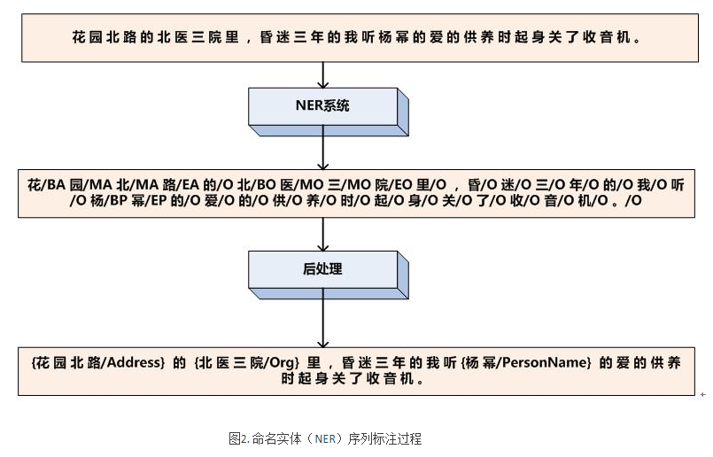
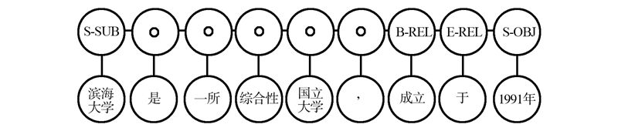
Sequence Label (Named Entity Recognition)
我 想看 周杰伦 的 灌篮高手
O O ACTOR O FILM

Slide 22
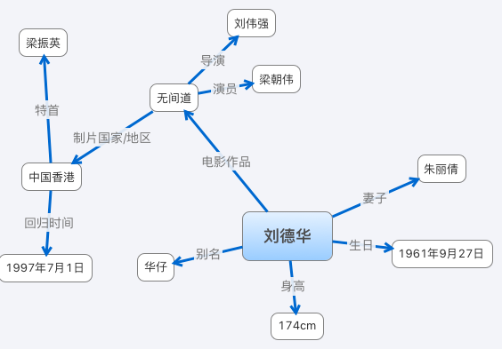
Knowledge Graph (Information Retrieve)
1. How to get Entity? NER
2. How to construct KG?
无间道 的 导演 是 刘伟强
刘德华 的 生日 是 1961年9月27日

Slide 23
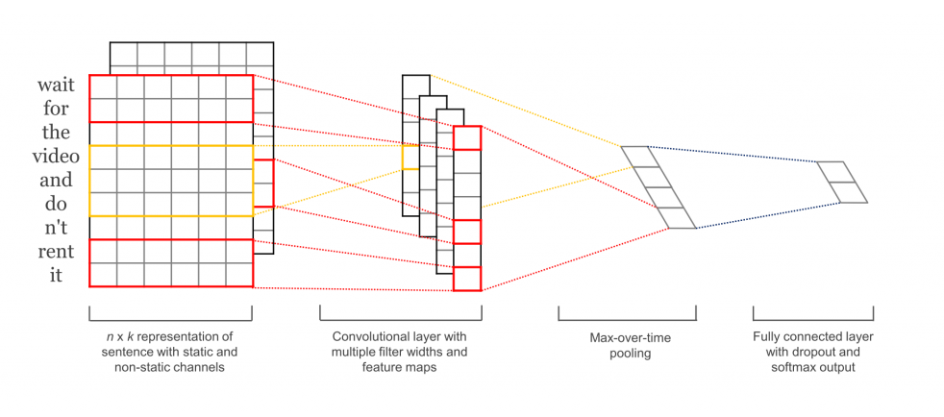
Apply CNN in NLP
计算流程（卷积层，池化层，softmax层）
句子长度不一致？定义每句最大单词个数
对于RNN的优势，maxpool剪除了额外信息，计算速度增加，过拟合程度减小
多用于文本分类与意图识别

Slide 24
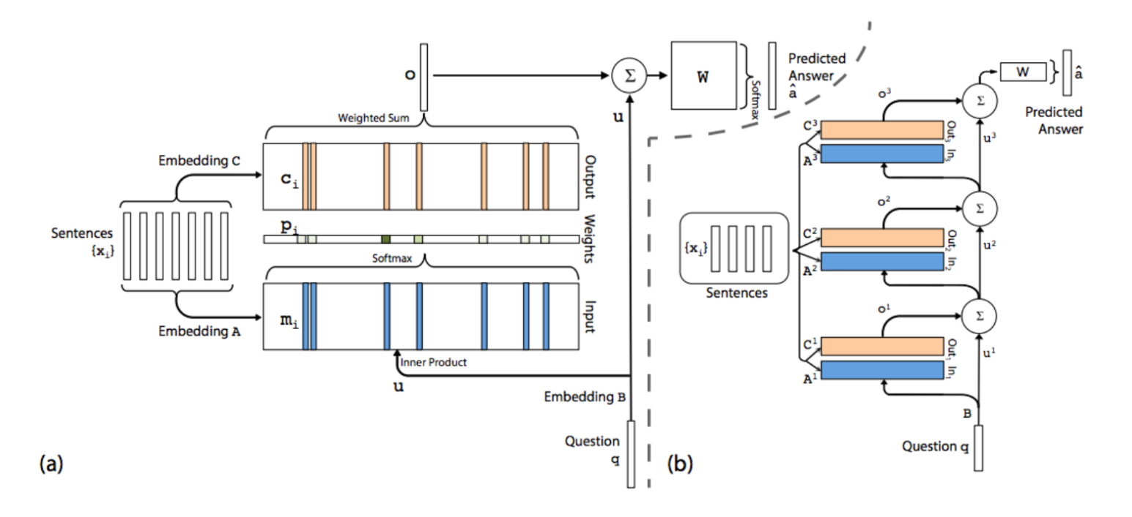
Memory Network (LSTM结构见下页)

Slide 25
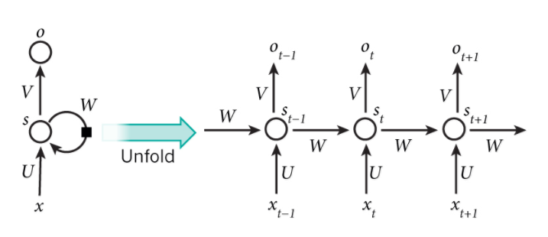
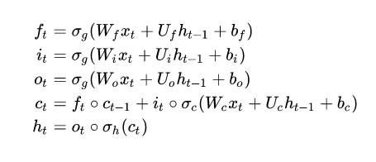
RNN (Recurrent Neural Networks)
RNN Cell: LSTM[2](长短期记忆网络，能够保存上一时刻的信息) GRU
[1]. Mikolov T, Karafiát M, Burget L, et al. Recurrent neural network based language model[C]//Eleventh Annual Conference of the International Speech Communication Association. 2010.
[2]. Sundermeyer M, Schlüter R, Ney H. LSTM neural networks for language modeling[C]//Thirteenth Annual Conference of the International Speech Communication Association. 2012.
[3]. Chung J, Gulcehre C, Cho K H, et al. Empirical evaluation of gated recurrent neural networks on sequence modeling[J]. arXiv preprint arXiv:1412.3555, 2014.

Slide 26
Q/A
THANKS

