Slide 1
Load Prediction
—— From electricity to cloud
吴雨霏

Slide 2
Content:
选题历程
选题介绍
我的工作

Slide 3
选题历程
时间轴：
寒假：确定大方向——data mining
开学初：确定小方向 ——load prediction
3月上旬：确定具体问题 —— efficient resource allocation based on historical data
Insight
SIGKID
一次研讨会
Grid computing 的bandwidth monitor and prediction
Notes:
病人病历时间数据，classification
Land cover prediction, click ads prediction

Slide 4
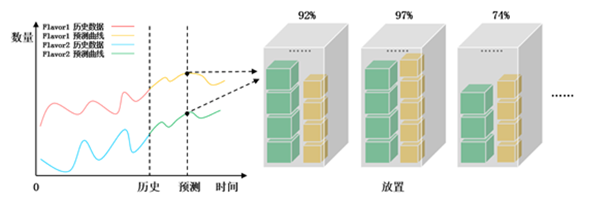
选题介绍——意义
云计算和虚拟化兴起原因
产能过剩
提高data center资源的利用率
Possible solution:
精准未来预测request，提前准备
智能化资源调度管理

Slide 5
选题介绍——挑战
Challenge
Privacy and black box:
无法分析你的用户究竟做了什么，想做什么(信息过少)
Outlier pointer
波动性
input
Predict Model
output
Future ECS
instance requests
historical ECS
instance requests

Slide 6
Technical support
Date Source : The datasets are provided by Huawei Company.
Data format
“Number of physical server CPU cores” “memory size” “disk size”
\n
“Number of virtual machines”
“VM1” “CPU-cores” “memory-size”
“VM2” “CPU-cores” “memory-size”
\n
“The resource to be optimized, e.g., CPU, memory”
\n
“Start time to predict”
“End time to predict”

Slide 7
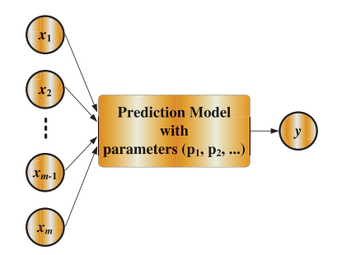

Related work
预测next 5 mins (时间间隔为1秒)
One step prediction: ${(i+1)}_{th} , {⋯,(i+300)}_{th}$
N step prediction: : ${(i+n)}_{th}$, $⋯$
Bandwidth prediction (ANN method)
(Timestamp, average package rate, average bit rate) of the past (n+i*m) minutes
Input layer – 3*3 hidden layer – output layer(1): available bandwidth
Ref:
A Neural Network Based Predictive Mechanism for Available Bandwidth(2005, IPDPS)
Online System for Grid Resource Monitoring and Machine Learning-Based Prediction(2013, TPDS )

Slide 8
又说到resource provisioning
目的：adaptively scale
Balance SLA and cost
——constraint programming approach
缺点：非主动，反应时间较长
Workload prediction
——application workload
Notes:
Prediction并不是目的，目的是为了优化资源使用

Slide 9
Related work
NWS(network weather service): combination of several models(传统统计模型)
RPS(Resource prediction system): conventional linear models(AR, MA,ARMA…)
SVM(1995): 参数确定选择困难, no general guideline
Ant Colony optimization
ECNN
…….

Slide 10
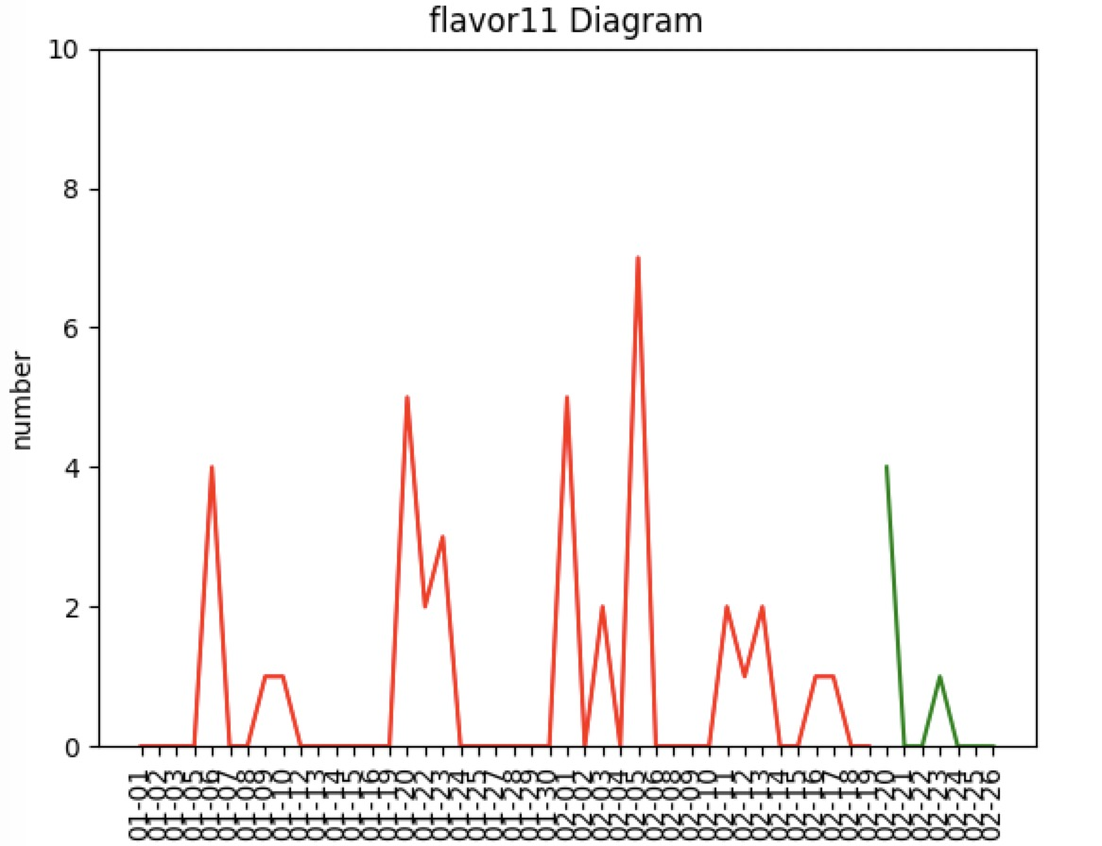
My work
可视化

Slide 11
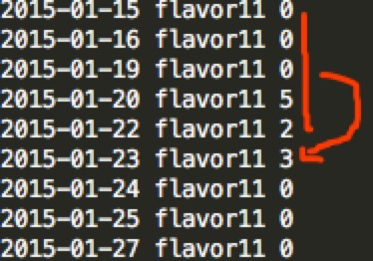
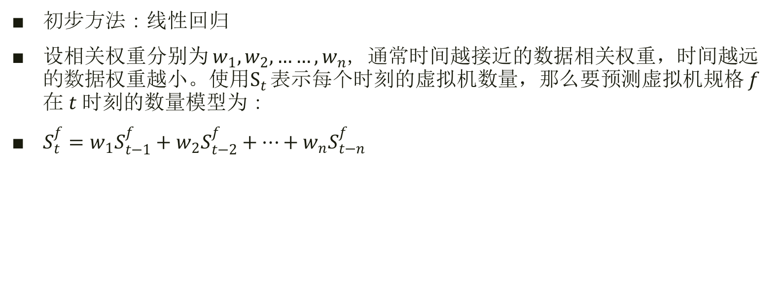
My work
初步方法：线性回归
设相关权重分别为 $w_{1},w_{2},……,w_{n}$，通常时间越接近的数据相关权重，时间越远的数据权重越小。使用$S_{t}$ 表示每个时刻的虚拟机数量，那么要预测虚拟机规格 $f$ 在 $t$ 时刻的数量模型为：￼
$S_{t}^{f}=w_{1}S_{t−1}^{f}+w_{2}S_{t−2}^{f}+…+w_{n}S_{t−n}^{f}$

Slide 12
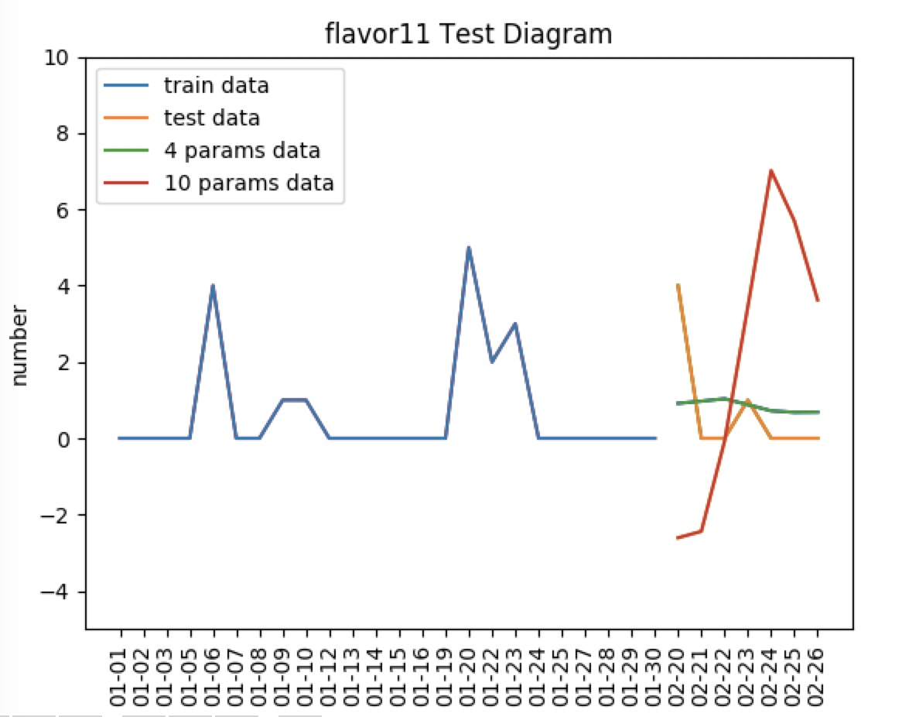
My work

