Slide 1

Online Retail Customer Segmentation

Slide 2
Topics Covered
Data import
Data cleaning and wrangling
EDA
Preparing data attributes for modeling
Building ML model
Conclusion and future work

Slide 3
Goal
Perform Cohort Analysis on Online Retail Data
Conduct RFM Analysis Based on Online Retail Data
Build Customer Segments Using K-Means Clustering Model
Introduce the observations and results from this project to the Online Retail marketing department and collaborate in order to apply these insights to marketing strategies.
GitHub link to the EDA and ML notebooks and utility functions can be found here.

Slide 4

Online Retail Data
Downloaded from Kaggel
Contains all the transactions made from 2010-12-01 to 2011-12-09
There were originally 541,909 rows and 8 columns in the data
Each row was associated with one product in an order

Slide 5
Data Field
InvoiceNo: Invoice number. Nominal. A 6-digit integral number uniquely assigned to each transaction. If the
InvoiceNo starts with the letter 'C', it indicates a cancellation.
StockCode: Product code. Nominal. A 5-digit integral number uniquely assigned to each distinct product.
Description: Product (item) name. Nominal.
Quantity: The quantities of each product (item) per transaction. Numeric.
InvoiceDate: Invoice date and time. Numeric. The day and time when a transaction was generated.
UnitPrice: Unit price. Numeric.
CustomerID: Customer number. Nominal. A 5-digit integral number uniquely assigned to each customer.
Country: Country name. Nominal. The name of the country where a customer resides.

Slide 6
Data Cleaning
Removed 135,080 rows missing Customer ID
Removed 8,905 rows with negative Quantity
Removed 40 rows with UnitPrice 0
Dropped Description column

Slide 7
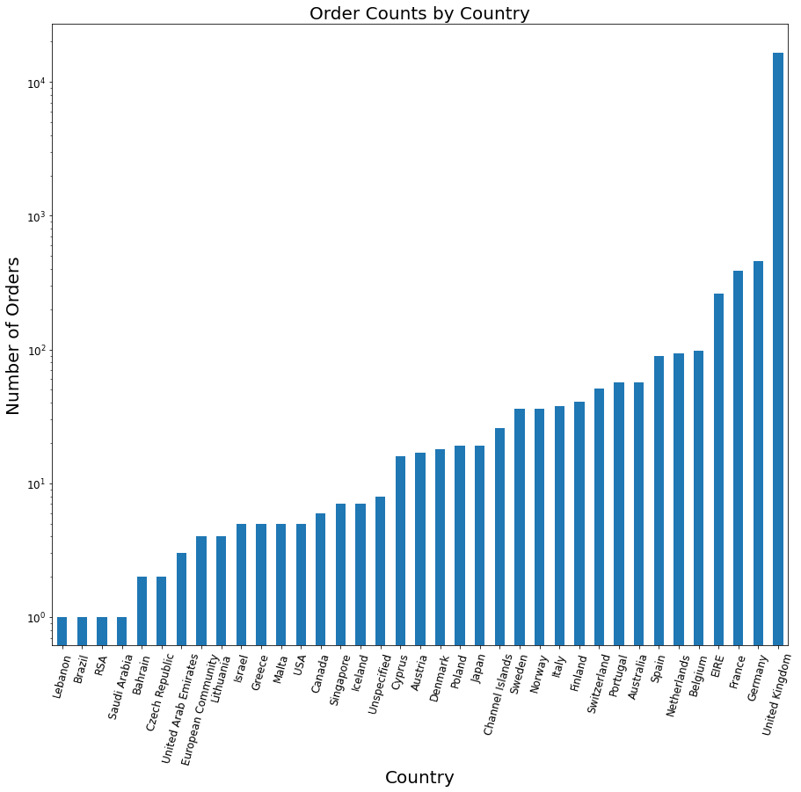

Slide 8
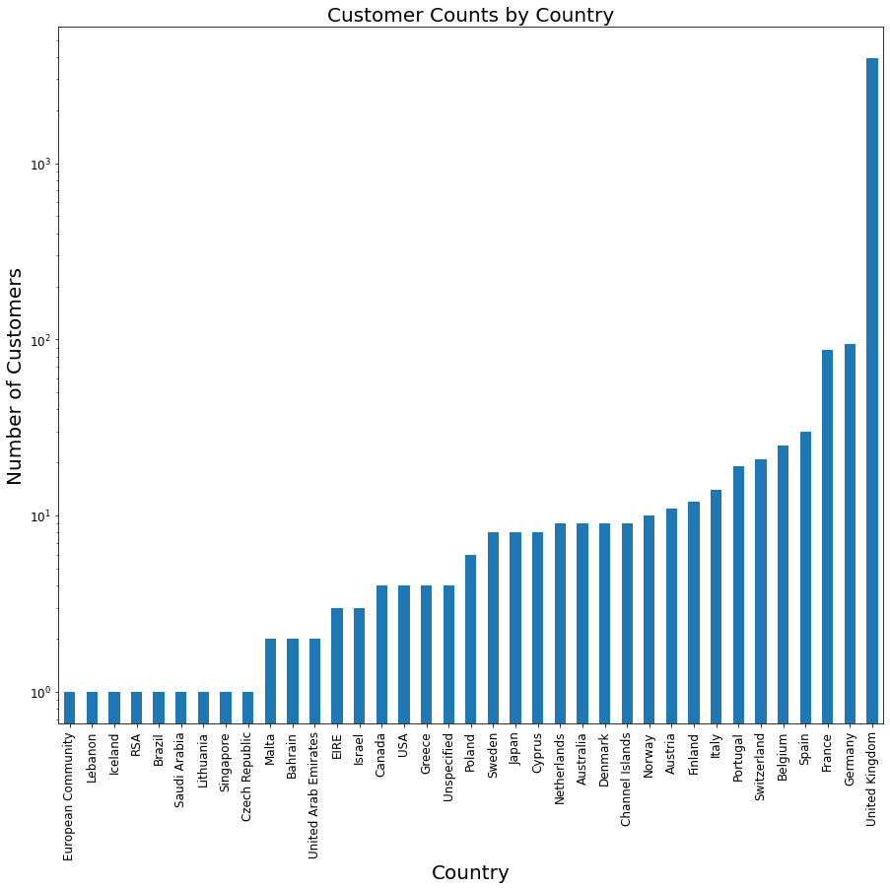

Slide 9
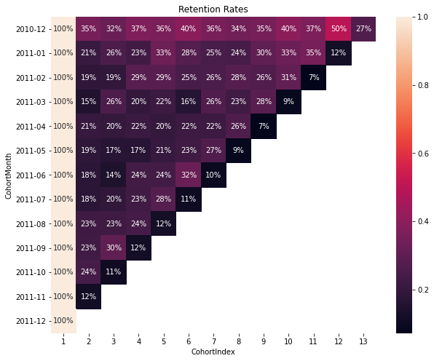
UK Customer Retention Rates

Slide 10
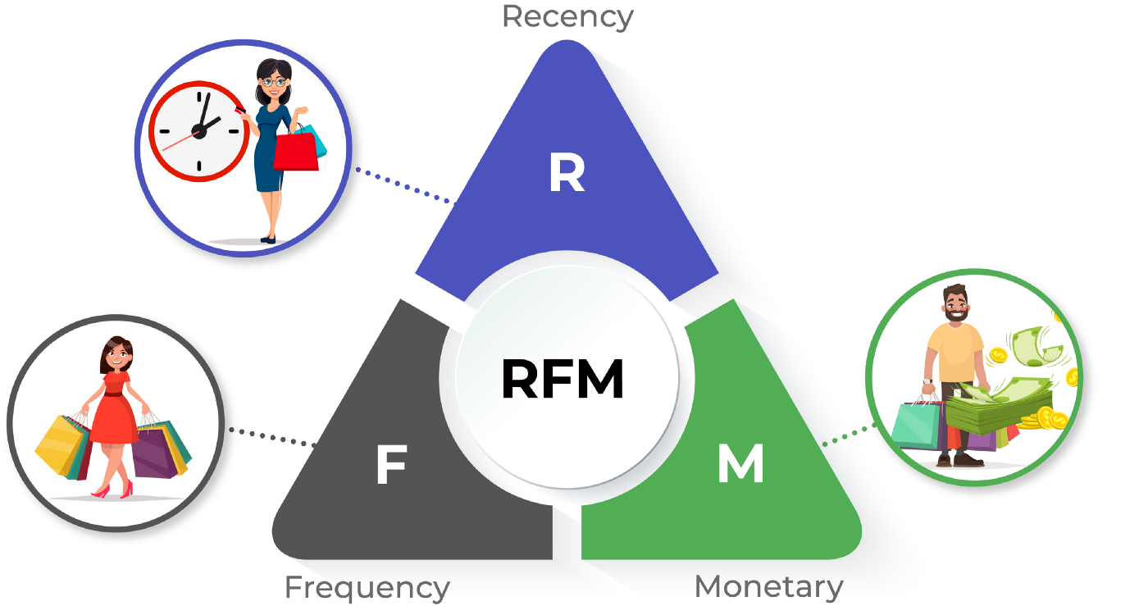
RFM Customer Segmentation

Slide 11
Summary Metrics of RFM Segmentation
RFM Score | Count | Recency Mean | Frequency Mean | Monetary Value Mean
3 | 396 | 265.5 | 1.0 | 158.6
4 | 454 | 184.7 | 1.1 | 280.7
5 | 443 | 110.5 | 1.3 | 363.6
6 | 407 | 90.3 | 1.7 | 704.1
7 | 374 | 76.6 | 2.3 | 698.8
8 | 366 | 58.7 | 3.0 | 1126.1
9 | 409 | 45.8 | 4.0 | 1401.8
10 | 347 | 30.0 | 5.2 | 2337.6
11 | 301 | 21.1 | 8.0 | 3476.3
12 | 423 | 7.7 | 15.8 | 8469.8

Slide 12
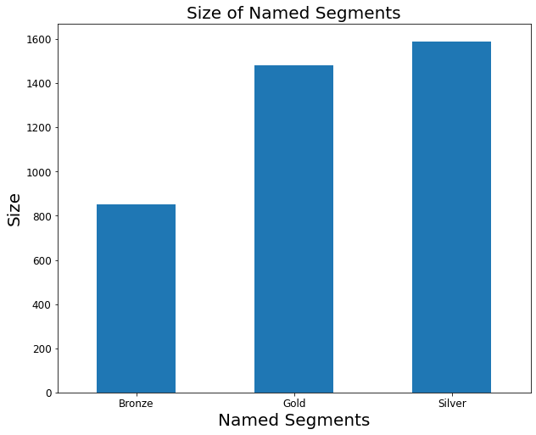
Named Customer Segments
Based on customers’ RFM Scores, we also group customers into named segments:
Gold (RFM Score > = 9), Silver (9>= RFM Score >= 5), and Bronze (RFM Score <= 4).

Slide 13
Summary Metrics for Named Segments
Named Segment | Count | Recency Mean | Frequency Mean | Monetary Value Mean
Gold | 1480 | 26.2 | 8.5 | $4,063
Silver | 1590 | 85.4 | 2.0 | $705
Bronze | 850 | 222.4 | 1.1 | $223

Slide 14
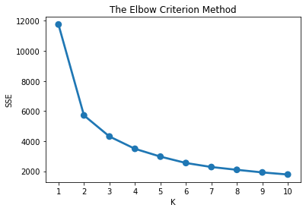
Machine Learning Modeling
K-Means Clustering Model
Used the elbow criterion method to choose number of clusters
The best: K=2

Slide 15
The Summary Metrics of K-Means Clusters
Cluster | Count | Recency Mean | Frequency Mean | Monetary Value Mean
0 | 1592 | 28.7 | 8.1 | $3,957
1 | 2328 | 136.5 | 1.6 | $440

Slide 16
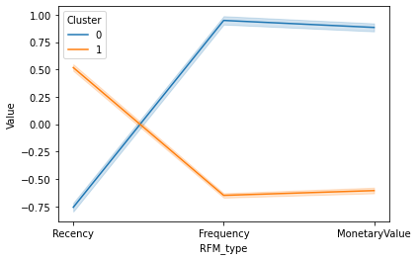
The Plot of Standardized RFM
The average Recency, Frequency and Monetary Value of customers in cluster 0 are much better than those of customers in cluster 1.

Slide 17
Conclusion
Target Silver segment
Largest group + most potential
Ex: offer deals on next purchase before a certain date, bundle discounts
Maintain Gold segment
Best customers + most profitable
Ex: implement a point system with exclusive benefits to reward continued customer involvement

Slide 18
Future Work
Distinguish between recency, frequency, and monetary value in terms of impact on overall RFM score (to better understand customer behavior within each segment)
Pinpoint the products that have been purchased most frequently and most recently

