Slide 1
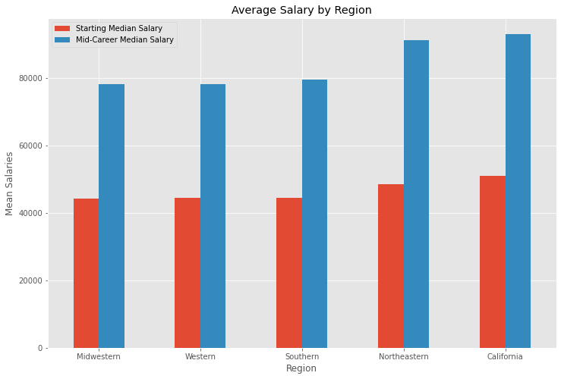
Where Should You Go to College with Higher Pay Later?
By analyzing the salary data collected from graduates from colleges in five different regions, the answer is colleges in California.
Graduates from colleges in California have the highest average starting median salary $51,000 and also the highest mid-career median salary $93,000, while graduates from colleges in Midwest have the lowest average starting median salary $44,000 and the lowest mid-career median salary $78,000 among all graduates from colleges in the five regions.
Graduates from colleges in northeastern have the highest salary increase percentage 88.37% while the graduates from colleges in Western have the lowest salary increase percentage 76.07% ten years down the road.
76.78% 76.07% 78.58% 88.37% 82.25%

Slide 2
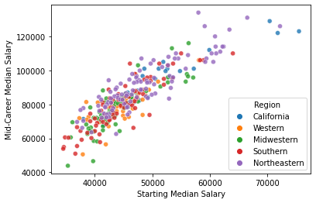
The Starting Salary is Highly Correlated with Mid-Career Salary
This scatter plot shows the relationship between on starting median salary and mid-career median salary. The starting median salary is highly correlated with mid-career median salary. The graduates with higher starting salary end up with high mid-career salary.

