Slide 1

College graduates with Higher Pay
Where to attend college What major to study what type of college to go to

Slide 2

Data
Salaries for College by Type
Salaries for College by Region
Salary Increase by Major

Slide 3
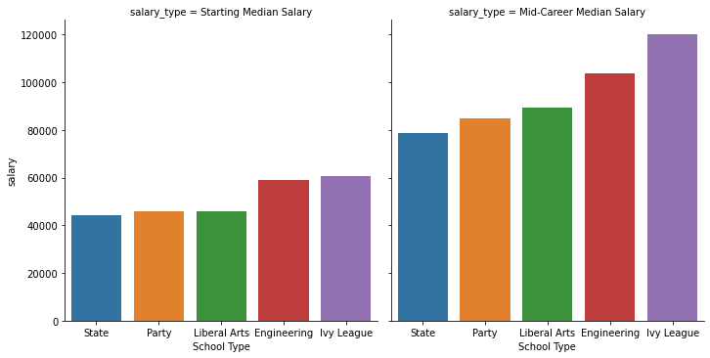
College types impact graduates starting salaries and mid-career salaries
Graduates from Ivy League schools have the highest mean starting median salary $ 60,475 and the highest mid−career median salary $120,125. Graduates from State schools have the lowest mean starting median salary $ 44,126, and the lowest mid−career median salary $78,567

Slide 4
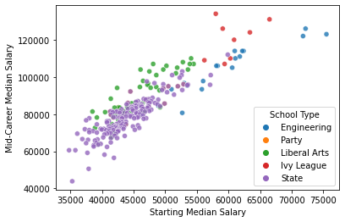
The relationship between starting median salaries and mid-career median salaries by college types

Slide 5
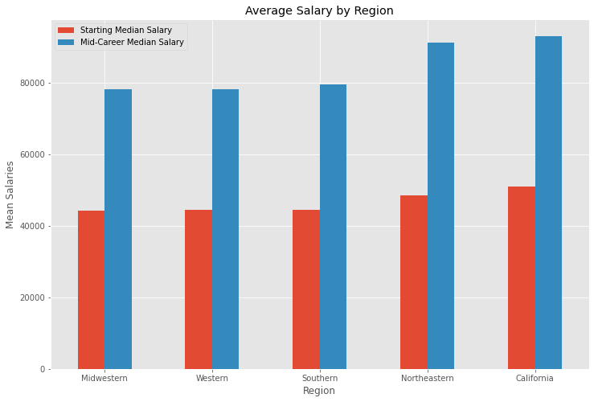
Locations of colleges impact graduates’ starting salaries and mid-career salaries
Graduates from colleges located in California have the highest mean starting median salary $51,032. Graduates from colleges located in the Northeastern region have the highest mean mid−career median salary $91,352. Graduates from colleges located in Midwest region have the lowest mean starting median salary $ 44,225, and the lowest mean mid−career median salary $78,180

Slide 6
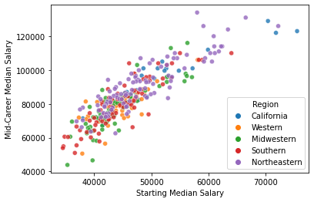
The relationship between starting median salaries and mid-career median salaries by regions

Slide 7
Majors studied in colleges impact graduates’ salary increase
Graduates with major Spanish have lowest Starting Median Salary $34,000
Graduates with major Physician Assistant have highest Starting Median Salary $74,300
Graduates with major Physician Assistant have lowest percent change from Starting to
Mid-Career Salary 23.4%
Graduates with major Math or Philosophy have highest percent change from Starting to Mid-Career Salary 103.5%
Graduates with major Education or Religion have lowest mid-career median salary $52,000
Graduates with major Chemical Engineering have highest mid-career median salary $107,000

Slide 8
Conclusions
Graduates from colleges in California earn $8,000 more starting Salaries and $13,000 more mid-career salaries than those from colleges in Midwest
Graduates from Ivy League schools earn $16,000 more starting Salaries and $40,000 more mid-career salaries than those state schools
Graduates with Physician assistant major earn $40,000 more starting salaries than those with Spanish major. Graduates with Chemical Engineering major earn $55,000 more mid-career salary than those with Math or Philosophy major.
College locations, school types and majors studied in college do impact college graduates’ starting salaries and mid-career salaries down the road. Graduates’ starting salaries are highly correlated to their mid-career salaries.

