Slide 1
A TEAM Flu Vaccinating Analysis
Members: yulin hou, yuexin ma, xin shen, qi li

Slide 2

Are you looking for a comprehensive tool to help you stay on top of the flu vaccination situation in the US?
Are you looking for a one-stop shop for all your flu vaccination needs?
Do you want to plan ahead and schedule your flu shot at a convenient time?
Look no further than our new R Shiny app!

Slide 3

Dataset Introduction
The Vaccines.gov Dataset
Provider Information
providers‘ names, addresses, phone numbers, zip codes, and locations, insurance_accepted, walkins_accepted, etc
Vaccine Information
vaccine information including vaccine names, in stock or not, supply levels, etc
The Vaccines.gov Dataset
powered by VaccineFinder
Provider Information
Vaccine Information
Link:
https://data.cdc.gov/Flu-Vaccinations/Vaccines-gov-Flu-vaccinating-provider-locations/bugr-bbfr
Notes:
Our shiny app is developed on the vaccines.gov dataset from the Center for disease control and Prevention. It is powered by the vaccine finder. In this dataset, it includes provider information and vaccine information on a national scale. For the provider information, we have providers‘ names, addresses, and phone numbers; For the vaccine information, it includes vaccine names, stock situation, supply levels, and so on.
This information is helpful for healthcare departments and professionals who want to monitor flu vaccination cover rates and trends as well as individuals who want to get vaccinated conveniently.

Slide 4
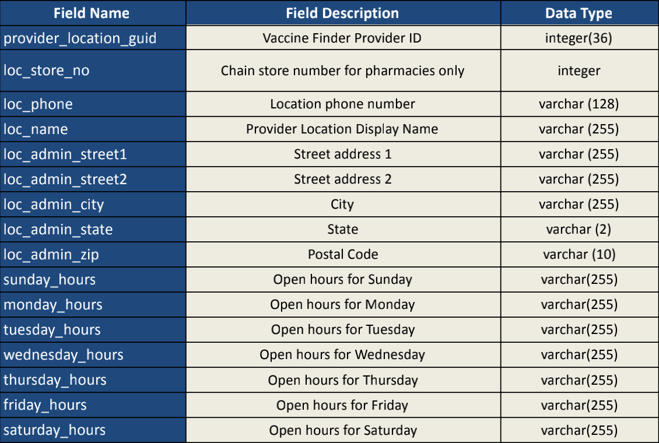
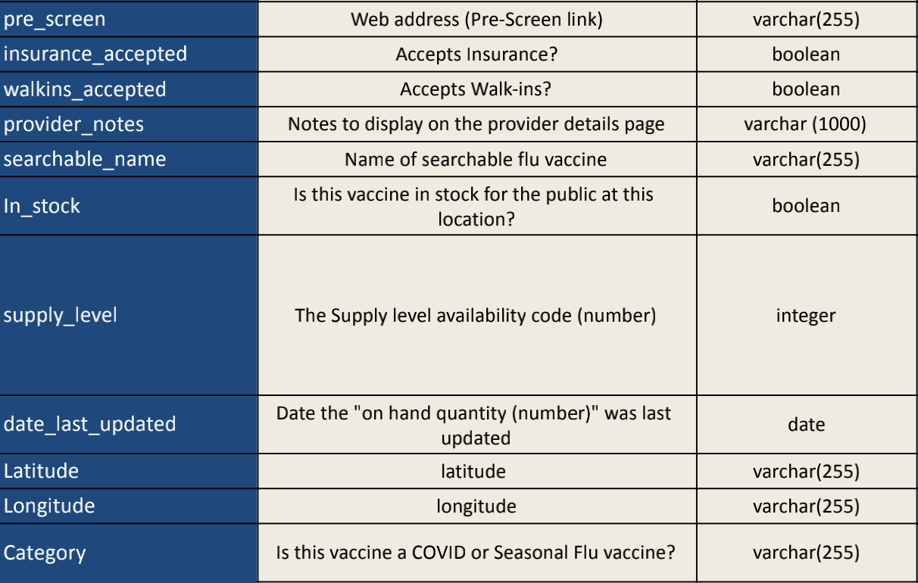
Dataset Introduction
Notes:
There is the dataset information, which includes description and datatype. we could know from the table that the raw data is complicated and chaotic.

Slide 5
Data Pipeline
Data Extraction
Data Transformation
Data Cleaning
Vaccine.gov
Shiny App
Notes:
So In the data preprocessing step, we developed a data pipeline to complete the data preprocessing automatically. With the original dataset, the pipeline will perform data extraction, data cleaning, and data transformation, providing the structured data to our shiny app. With this pipeline, we could update our shiny app with the latest data periodically.

Slide 6
Shiny App Introduction
Geospatial
Analysis
Recommendation
System
Stock
Management
System
Notes:
Now, we will introduce our shiny app. Our shiny app is mainly made up of 3 sections, which is geospatial analysis, recommendation system and stock management system. Now I will hand it over to my teammate Yuexin.

Slide 7
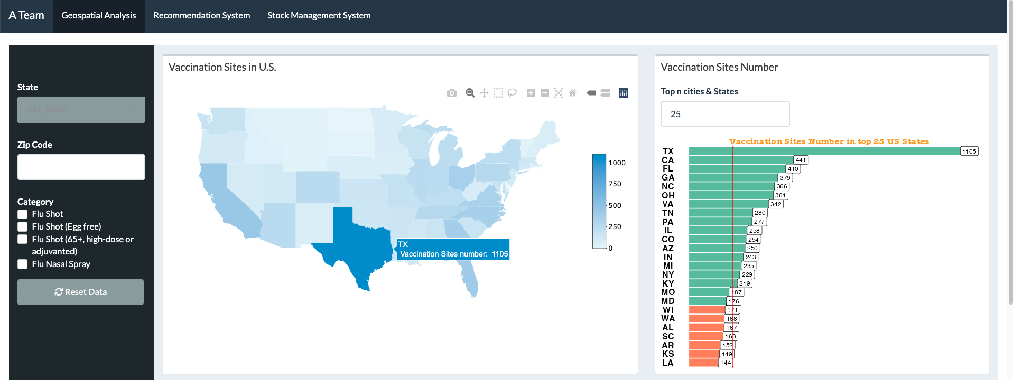
Input: State, City, Zip Code, Flu Category, bars num
Interactive Map: Vaccination Sites Distribution in US
Geospatial Analysis
Interactive Bar Chart: Vaccination Site Number in top n States
Input Widgets
Interactive Map
Interactive Table
Interactive Bar Chart
Interactive Pie Chart
Notes:
The Geospatial Analysis page contains 4 sections, including Interactive Map, Interactive Table, Interactive Bar Chart and Pie Chart. The interactive widgets on the sidebar, allow users to dynamically manipulate the display and gain deeper insights into the data. When we input nothing, there will be a vaccination sites distribution map in us. The bar chart shows the vaccination sites number in each state compared to the national average.

Slide 8
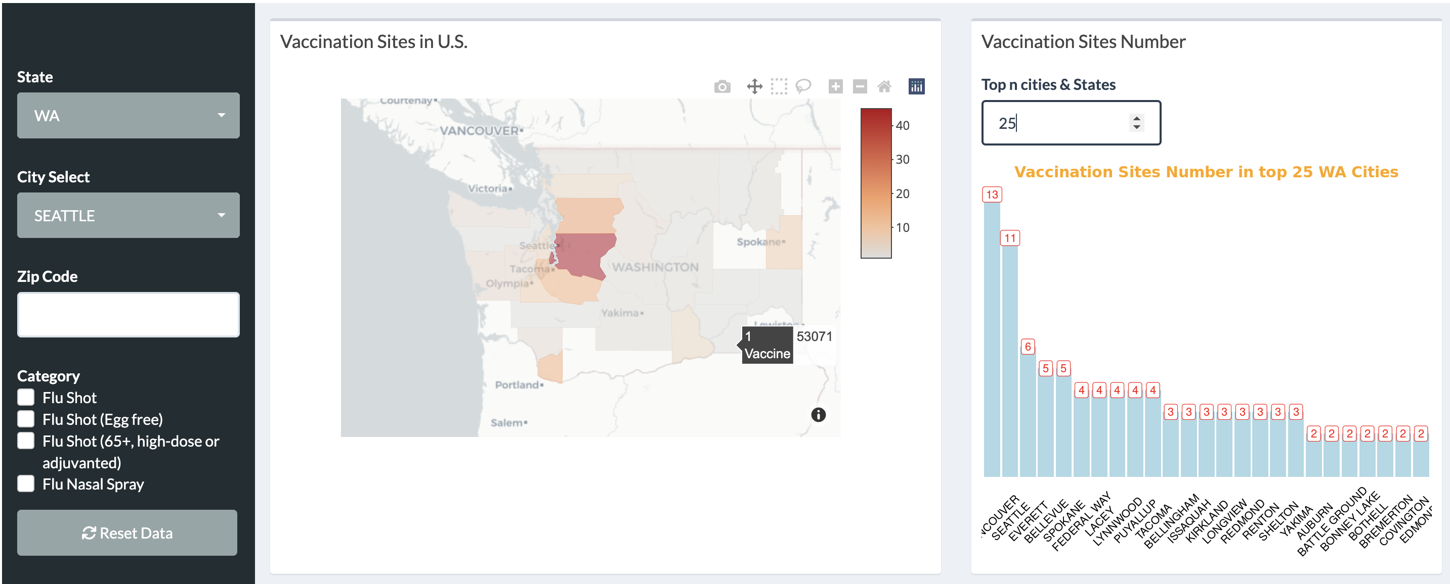
Input: State, City, Zip Code, Flu Category
Interactive Map: Vaccination Site County distribution in selected State
Geospatial Analysis
Interactive Bar: Vaccination Site Number in top n cities of selected state
Input Widgets
Interactive Map
Interactive Table
Interactive Bar Chart
Interactive Pie Chart
Notes:
Upon inputting a value, the map displays a county distribution of the selected state, while the bar chart shows the top cities vaccination sites in the state you selected.

Slide 9
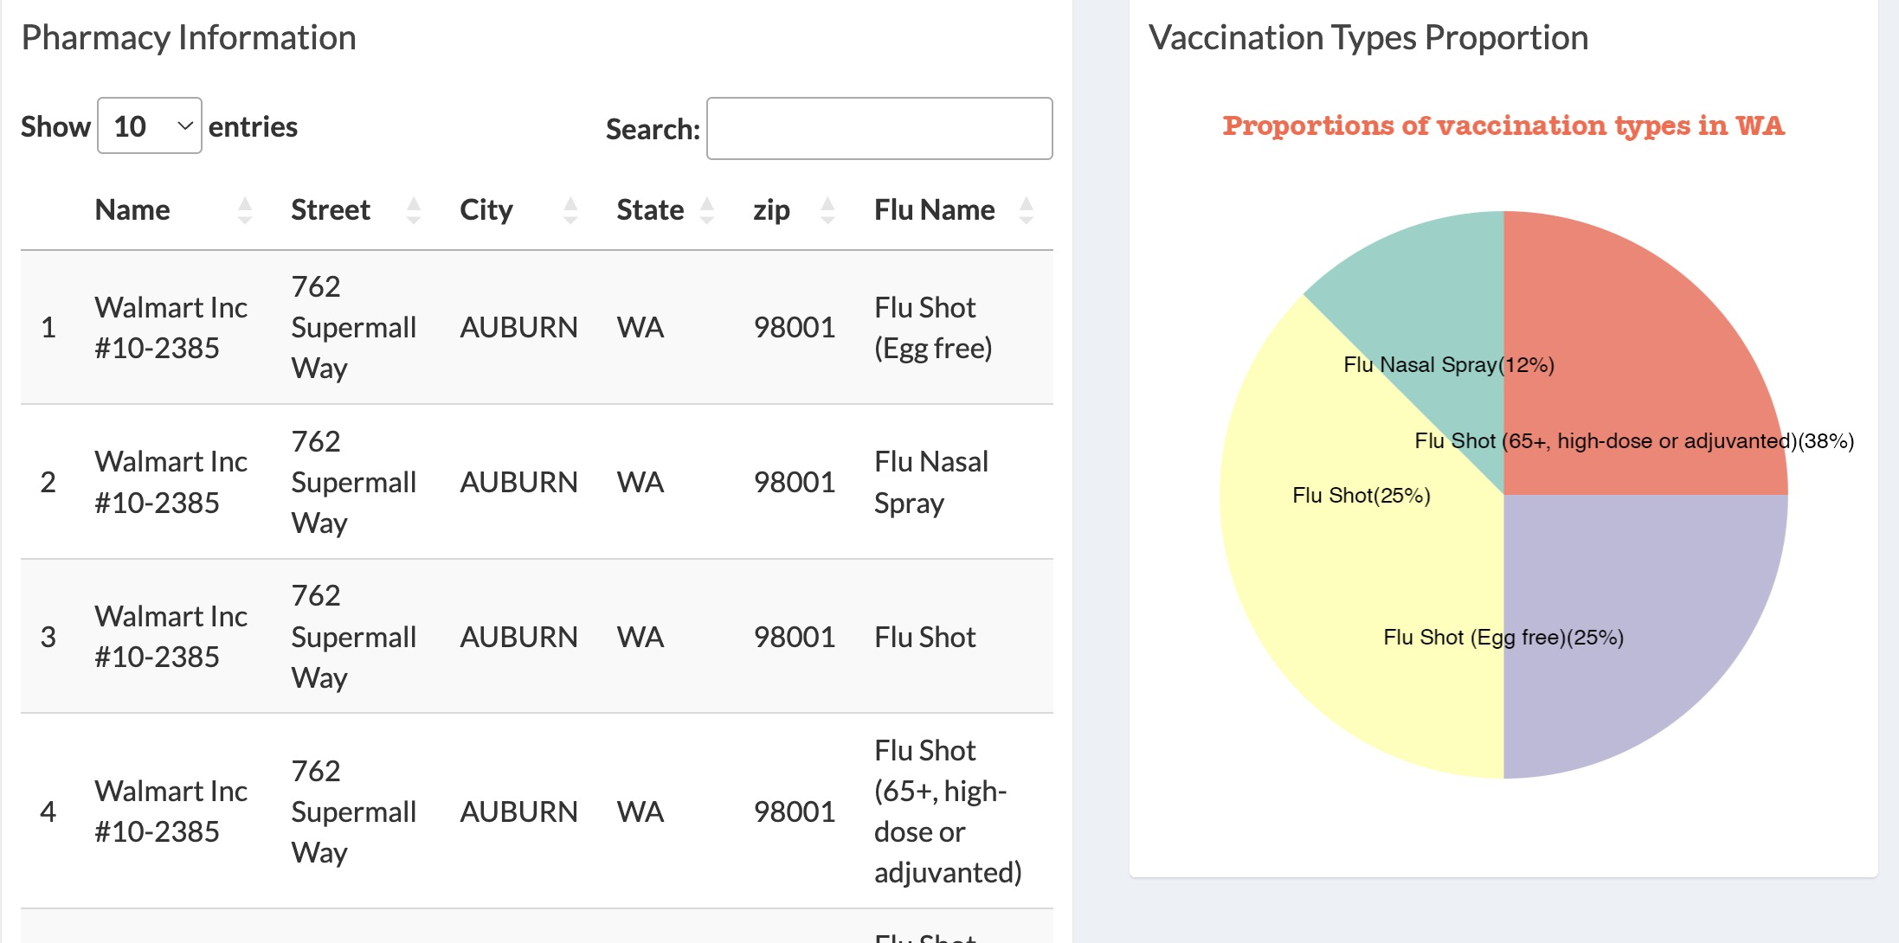
Input: State, City, Zip Code, Flu Category
Interactive Table: Pharmacy information in selected state /city/zip code/flu category
Geospatial Analysis
Pie Chart: Proportions of Vaccination Types in selected state
Input Widgets
Interactive Map
Interactive Table
Interactive Bar Chart
Interactive Pie Chart
Notes:
Meanwhile, the pharmacy information table will dynamically change according to the value you enter in the sidebar. The pie chart will show the proportion of vaccine supply for different types of vaccines in your selected state.

Slide 10
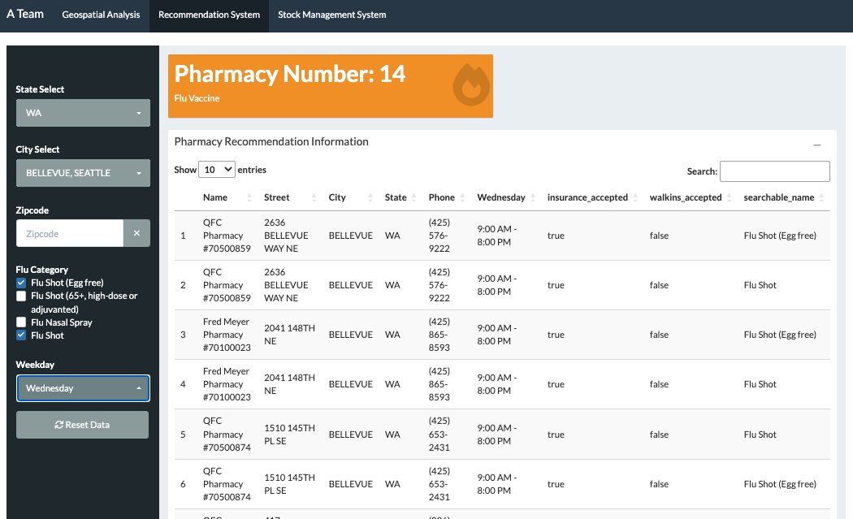
Input: State, City, Zip code, Flu Category, Weekday
Interactive Table: Pharmacy Recommendation Information
Recommendation
System
KPI Card: the Number of Available Pharmacies
Input Widgets
Interactive Table
KPI Card
Notes:
The Recommendation system contains 3 sections, including Interactive Table, KPI card and the interactive widgets on the sidebar. Users could obtain the most suitable pharmacies near the selected location to get the flu shot. With the interactive table, users can view information on the availability of flu shots at each pharmacy as well as any insurance or appointment requirements.

Slide 11
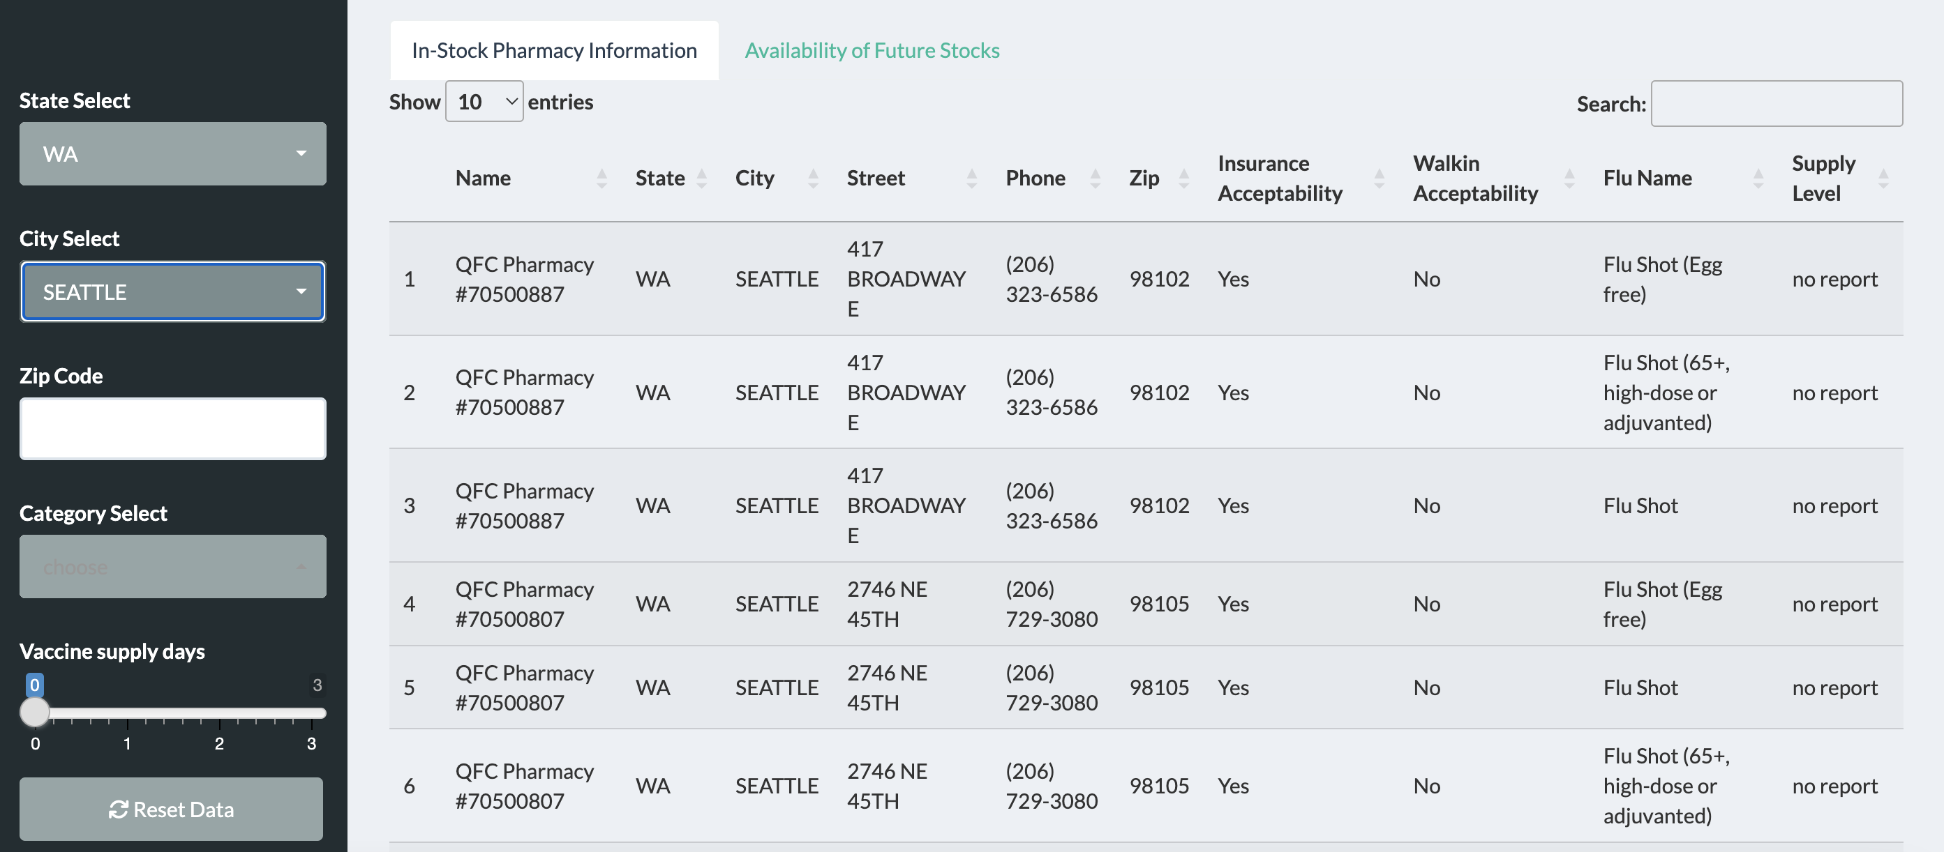
Stock Management System
Input: State, City, Zip Code, Flu Category, Supply days
Interactive Table: Stock Management Information
Interactive Bar Chart: Vaccination distribution in selected region according to supply level
Input Widgets
Interactive Table
Interactive Bar Chart
Notes:
We use attributes including Pharmacy Name, State, City, Street, Phone, Zip code, Insurance Acceptability, Walkin Accepbiity, Flu Name and Supply level to create a table to show the information to customers. Customers can use choose the flu vaccine they want to take and the city they are in to check for flu shot availability before going to the pharmacy.
If the vaccine is in stock, they can check if walk-in is acceptable of the nearest stores. If the vaccine is not in stock, they can use it to find out when they can take it in the future. We also made a bar chart to show the flu stock situation of a particular city according to the supply level, it will give us more intuitive information.

Slide 12
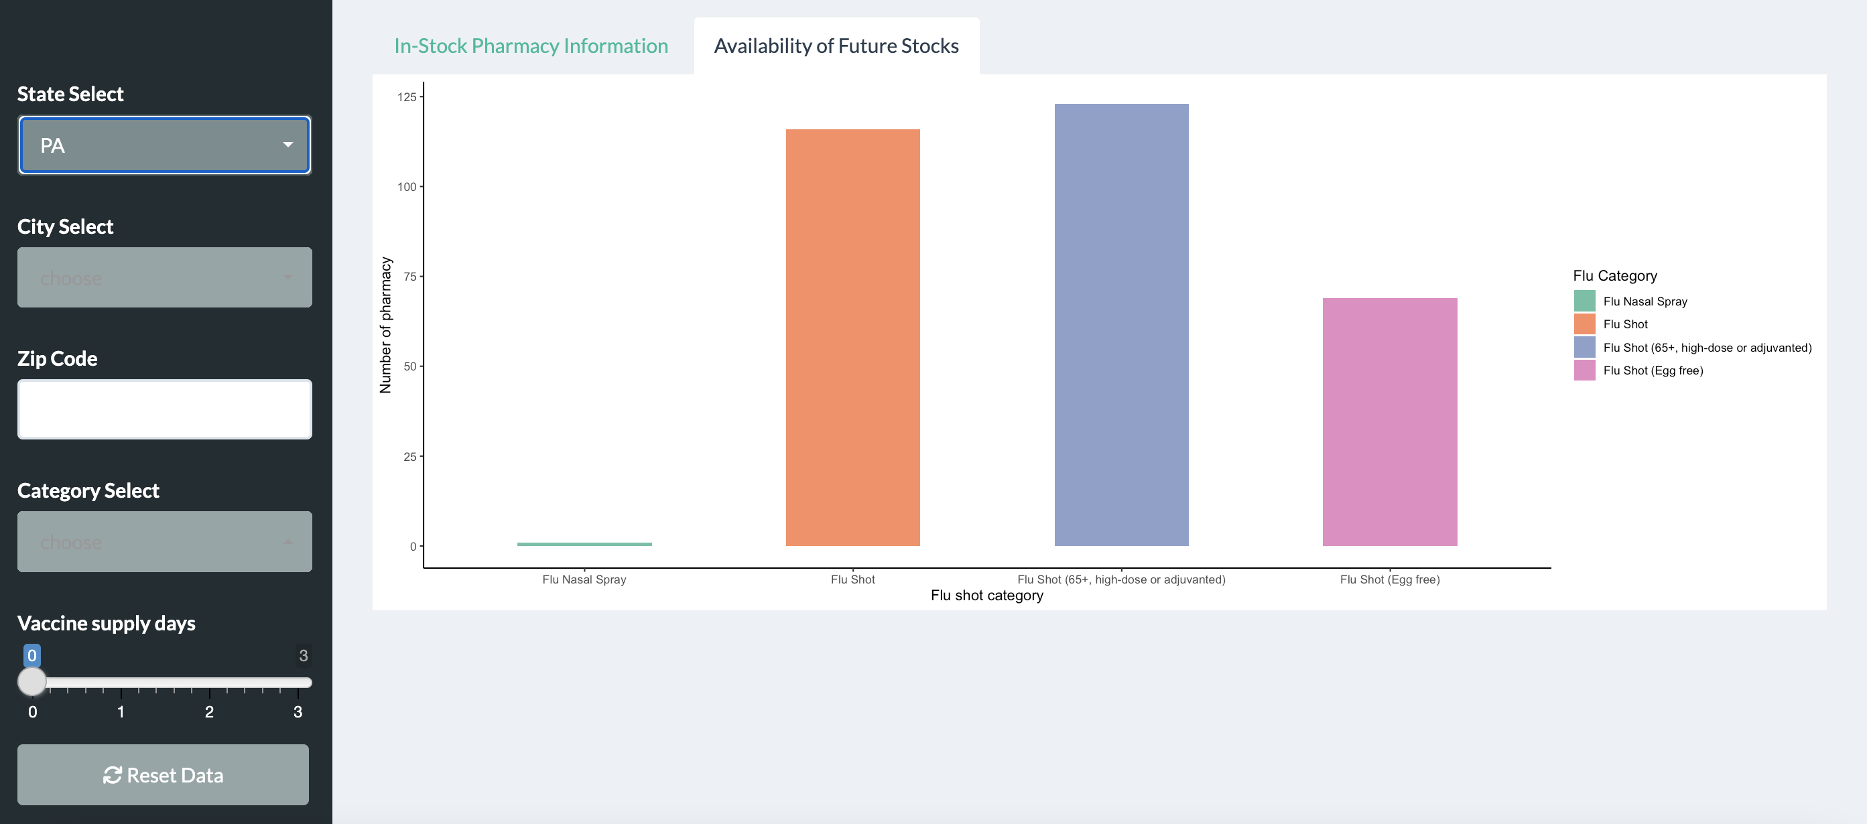
Stock Management System
Input: State, City, Zip Code, Flu Category, Supply days
Interactive Table: Stock Management Information
Interactive Bar Chart: Vaccination distribution in selected region according to supply level
Input Widgets
Interactive Table
Interactive Bar Chart
Notes:
We use attributes including Pharmacy Name, State, City, Street, Phone, Zip code, Insurance Acceptability, Walkin Accepbiity, Flu Name and Supply level to create a table to show the information to customers. Customers can use choose the flu vaccine they want to take and the city they are in to check for flu shot availability before going to the pharmacy.
If the vaccine is in stock, they can check if walk-in is acceptable of the nearest stores. If the vaccine is not in stock, they can use it to find out when they can take it in the future. We also made a bar chart to show the flu stock situation of a particular city according to the supply level, it will give us more intuitive information.

Slide 13
Don‘t forget to get vaccinated in a timely manner for your own and others health.
Let’s try our system!!!

