Slide 1

Digital Signature
Xinwen Fu, Ph.D
Professor
Department of Computer Science
University of Massachusetts Lowell

Slide 2
Outline
Introduction to digital signature
Introduction to certificate
Hands-on labs

Slide 3
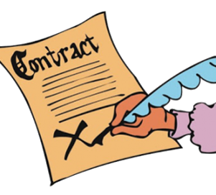
Conventional Signature
Verifies that the signer approves the writing
How do we sign a digital document like a pdf file?

Slide 4

Review of Public Key Cryptography
e_{B}
Bob’s public key
d_{B}
Bob’s private key
plaintext
message, m
encryption
algorithm
ciphertext
decryption
algorithm
plaintext
message
e_{B}( )
m
m = d_{B}(e_{B}(m))
(e_{A}, d_{A})
(e_{B}, d_{B})
Alice
Bob

Slide 5
Generate Public and Private Key Pair
Generate public and private key pair
openssl genpkey -out privkey.pem -algorithm rsa
Note: privkey.pem contains both public and private keys
Extract public key from privkey.pem and save it in pubkey.pem
openssl rsa -in privkey.pem -outform PEM -pubout -out pubkey.pem

Slide 6
Encryption with RSA
Create a file
echo "Welcome to LinuxCareer.com" > encrypt.txt
Encryption
openssl rsautl -encrypt -inkey pubkey.pem -pubin -in encrypt.txt -out encrypt.dat
Encode the binary ciphertext with base64
openssl enc -base64 -in encrypt.dat -out encrypt.dat.base64
Note: encoding is not necessary, but needed for sending the ciphertext through our chat server
Notes:
https://linuxconfig.org/using-openssl-to-encrypt-messages-and-files-on-linux

Slide 7
Decryption with RSA
Decode encrypt.dat.base64 and get the binary ciphertext
openssl enc -base64 -d -in encrypt.dat.base64 -out encrypt.dat
Decryption
openssl rsautl -decrypt -inkey privkey.pem -in encrypt.dat -out new_encrypt.txt
Notes:
https://linuxconfig.org/using-openssl-to-encrypt-messages-and-files-on-linux

Slide 8
Public Key Encryption Properties
.
1
need e(.) and d(.) such that
d_{B}(e_{B}(m)) = m
2
given public key e_{B}, it should be impossible to compute private key d_{B}
RSA: Rivest, Shamir, Adelson algorithm

Slide 9
Another important property
The following property will be very useful
e_{B}(d_{B}(m)) = m = d_{B}(e_{B}(m))
use public key first, followed by private key
use private key first, followed by public key
result is the same!

Slide 10
Naive Digital Signature
(e_{B}, d_{B})
contract, d_{B}(contract)
contract
Yes/No
Sign
Verify
Private key (d_{B})
Public key (e_{B})
?
e_{B}(d_{B}(contract))=contract
Bob encrypts the contract with his private key
d_{B}(contract) is the signature
Those who have Bob’s public key can verify the signature
Decrypt the signature
Compare the decrypted contract with the contract sent over

Slide 11
Digital Signature Properties
(e_{B}, d_{B})
contract, d_{B}(contract)
contract
Yes/No
Sign
Verify
Private key (d_{B})
Public key (e_{B})
?
e_{B}(d_{B}(contract))=contract
The party with private key can create digital signature
Anyone who knows the public key can verify digital signature
The signer cannot deny that he/she has done so

Slide 12
Problem of Naive Digital Signature?
contract, d_{B}(contract)
Signature too long!

Slide 13

Signing of true Digital Signature
Generate message hash
Encrypt the hash with the private key
Message
m
H(m)
Signature
H
Sign
m, d_{B}(H(m))
Private key (d)

Slide 14
Verification of True Digital Signature
Hash the message m that was sent over to get H(m)
Decrypt digital signature d_{B}(H(m)) with Bob’s public key
Compare H(m) and e_{B}(d_{B}(H(m)))
H
H(m)
m, d_{B}(H(m))
Compare
Yes/No
e_{B}(.)
Alice
e_{B}(d_{B}(H(m)))

Slide 15
Outline
Introduction to digital signature
Introduction to certificate
Hands-on labs

Slide 16


Question
How can you safely give your public key to everyone?
(e_{C}, d_{C})
e_{C}
Cody

Slide 17




Obtain a Certificate Issued by a certificate authority (CA)
Cody generates his key pair (e_{c}, d_{c})
He goes to a CA face-to-face
CA verifies his information: email, ID, address, etc.
CA issues Cody a certificate, which contains
Cody’s identity, other information and his public key e_{C}
Signed by CA
Cody
CA
e_{c}
(e_{c}, d_{c})
Cody
e_{c}
Signature

Slide 18

Verify a Certificate
Cody can get a certificate from a certificate authority (CA)
Every computer is shipped with the CA’s public key in the format of a certificate
When Cody sends its certificate to a computer, how can the computer verify Cody’s public key is genuine?
Cody
e_{c}
Signature

Slide 19
Terms for Certificates
The owner of a certificate is called a subject
Common name is the identity of the owner
Subject’s CommonName can be:
An explicit name, e.g. cs.uml, or
A name with a wildcard character, e.g. *.uml.edu
Cody
e_{c}
Signature

Slide 20
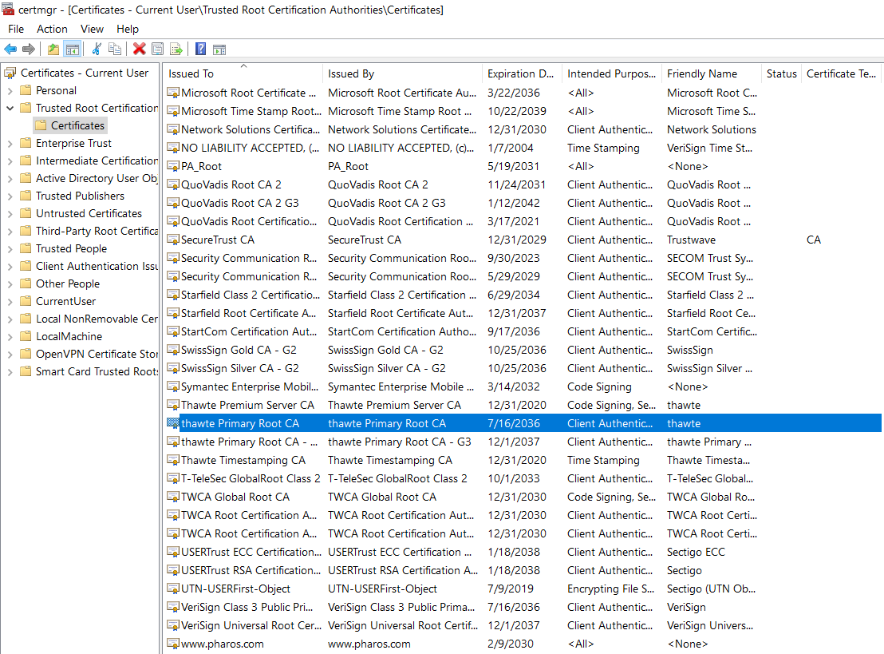
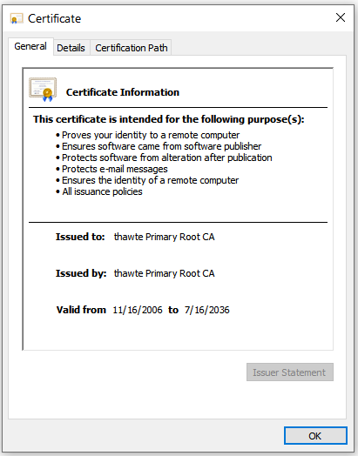
Windows 10 Certificate Store
Type here to search -> certmgr.msc

Slide 21
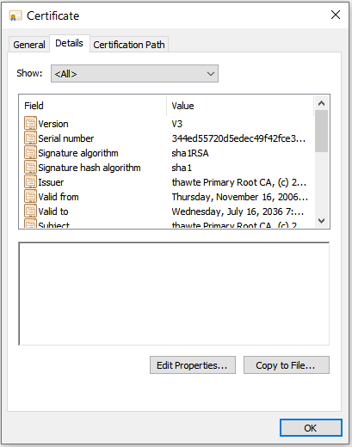
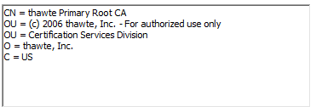
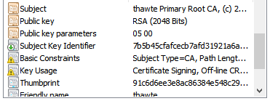
Example Certificate Details
Click subject

Slide 22
Kali Certificate Store
/etc/ssl/certs
Command to view a certificate
openssl x509 -in certificate-name.pem -text

Slide 23
Outline
Introduction to digital signature
Introduction to certificate
Hands-on labs
Windows 10 certificate store
Sign and verify a file locally
Sign and verify a message through chat server
Notes:
https://opensource.com/article/19/6/cryptography-basics-openssl-part-2

Slide 24
Certificate Store

Slide 25
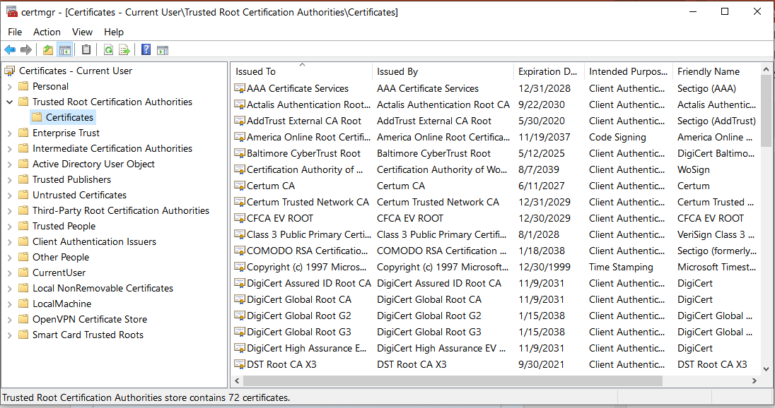
Windows 10 Certificate Store
TA finds the Windows 10 certificate store
All people check content of a certificate from Trusted Root Certificate Authorities
Group discussion: why are these certificates needed?

Slide 26
Digital Signature

Slide 27
Generate Public and Private Key Pair
If done before, no need
Generate public and private key pair
openssl genpkey -out privkey.pem -algorithm rsa
Note: privkey.pem can be used as the private key although it contains the public key
Extract the public key from privkey.pem
openssl rsa -in privkey.pem -outform PEM -pubout -out pubkey.pem
Publish your pubkey.pem, e.g. to our chat server
Never share privkey.pem

Slide 28
Sign a file at Your Computer
Sign a file called changelog or messages saved in a file
openssl dgst -sha256 -sign privkey.pem -out sign.sha256 changelog
The output sign.sha256 is binary
Encode the binary signature with base64
openssl enc -base64 -in sign.sha256 -out sign.sha256.base64
Not really needed. It is needed here since we can send the base64 encoded message to our chat server
Send both message and base64 encoded signature to our chat server

Slide 29
Verify the Signature
Save received signature into a file, e.g., called sign.sha256.base64
Decode sign.sha256.base64 and get the binary signature
openssl enc -base64 -d -in sign.sha256.base64 -out sign.sha256
Verify the signature with the public key
openssl dgst -sha256 -verify pubkey.pem -signature sign.sha256 changelog

Slide 30
Message Signature via Chat Server
Sender generates public and private key pair (no need to do it if already done)
Sender sends the public key (content of pubkey.pem) to Receiver
Receiver saves the public key into a file, e.g. called pubkey.pem
Sender sends a message to receiver and saves the message into a file called, e.g., msg
Receiver saves the received message into a file called, e.g., msg
Sender signs its msg, generate the signature file and encodes it with base64, e.g. called sign.sha256.base64
Sender sends the content of sign.sha256.base64 to Receiver
Receiver saves it into a file, e.g., called sign.sha256.base64
Receiver decodes sign.sha256.base64 into the binary signature file and verifies it

Slide 31
Message under MITM
Assume only the message is changed by MITM
That is, hahaha… is added to the received message
Repeat the same procedure
Is the verification ok this time?

