Slide 1

Introduction to Software Security
Xinwen Fu, Ph.D
Professor
Department of Computer Science
University of Massachusetts Lowell

Slide 2
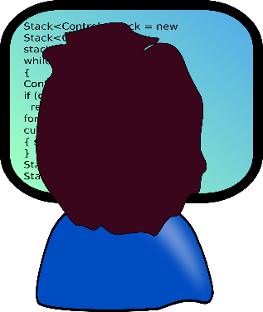
Outline
Common software vulnerabilities
Fundamentals of software security

Slide 3
19 Deadly Sins (defects)
Buffer Overruns
Format String problems
Integer Overflows
SQL Injection
Command Injection
Failing to Handle Errors
Cross-Site Scripting
Failing to Protect Network Traffic
Use of "magic" URLs and Hidden Forms
Improper use of SSL and TLS
Use of Weak Password-Based Systems
Failing to Store and Protect Data Securely
Information Leakage
Improper File Access
Trusting Network Name Resolution
Race Conditions
Unauthenticated Key Exchange
Cryptographically Strong Random Numbers
Poor Usability
There are more

Slide 4
Sin 1: Buffer Overruns “smashing the stack”
The core problem is that user data and program flow control information are intermingled for the sake of performance, and low-level languages allow direct access to application memory.
Mostly prevalent in C and C++.
Occurs when a program allows input to write beyond the end of the allocated buffer.
The effect of a buffer overrun is anything from a crash to the attacker gaining complete control of the application.

Slide 5
Sin 1: Buffer Overruns examples
#include <stdio.h>
#include <string.h>
void f(char *str) {
char foo[1000];
strcpy(foo, str);
}
void main() {
// code receiving msg
f(msg);
// code do other things
return;
}
Computer memory
SHELL
32 Cs
0x6250151C
2002 As KNOCK /.:/
Function f’s return address
foo[1000]
junk
junk
junk
junk
msg

Slide 6
Sin 1: Buffer Overruns Summary
Do carefully check buffer accesses by using safe string and buffer handling functions.
Do use compiler-based defenses such as /GS and ProPolice.
Do use operating-system-level buffer overrun defenses such as DEP.
Do understand what data the attacker controls, and manage that data safely in your code.
Do not think that compiler and OS defenses are sufficient—they are not; they are simply extra defenses.
Do not create new code that uses unsafe functions.
Consider updating your C/C++ compiler since the compiler authors add more defenses to the generated code.
Consider removing unsafe functions from old code over time.
Consider using C++ string and container classes rather than low-level C string functions.

Slide 7
Sin 19: Poor Usability
The second law from 10 Immutable Laws of Security Administration states that “Security only works if the secure way also happens to be the easy way.”
It is common to see security-related text and messages exhibiting one or more of the following properties:
Too little appropriate information:
This is the bane of the administrator: not enough information to make a good security decision.
Too much information:
This is the bane of the normal user: too much security information that is simply confusing.

Slide 8
Sin 19: Poor Usability (Cont’d)
Too many messages:
Eventually both admins and users will simply click the “OK” or “Yes” buttons when faced with too many messages. And that last acknowledgment may be the wrong thing to do.
Inaccurate or generic information:
There is nothing worse than this because it doesn’t tell the user anything. Of course, you don’t want to tell an attacker too much either; it’s a fine balance.
Errors with only error codes:
Error codes are fine, so long as they are for the admins’ benefit, and they include text to help the user.

Slide 9
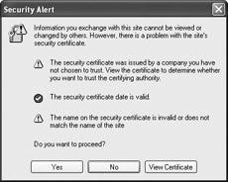
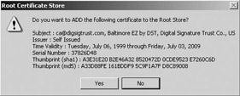
Sin 19: Poor Usability examples

Slide 10
Sin 19: Poor Usability: Spotting the sin pattern
The pattern here is a failure to explore the way the typical user is going to interact with your security features.
Poor usability can also mean poor security
Always clicking “OK” when given lots of dialogs
Cryptic error or status messages

Slide 11
Sin 19: Poor Usability - Redemption Steps
When users are involved, make the UI simple and clear
Make security decisions for users
Make selective relaxation of security policy easy
Clearly indicate consequences
Make it actionable
Provide central management

Slide 12
Sin 19: Poor Usability Summary
Do understand your users’ security needs, and provide the appropriate information to help them get their jobs done.
Do default to a secure configuration whenever possible.
Do provide a simple and easy to understand message, and allow for progressive disclosure if needed by more sophisticated users or admins.
Do make security prompts actionable.
Do not dump geek-speak in a big-honking dialog box. No user will read it.
Do not make it easy for users to shoot themselves in the foot—hide options that can be dangerous!
Consider providing ways to relax security policy selectively, but be explicit and clear about what the user is choosing to allow.

Slide 13
Outline
Common software vulnerabilities.
Fundamentals of software security.

Slide 14
What is Software Security?
Software security is the idea of engineering software so that it continues to function correctly under malicious attack
Software Security aims to avoid security vulnerabilities by addressing security from early stages of software development life cycle
"Security is a risk management."

Slide 15
Why Software Security?
Most software systems today contain numerous flaws and bugs that get exploited by attackers.
New threats emerge everyday.
Convenience trumps security measures.
Exponential increase in vulnerabilities in software systems.
Software security is everybody's job.
Programmers have a long history of repeating the same security-related mistakes!!!

Slide 16
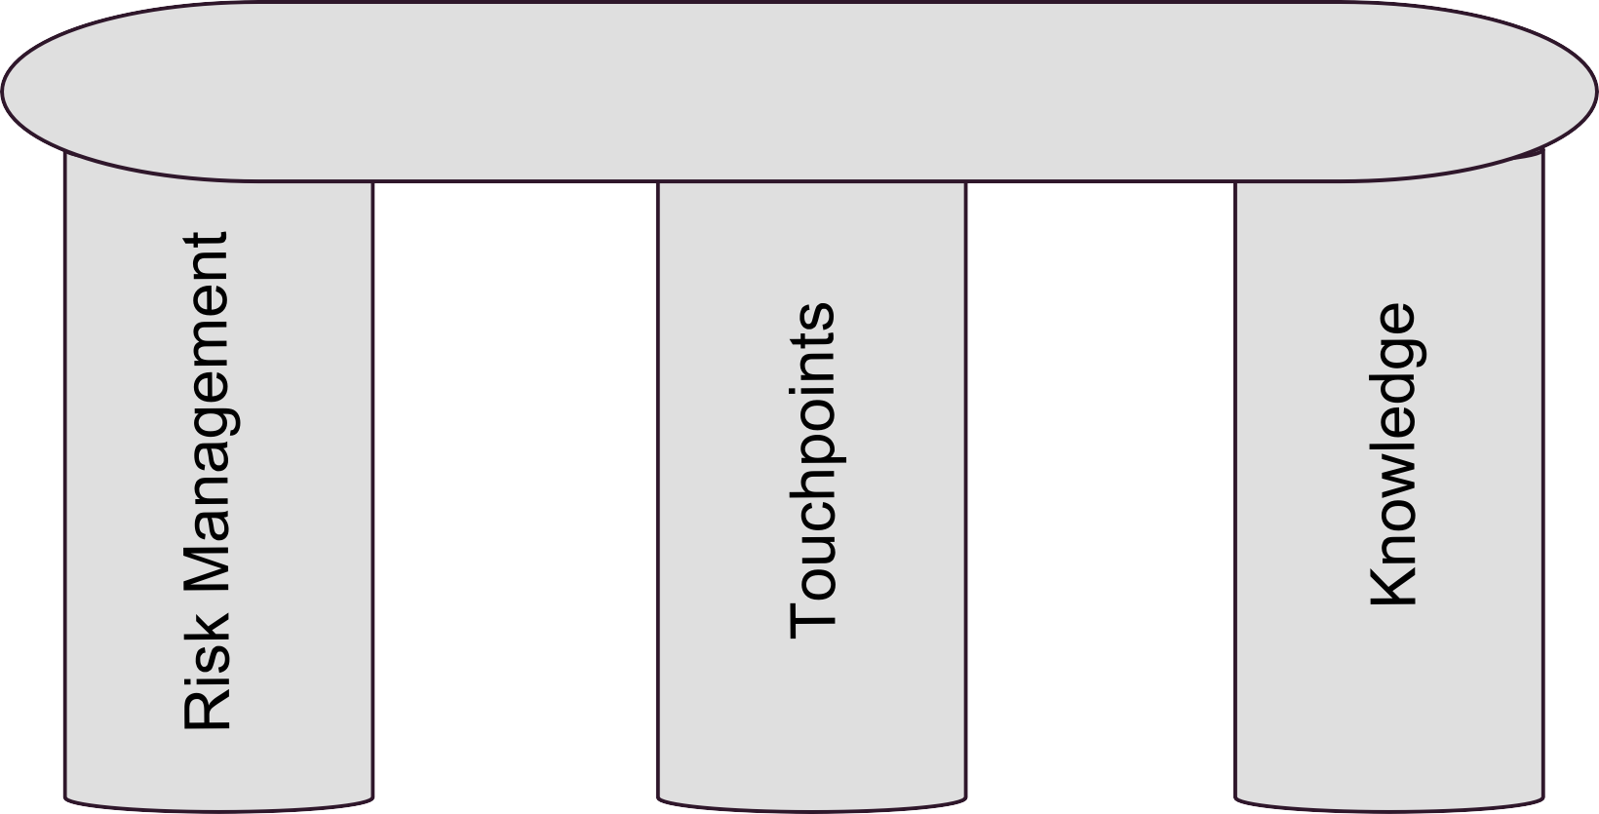
Pillars of Software Security
The three pillars of software security

Slide 17
Pillar I: Risk Management
A continuous risk management process is an essential part to software security.
Identifies, ranks, tracks, and understands software security risks.
Risk management framework (RMF)
An overall approach to risk management.
The goal is to consistently track and handle risks.

Slide 18
Risk Management Framework (RMF) Activities
Measurement and Reporting
1) Understand the business context.
2) Identify the business and technical risks.
4) Define the risk mitigation strategy.
3) Synthesize, prioritize, and rank the risks.
Artifact Analysis
Business Context
5) Carry out fixes and validate.

Slide 19
1) Understand the business context
A key task of an analyst.
Extract and describe business goals.
Set priorities.
Understanding what risks to consider.
Gathering the artifacts.
Conducting project research to the scope.

Slide 20
2) Identify business and technical risks
Business risks impact business goals.
Mapping technical risks to business goals.
Developing a set of risk questionnaires.
Interviewing the target project team.
Analyzing the research interview data.
Evaluating software artifacts.

Slide 21
3) Synthesize, prioritize, and rank risks
Prioritize risks based on business goals.
Risk metrics:
Risk likelihood.
Risk impact.
Number of risks emerging over time.
What shall we do first given the current risk situation?
What is the best allocation of resources?

Slide 22
4) Define the risk mitigation strategy
Create a coherent strategy for mitigating the risks that takes into account:
Cost.
Implementation time.
Likelihood of success.
Competence.
Impact.
Identify the validation techniques.
Metrics are financial in nature.

Slide 23
5) Carry out fixes and validate that they are correct
Implement the mitigation strategy.
The artifacts should be rectified.
Progress is measured in terms of completeness against mitigation strategy.
Use validation techniques to validate that artifacts no longer bear unacceptable risk.
Metrics include artifact quality metrics and levels of risk mitigation effectiveness.

Slide 24
Summary of Risk Management Framework (RMF) Activities
Risk management is a central software security practice.
Successful use of RMF relies on continuous and consistent identification of risks.
Use project management tools to track risk information.
Example: Open Workbench.
RMF is a multilevel loop.
Identifying risks only once during the project is incorrect.
The five fundamental activities need to be applied repeatedly throughout the project.

Slide 25
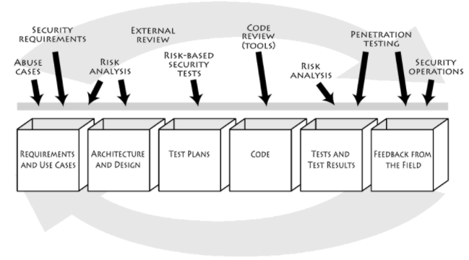
Pillar II: Touchpoints
Security touchpoints are set of security best practices.
❻
❽
❶
❸
❺
❷
❹
❼
❷

Slide 26
Seven Touchpoints (I)
Code Reviews.
Artifact: Code.
Example of risks found: Buffer overflow on line 30.
Architectural Risk Analysis.
Artifact: Design and specifications.
Example of risks found: Failure of a Web Service to authenticate calling code.
Penetration Testing.
Artifact: System in its environment.
Example of risks found: Poor handling of program state in Web interface.?

Slide 27
Seven Touchpoints (II)
Risk-Based Security Testing.
Artifact: Units and system.
Example of risks found: Extent of data leakage possible by leveraging data protection risk.
Abuse cases.
Artifact: Requirements and use cases.
Example of risks found: Susceptibility to well-known tampering attack.

Slide 28
Seven Touchpoints (III)
Security Requirements.
Artifact: Requirements.
Example of risks found: Explicit description of data protection needs is missing.
Security Operations.
Artifact: Fielded system.
Example of risks found: Insufficient logging to prosecute a known attacker.

Slide 29
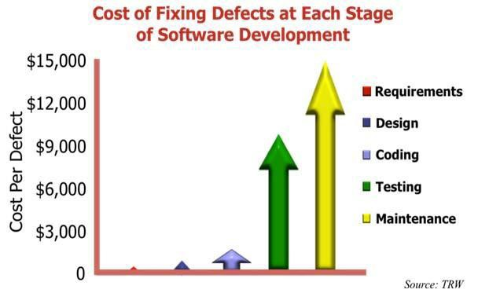
Fixing defects: Early is better!

Slide 30
1- Code Review (I)
Source code analysis.
Focus is on finding and fixing bugs.
Use static analysis tools to find security bugs.
Static analysis tools suffer from false negatives and false positives.
Examples: Coverity, Fortify, Ounce Labs, and Secure Software.

Slide 31
1 - Code Review (II)
Useful source code analysis tools must:
Be designed for security.
Support multiple tires.
Be extensible.
Be useful for security analysts and developers alike.
Support existing development processes.
Make sense to multiple stakeholders.

Slide 32
2 - Architectural Risk Analysis (I)
Design flaws:
Account for 50% of security problems.
Can't be detected by staring at code.
A higher-level understanding is required.
Architectural Risk Analysis:
Tracks risk over time.
Links system-level concerns to probability and impact measures.
Fits with RMF.

Slide 33
2 - Architectural Risk Analysis (II): Critical Aspects of Architectural Risk Analysis
Attack Resistance Analysis.
Ambiguity Analysis.
Weakness Analysis.

Slide 34
2- Architectural Risk Analysis (III) - Attack Resistance Analysis
It captures the check-list like approach to the risk analysis taken in Microsoft STRIDE approach.
Steps:
Identify general flaws using secure design literature and checklists.
Map attack patterns using either the results of abuse case development or a list of historical risks.
Identify risks in the architecture based on the use of checklists.
Understand and demonstrate the viability of these known attacks.

Slide 35
2- Architectural Risk Analysis (IV)
Ambiguity Analysis:
It captures the creative activity required to discover new risks.
It requires at least two analysts and experience.
Weakness Analysis:
Is aimed at understanding the impact of software dependencies.
Software is built on top of complex middleware frameworks.
Understand what kind of assumptions we make about outside software.
What happens when assumptions fail?

Slide 36
3 - Software Penetration Testing
A method of evaluating software security by simulating an attack in an outside-in manner.
Testing the system in its final.
Most commonly applied of all seven touchpoints.
Use static and dynamic penetration testing tools.
Examples: fault injection tools, Cenzic, Holodeck, SPI Dynamics, Immunity CANVAS, and IEInspector HTTP Analyzer.

Slide 37
4 - Risk-Based Security Testing (I)
Testers must follow risk-based approach:
Grounded in both system's architectural reality and the attacker's mindset.
Focused on areas of code where an attack is likely to succeed.
Different from Penetration Testing:
Level of approach: Inside-out approach.
Timing of testing: Before the software is complete.
Should start prior to system integration.
Risk analysts should identify and rank risks.

Slide 38
4 - Risk-Based Security Testing (II)
Security Testing must involve two approaches
Functional security testing:
Testing mechanisms that ensure that functionality is well implemented.
Adversarial security testing:
Risk-based security testing motivated by understanding the attacker's approach.

Slide 39
5 - Abuse Cases (I)
Determining what the software can't and won't do
Example: users can't enter more than 50 characters.
Must anticipate abnormal behaviors.
Don't accept the idea that says "No one would do these things".
What happens when functional security mechanisms are compromised?

Slide 40
5 - Abuse Cases (II) Generating abuse cases
Creating Anti-Requirements:
Provide insights into how attackers will approach system's assumptions.
Applied throughout the lifecycle.
Generated by security analysts.
Creating an attack model:
Explicit consideration of well-known attacks.
Select attack patterns relevant to the system.
Build abuse cases around attack patterns.
Include anyone who can gain access to the system.

Slide 41
6 - Security Requirements
Cover both functional security and emergent characteristics.
Satisfy three criteria:
Definition: Must be explicitly defined what security requirements are.
Assumption: Must take into account the assumptions that the system will behave as expected.
Satisfaction: Security requirements must satisfy the security goals, and the system must satisfy the security requirements.

Slide 42
7- Security Operations
Software security operations can be integrated with network security operations.
Defensive technique:
Understanding software behavior that leads into Knowledge gained by understanding attacks should be cycled back into software development.

Slide 43
Pillar III: Knowledge (I)
Involves gathering, encapsulating, and sharing security knowledge.
Software Security Knowledge Catalogs:
Principles.
Guidelines.
Rules.
Vulnerabilities.
Exploits.
Attack Patterns.
Historical Risks.

Slide 44
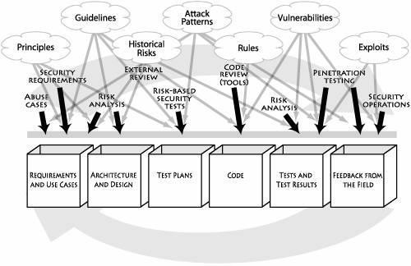
Pillar III: Knowledge (II)
Mapping of software security knowledge catalogs to various software artifacts and software security best practices.

Slide 45
Summary
Fundamentals of software security. Three pillars of software security:
Risk Management
Touchpoints
Knowledge
Software security design principles.
1. Code Review
2. Risk Analysis
3. Penetration Testing
4. Risk-Based Security Tests
5. Abuse Cases
6. Security Requirements
7. Security Operations

Slide 46
Summary (Cont’d)
Building secure software systems.
Learned how to apply best software security practices to various software artifacts throughout the software life cycle in an iterative approach.
19 Deadly sins.
Learned extensively about the common software vulnerabilities.

Slide 47
References
Gary McGraw, Software Security: Building Security In. Addison-Wesley Professional, 2006.
McGraw, G.; , "Software security," Security & Privacy, IEEE , vol.2, no.2, pp. 80- 83, Mar-Apr 2004doi: 10.1109/MSECP.2004.1281254 URL: http://ieeexplore.ieee.org/stamp/stamp.jsp?tp=&arnumber=1281254&isn umber=28622
Haley, C.B.; Laney, R.; Moffett, J.D.; Nuseibeh, B.; , "Security Requirements Engineering: A Framework for Representation and Analysis," Software Engineering, IEEE Transactions on , vol.34, no.1, pp.133-153, Jan.-Feb. 2008.
LeBlanc, John Viega, 19 deadly sins of software security. McGraw-Hill, 2005.

