Slide 1
INTRUSION DETECTION SYSTEMS
SASHANK NARAIN

Slide 2
INTRUSION DETECTION SYSTEMS (IDS)
Detect intrusions on systems and network activity
Monitor user and system activity
Recognize known attack patterns in network activity
Two types
Host-based Intrusion Detection Systems (HIDS)
Network-based Intrusion Detection Systems (NIDS)

Slide 3
HOST-BASED IDS
Host-based Intrusion Detection Systems (HIDS)
Assess integrity of critical system and data files
Check for file system changes compared to a database of known good state
E.g., AIDE, Tripwire, Fail2Ban

Slide 4
SETUP FOR HOST-BASED IDS
Step 1 – create a database of system / sensitive files in a known good state
Include hashes, permissions and timestamps of the files
Store the database in a known secure location
MUST ensure that this database is not tampered
Step 2 – create an automated task to check filesystem regularly against database
Load database from the known secure location
System alerts of changes to file contents, permissions or timestamps
Step 3 – perform analysis to determine cause of the changes and repeat step 1, if necessary

Slide 5
HOST-BASED IDS DEMO
Popular Host-based Intrusion Detection Systems -
Tripwire (commercial)
AIDE (open-source)
AIDE Demo
Notes:
sudo apt install aide
more /etc/aide/aide.conf
sudo aide --config /etc/aide/aide.conf --config-check
sudo aide --config /etc/aide/aide.conf --init
sudo mv /var/lib/aide/aide.db.new /var/lib/aide/aide.db
sudo aide --config /etc/aide/aide.conf --check
touch ~/Desktop/test.txt
chmod o-rwx ~/files/buffer_exploit
sudo aide --config /etc/aide/aide.conf --check

Slide 6
NETWORK-BASED IDS
Network Intrusion Detection Systems (NIDS)
Recognize known attack patterns in network activity
Identify abnormal activity through statistical analysis
Manage audit trails and highlight policy violations
E.g., Snort, Suricata, OSSEC, SecurityOnion

Slide 7
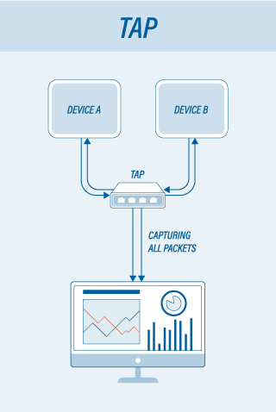
SIMPLE SETUP FOR NETWORK-BASED IDS
Source: https://insights.profitab.com/

Slide 8
TYPES OF NETWORK-BASED IDS
Detection methods
Signature-based
Heuristic
Capabilities
Passive
Active (known as Intrusion Prevention Systems (IPS))

Slide 9
NETWORK-BASED IDS DEMO
Snort Demo

