Slide 1
IoT Security and Privacy
Input/Output of ESP32
Xinwen Fu

Slide 2
Outline
General-Purpose Input/Output (GPIO)
Universal Asynchronous Receiver/Transmitter (UART)
Inter-integrated circuit (I2C)
Serial Peripheral Interface (SPI)

Slide 3
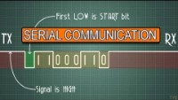
UART - I2C – SPI Serial communications

Slide 4
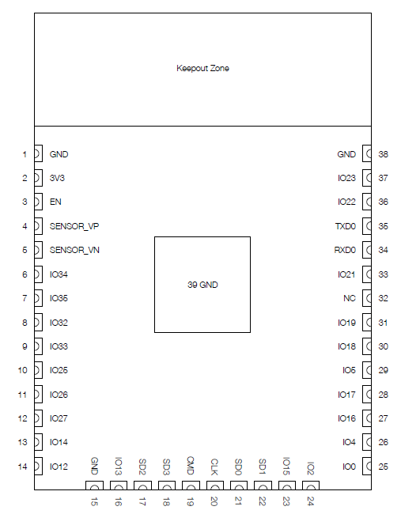
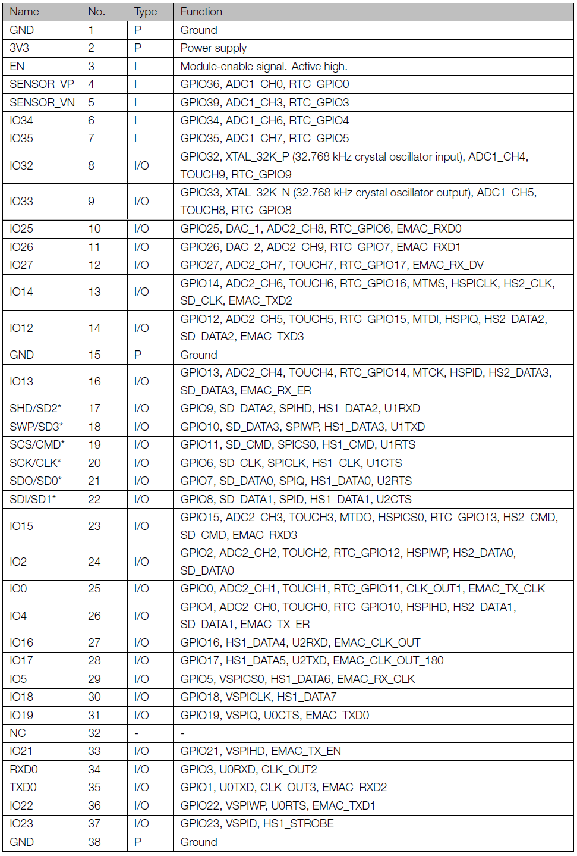
ESP32-WROOM-32 Pin Layout
Notes:
Type P: Power
Type I: Only for Input?
Type I/O: Input or output

Slide 5
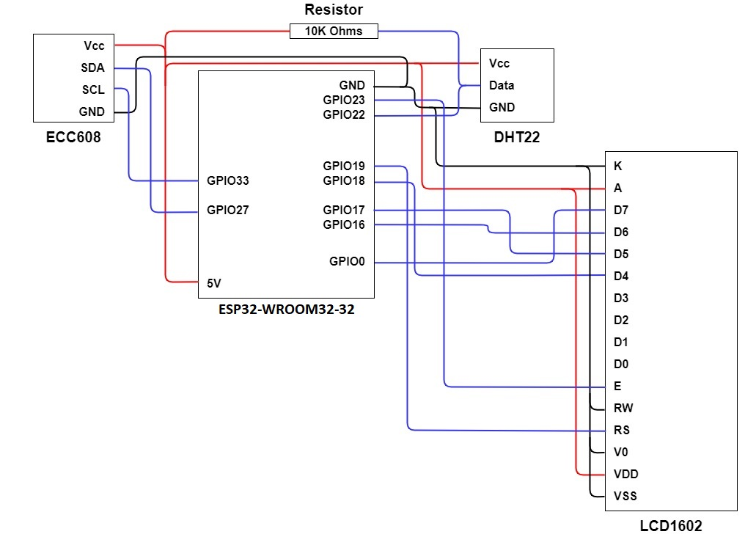
Schematic of Our Board

Slide 6
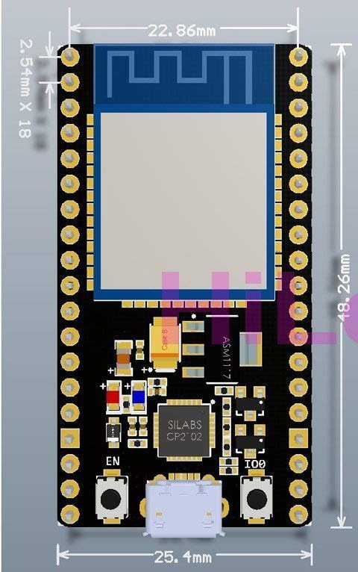
Pins
Power pins
Input (only) pins
I/O pins
GPIO (General-Purpose Input/Ooutput)
May be used for special purposes
Pins SCK/CLK, SDO/SD0, SDI/SD1, SHD/SD2, SWP/SD3 and SCS/CMD, namely, GPIO6 to GPIO11 are connected to the integrated SPI flash integrated on the module and are not recommended for other uses.

Slide 7
GPIO (General-Purpose Input/Ooutput)
These pins are a physical interface between a MCU and the outside world.
At the simplest level, you can think of them as switches that you can turn on or off (input) or that the MCU can turn on or off (output).

Slide 8
Use of GPIO Pins
You can program the pins to interact in amazing ways with the real world.
It could be input from a sensor or a signal from another computer or device, for example.
The output can also do anything, from turning on an LED to sending a signal or data to another device.
If the IoT kit is on a network, you can control devices that are attached to it from anywhere** and those devices can send data back.
Connectivity and control of physical devices over the internet is a powerful and exciting thing, and the Raspberry Pi is ideal for this.

Slide 9
Warning
If you follow the instructions, then messing about with the GPIO is safe and fun.
Randomly plugging wires and power sources into your Pi, however, may kill it.
Bad things can also happen if you try to connect things to your board that use a lot of power; LEDs are fine, motors are not.
If you are worried about this, then you might want to consider using a breakout board such as the Pibrella until you are confident enough to use the GPIO directly.

Slide 10
Output
GPIO outputs are on or off, HIGH or LOW, 3v3 or 0v.
When we use a GPIO pin as an output as shown in the right diagram, the IoT kit replaces both the switch and the battery in the left diagram.
Each pin can turn on or off, or go HIGH or LOW in computing terms. When the pin is HIGH it outputs 3.3 volts (3v3); when the pin is LOW it is off.

Slide 11
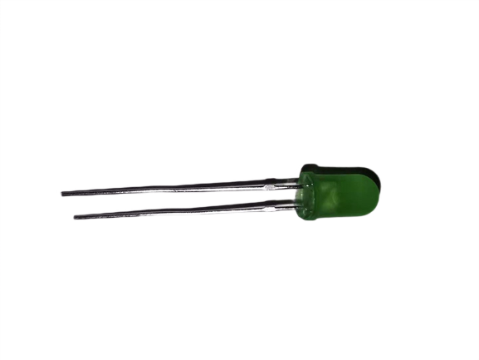
LED (Light-Emitting Diode)
LED is polarized
Many identifiers for finding positive and negative pins
E.g. longer leg should indicate the positive, anode pin.

Slide 12
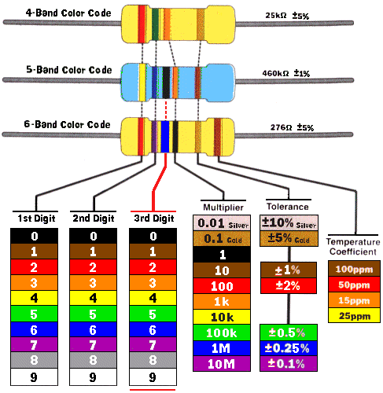
Resistor
The gold/silver band shall be held on the right

Slide 13
INPUT
Inputs are a bit trickier because of the way that digital devices work.
You will see phrases like "pull up" and "pull down" in GPIO tutorials.
It's a way of giving the input pin a reference so it knows for certain when an input is received.

Slide 14
Other Use of GPIO pins
UART (Universal Asynchronous Receiver/Transmitter)
SPI (Serial Peripheral Interface)
I2C (Inter-integrated circuit)
PWM (pulse-width modulation)

Slide 15
Outline
General-Purpose Input/Output (GPIO)
Universal Asynchronous Receiver/Transmitter (UART)
Inter-integrated circuit (I2C)
Serial Peripheral Interface (SPI)

Slide 16
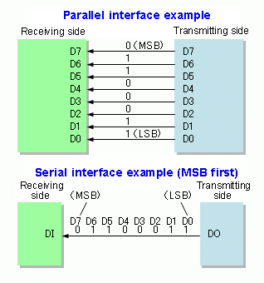
Serial vs Parallel

Slide 17
Synchronous vs. Asynchronous
Synchronous data transfer: sender and receiver use the same clock signal
supports high data transfer rate
needs clock signal between the sender and the receiver
requires master/slave configuration
Asynchronous data transfer: sender provides a synchronization signal to the receiver before starting the transfer of each message
does not need clock signal between sender the receiver
slower data transfer rate

Slide 18
UART (Universal Asynchronous Receiver/Transmitter)
Hardware translates between parallel and serial forms
Takes bytes of data and transmits the individual bits in a sequential fashion.
At the destination, a second UART re-assembles the bits into complete bytes.
Commonly used in conjunction with communication standards such as EIA, RS-232, RS-422 or RS-485
The universal designation indicates that
Data format and transmission speeds are configurable

Slide 19
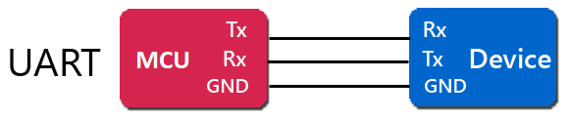
Tx and Rx
The UART has a transmission engine, and also a reception engine
They can operate simultaneously
Software controls the UART’s operations by accessing several registers, using the CPU’s input and output instructions

Slide 20
Serial Data Transmission
Transmitter Holding Register (8-bits)
Software outputs a byte of data to the THR
The bits are immediately copied into an internal ‘shift’-register
The bits are shifted out, one-at-a-time, in sync with a clock-pulse
0
1
1
0
0
0
0
1
❶
❷
0
1
1
0
0
0
0
1
❸
1-0-1-1-0-0-0-0-1-0
transmitter’s internal ‘shift’ register
data-bits
clock
stop
bit
start
bit
clock-pulses
trigger bit-shifts

Slide 21
Serial data reception
input voltage
clock
clock-pulses trigger voltage-sampling and bit-shifts at regular intervals
Receiver’s internal ‘shift’ register
1-0-1-1-0-0-0-0-1-0
0
1
1
0
0
0
0
1
data-bits
stop
bit
start
bit
Software can retrieve the received byte from the RBR
0
1
1
0
0
0
0
1
Receiver Buffer Register (8-bits)

Slide 22
Outline
General-Purpose Input/Output (GPIO)
Universal Asynchronous Receiver/Transmitter (UART)
Inter-integrated circuit (I2C)
Serial Peripheral Interface (SPI)

Slide 23
I²C (I2C, IIC, Inter-integrated circuit)
Pronounced “eye-squared-see”
Two-wire serial bus protocol
Between MCUs and sensors
Speed up to 3.4Mbits/s
Invented by Philips in the early 1980’s
The division now spun off into NXP

Slide 24
I2C Advantages and Disadvantages
Advantages
Needs two signal connections to MCU
Allows multiple devices on the two connections
Gets acknowledgment that signals have been correctly received
Disadvantages
Data rate is slower than SPI (Serial Peripheral Interface)
Data can only be traveling in one direction at a time, lowering the data rate even more if two-way communication is needed.
Necessary to connect pull-up resistors to the connections to ensure reliable transmission of signals

Slide 25
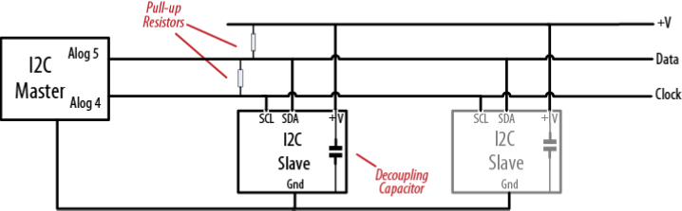
Two Connections
The two connections for the I2C bus are called
SCL (clock) and
SDA (data).
One device on the I2C bus is considered the master device.
Coordinate the transfer of information between the other devices (slaves) that are attached.
There must be only one master like the MCU

Slide 26
Slave Devices
Slave devices are identified by their address number
Each slave must have a unique address.
Some I2C devices have a fixed address
while others allow you to configure their address by setting pins high or low or by sending initialization commands

Slide 27
Outline
General-Purpose Input/Output (GPIO)
Universal Asynchronous Receiver/Transmitter (UART)
Inter-integrated circuit (I2C)
Serial Peripheral Interface (SPI)

Slide 28
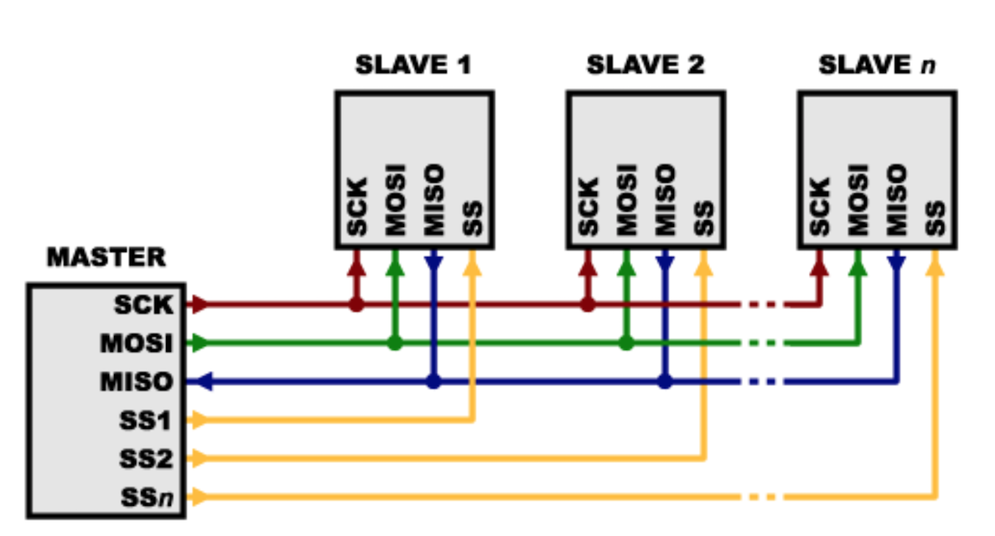
SPI (Serial Peripheral Interface)
A synchronous circuit is a digital circuit in which the changes in the state of memory elements are synchronized by a clock signal
SCLK (SCK): Serial Clock (output from master)
MOSI: Master Out Slave In (data output from master)
MISO: Master In Slave Out (data output from slave)
SS (CS): Slave Select (often active low, output from master)

Slide 29
Advantages of SPI
it runs at a higher data rate, and
it has separate input and output connections, so it can send and receive at the same time
Duplex
It uses one additional line per device to select the active device, so more connections are required if you have many devices to connect.

Slide 30
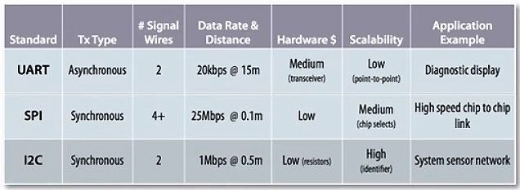
Comparison

Slide 31
Uplayer Protocol
UART, I2C and SPI only define how communication takes place between devices
The messages that need to be sent depend on each individual device and what it does.
You will need to consult the data sheet for your device to determine what commands are required to get it to function, and what data is required, or returned.

Slide 32
References
[1] GPIO, Accessed on Feb. 25, 2021
[2] I2C, Accessed on Feb. 25, 2021
[3] SPI, Accessed on Feb. 25, 2021

